Slide 1
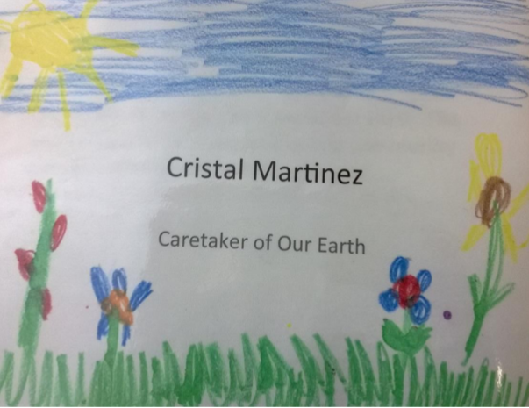
Notes:
vacant: empty
envision: to imagine; to plan for the future

Slide 2
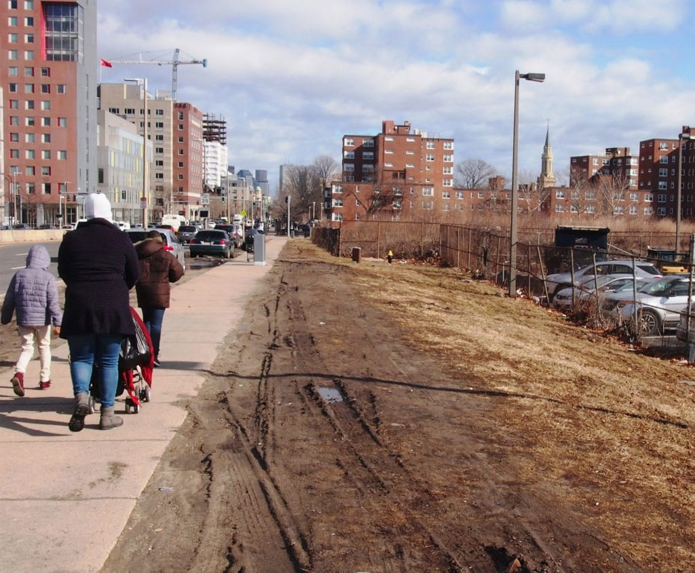
vacant
https://www.baystatebanner.com/2018/05/10/parcel-p-3-a-new-beginning-or-a-dead-end/
Notes:
A word in the story is vacant.
In Spanish it is vacío (bah-see-oh).
Vacant means empty. There is a big vacant lot on Tremont St in Boston. People are thinking about what they could develop or build on it.
Let’s say the word vacant together. Ready?
”Vacant.” When you say vacant, I hear the /v/ sound at the beginning of the word.
Look, vacant begins with the letter v.
Here is a picture that shows vacant.

Slide 3
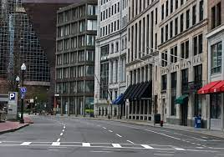
vacant
https://www.pinterest.com/pin/407364728764781903/
Notes:
Here is another picture of vacant.
How does this picture show the meaning of vacant? Turn and talk to your partner.
This street in Boston is vacant. [Elaborate according to a current situation—a holiday, or during COVID times, for example.]
How many syllables are in the word vacant? Let’s find out by clapping. Ready?
“Va-cant.” 2 syllables.
Now, let’s say vacant three times while clapping the syllables. Ready?
“Va-cant, va-cant, va-cant.”

Slide 4
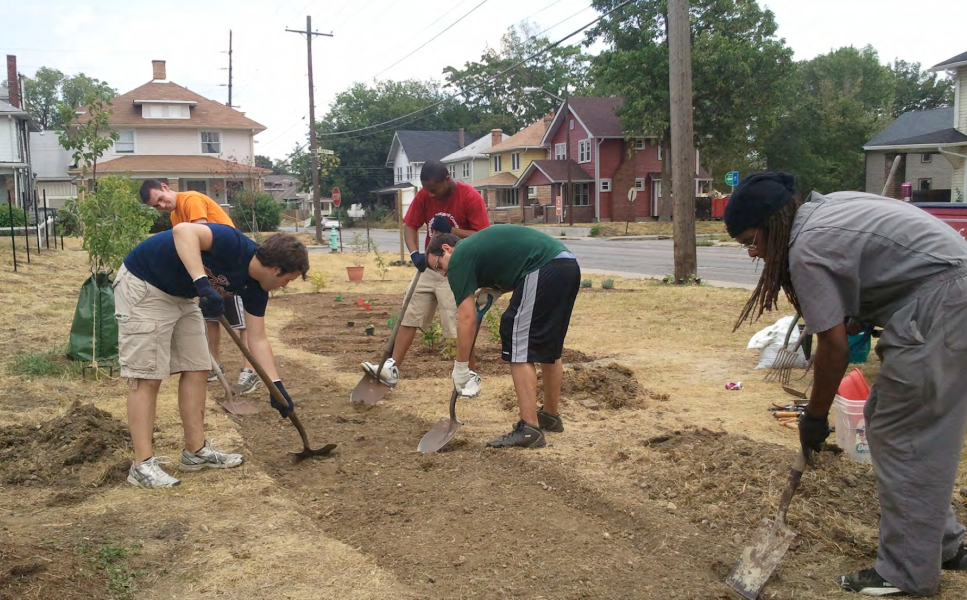
envision
https://blog.ioby.org/how-to-turn-a-vacant-lot-into-a-community-garden-a-primer/
Notes:
Another word in the story is envision.
In Spanish it is imaginar (ee-mah-hee-nahr).
Envision is to imagine; to plan for the future.
Let’s say the word envision together. Ready?
”Envision.” When you say envision, I hear the /e/ sound at the beginning of the word.
Look, envision begins with the letter e.
This picture shows envision. This group of citizens are working to turn a vacant lot into a community garden. They envisioned the lot being used in a different way, and they are making it happen!

Slide 5
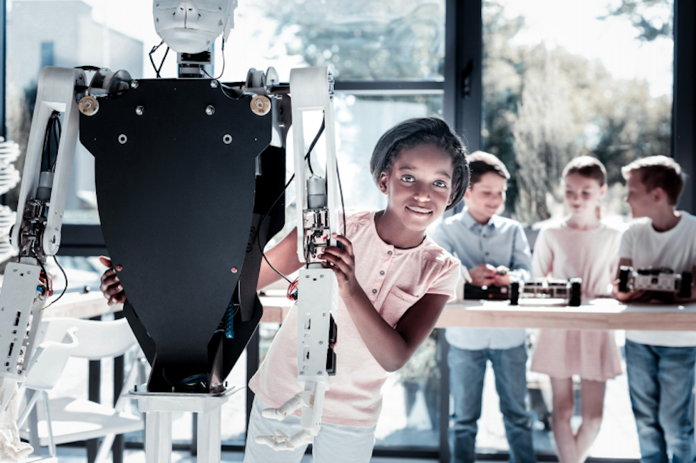
envision
https://theirworld.org/news/how-schools-give-children-skills-for-future-jobs-world-economic-forum
Notes:
Here is another picture of envision.
How does this picture show the meaning of envision? Turn and talk to your partner.
This young woman envisions robots of the future. She is working with materials to make her ideas and plans become real.
How many syllables are in the word envision? Let’s find out by clapping. Ready?
“En-vi-sion.” 3 syllables.
Now, let’s say envision three times by clapping the syllables. Ready?
“En-vi-sion, en-vi-sion., en-vi-sion.”

