Slide 1
The Third Person and Research
Writing Unit 4 Week 2 Day 2

Slide 2
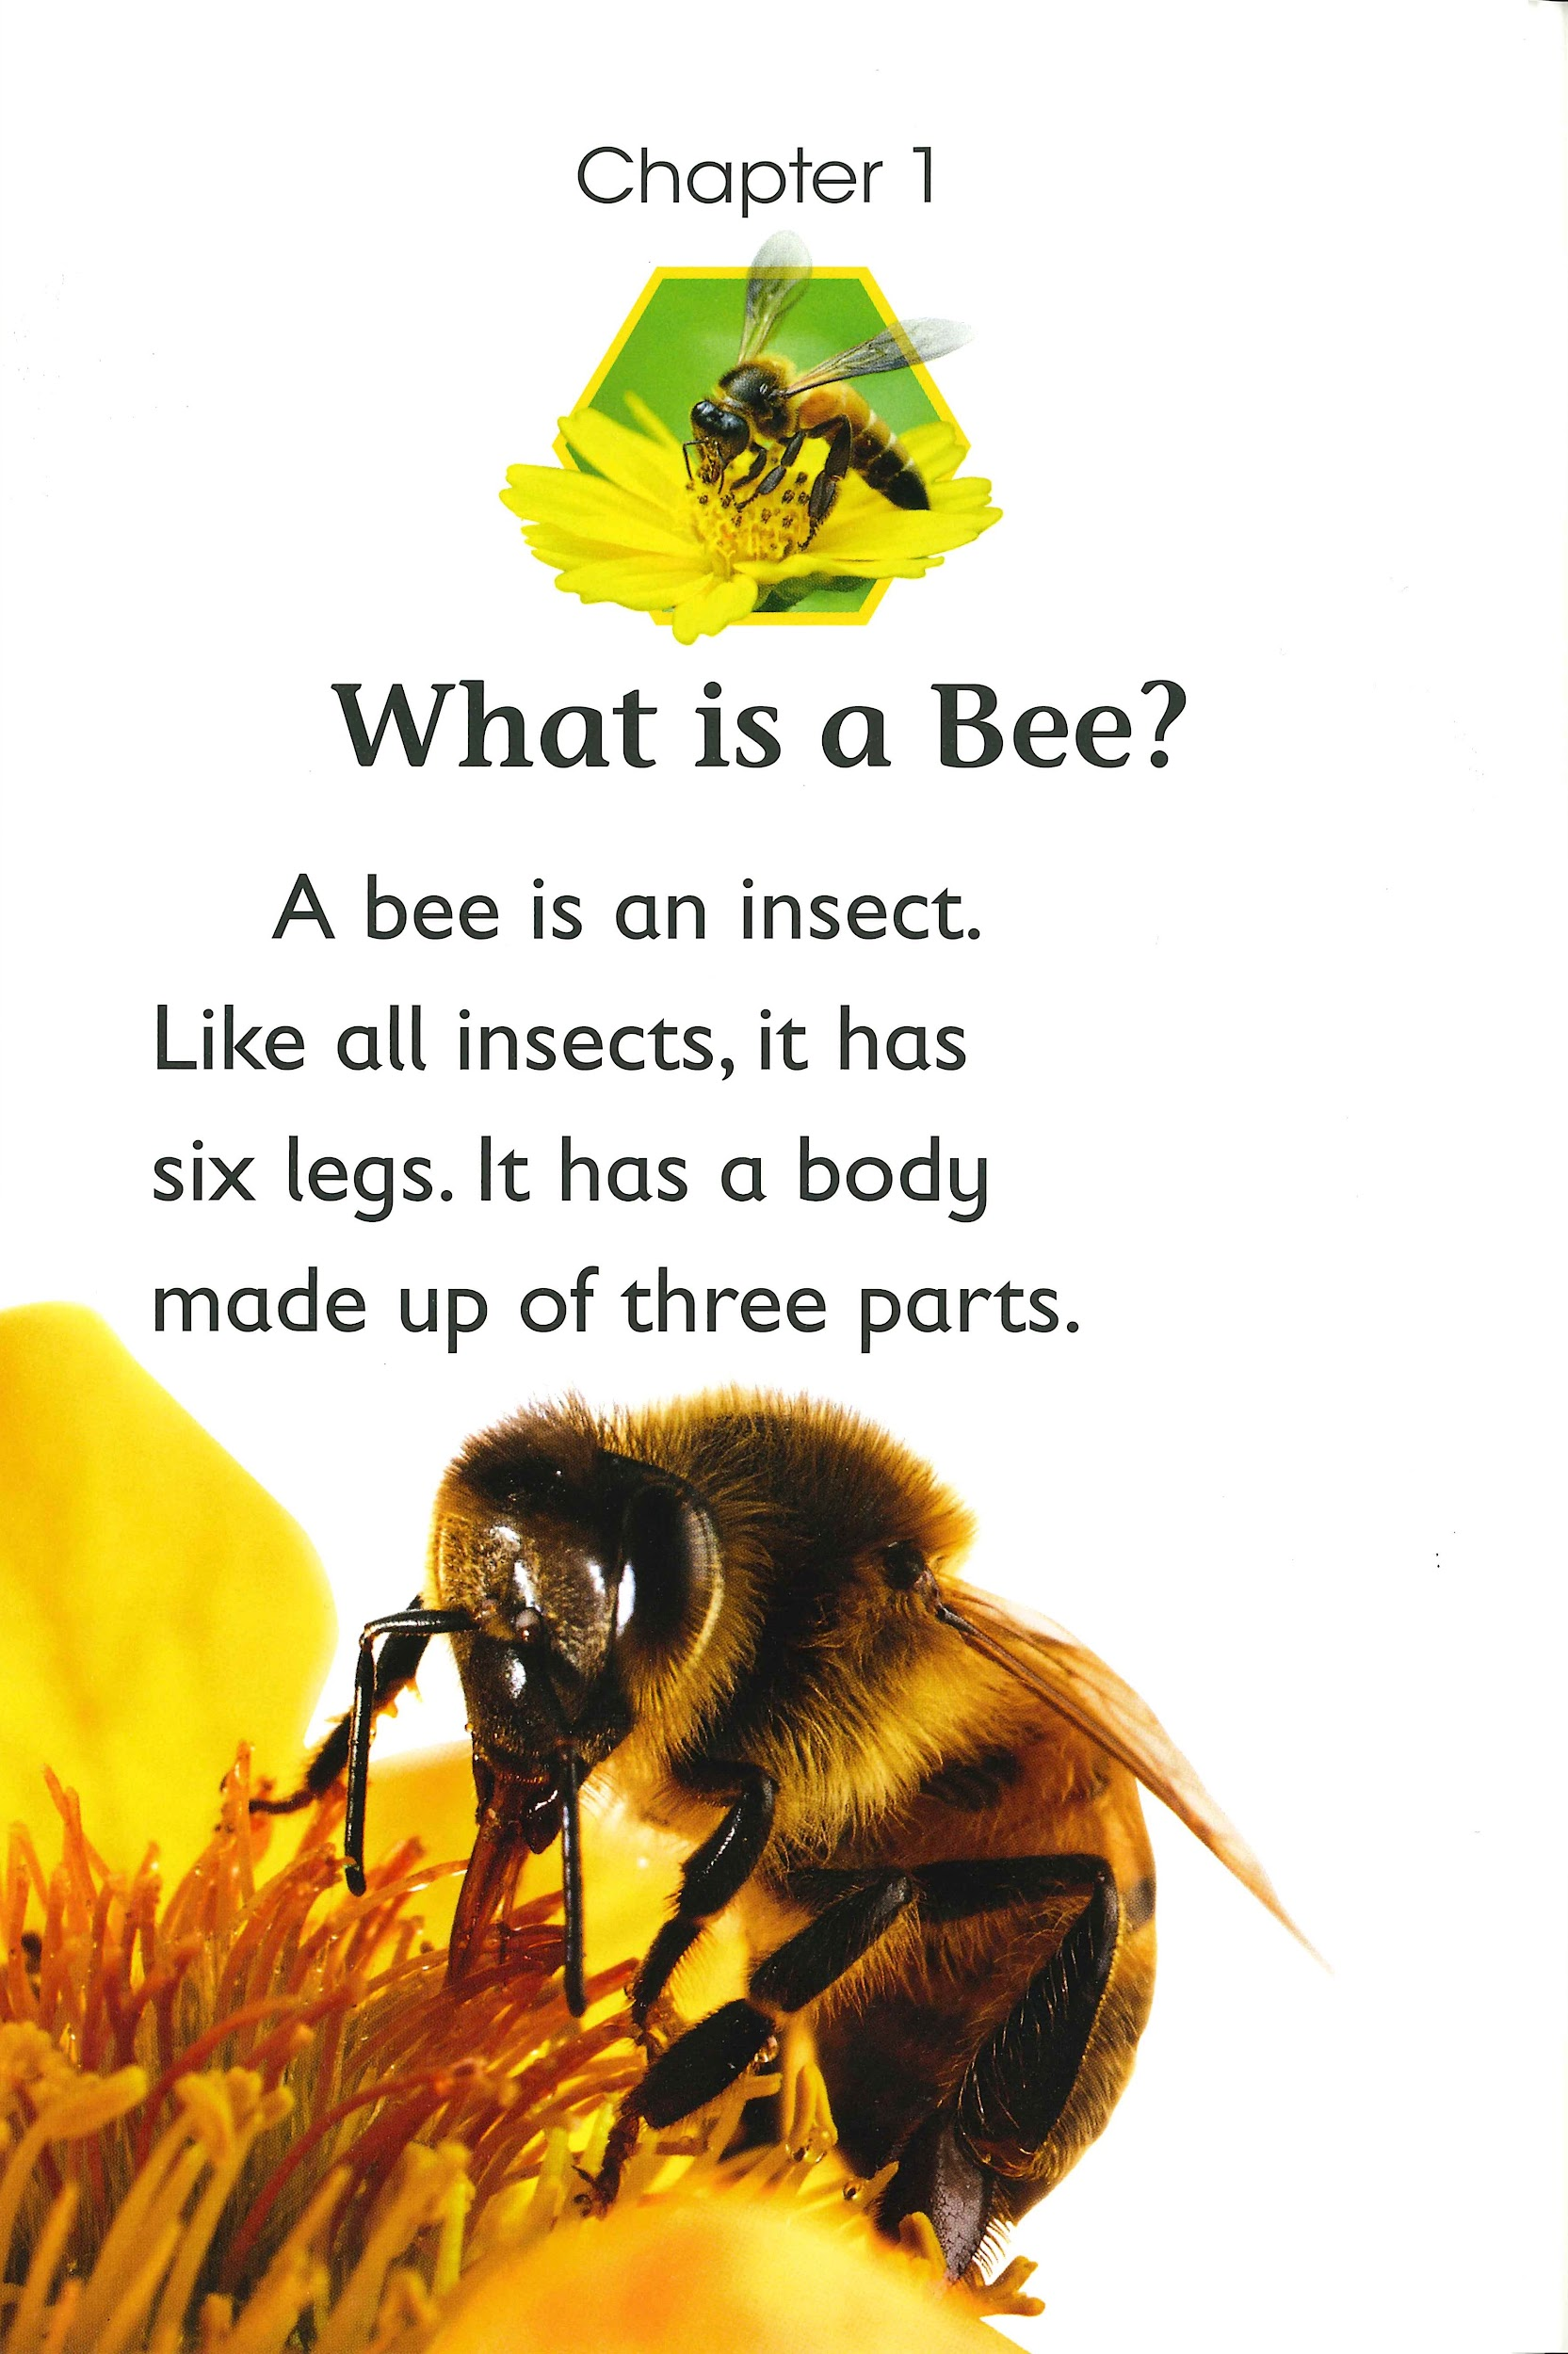

Slide 3
Bees are insects.
Yes! This sentence in the third person. It gives information about bees.

Slide 4
I like bees.
No. This sentence talks about the writer and not just bees.

Slide 5
You know a lot about bees!
No. This sentence talks about the audience and not just bees.

Slide 6
Bees are pollinators.
Yes! This sentence in the third person. It gives information about bees.

Slide 7
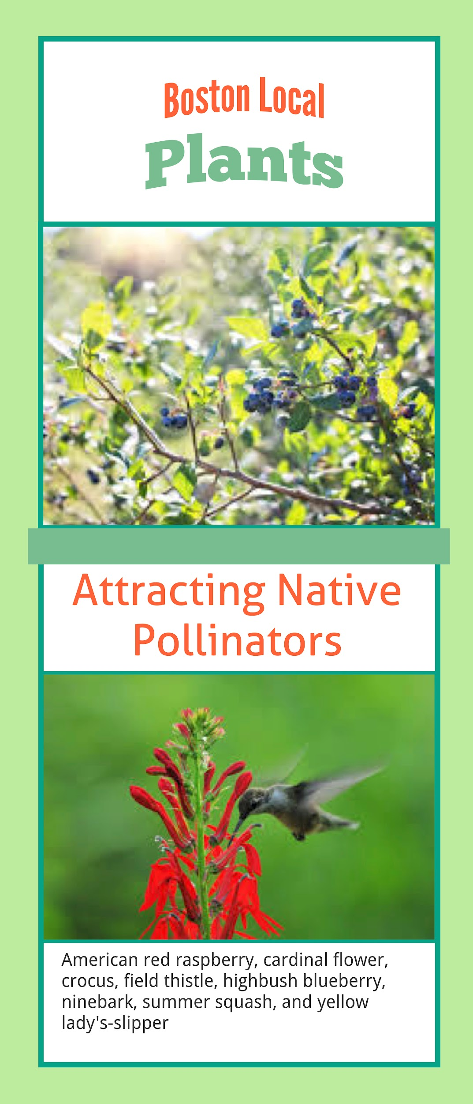
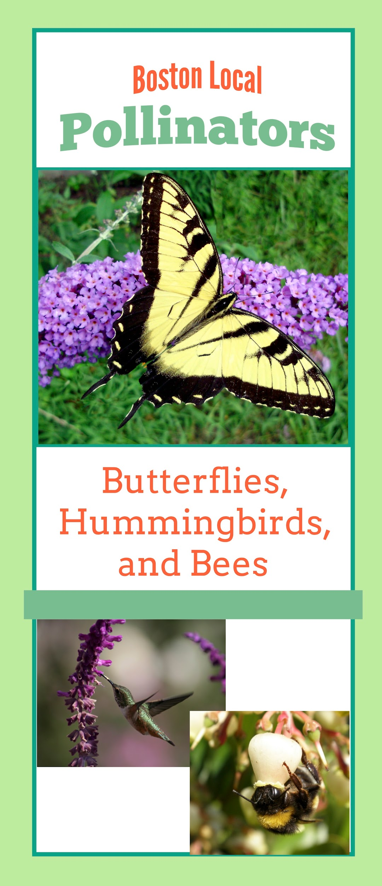
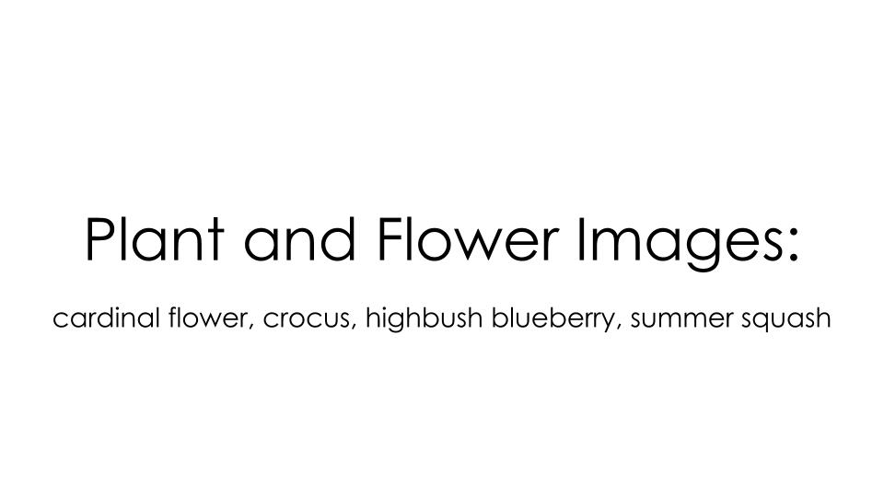
Report Research: Step 1
Based on the Research Question(s) you need to answer, decide which research resources below you need to review.

Slide 8
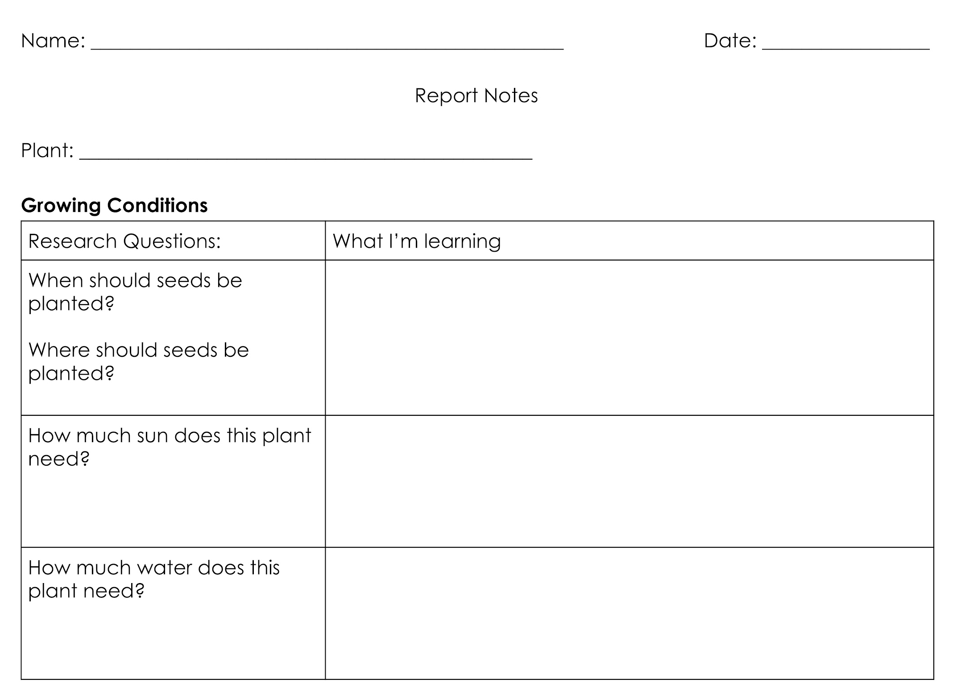
Report Research: Step 2
Re-read the section(s) about your plant.
Underline the parts of the text that answer the Research Questions.

Slide 9
Report Research: Step 3
Say the information in your own words.

Slide 10
Report Research: Step 4
Write your notes in your Report Notes, next to the question(s) you are answering.

