Slide 1
“Boston Local Pollinators” Research
Writing Unit 4 Week 2 Day 1

Slide 2
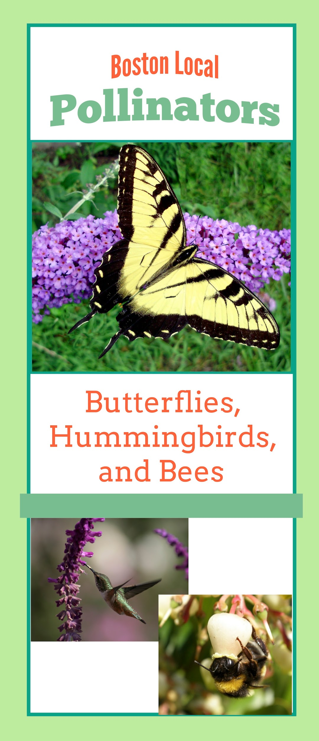
Report Research: Step 1
Look for information about your plant. You might find it with more than one pollinator!
Read all of the information about your plant.

Slide 3
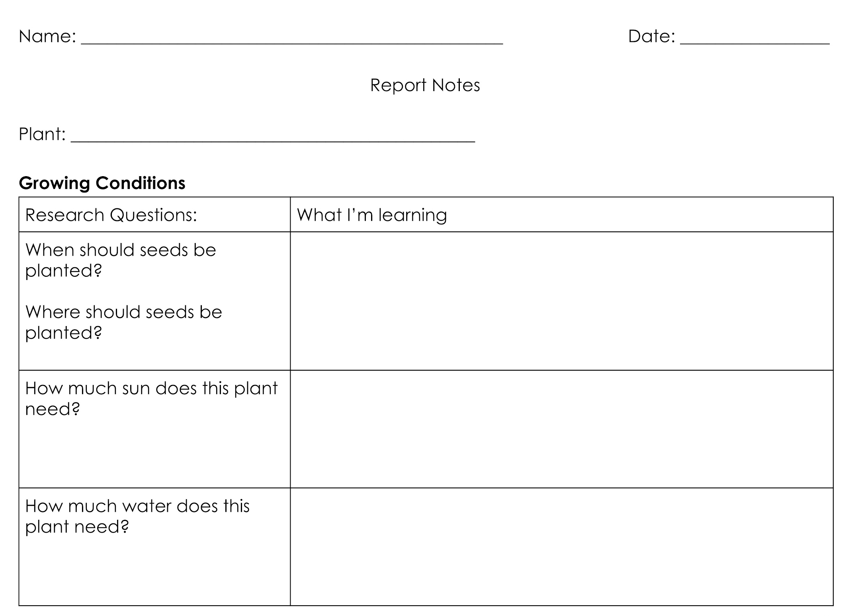
Report Research: Step 2
Read the Research Questions again.
Re-read the section(s) of the brochure about your plant.
Identify the parts of
the text that answer
the Research
Questions.

Slide 4
Report Research: Step 3
Say the information in your own words.

Slide 5
Report Research: Step 4
Write your notes in your Report Notes, next to the question(s) you are answering.

