Slide 1
Inside a Seed
Science and Engineering Week 2, Lesson 2

Slide 2
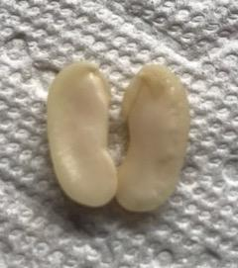
Inside a bean seed
Photo: Ana Vaisenstein

Slide 3
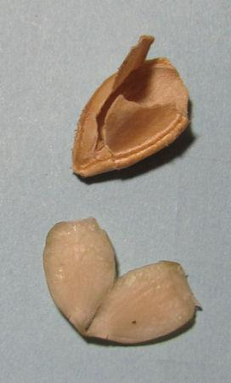
Inside a pumpkin seed
Source: http://www.karengoatkeeper.com/2015/os2-germinating-seeds/

Slide 4
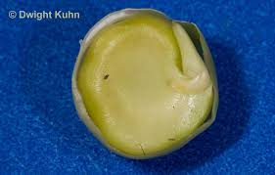
Inside a pea seed
Source: https://dkphoto.photoshelter.com/image/I0000i2GE4mlk4gk

Slide 5
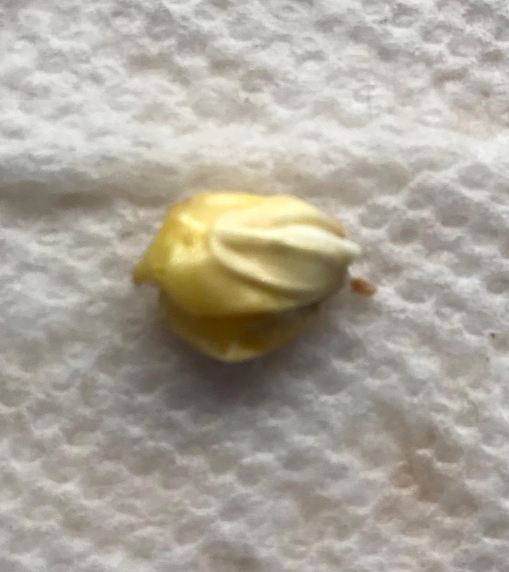
Inside a
corn seed
Photo: Ana Vaisenstein

