Slide 1
Apples and Bees
Text Talk Week 2, Day 4

Slide 2
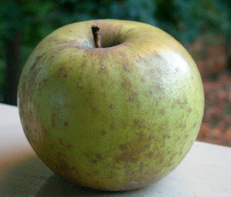
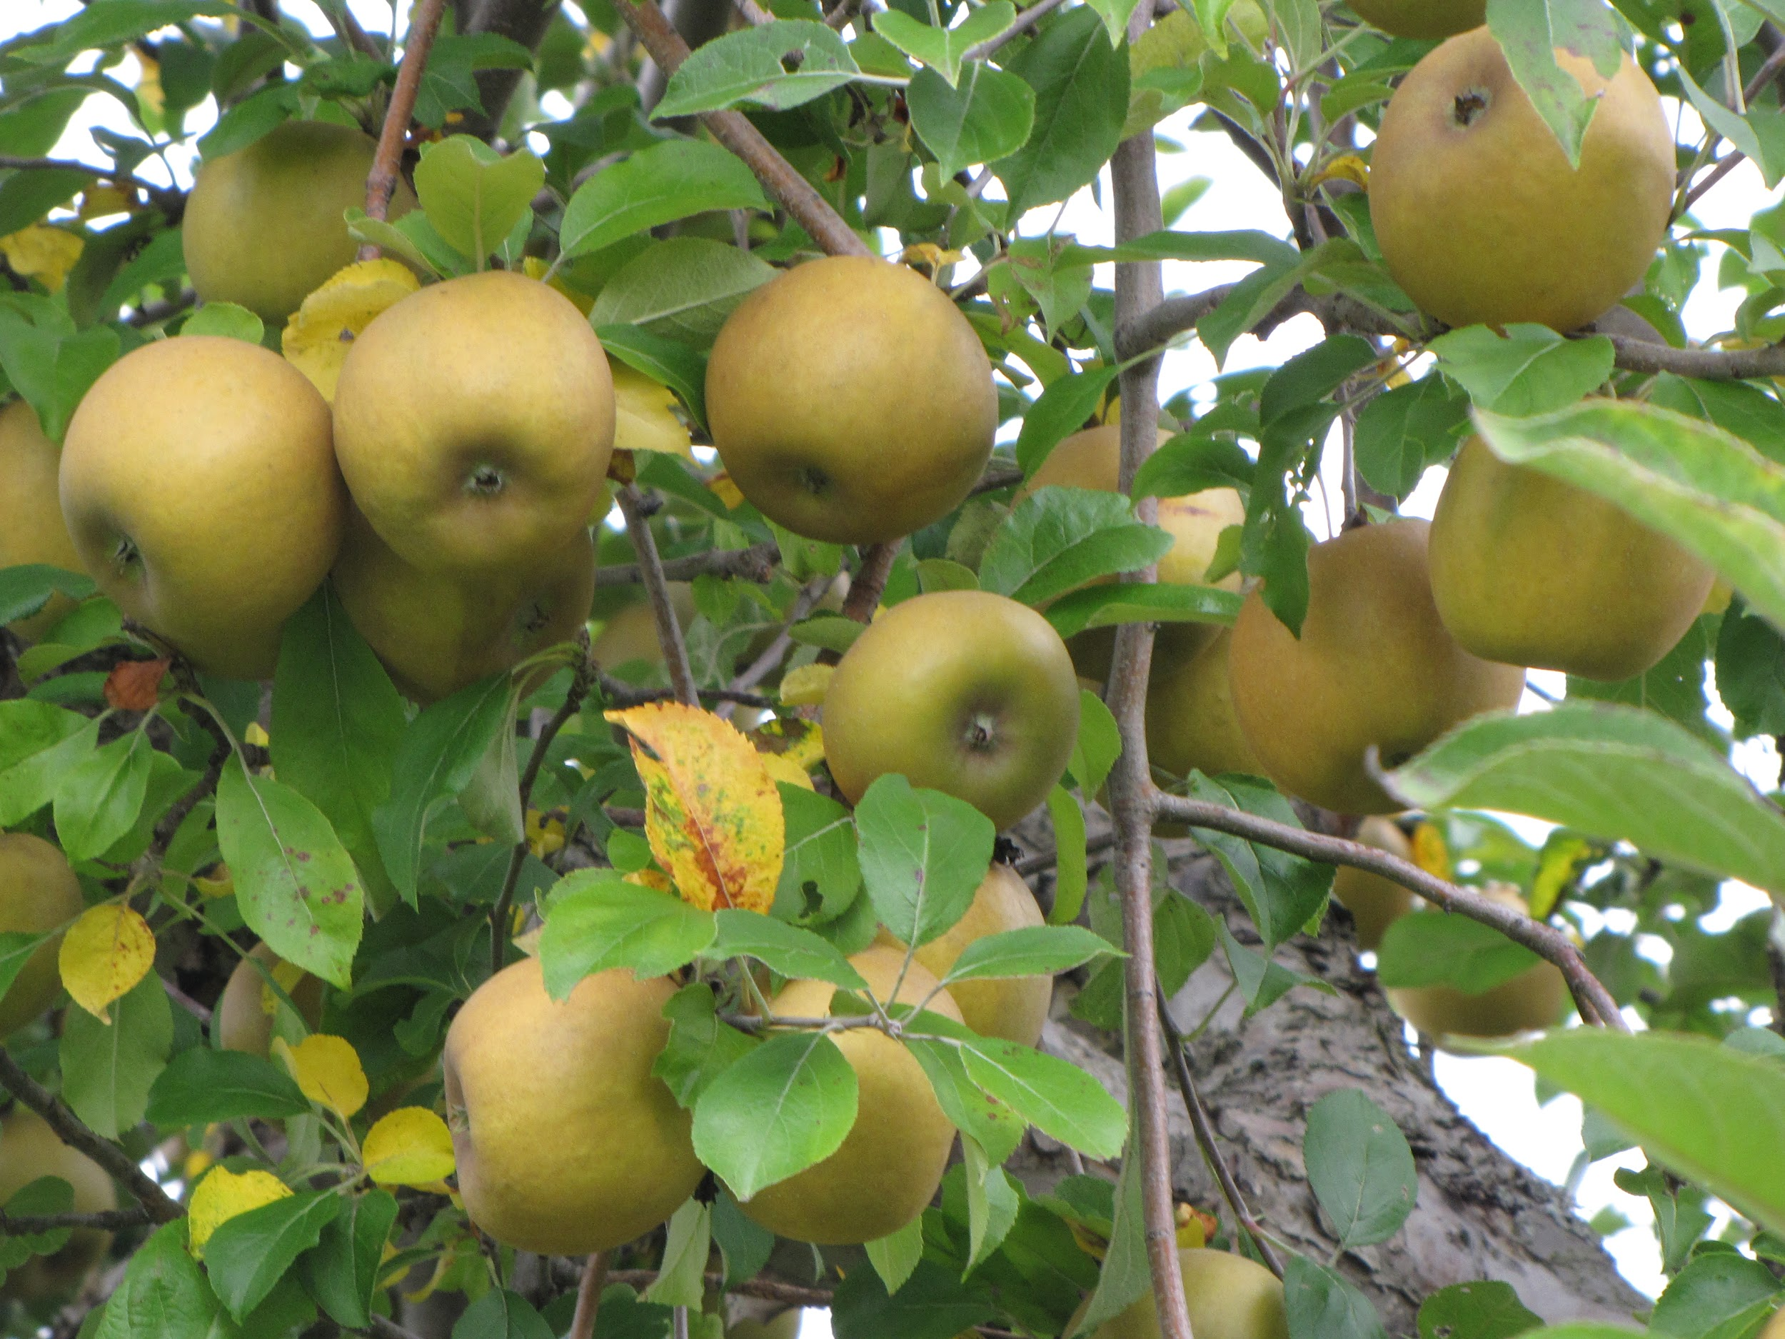
A special apple
The oldest apple in North America is the Roxbury Russet.
This kind of apple was first discovered and farmed in Roxbury, Massachusetts, about 400 years ago. At that time, people had not yet discovered refrigeration. Fortunately, the Roxbury Russet lasts a long time without being kept very cold, and its taste changes from tart to sweet as it is stored.
Through the years, Roxbury Russet apples have been used for many purposes: eating, baking, applesauce, cider, and vinegar. They can still be found at farmers markets and growing in orchards. The word russet refers to a rough, brownish color, so this apple has a perfect name!

Slide 3
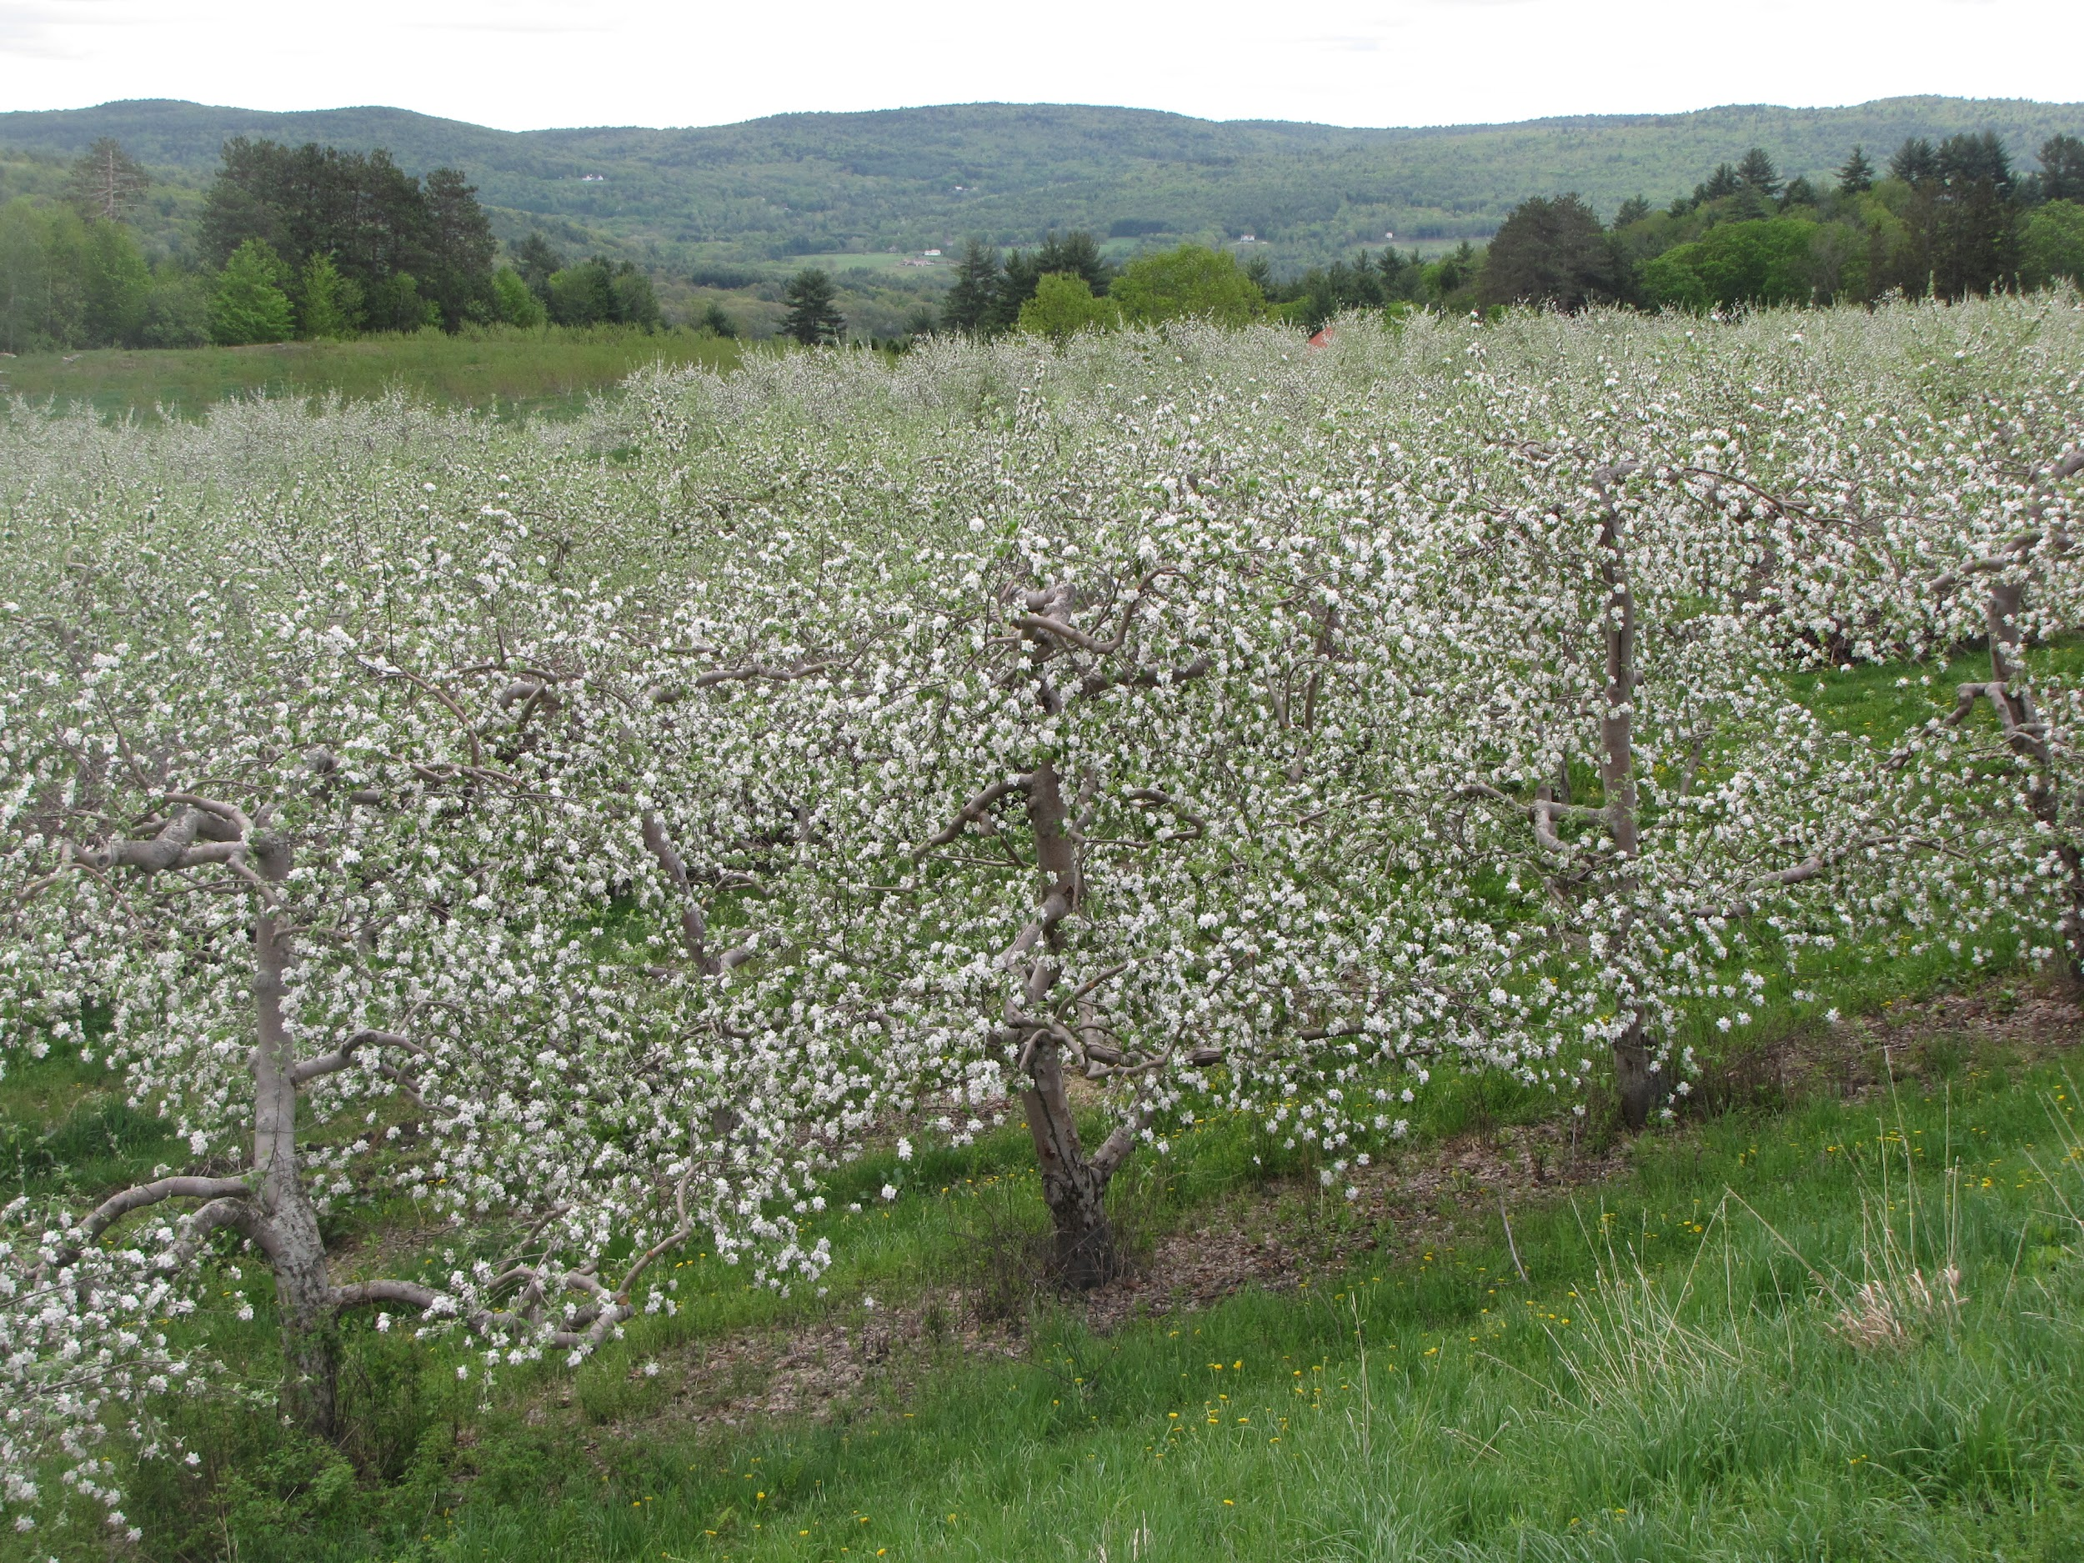
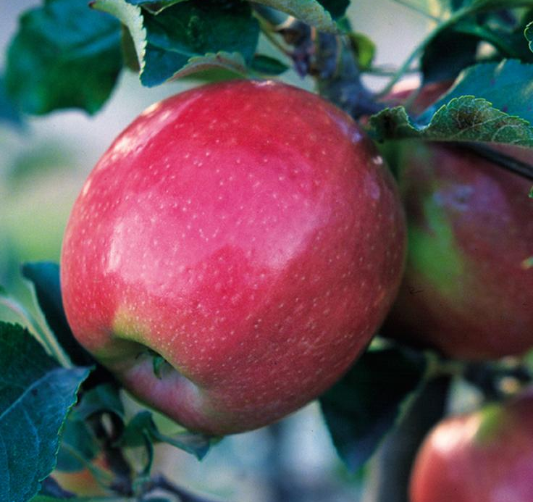
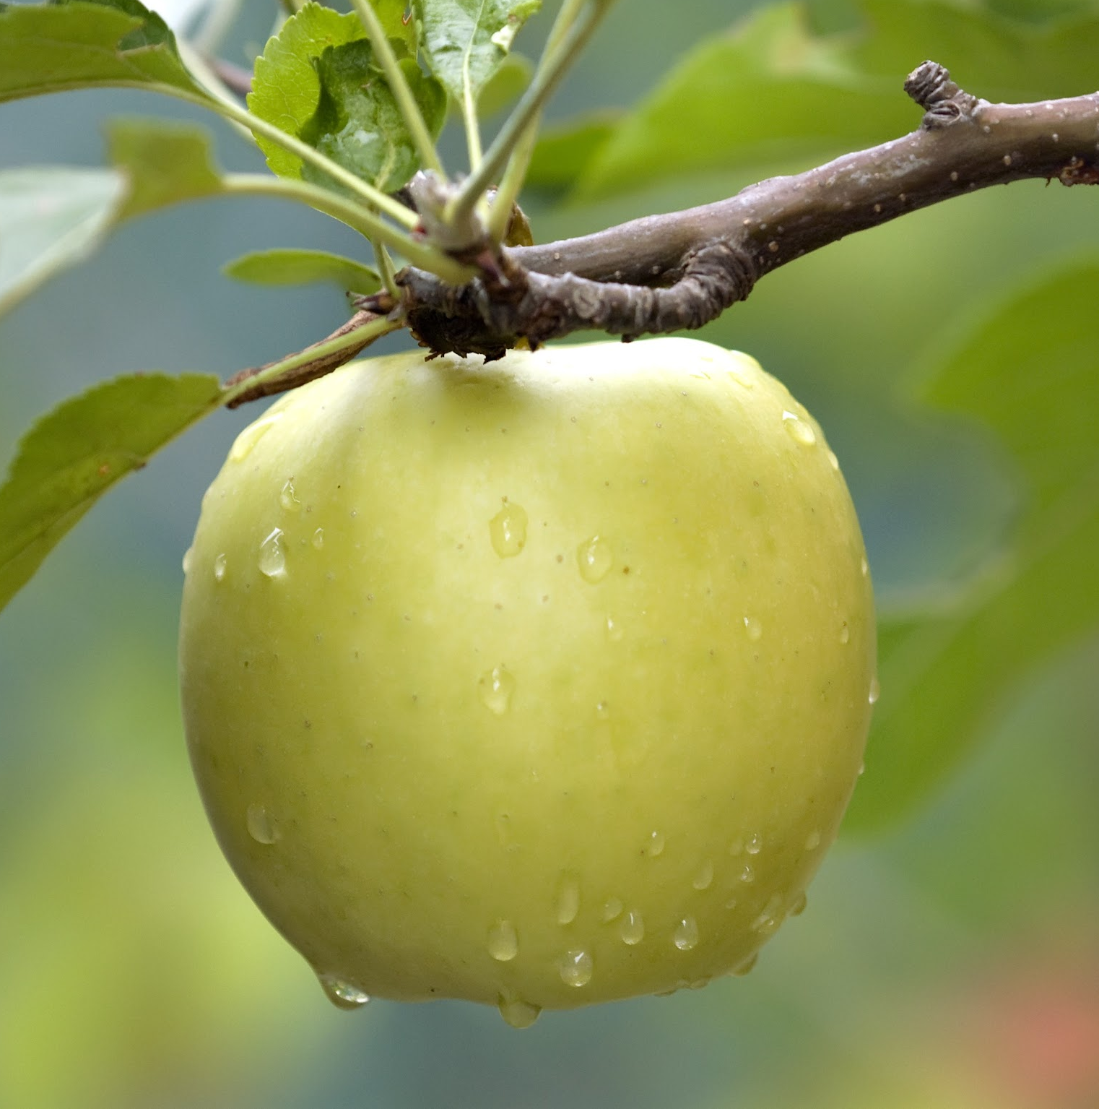
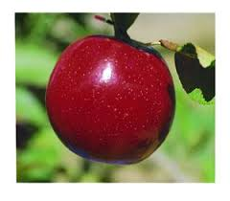
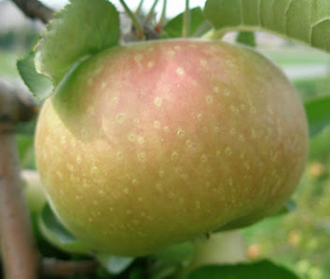
Growing apples
In the springtime, fruit trees are in blossom. This is the time when
pollination has to happen in order for apple trees to produce the
apples we eat in the summer and fall. Pollination is the movement of
pollen from the male to the female part of a flower. Some types of
fruit trees can be pollinated with their own pollen, such as peach trees. Other types of trees need pollen from different trees. Apple trees must be cross-pollinated in order to produce fruit.
A Baldwin apple tree might use pollen from a …
Northern Spy apple tree... | or a Mutsu apple tree... | or an Empire apple tree.
That’s one reason why an apple orchard has different kinds of apple trees. But how does pollen travel from one apple tree to another?

Slide 4
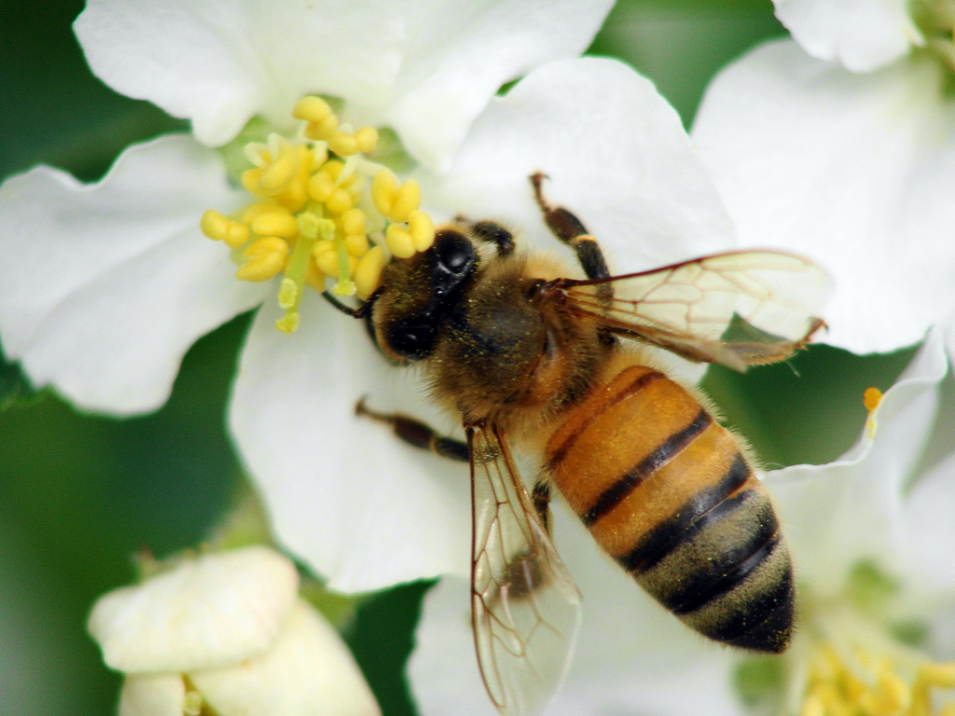
A special pollinator
Many different kinds of bees are excellent pollinators, but one bee is special. Honey bees collect pollen to take back to their hives to feed growing bees. Along the way, some of that pollen drops off their bodies, right onto the stigmas of other flowers they visit.
Farmers depend on honey bees. They set up beehives in their orchards and fields so that the bees are always close by to pollinate their crops. These beehives are perfect places for large colonies of bees to live.
Each honey bee visits 50 to 100 flowers on each trip from the hive. Apple blossoms usually grow in clusters, or groups, on one branch, making it easy for pollinators to move from one flower to another. Farmers also plant their apple trees close to each other. Honey bees visit so many flowers and trees that they are known as the most important pollinator of apple trees in North America.

Slide 5
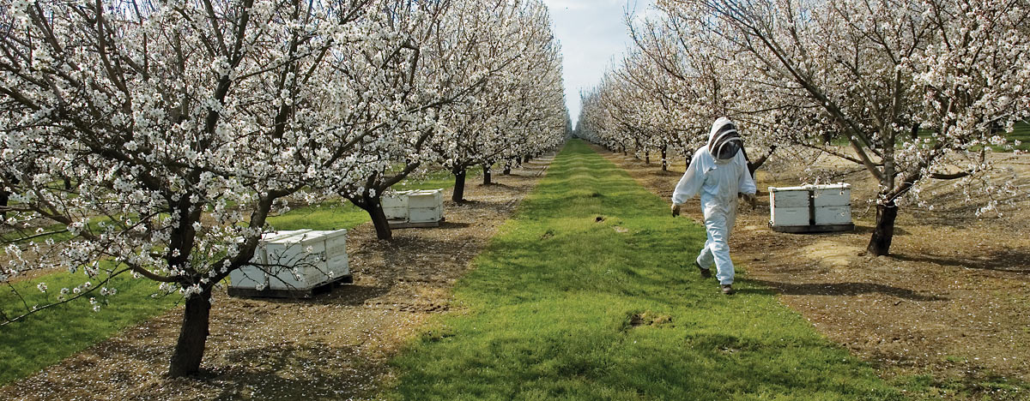
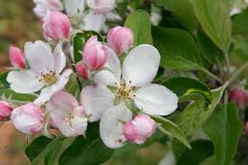

Slide 6
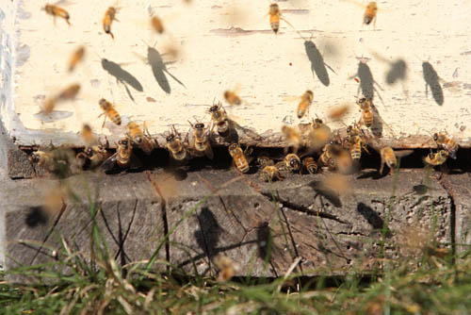
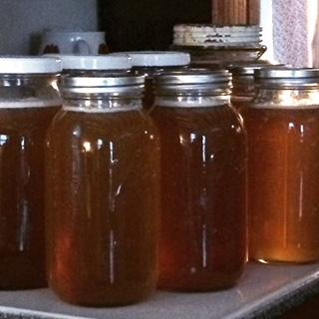
Bees and apples
Bees don’t only collect pollen. As they travel from flower to
flower they also sip nectar. Then they carry it back to their
hives to make honey. This is their food.
Many people also like honey! Do you? Honey bees make so much honey that when people take some of it to use, there is still plenty left for the bees.
Apple farmers use honey bees to pollinate their trees, and honey bee farmers benefit from having such busy bees to produce lots of honey from all those flowers.
Farmers and consumers depend on each other to keep producing apples and honey.

Slide 7
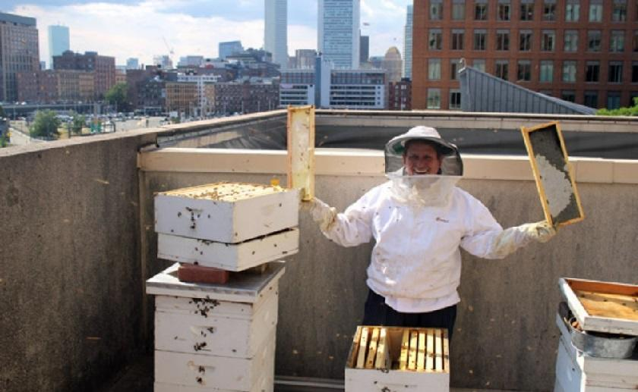
Most apples and honey come from farms outside the city. But apple trees still grow around us. And some urban beekeepers set up hives in yards and community gardens, and on rooftops. These hives allow honey bees to pollinate flowers, vegetable plants, and fruit trees everywhere.

Slide 8
Citations
Information
http://www.pollinator.ca/bestpractices/colony.html
https://extension.psu.edu/the-role-of-pollen-bees-in-fruit-tree-pollination
https://www.fs.fed.us/wildflowers/pollinators/pollinator-of-the-month/mason_bees.shtml
Photos
Roxbury Russet: http://appleharvester.blogspot.com/2010/03/roxbury-russet.html
Apple blossoms: https://commons.wikimedia.org/wiki/File:Apple_blossoms.jpg
Honey bee: https://www.flickr.com/photos/refmo/2439542125/
Empire: https://www.grandpasorchard.com/Tree/Malus-Empire
Mutsu: https://www.isons.com/shop/fruit-trees/mutsu-apple-tree/
Baldwin: http://appleharvester.blogspot.com/2010/04/story-of-apple-baldwin.html
Roxbury Russets in tree: https://newenglandapples.files.wordpress.com/2011/12/img_6239.jpg
Honey: Laura Booth
Rooftop hives: https://www.chowhound.com/pictures/rooftop-hives-buzzing-boston/seaport-hotel

