Slide 1
Words with Multiple Meanings
Vocabulary & Language Week 2, Days 3-4

Slide 2
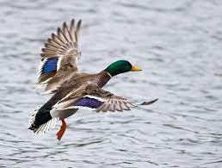
land
verb
to arrive on the ground or other surface
Notes:
https://commons.wikimedia.org/wiki/File:Landing_mallard.jpg

Slide 3
Wind can change the shape of the land.

Slide 4
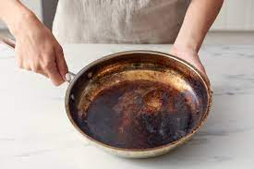
scorched
adjective
burned
Notes:
https://www.apartmenttherapy.com/how-to-clean-burnt-pots-scorched-pans-140547

Slide 5
The fire scorched the earth.

Slide 6
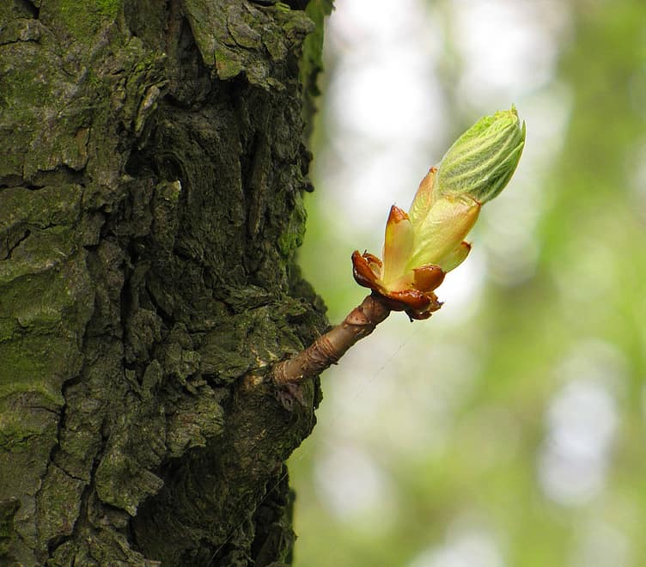
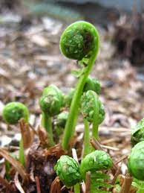
shoot
noun
a new plant or branch
Notes:
https://backyardforager.com/matteuccia-species-delicious-fiddlehead-ferns/, https://www.pikist.com/free-photo-xyizf

Slide 7
She is ready to shoot the basketball.

Slide 8
Words with Multiple Meanings
Choose one of the words we explored yesterday: land, scorched, or shoot.
Write two sentences with that word, one showing each meaning of the word.

