Slide 1
Weekly Words
Unit 4, Week 2
Notes:
attract: to interest, to draw closer
benefit: something positive, an advantage
depend: to rely on, to trust
fertilize: to make able to produce babies, seeds, fruit, or eggs
interdependent: relying on each other
provide: to give what is needed, to supply
release: to let go
rely: to trust or depend on

Slide 2
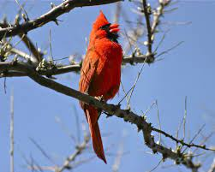
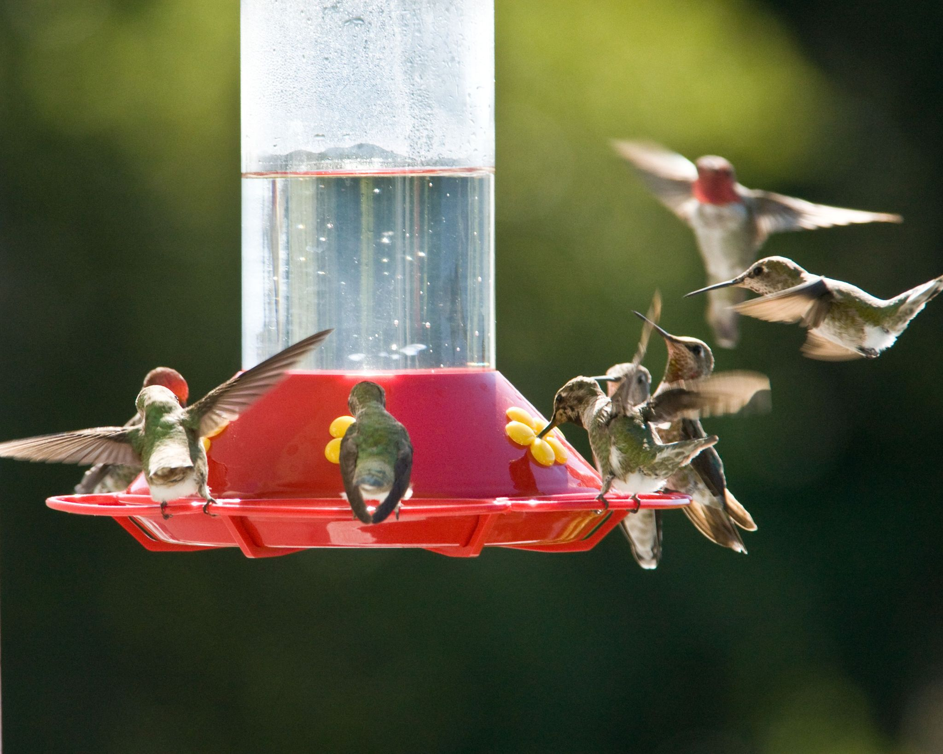
attract
verb
to interest, to draw closer
Notes:
attract (verb)
Elaboration:
A male cardinal sings from a high branch to attract a mate. Then they will make a nest together and raise their young. This bird feeder is specially designed to attract hummingbirds.
Think, Pair, Share prompt:
What features of a flower might attract a pollinator?
https://www.thestar.com/news/insight/2013/02/24/cardinals_song_means_spring_is_around_the_corner.html, https://www.goodhousekeeping.com/home-products/g28008704/best-hummingbird-feeders/

Slide 3
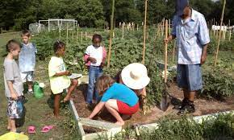
benefit
noun
something positive, an advantage
Notes:
benefit (noun)
Elaboration:
One benefit of a community garden is that people can spend time together there.
Think, Pair, Share prompt:
What are some other benefits of gardens?
https://www.unitedway.org/blog/using-your-green-thumb-for-a-good-cause

Slide 4
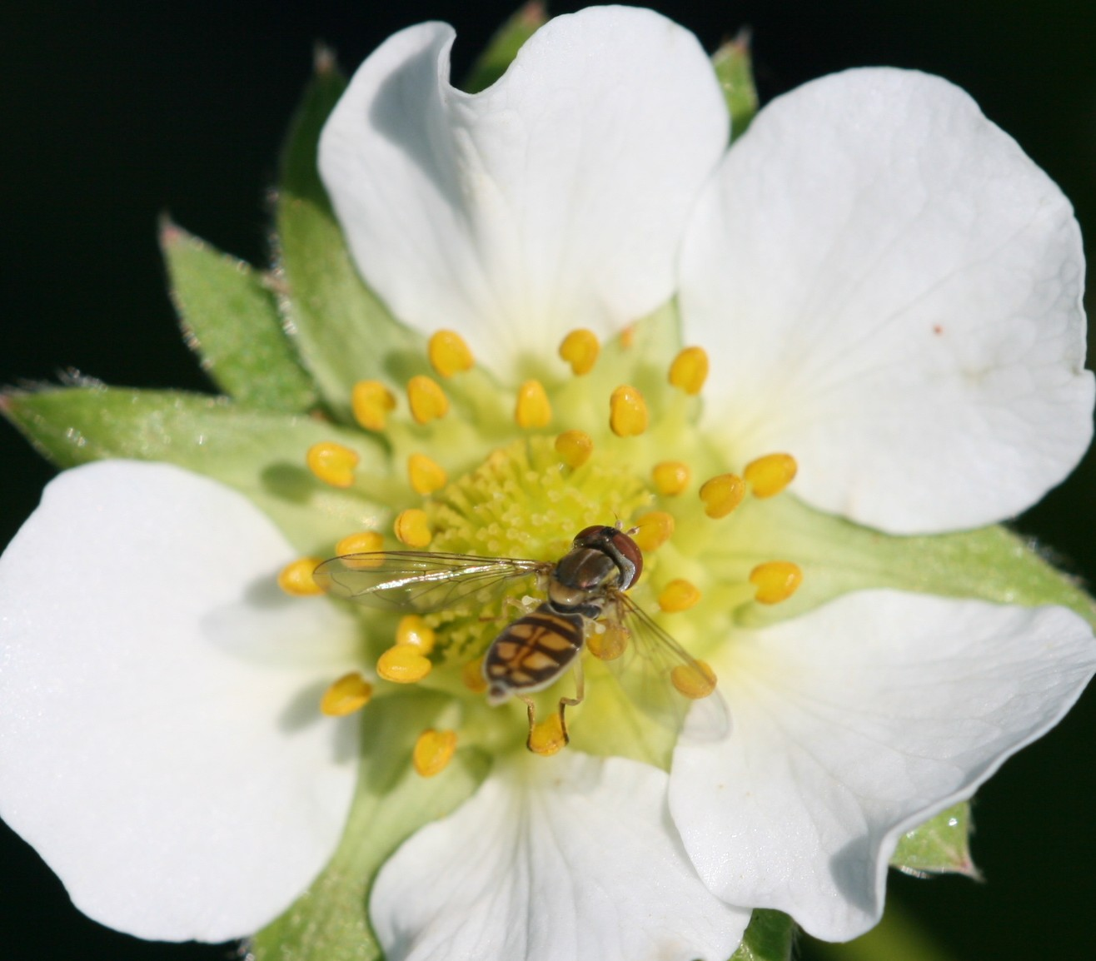
depend
verb
to rely on, to trust
Notes:
depend (verb)
Elaboration:
Depend is a synonym for “rely.”
This strawberry plant depends on pollinators for pollination. The insect, a syrphid fly, depends on the flower for food.
Think, Pair, Share prompt:
Who do you depend on for something you need?
Or:
How do you think people depend on insects?
https://entomology.ces.ncsu.edu/strawberry-pollinating-insects/

Slide 5
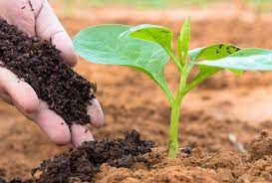
fertilize
verb
to make able to produce babies, seeds, fruit, or eggs
Notes:
fertilize (verb)
Elaboration:
When farmers and gardeners fertilize plants, they hope that the plants will have a better chance of growing stronger and producing more crops.
Think, Pair, Share prompt:
How do pollinators help fertilize flowers?
https://www.geturbanleaf.com/blogs/care/fertilize-plants

Slide 6
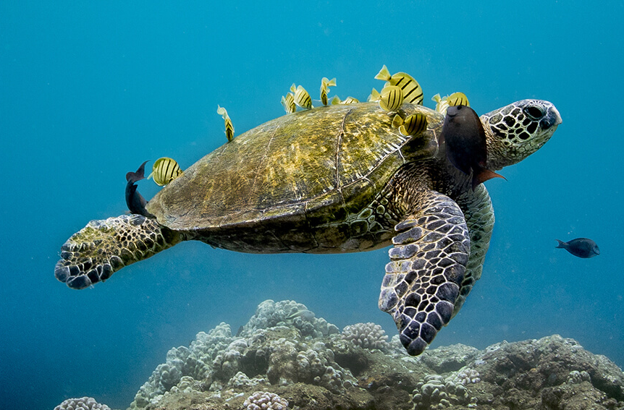
interdependent
adjective
relying on each other
Notes:
interdependent (adjective)
Elaboration:
The prefix “inter” means between or connected. The suffix “ent” tells us this is an adjective. The root word, or base word, in the middle, is “depend.” This word, interdependent, describes a relationship in which two or more organisms or entities are dependent on one another.
This green sea turtle depends on fish to clean its shell. The fish depend on the tiny plants that grow on the turtle’s shell for food. Each kind of animal gets something they need from the other; they are interdependent.
Think, Pair, Share prompt:
How are pollinators and plants interdependent?
https://sanctuaries.noaa.gov/magazine/5/day-at-the-turtle-spa/

Slide 7
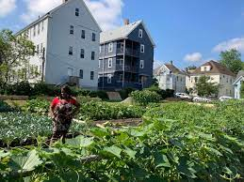
provide
verb
to give what is needed, to supply
Notes:
provide (verb)
Elaboration:
Farms provide us with the food we eat. This farmer, Kafi Dixon, farms with other women to provide vegetables for families and seniors in Boston.
Think, Pair, Share prompt:
What support or help do you provide to each other? What materials or other resources does the school provide to you for learning?
https://www.wbur.org/news/2021/05/05/urban-farmer-kafi-dixon-a-reckoning-in-boston

Slide 8
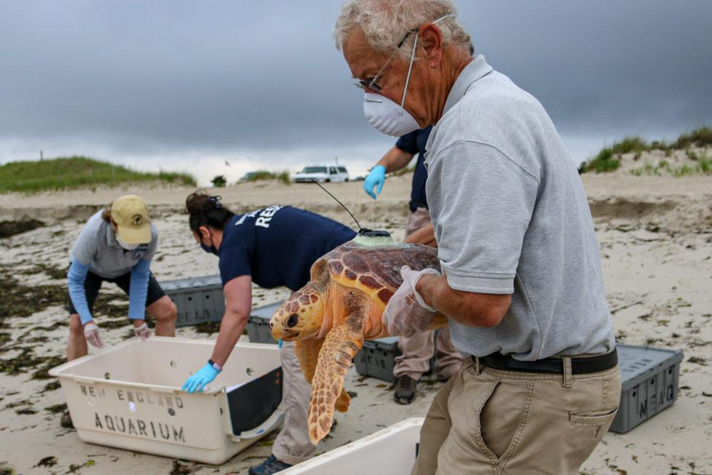
release
verb
to let go
Notes:
release (verb)
Elaboration:
These scientists and volunteers from the New England Aquarium release sea turtles back into the ocean after providing the medical treatment they needed. They take them out of their boxes and send them back out to the ocean.
Think, Pair, Share prompt:
Imagine having a fist full of seeds. If you release them into the air [make a gesture of tossing seeds out from your hand], what happens next?
https://www.wbur.org/news/2020/07/01/seven-sea-turtles-released-back-into-wild-after-a-winter-of-rehab-in-quincy

Slide 9
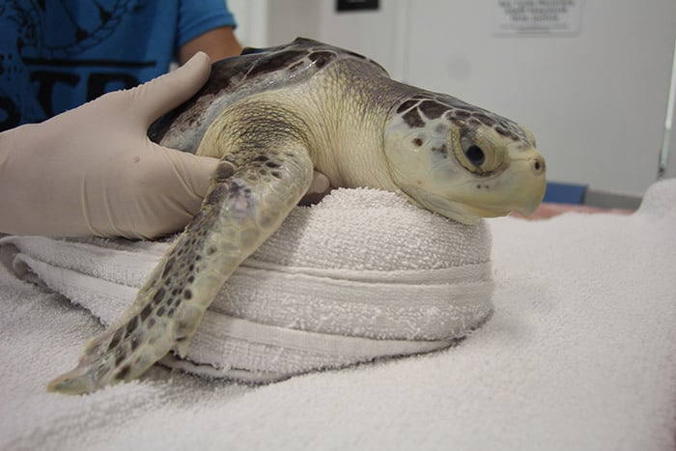
rely
verb
to trust or depend on
Notes:
rely (verb)
Elaboration:
Rely is a synonym for “depend.”
This sea turtle relies on care from a scientist to get healthy enough to return to the wild.
Think, Pair, Share prompt:
What is something plants rely on to survive?
https://www.jerseyshoreonline.com/ocean-county/sea-turtles-being-released-into-wild/

