Slide 1
Plant Images
Writing Unit 4 Week 1 Day 4

Slide 2
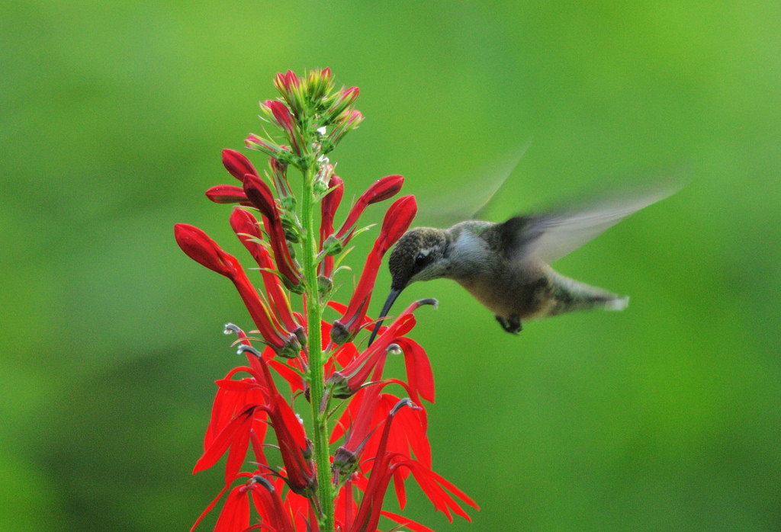
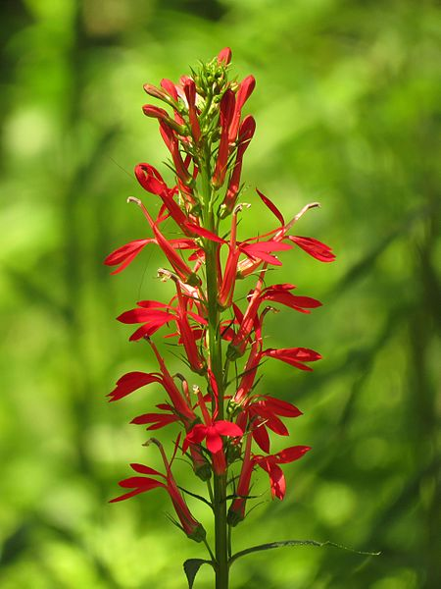
cardinal flower

Slide 3
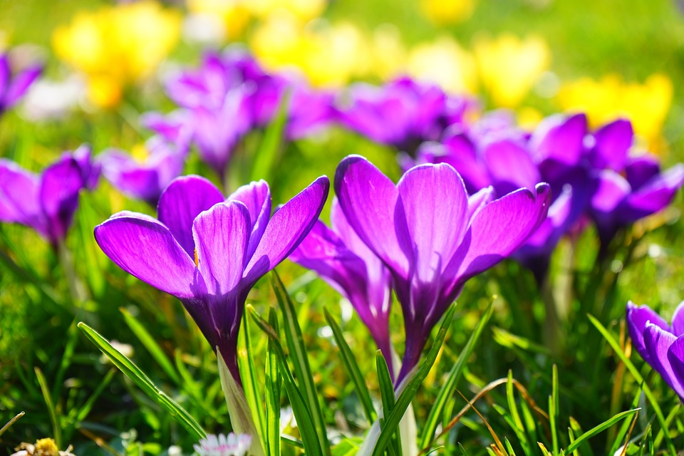
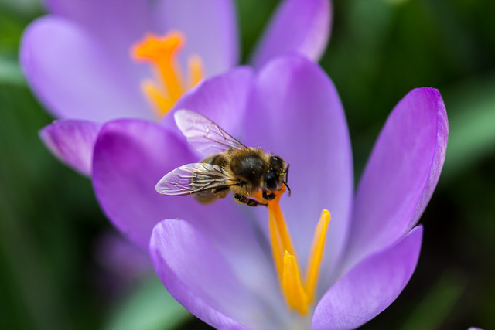
crocus

Slide 4
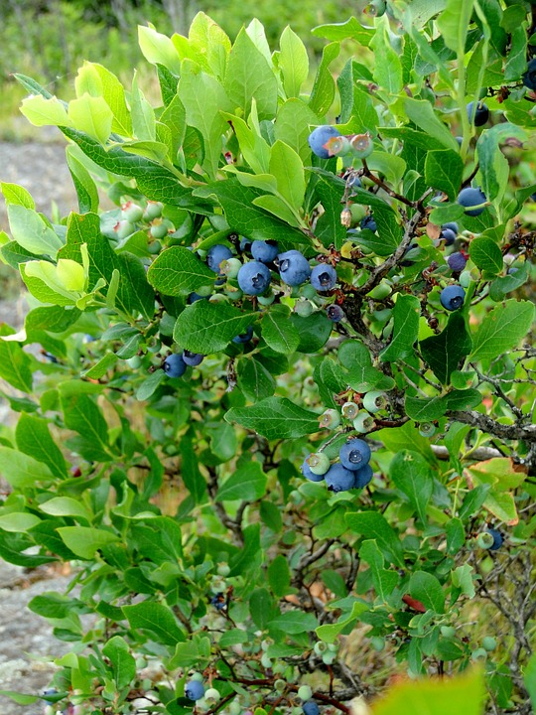
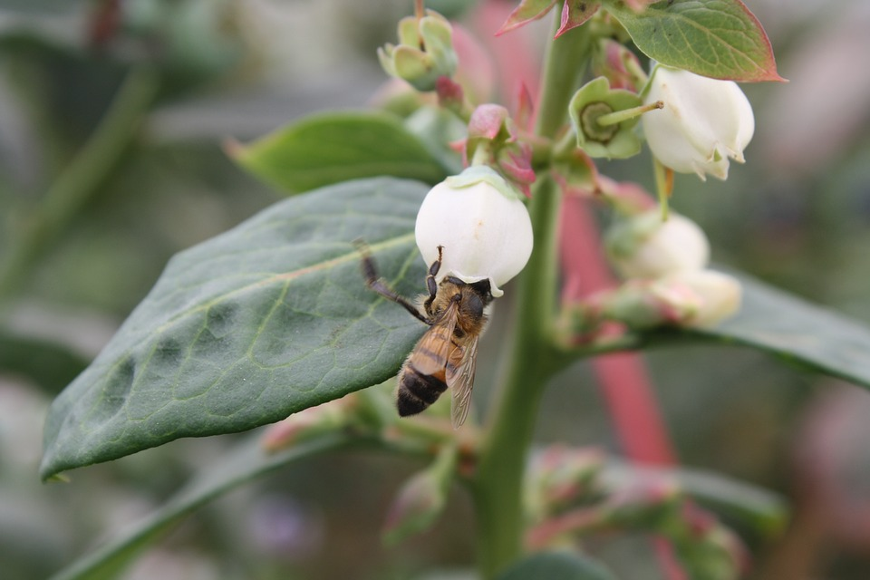
highbush blueberry

Slide 5
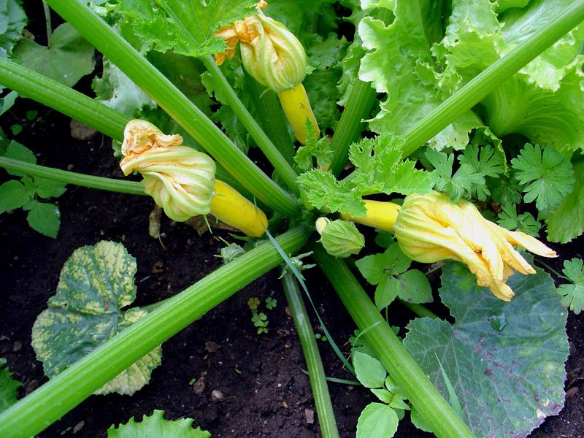
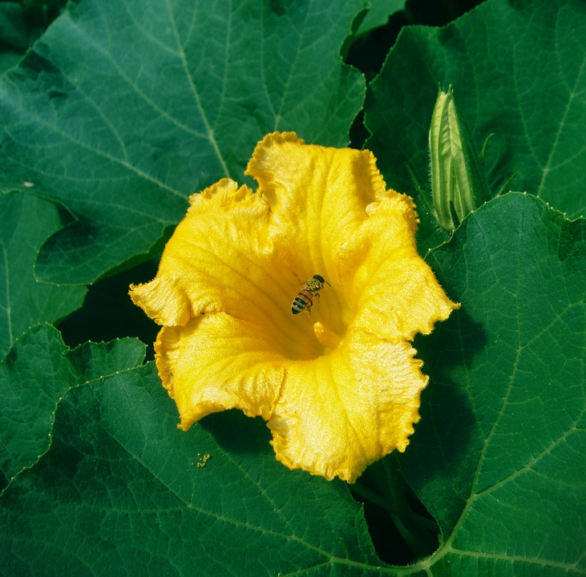
summer squash

Slide 6
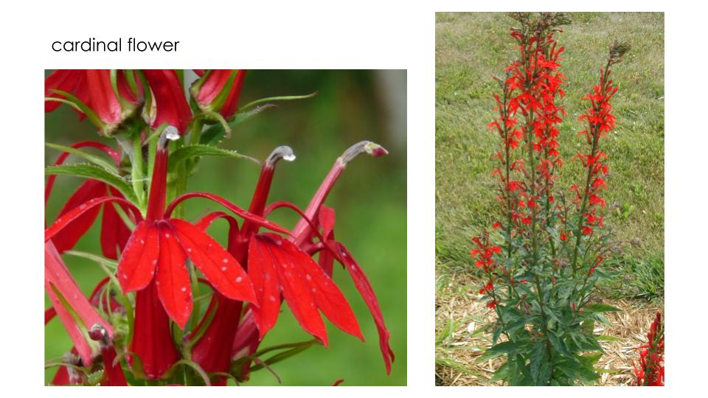
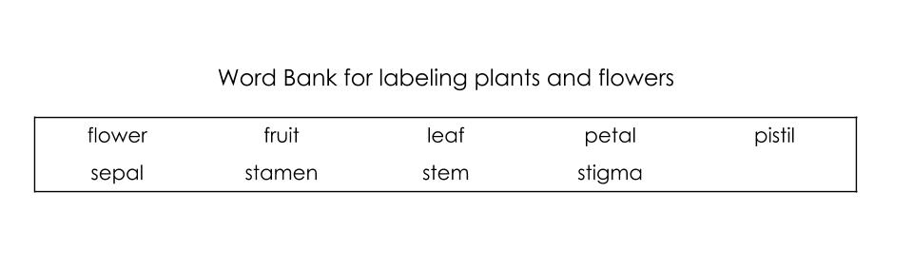
Report Research: Step 1
The Plant and Flower Images packet has detailed images of each plant and its flower. It also includes a word bank with words you can use to label a diagram of your plant.
Look carefully at the page that has images of your plant.

Slide 7
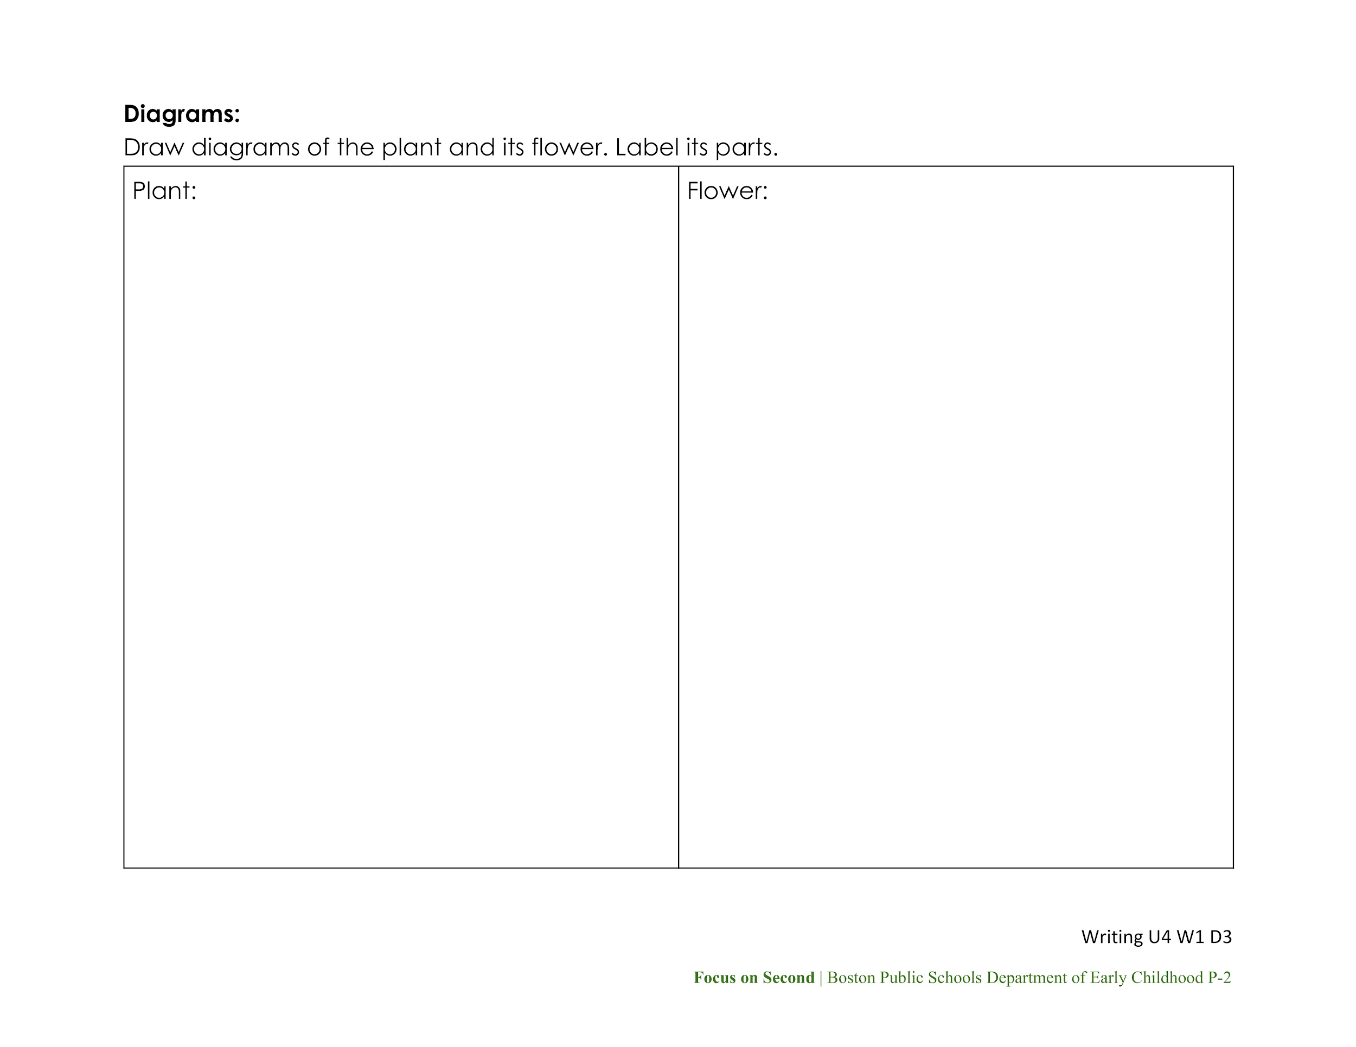
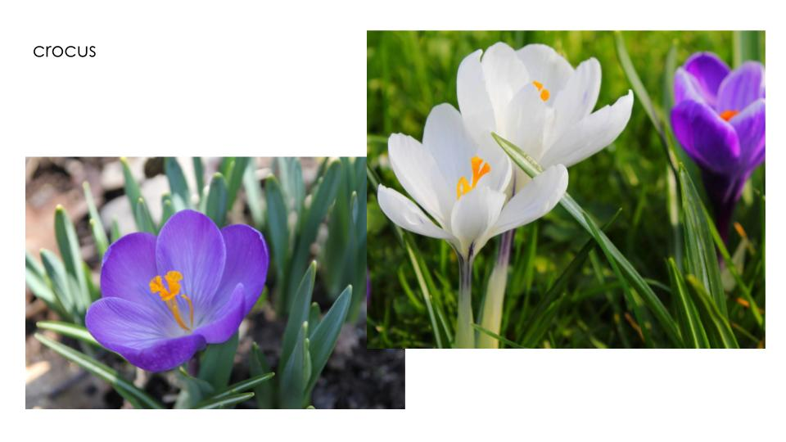
Report Research: Step 2
Read the Diagrams section of the Report Notes.
Look again at the images of your plant. Use the Word Bank to help you name its parts.

Slide 8
Report Research: Step 3
Draw and label diagrams of you plant and its flower.

Slide 9

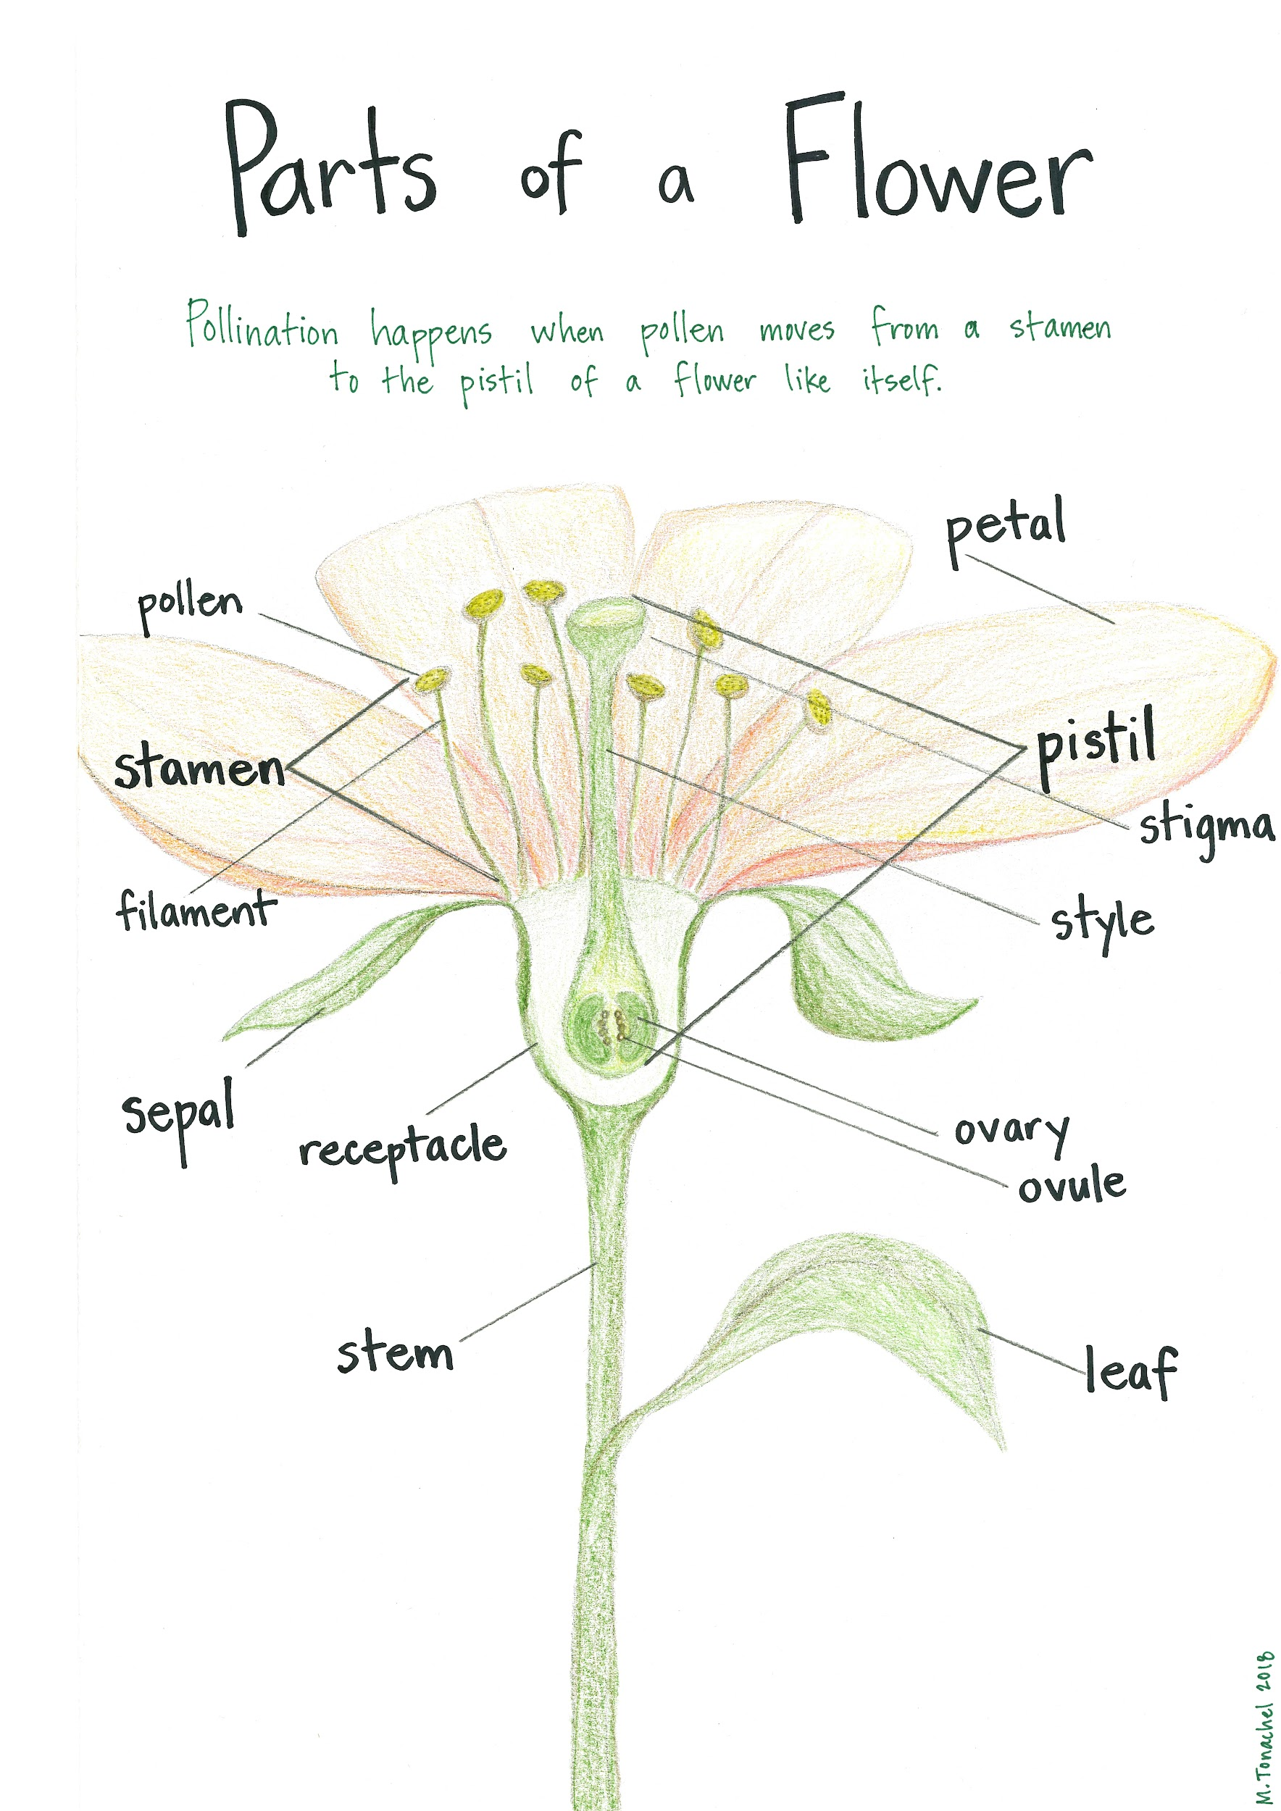
Additional Resources
For more information about the parts of a flower, see these resources.

Slide 10
Citations
Slide 2: https://www.flickr.com/photos/horsepunchkid/14986081725, https://commons.wikimedia.org/wiki/File:Cardinal_Flower_-_Flickr_-_treegrow.jpg
Slide 3: https://pixabay.com/en/crocus-flower-spring-b%C3%BChen-purple-318291/, http://www.geograph.org.uk/photo/3861117
Slide 4: https://pixabay.com/en/photos/api/, https://pixabay.com/en/blueberry-bush-shrub-highbush-101862/
Slide 5: https://commons.wikimedia.org/wiki/File:Cukina_1.jpg, https://pixabay.com/en/photos/pumpkin%20flower/

