Slide 1
Yellow Lady’s-slipper
Writing Unit 4 Week 1 Day 3 and Week 2, Day 4

Slide 2
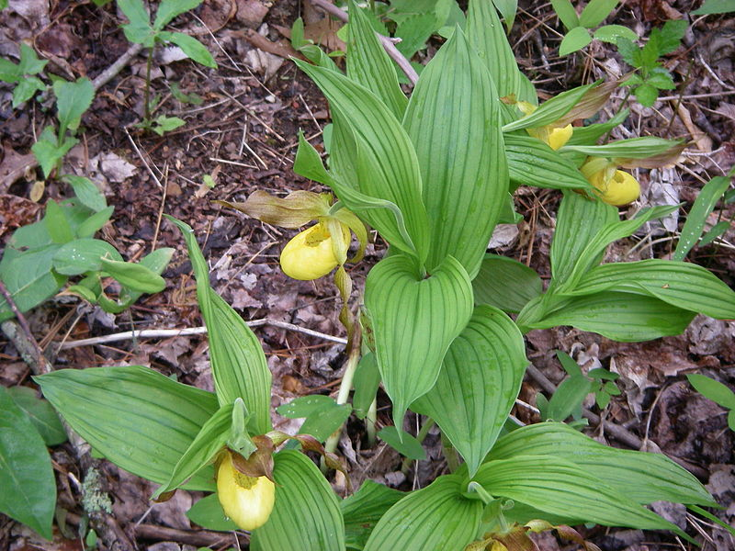
Yellow Lady's-slipper
The Yellow Lady's-slipper is an orchid plant with a yellow flower. It grows naturally in woodlands, wetlands, and swamps.
The Yellow Lady's-slipper should be grown inside for a few seasons before moving it outside. It grows well in wet, shady areas and blooms in the early spring.

Slide 3
Yellow Lady's-slipper
The Yellow Lady's-slipper is an orchid plant with a yellow flower. It grows naturally in woodlands, wetlands, and swamps.
The Yellow Lady's-slipper should be grown inside for a few seasons before moving it outside. It grows well in wet, shady areas and blooms in the early spring.

Slide 4
Growing Conditions
Research Questions: | What I’m learning
When should seeds be planted? Where should seeds be planted? | seeds need to be grown inside first plant can be moved outside after a few seasons
How much sun does it need?
How much water does it need?

Slide 5
Growing Conditions
Research Questions: | What I’m learning
When should seeds be planted? Where should seeds be planted? | seeds need to be grown inside first plant can be moved outside after a few seasons
How much sun does it need? | not a lot plant in a shady area
How much water does it need? | a lot - needs to be wet

Slide 6
Yellow Lady’s-slipper should be planted and grown inside first. After a few seasons, the plant can be moved outside. Yellow Lady’s-slipper should be planted in a shady area and given a lot of water.

Slide 7
Write Report Subtopics
Choose the subtopic you will write about first.
Review your research notes for that subtopic.
Write your notes in complete sentences to make a paragraph.
Reread your paragraph. Does it make sense?
If not, revise it so it makes sense.
Think about the main idea of your paragraph. What is it mostly about? Think of a heading to introduce that subtopic. Write the heading above your paragraph.

