Slide 1
Amazing Bees Stages
Writing Unit 4 Week 1 Day 2

Slide 2
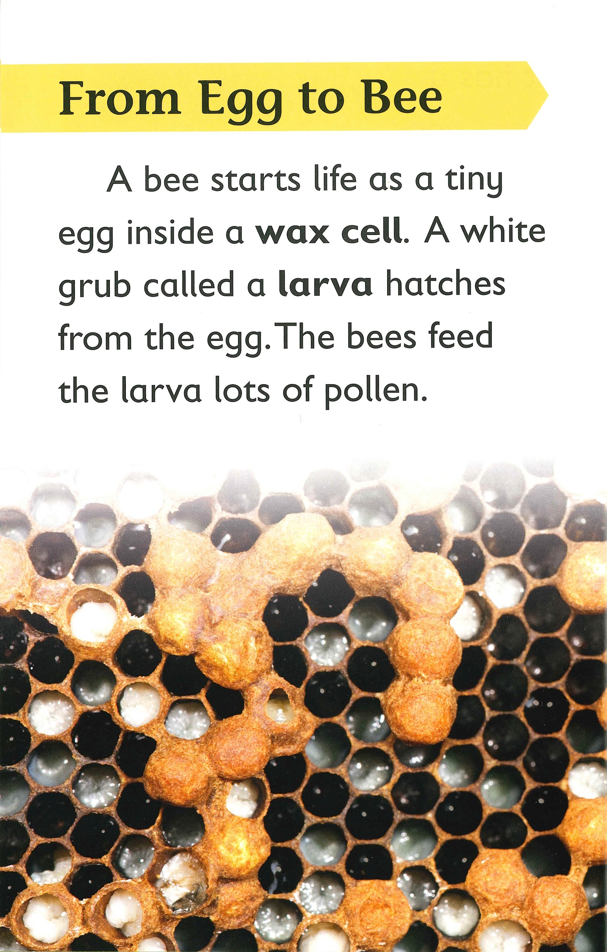
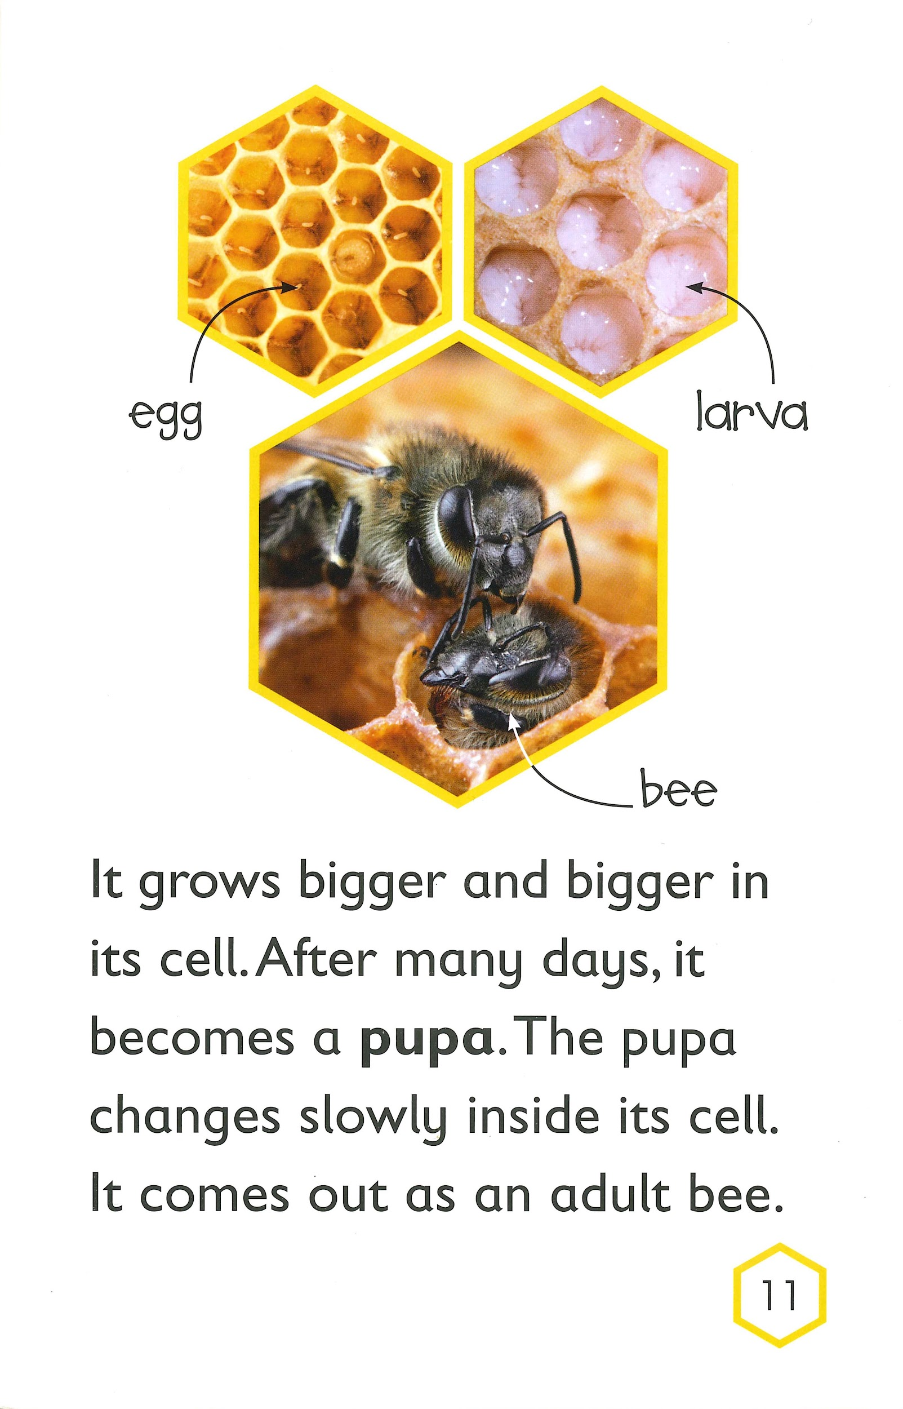
_____________________________

Slide 3
_____________________________

Slide 4
The Bee Life Cycle

