Slide 1
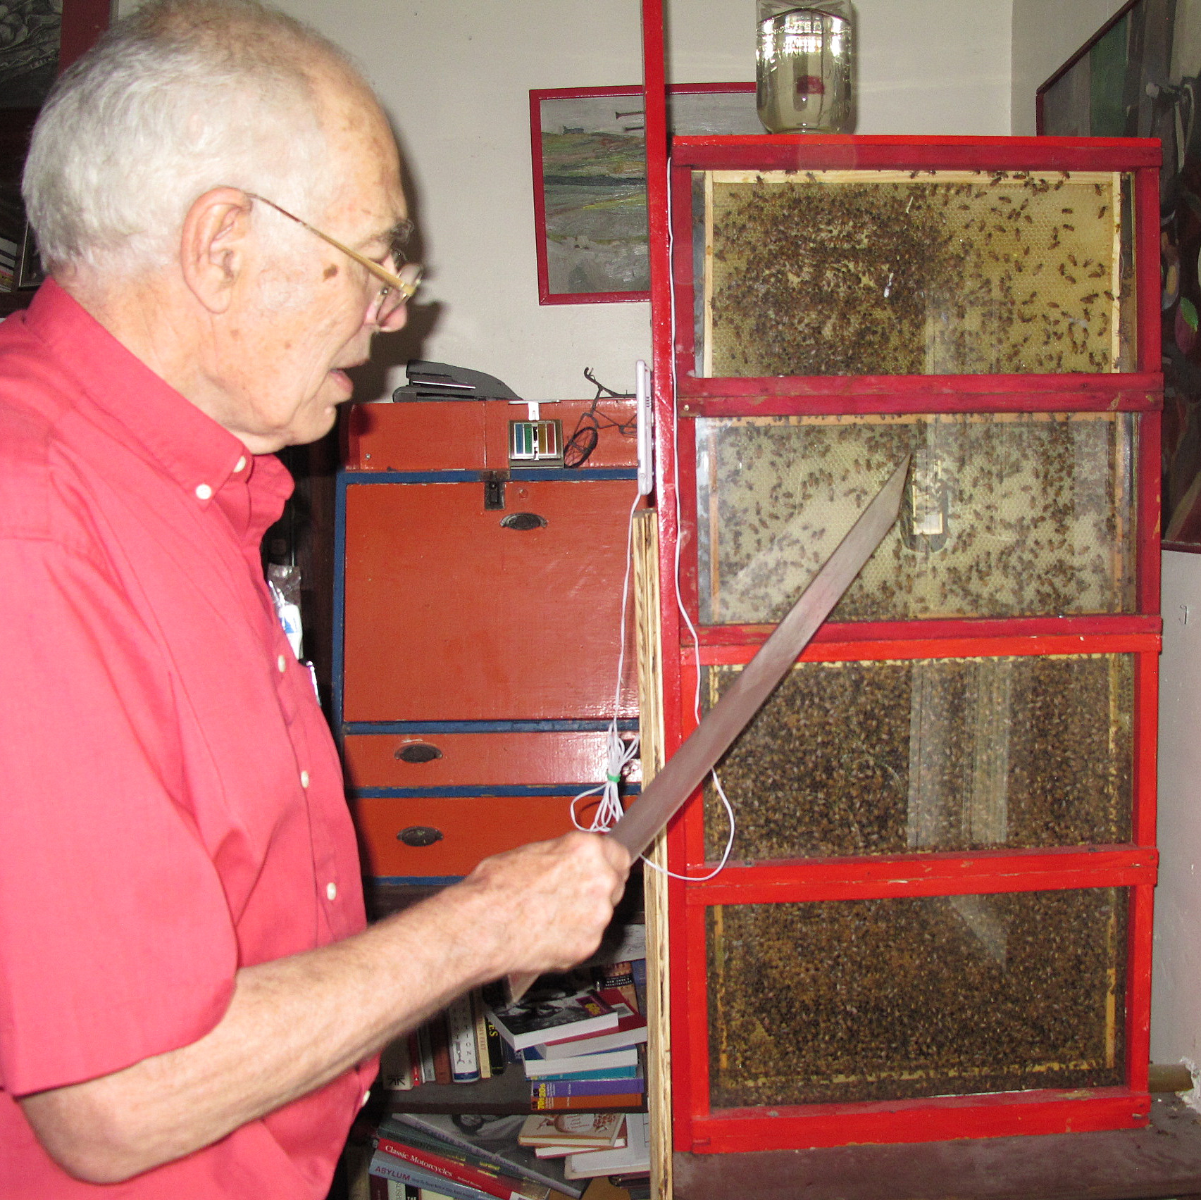
Classroom Hives
Text Talk Week 8, Day 1

Slide 2
Classroom Hives
Jeff Murray started building beehives in classrooms to help children, teachers, and families understand how important bees are. He lives in Cambridge, Massachusetts. He has built hives in public elementary and high schools.

Slide 3
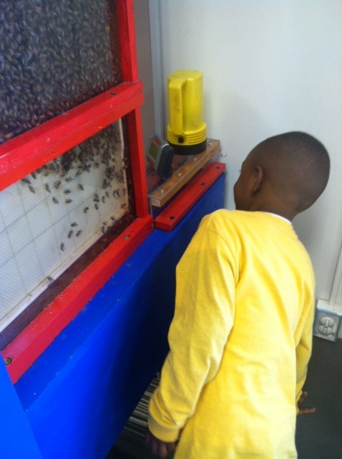
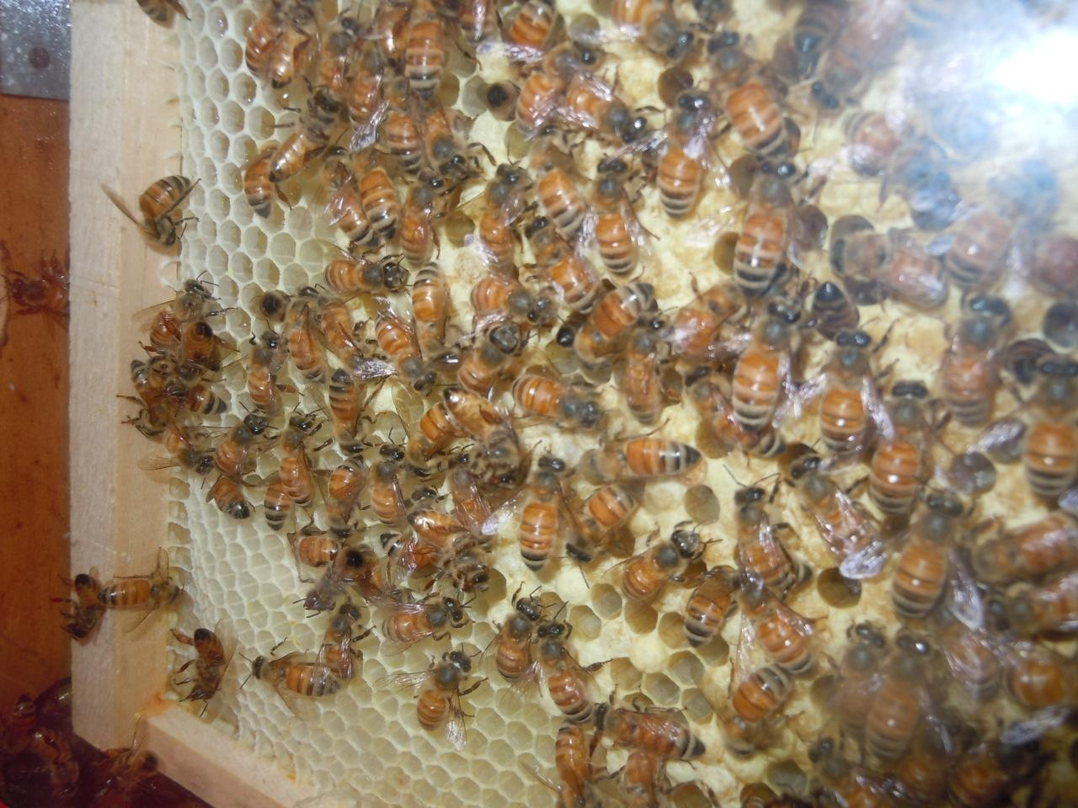

Slide 4
A classroom hive is an observation beehive in a classroom. The hive is attached to the building so it can’t be moved. The bees can’t get into the classroom. They live in the frames where the beeswax is, with the frames sandwiched between two panes of glass. Jeff says, “This is how all the activity in the hive can be seen.” The bees are wild bees. They go outside to collect nectar and pollen, and they come back into the hive through a small tube at the bottom that connects the hive to the outdoors. Jeff also says, “We are beekeepers, but the bees don’t know they are being kept.”

Slide 5
Interview with Jeff Murray
Beekeeper and founder of Classroom Hives
How did you become interested in classroom hives?
I wanted my own kids to have the experience of seeing bees. I was inspired by the observation hive at the Museum of Science, and I thought that this is a good way to see what a hive is like inside. On a regular hive, you can open it up and see the bees for only a few minutes. In an observation hive, you can observe them all the time. Many years ago, I set up an observation hive in my home. Then when I retired, a friend suggested that I set up a hive on the rooftop of a school.

Slide 6
What can children learn from bees in an observation hive?
In an observation hive, you can see the bees performing the dance. This is so important because it shows us how the bees communicate and work together for a common purpose. The dance is extraordinary. Like our own language, the dance is based on symbols. Bees use it to communicate where the food is. At other times, bees communicate like other insects do, by using chemicals.

Slide 7
Also, a beehive is a school exhibit that shows a wild animal functioning in its real environment, in real time. No other exhibit does that. I think this is especially helpful for children who grow up in cities. In cities we do not usually have an opportunity to see how wild animals function and how they are affected by their environment, such as the weather.

