Slide 1
Weekly Words
Unit 4, Week 7
Notes:
commitment: dedication to something or to an idea
local: having to do with a particular place close by
organization: a group of people working together for a shared purpose
plot: a small piece of land
public: open to all
restore: to return to an earlier condition
trace: a very small amount of something; a mark or sign of something
wildflower: flower that grows without planting or care by people

Slide 2
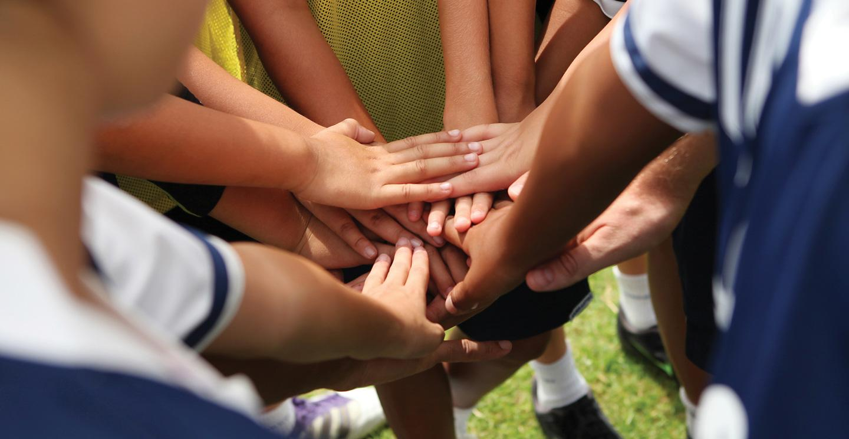
commitment
noun
dedication to something or to an idea
Notes:
commitment (noun)
Elaboration:
Let’s revisit this word from when we talked about learning and schools.
A commitment is a kind of promise. This fall in our classroom community, we made a commitment to _____. Have we kept that commitment?
We can make a verb by taking off the suffix -ment: “commit.” I commit to _____.
Think, Pair, Share prompt:
How can you show that you have a commitment to making our environment healthy for all kinds of plants and animals, including people?
https://aurora.edu/academics/undergraduate/coaching/index.html

Slide 3
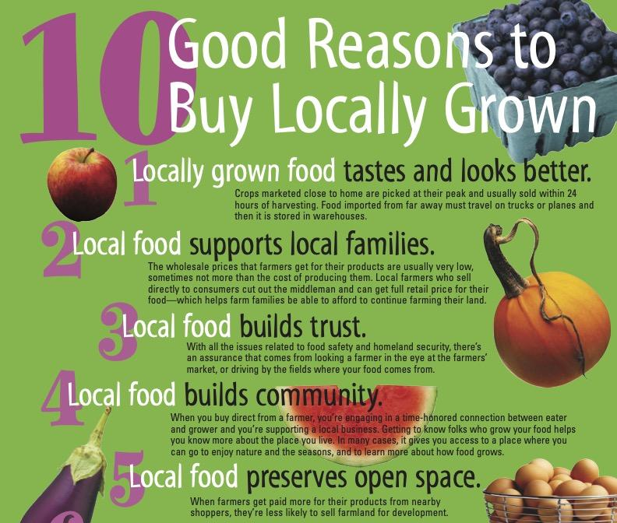
local
adjective
having to do with a particular place close by
Notes:
local (adjective)
Elaboration:
Apples are a local resource—they grow well here in Massachusetts. This poster shows reasons to buy and eat food that come from local farms. We add -ly to make “locally,” an adjective that describes food grown nearby.
Think, Pair, Share prompt:
The _____ Library is our local library—it’s near our school.
What are some local places you go?
https://www.mass.gov/orgs/massachusetts-grownand-fresher

Slide 4
organization
noun
a group of people working together for a shared purpose
Notes:
organization (noun)
Elaboration:
This is an organization working to make traveling by bicycle safe and accessible for everyone in and around their town. One thing the organization does is teach people about repairing their bikes, for free, at farmers markets.
Think, Pair, Share prompt:
If you were going to start an organization, what kind of work would it do for the community?
https://bostoncyclistsunion.org/bike-repair-programs/biketomarket

Slide 5
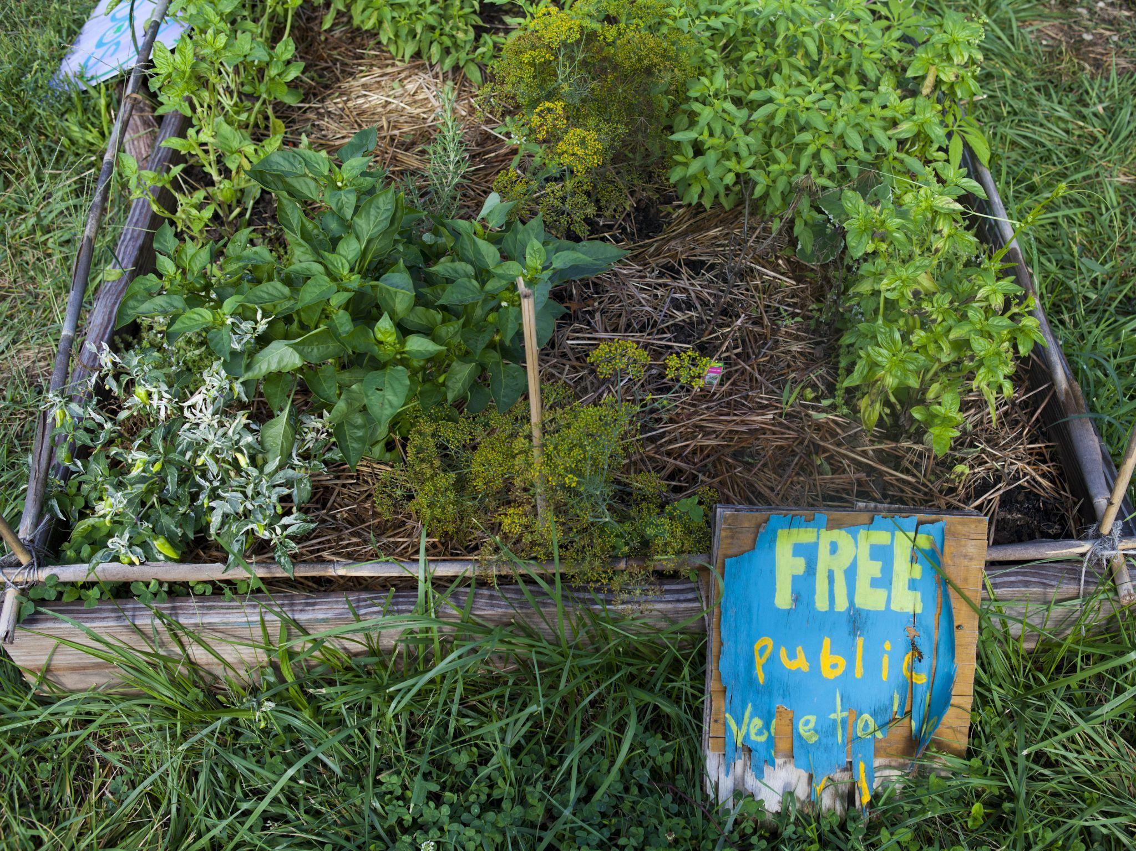
plot
noun
a small piece of land
Notes:
plot (noun)
Elaboration:
“Plot” is a word with multiple meanings. The plot of a story or movie is the chain of events from beginning to end.
Here we are talking about a plot of land, a small area used for something in particular, such as a building plot or a garden plot. (Notice the sign: This gardener has decided to use their garden plot to grow vegetables and offer them free to the public—anyone can pick and eat them!)
Think, Pair, Share prompt:
Pretend you had a little plot of land. What would you do with it? What would you plant or build there? Why?
https://www.npr.org/sections/thesalt/2017/08/17/543421360/how-my-little-community-garden-plot-went-from-flop-to-flourish

Slide 6
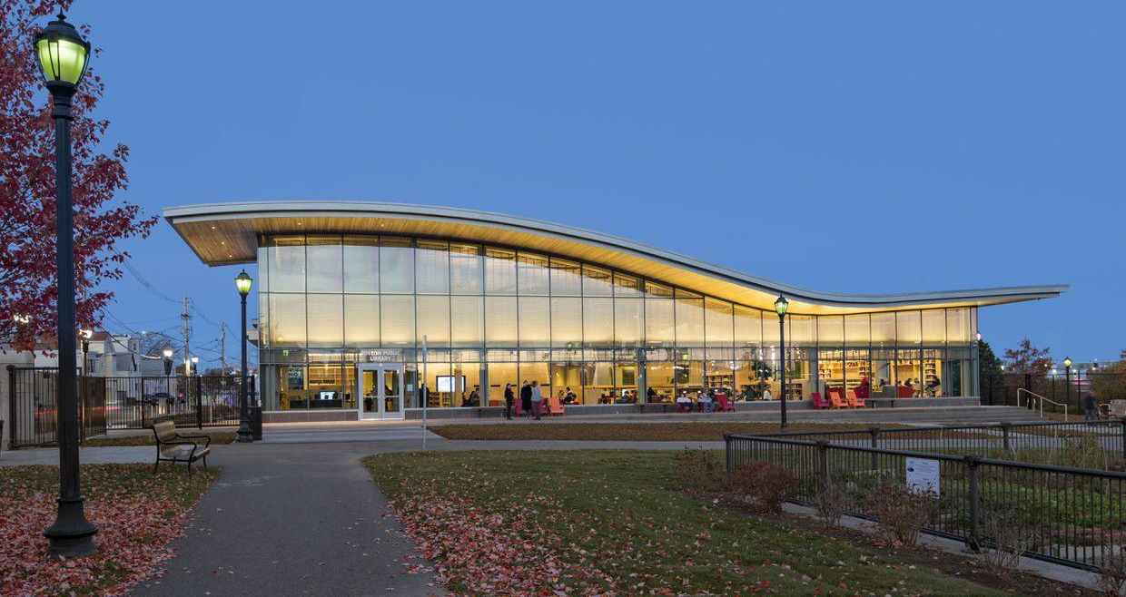
public
adjective
open to all
Notes:
public (adjective)
Elaboration:
This is an example of a public library branch. Anyone can go there, use the resources, get a library card, and check out books and videos.
Parks are public places.
An antonym—or word with the opposite meaning—is “private.”
Think, Pair, Share prompt:
What public areas have you been to?
Why is it important to have open spaces that are public, like parks and gardens?
https://www.bostonglobe.com/arts/2014/03/01/east-boston-library-inspired-blended-community-serves/9dmvGE7knE85Np3q5Xi6RK/story.html

Slide 7
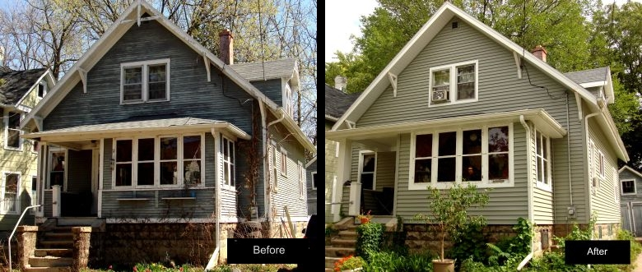
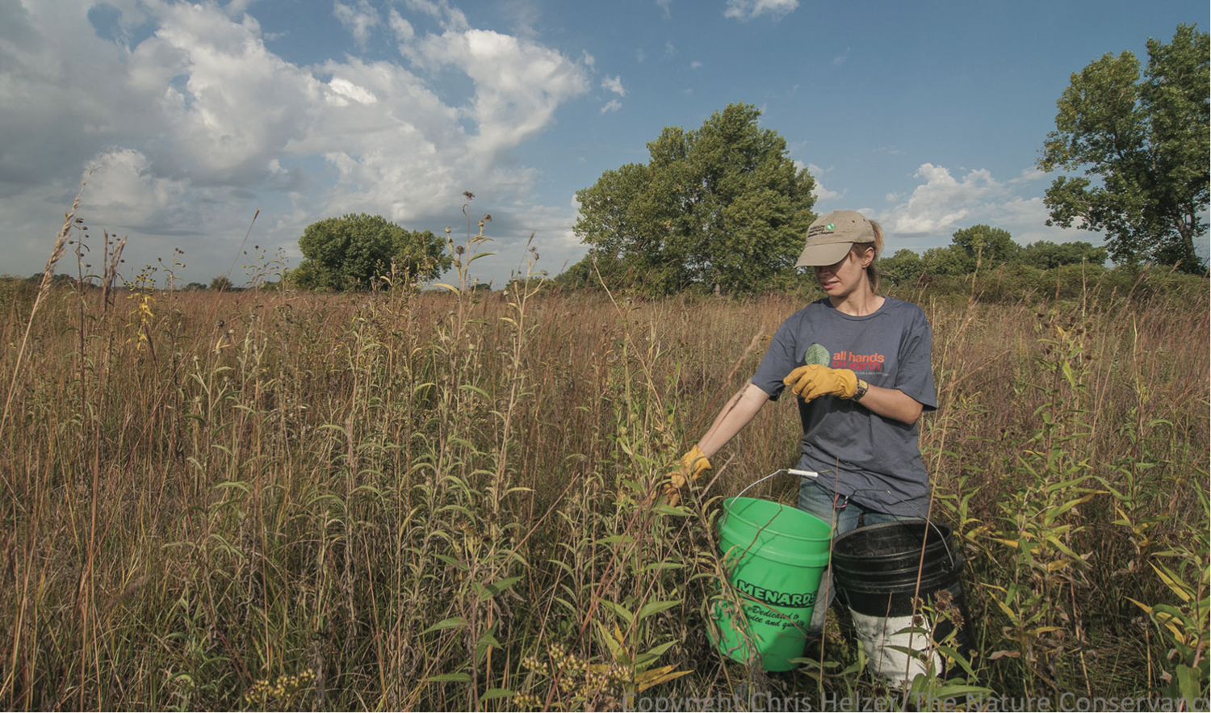
restore
verb
to return to an earlier condition
Notes:
restore (verb)
Elaboration:
We have seen this word before. We can restore buildings; we can also restore natural areas. This person is helping to restore a prairie so that the grasses, flowers, and other plants can thrive there again. They are collecting seeds so they can be saved and planted more widely.
The noun for restore is “restoration.” This person is participating in prairie restoration.
Think, Pair, Share prompt:
What is something you and others might do to help restore a natural area?
http://rowiewalker.com/restore-old-buildings/, https://www.segrasslands.org/seedbanking

Slide 8
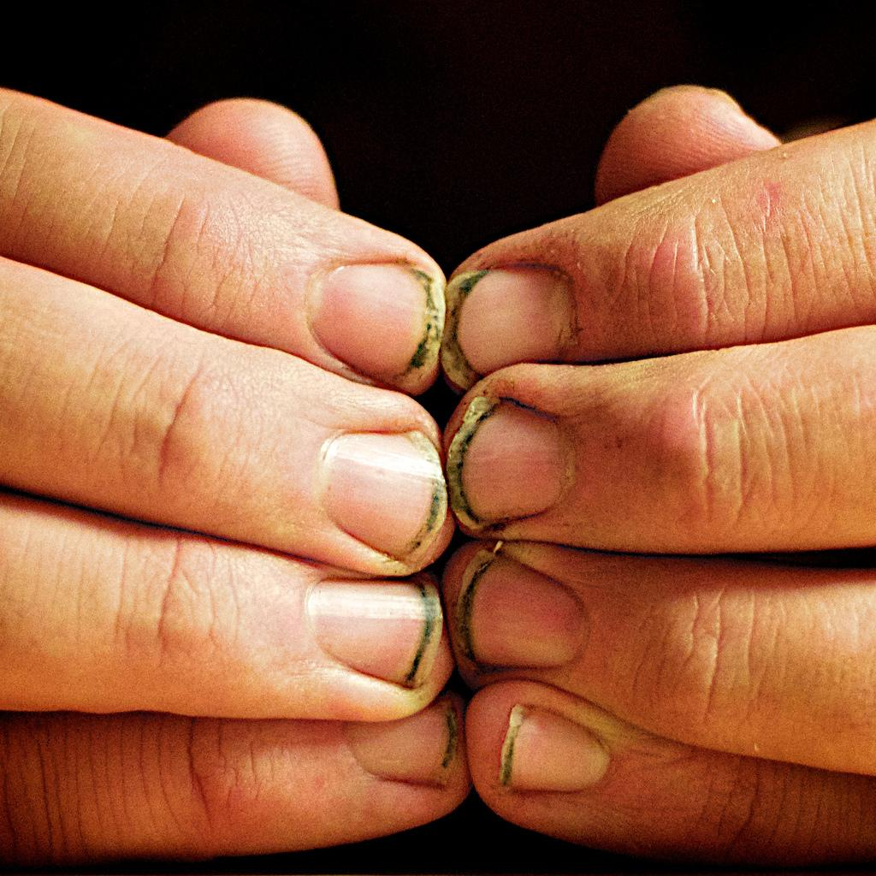
trace
noun
a very small amount of something; a mark or sign of something
Notes:
trace (noun)
Elaboration:
There’s a trace of dirt under this gardener’s fingernails. We can tell that they have been planting!
We sometimes say that someone leaves a trace, a kind of clue about what they have been up to.
Think, Pair, Share prompt:
I walk into the kitchen and I see crumbs on the counter. What might have left this trace?
https://laidbackgardener.blog/2016/06/22/for-clean-fingernails-when-you-garden/

Slide 9
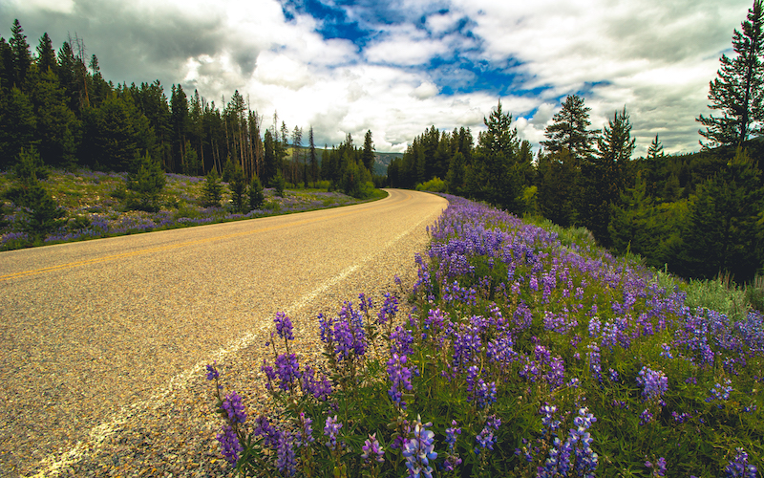
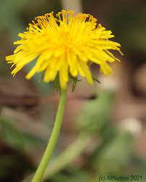
wildflower
noun
flower that grows without planting or care by people
Notes:
wildflower (noun)
Elaboration:
These flowers are called lupine. They grow in fields and along highways in some areas. Pollinators love them. They grow and spread without people doing anything to help them.
Think, Pair, Share prompt:
What wildflowers have you noticed in our school yard or around the city?
https://altnature.com/gallery/dandelion.htm, https://www.sierraclub.org/sierra/roadsides-are-refuges-for-declining-pollinators

