Slide 1
Legislation to Protect Pollinators
The slides that follow are of Boston legislation. If there is similar legislation in Maine, replace these slides. If not, these slides can still be used.
Text Talk Week 6, Day 5

Slide 2







Slide 3
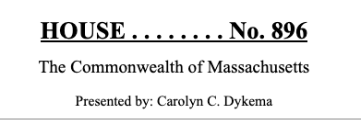
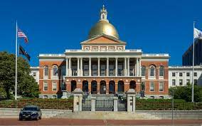
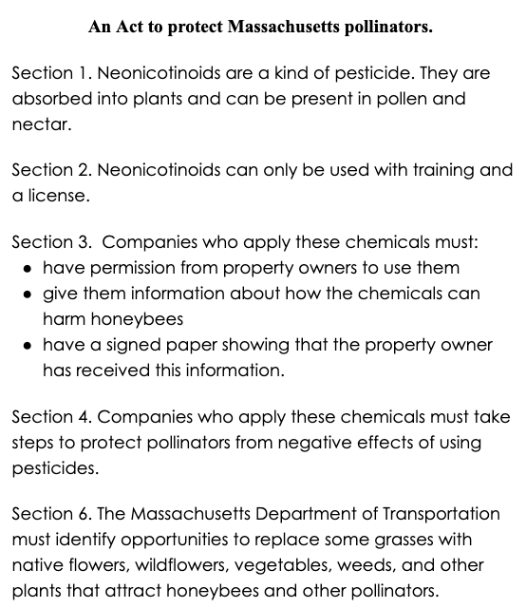
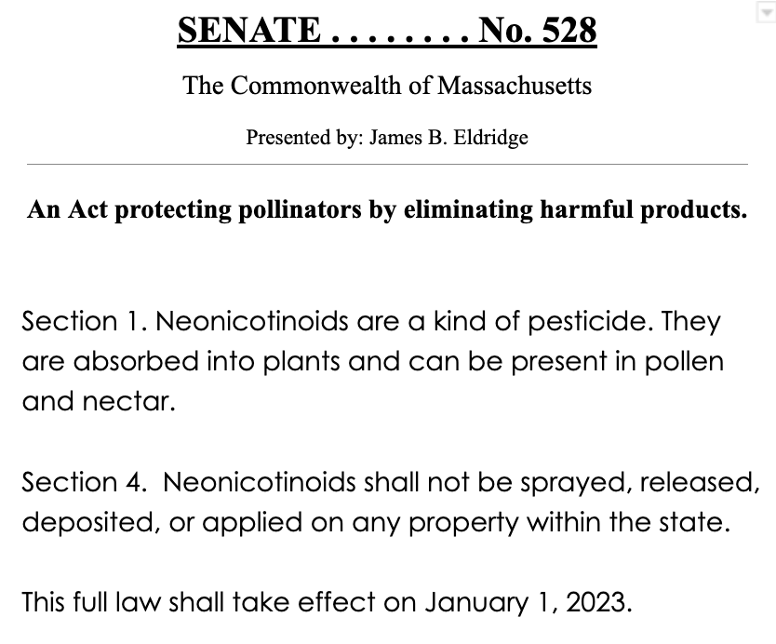
https://commons.wikimedia.org/wiki/File:Boston_-Massachusetts_State_House_(48718911666).jpg

Slide 4
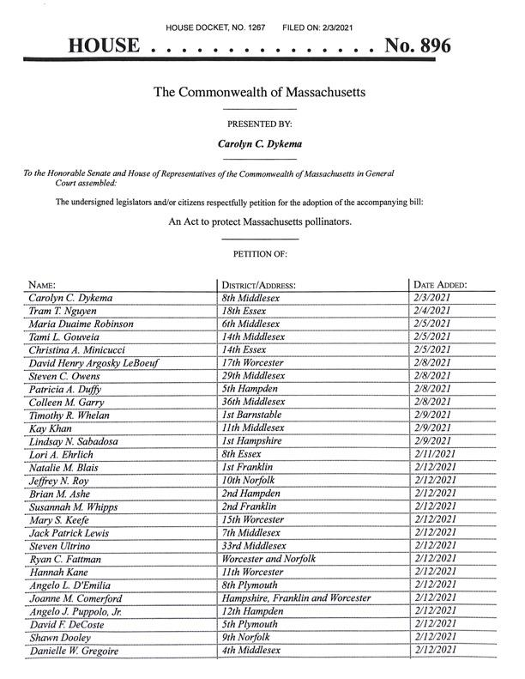
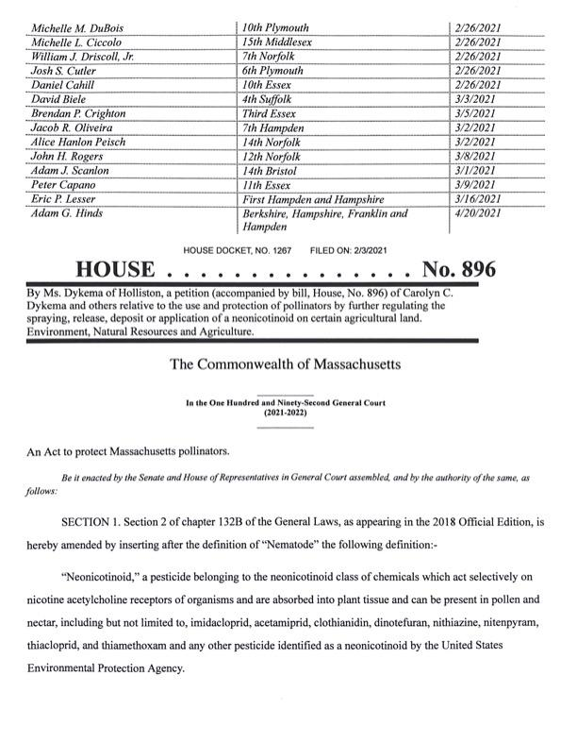
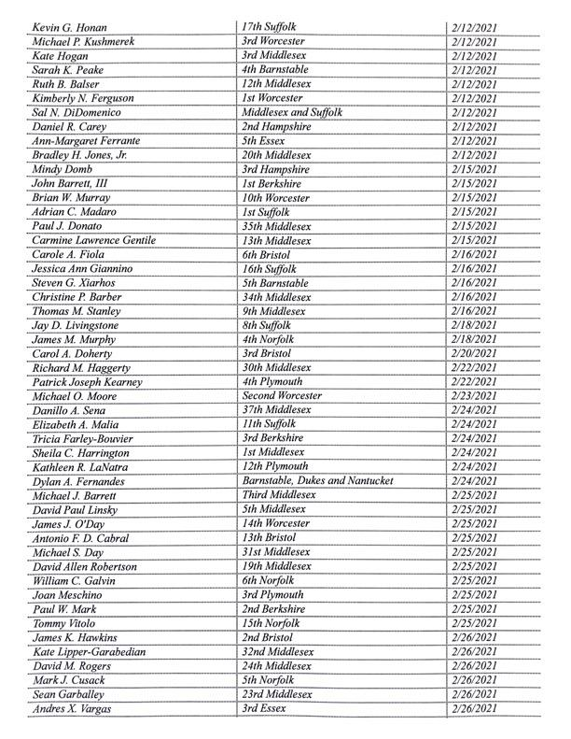

Slide 5
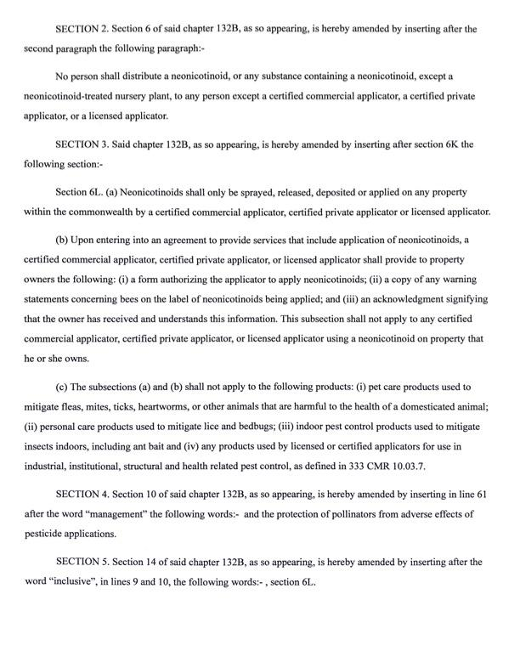
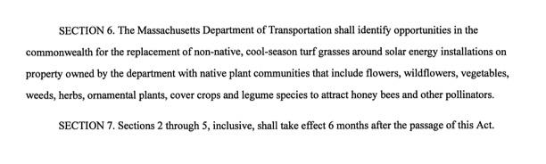

Slide 9
