Slide 1
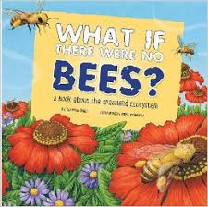
What If There Were No Bees?
excerpt (pages 4-5)
Text Talk Week 6, Day 3

Slide 2
