Slide 1
Changing Parts of Speech
Vocabulary & Language Week 6, Days 3-4

Slide 2
marking | legislation | nourishment

Slide 3
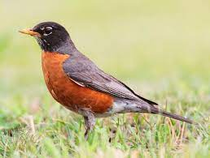
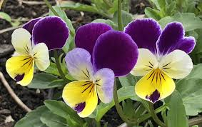
marking
noun
a pattern or marks or coloring on a plant or animal
Notes:
https://en.wikipedia.org/wiki/American_robin, https://www.hometownseeds.com/products/johnny-jump-ups-viola-perennial-seeds

Slide 4
noun | suffix | verb
marking | mark - ing | mark
legislation
nourishment

Slide 5
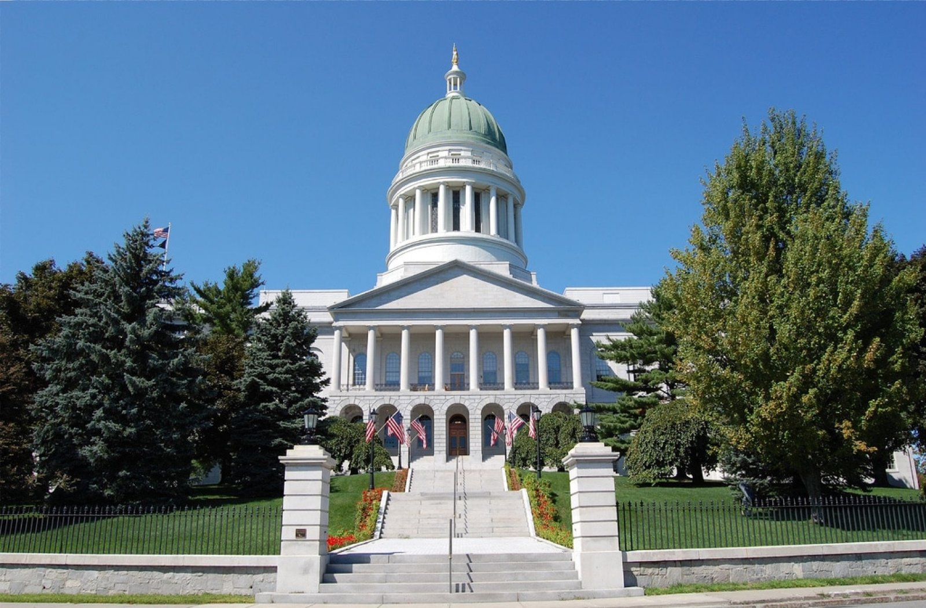
legislation
noun
the process of passing laws
Notes:
https://legislature.maine.gov/lio/security-screening/9120

Slide 6
noun | suffix | verb
marking | mark - ing | mark
legislation | legislate - tion | legislate
nourishment

Slide 7
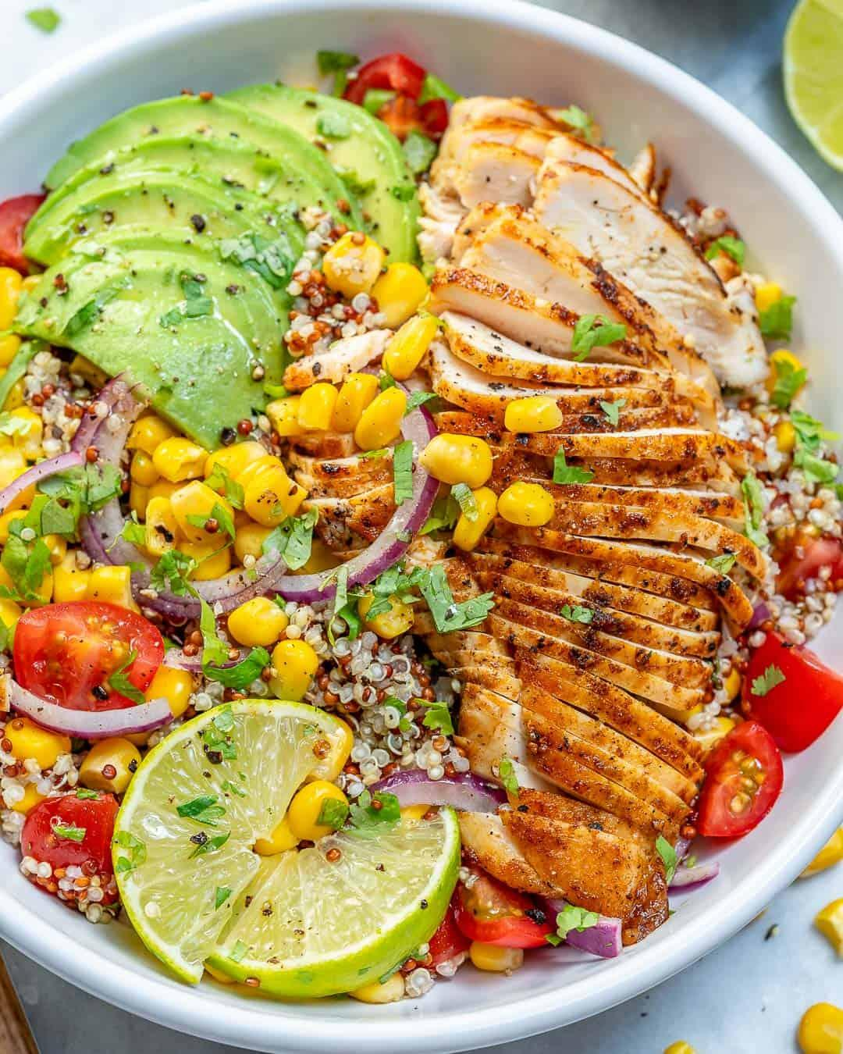
nourishment
noun
food or other substances needed for health and growth
Notes:
https://www.goodhousekeeping.com/home-products/g28008704/best-hummingbird-feeders/

Slide 8
noun | suffix | verb
marking | mark - ing | mark
legislation | legislation - tion | legislate
nourishment | nourishment - ment | nourish

Slide 9
locate | disperse | navigate

Slide 10
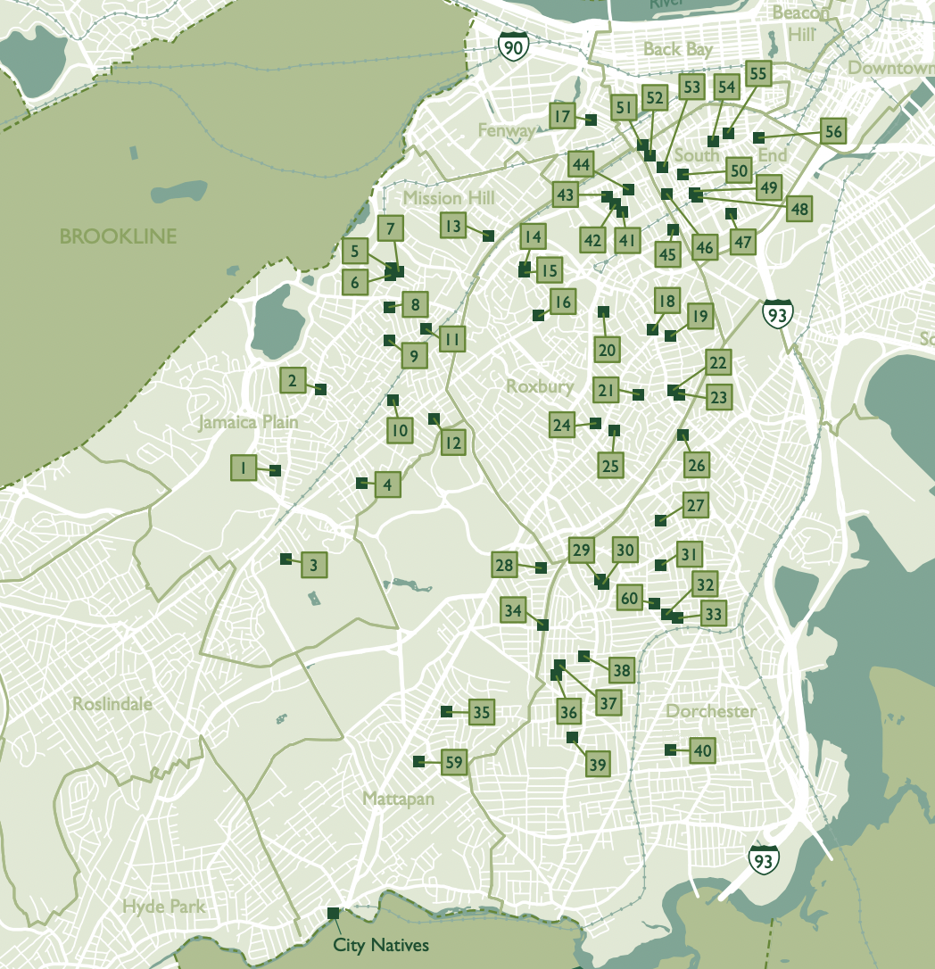
locate
verb
to find the position or place of
Notes:
https://thetrustees.org/wp-content/uploads/2020/07/boston-community-gardens-map.pdf

Slide 11
verb | suffix | noun
locate | locate + tion | location
disperse
navigate

Slide 12
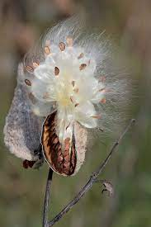
disperse
verb
to scatter
Notes:
https://www.britannica.com/topic/milkweed-floss

Slide 13
verb | suffix | noun
locate | locate + tion | location
disperse | disperse + al | dispersal
navigate

Slide 14
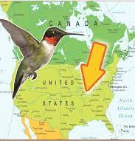
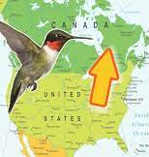
navigate
verb
to find one’s way to, around, or through
Notes:
https://empressofdirt.net/fall-hummingbird-migration/

Slide 15
verb | suffix | noun
locate | locate + tion | location
disperse | disperse + al | dispersal
navigate | navigate + tion | navigation

