Slide 1
Weekly Words
Unit 4, Week 6
Notes:
critical: very important
damage (n): harm that makes something less valuable; (v): to do harm
evolve: to develop over time
extinct: having no living examples, such as an animal or plant
food chain: a series of organisms, each dependent on the next as a source of food
legislation: the process of passing laws
nourishment: food or other substances needed for health and growth
pesticide: a substance used to destroy insects that are harmful to plants

Slide 2
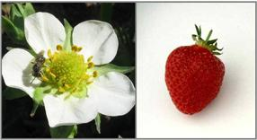
critical
adjective
very important
Notes:
critical (adjective)
Elaboration:
Bees and other insects are critical for the pollination of strawberry plants. They are so important that we might not have strawberries without these pollinators!
Think, Pair, Share prompt:
We have been learning about bats. In what ways are bats and flowers critical to each other?
https://blog.nature.org/science/2013/04/23/wild-pollinators-are-critical-in-keeping-our-picnic-baskets-full/

Slide 3
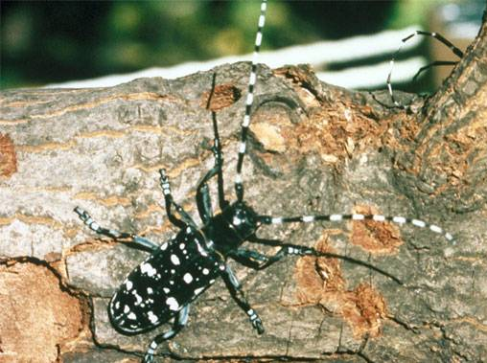
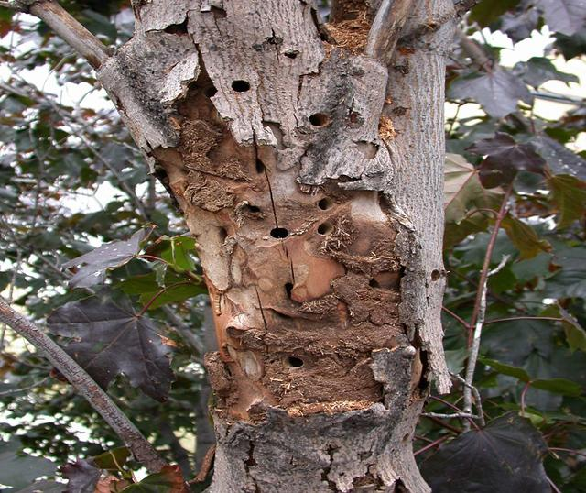
damage
noun
harm that makes something less valuable
verb
to do harm
Notes:
damage (noun, verb)
Elaboration:
Many insects are essential for the health of flowering trees. Other insects, like this longhorn beetle, are pests that do damage to trees.
“Damage” can be used as both a noun—a tree’s damage—and a verb—some insects damage trees.
Think, Pair, Share prompt:
Describe how you think this little beetle might damage a big tree. What kind of damage can you see in the photograph?
As you talk, notice whether you are using the word “damage” as a noun or a verb.
https://news.clemson.edu/inspectors-survey-low-country-trees-after-invasive-beetle-discovered/

Slide 4
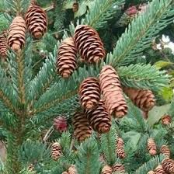
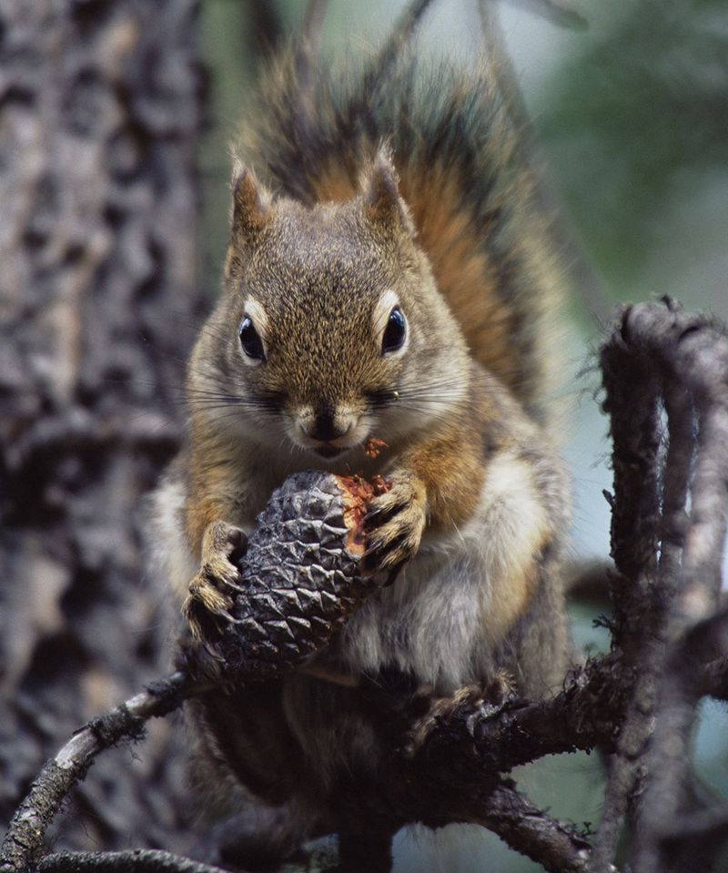
evolve
verb
to develop over time
Notes:
evolve (verb)
Elaboration:
Because the earth is growing warmer each year, white spruce trees are producing more cones. There are more cones for red squirrels to eat in the fall, and because of this, the females have evolved to have their babies earlier. This means a healthier population of red squirrels.
Think, Pair, Share prompt:
Certain pollinators have evolved to feed on nectar from certain kinds of flowers. What do you think about this?
https://www.smithsonianmag.com/science-nature/ten-species-are-evolving-due-changing-climate-180953133/?page=8, https://bplant.org/compare/6693-8176

Slide 5
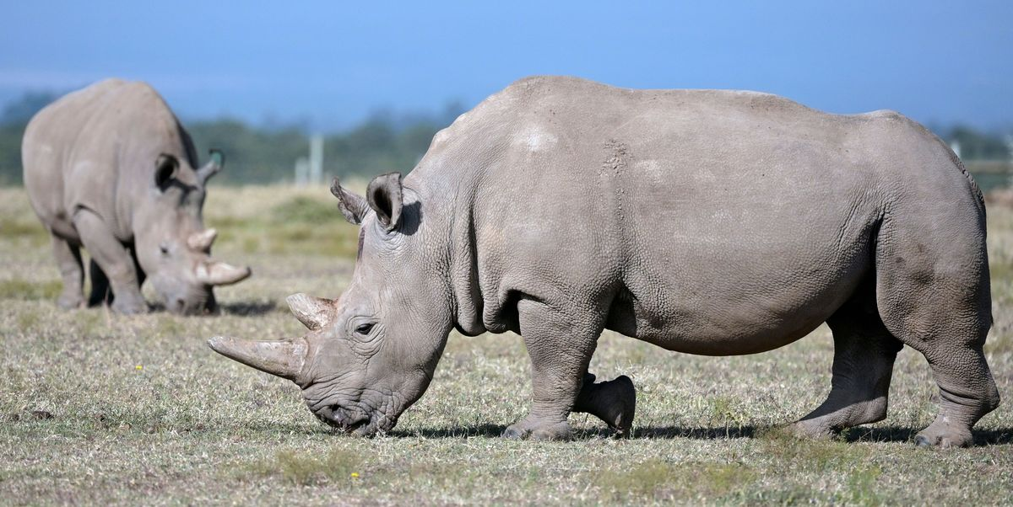
extinct
adjective
having no living examples, such as an animal or plant
Notes:
Note: Consider introducing this word after introducing “food chain.”
extinct (adjective)
Elaboration:
We all know that dinosaurs became extinct thousands of years ago.
The Western Black Rhino became extinct in 2020 when the last two Western Black Rhinos died. There are no more of this species of rhinos living on earth.
Think, Pair, Share prompt:
Think about interdependent ecosystems.
[Reminder: ecosystem: a group of animals and plants living in one place and impacting each other]
Why might it matter when a species becomes extinct?
https://www.popularmechanics.com/science/animals/g201/recently-extinct-animals-list-470209/

Slide 6
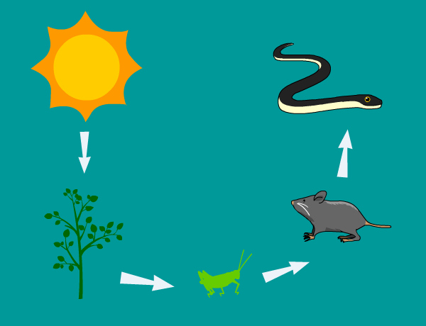
food chain
noun
a series of organisms, each dependent on the next as a source of food
Notes:
food chain (noun)
Elaboration:
A food chain describes how different organisms get energy.
A series of interdependent food chains is called a food web.
Think, Pair, Share prompt:
This food chain starts with the sun. With your partner, describe the rest of the food chain.
https://jr.brainpop.com/science/animals/foodchain/

Slide 7
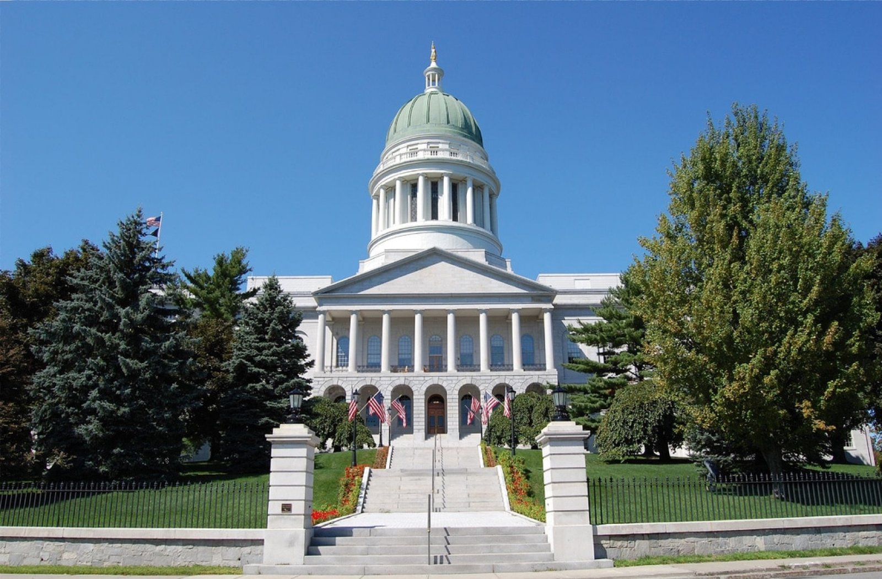
legislation
noun
the process of passing laws
Notes:
legislation (noun)
Elaboration:
This is a government building. Inside, our Senators and State Representatives argue for the laws they think are important. Their main job is to work on legislation.
Think, Pair, Share prompt:
We are looking at legislation to protect pollinators this week. Why is this legislation important?
https://legislature.maine.gov/lio/security-screening/9120

Slide 8
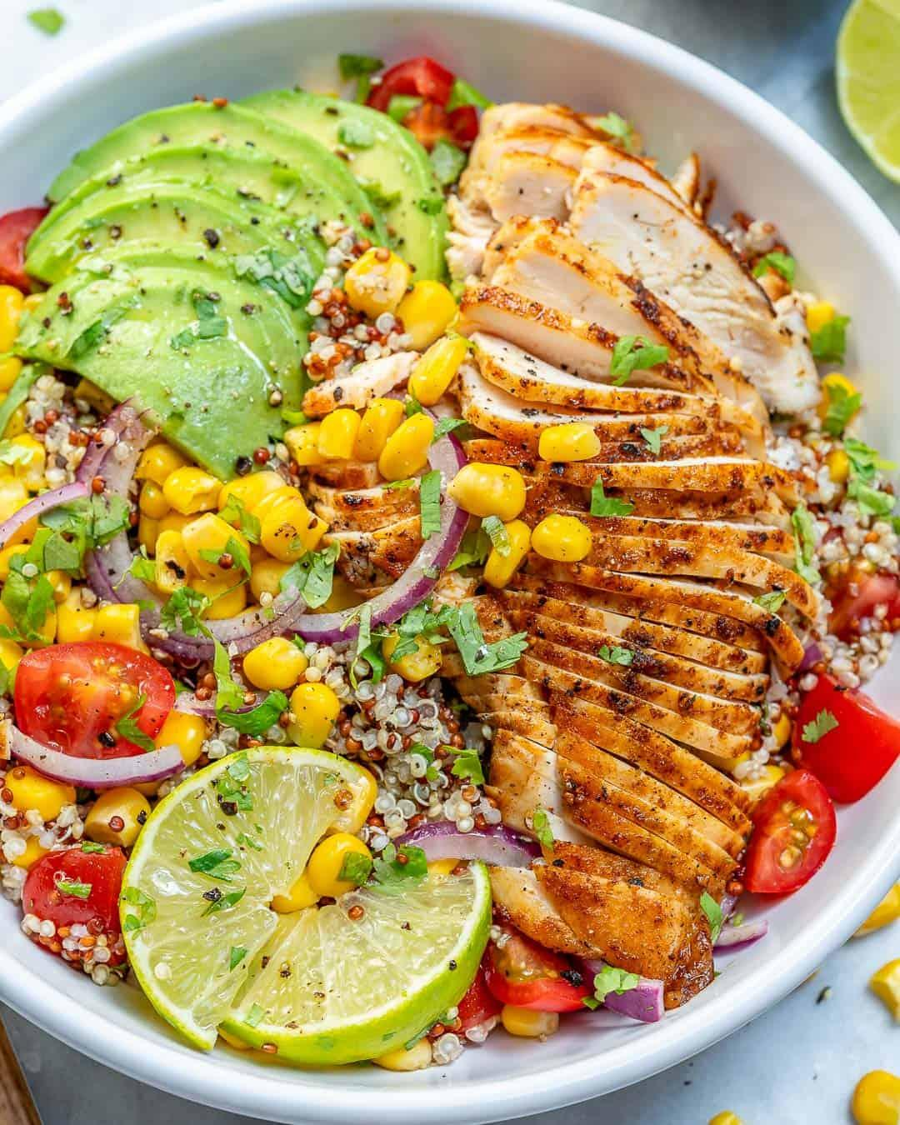
nourishment
noun
food or other substances needed for health and growth
Notes:
nourishment (noun)
Elaboration:
We get nourishment from healthy food. Chips or sweets may taste good and be fun to eat, but they do not give us the nourishment we need to grow and be strong.
Think, Pair, Share prompt:
How do bees get nourishment?
How do flowers get nourishment?
https://www.goodhousekeeping.com/home-products/g28008704/best-hummingbird-feeders/

Slide 9
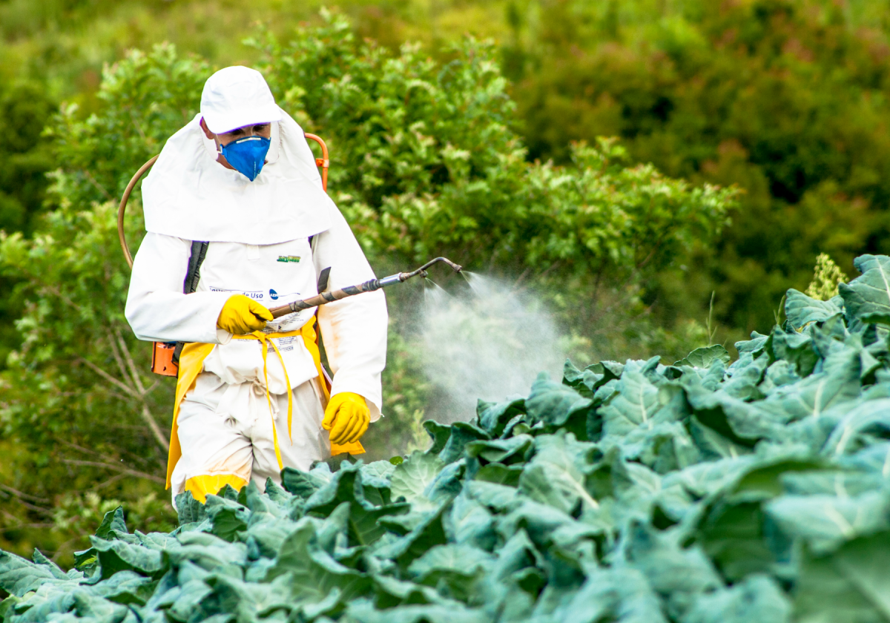
pesticide
noun
a substance used to destroy insects that are harmful to plants
Notes:
pesticide (noun)
Elaboration:
Pesticides are often used to kill bugs that eat plants we grow for food. Some farmers choose to use substances that are not harmful to keep these bugs away.
Think, Pair, Share prompt:
Why might this person be wearing protective clothing and a mask to spray pesticides?
https://www.sustainability-times.com/environmental-protection/two-thirds-of-agricultural-land-globally-are-at-risk-of-pesticide-pollution/

