Slide 1
Community Gardeners
from “Places for Pollinators in Boston”
Writing Unit 4

Slide 2
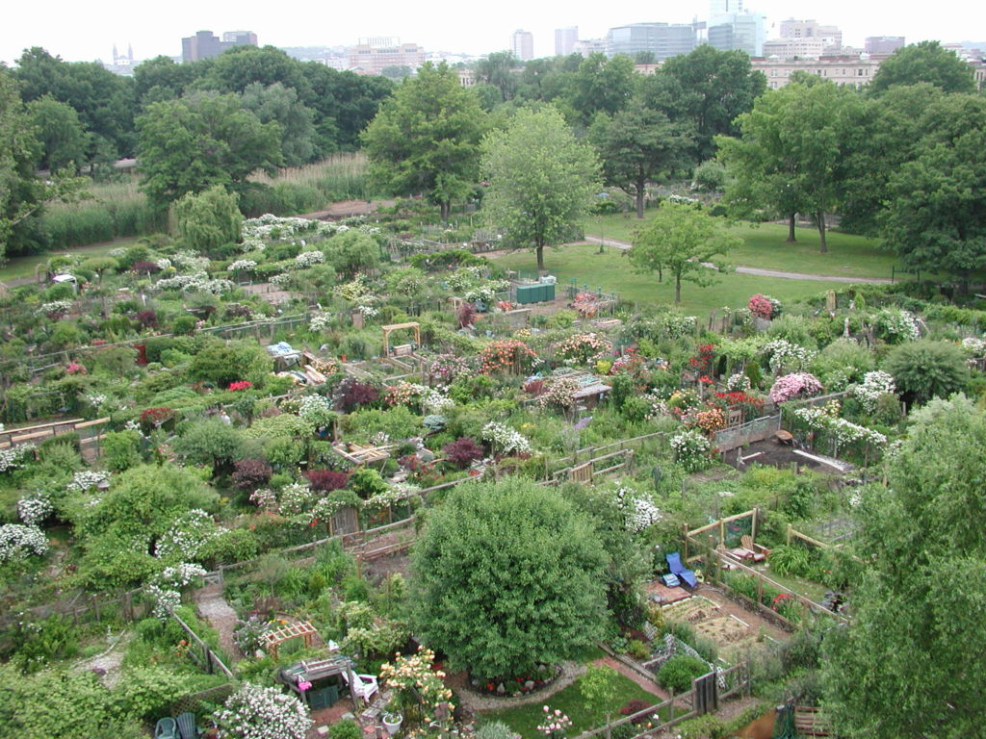

Community gardens are shared land for gardening. People and families each have a small space for growing what they want to. These spaces are called garden plots. All the small plots together make up one big garden. In a community garden, people can share tools, seeds, traditions, and ideas.
Putting many small gardens together makes a place that is more attractive to pollinators.

Slide 3
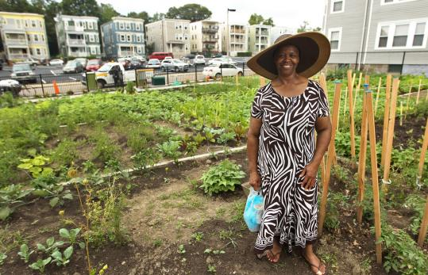
Boston now has 176 community gardens, scattered all through the city. These gardens are cared for by residents.
Community gardens look different from each other depending on how much space there is.
Community gardens are also different from each other depending on who gardens there. People plant plants that they like to eat and that are familiar to them. People in Boston come from all over the world, and they often grow plants that remind them of home.
Elnora Thompson at the Nightingale Community Garden

Slide 4
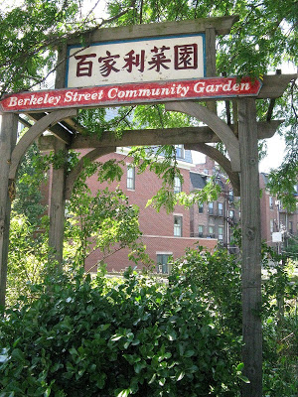
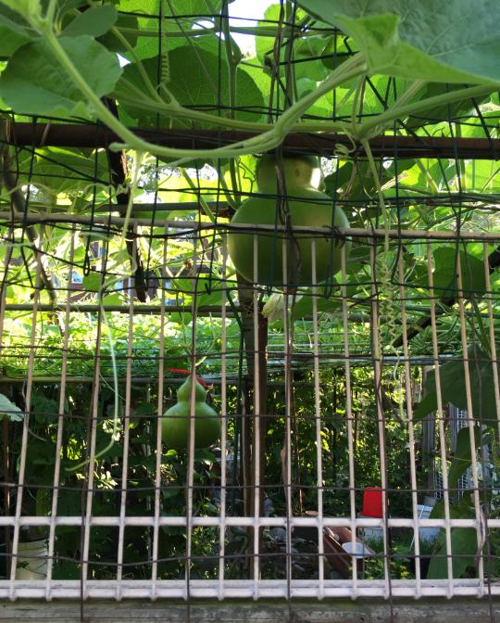
Bottle Gourd growing at the Berkeley Street
Community Garden

Slide 5
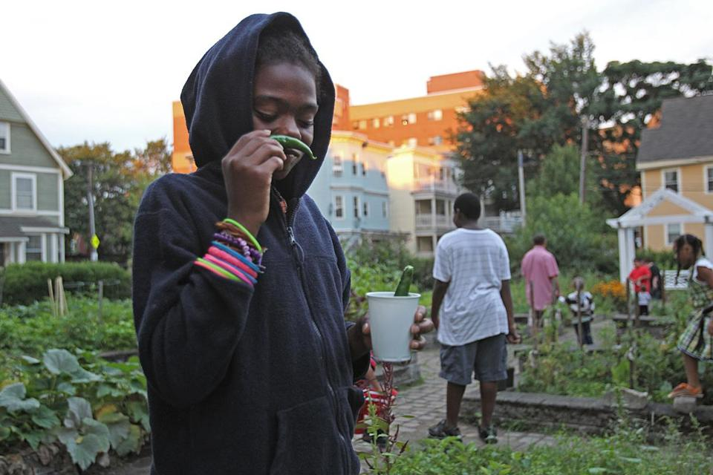
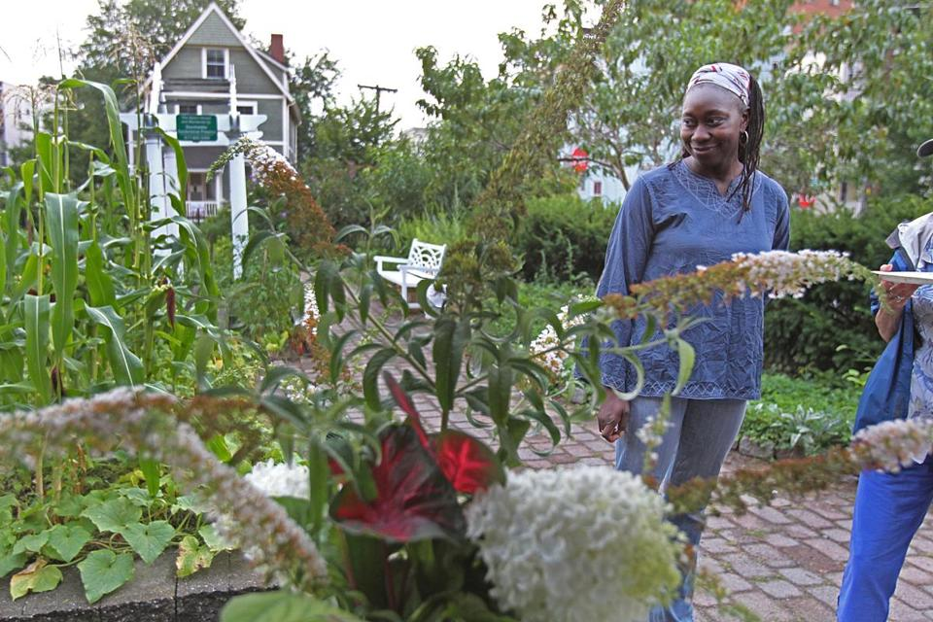
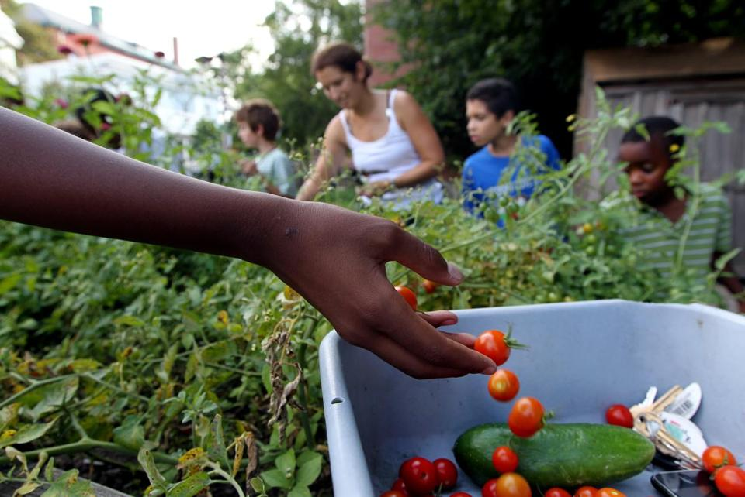
Jhana Senxian and Kaori Tate in the community garden on Coleman Street

Slide 6
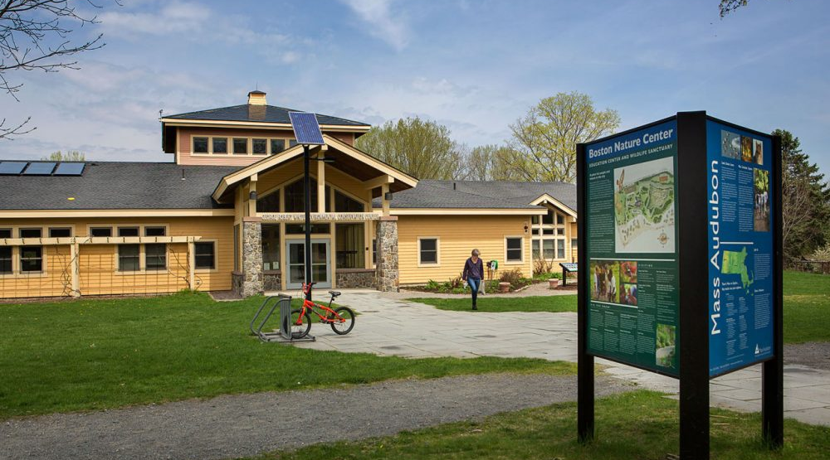
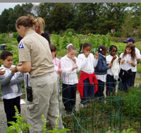
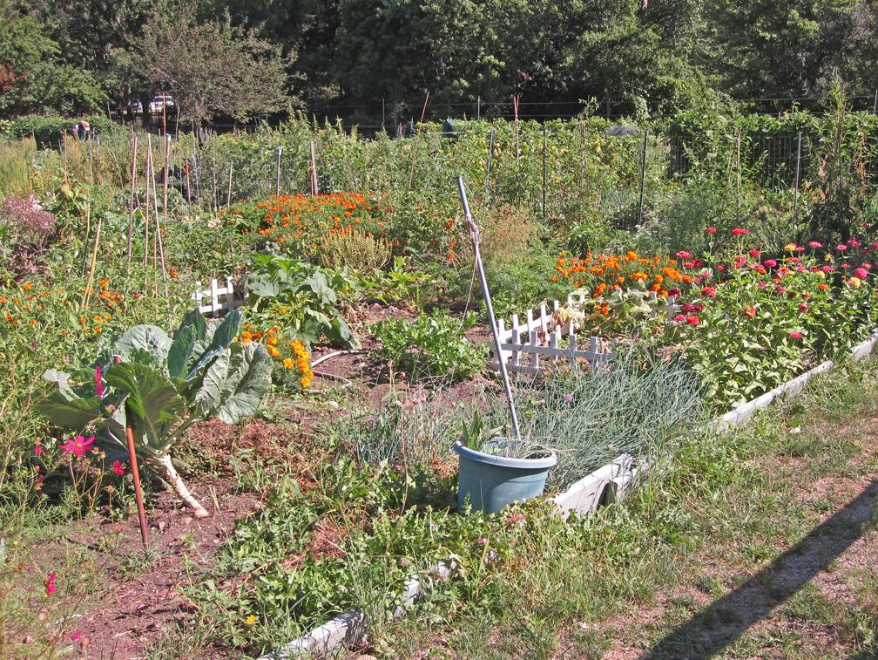
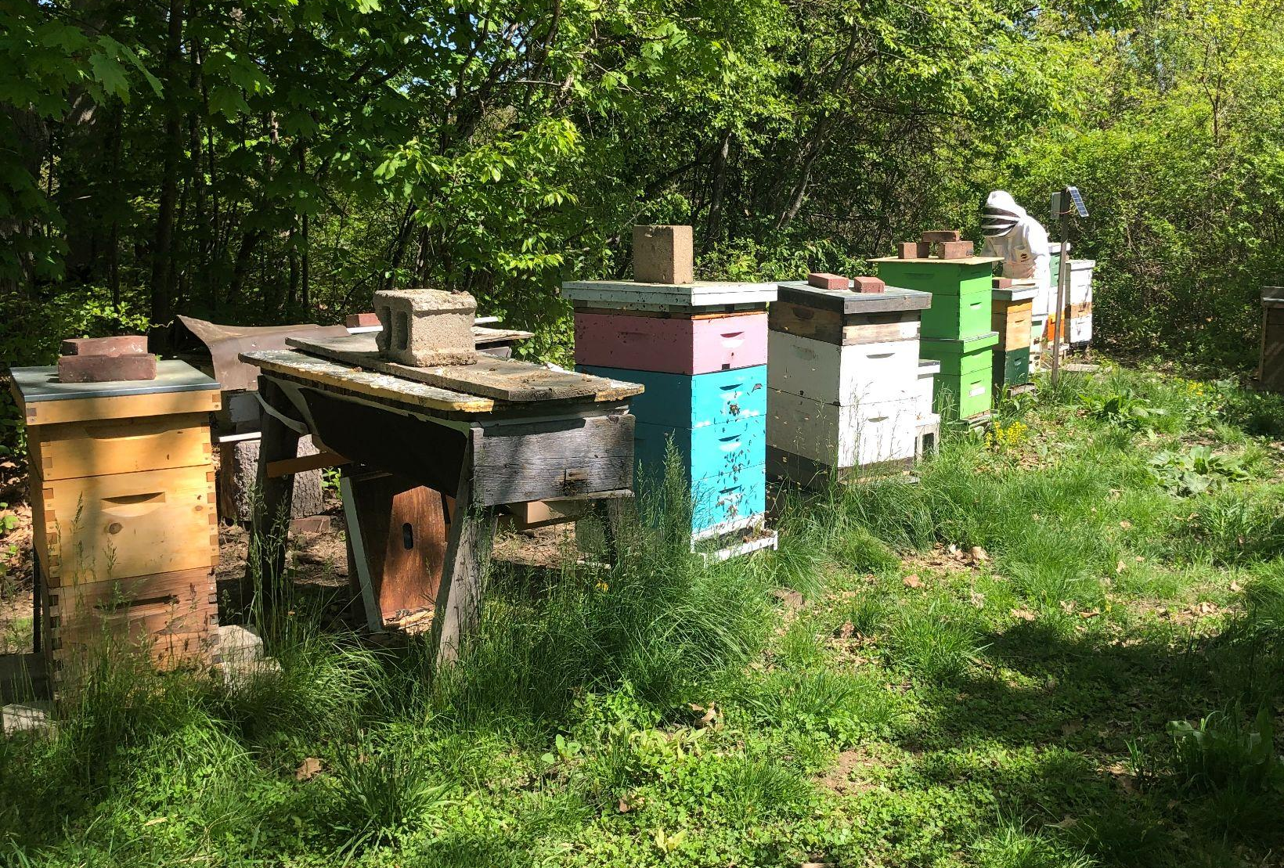
The Boston Nature Center is a place to learn about the natural world, to take a walk, for school groups to visit, and even for kids to go to camp.
There are community gardens at the Boston Nature Center…
… and there is a community bee yard!

Slide 7
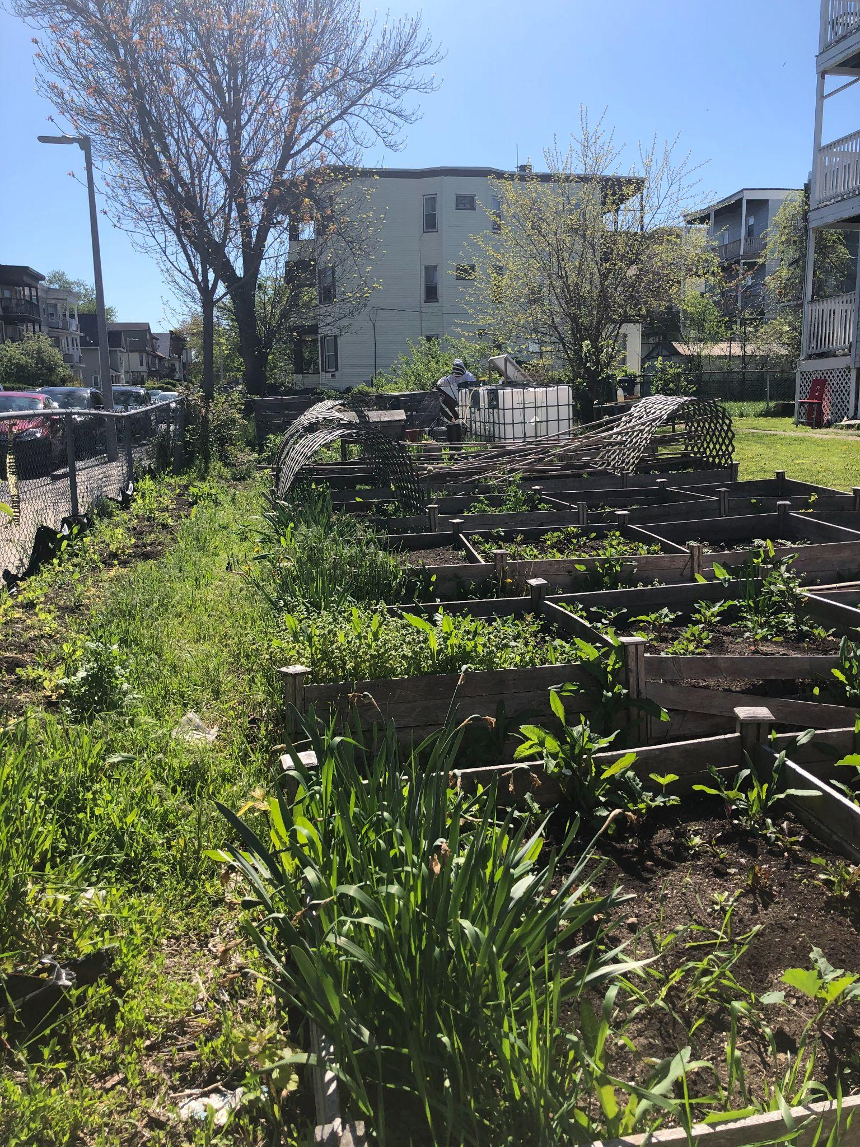
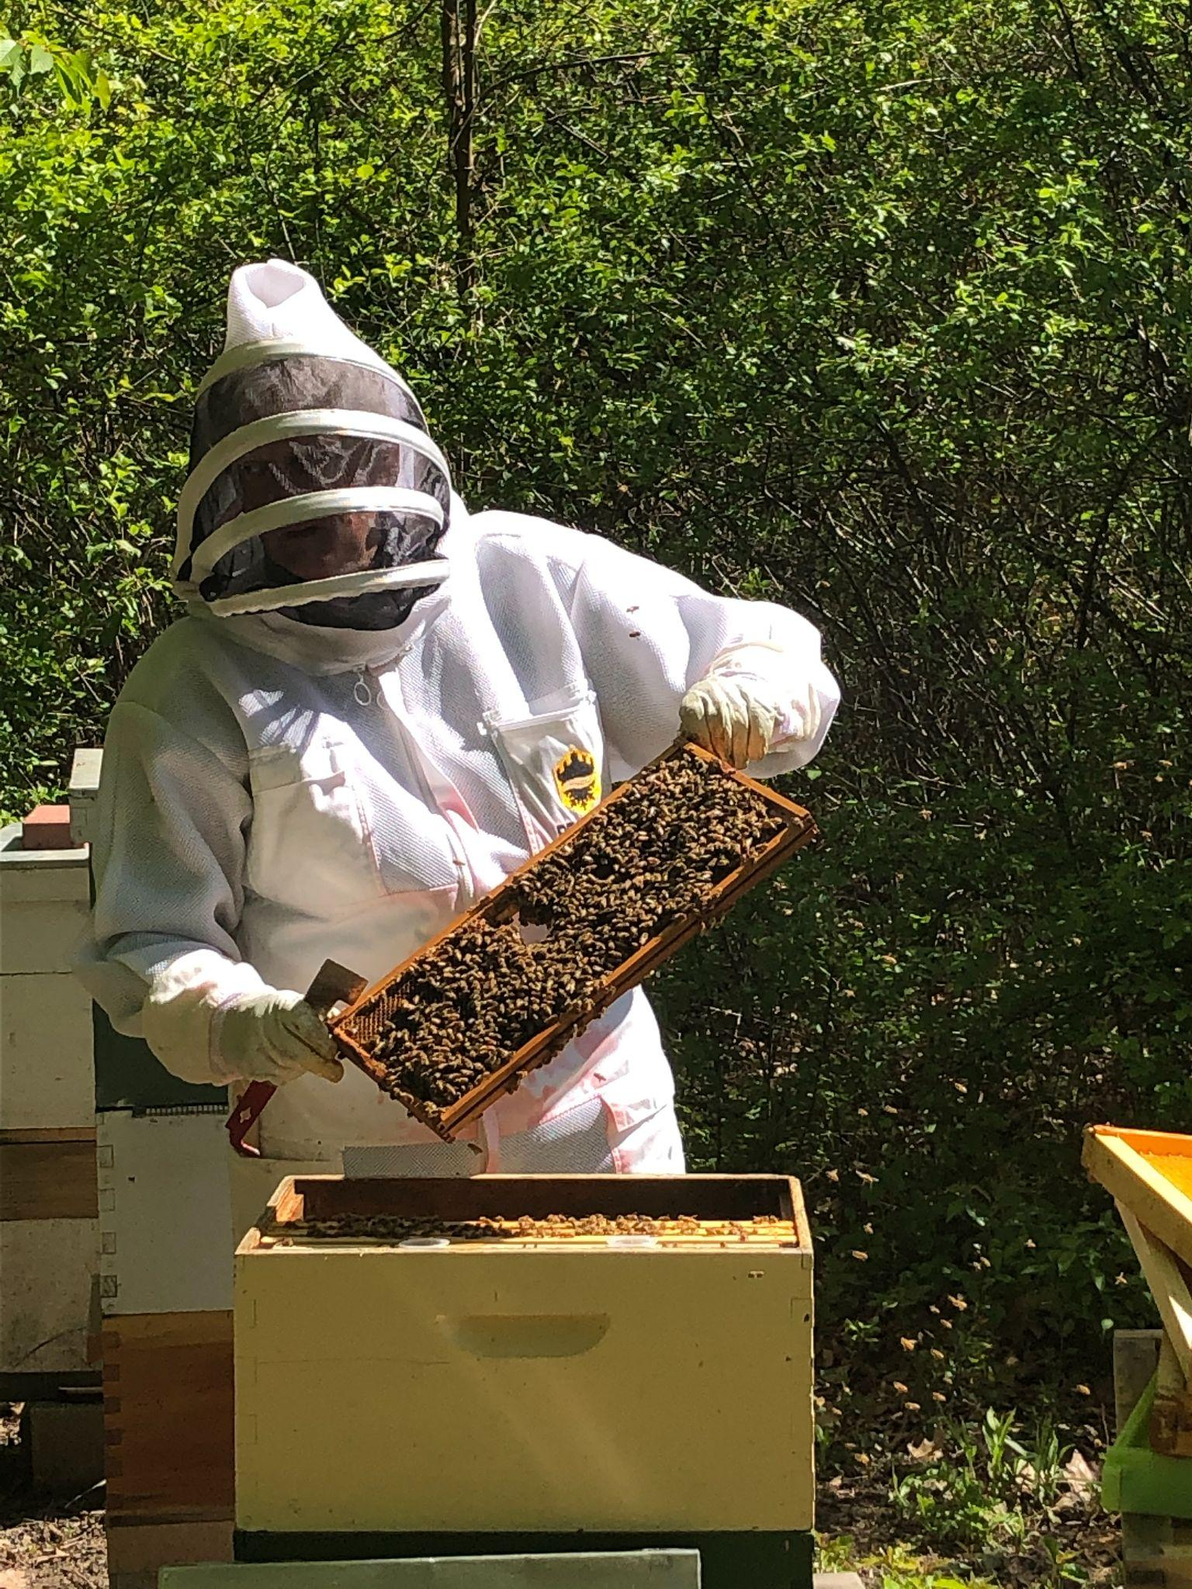
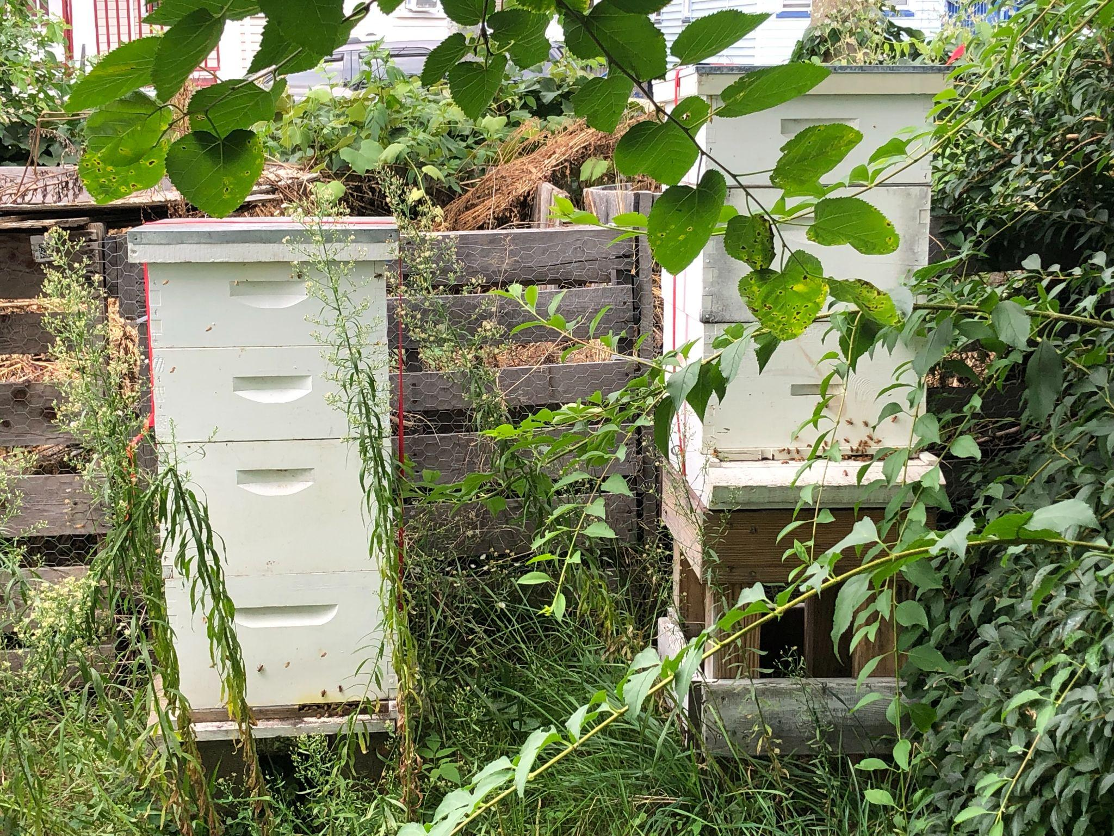
The Food Forest Coalition organizes different kinds of community growing places.
A food forest is planted on unused plots of land. In a food forest, each gardener does not have their own space. Instead, all of the gardeners contribute to one community garden, and everyone shares the harvest.
Look carefully in the back corner of the Olmec Food Forest in Dorchester.
Notes:
Melissa Tonachel

Slide 8
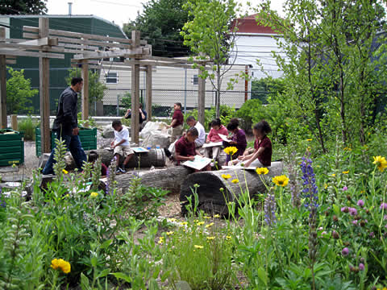
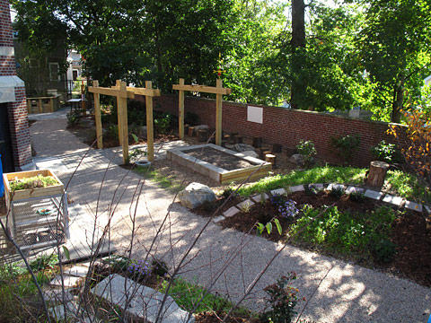
Some gardens are in schoolyards around Boston. Children, teachers, and community members work together to build and plant the gardens.
Mason School
Chittick School

Slide 9
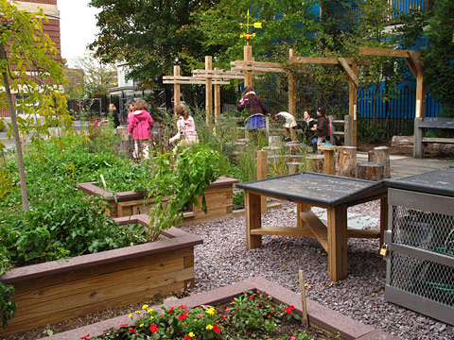
Schoolyard gardens are special places.
Children can dig in the soil and plant seeds. They can harvest what they grow. They can plant to attract more pollinators. And they can get up close to pollinators to observe them.
Winship School

Slide 10
Citations: Photos and Information
Slide 2: http://www.metropolismag.com/cities/common-boston-common-build-2/
Slide 3: Jessey Dearing for the Boston Globe, http://archive.boston.com/bostonglobe/editorial_opinion/editorials/articles/2011/10/05/civility_one_leaf_at_a_time/
Slide 4: http://www.gardenclubbackbay.org/2011/08/page/2/, http://www.lydialikesit.com/2017/05/community-gardens.html
Slide 5: Suzanne Kreiter/Globe staff,
https://www.bostonglobe.com/metro/2012/12/15/the-community-garden/uG3H6gmzhNH55eLQkRAjzK/story.html?pic=11
Slides 6-7: https://www.massaudubon.org/get-outdoors/wildlife-sanctuaries/boston-nature-center/programs-classes-activities/schools-groups/schools, https://www.wbur.org/news/2015/05/18/boston-nature-center-mattapan, https://blogs.massaudubon.org/takingflight/tag/boston-nature-center/; Melissa Tonachel
Slides 8-9: http://www.schoolyards.org/

