Slide 1
Advertisements
Writing Unit 4, Week 5, Day 2

Slide 2
https://www.behance.net/gallery/23111431/Streamliner-Yogurt-Ad

Slide 3
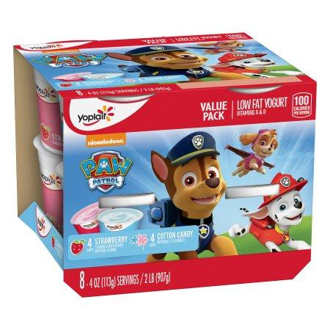
https://www.walmart.com/ip/Yoplait-Kids-Yogurt-Variety-Pack-Cotton-Candy-Strawberry-8-Count/37402788

Slide 4
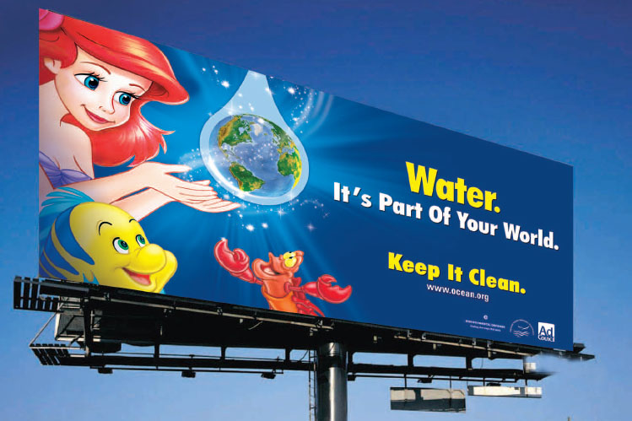
https://oaaa.org/AboutOOH/PublicService/EnvironmentalResponsibility.aspx

Slide 5
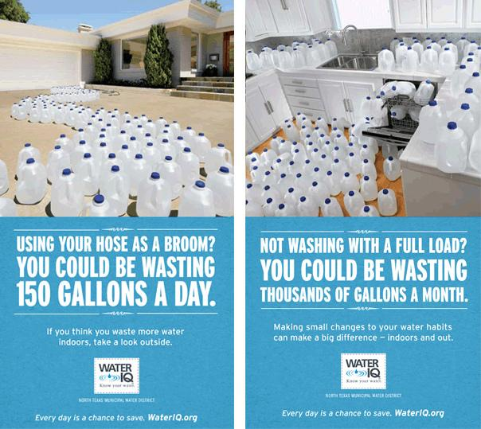
https://www.flickr.com/photos/50192211@N07/4663202641

Slide 6
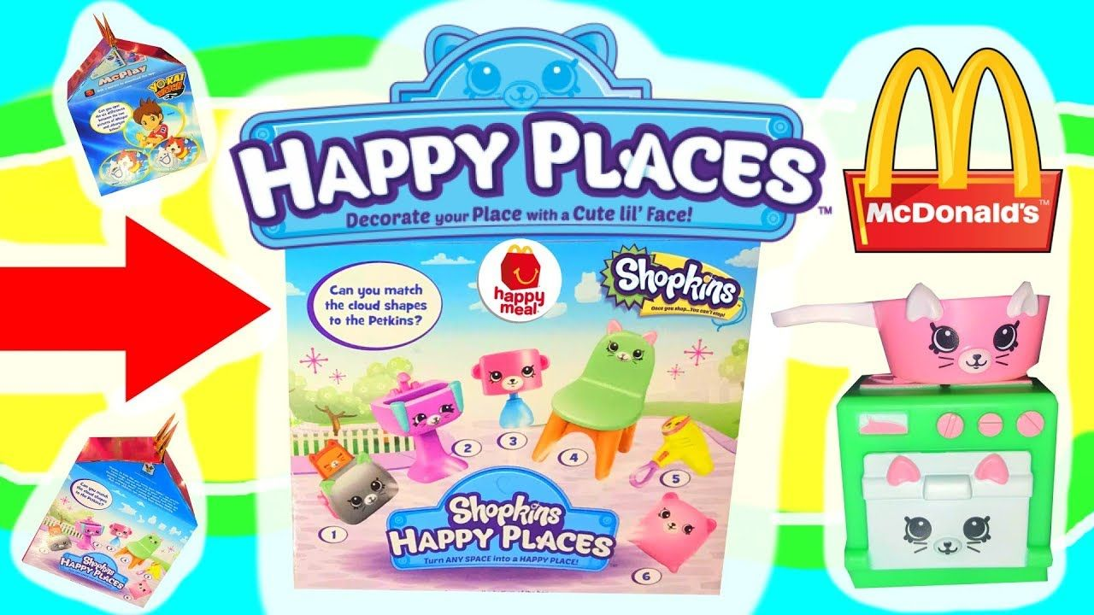
https://www.youtube.com/watch?v=ZI_bdE_ZAwM&feature=share

Slide 7

https://www.nerdwallet.com/blog/shopping/black-friday/ikea-ad/

