Slide 1
I Will Be a Hummingbird
Text Talk Week 5, Day 1

Slide 2
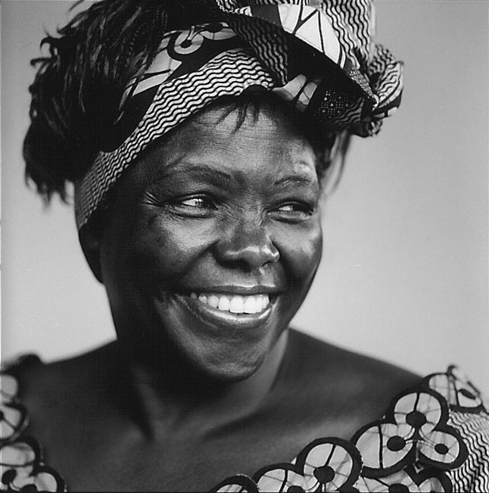
http://www.greenbeltmovement.org/node/714

Slide 3
