Slide 1
Adjectives
Vocabulary & Language Week 5, Days 3-4

Slide 2
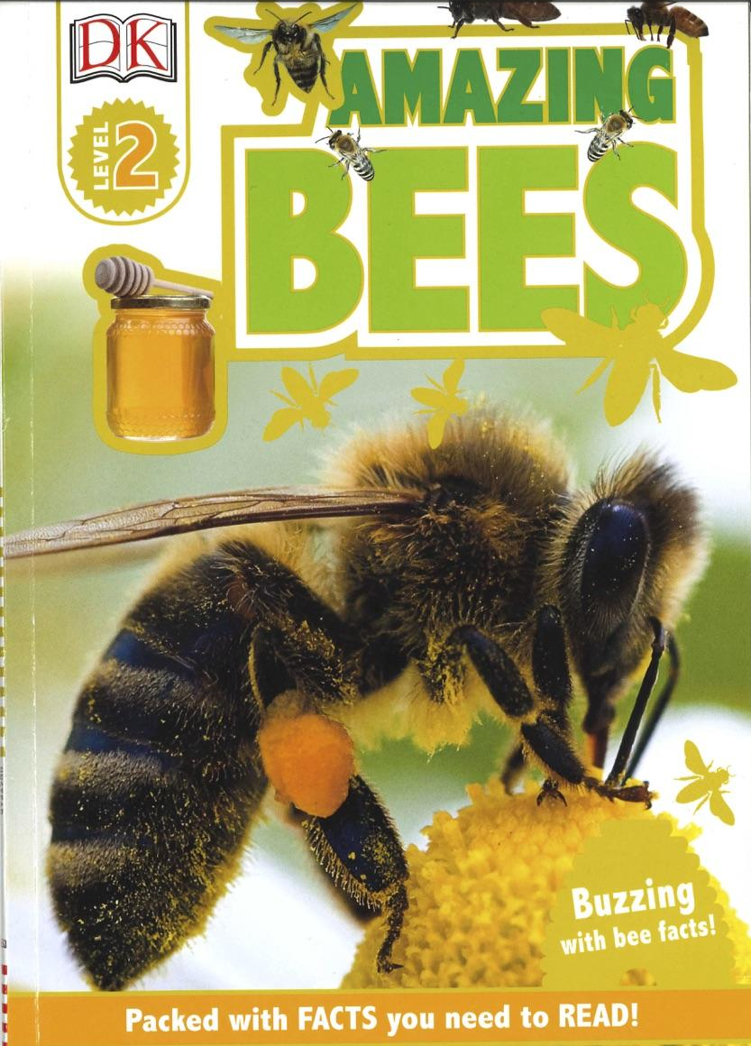
Adjectives
Adjectives describe nouns.
They answer these questions:
How many/much?
What kind?
What like?
Which ones? Whose?

Slide 3
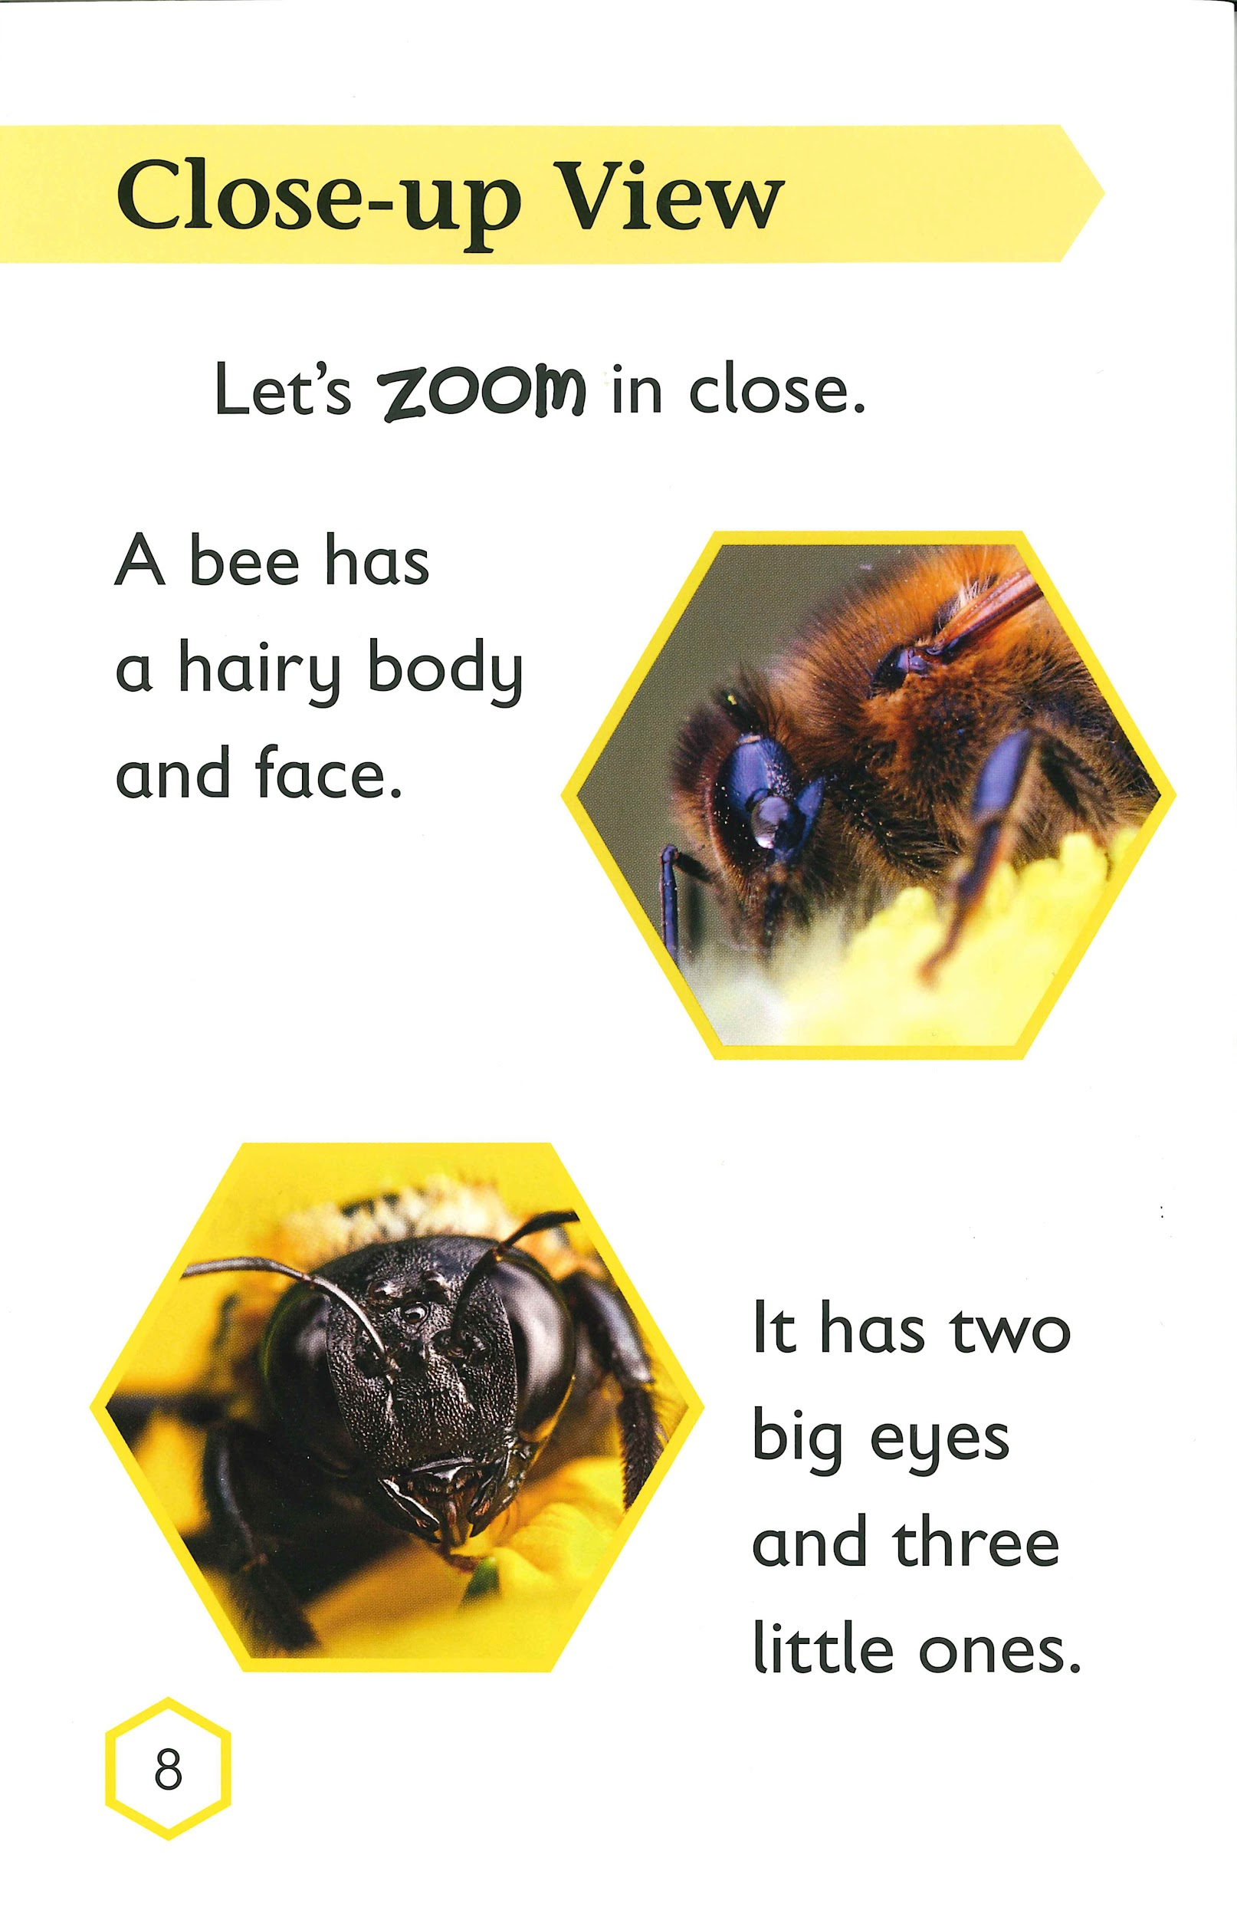
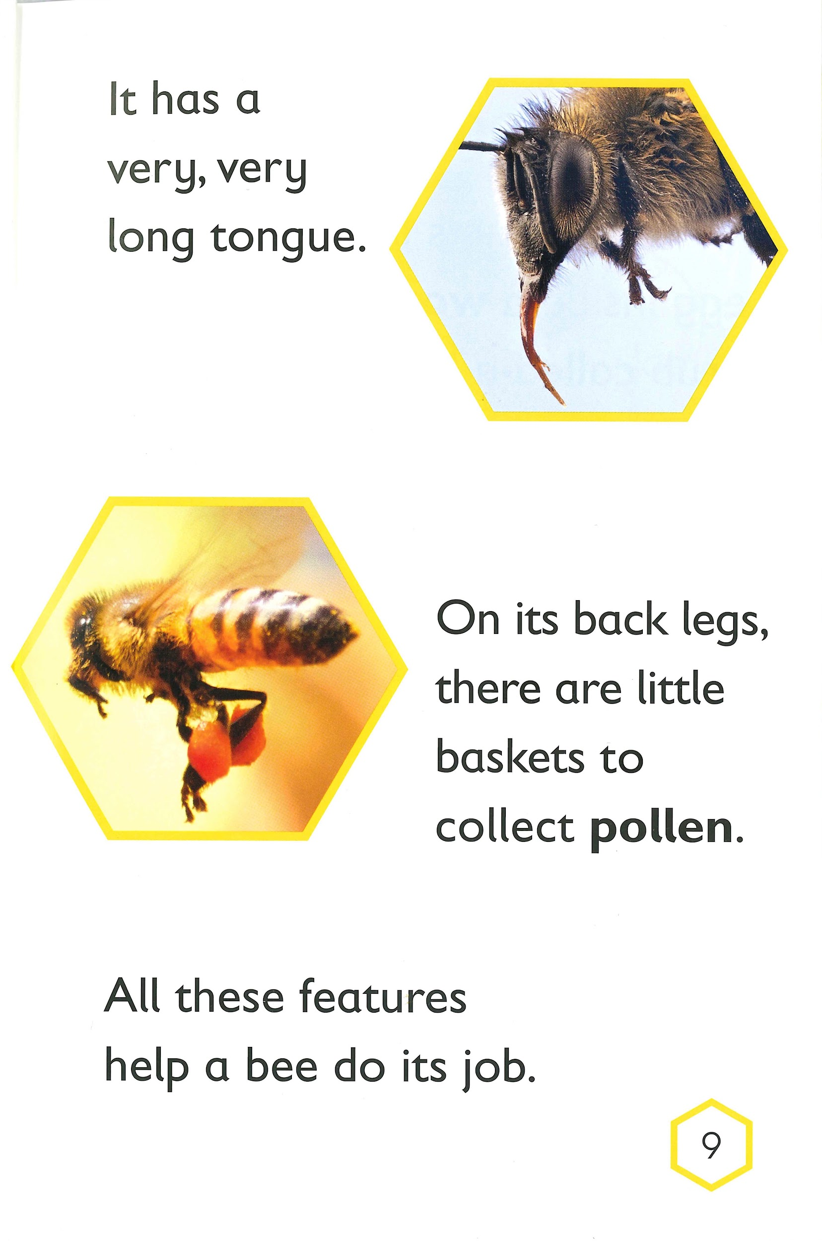

Slide 4
Adjectives
What? body, face
What like?
hairy

Slide 5
Adjectives
What? eyes
How many?
two
three
What like?
big
little

Slide 6
Adjectives
What? tongue
What like?
long

Slide 7
Adjectives
What? baskets
What like?
little
What kind?
to collect pollen

Slide 8
Your Turn!
Choose a pollinator and plant pair.
Think about what makes them a good match.
Write one sentence about the pollinator that includes an adjective to describe one of its features.
Write one sentence about the plant that includes an adjective to describe one of its features.
In each sentence, underline the noun and circle the adjective.

Slide 9
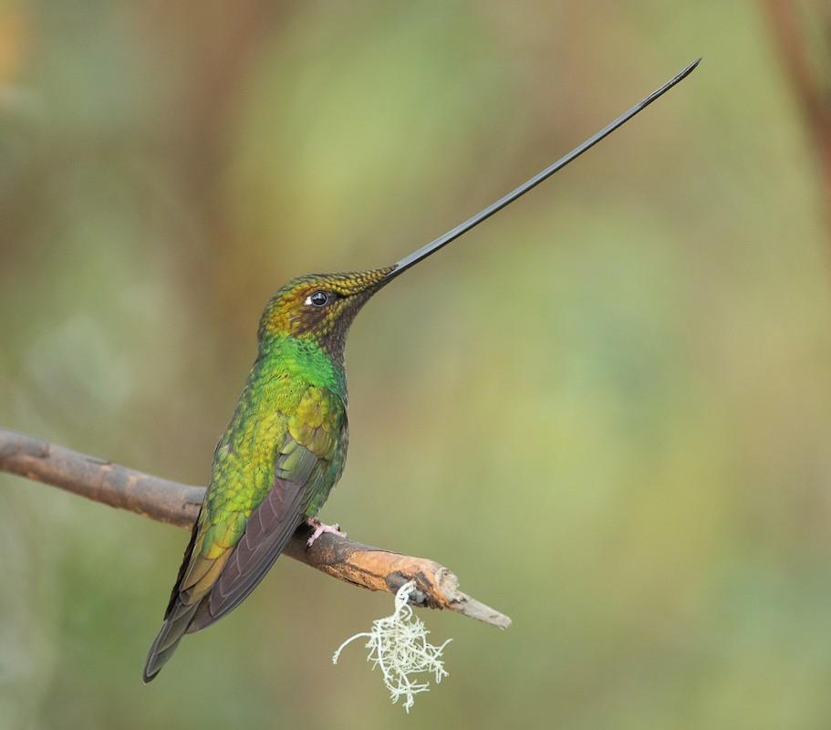
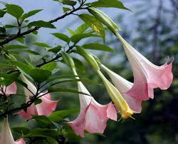
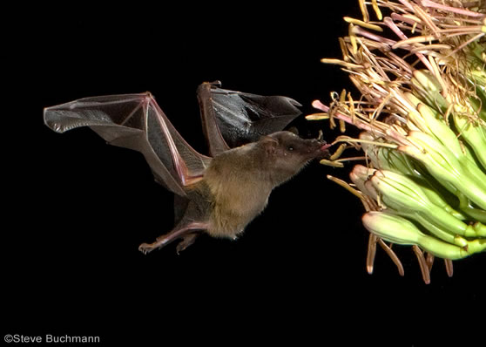
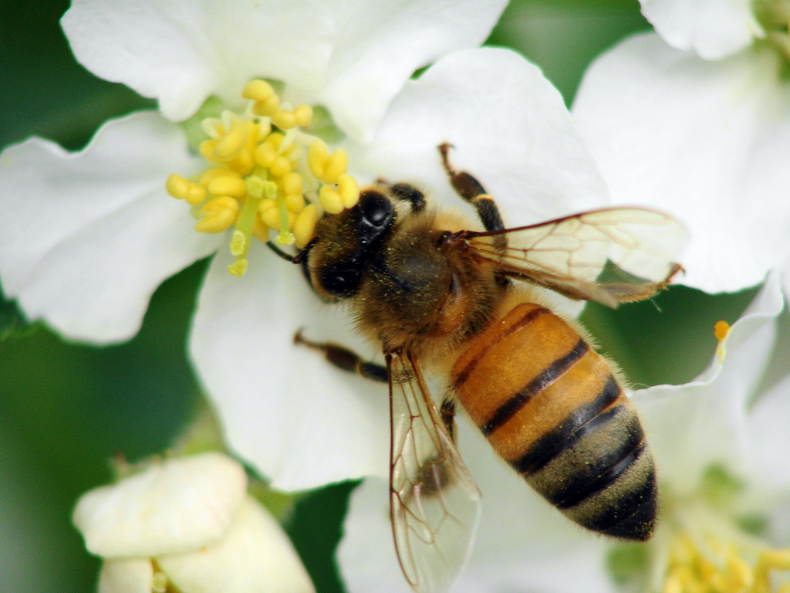
Sword Hummingbird and Trumpet Datura
bat and Saguaro cactus
honey bee and apple flower
Notes:
From “Bees are Not the Only Pollinators that Buzz”

Slide 10
