Slide 1
Weekly Words
Unit 4, Week 5
Notes:
disperse (n: dispersal): to scatter
essential: necessary, needed
locate (n: location): to find the position or place of
mutual: done by each for the other; having the same relationship toward each other
slurp: to noisily suck food or drink
species: a group of living things that can mate with one another but not with those of other groups
spread: to scatter or send out
transfer: to move or carry from one place to another

Slide 2
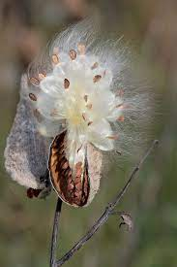
disperse
verb
to scatter
Notes:
disperse (verb)
Elaboration:
A milkweed seed pod dries and pops open at the end of the summer. When it does, the wind picks up the seeds and disperses them all over.
Think, Pair, Share prompt:
If you were going to disperse seeds over a large area, how might you do it?
https://www.britannica.com/topic/milkweed-floss

Slide 3
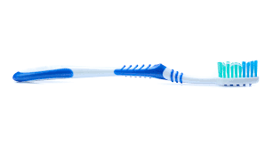
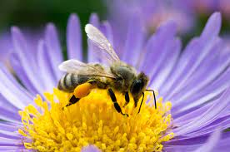
essential
adjective
necessary, needed
Notes:
essential (adjective)
Elaboration:
A toothbrush is essential for healthy teeth. We can’t have healthy teeth without brushing them.
Think, Pair, Share prompt:
Explain why pollination is essential.
https://dienamics.com.au/blog/toothbrush-overview-design-process/, http://pollinatorpartners.ksdot.org/WhatIsPollination.html

Slide 4
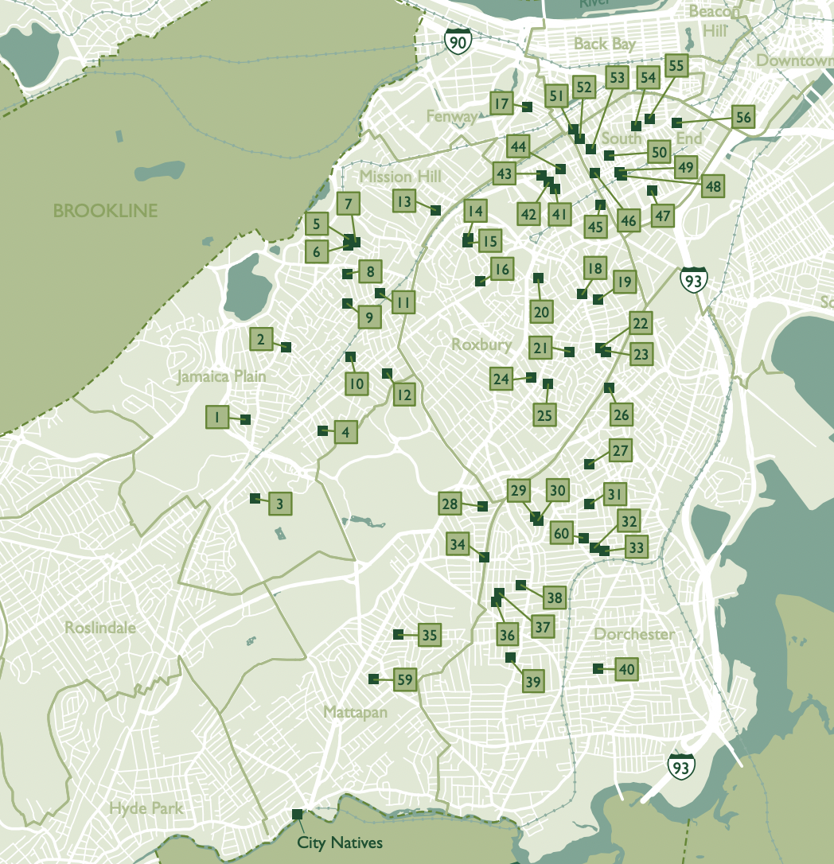
locate
verb
to find the position or place of
Notes:
locate (verb)
Elaboration:
This map helps people locate community gardens. People can figure out where the gardens are by using the map.
Think, Pair, Share prompt:
How would you locate a library in your neighborhood? What tools would you use?
https://thetrustees.org/wp-content/uploads/2020/07/boston-community-gardens-map.pdf

Slide 5

mutual
adjective
done by each for the other; having the same relationship toward each other
Notes:
mutual (adjective)
Elaboration:
Pen pals have a mutual agreement to write letters to each other and develop a long distance friendship. They both benefit from this mutual agreement.
Think, Pair, Share prompt:
How is pollination a mutual relationship for both plants and pollinators?
https://www.cbsnews.com/video/student-pen-pals-help-senior-citizens-cope-with-coronavirus-isolation/

Slide 6

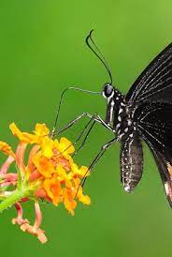
slurp
verb
to noisily suck food or drink
Notes:
slurp (verb)
Elaboration:
Have you ever been told not to slurp? It is sometimes considered rude to make a loud noise while sipping a drink.
Think, Pair, Share prompt:
How is a person slurping with a straw like an insect slurping with a proboscis?
https://www.nytimes.com/wirecutter/reviews/best-reusable-straws/, http://the-butterfly675.blogspot.com/2008/06/the-butterfly-proboscis.html

Slide 7
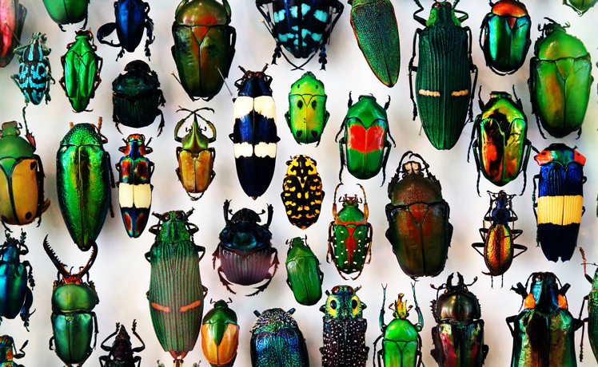
species
noun
a group of living things that can mate with one another but not with those of other groups
Notes:
species (noun)
Elaboration:
All of these insects are beetles, but they are each from a different species, a different kind of beetle.
Notice that this noun ends in -ies. This is how we say both the singular and plural noun: one species, many species.
Think, Pair, Share prompt:
With your partner, see how many different species of animals or species of plants you can name. How do you know that each one is a different species?
https://www.sciencenewsforstudents.org/article/scientists-say-species

Slide 8
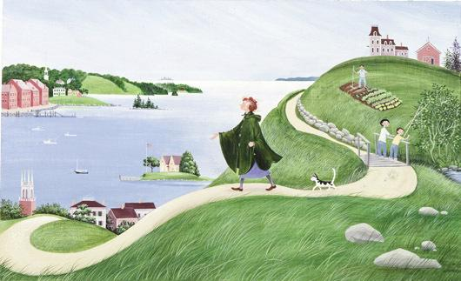
spread
verb
to scatter or send out
Notes:
spread (verb)
Elaboration:
“Spread” is a synonym of “disperse” and “scatter.” Miss Rumphius is a book about a person who walks all around her community spreading flower seeds to make the world more beautiful.
(Note that Miss Rumphius is by Barbara Cooney, the author/illustrator of Roxaboxen, which children may know from Kindergarten.)
Think, Pair, Share prompt:
What other meanings of the word “spread” do you know? [to lay, such as butter on toast; a bedcover; a layout of food]
Now use the word in a sentence with this meaning: What kinds of seeds would you like to spread around our community or in gardens around our community?
Illustration from the book Miss Rumphius by Barbara Cooney

Slide 9

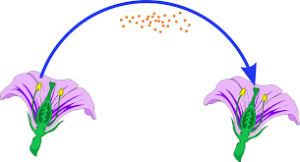
transfer
verb
to move or carry from one place to another
Notes:
transfer (verb)
Elaboration:
Here is a kind of silly image to illustrate “transfer”: goldfish transferring from one bowl to another. That does not really happen, but it’s a good illustration!
Think, Pair, Share prompt:
With your partner, describe how pollination involves the action of transferring.
https://www.fastweb.com/college-search/articles/is-it-worth-it-6-reasons-to-transfer, https://pixabay.com/vectors/flowers-pollination-pollen-transfer-5617774/

