Slide 1
“Bees are Not the Only Pollinators that Buzz”
Text Talk Week 4, Day 4

Slide 2
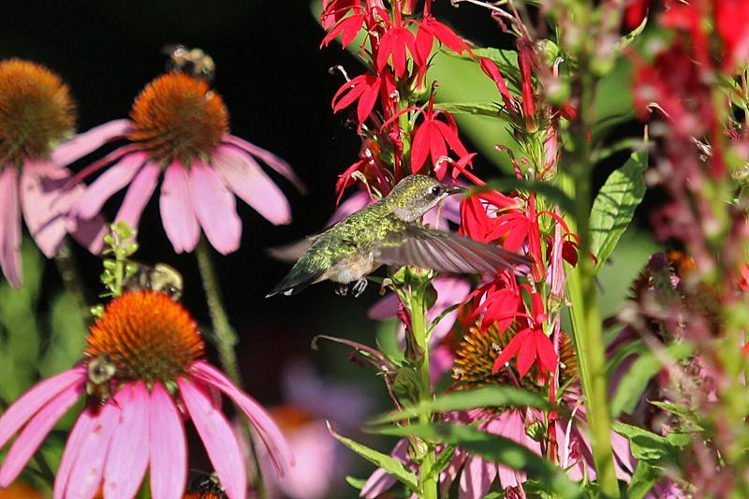
slide 1
Stand quietly near some red flowers on a summer day. You might hear a buzzing sound. It’s not a bee, although it is a pollinator. It’s not even an insect…

Slide 3
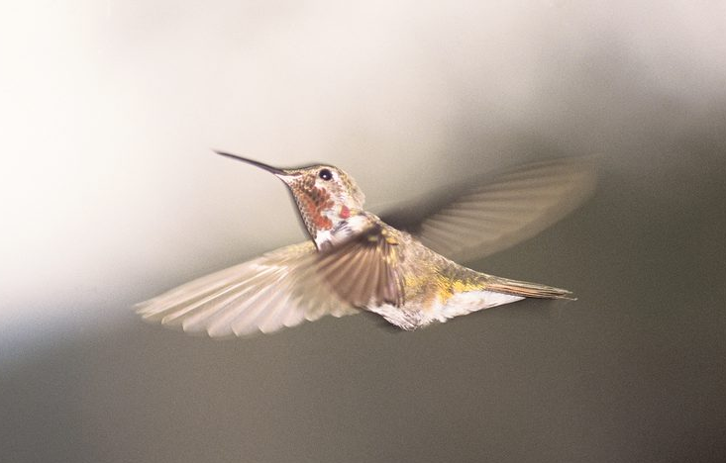
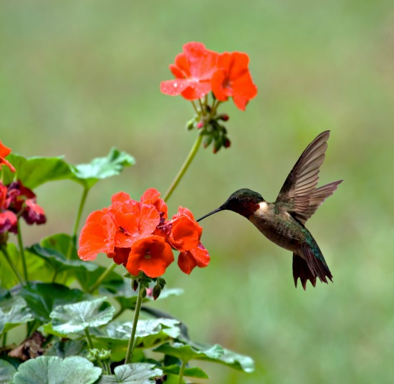
slide 2
That buzz is the sound of a hummingbird’s wings. Hummingbirds can beat their wings 80 to 100 times each second. This extraordinary wing motion allows hummingbirds to fly forward, backward, side to side, and even upside down. Hummingbirds can also hover. This means they can stay in one place in the air, as if they were hanging on a string.
Hummingbirds hover to get to their food.
Then they buzz away.

Slide 4
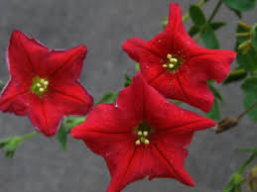
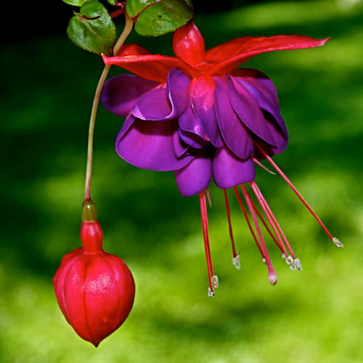
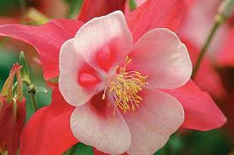
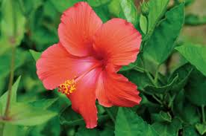
slide 3
Hummingbirds eat nectar, so they fly from flower to flower to get food. They are attracted to brightly colored flowers because those are the ones their eyes can see best—especially red and bright pink ones.
petunia fuchsia
columbine hibiscus

Slide 5
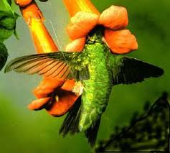
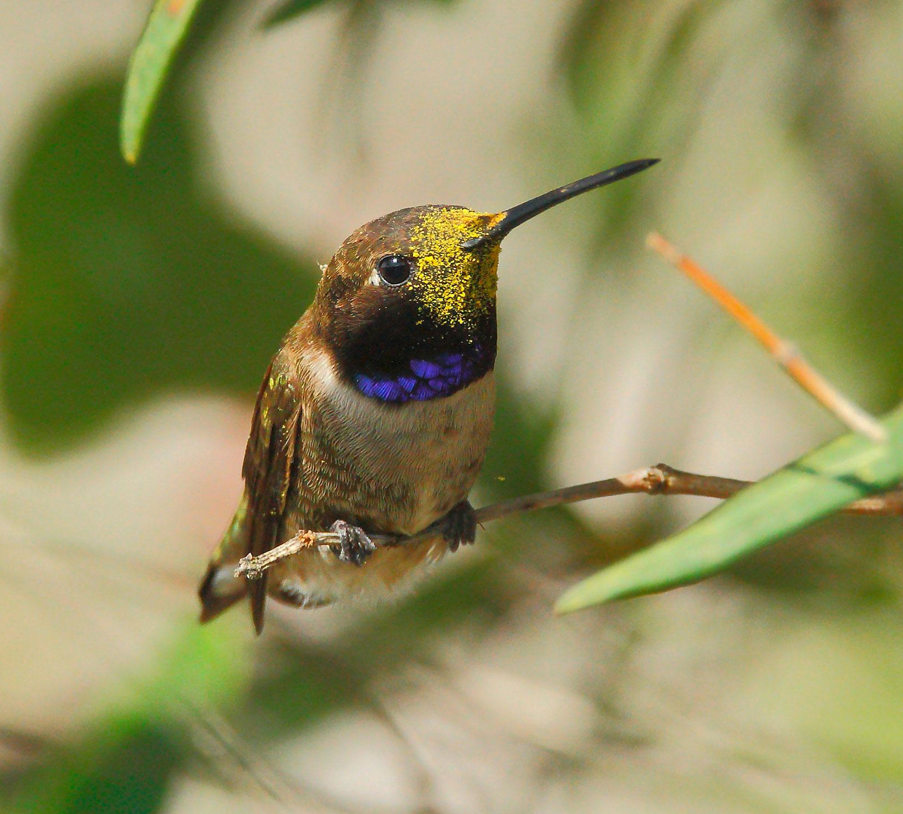
slide 4
When a hummingbird sips nectar, it hovers its body and sticks its beak into the flower. Sometimes it sticks its whole head in the flower!
Its head and body brush against the flower’s stamen. The hummingbird gets pollen grains all over itself.

Slide 6
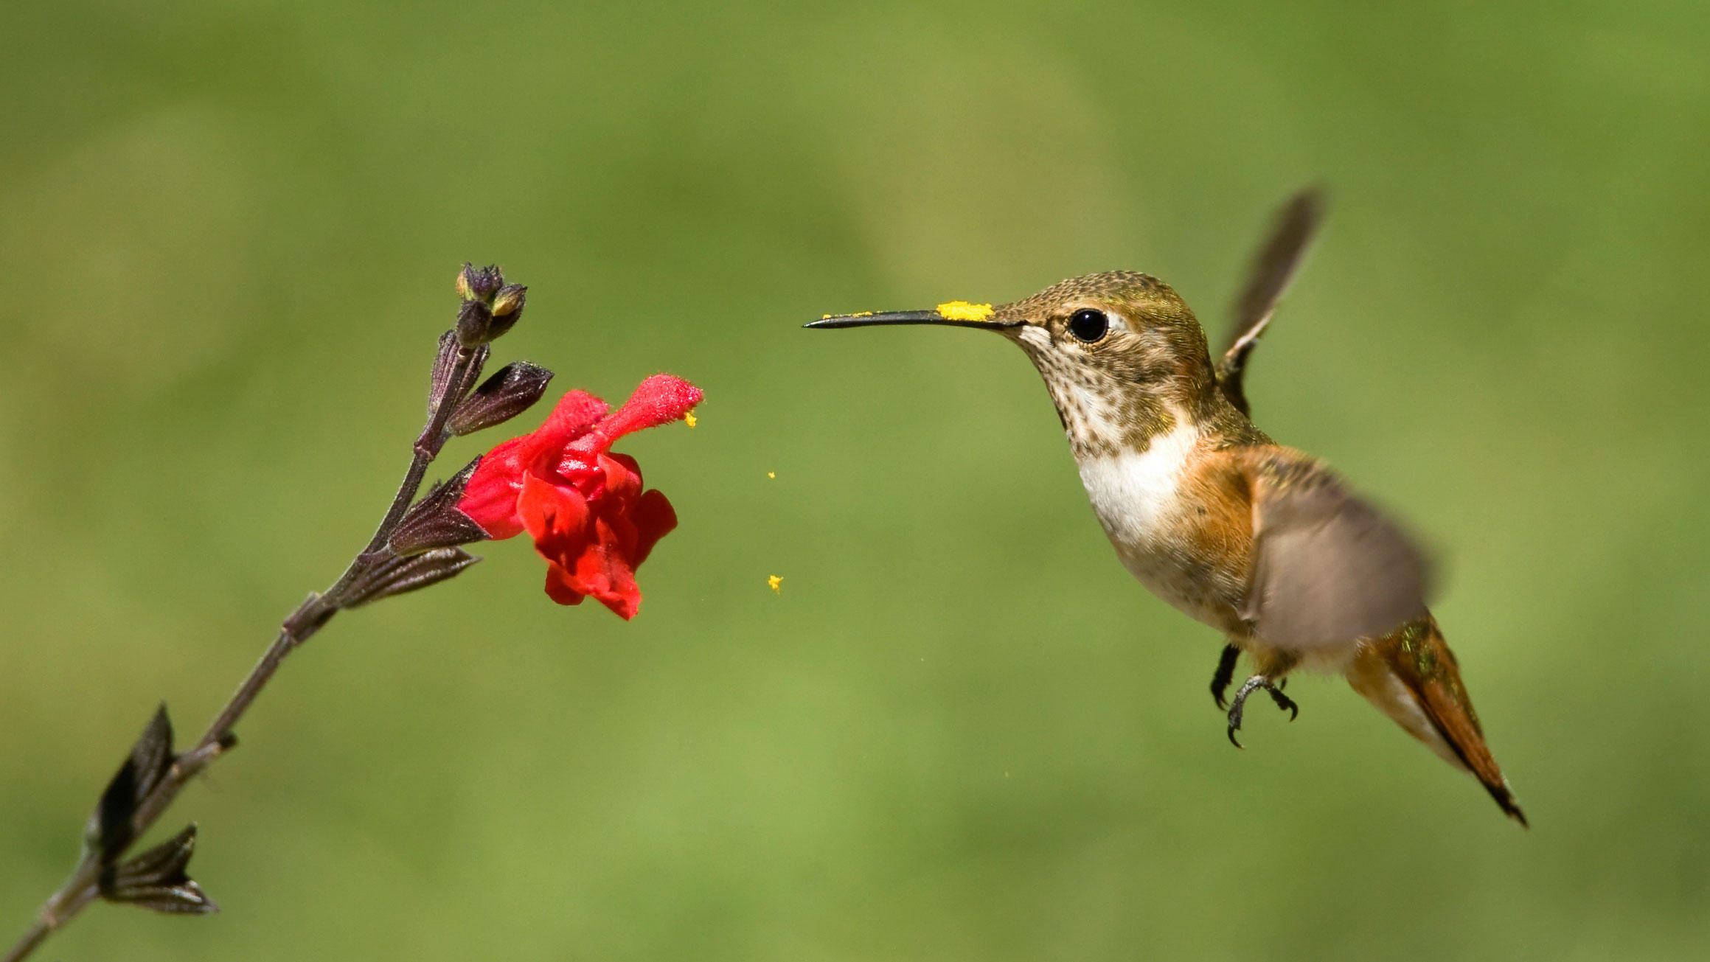
slide 5
When the hummingbird buzzes off to the next flower, the pollen rubs off onto the stigma of the new flower. In this way, hummingbirds help flowers make new seeds.
A hummingbird can feed on a thousand flowers each day. That means a lot of flowers are getting pollen from other flowers.

Slide 7
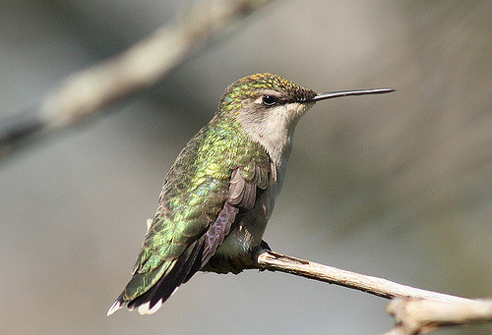
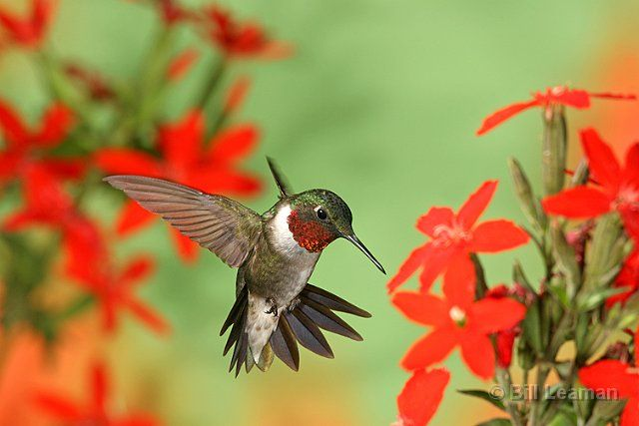
slide 6
Hummingbirds are tiny birds with brilliant feathers. There are about 300 species of hummingbirds. They live in North America and South America. Most of them live in tropical climates.
The ruby-throated hummingbird migrates 500 miles from Mexico to New England every spring. It has shiny green feathers. The male bird has a bright red throat.

Slide 8
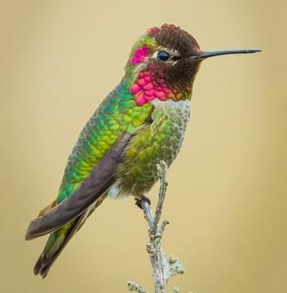
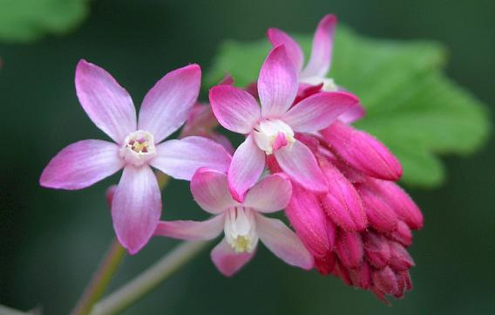
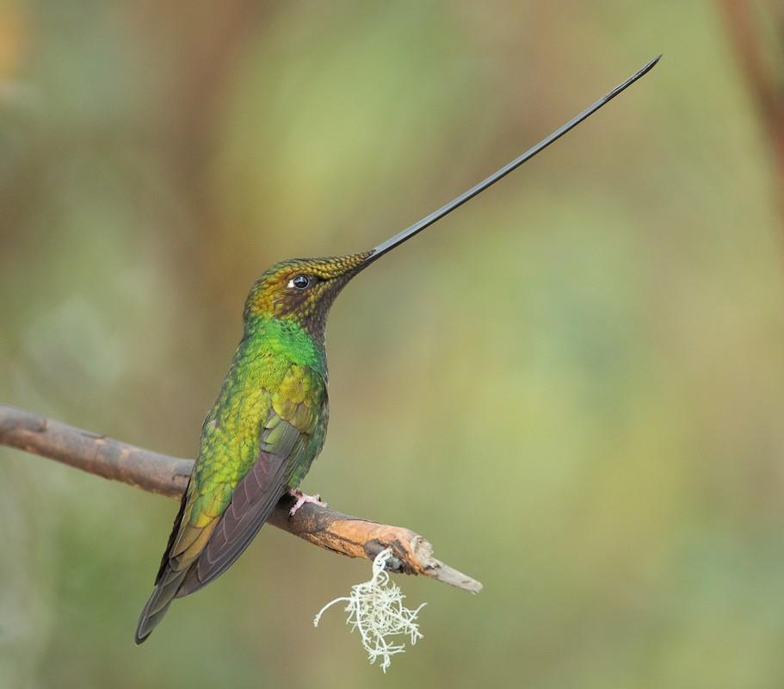
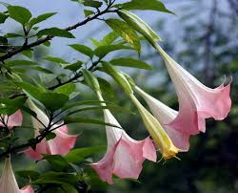
slide 7
Hummingbirds have long beaks. But not all hummingbird beaks are shaped the same way. Each hummingbird looks for the flowers that best match the size and shape of its beak.
Anna’s Hummingbird and Currant flower
Sword Hummingbird and Trumpet Datura

Slide 9
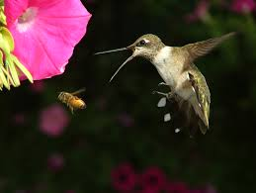
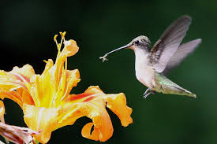
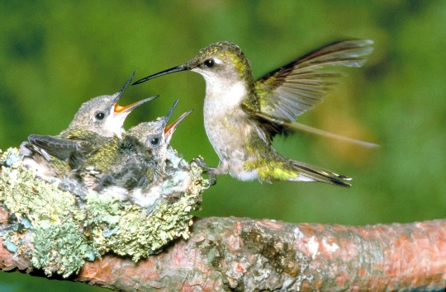
slide 8
Hummingbirds also prey on small insects and spiders. Hummingbirds use a lot of energy to fly so much and so fast. Bugs give them the protein they need to make this energy.
Young hummingbirds eat insects and spiders that their parents bring back to the nest.

Slide 10
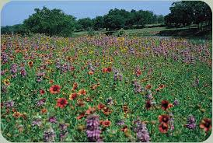
slide 9
In North America, hummingbirds mostly pollinate wildflowers. These plants are part of a healthy ecosystem. They also make our world more beautiful.
The kinds of flowers hummingbirds feed on produce nectar that is especially tasty to hummingbirds.

Slide 11
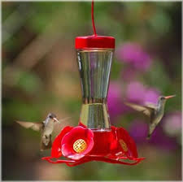
slide 10
People like having hummingbirds around. They are fun to watch and listen to as they fly. They are beautiful. And they are pollinators. One way to lure hummingbirds to an area is to plant flowers that attract them in gardens. Another way to lure hummingbirds is to hang hummingbird feeders and fill them with sweet syrup.
Why might a hummingbird feeder be designed like this?

Slide 12
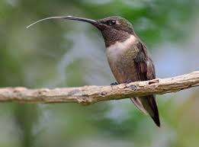
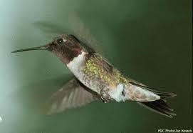
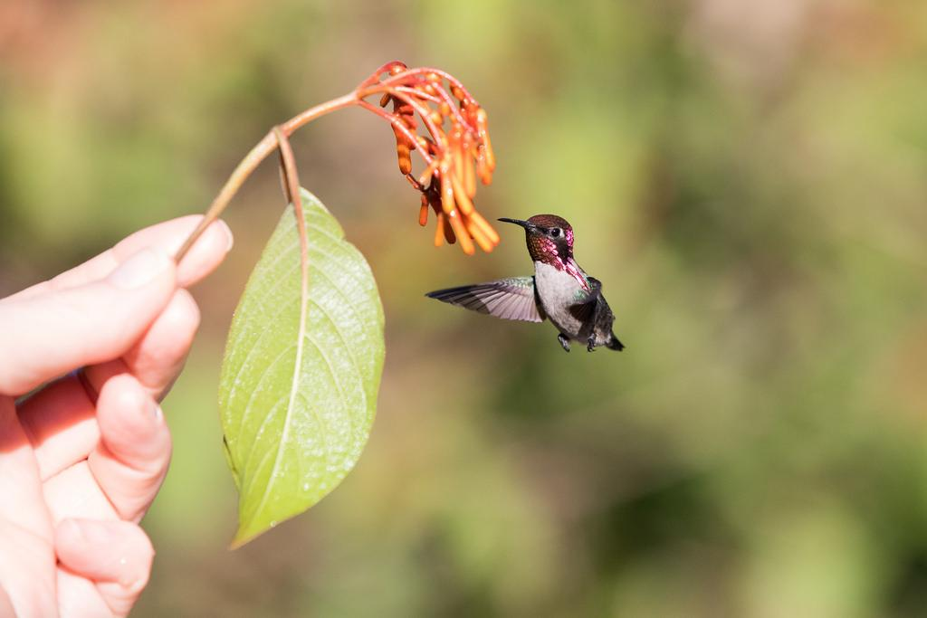
slide 11
 | Hummingbirds lap up nectar with their tongues. They can lick 10-15 times per second while feeding.
A hummingbird’s heart can beat 12 times faster than a human’s heart. But when the hummingbird sleeps, it slows its heart down to save energy.
 | The bee hummingbird is the smallest bird in the world. It is only a little over two inches long. The bee hummingbird lives mostly in Cuba.
Hummingbird Facts
A buzzing sound could mean there’s a pollinator close by…
but what kind?

Slide 13
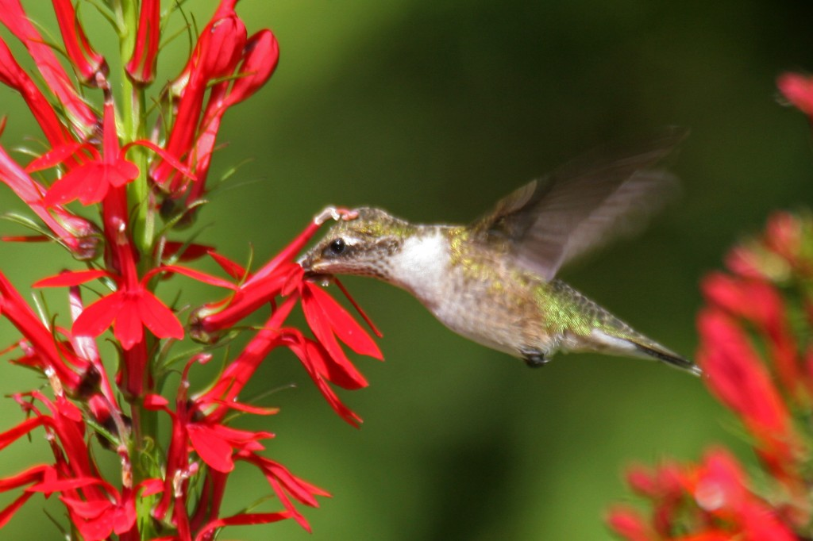
Glossary
brilliant: very bright
climate: the weather in an area
common: often found, not rare
ecosystem: a community of plants and animals that depend on each other, and their environment
extraordinary: very unusual or amazing
hover: to stay in one place in the air
prey: an animal that is hunted by another animal as food
protein: a nutrient that is needed for health
stamen: part of the plant that makes pollen
stigma: part of the pistil that receives the pollen
tropical: very hot and humid

Slide 14
Sources: Information
https://www.fs.fed.us/wildflowers/pollinators/pollinator-of-the-month/ruby-throated_hummingbird.shtml
https://aggie-horticulture.tamu.edu/galveston/beneficials/beneficial-62_pollinators-hummingbirds.htm
https://www.massaudubon.org/learn/nature-wildlife/birds/hummingbirds
http://www.audubon.org/news/hummingbirds-see-red
Sources: Photos
https://bybio.wordpress.com/tag/cardinal-flower/
https://sciencing.com/effects-extinction-organism-desert-ecosystem-food-chain-23435.html
https://hummingbirdgardener.com/2011/10/09/a-petunia-for-hummingbirds/, http://www.birdsandblooms.com/gardening/plants-and-flowers-to-attract-hummingbirds/top-10-red-flowers-to-attract-hummingbirds/
http://www.pacifier.com/~acashion/002.htm, http://www.audubon.org/magazine/summer-2016/five-ways-troubleshoot-your-birding-problems
http://www.audubon.org/news/what-do-birds-and-bees-have-do-global-food-supply
https://www.pinterest.com/pin/337558934545314679/, https://www.flickr.com/photos/tzunun/galleries/72157632784888018/?rb=1
https://www.fs.fed.us/wildflowers/pollinators/pollinator-of-the-month/ruby-throated_hummingbird.shtml, https://www.birdnote.org/show/sapsuckers-and-hummingbirds, http://www.nenature.com/RubyThroatedHummmingbirdPhoto.htm
https://www.allaboutbirds.org/guide/Annas_Hummingbird/lifehistory
http://www.nwplants.com/business/catalog/rib_san.html
https://neotropical.birds.cornell.edu/Species-Account/nb/species/swbhum1
https://m.dhgate.com/product/wholesale-flower-seeds-devil-039-s-trumpet/390339406.html
https://aggie-horticulture.tamu.edu/wildseed/mixes.html
https://www.countrymax.com/perky-pet-glass-hummingbird-feeder-with-bee-guards/,
http://www.audubon.org/news/hummingbirds-see-red
https://castellowhammock.wordpress.com/2008/11/22/hummingbirds/img_0573/
https://www.bayjournal.com/article/hummingbird_provides_improbable_nectar_for_the_soul
https://www.flickr.com/photos/jesusreinacarvajal/33037178476
http://fiddleheadcreek.com/a-match-made-in-a-wetland-cardinal-flower-and-the-ruby-throated-hummingbird/

