Slide 1
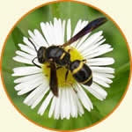
Insect Pollinators
Text Talk Week 4, Day 2

Slide 2

Insect Pollinators
Many people know that bees and butterflies are insects. They also know that they are strong pollinators. But other insects pollinate, too.

Slide 3
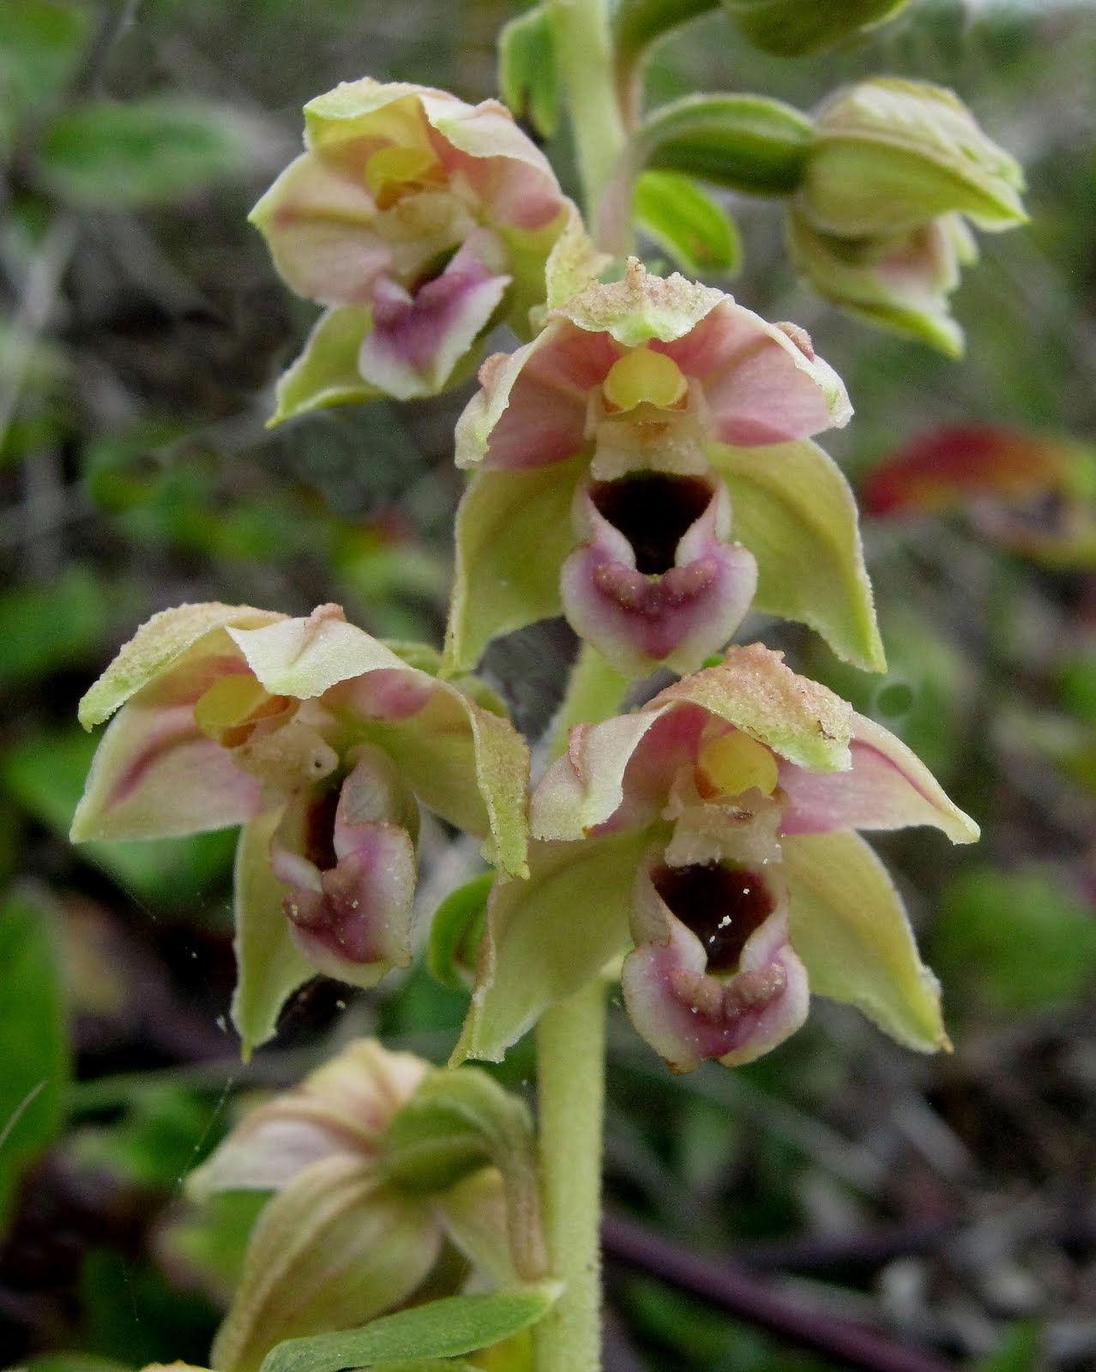
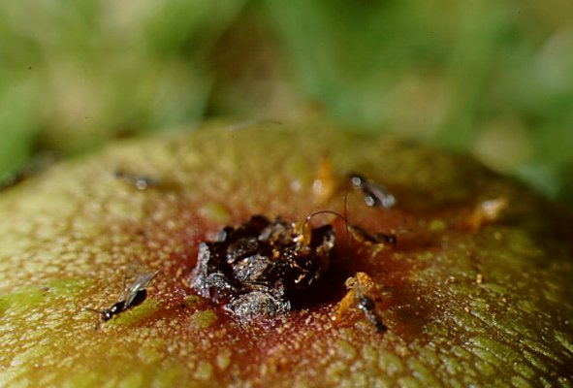
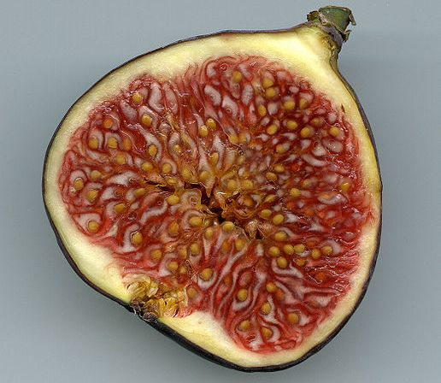
Wasps
Wasps do not have hairy bodies to pick up pollen, but some pollen does
stick to them. The pollen spreads as wasps move from flower to flower.
A pollen wasp also brings nectar and pollen to its young.
Common wasps eat caterpillars. Scientists have discovered that one kind of orchid plant smells like caterpillars. This lures wasps to its flowers.
A sweet fig has its flowers on the inside. The tiny fig wasp crawls inside the fig, lays its eggs, eats nectar, and pollinates the flowers.
Fig wasps heading inside the bottom of the fig to get to the flower
The inside of a fig

Slide 4
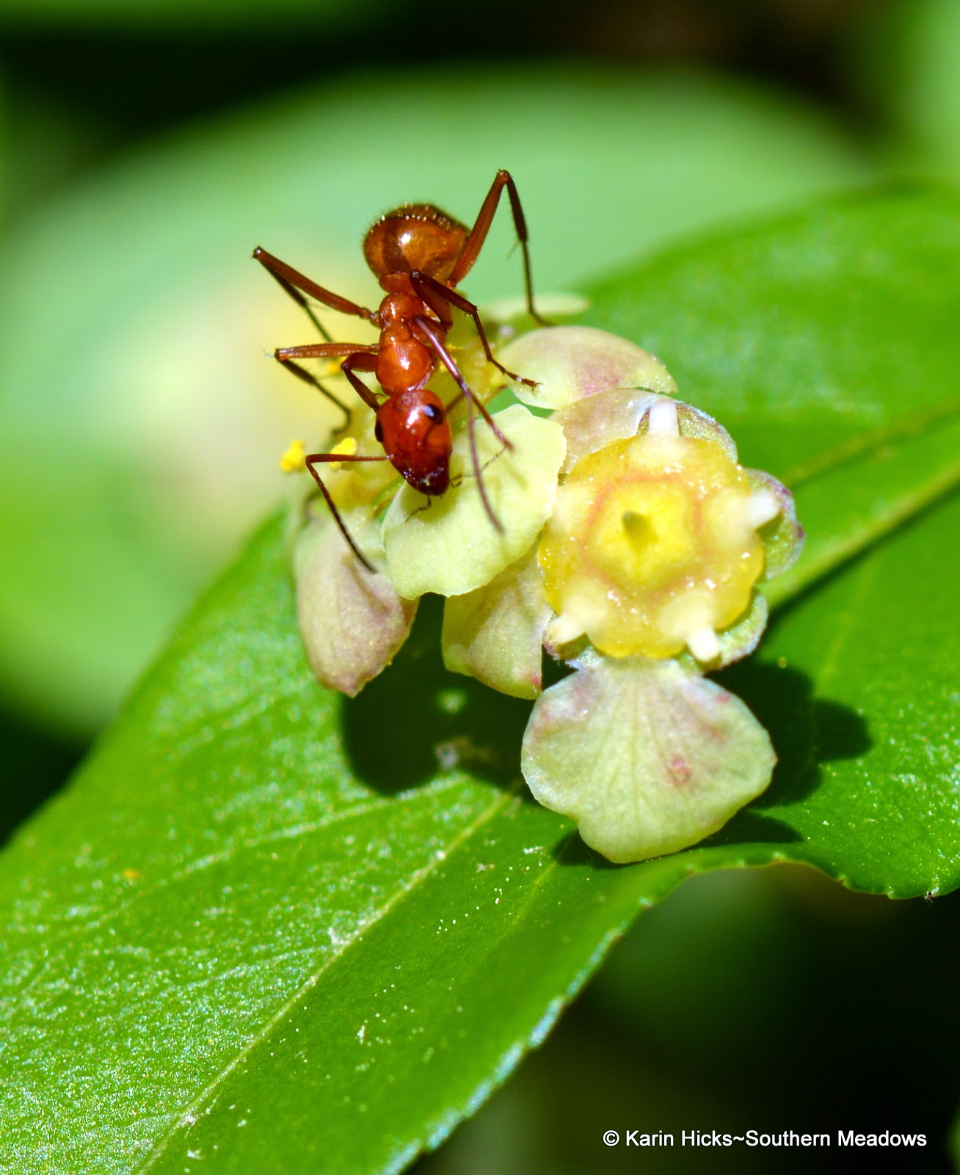
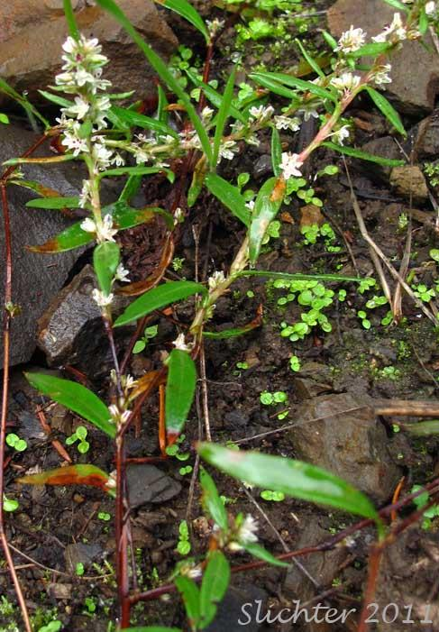
Ants
Ants are not very effective pollinators, because they can’t fly. When we see ants crawling on flowers, they are looking for nectar to eat. They might pick up and carry some pollen to another flower by accident. The flowers ants feed on grow close to the ground.
Ants do help pollination in another way. Some flowers produce nectar on the outside of the flowers, instead of inside. This nectar on the outside is easy for ants to crawl to. When other insects see the ants on the outside, they go inside the flower to look for nectar. That’s where the pollen is. The ants point the flying insects to the pollen. This helps the flowers get pollinated.
Nailwort plant

Slide 5
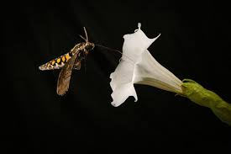
Moths
Moths are excellent pollinators. They pollinate many flowers that bees and butterflies do not. Moths mostly visit flowers that are white, open at nighttime, and have a strong smell.
Like a butterfly, a moth has a proboscis that acts as a straw to suck nectar out of a flower. A hawk moth has strong wings and a very long proboscis. It flies quickly from flower to flower to eat, spreading pollen along the way.

Slide 6
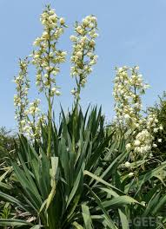
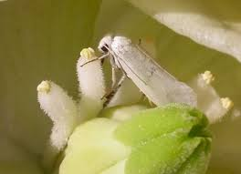
The yucca plant grows in warm places and produces edible fruits and flowers. Many people use this plant for decoration, too. The yucca plant is only pollinated by the yucca moth, so this plant and insect pair have a special relationship. The female yucca moth crawls inside the yucca flower to lay her eggs. Then she collects pollen from the flower, forms it into a ball, and puts the pollen on the flower’s stigma. The pollinated flower can now produce seeds, just in time for the yucca moth larvae to hatch and feed on them.

Slide 7
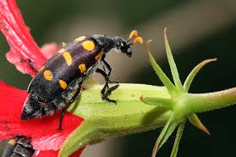
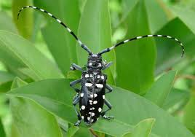
Beetles
Beetles were one of the first insects to visit flowers, starting about 150 million years ago. Today, they are still important pollinators. They are attracted to flowers with spicy or fruity scents, such as magnolia and spicebush.
Most beetles that visit flowers do not sip nectar. Instead, they chew and eat other parts of the plants. They get pollen on them as they eat. Families of beetles that pollinate flowers have interesting names:
blister beetle
long-horned beetle

Slide 8
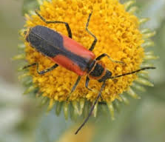
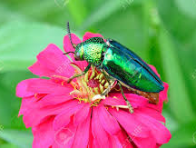
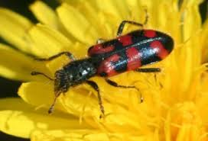
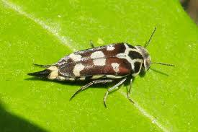
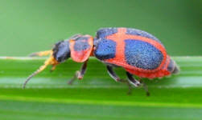
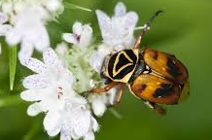
soldier beetle
jewel beetle
checkered beetle
tumbling flower beetle
soft-winged flower beetle
flower scarab beetle

Slide 9
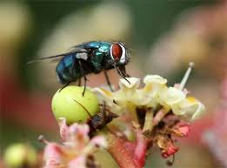
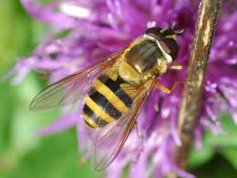
Flies
Flies are pollinators. There are many different species of flies. They visit flowers for nectar, for pollen, to lay eggs, or to feed on other smaller insects that might be on the plants. Many flowers that attract flies smell terrible, like rotten meat!
Scientists and farmers believe that flies like the bluebottle fly are the most important pollinator for mangoes.
Hoverflies look like honeybees, but they are flies. They are important pollinators for carrots and avocados.

Slide 10
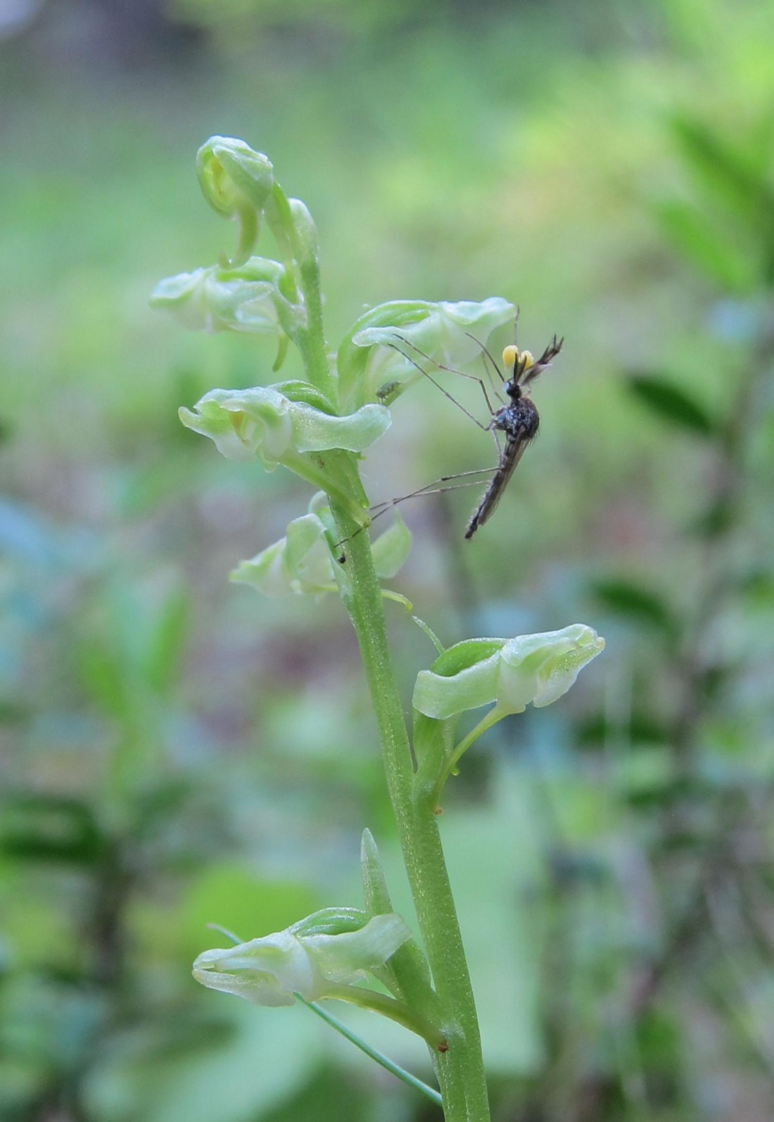
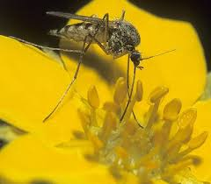
Mosquitos are a type of fly. Nectar is mosquitos’ most important food. Mosquitos also feed on blood. That’s why they bite people and other animals. Some orchids give off a smell like a human body smell to attract mosquitos.
A mosquito with pollen sacs attached to its head visits a Platanthera orchid.

Slide 11
Glossary edible: able to be eaten fig: a small, soft, pear-shaped fruit with seeds inside larvae: the young form of an insect, as a caterpillar is to a butterfly lure: to tempt, to draw something in proboscis: long, sucking part of an insect’s mouth scent: smell or odor terrible: extremely bad or unpleasant

Slide 12
Citations
Potter wasp on aster, Beatriz Moisset: https://www.fs.fed.us/wildflowers/pollinators/animals/wasps.shtml
Helleborine: http://goweros.blogspot.com/2011/07/broad-leaved-helleborine.html
Fig pollination: http://www.figweb.org/Interaction/Who_pollinates_fig_trees/index.htm
Figs: https://gardentodoorstep.com/product/brown-turkey-fig-tree/
Inside of fig: https://www.esa.org/esablog/research/the-story-of-the-fig-and-its-wasp/
Ants: http://gardeningsoul.blogspot.com/2015/05/ants-unlikely-pollinators.html
Nailwort plant: https://www.fredswildflowers.com/paronychia.html
Hawk moth: http://nationalmothweek.org/2015/06/25/the-year-of-the-sphingidae-pollination/
Yucca flower: http://www.wisegeek.com/what-is-a-yucca-flower.htm
Yucca moth: https://sites.jmu.edu/
Soldier beetle: https://www.whatsthatbug.com/category/beetles/soldier-beetles/
Jewel beetle: https://nature.mdc.mo.gov/discover-nature/field-guide/scarab-beetles
Blister beetle: https://en.wikipedia.org/wiki/Blister_beetle
Long-horned beetle: http://www.post-gazette.com/life/my-generation/2017/07/11/Let-s-talk-about-parks-Asian-longhorned-beetle/stories/201707110027
Checkered beetle: https://wiki.bugwood.org/HPIPM:Clerid_Checkered_Beetle
Tumbling flower beetle: http://www.pybio.org/13550/mordellidae/
Soft-winged flower beetle: http://www.dpughphoto.com/beetles.htm
Flower scarab beetle: https://nature.mdc.mo.gov/discover-nature/field-guide/scarab-beetles
Mosquito:http://www.prairiepollination.ca/pollinisateur-pollinator/moustiques-mosquitoes/
A mosquito with pollen sacs attached to its head visits a Platanthera orchid. Photo: Jeff Riffell
https://phys.org/news/2017-01-orchids-mimic-human-body-odor.html#jCp

