Slide 1
Shades of Meaning: Verbs
Vocabulary & Language Week 4, Days 3-4

Slide 2
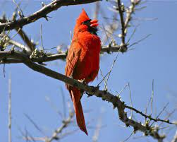
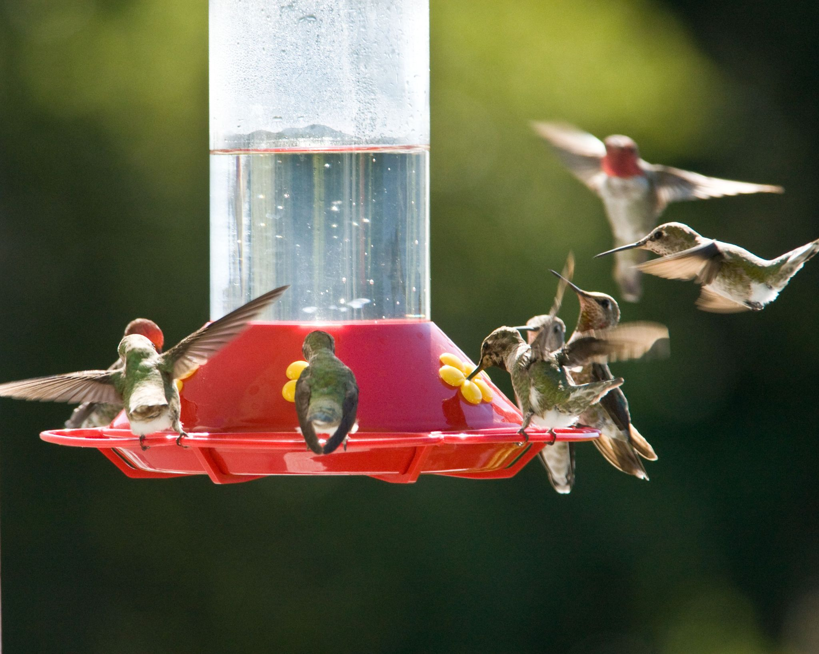
attract
verb
to interest, to draw closer
Notes:
https://www.thestar.com/news/insight/2013/02/24/cardinals_song_means_spring_is_around_the_corner.html, https://www.goodhousekeeping.com/home-products/g28008704/best-hummingbird-feeders/

Slide 3
lure
verb
to attract
Notes:
https://www.goodhousekeeping.com/home-products/g28008704/best-hummingbird-feeders/, https://www.thestar.com/news/insight/2013/02/24/cardinals_song_means_spring_is_around_the_corner.html

Slide 4
attract
lure

Slide 5
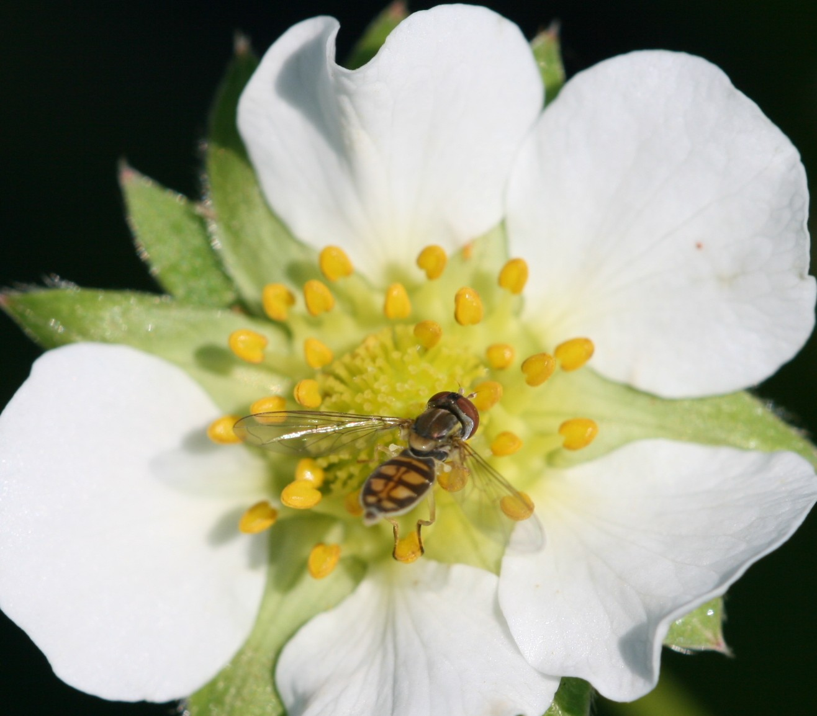
depend
verb
to rely on, to trust
Notes:
https://entomology.ces.ncsu.edu/strawberry-pollinating-insects/

Slide 6
depend

Slide 7
lure
attract

Slide 8
depend
Need
Trust

