Slide 1
Weekly Words
Unit 4, Week 4
Notes:
brilliant: very shiny or bright, glittering; extremely wonderful or well done
buzz (n): a soft, low hum; (v): to produce a low, soft hum
ecosystem: a group of animals and plants living in one place and impacting each other
effective: producing a good or positive result
extraordinary: very unusual, remarkable
lure: to attract
match: a person or thing that relates to another as an equal in a particular way
protein: a substance that gives energy and is essential for life

Slide 2
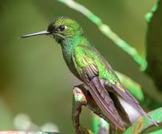
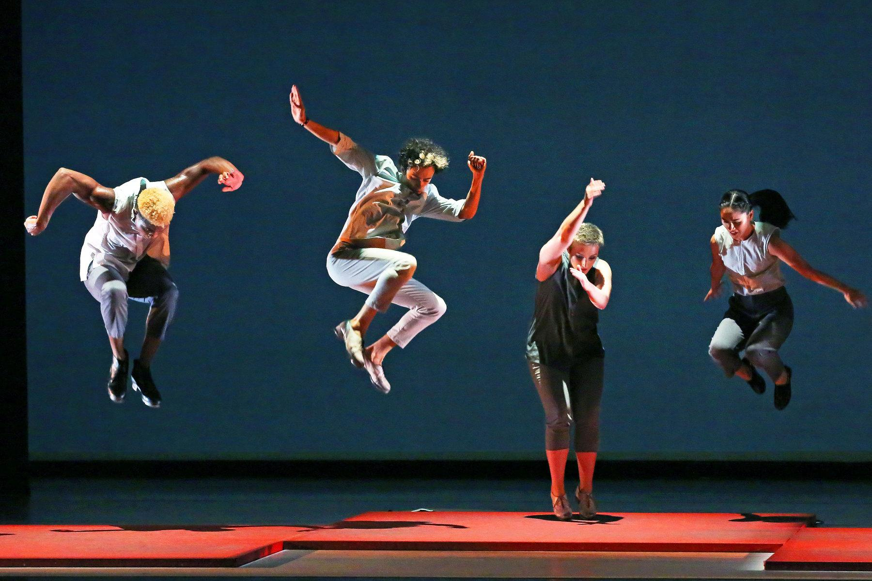
brilliant
adjective
very shiny or bright, glittering; extremely wonderful or well done
Notes:
brilliant (adjective)
Elaboration:
This hummingbird can be described as brilliant; its feathers are shiny and glittering.
These dancers can also be described as brilliant; they are extremely talented and wonderful to watch!
Think, Pair, Share prompt:
Try to describe an object that is brilliant and what makes it brilliant.
And then tell your partner something you do or your partner does that is brilliant!
https://commons.wikimedia.org/wiki/File:Green-crowned_Brilliant_Hummingbird_(46436303872).jpg, https://www.nytimes.com/2019/12/06/arts/dance/best-dance.html

Slide 3
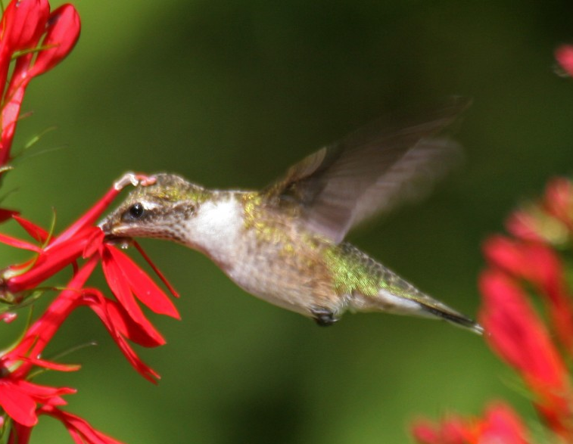

buzz
noun
a low, soft hum
verb
to produce a humming noise
Notes:
buzz (noun, verb)
Elaboration:
Buzz can be a noun, a sound. Let’s make a buzz.
Buzz can also be a verb, an action. Bees and flies buzz when they move their wings very, very quickly.
Think, Pair, Share prompt:
Tell your partner two sentences, using the word “buzz” as a noun and then as a verb.
http://fiddleheadcreek.com/a-match-made-in-a-wetland-cardinal-flower-and-the-ruby-throated-hummingbird/, https://butterflymx.com/blog/replace-apartment-buzzer/

Slide 4
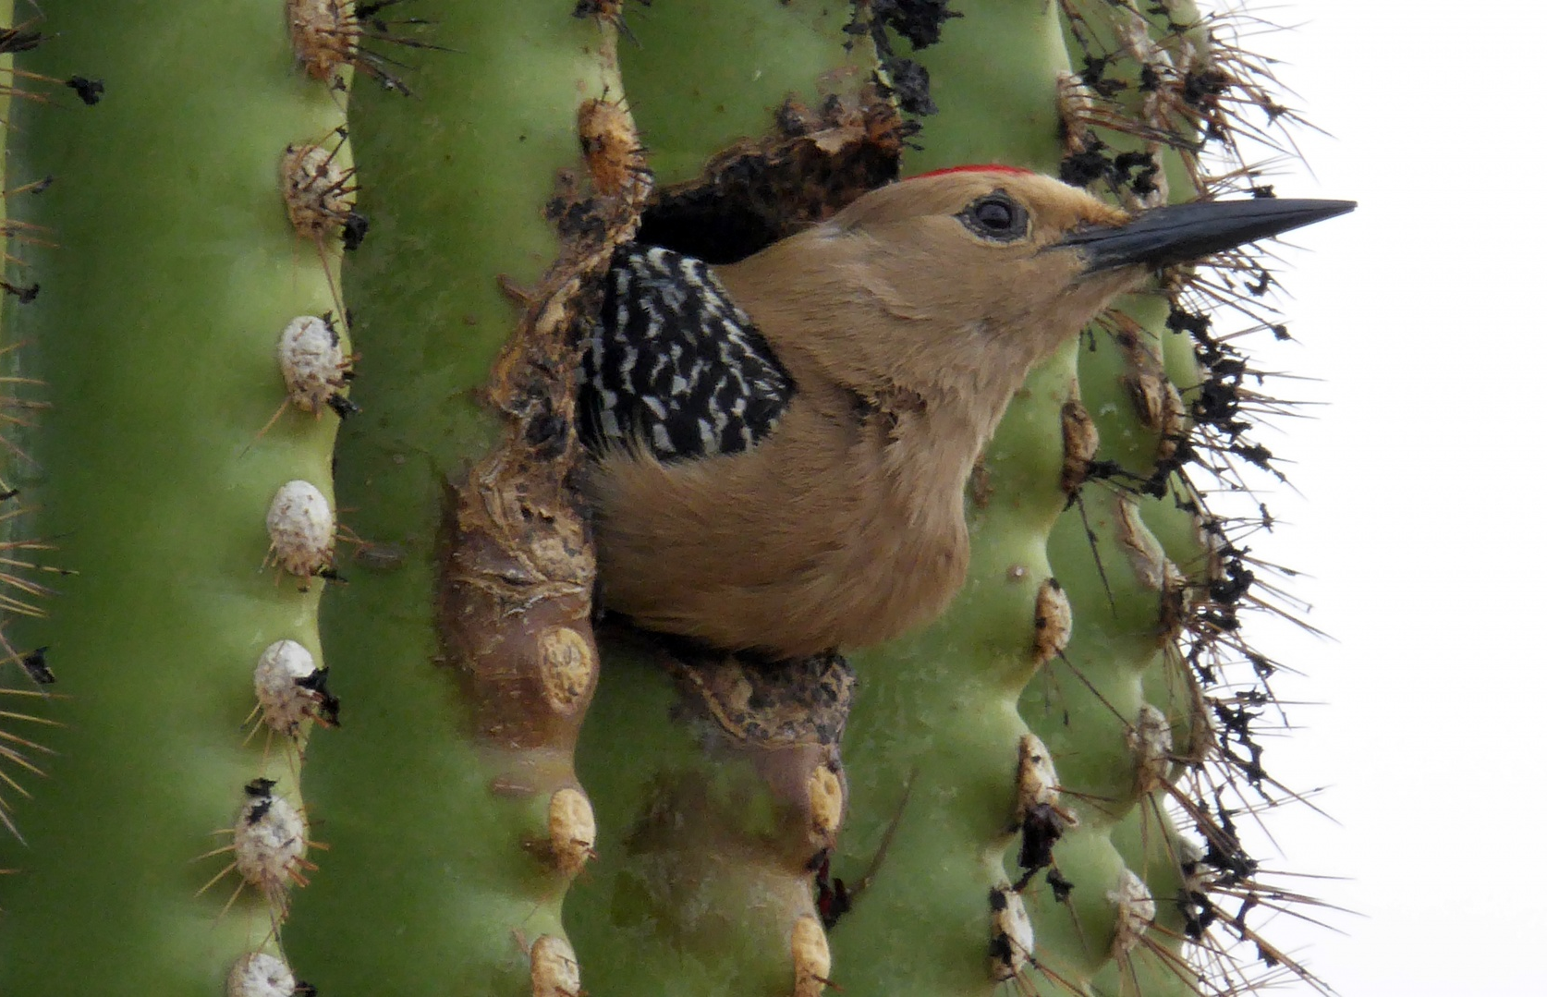
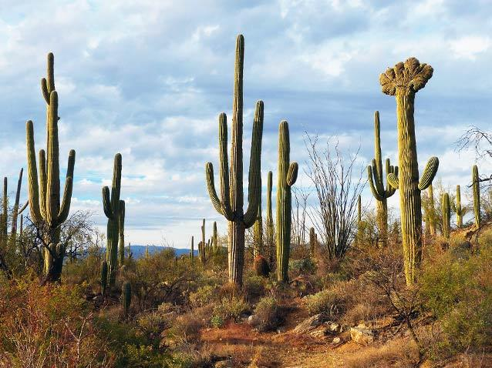
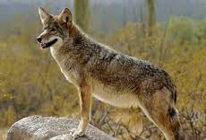
ecosystem
noun
a group of animals and plants living in one place and impacting each other
Notes:
ecosystem (noun)
Elaboration:
An ecosystem includes many different kinds of plants and animals.
Think, Pair, Share prompt:
What do you notice about the ecosystem that includes saguaro cacti and bats?
https://www.nps.gov/articles/saguaro-cactus-facts.htm, https://desertridgelifestyles.com/coexisting-with-coyotes/, https://www.publicdomainpictures.net/en/view-image.php?image=214145&picture=bird-inside-a-saguaro-cactus

Slide 5
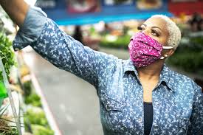
effective
adjective
producing a good or positive result
Notes:
effective (adjective)
Elaboration:
We have learned that a mask is one effective way to not share germs with other people.
Think, Pair, Share prompt:
Talk with your partner about the things that make a bee a very effective pollinator.
https://www.ucsf.edu/news/2020/06/417906/still-confused-about-masks-heres-science-behind-how-face-masks-prevent

Slide 6
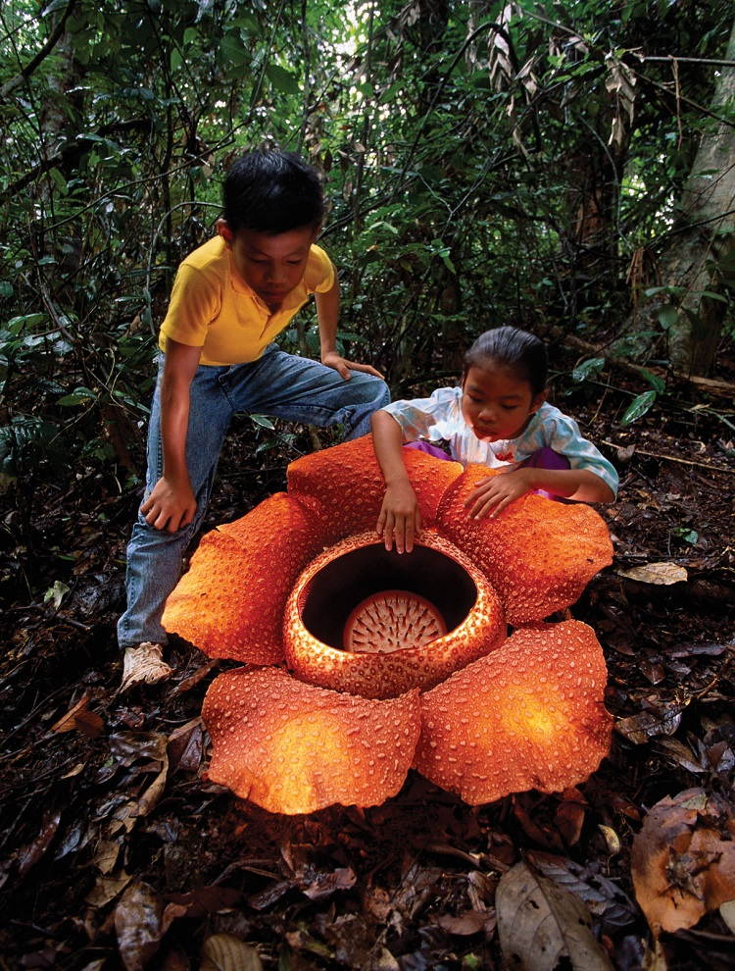
extraordinary
adjective
very unusual,
remarkable
Notes:
extraordinary (adjective)
Elaboration:
“Extra” is a prefix meaning “more than.”
Something that is extraordinary is more than ordinary or usual. When you see something extraordinary, you might find yourself saying “Wow!”
This is a real flower, the largest flower on Earth. It grows in rainforests. People say it smells like rotting meat, and this smell attracts flies, beetles, and other insects for pollination.
Think, Pair, Share prompt:
What or who is extraordinary to you? What makes it or them extraordinary?
https://allthatsinteresting.com/interesting-plants

Slide 7
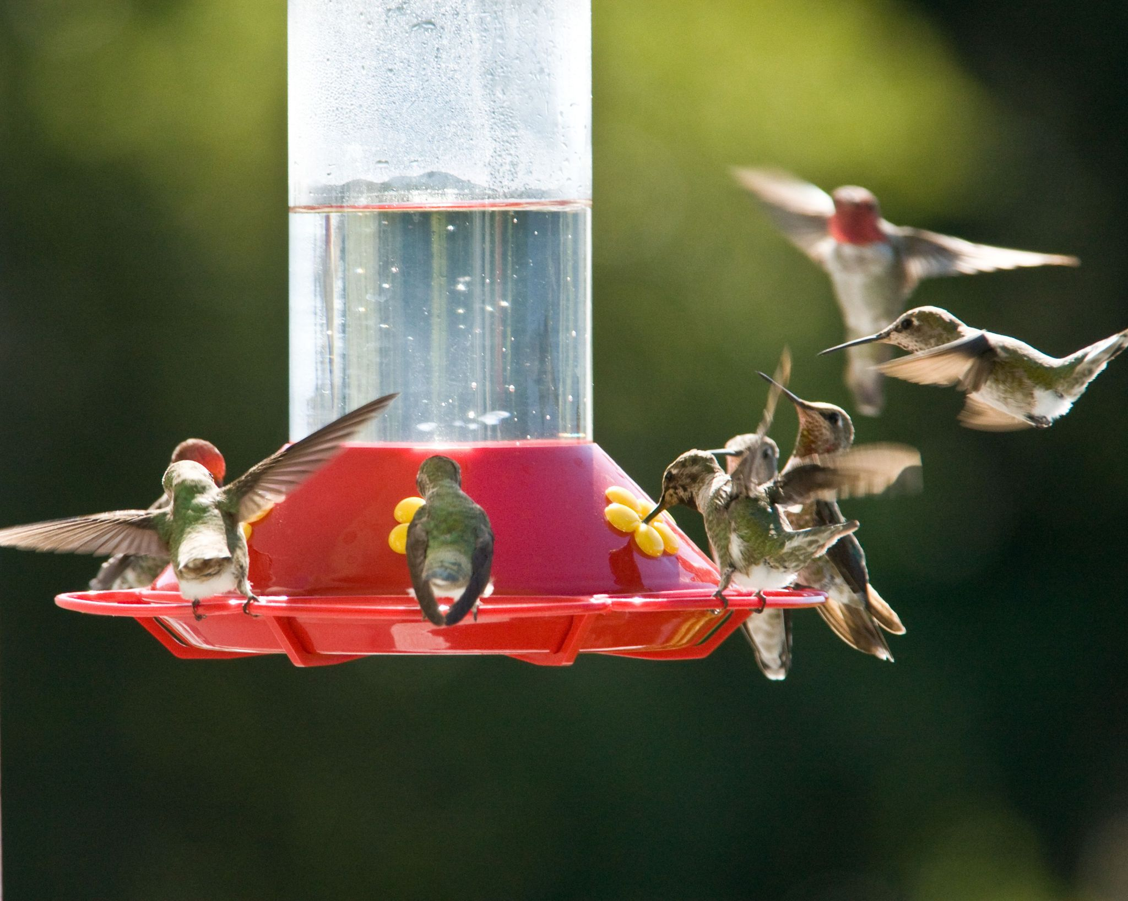
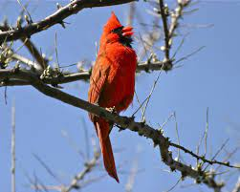
lure
verb
to attract
Notes:
lure (verb)
Elaboration:
The bright red color, flower-shaped holes, and sweet liquid all lure hummingbirds to this feeder. “Lure” is a synonym for “attract.”
Think, Pair, Share prompt:
What kinds of smells lure you to the table for a meal?
https://www.goodhousekeeping.com/home-products/g28008704/best-hummingbird-feeders/, https://www.thestar.com/news/insight/2013/02/24/cardinals_song_means_spring_is_around_the_corner.html

Slide 8
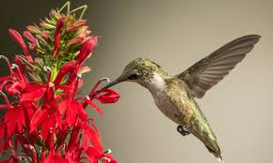
match
noun
a person or thing that relates to another as an equal in a particular way
Notes:
match (noun)
Elaboration:
“Match” has a variety of definitions. In this context, it refers to two things going together in some way. The cardinal flower and hummingbird are a pollination match.
You might know other meanings of the word “match,” such as something used to light a fire. A “match” could also be a game, such as a soccer match.
Think, Pair, Share prompt:
What are two things that are a match when we talk about the process of pollination, such as an apple blossom and a bee?
https://birdwatchinghq.com/what-do-hummingbirds-eat/ruby-throated-hummingbird-with-cardinal-flower/

Slide 9
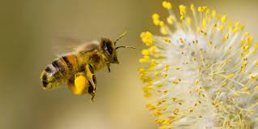
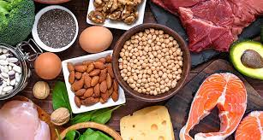
protein
noun
a substance that gives energy and is essential for life
Notes:
protein (noun)
Elaboration:
Pollen is the most important source of protein for bees. They collect pollen from flowers and convert it into protein-rich food for young bees and the queen bee.
Think, Pair, Share prompt:
What kinds of protein do you most enjoy eating?
https://rtmagazine.com/disorders-diseases/chronic-pulmonary-disorders/allergies/pollen-sensing-app-allergy-asthma/, https://www.sciencenewsforstudents.org/article/explainer-what-are-proteins

