Slide 1
Report Titles
Writing Unit 4 Week 3 Day 5

Slide 2





Slide 3
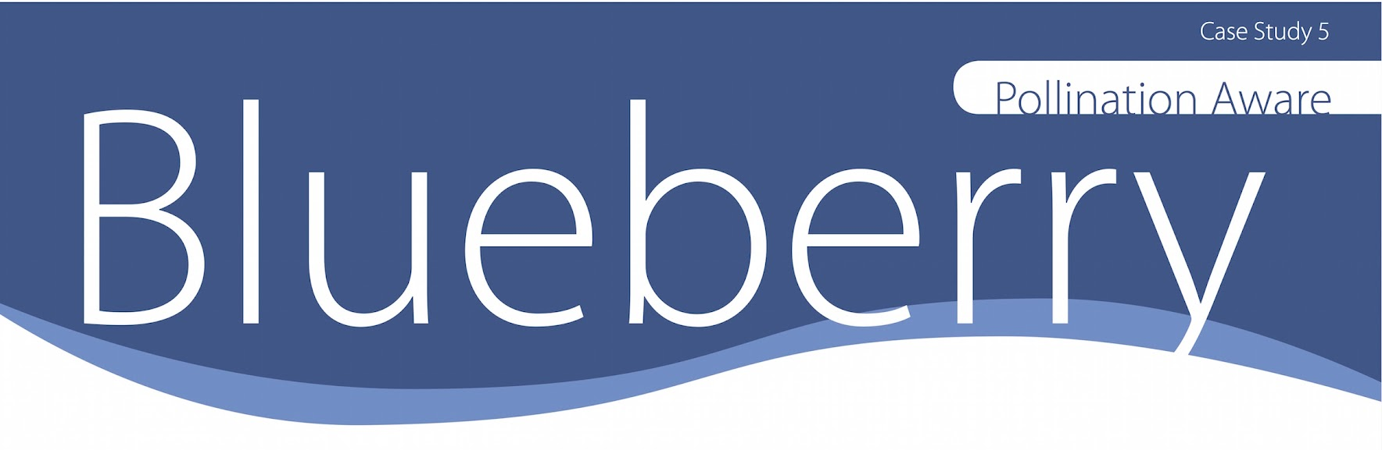
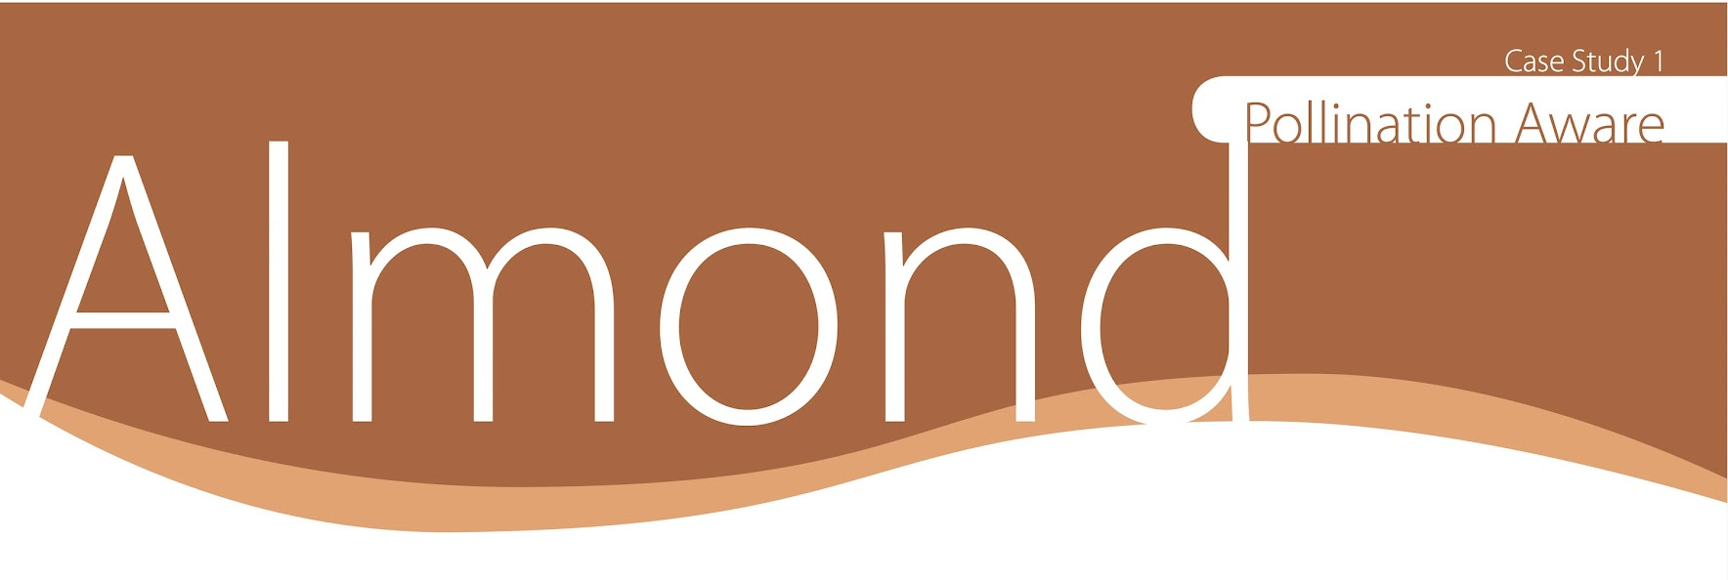
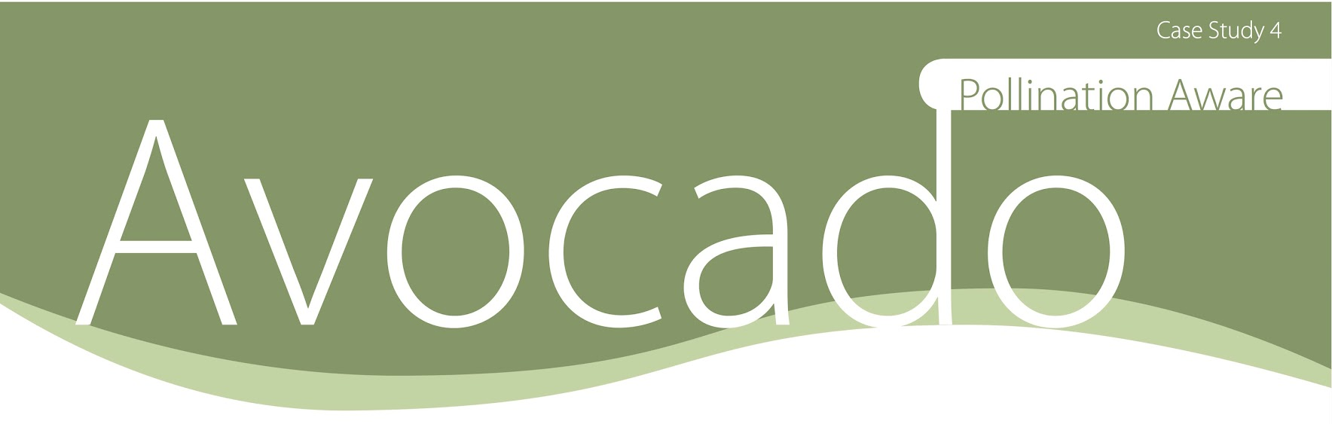

Slide 4

