Slide 1
General Statement and Diagrams
Writing Unit 4 Week 3 Day 4

Slide 2
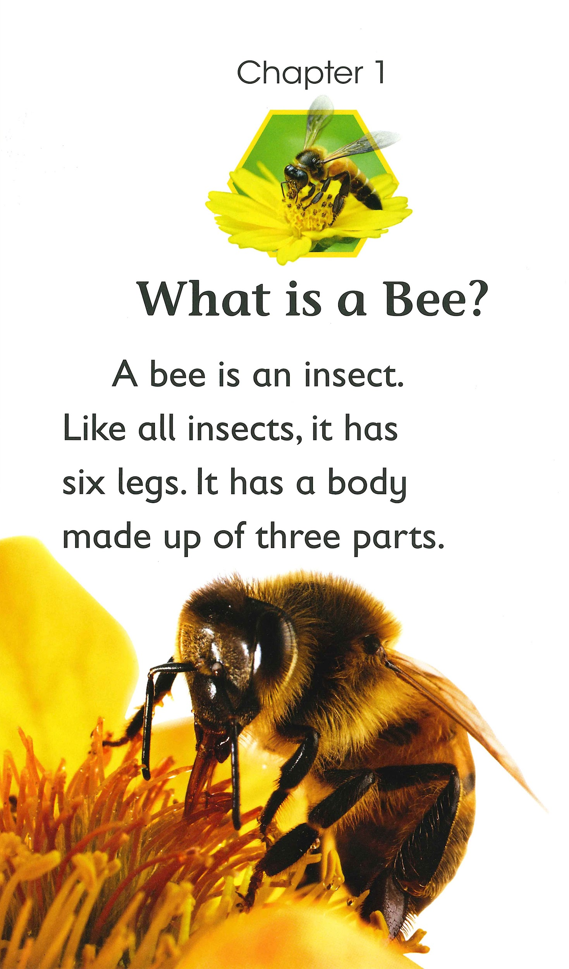
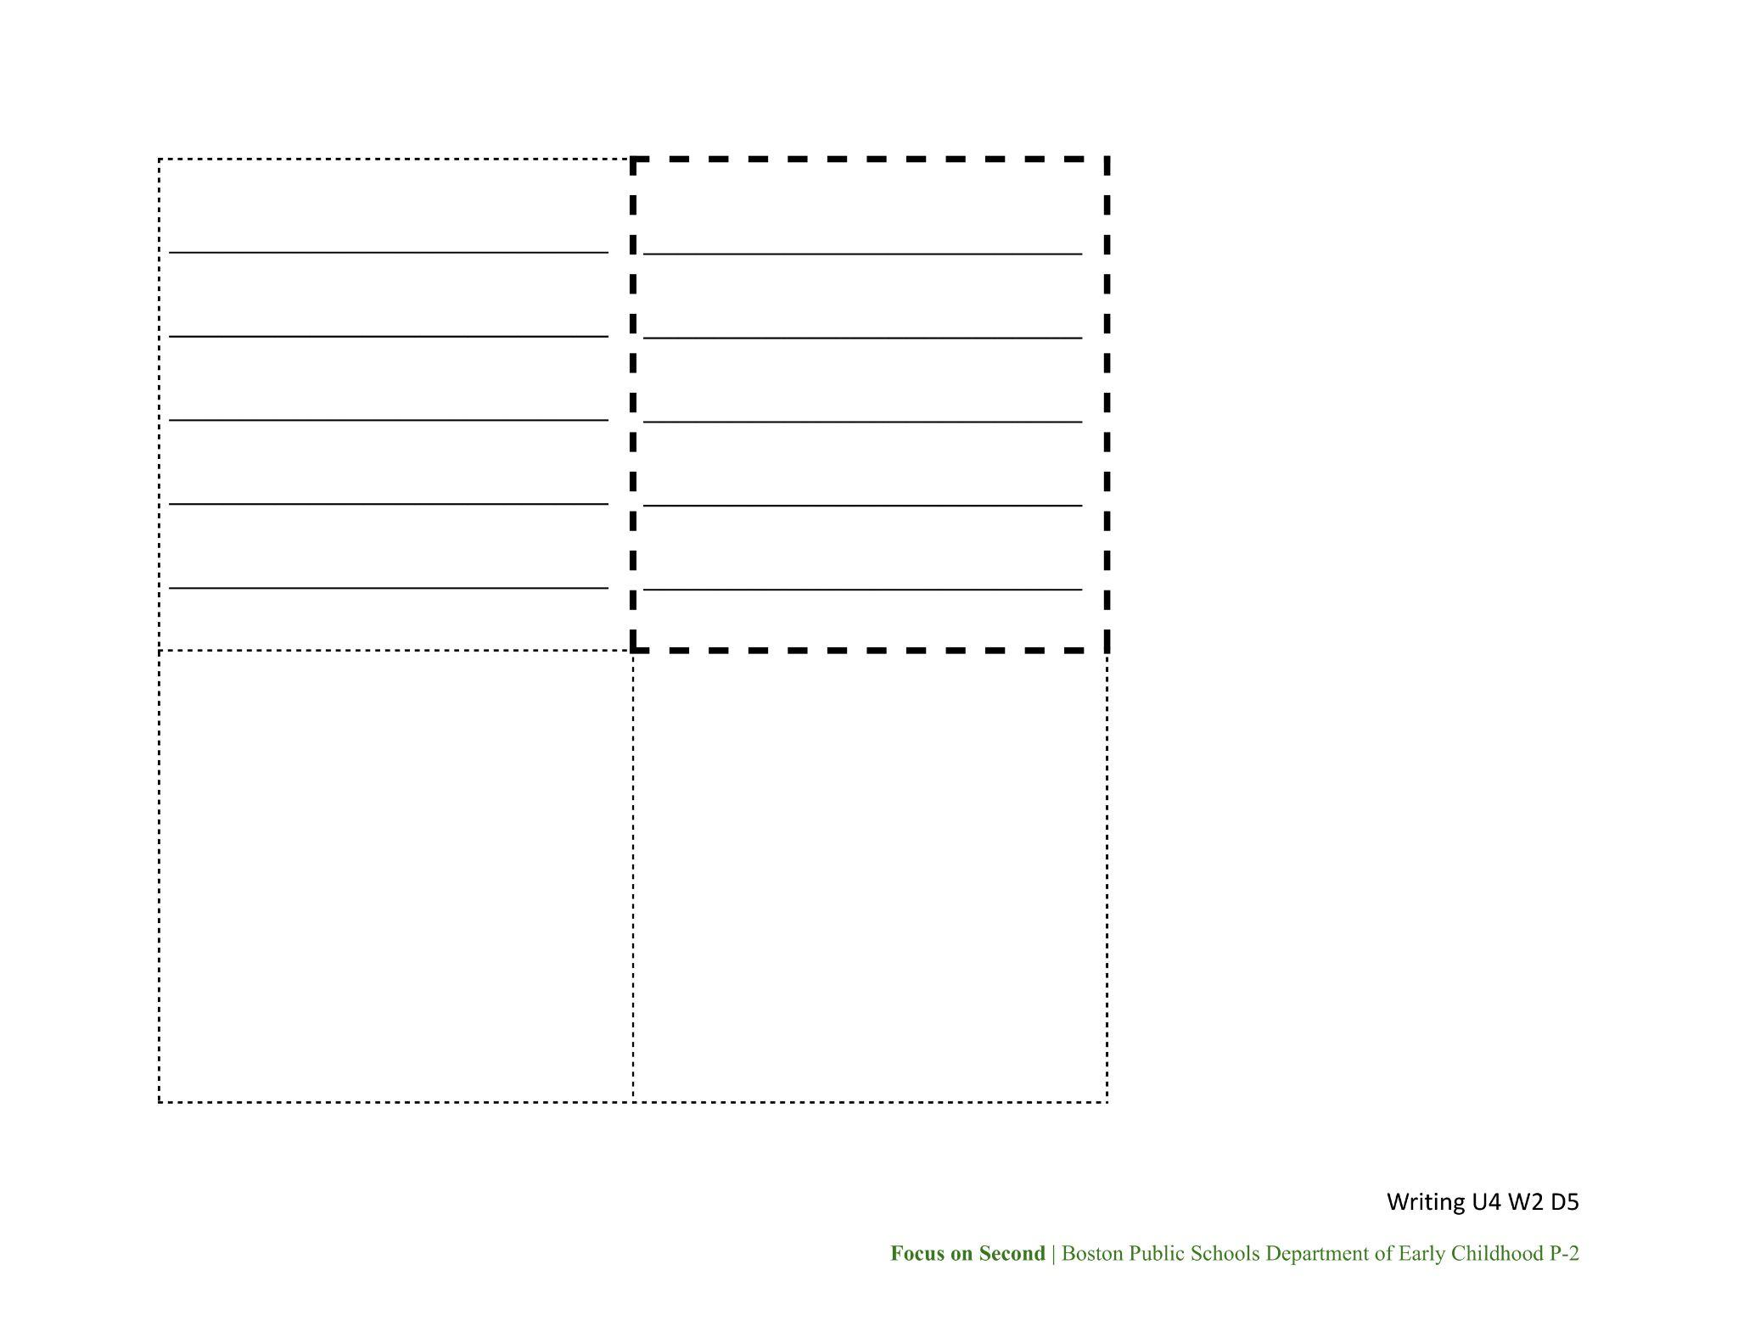
General Statement

Slide 3
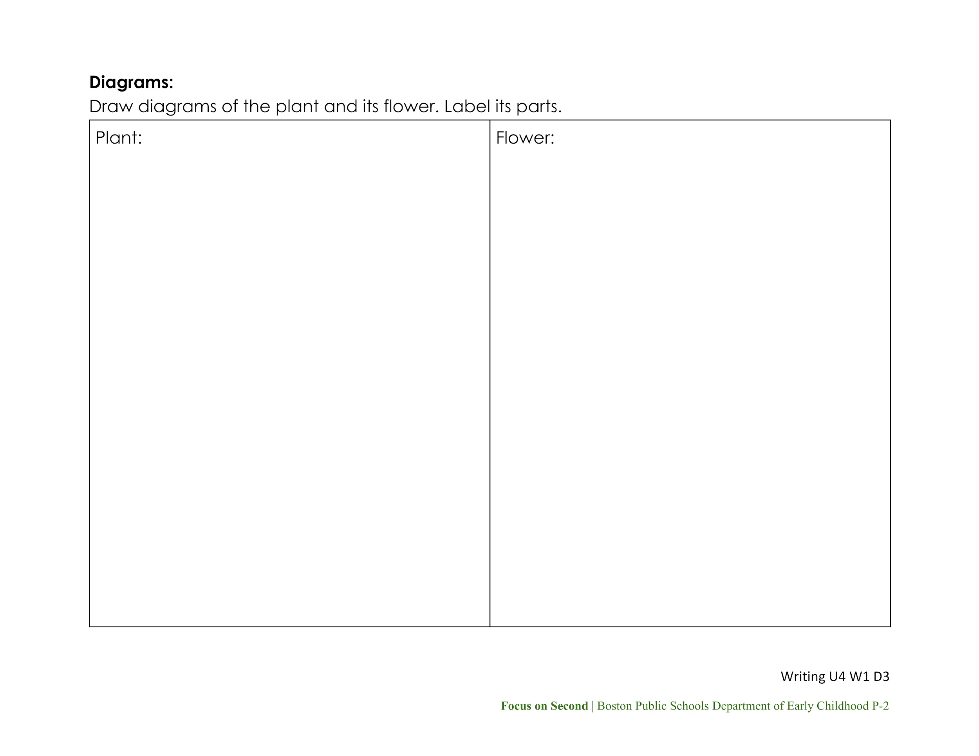

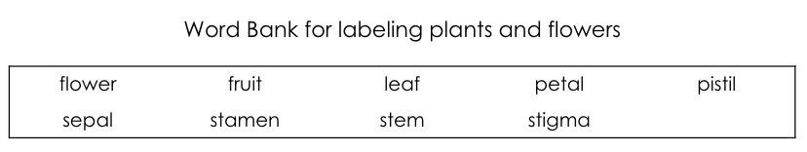
Draw Plant and Flower Diagrams
Review the Diagrams section of your Report Notes.
Look again at the images of your plant in the Plant and Flower Images packet.
Draw diagrams of your plant and its flower in the blank sections of your brochure pages.
Use the Plant and Flower Images Word Bank to help you label the parts.

Slide 4
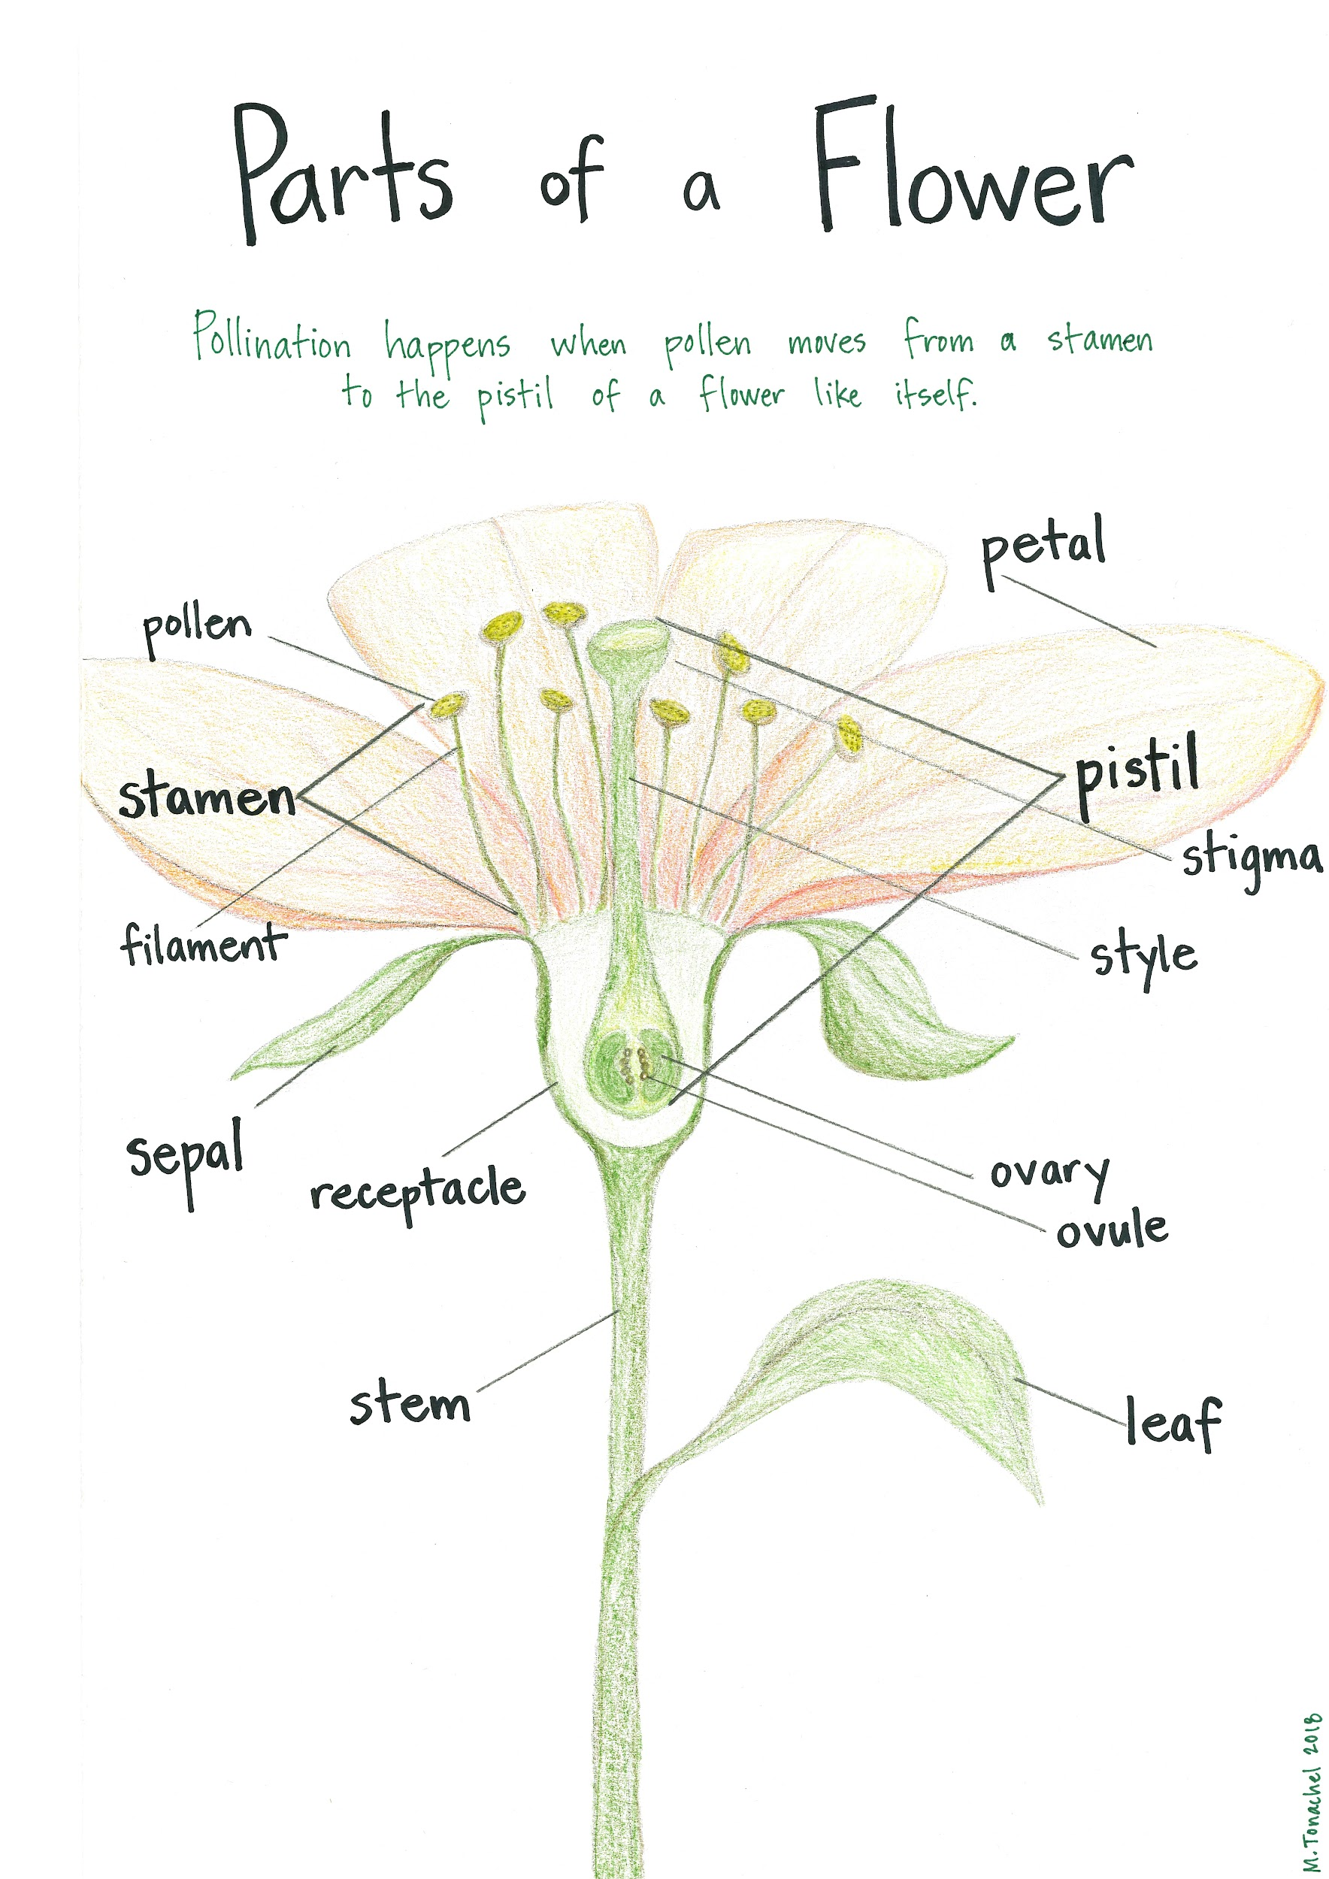


Resources
Remember, you can use these resources as you draw and label your plant and flower.

Slide 5
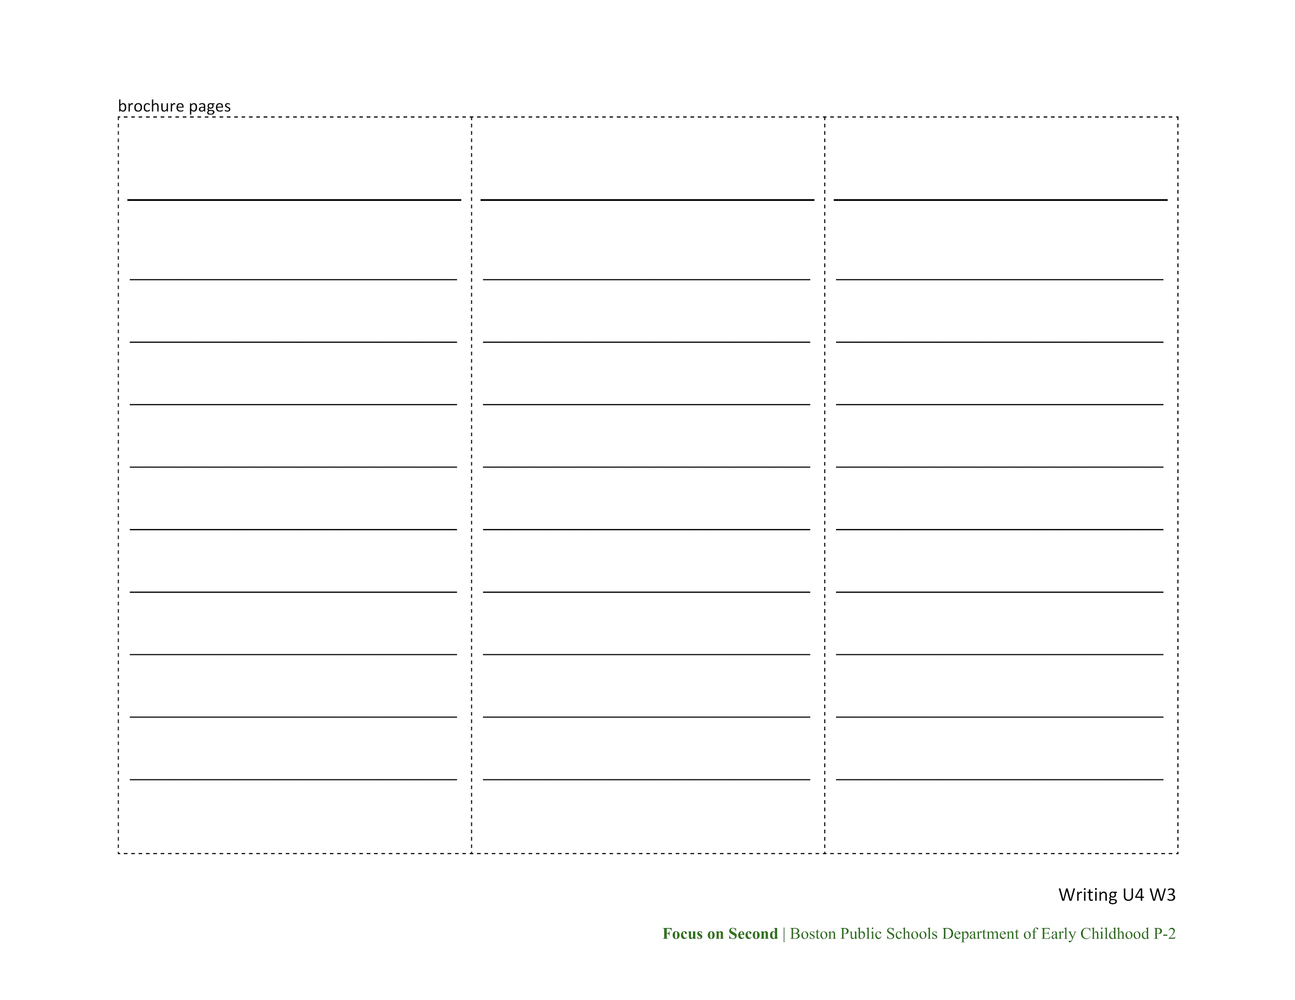
Write Report Subtopics
Go back to your subtopics. Is any information missing? If you missed something, you can add it now.
Don’t forget to:
include a heading with each subtopic
write in the third person
use general nouns
add information using adjectives

