Slide 1
Roots
Science and Engineering, Week 3, Lesson 2

Slide 2
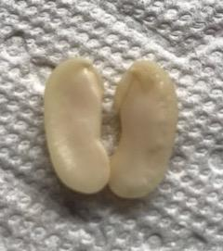
Inside a bean seed

Slide 3
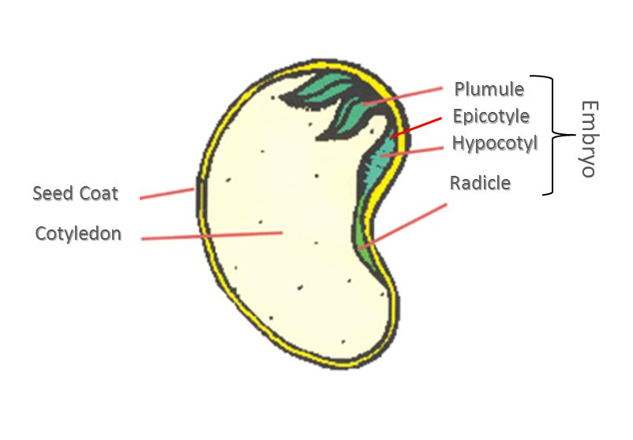

Slide 4
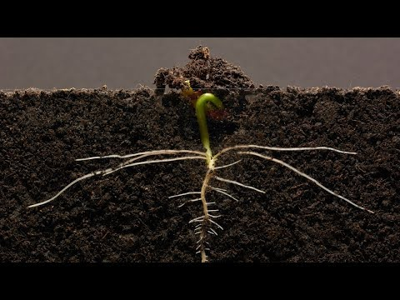

Slide 5
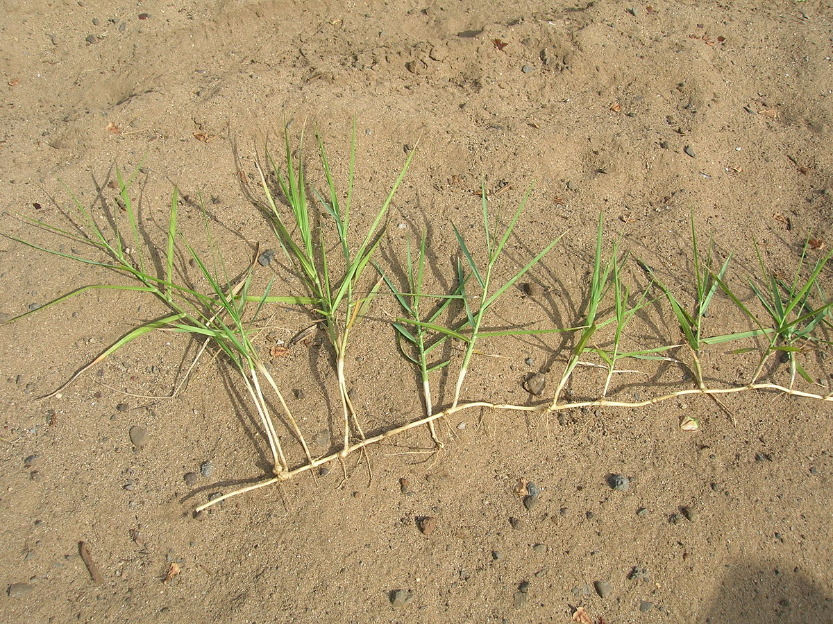

Slide 6
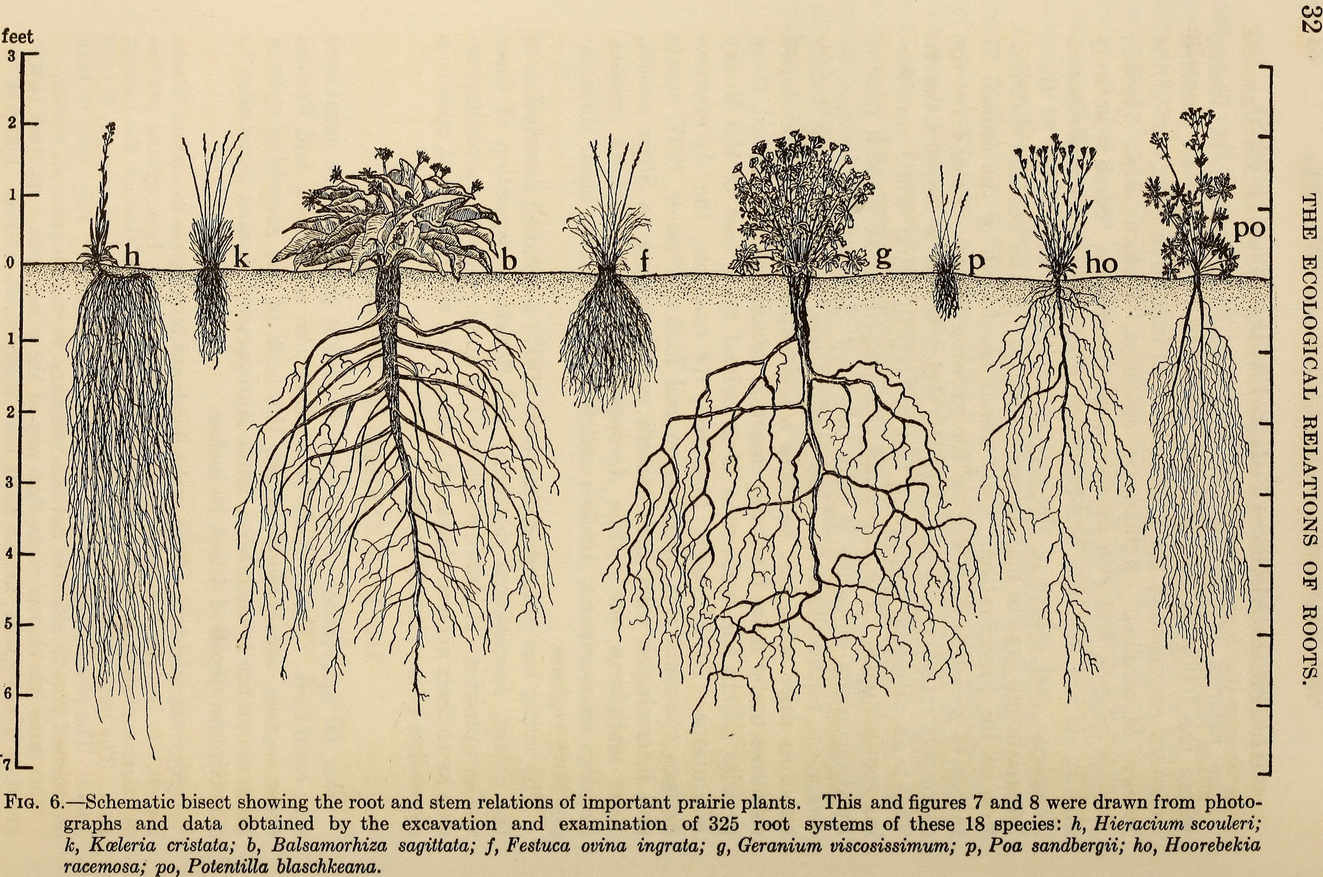

Slide 7
Citations
Slide 2: Photo: Ana Vaisenstein
Slide 3: http://slideplayer.com/slide/5661370/
Slide 4: https://www.youtube.com/watch?v=w77zPAtVTuI&t=2s
Slide 5: https://en.wikipedia.org/wiki/Panicum_repens
Slide 6: By Weaver, John E. (John Ernest), 1884-1966 [No restrictions], via Wikimedia Commons

