Slide 1
General Nouns
Vocabulary & Language Week 3, Days 3-4

Slide 2
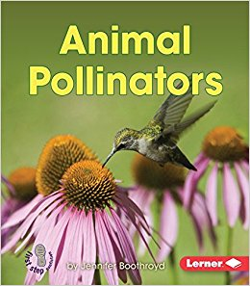

Slide 3
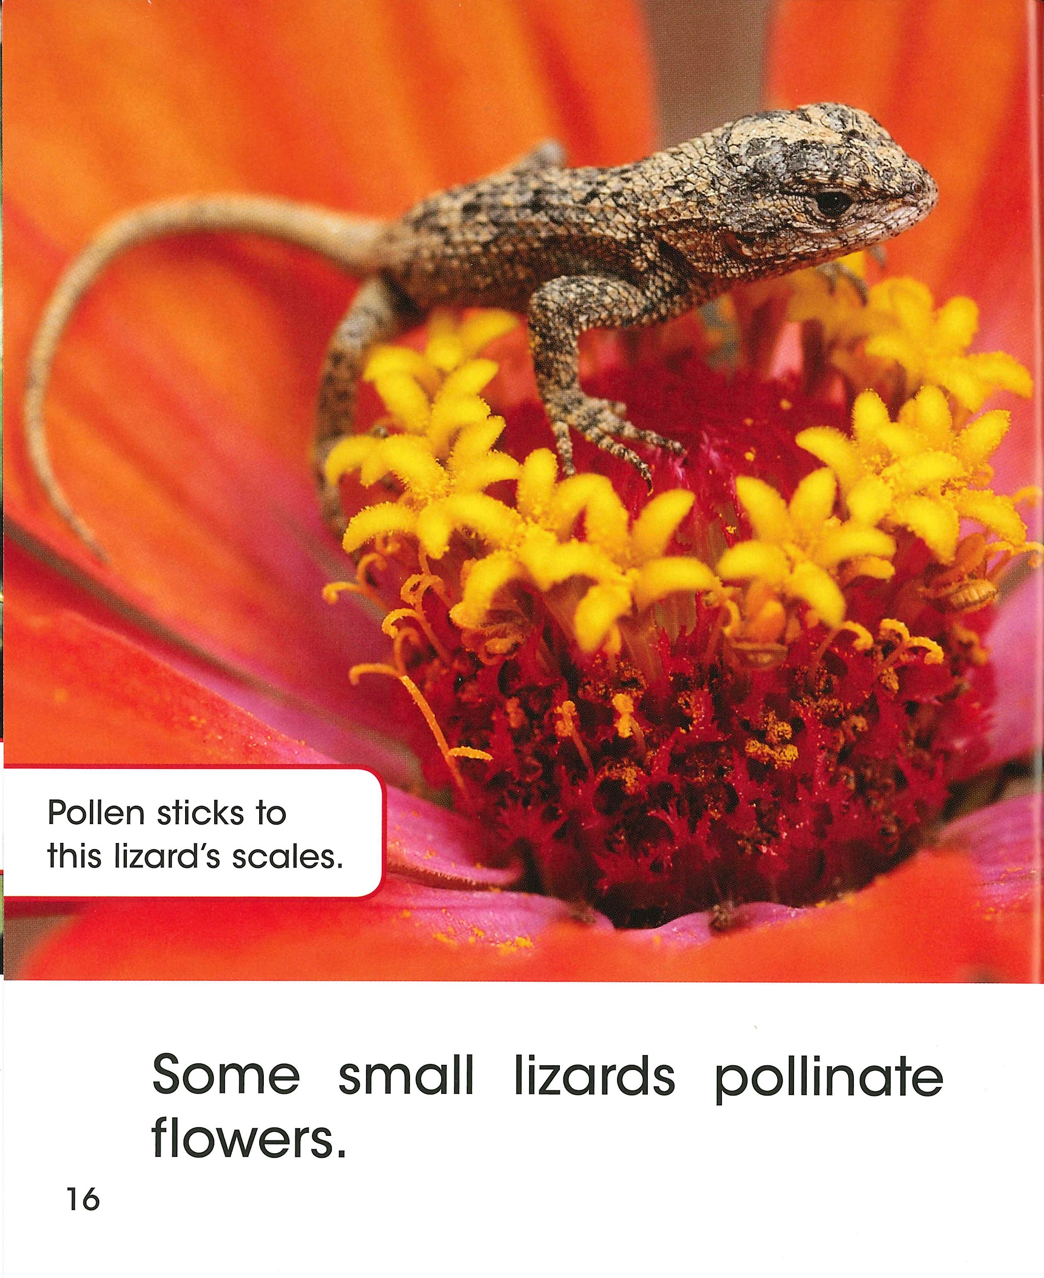
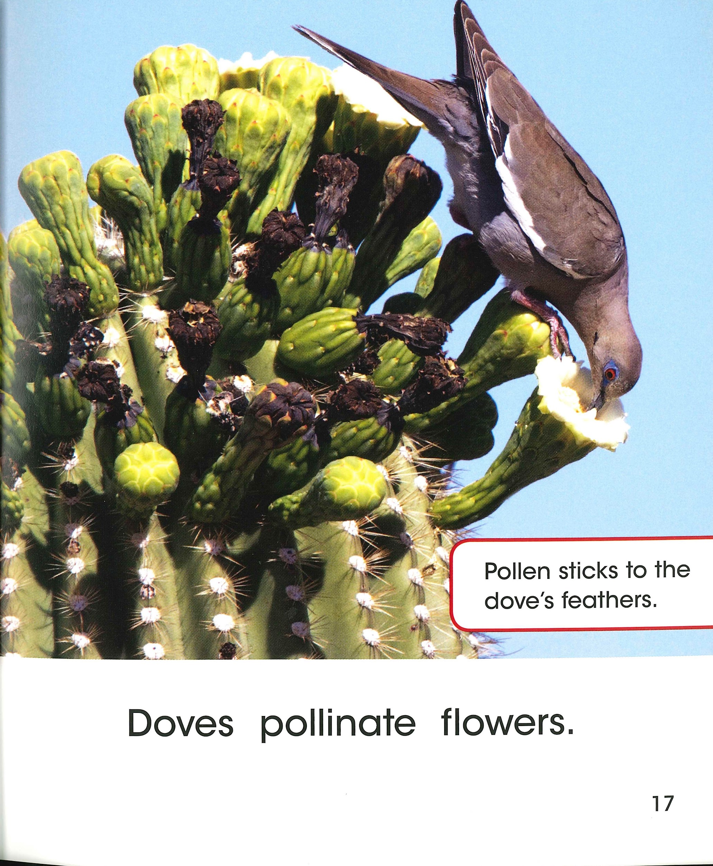

Slide 5
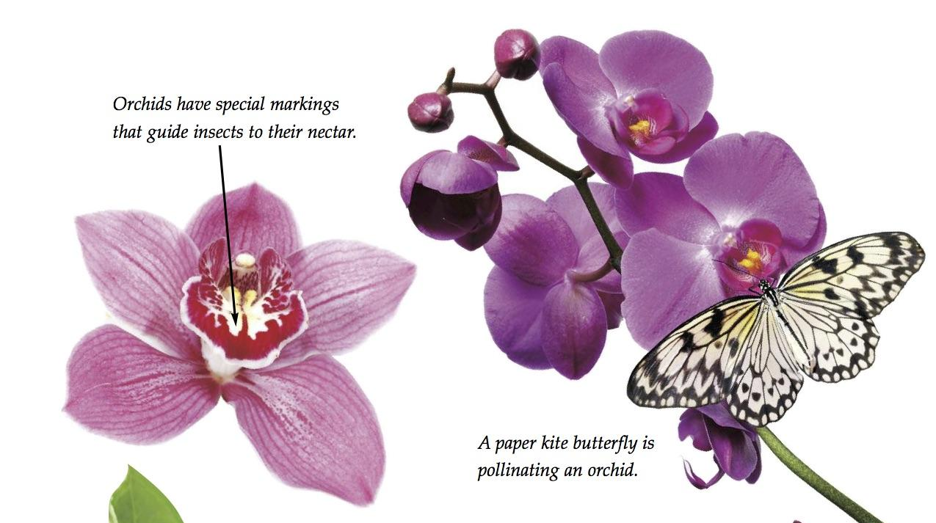

Slide 8
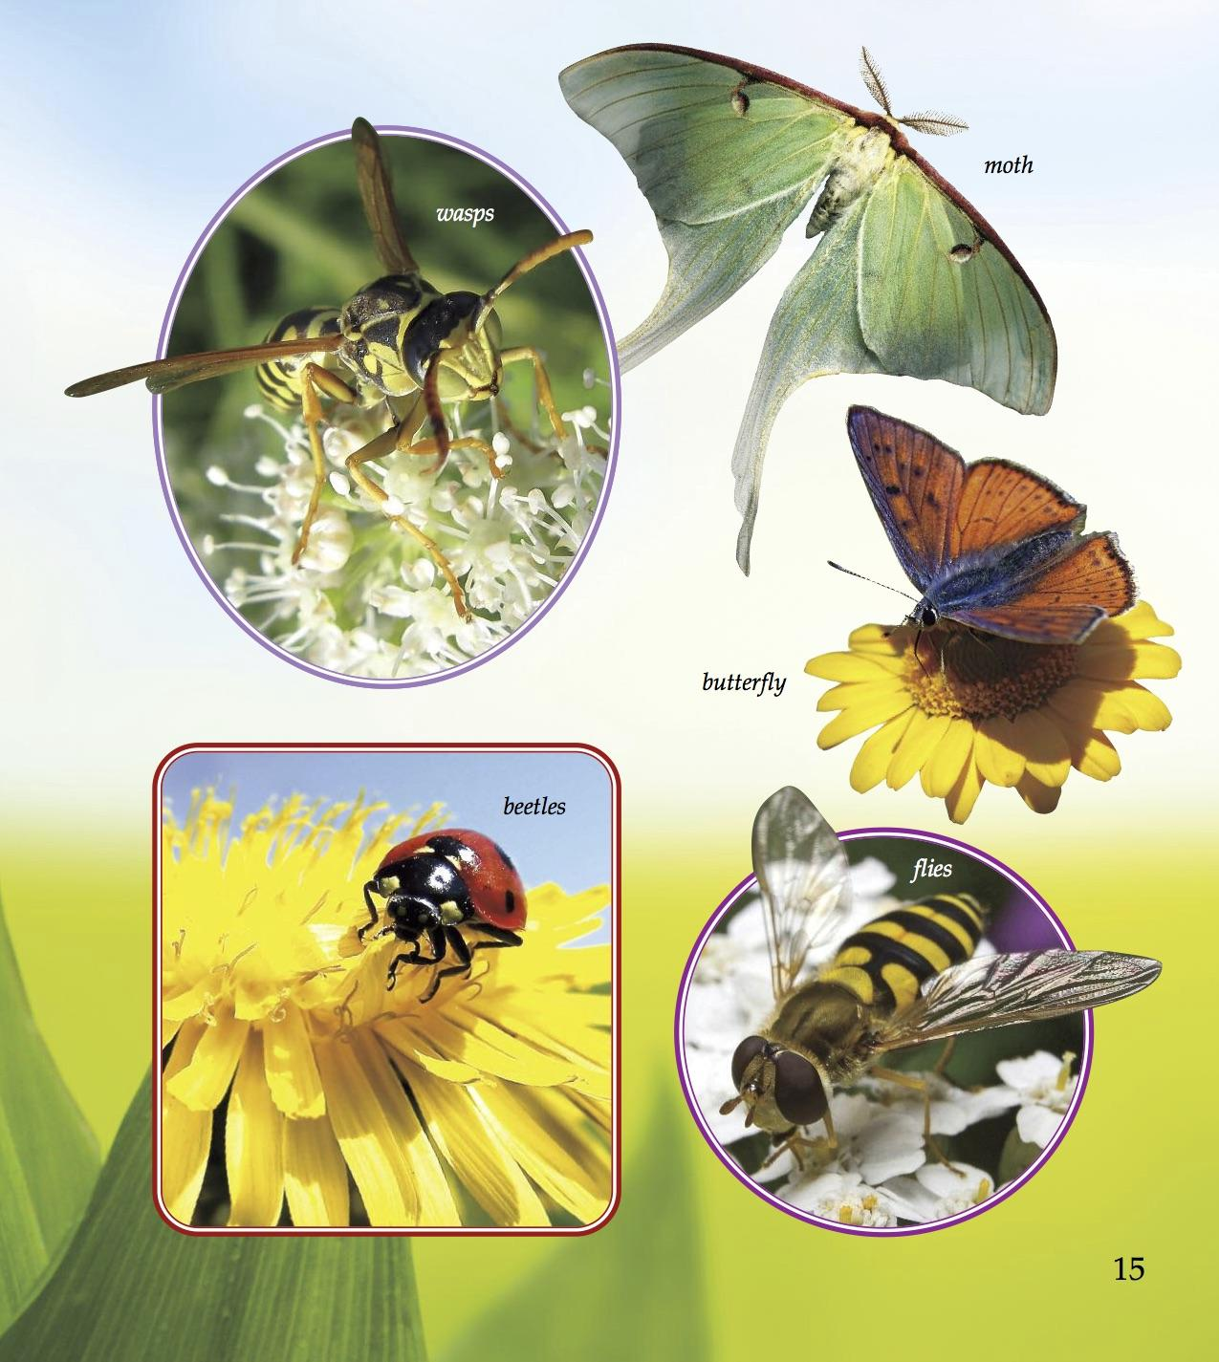
Look at the image from What is Pollination?
Choose one insect pollinator to write about.
Write one sentence that uses a general noun to give information about all of that insect pollinator.
Write another sentence that gives information about that particular insect pollinator in the photograph.

