Slide 1
Weekly Words
Unit 4, Week 3
Notes:
convert: to change into another form or state
flick: to move with a swift and jerky motion
groom (v): to make clean and neat in appearance
marking: a pattern of marks or coloring on a plant or animal
navigate: to find one’s way to, around, or through
pluck: to pick off
plunge: to push into something
wear out: to use until no longer useful

Slide 2
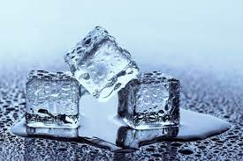
convert
verb
to change into another form or state
Notes:
convert (verb)
Elaboration:
In the process of melting, we can convert ice, a solid, into water, a liquid. How does this happen?
Think, Pair, Share prompt:
How can we convert a liquid back into a solid?
https://sciencing.com/ice-cubes-melting-process-5415212.html

Slide 3
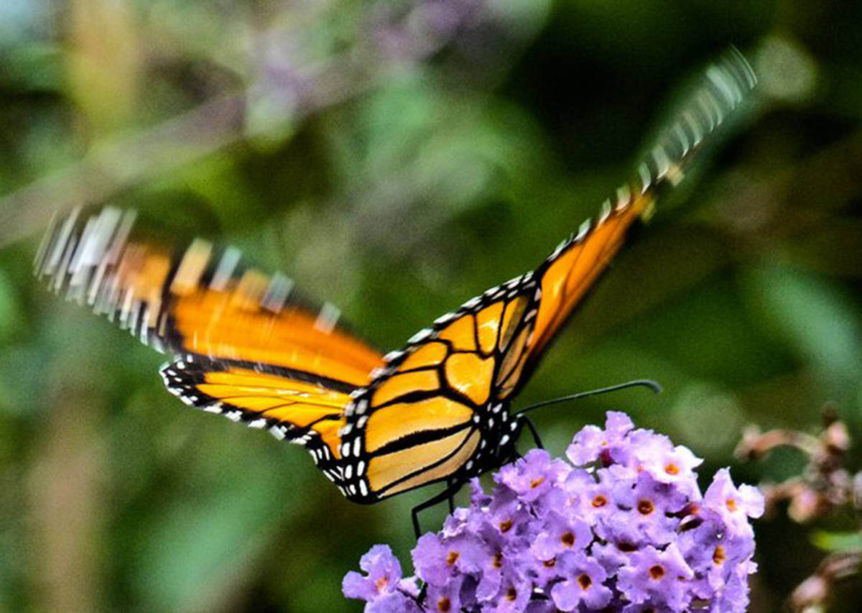
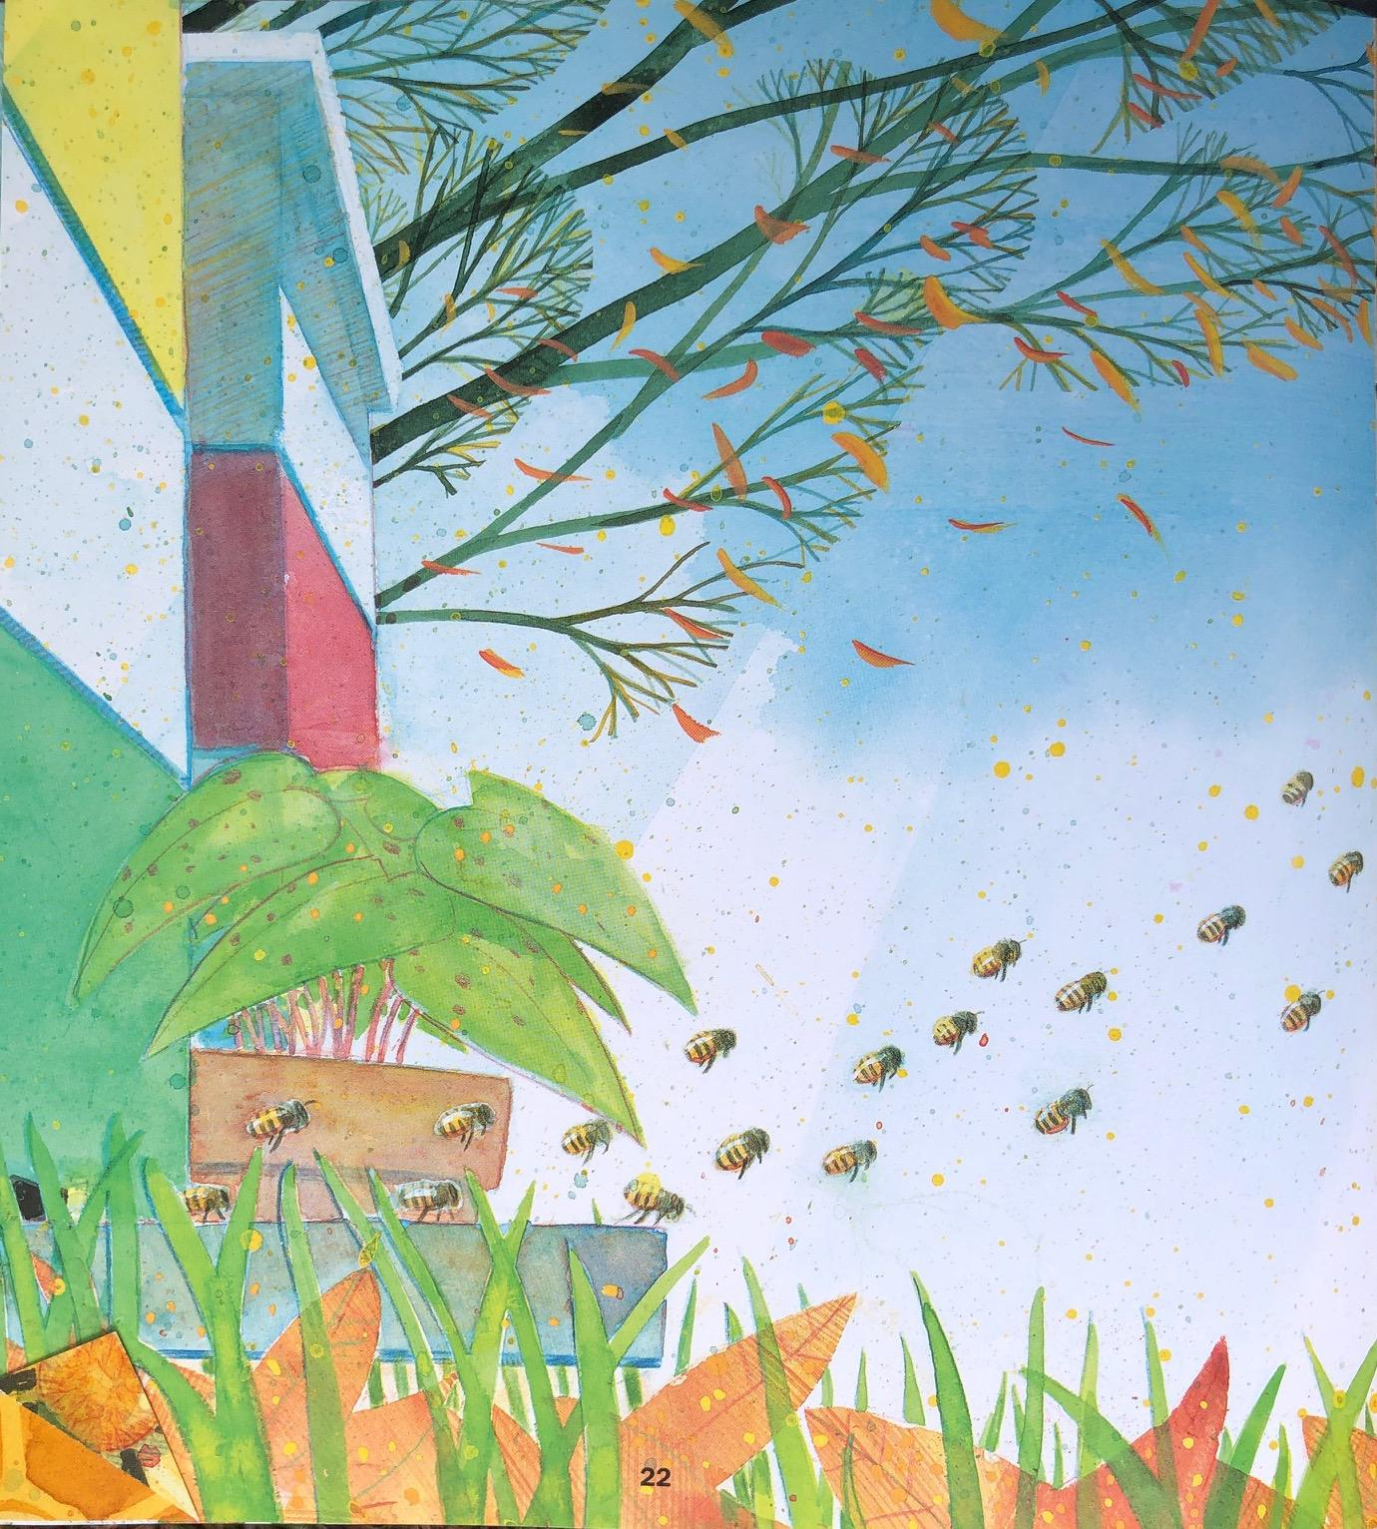
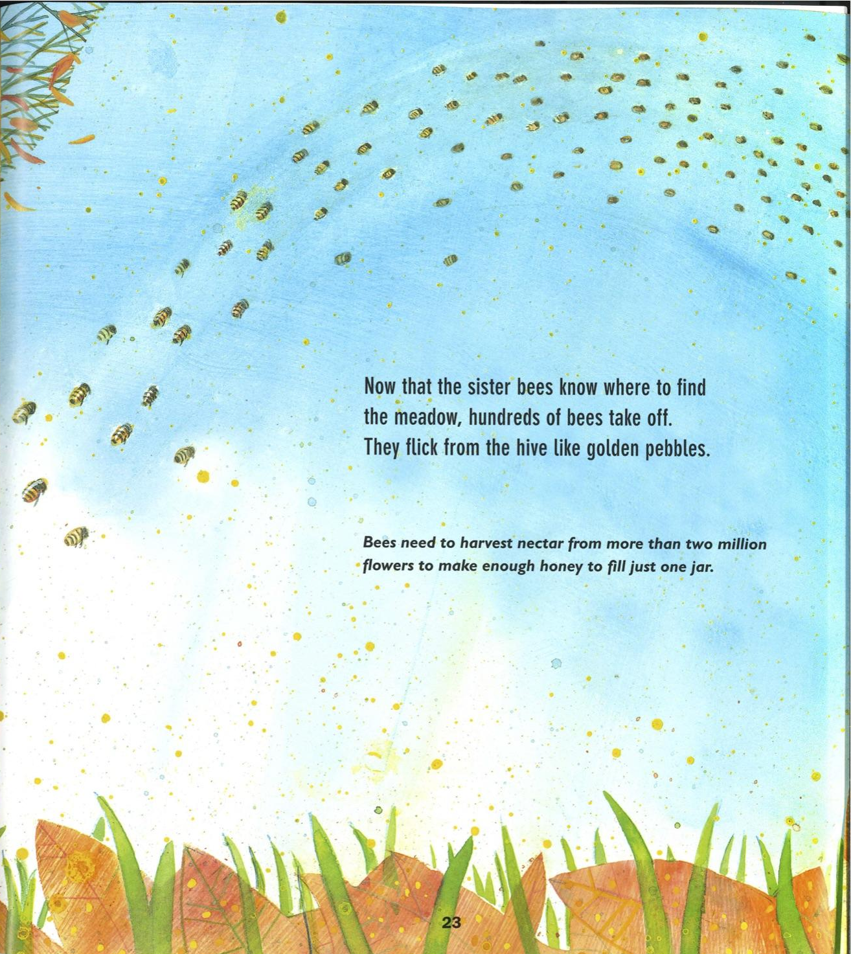
flick
verb
to move with a swift and jerky motion
Notes:
flick (verb)
Elaboration:
In Flight of the Honey Bee the bees “flick from the hive like golden pebbles.” This is figurative language, used to describe something poetically.
Show the illustrations on pages 17-18, and discuss what this language means.
Think, Pair, Share prompt:
You can flick a crumb off the table with your fingers. Turn to your partner and pretend to flick something off their shoulder. As you do, say, “I’m flicking a _____ off your shoulder!”
https://www.cranbrooktownsman.com/opinion/a-butterfly-flaps-its-wings-blows-up-a-rumour/, from Raymond Huber and Brian Lovelock, Flight of the Honey Bee

Slide 4
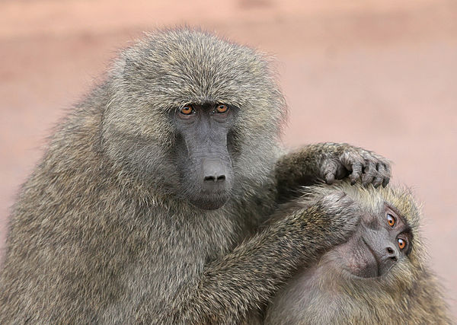
groom
verb
to make clean and neat in appearance
Notes:
groom (verb)
Elaboration:
Monkeys are known to groom each other. They might comb each other’s hair with their fingers, lick each other, pluck off bits of plants or bugs. Grooming is a way for them to keep each other clean, and also a way to connect with each other.
Think, Pair, Share prompt:
What are some things you do to groom yourself? Is there anyone who grooms you? What do they do?
https://en.wikipedia.org/wiki/Social_grooming

Slide 5
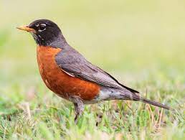
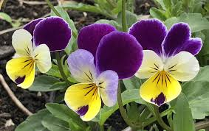
marking
noun
a pattern or marks or coloring on a plant or animal
Notes:
marking (noun)
Elaboration:
Many people recognize the red breast feathers of a robin. These markings help us identify what kind of bird it is.
Think, Pair, Share prompt:
These flowers are called Johnny Jump Ups. They are a species of flower that comes up early in the Spring. They might be planted in gardens or growing as wildflowers.
Talk with your partner to describe the Johnny Jump Ups’ markings.
https://en.wikipedia.org/wiki/American_robin, https://www.hometownseeds.com/products/johnny-jump-ups-viola-perennial-seeds

Slide 6
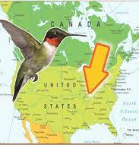
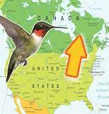
navigate
verb
to find one’s way to, around, or through
Notes:
navigate (verb)
Elaboration:
Each Fall, ruby throated hummingbirds migrate south, and each Spring, they migrate north again. They navigate from one place to another without using maps or GPS or asking for directions!
Think, Pair, Share prompt:
What is one question you have about how birds or other pollinators navigate the route from one place to another?
https://empressofdirt.net/fall-hummingbird-migration/

Slide 7
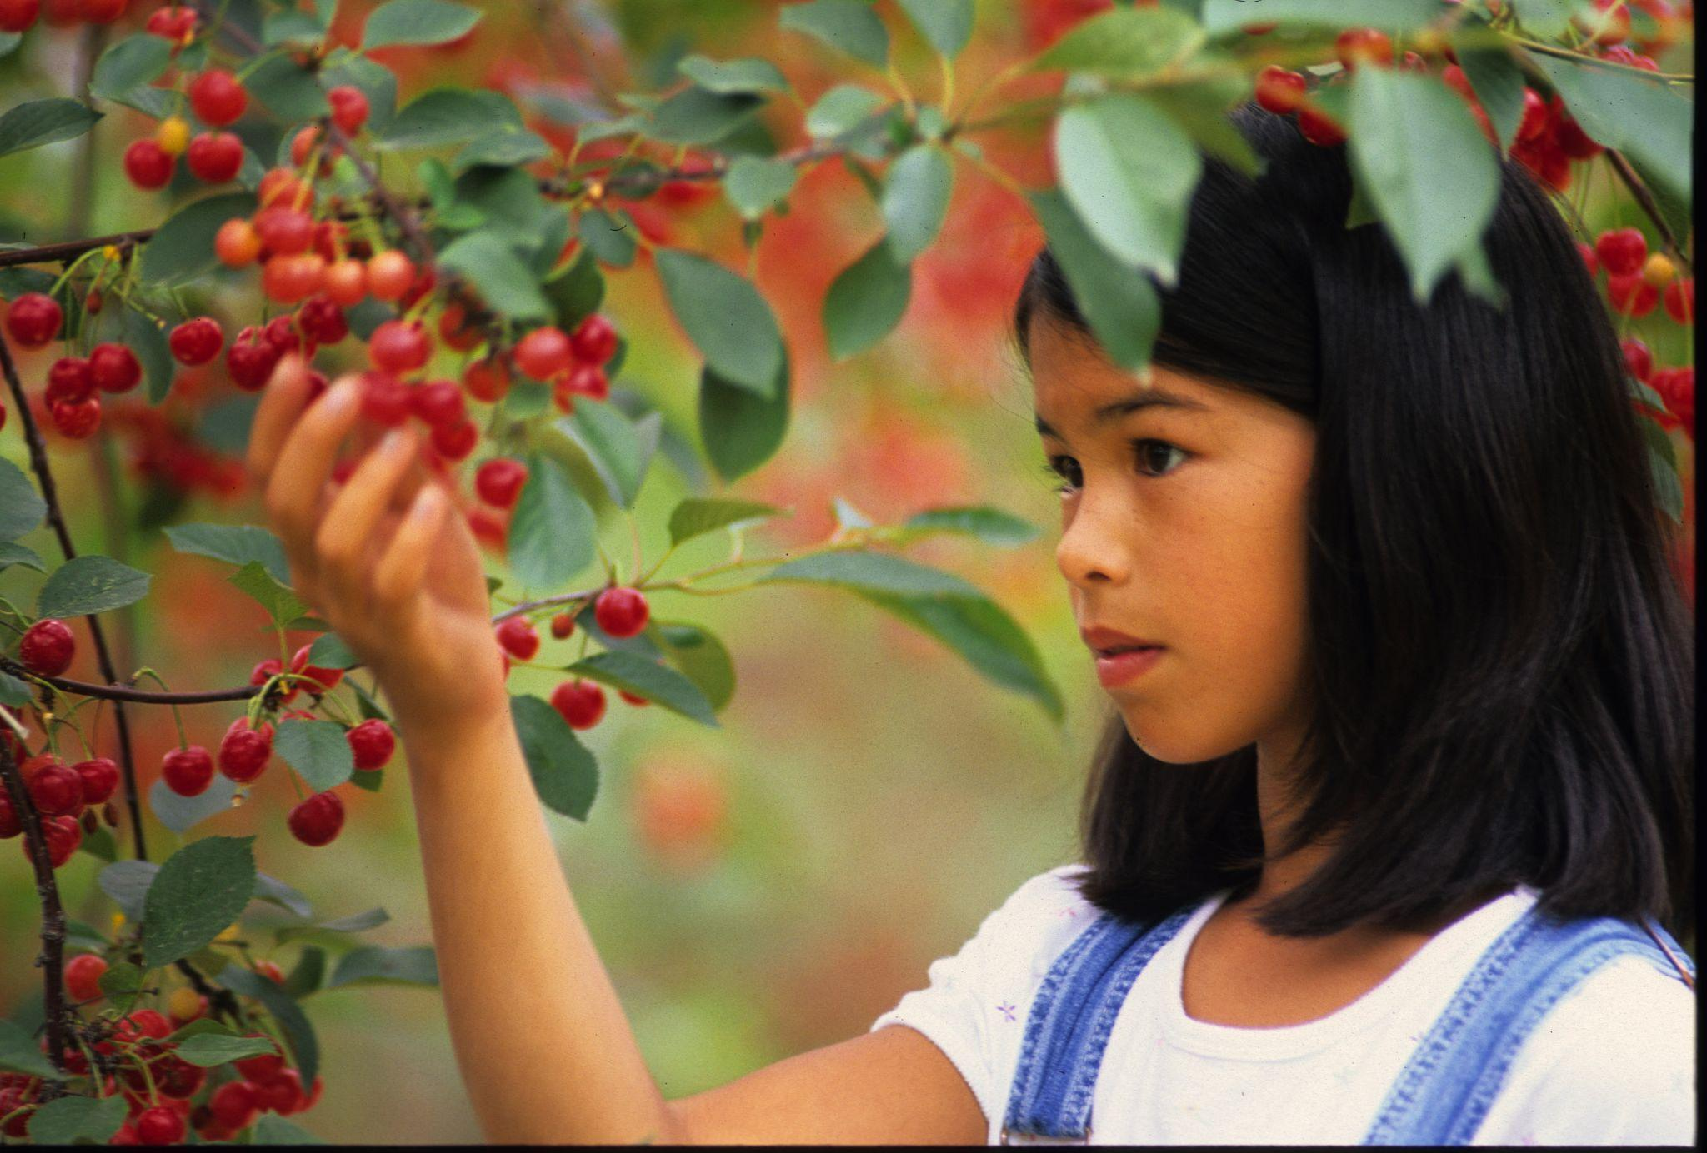
pluck
verb
to pick off
Notes:
pluck (verb)
Elaboration:
This person is plucking cherries right off the tree branches. Then maybe she’ll put them in a basket or pop them right into her mouth!
Think, Pair, Share prompt:
Finish this sentence: I would like to pluck some _____ right off a _____!
https://mikelovestc.wordpress.com/tag/cherries/

Slide 8
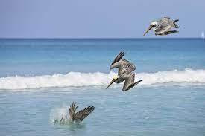
plunge
verb
to push into something
Notes:
plunge (verb)
Elaboration:
A hummingbird plunges its beak into a flower.
Pelicans are large birds that eat fish. To get the fish, they plunge headfirst directly into the water!
Think, Pair, Share prompt:
Have you ever plunged your head underwater in the bathtub? How did that feel?
Imagine plunging your hands into a bucket of ice water. How would that feel?
https://www.thoughtco.com/facts-about-pelicans-130588

Slide 9
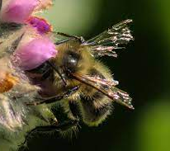
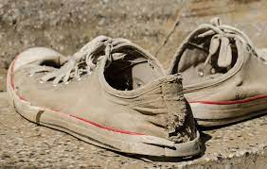
wear out
verb
to use until no longer useful
Notes:
wear out (verb)
Elaboration:
We used an expression like this when we talked about erosion: wind and water wear away land.
To wear out means to use something until it is no longer useful. Bees’ wings wear out after flying for around 500 miles.
Think, Pair, Share prompt:
What are some signs that these sneakers are worn out?
https://www.honeybeesuite.com/diaphanous-wings-they-soar/, https://www.physioinqpenrith.com.au/blog/worn-out-shoes-cause-back-knee-pain

