Slide 1
Nouns and Adjectives
Writing Unit 4 Week 2 Day 3

Slide 2
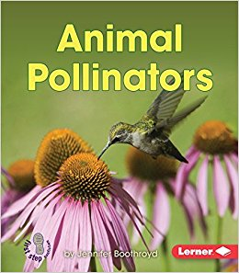
Report Language: General Nouns

Slide 3
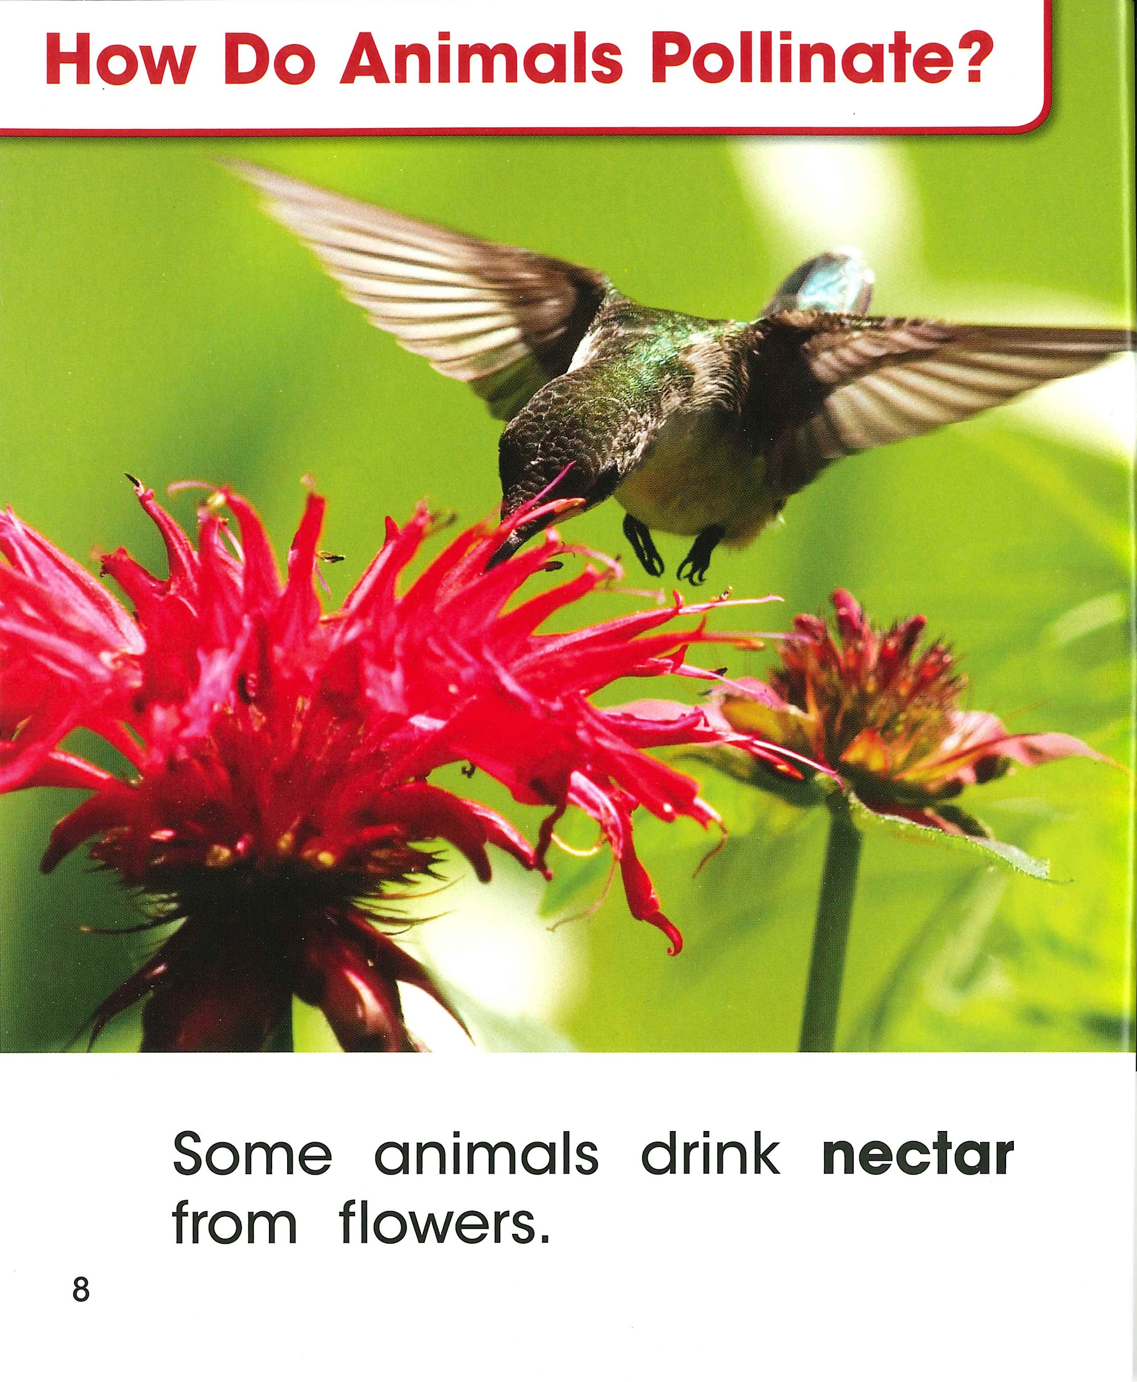
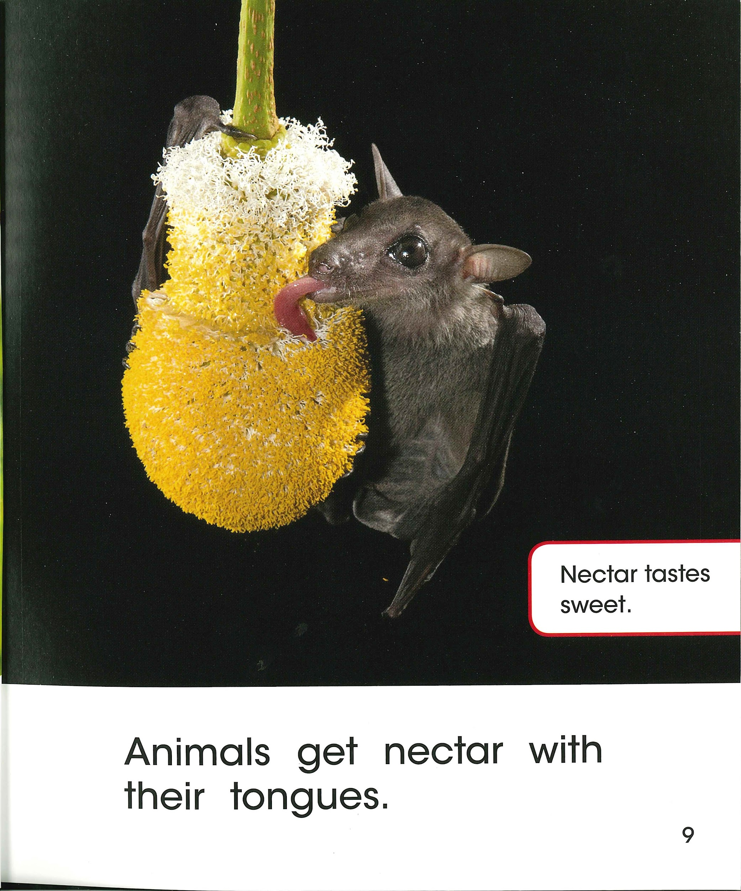

Slide 5
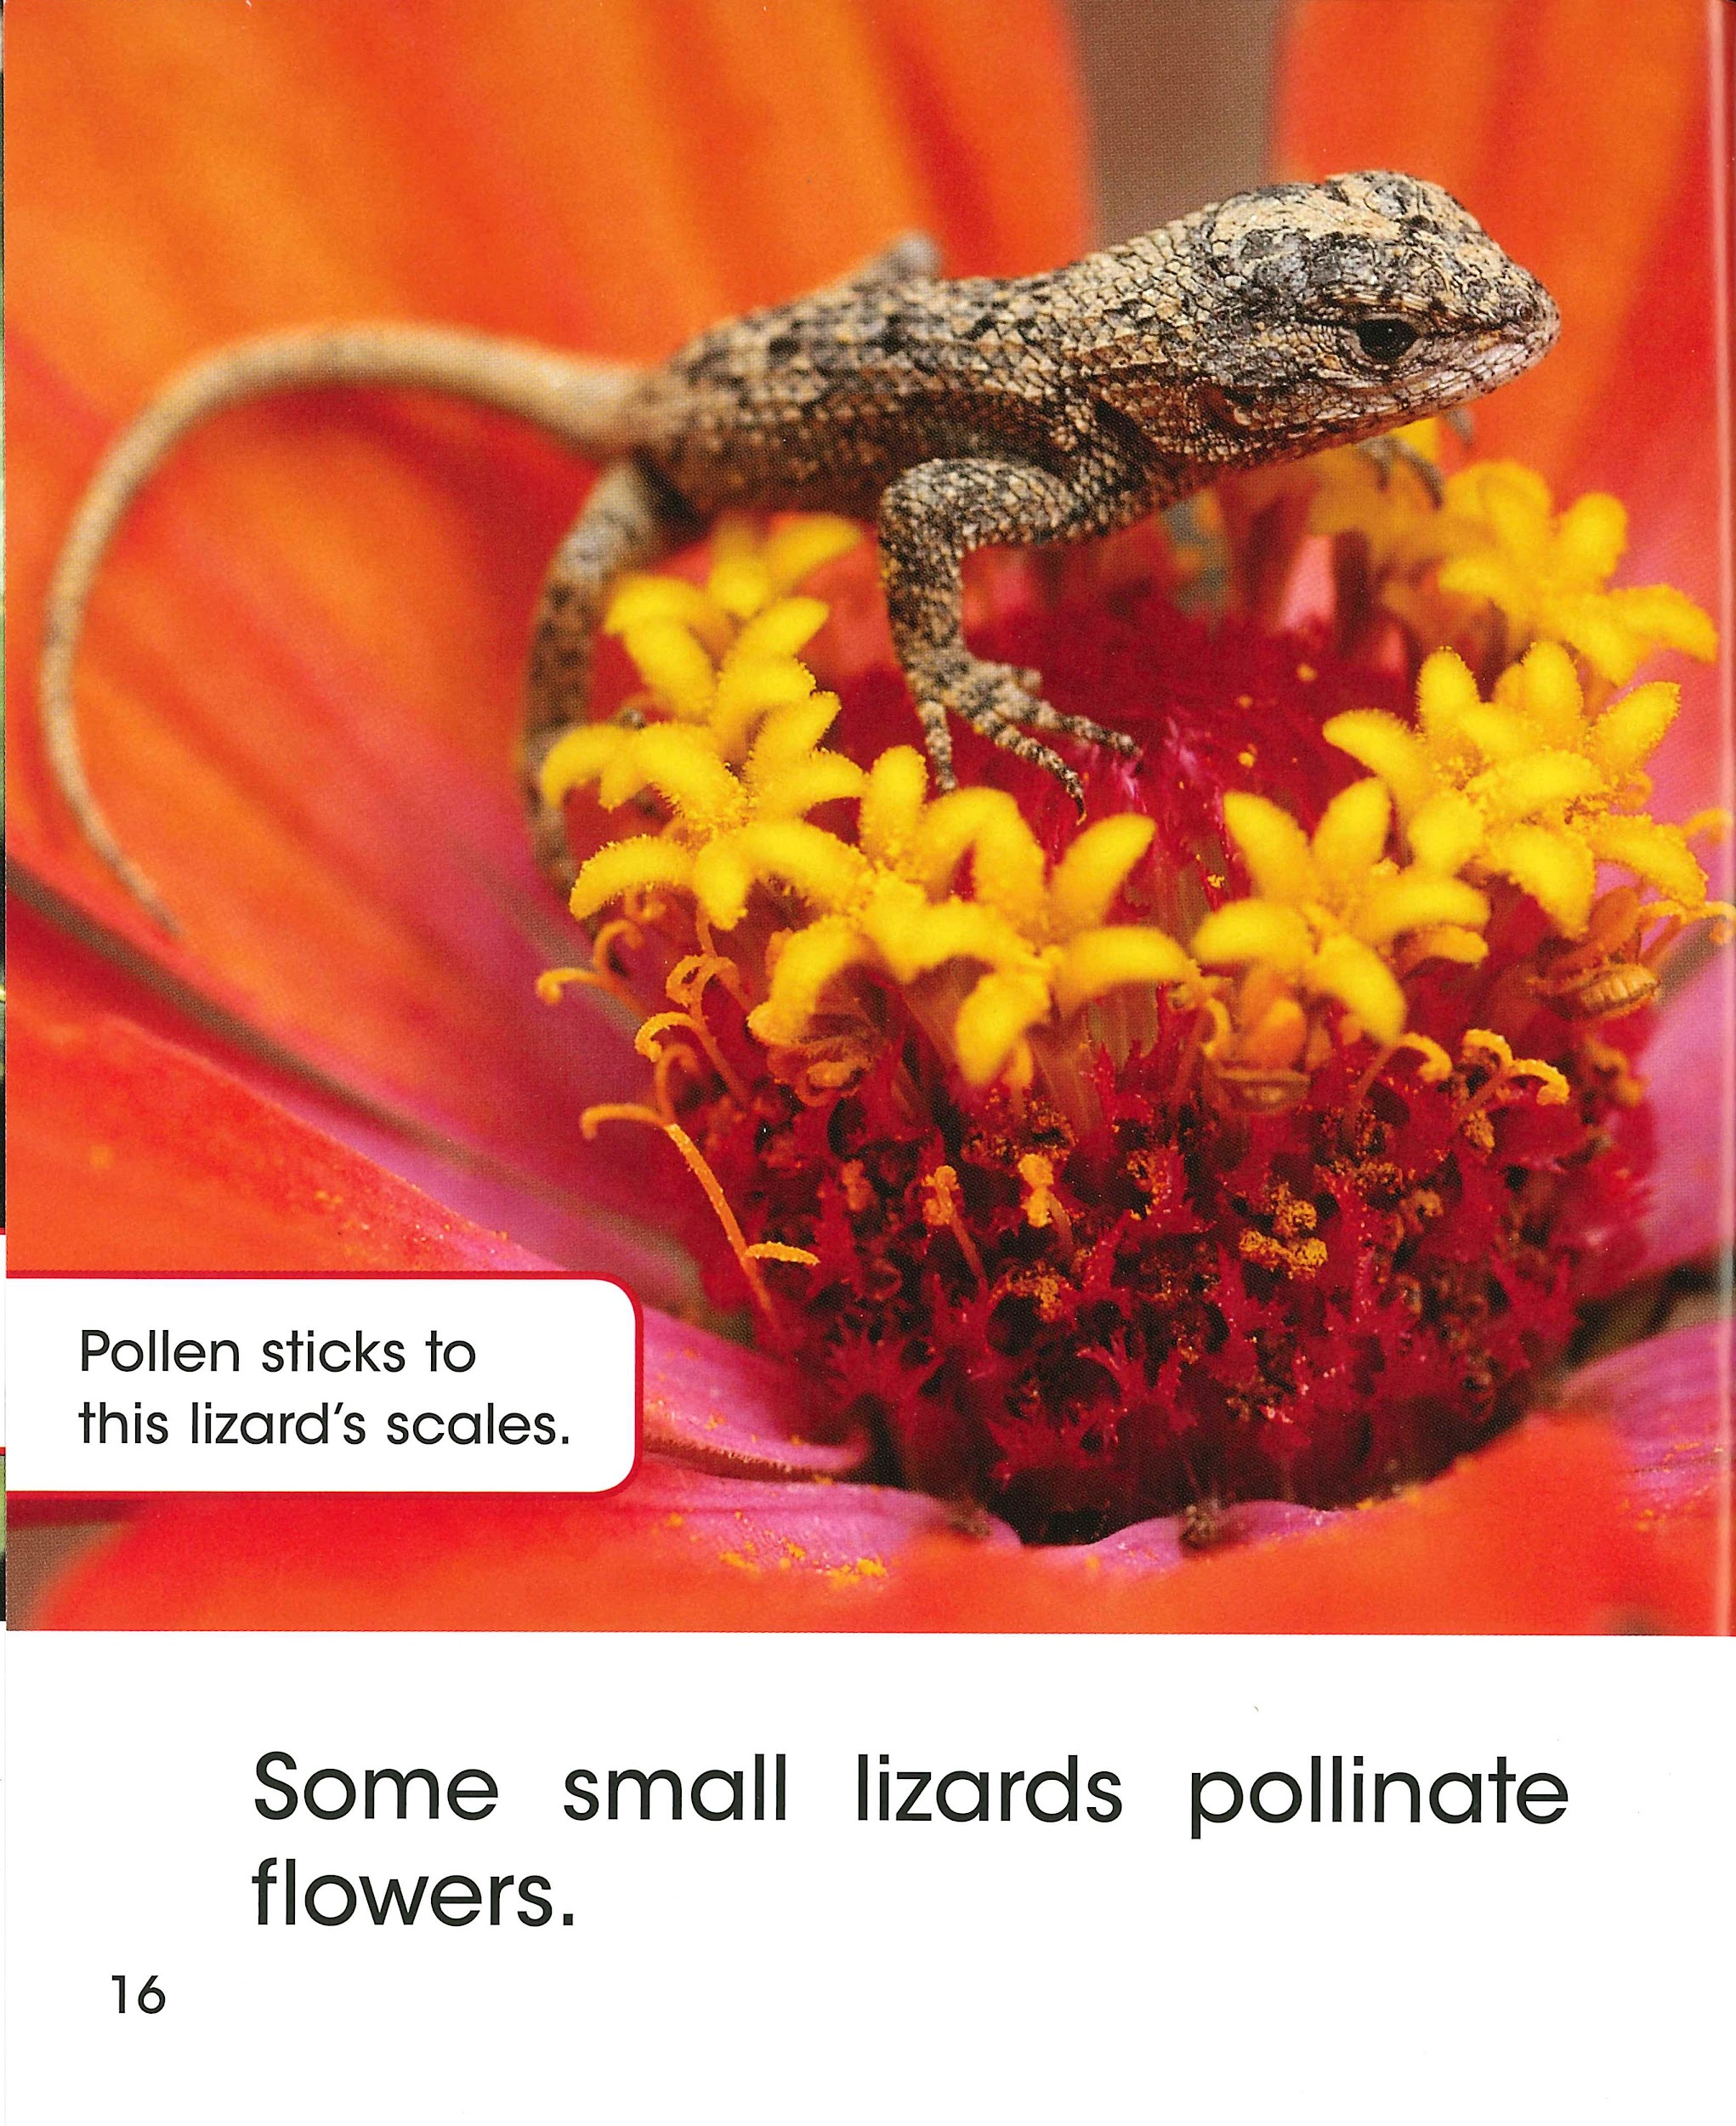
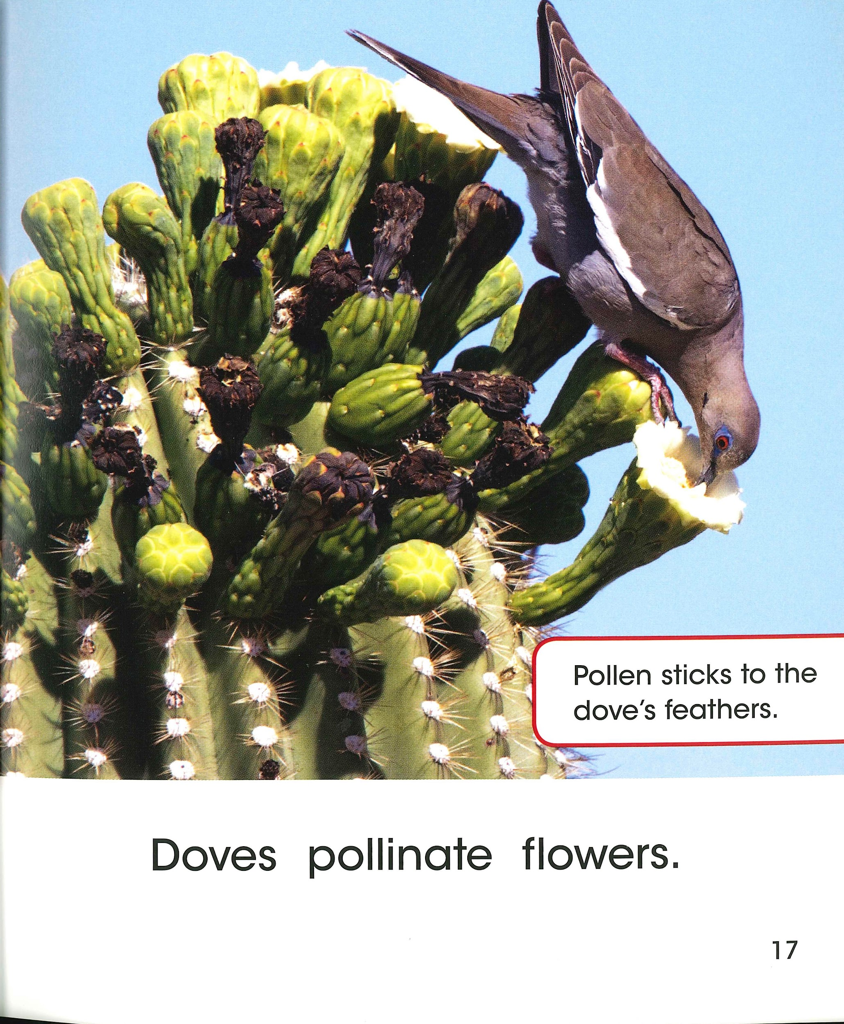

Slide 7
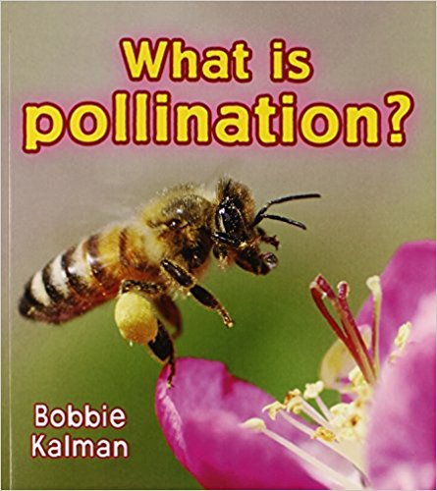
Report Language: Adjectives

Slide 8
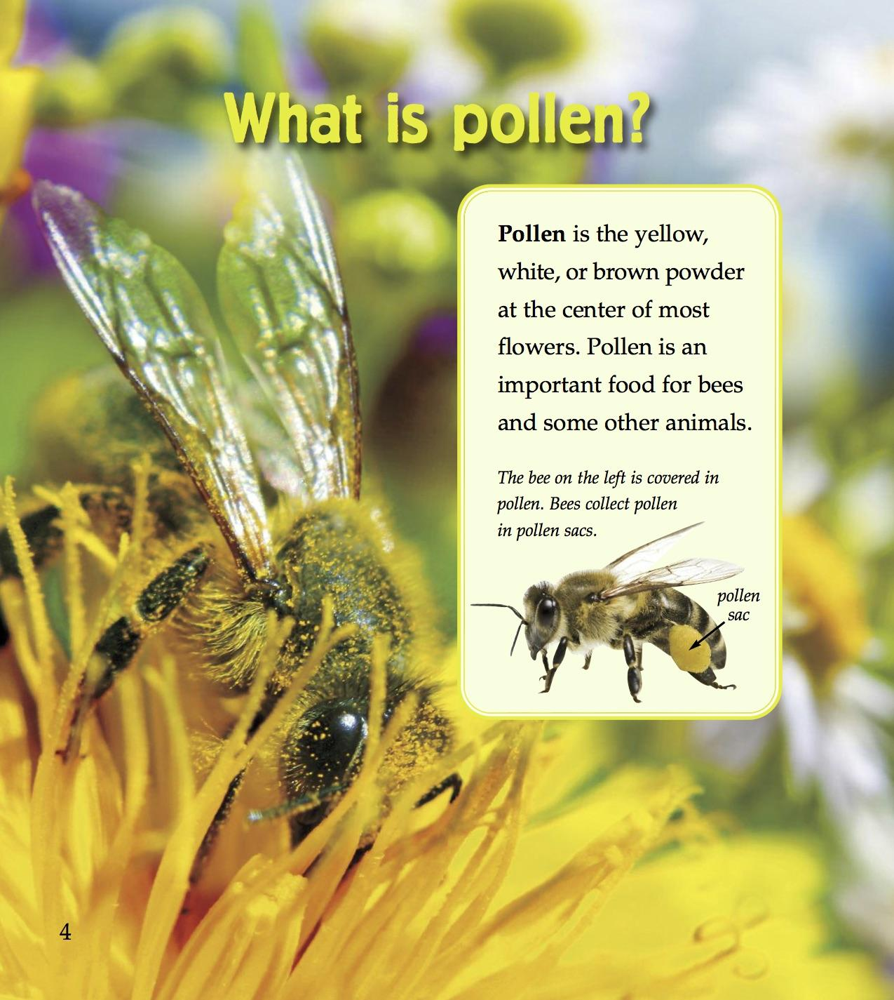
Pollen is an important food for bees and some other animals.

Slide 9
Pollen is an important food for bees and some other animals.

Slide 10
Remember, adjectives describe the nouns. They answer these questions:
Which ones? Whose?
How many?
What like?
What kind?

Slide 11
food
What like?
important
Which ones? Whose?
for bees and some other animals

Slide 12
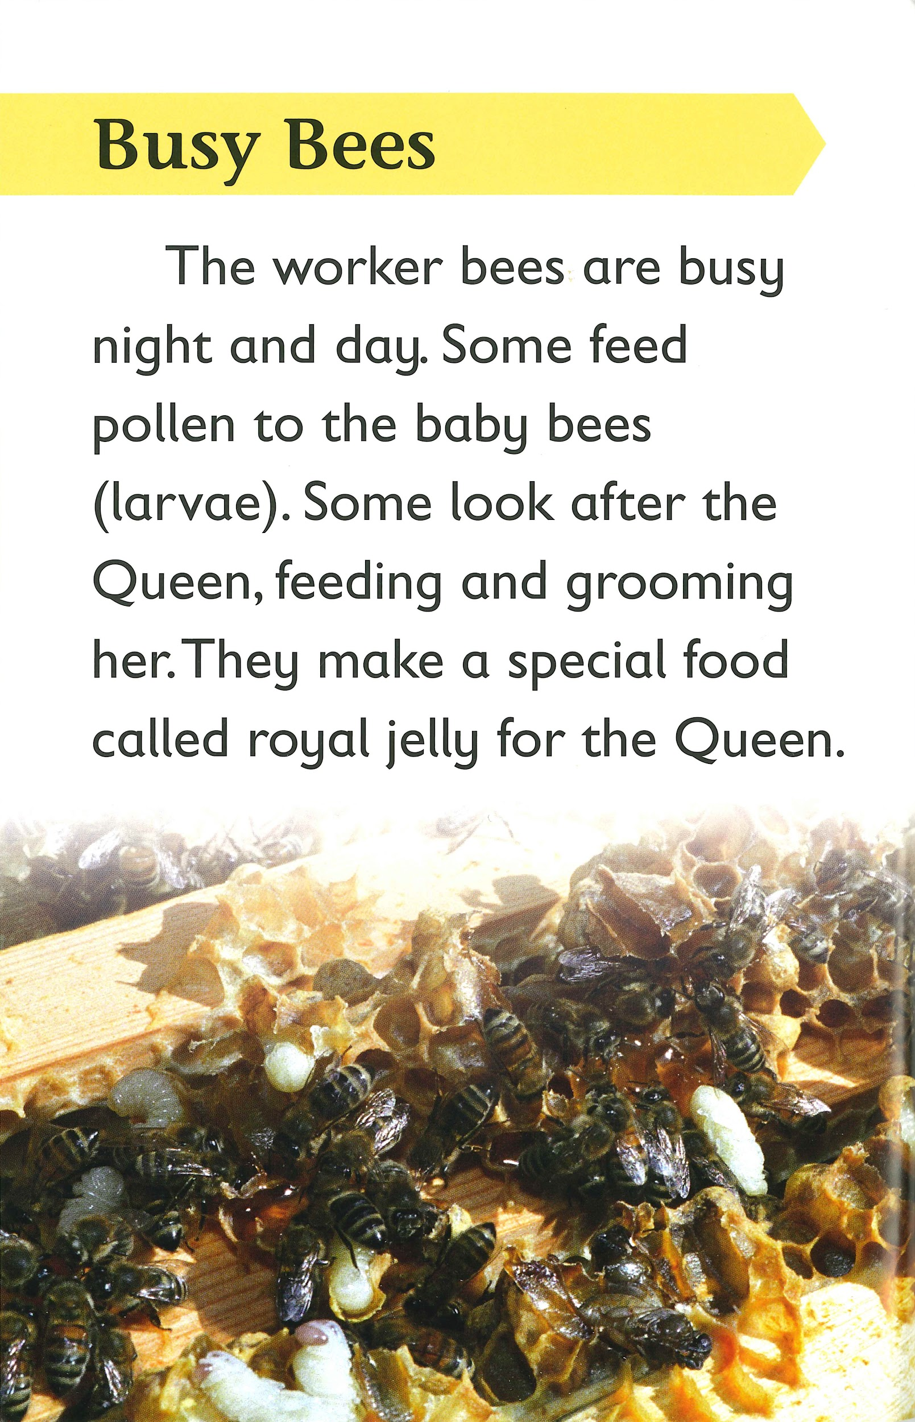
The worker bees are busy night and day.

Slide 13
The worker bees are busy night and day.
bees
What kind?
worker

Slide 14
Your turn!
Review your research notes.
Write one sentence that gives information about your plant.
Make sure you use the language of report.
Write in the third person to show that you are an expert.
Use general nouns.
Pack information into your sentence using at least one adjective.

