Slide 1
Root Words
Vocabulary & Language Week 1, Days 3-4

Slide 2
container

Slide 3
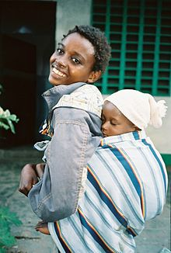
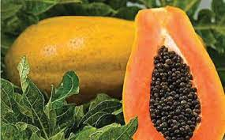
contain
verb
to hold within
Notes:
http://tehelka.com/papaya-seeds-are-magical/, https://en.wikipedia.org/wiki/Baby_sling

Slide 4
container

Slide 5
landing

Slide 6
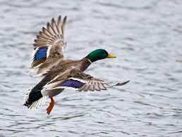
land
verb
to arrive on the ground or other surface
Notes:
https://commons.wikimedia.org/wiki/File:Landing_mallard.jpg

Slide 7
landing

Slide 8
Right now my thoughts are scattered.

Slide 9
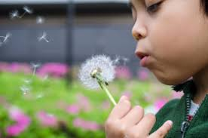
scatter
verb
to disperse, to toss or go in different directions
Notes:
https://wonderopolis.org/wonder/why-do-people-wish-on-dandelions

Slide 10
Right now my thoughts are scattered.

Slide 11
I don’t understand that language. I need a translation.

Slide 12
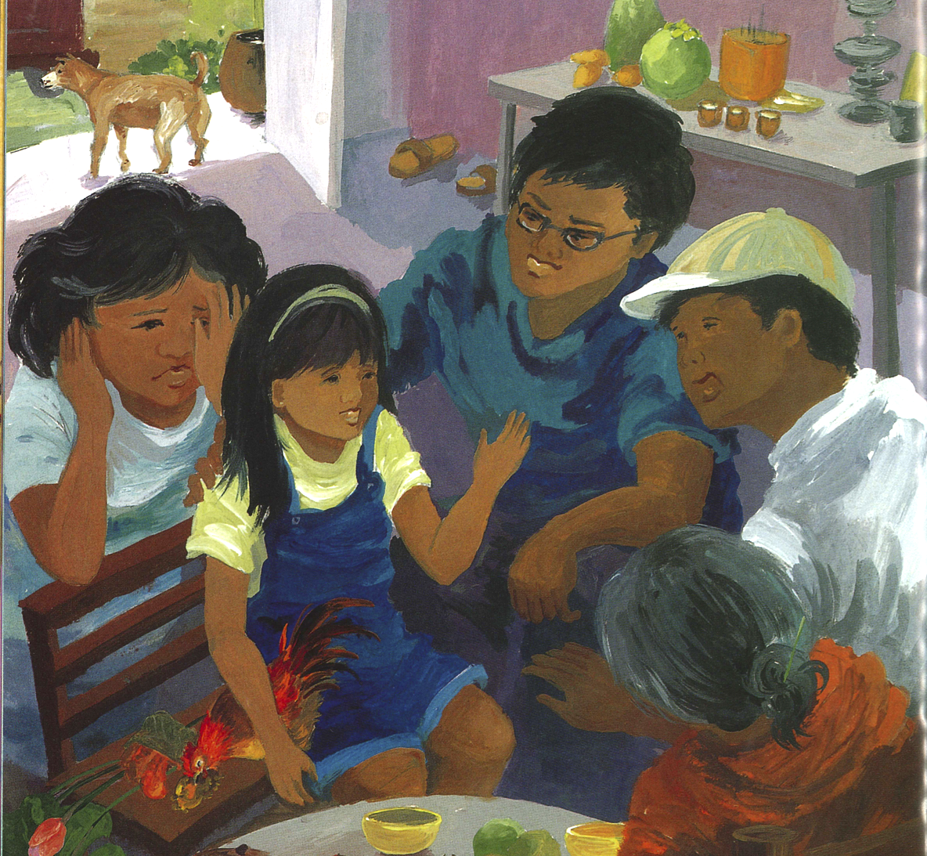
translate
verb
to change into the words of another language
Notes:
Illustration from Going Home, Coming Home by Ann Phong, written by Truong Tran

Slide 13
I don’t understand that language. I need a translation.

