Slide 1
Weekly Words
Unit 4, Week 1
Notes:
become: to begin to be
contain: to hold within
land (v): to arrive on the ground or other surface
mineral: a substance in the earth that is not from an animal or a plant and that contains nutrients
ripen: to become ripe or ready
scatter: to disperse, to toss or go in different directions
scorched: burned
shoot: a new plant or branch

Slide 2
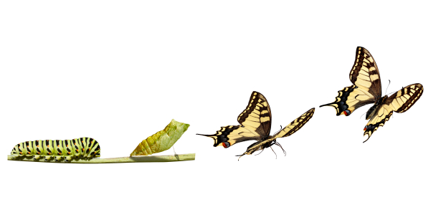
become
verb
to begin to be
Notes:
become (verb)
Elaboration:
Many of us are amazed that a caterpillar can become a butterfly.
Think, Pair, Share prompt:
Here’s a question many adults like to ask children: What would you like to become when you grow up?
Think of and share as many possibilities as you can!
https://greattransitionstories.org/patterns-of-change/the-metaphor-of-metamorphosis/

Slide 3
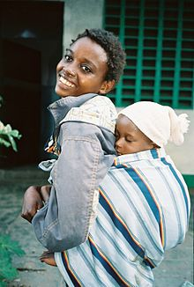
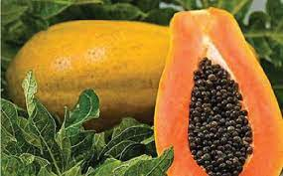
contain
verb
to hold within
Notes:
contain (verb)
Elaboration:
The baby is contained in the sling. The papaya contains lots of small, dark seeds.
Think, Pair, Share prompt:
Think about your lunch, your backpack, or your pockets right now. What do they contain?
http://tehelka.com/papaya-seeds-are-magical/, https://en.wikipedia.org/wiki/Baby_sling

Slide 4
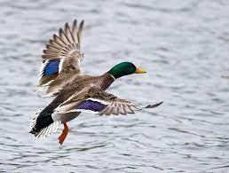
land
verb
to arrive on the ground or other surface
Notes:
land (verb)
Elaboration:
We’ve studied land as a noun—an area of the earth’s surface. Here it’s a verb, an action. An airplane lands on the runway. This duck is ready to land on the water.
Think, Pair, Share prompt:
Why might a butterfly land on a flower?
https://commons.wikimedia.org/wiki/File:Landing_mallard.jpg

Slide 5
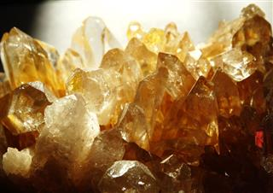
mineral
noun
a substance in the earth that is not from an animal or a plant and that contains nutrients
Notes:
mineral (noun)
Elaboration:
People often confuse minerals and rocks. A mineral is one substance in the earth, and a rock is made up of different minerals.
This mineral in the photo is called citrine.
Think, Pair, Share prompt:
Salt is a mineral, also called sodium. It is a nutrient for our bodies. When do you use this mineral?
https://sciencestruck.com/rocks-minerals-facts

Slide 6
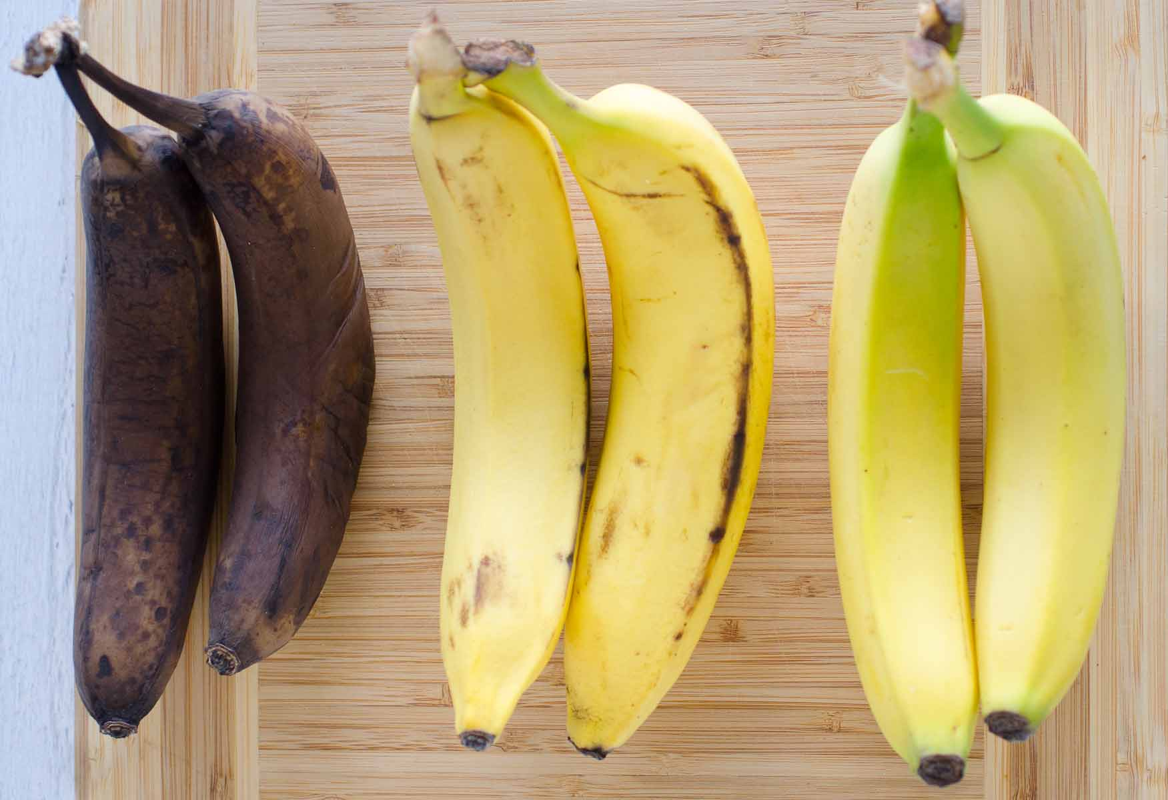
ripen
verb
to become ripe or ready
Notes:
ripen (verb)
Elaboration:
People have lots of tricks for how to ripen bananas. One thing you can always do is just wait!
Think, Pair, Share prompt:
If you have ever eaten something that did not have time to ripen, how did it taste?
https://www.seededatthetable.com/how-to-ripen-bananas/

Slide 7
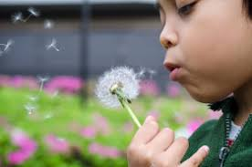
scatter
verb
to disperse, to toss or go in different directions
Notes:
scatter (verb)
Elaboration:
Have you ever done this—blown on a dandelion head so the seeds scatter in the wind? The seeds go everywhere; you can’t control where they land.
Crayons scatter when we drop a box of them. You children scatter when we go out to the playground.
Think, Pair, Share prompt:
How is scattering seeds different from planting them?
https://wonderopolis.org/wonder/why-do-people-wish-on-dandelions

Slide 8
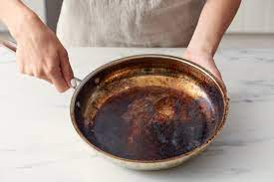
scorched
adjective
burned
Notes:
scorched (adjective)
Elaboration:
Oh, no. It looks like the cook forgot this pan on the stove. It’s scorched. It’s going to take a lot of scrubbing to clean this scorched pan.
Think, Pair, Share prompt:
Sometimes there are fires in forests. If you found a scorched tree, what would you think? What would you want to do?
https://www.apartmenttherapy.com/how-to-clean-burnt-pots-scorched-pans-140547

Slide 9
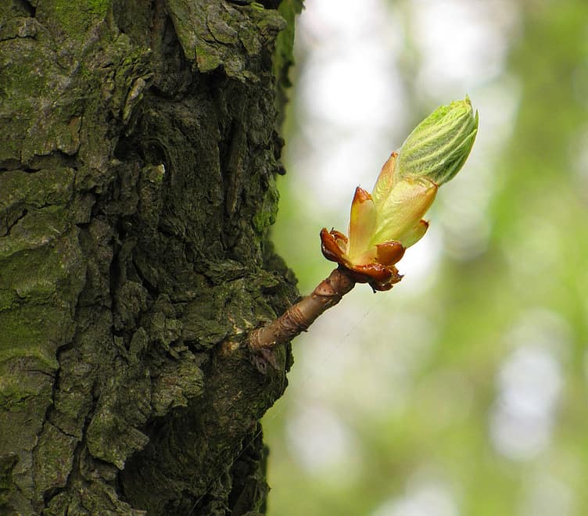
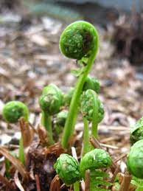
shoot
noun
a new plant or branch
Notes:
shoot (noun)
Elaboration:
This is a word with lots of meanings. We often think of shoot as a verb—shoot a picture with a camera, shoot a basketball at a hoop.
This shoot is a noun, a thing that is a new plant or part of a plant. Here we see a shoot of a fern plant—a new plant coming up through the ground in the springtime—and a tiny new branch coming out of a tree trunk.
Think, Pair, Share prompt:
If you find a plant shoot at the edge of the sidewalk, what can you do to protect it so the plant can thrive?
https://backyardforager.com/matteuccia-species-delicious-fiddlehead-ferns/, https://www.pikist.com/free-photo-xyizf

