Slide 1
Dialogue
Writing Week 4, Day 3

Slide 2
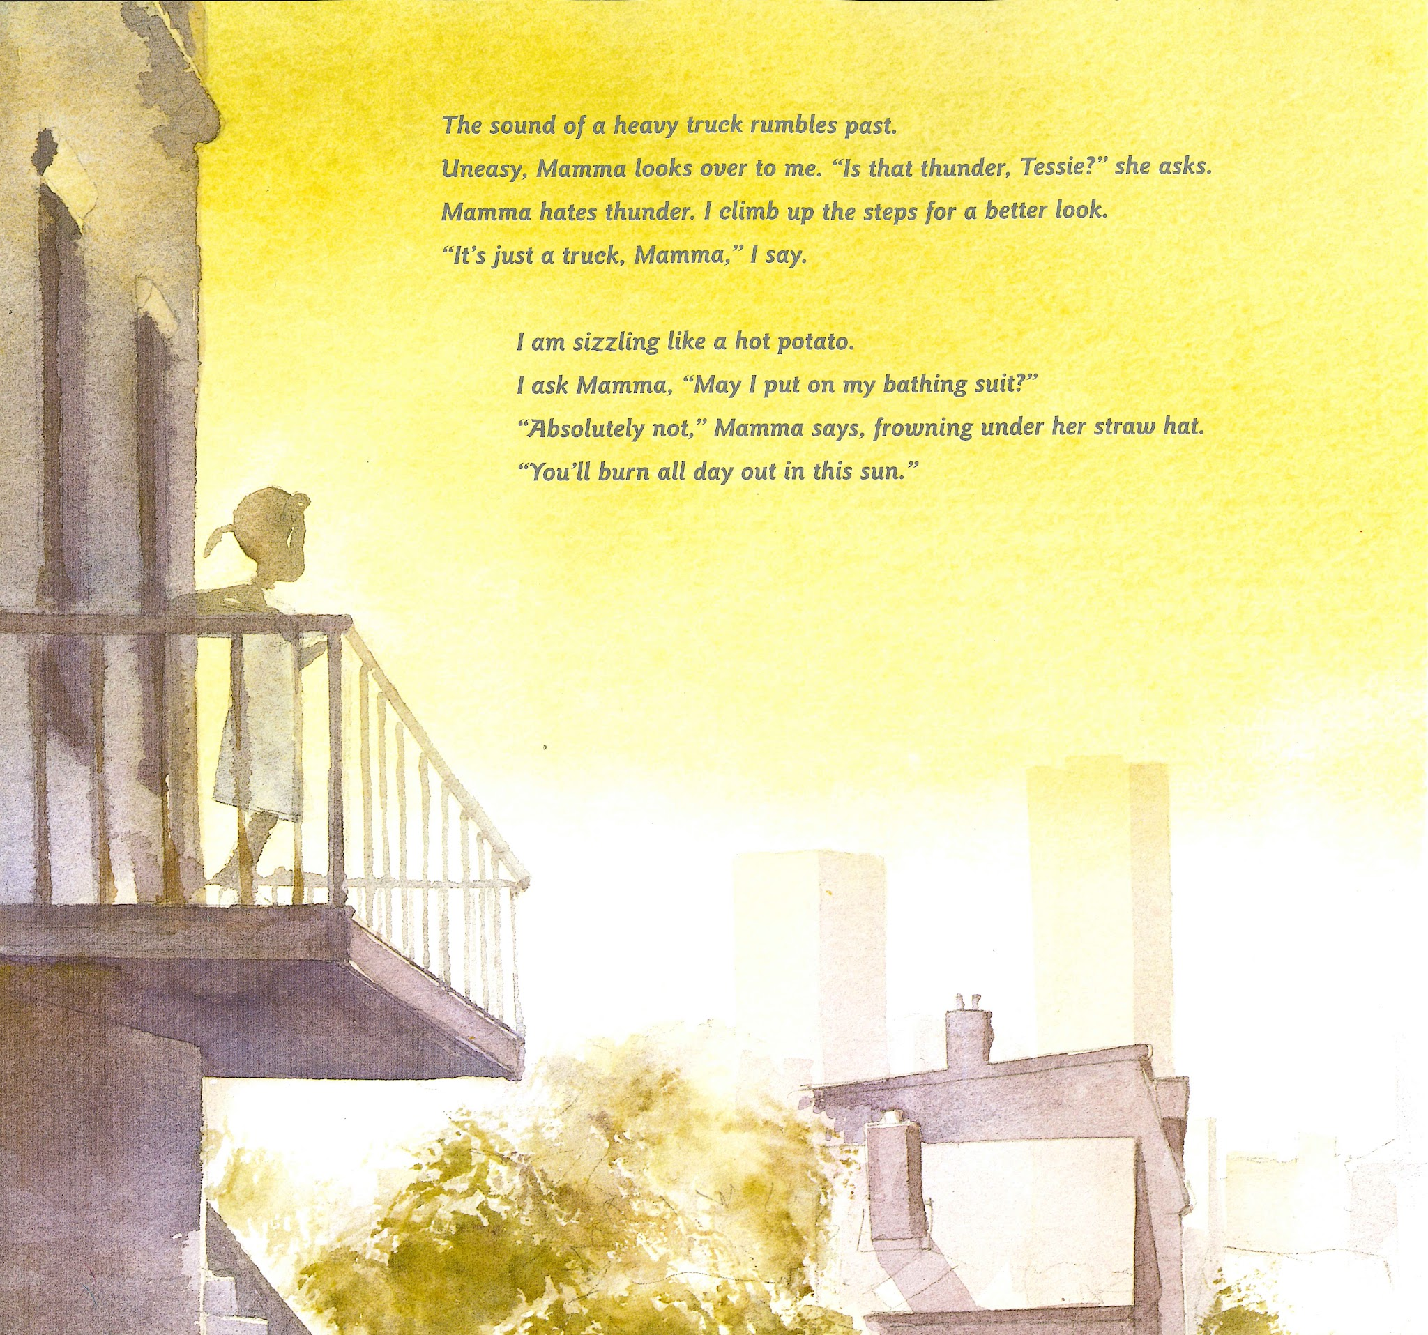
Slide 1

Slide 3
Slide 2
What does the dialogue show?
How much dialogue does Karen Hesse use?
How does Karen Hesse show that dialogue is happening?

Slide 4
Slide 3
present tense | past tense
ask
says

