Slide 1
Development of Events
Writing Week 3, Day 5 - Week 4, Day 1

Slide 2
Slide 1
Major Event: I marched to school on the first day.
Sub-Events:

Slide 3
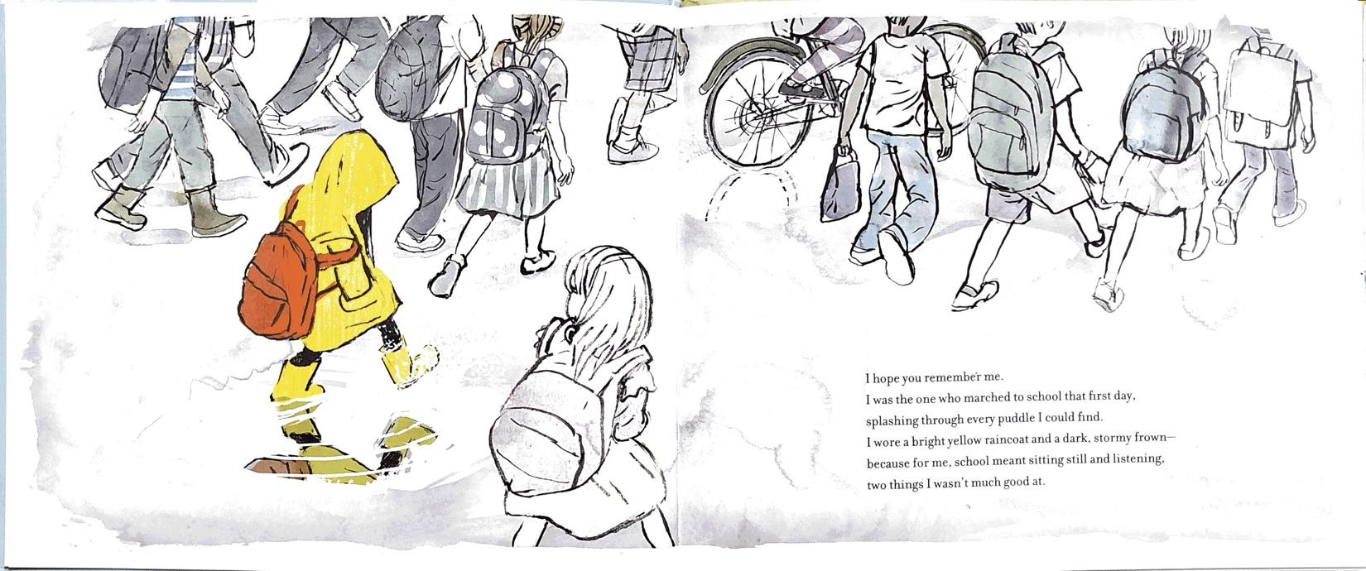
Slide 2

Slide 4
Slide 3
Major Event: I marched to school on the first day.
Sub-Events:

Slide 5
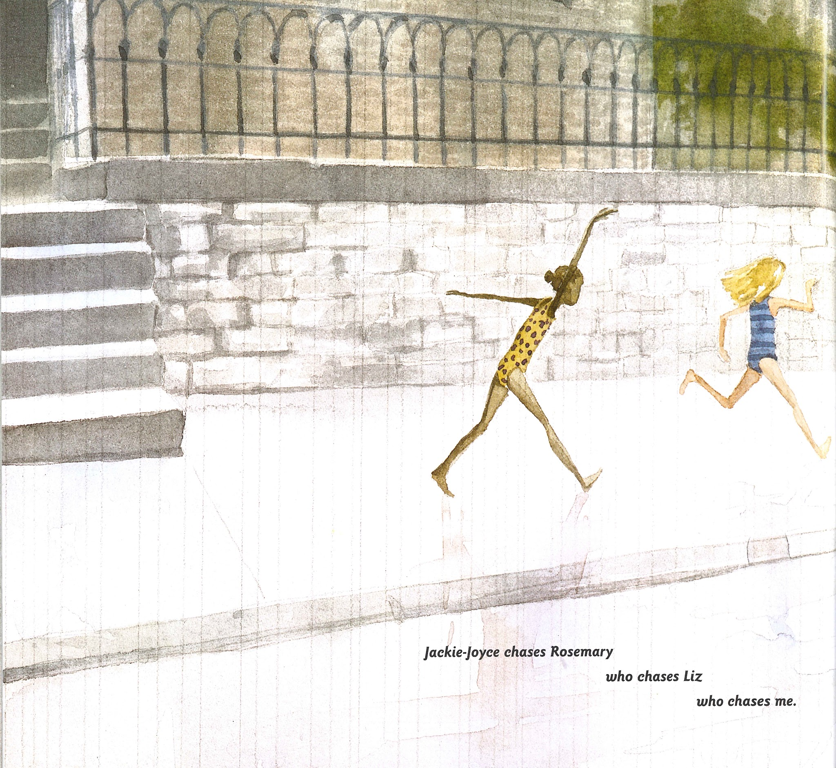
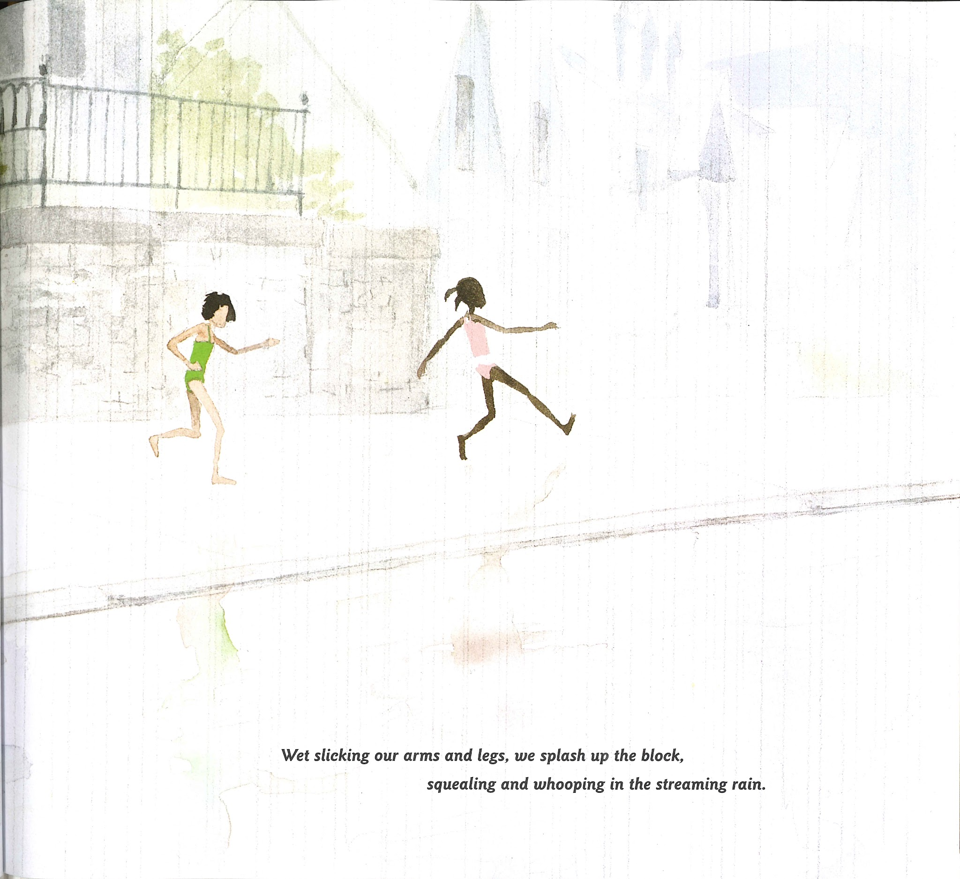
Slide 4

Slide 6
Slide 5
Jackie-Joyce chases Rosemary who chases Liz who chases me.
Wet slicking our arms and legs, we splash up the block, squealing and whooping in the streaming rain.

Slide 7
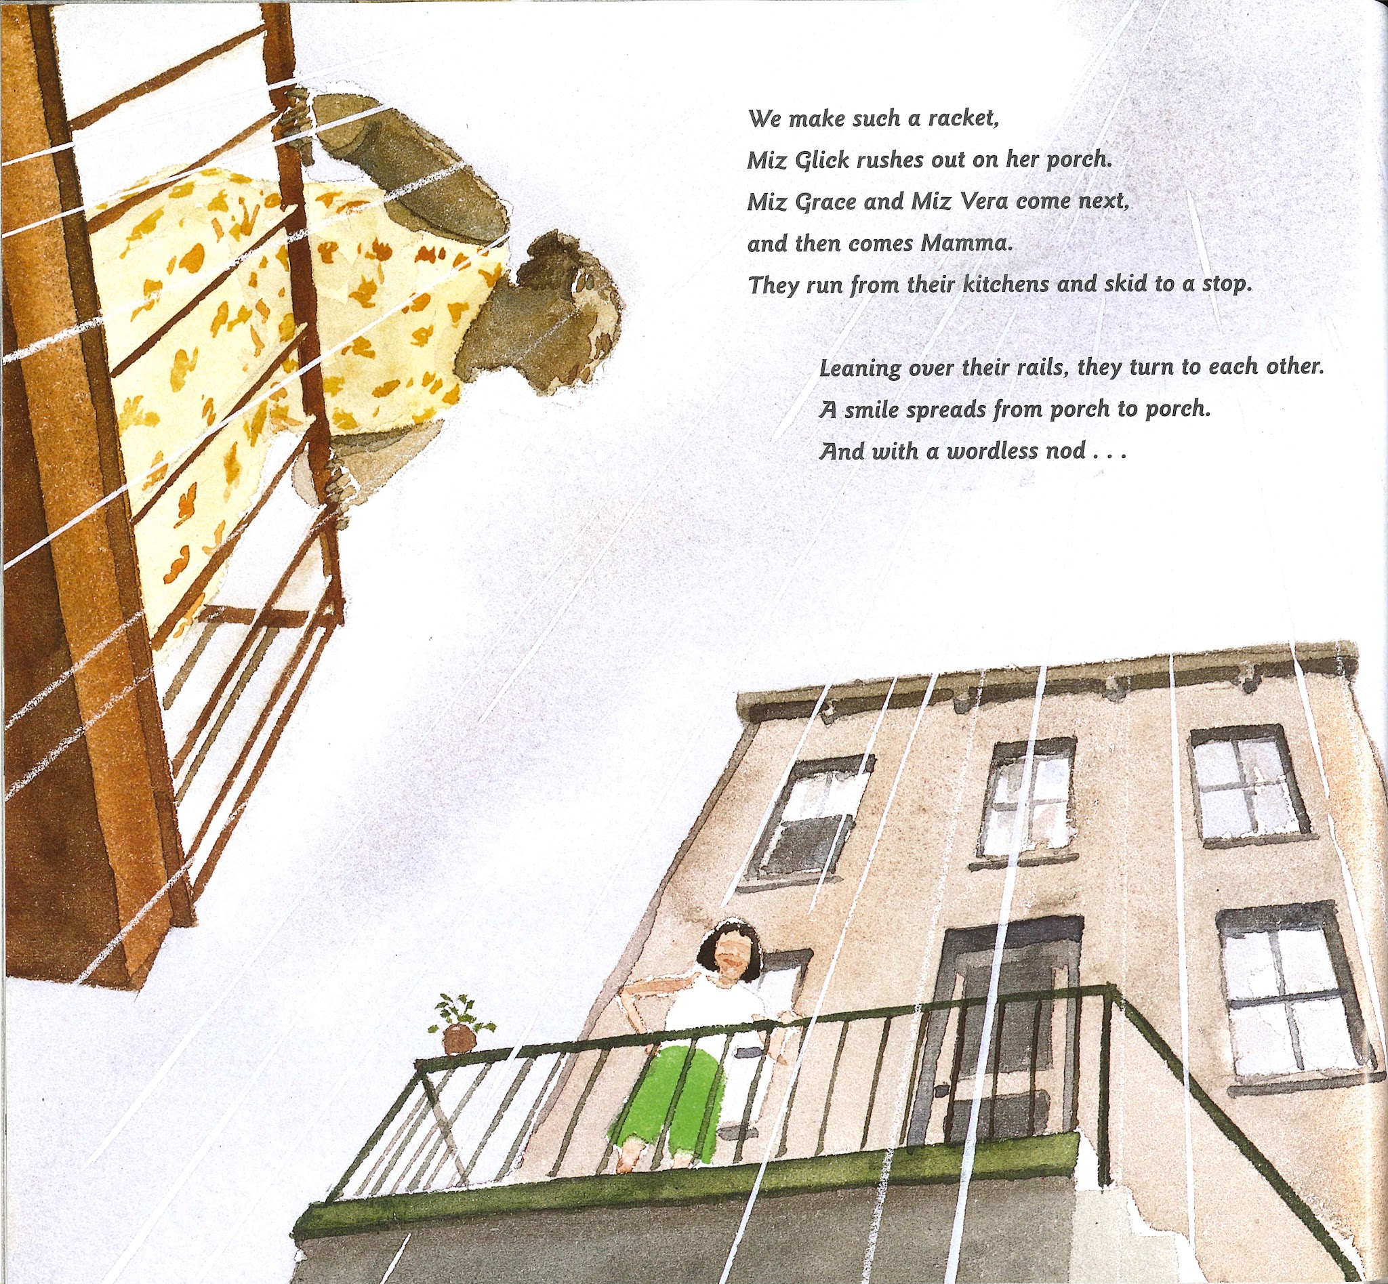
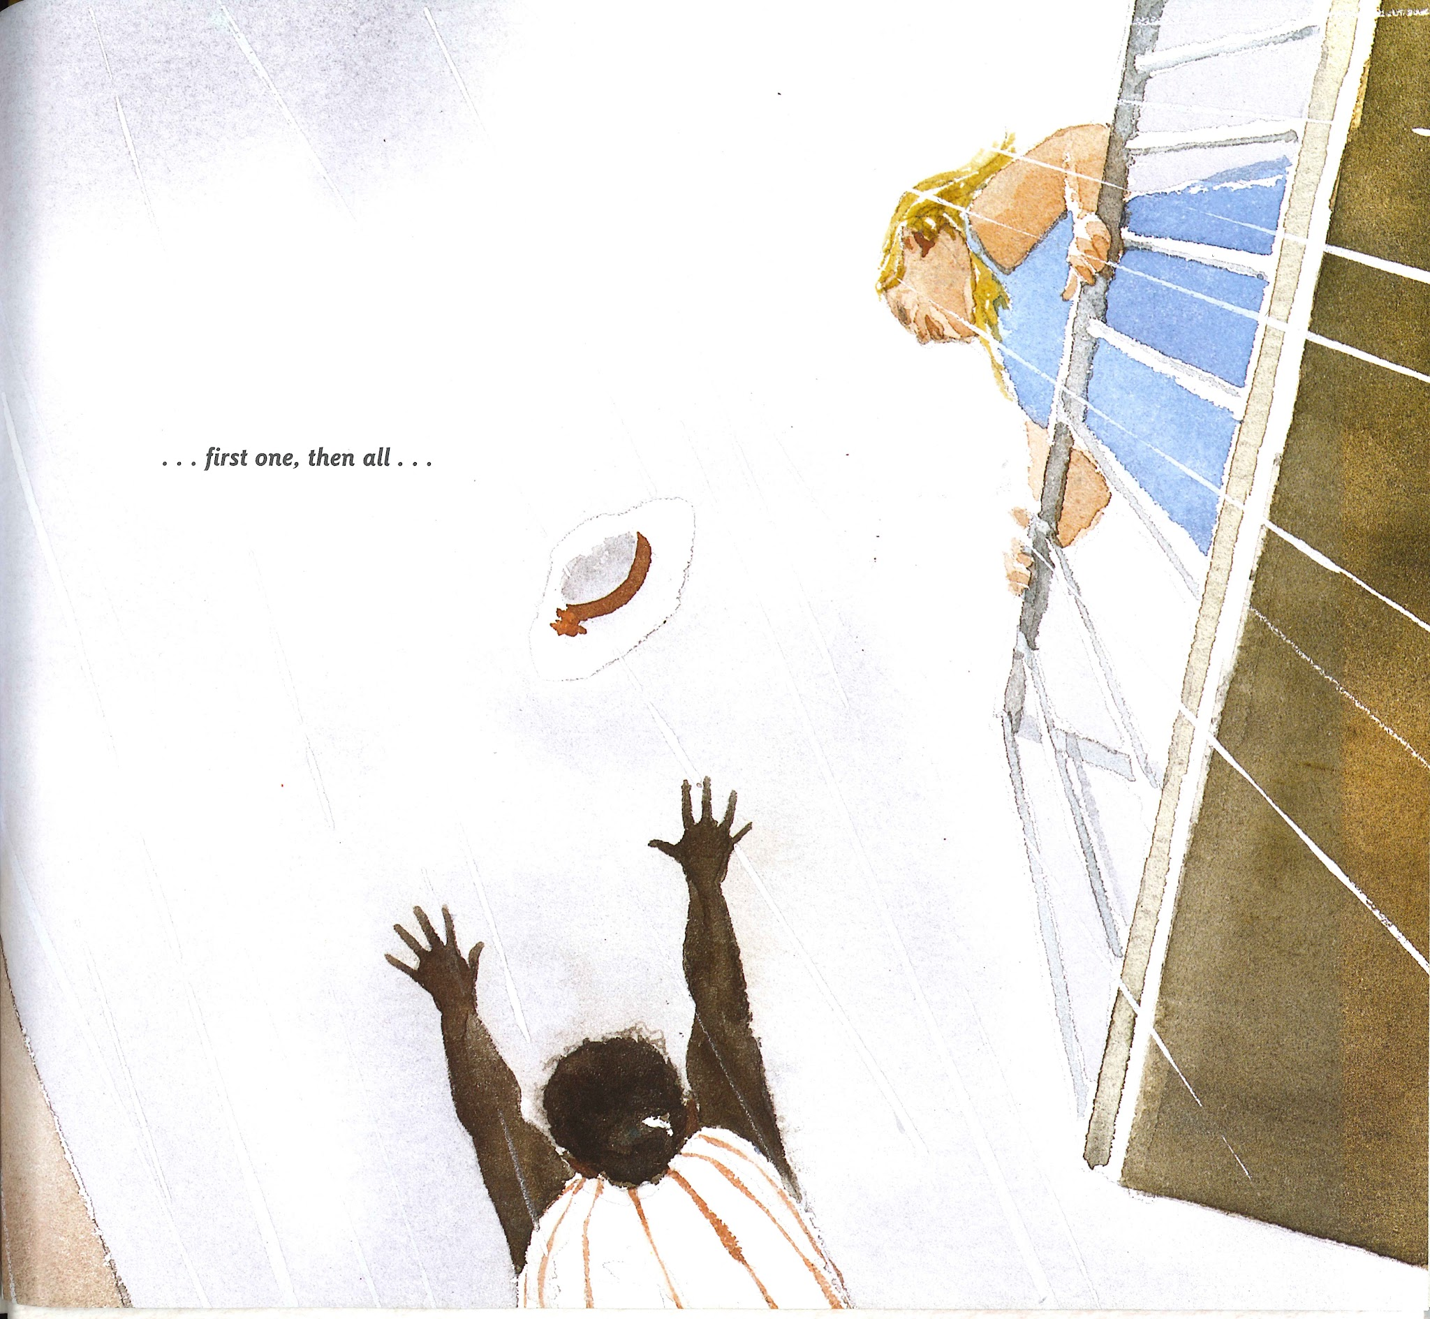
Slide 6

Slide 8
Slide 7
We make such a racket, Miz Glick rushes out on her porch. Miz Grace and Miz Vera come next, and then comes Mamma.
They run from their kitchens and skid to a stop.

