Slide 1
Adverbs
Writing Week 3, Day 2

Slide 2
Slide 1
Dad drove.
Subject | Predicate
Who? | Did what?
Dad | drove.

Slide 3
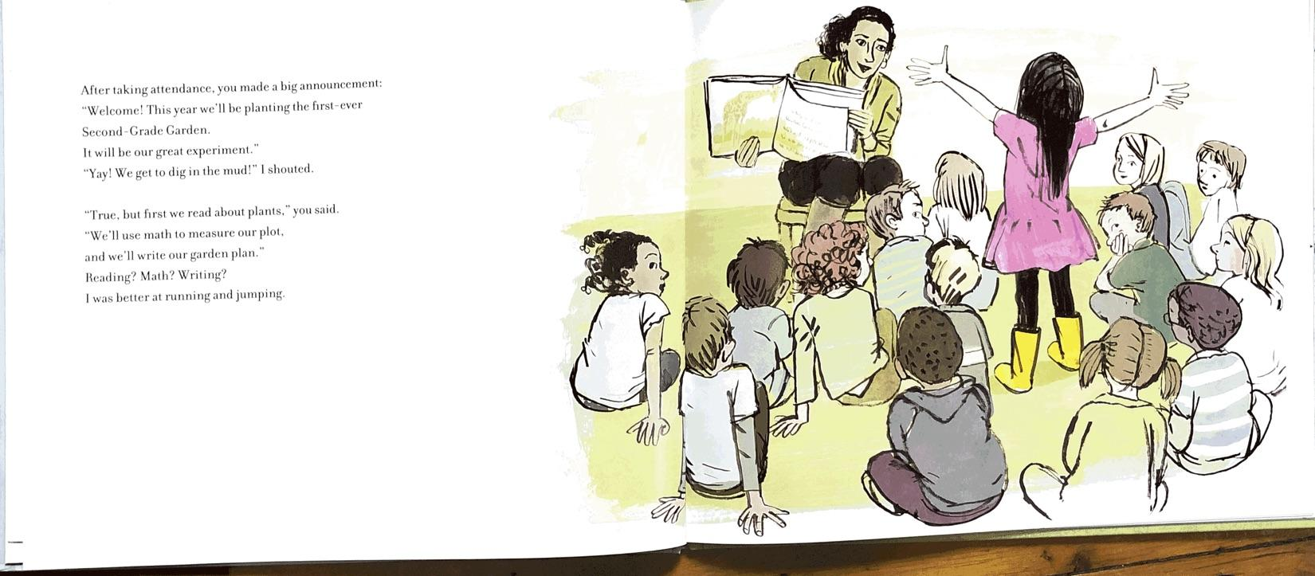
Slide 2
After taking attendance

Slide 4
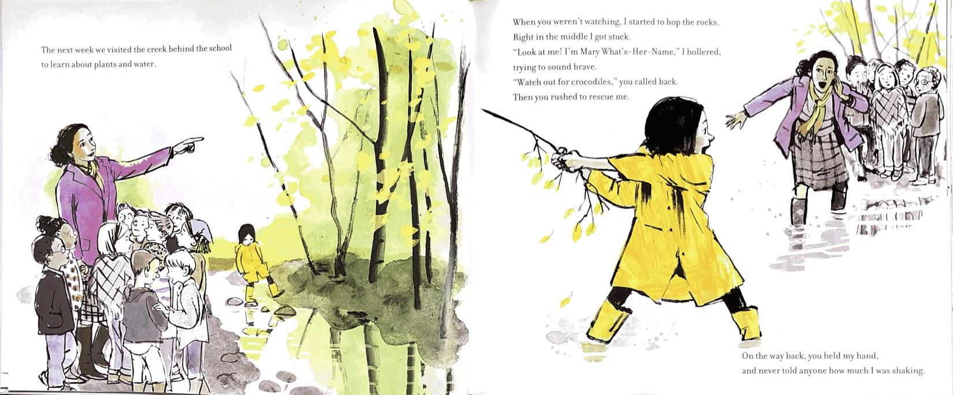
Slide 3
The next week
When you weren’t watching

Slide 5
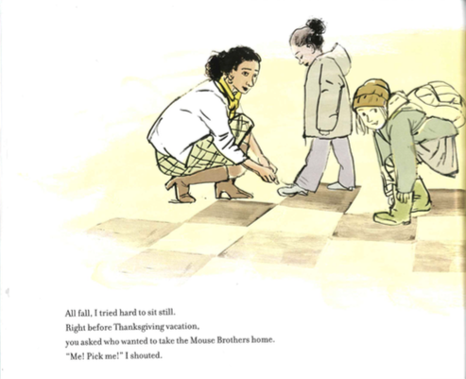
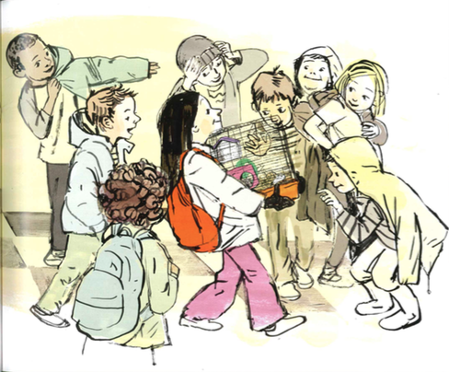
Slide 4
All fall

Slide 6
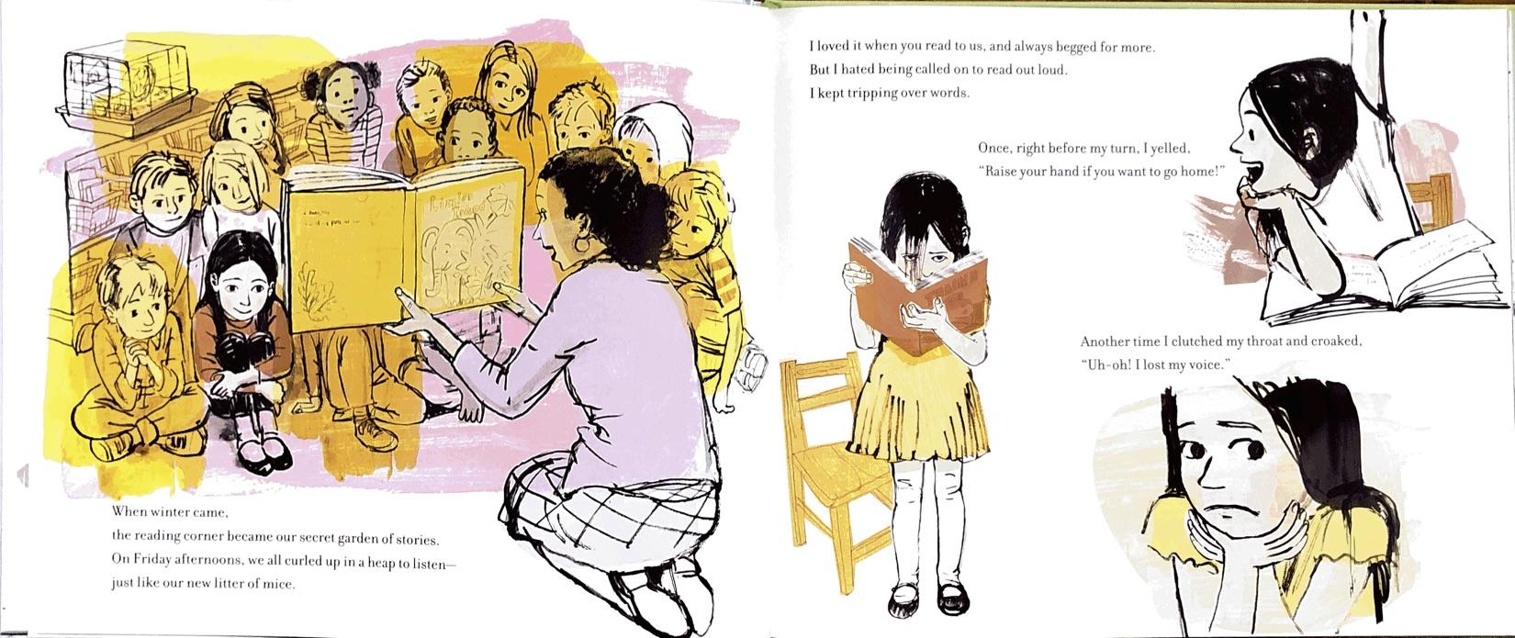
Slide 5
When winter came

Slide 7
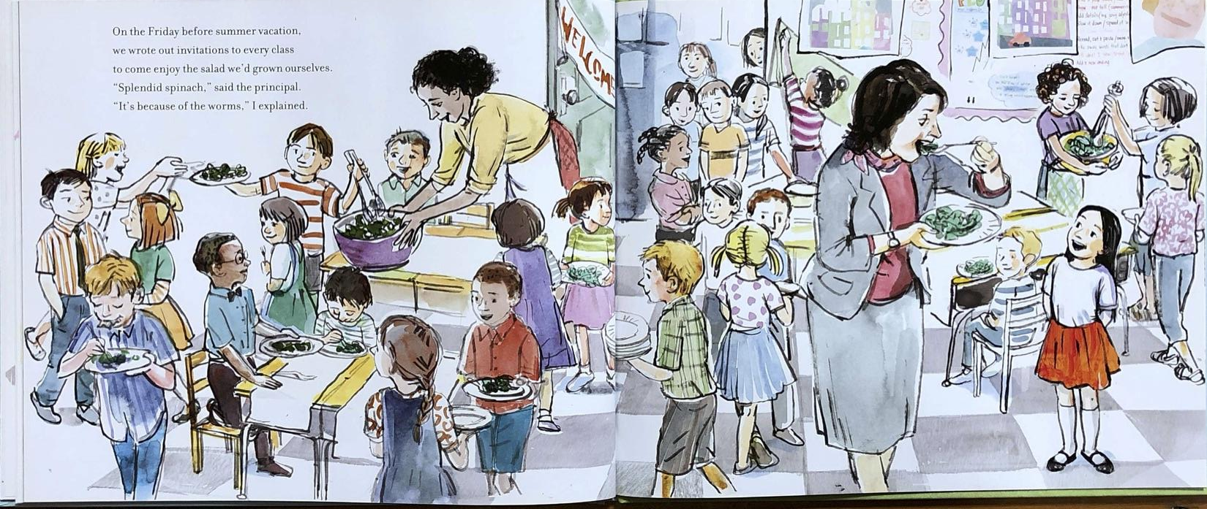
Slide 6
On the Friday before summer vacation

Slide 8
Slide 7
Miz Glick rushes.
Subject | Predicate
Who? | Does what?
Miz Glick | rushes.

Slide 9
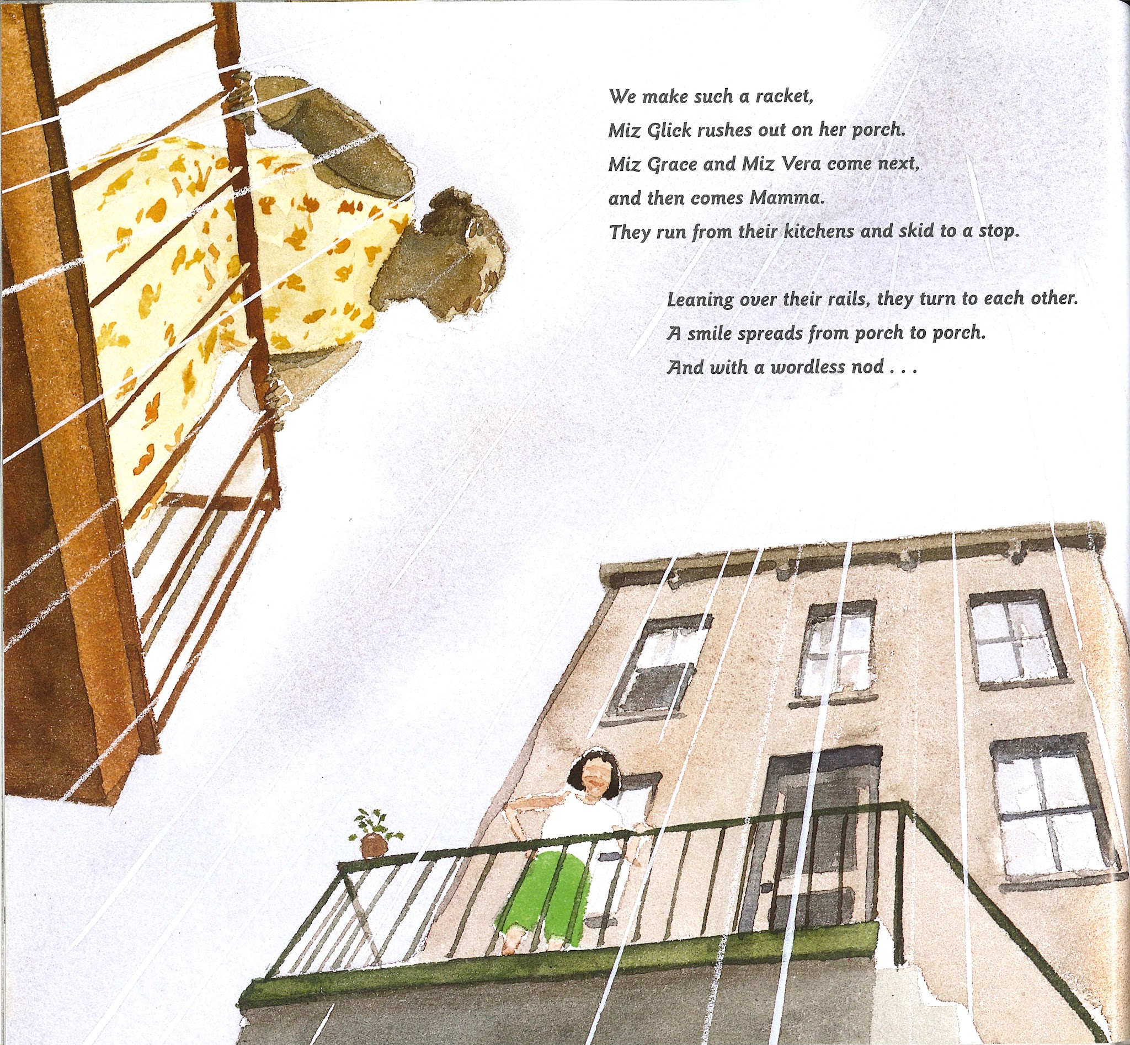
Slide 8
Miz Glick rushes out on her porch.
Subject | Predicate
Who? | Does what? | Where?
Miz Glick | rushes | out on her porch.

Slide 10
Slide 9
Mammas dance.
Subject | Predicate
Who? | Do what?
Mammas | dance.

Slide 11
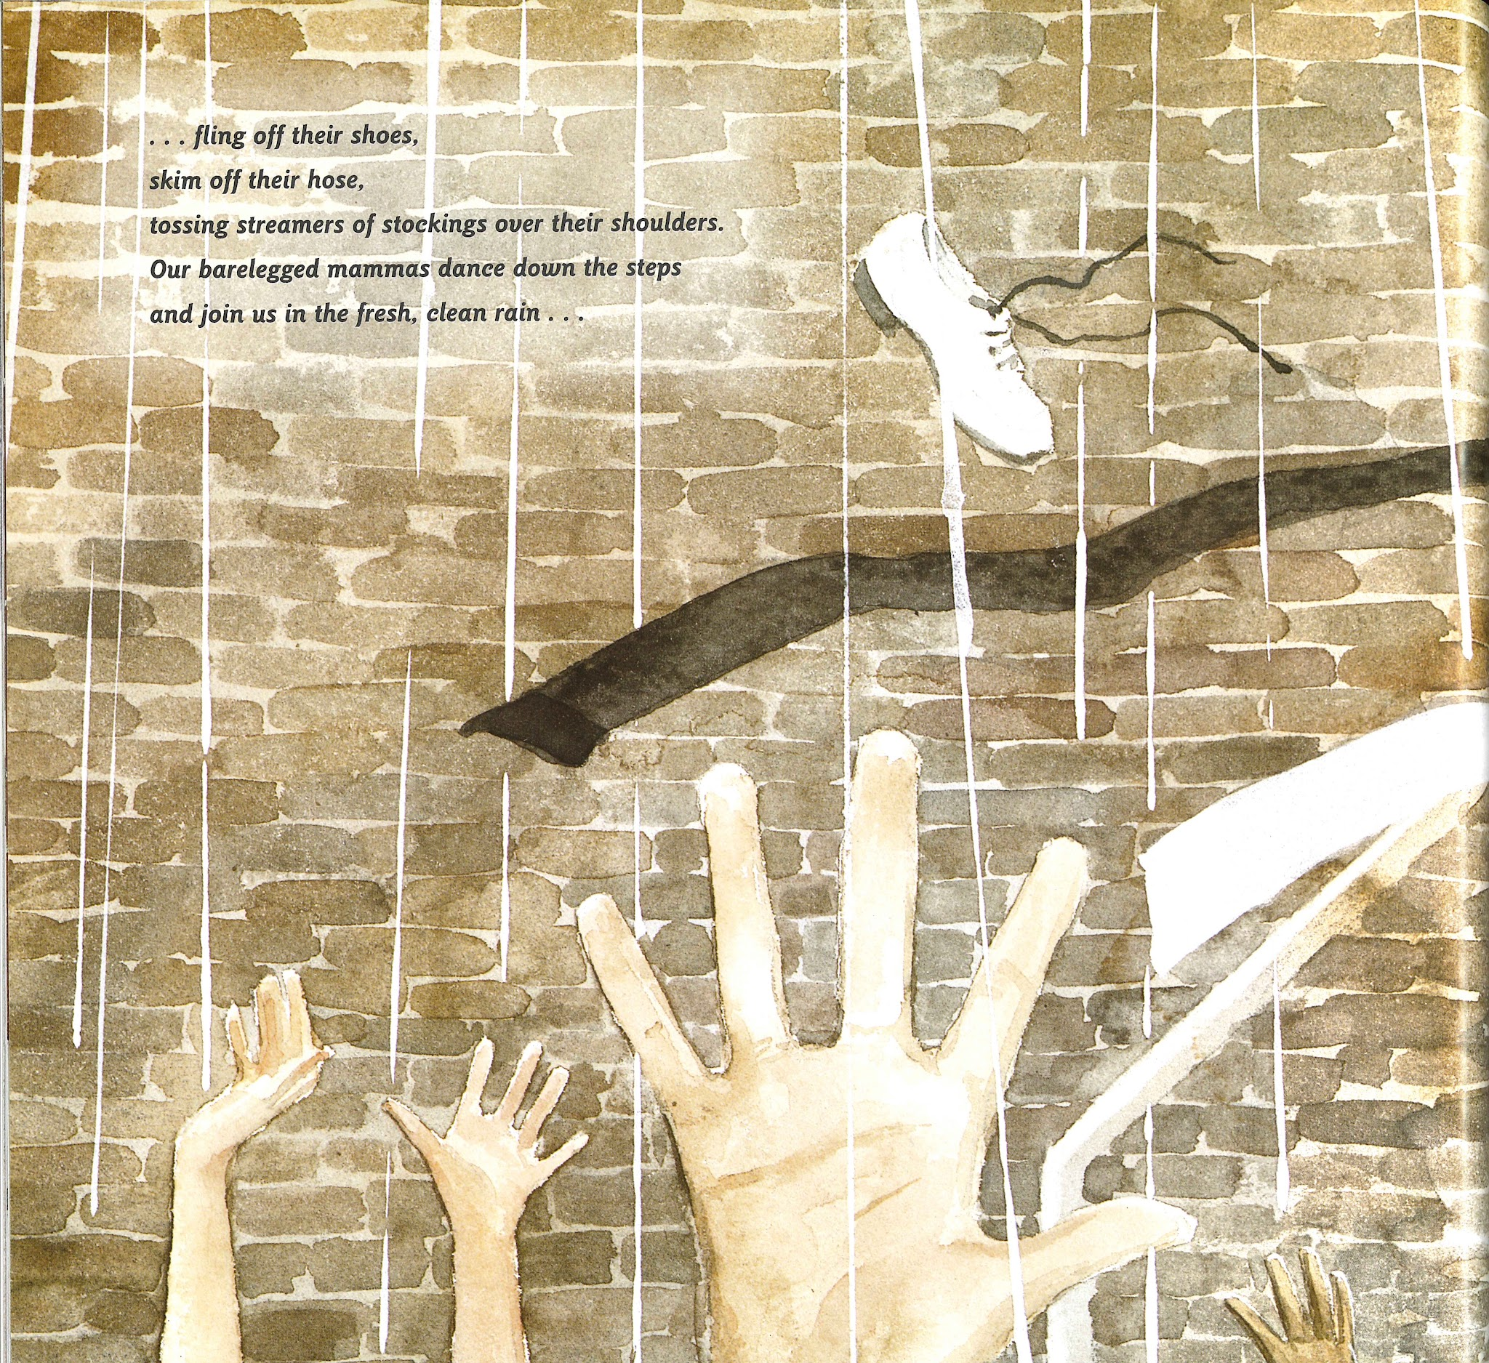
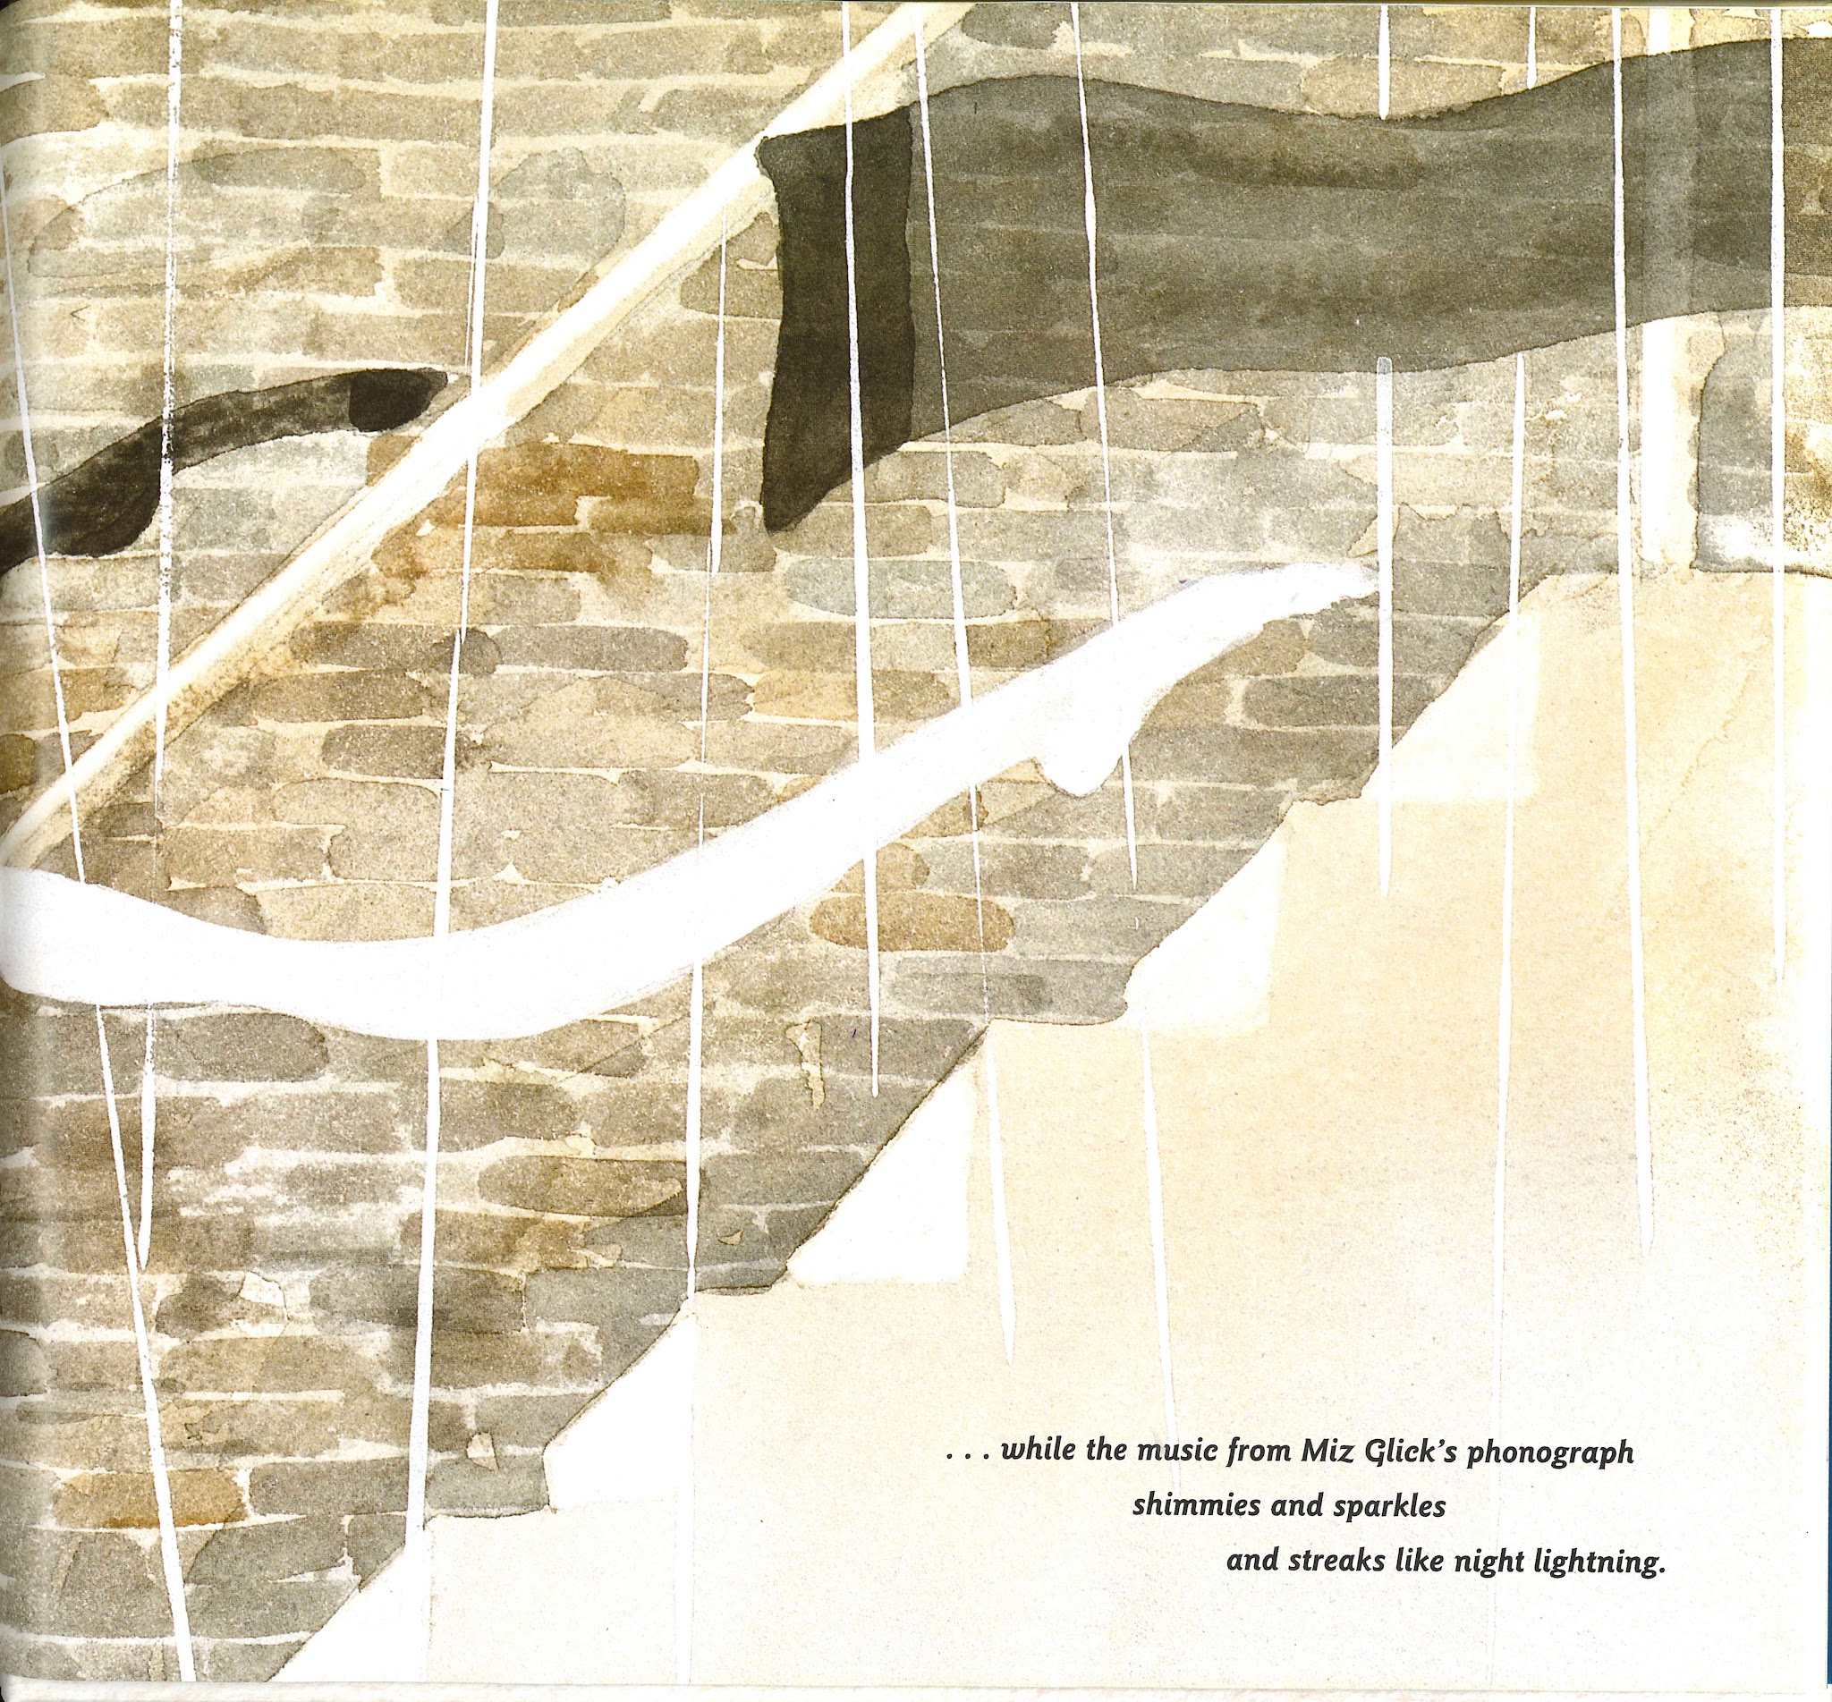
Slide 10
Our barelegged mammas dance down the steps.
Subject |  |  | Predicate
Whose? | What are they like? | Who? | Do what? | Where?
Our | barelegged | mammas | dance | down the steps.

Slide 12
Slide 11
Subject |  | Predicate
When? | Who? | Did what? | Where?
 | Dad | drove
 | Dad | drove
Subject | Predicate
Who? | Did what? | Where? | When?
Dad | drove
Dad | drove

