Slide 1
Adverbs
Writing Week 5, Day 4

Slide 2
Slide 1
Mom walked.
Subject | Predicate
Who? | Did what?
Mom | walked.

Slide 3
Slide 2
She comes.
Subject | Predicate
Who? | Does what?
She | comes.

Slide 4
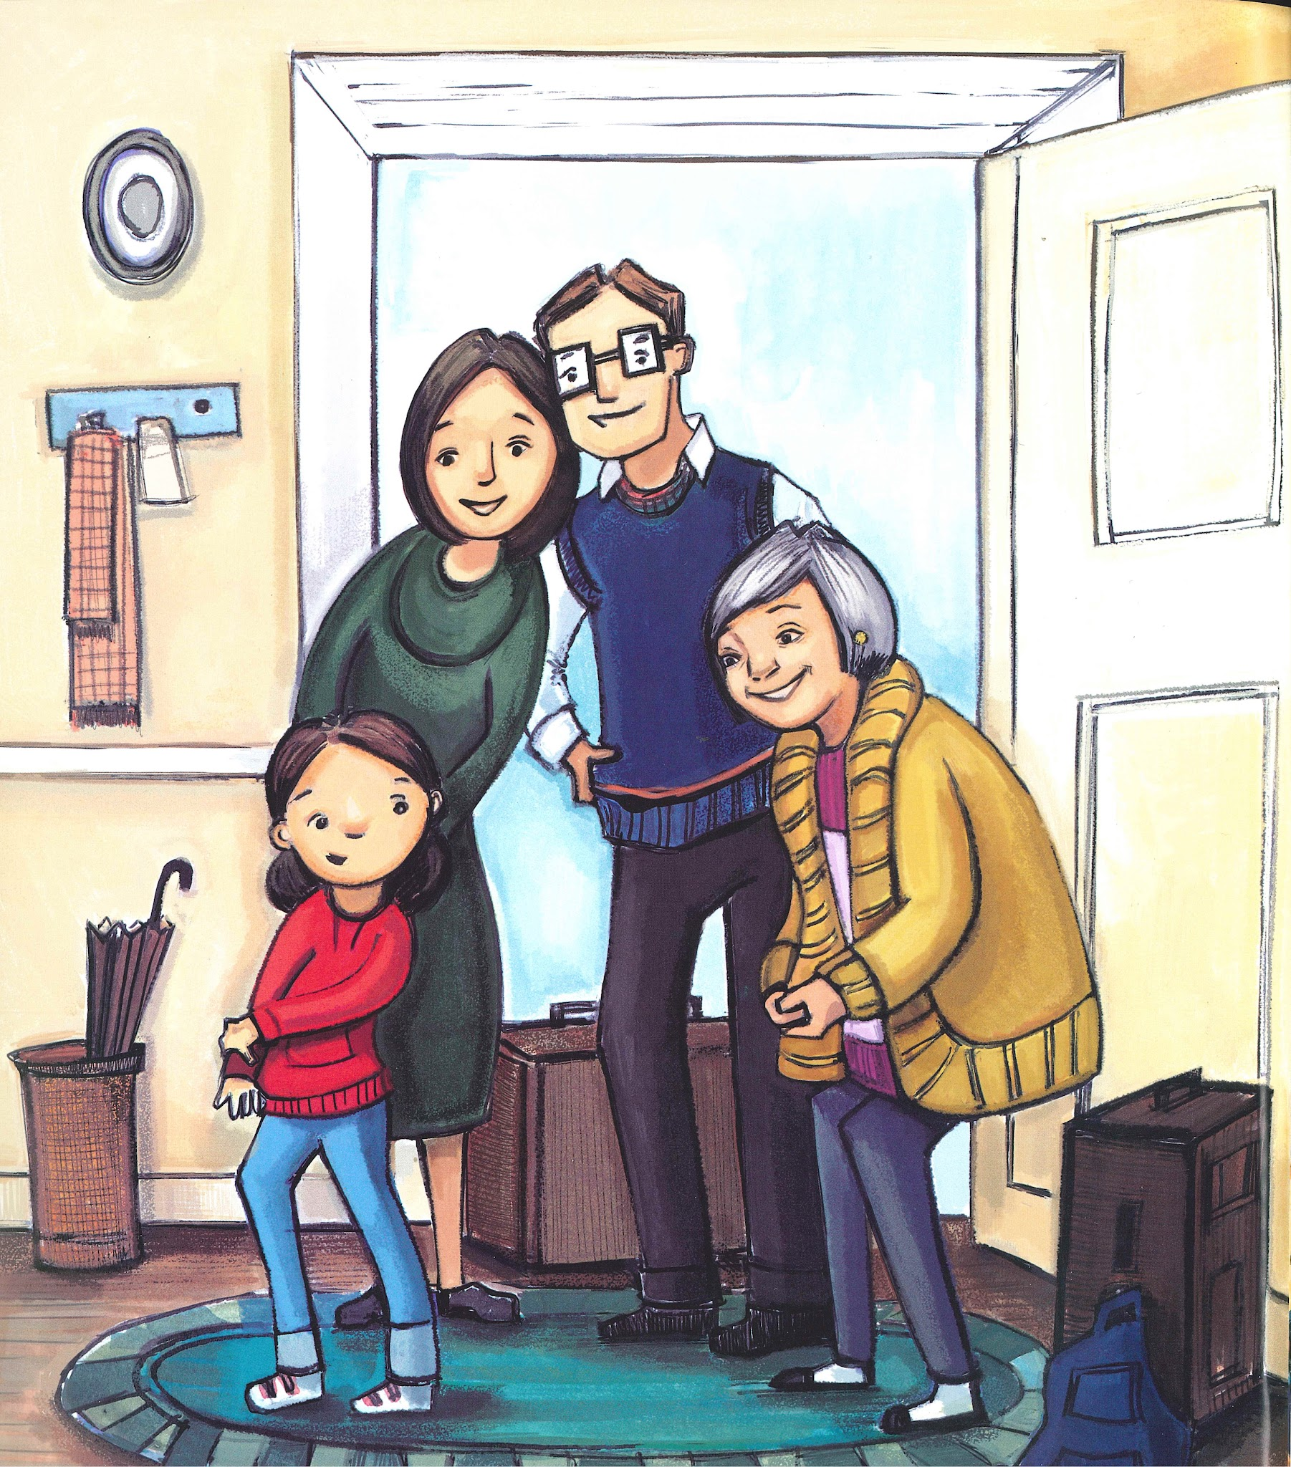
Slide 3
She comes to us in winter.
Subject | Predicate
Who? | Does what? | Where? | When?
She | comes | to us | in winter.

Slide 5
Slide 4
CJ pushed.
Subject | Predicate
Who? | Did what?
CJ | pushed.

Slide 6
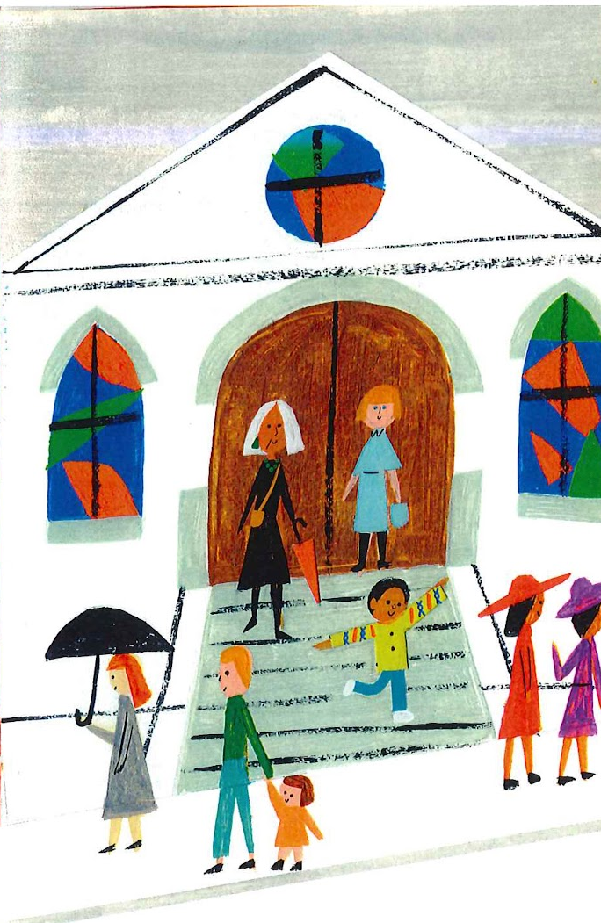
Slide 5
CJ pushed through the church doors.
Subject | Predicate
Who? | Did what? | Where?
CJ | pushed | through the church doors.

Slide 7
Slide 6
She worked.
Subject | Predicate
Who? | Did what?
She | worked.

Slide 8
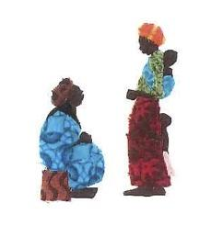
Slide 7
When Wangari grew up, she worked in the city.
Subject |  | Predicate
When? | Who? | Did what? | Where?
When Wangari grew up | she | worked | in the city.

Slide 9
Slide 8
Subject |  | Predicate
When? | Who? | Did what? | Where?
 | Mom | walked
 | Mom | walked
Subject | Predicate
Who? | Did what? | When? | Where?
Mom | walked
Mom | walked

