Slide 1
Development of Events
Writing Week 7, Day 1

Slide 2
Slide 1
Major Event: Mia and abuela taught each other words in English and Spanish.
Sub-Events:

Slide 3

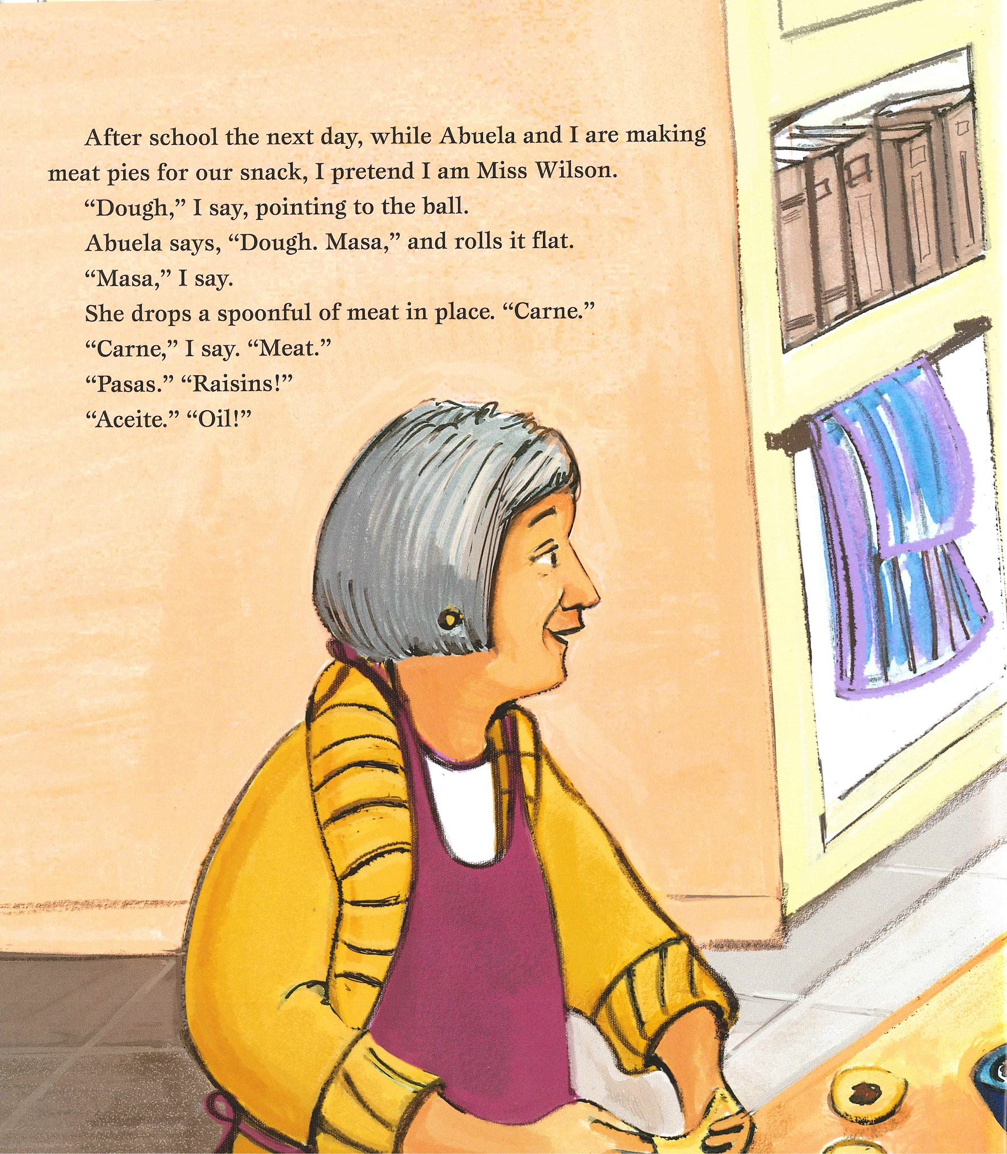
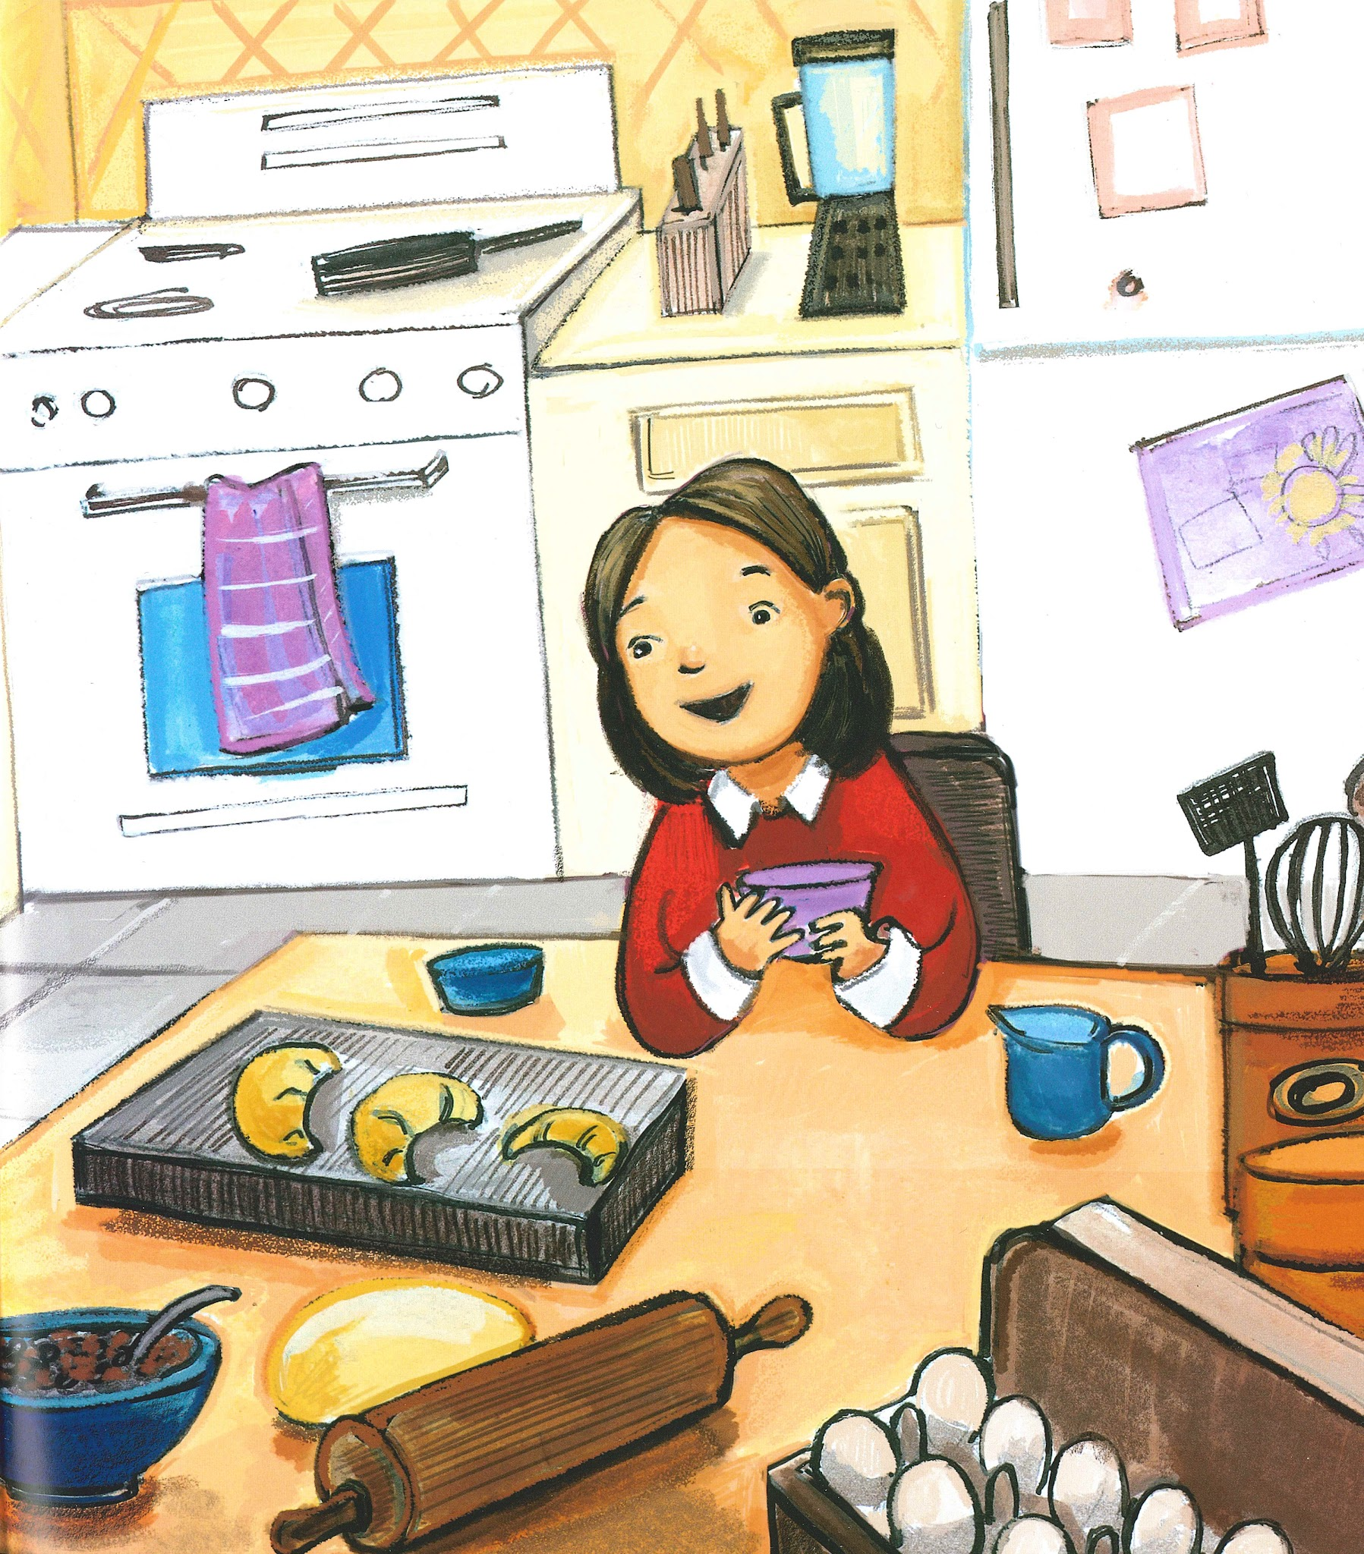
Slide 2

Slide 4
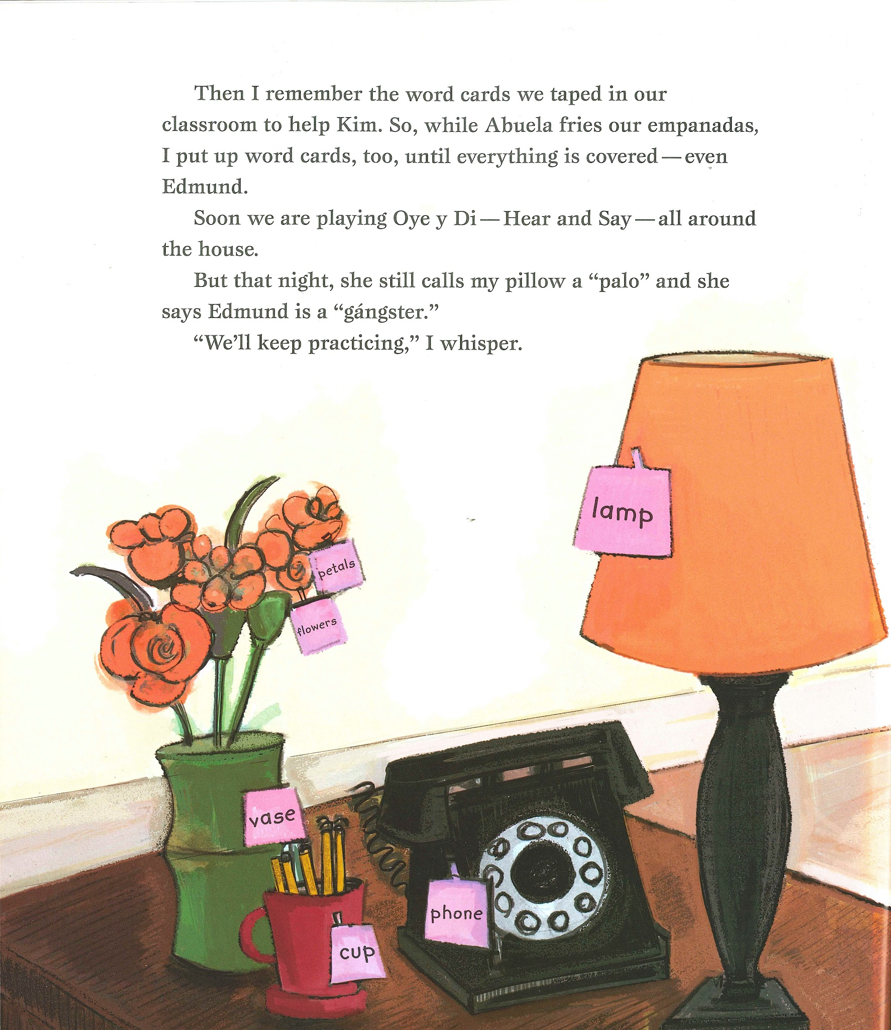
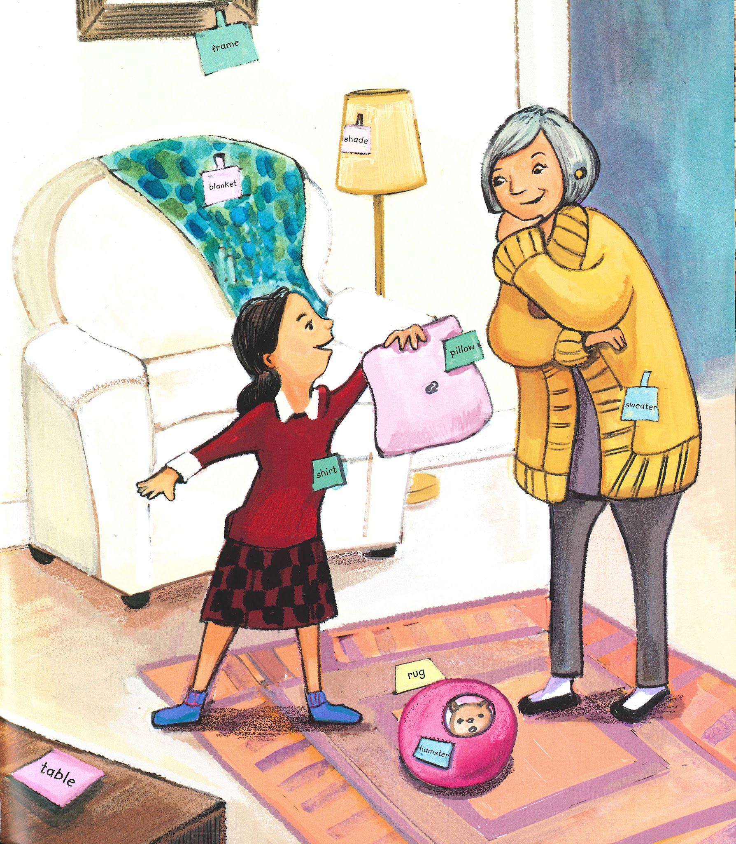
Slide 3

Slide 5
Slide 4
Major Event: Mia and abuela taught each other words in English and Spanish.
Sub-Events:

Slide 6
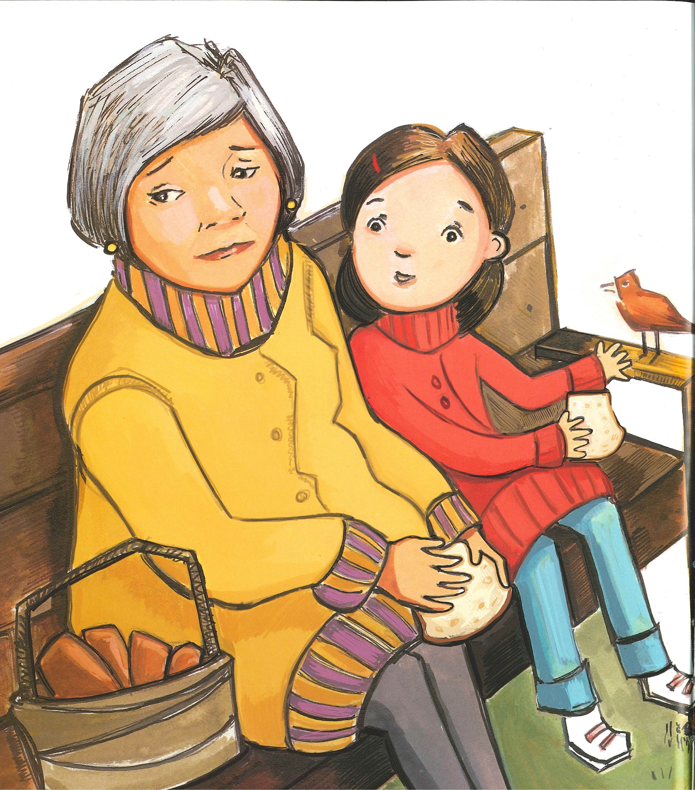
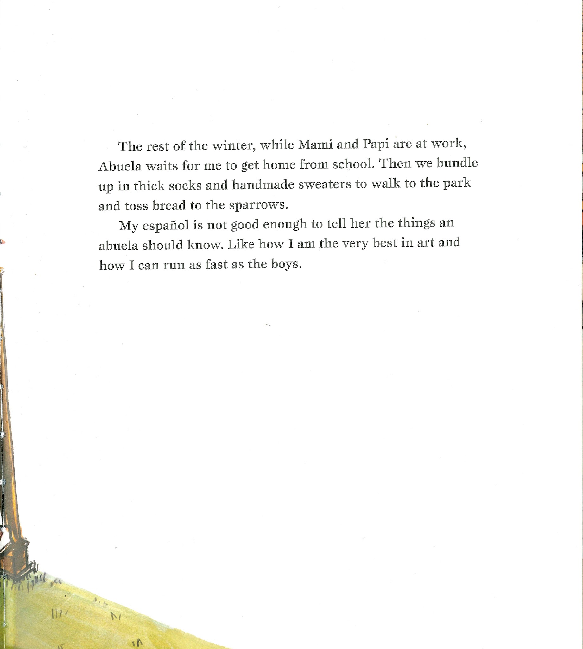
Slide 5

Slide 7
Slide 6
The rest of winter, while Mami and Papi are at work, Abuela waits for me to get home from school.
Then we bundle up in thick socks and handmade sweaters to walk to the park and toss bread to the sparrows.

