Slide 1
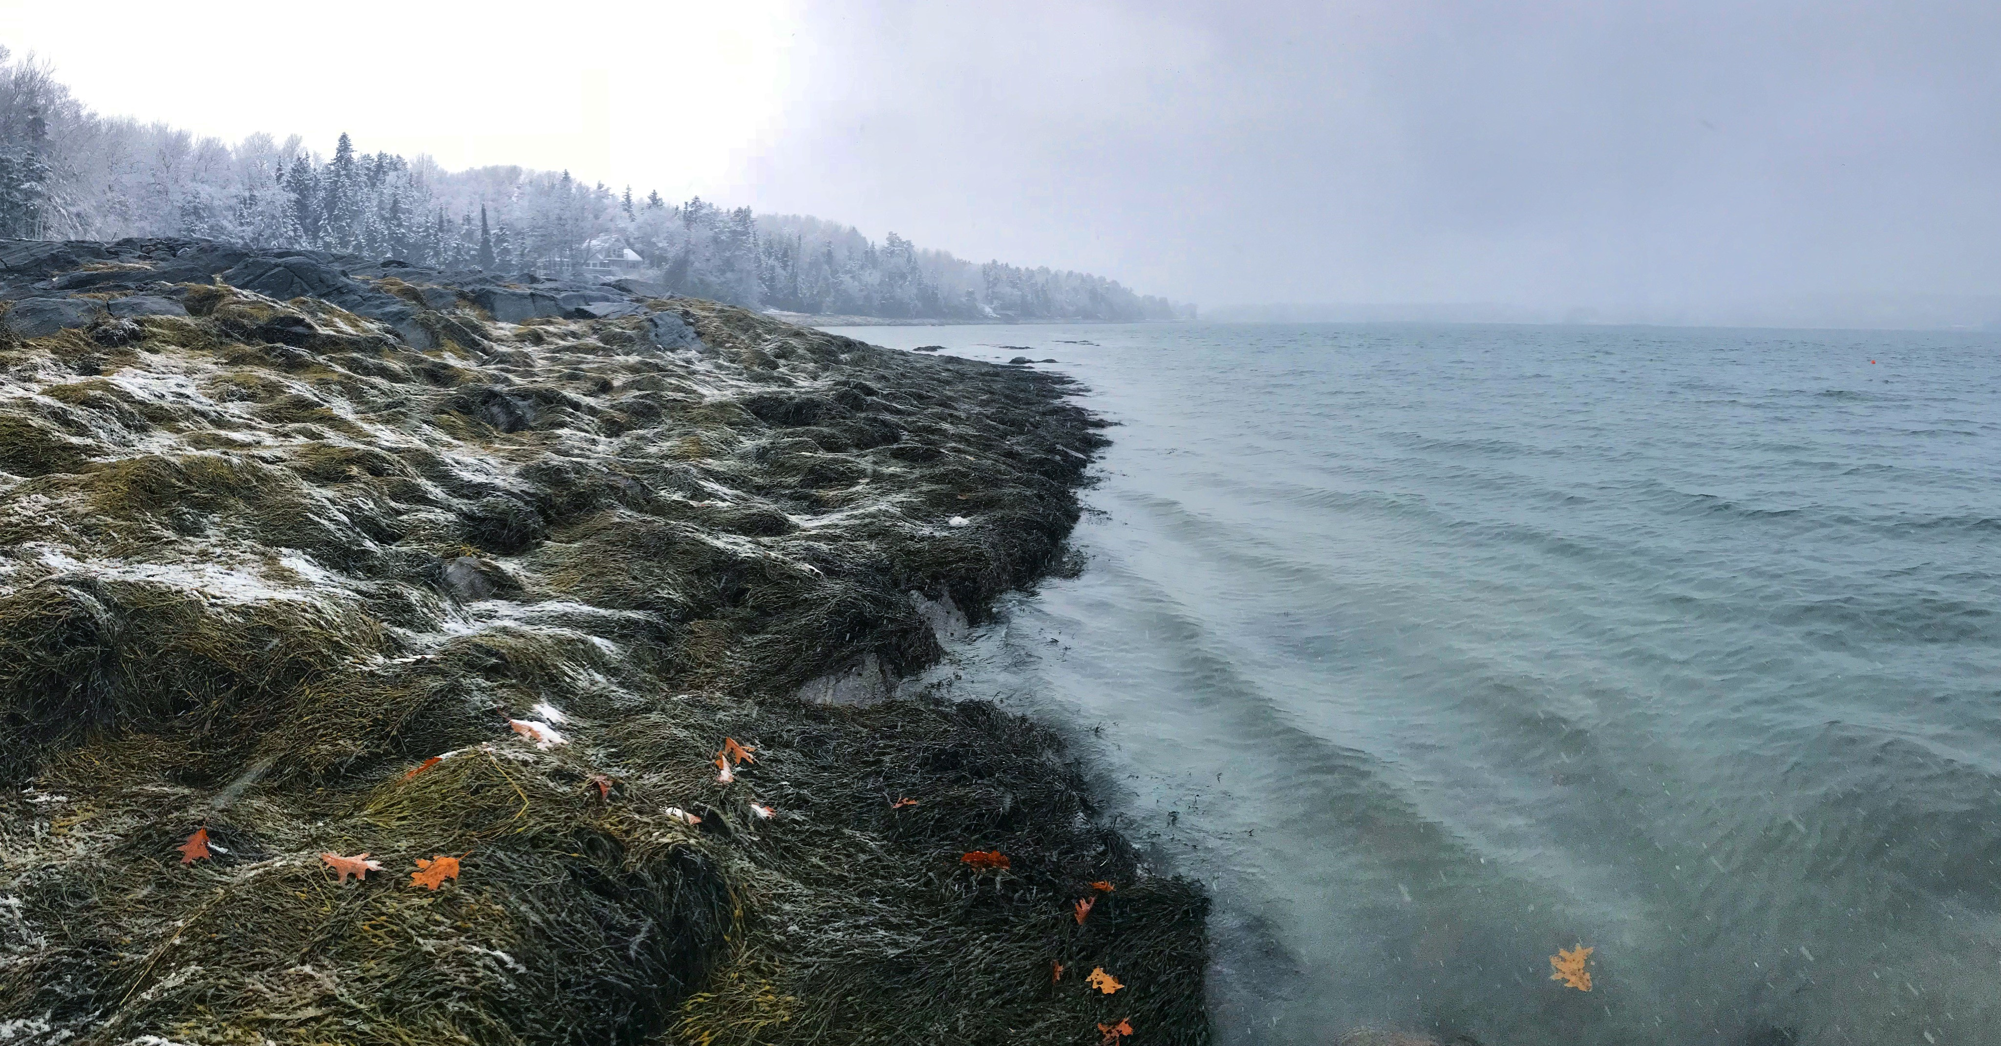

Maine Department of Marine Resources
Bureau of Public Health & Aquaculture
Water Quality Volunteer Program
Quality Assurance Training

Slide 2
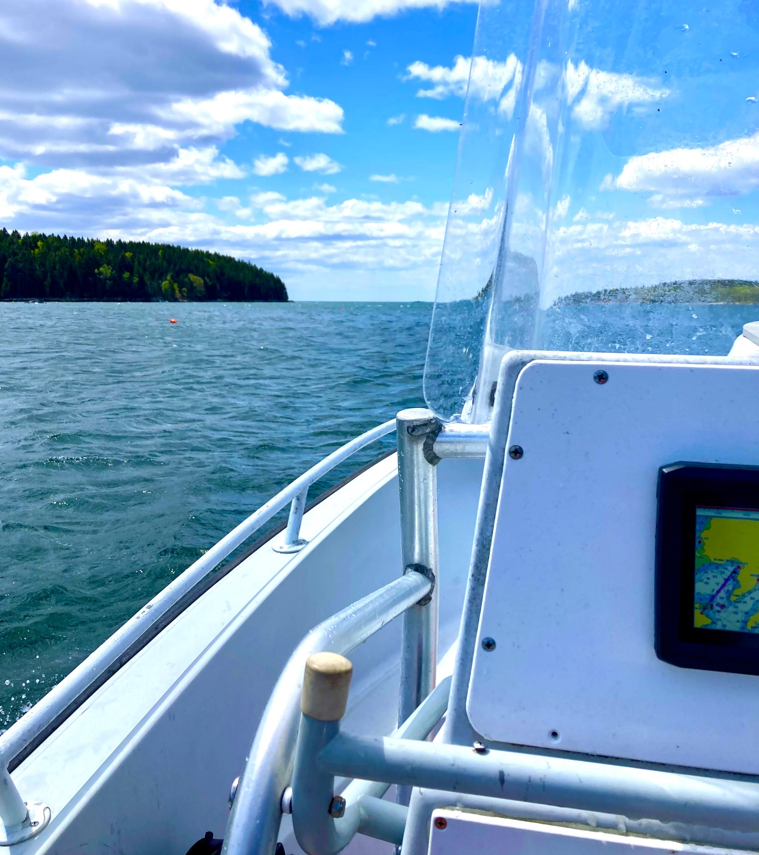
Certification Requirements
Fill out the online Water Quality Volunteer Application and Liability Waiver
Review the online Volunteer SOP
Review the Quality Assurance Training Power Point (this document)
Complete the in-person Site Certification
(to be completed with DMR staff member)

Slide 3
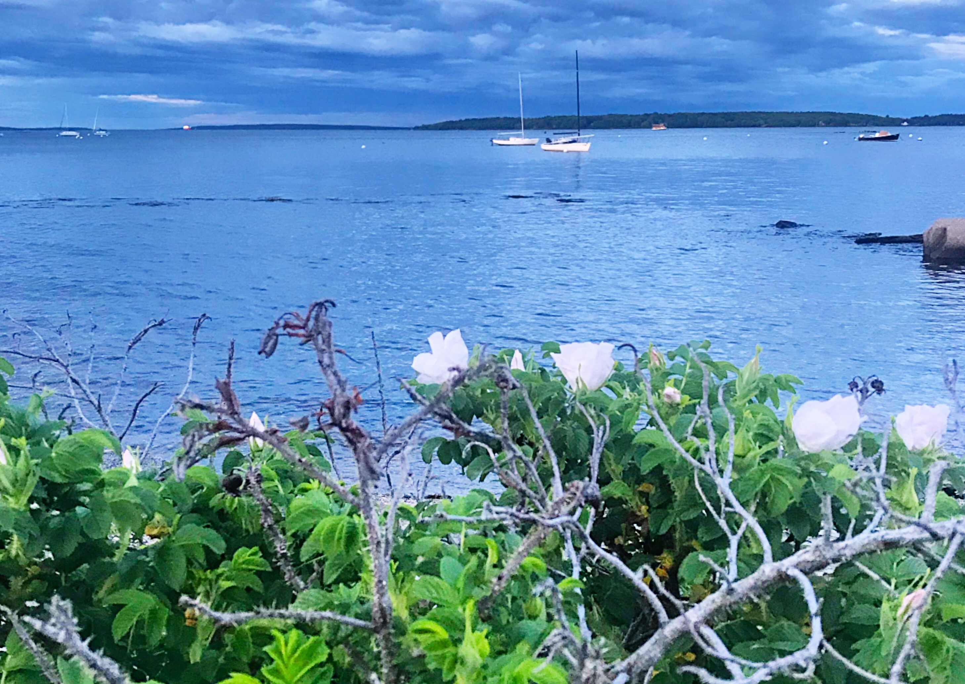
Sampling Strategy
DMR uses the systematic random sampling strategy based on establishing an annual schedule early in the calendar year and adhering to that schedule throughout the year.
A copy of your schedule will be emailed to you at the beginning of the year along with run directions and a run map.
Every effort must be made to adhere to the scheduled sampling dates.

Slide 4
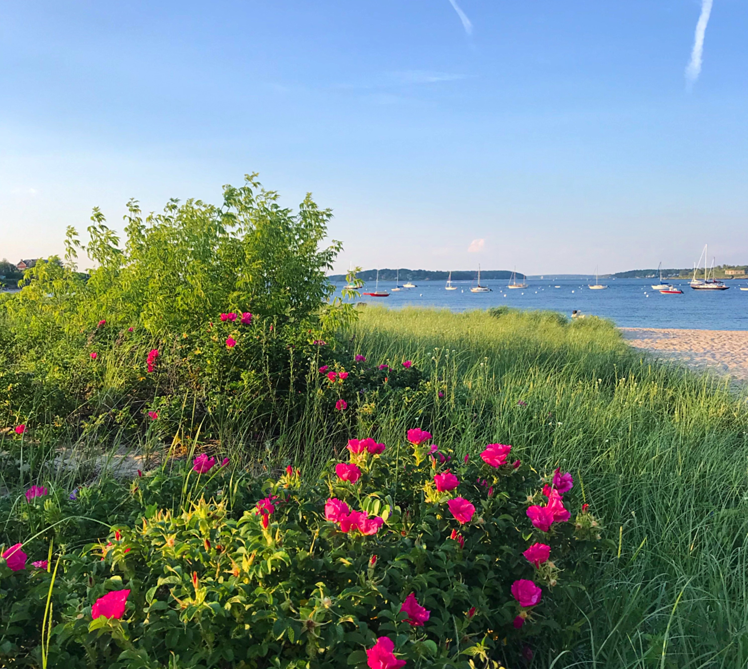
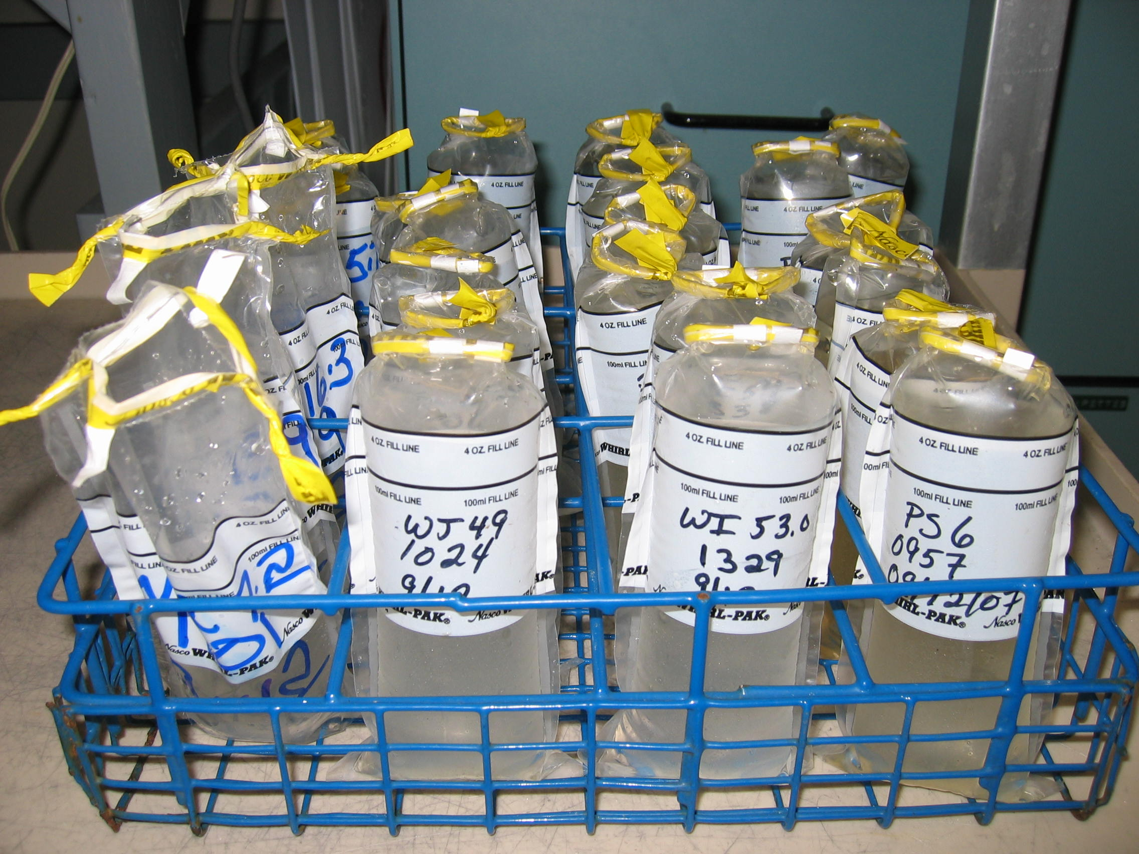
Equipment and Supplies
Cooler with calibrated thermometer
Field data sheet
Gel freezer packs (4)
Sampling tongs
Whirl-Pak bags
Sample racks
Permanent marker
Pen
Field thermometer
GPS
Hip waders (if sampling by land)

Slide 5
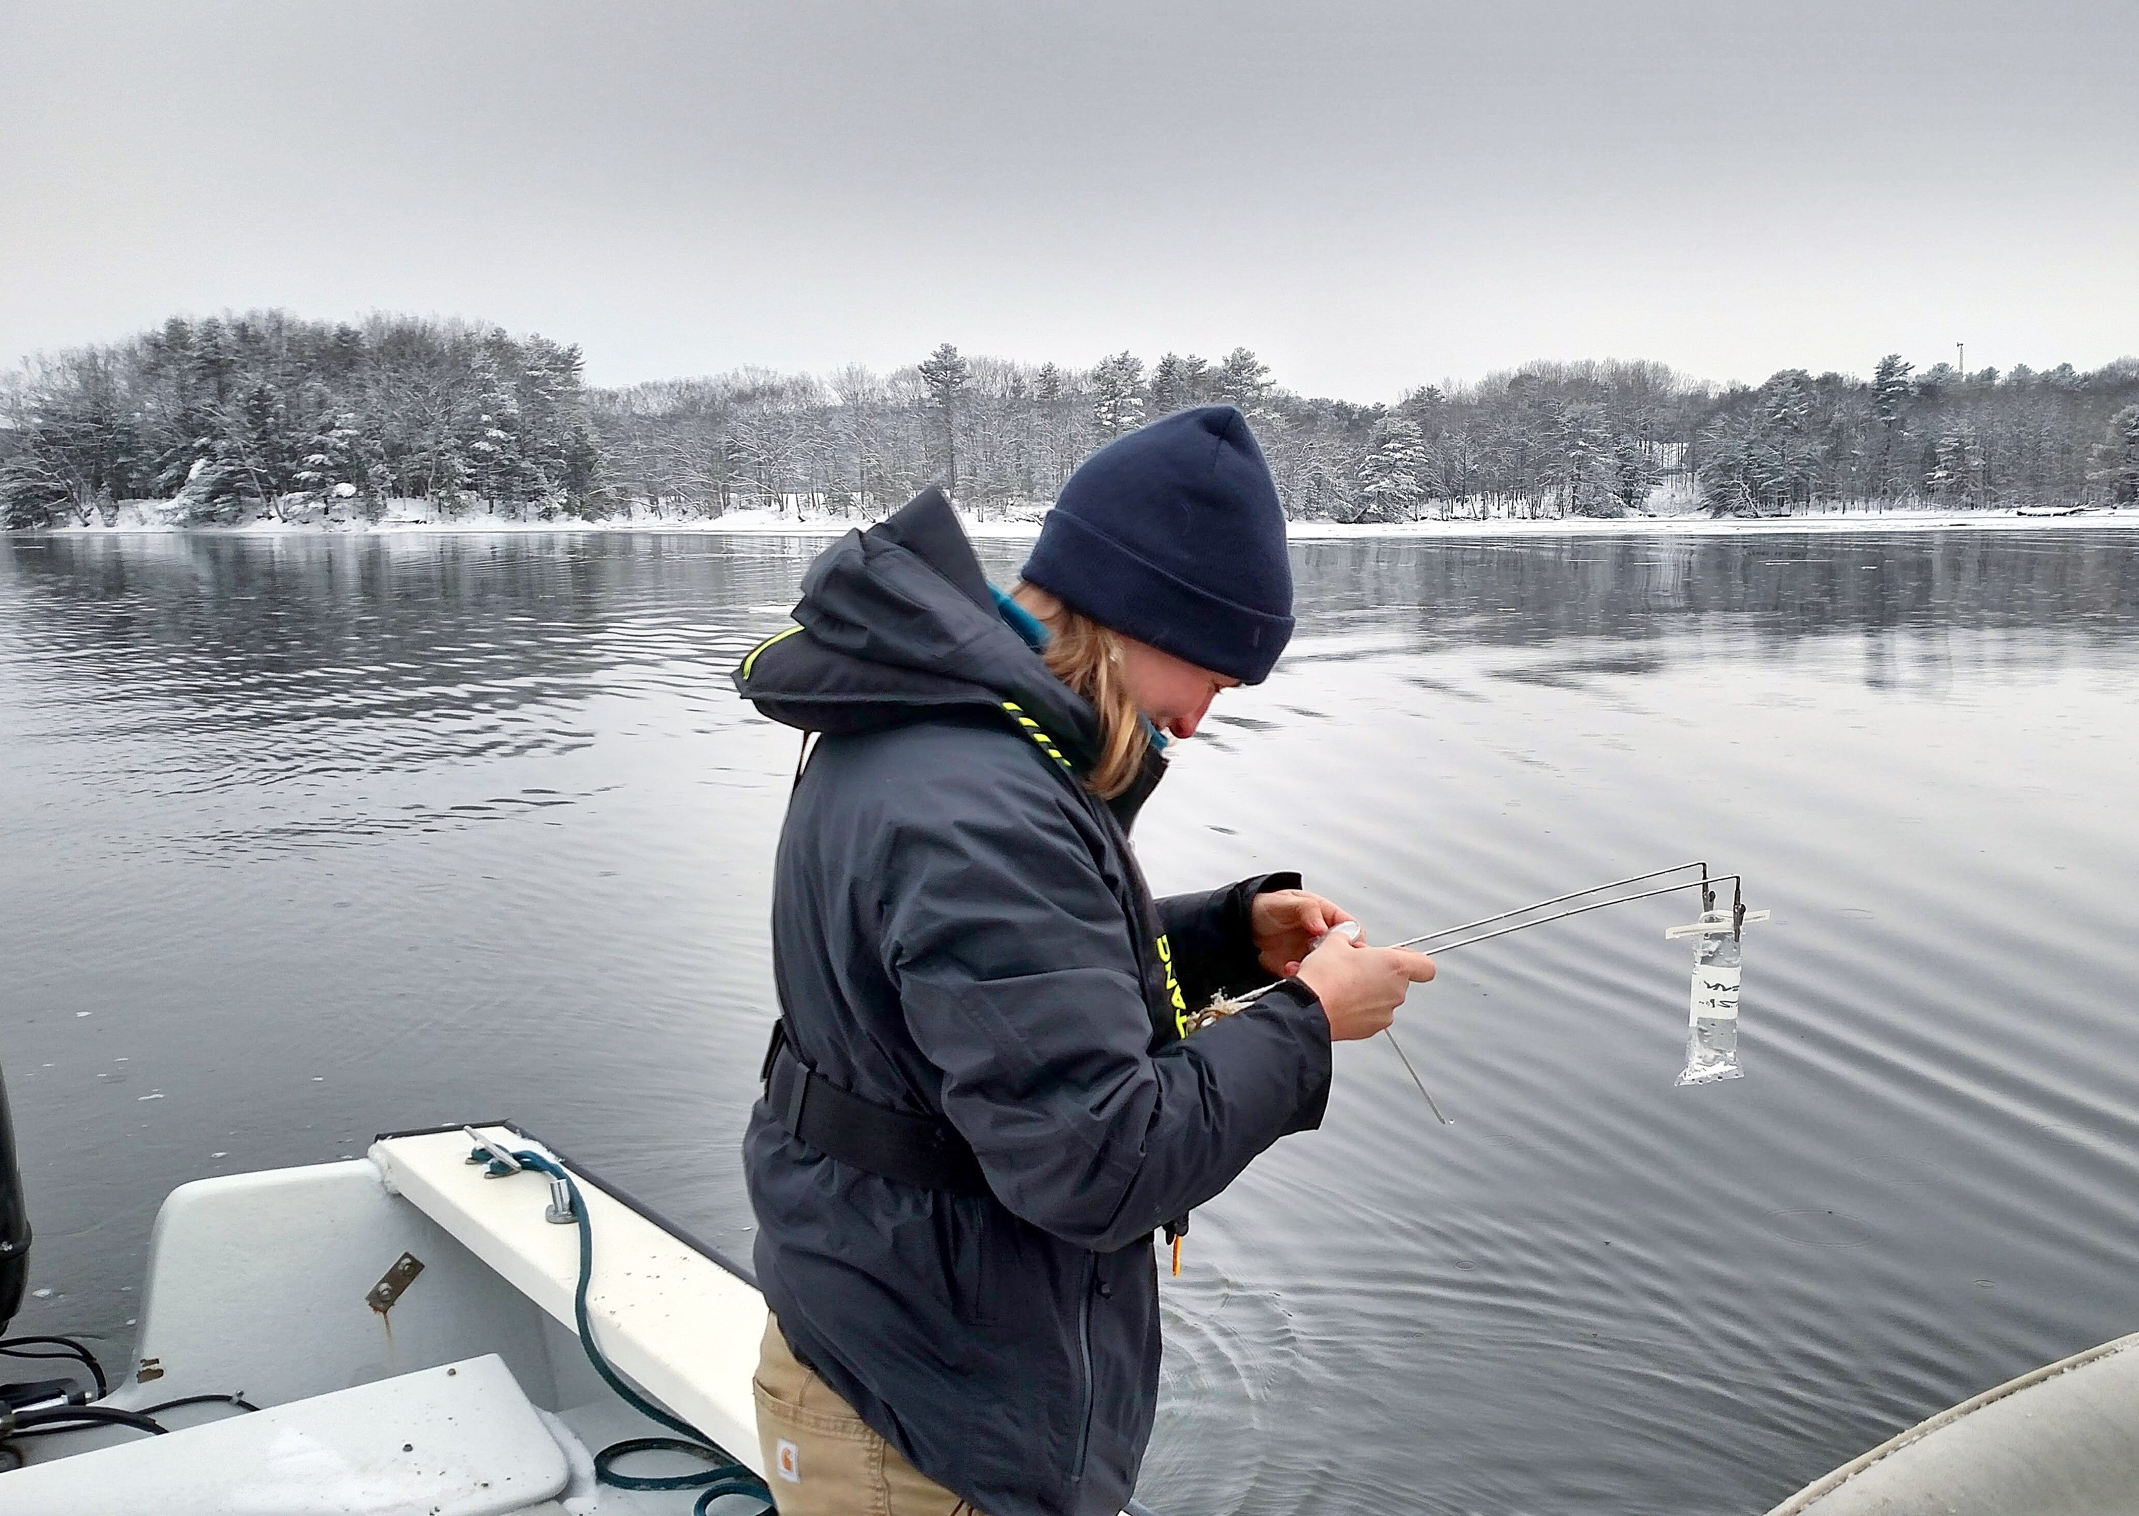
Sampling Method
Samples are taken with a sterile Whirl-pak bag and set of tongs.
Samples must be kept sterile (no fingers in bags, minimize upwelling of sediment if land sampling, re-take sample if bag is leaking etc.).
It is required to sample within 300 feet of station coordinates.
If taken by land, the sampler must be standing in a minimum of 18 inches of water.
The sample must be taken at a minimum depth of 8 inches.
Samples should not be taken at low tide. (DMR recommends sampling 3 hours before or after high tide).

Slide 6
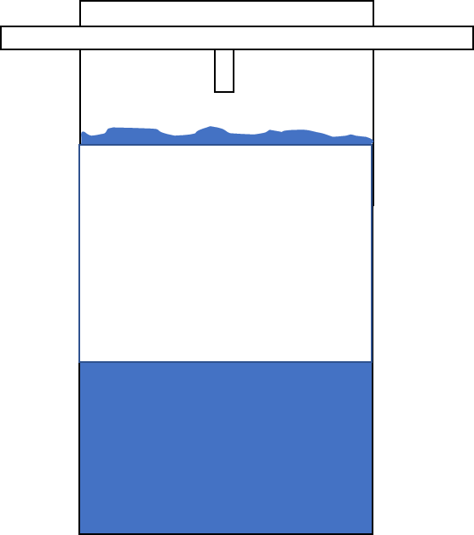
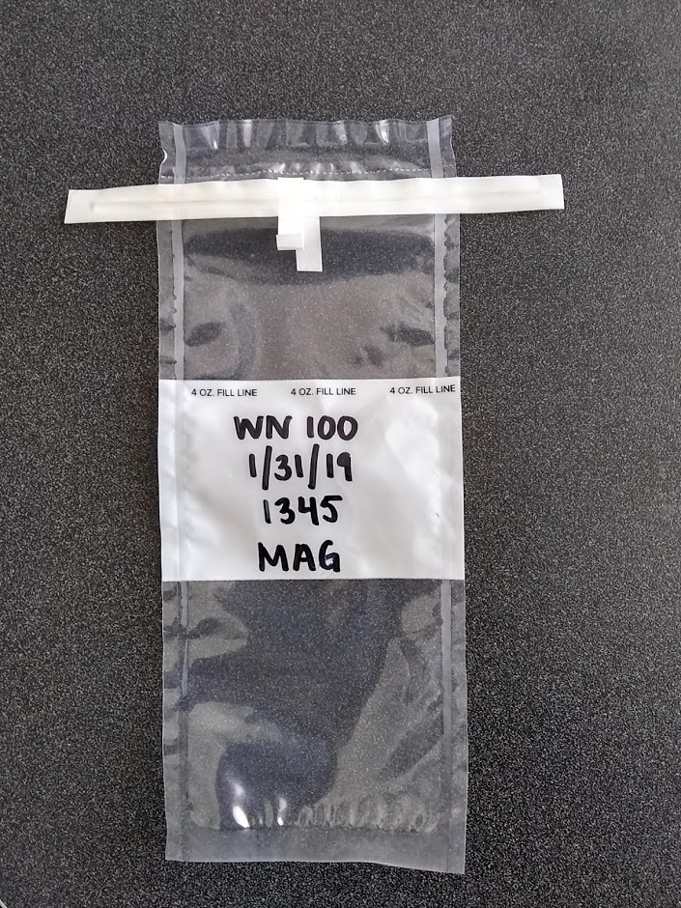
Labeling Sample Bags
Headspace to allow shaking
and aeration at the lab
Growing Area & Station #
Sample Date
Sample Time
Sampler Initials
Use permanent marker.
Write in the white space.
Fill to the 4oz line but leave “headspace” as shown in the pictogram.
Use military time.

Slide 7
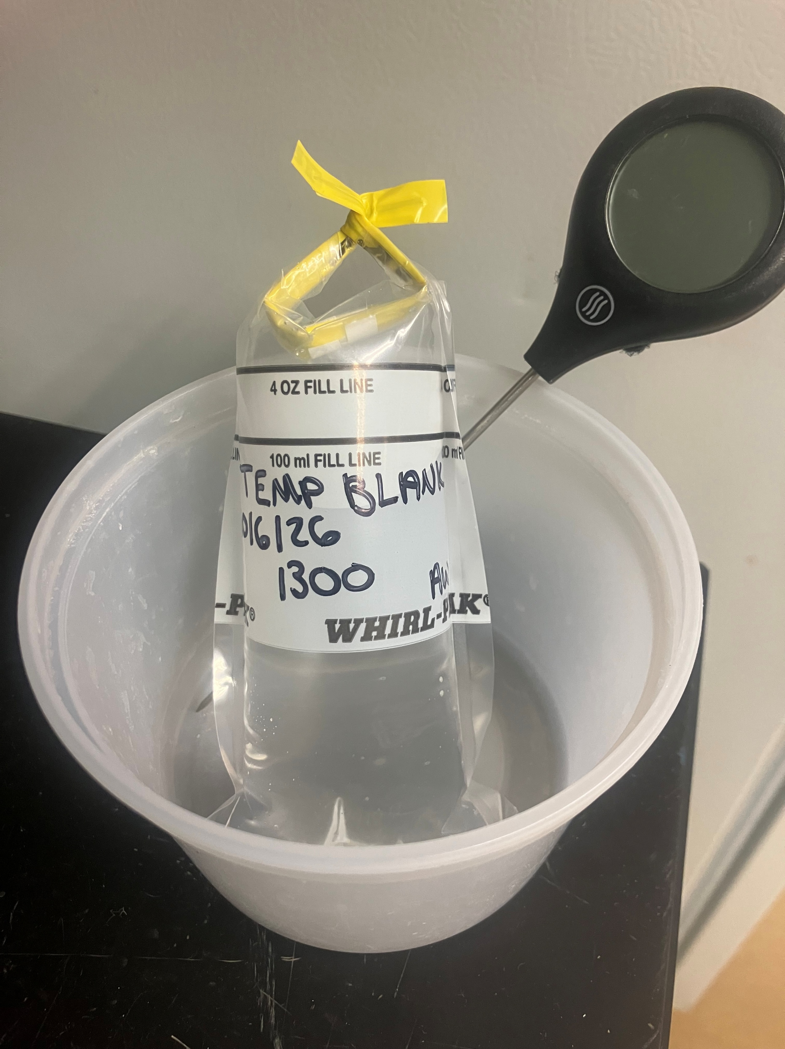
New Requirement for 2027
New Temperature Blank Collection Procedure
We are now monitoring sample temperature using a Temperature Blank instead of cooler temperatures.
Collect: At the first station: Collect one additional water sample labeled “Temp Blank.”
Record: Enter the collection time and water temperature on the first line of the updated bench sheet.
Transport: Place the Temp Blank in the cooler with the other samples and deliver it to the satellite refrigerator.
COC: When dropping samples record the refrigerator temperature (not cooler temperature) and complete the Chain of Custody section as usual.
At the DMR lab: DMR staff will measure and record the Temp Blank temperature upon receipt.
Temperature Requirement: The Temp Blank must be 0–10°C upon receipt OR cooler than its temperature at collection.

Slide 8
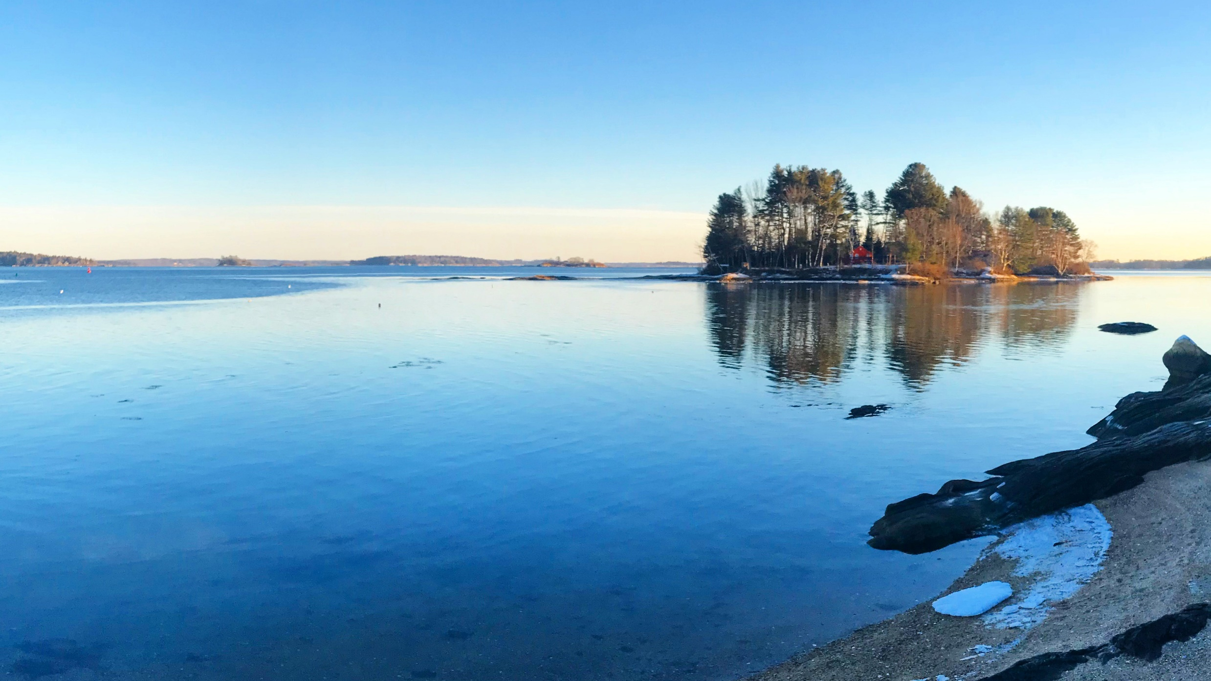
Transporting & Storing Samples
DMR will provide volunteers with a cooler, tongs, racks, a calibrated cooler thermometer and a calibrated field thermometer (if sampling by land, volunteers will need to provide their own hip waders).
Samples must be placed in the cooler immediately after collection.
The temperature blank must be 0–10°C upon receipt OR cooler than its temperature at collection (DMR recommends using 4 ice packs to achieve this temperature range).
Samples can be dropped at a DMR satellite fridge, the DMR lab in BBH or Lamoine, or a pick up with a DMR staff member can be coordinated.
Samples must be processed at the lab within 30 hours of collection time.

Slide 9
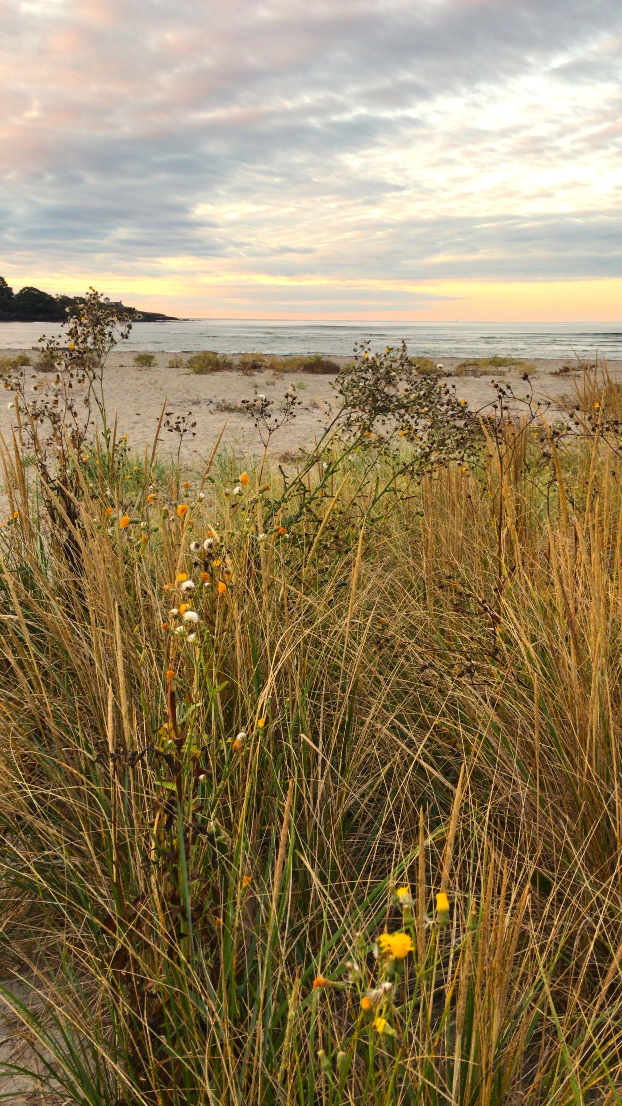
Field Sheet Requirements
Time must be recorded in 24-hour format (military time).
Date should be recorded as: Month-Day-Year.
Temperature must be recorded in Celsius.
Missed stations need a “missed station code” (back of data sheet).
Missed stations still need attempted sample time.
Any potential source of pollution observed needs an Adversity code (back of data sheet).
Fill out chain of custody (number of samples per sheet, not the total samples per run).
Mistakes need a single line strikethrough with date and initials of the corrector (can be in annotation style, ex. on next page).
Use black or blue pen. Do not use pencil.

Slide 10
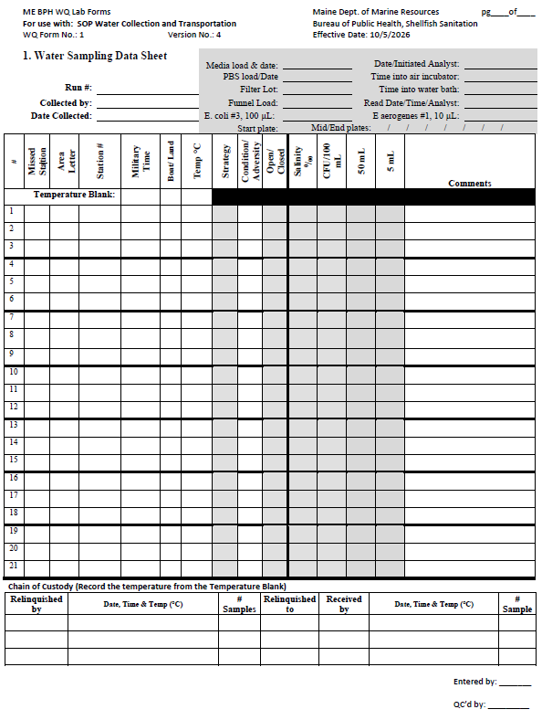
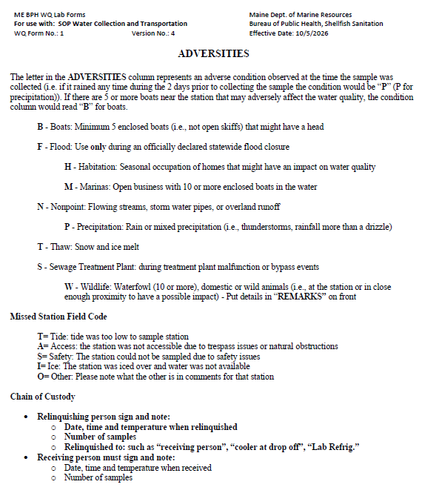
Field Sheet Example
Front
Back
17V
KRW, AW
08-06-2026
1300
B
18
WN
36
1305
18
W
Over 20 geese nearby
T
37
1310
Tide too low to collect
39
1315
19
1
All fields in grey are for DMR staff use only
KRW
8/6/26 1500 3C
2
SAG
1
Sample taken at 1320 – KRW 08-06-2026

Slide 11
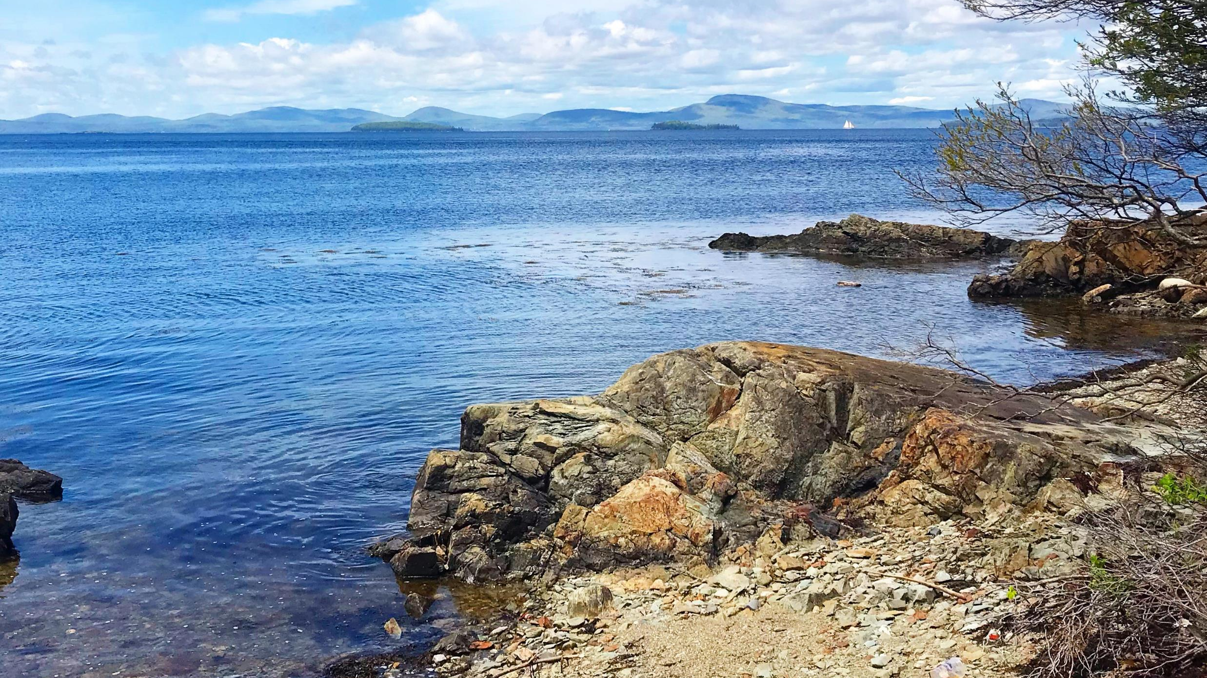
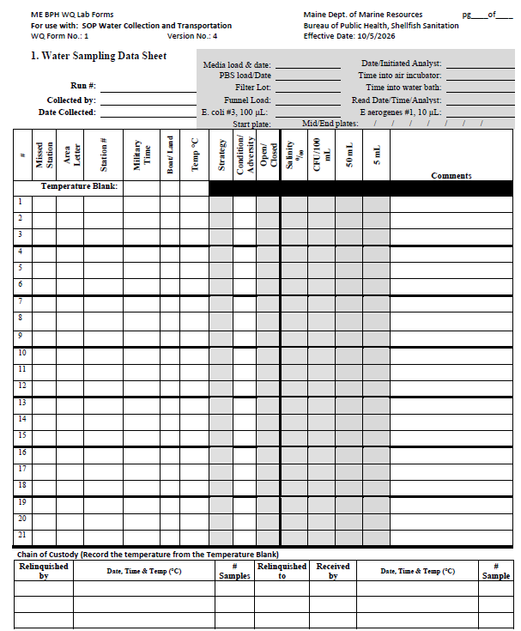
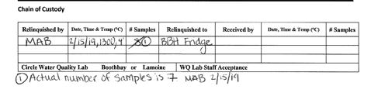
Chain of Custody
Filling out CoC is mandatory every time the samples are moved (cooler to cooler, cooler to fridge, etc.). Always use the DMR provided cooler for sample transport.
The number of samples entered correspond to each sheet rather than the full run and do not include missed stations.
Footnote correction

Slide 12
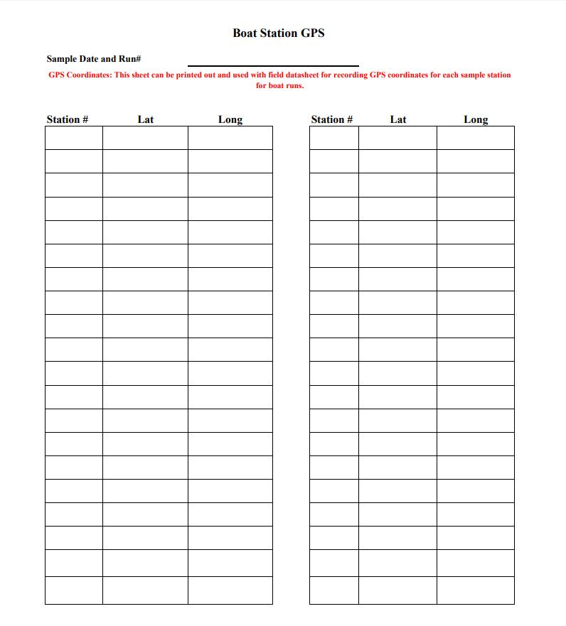
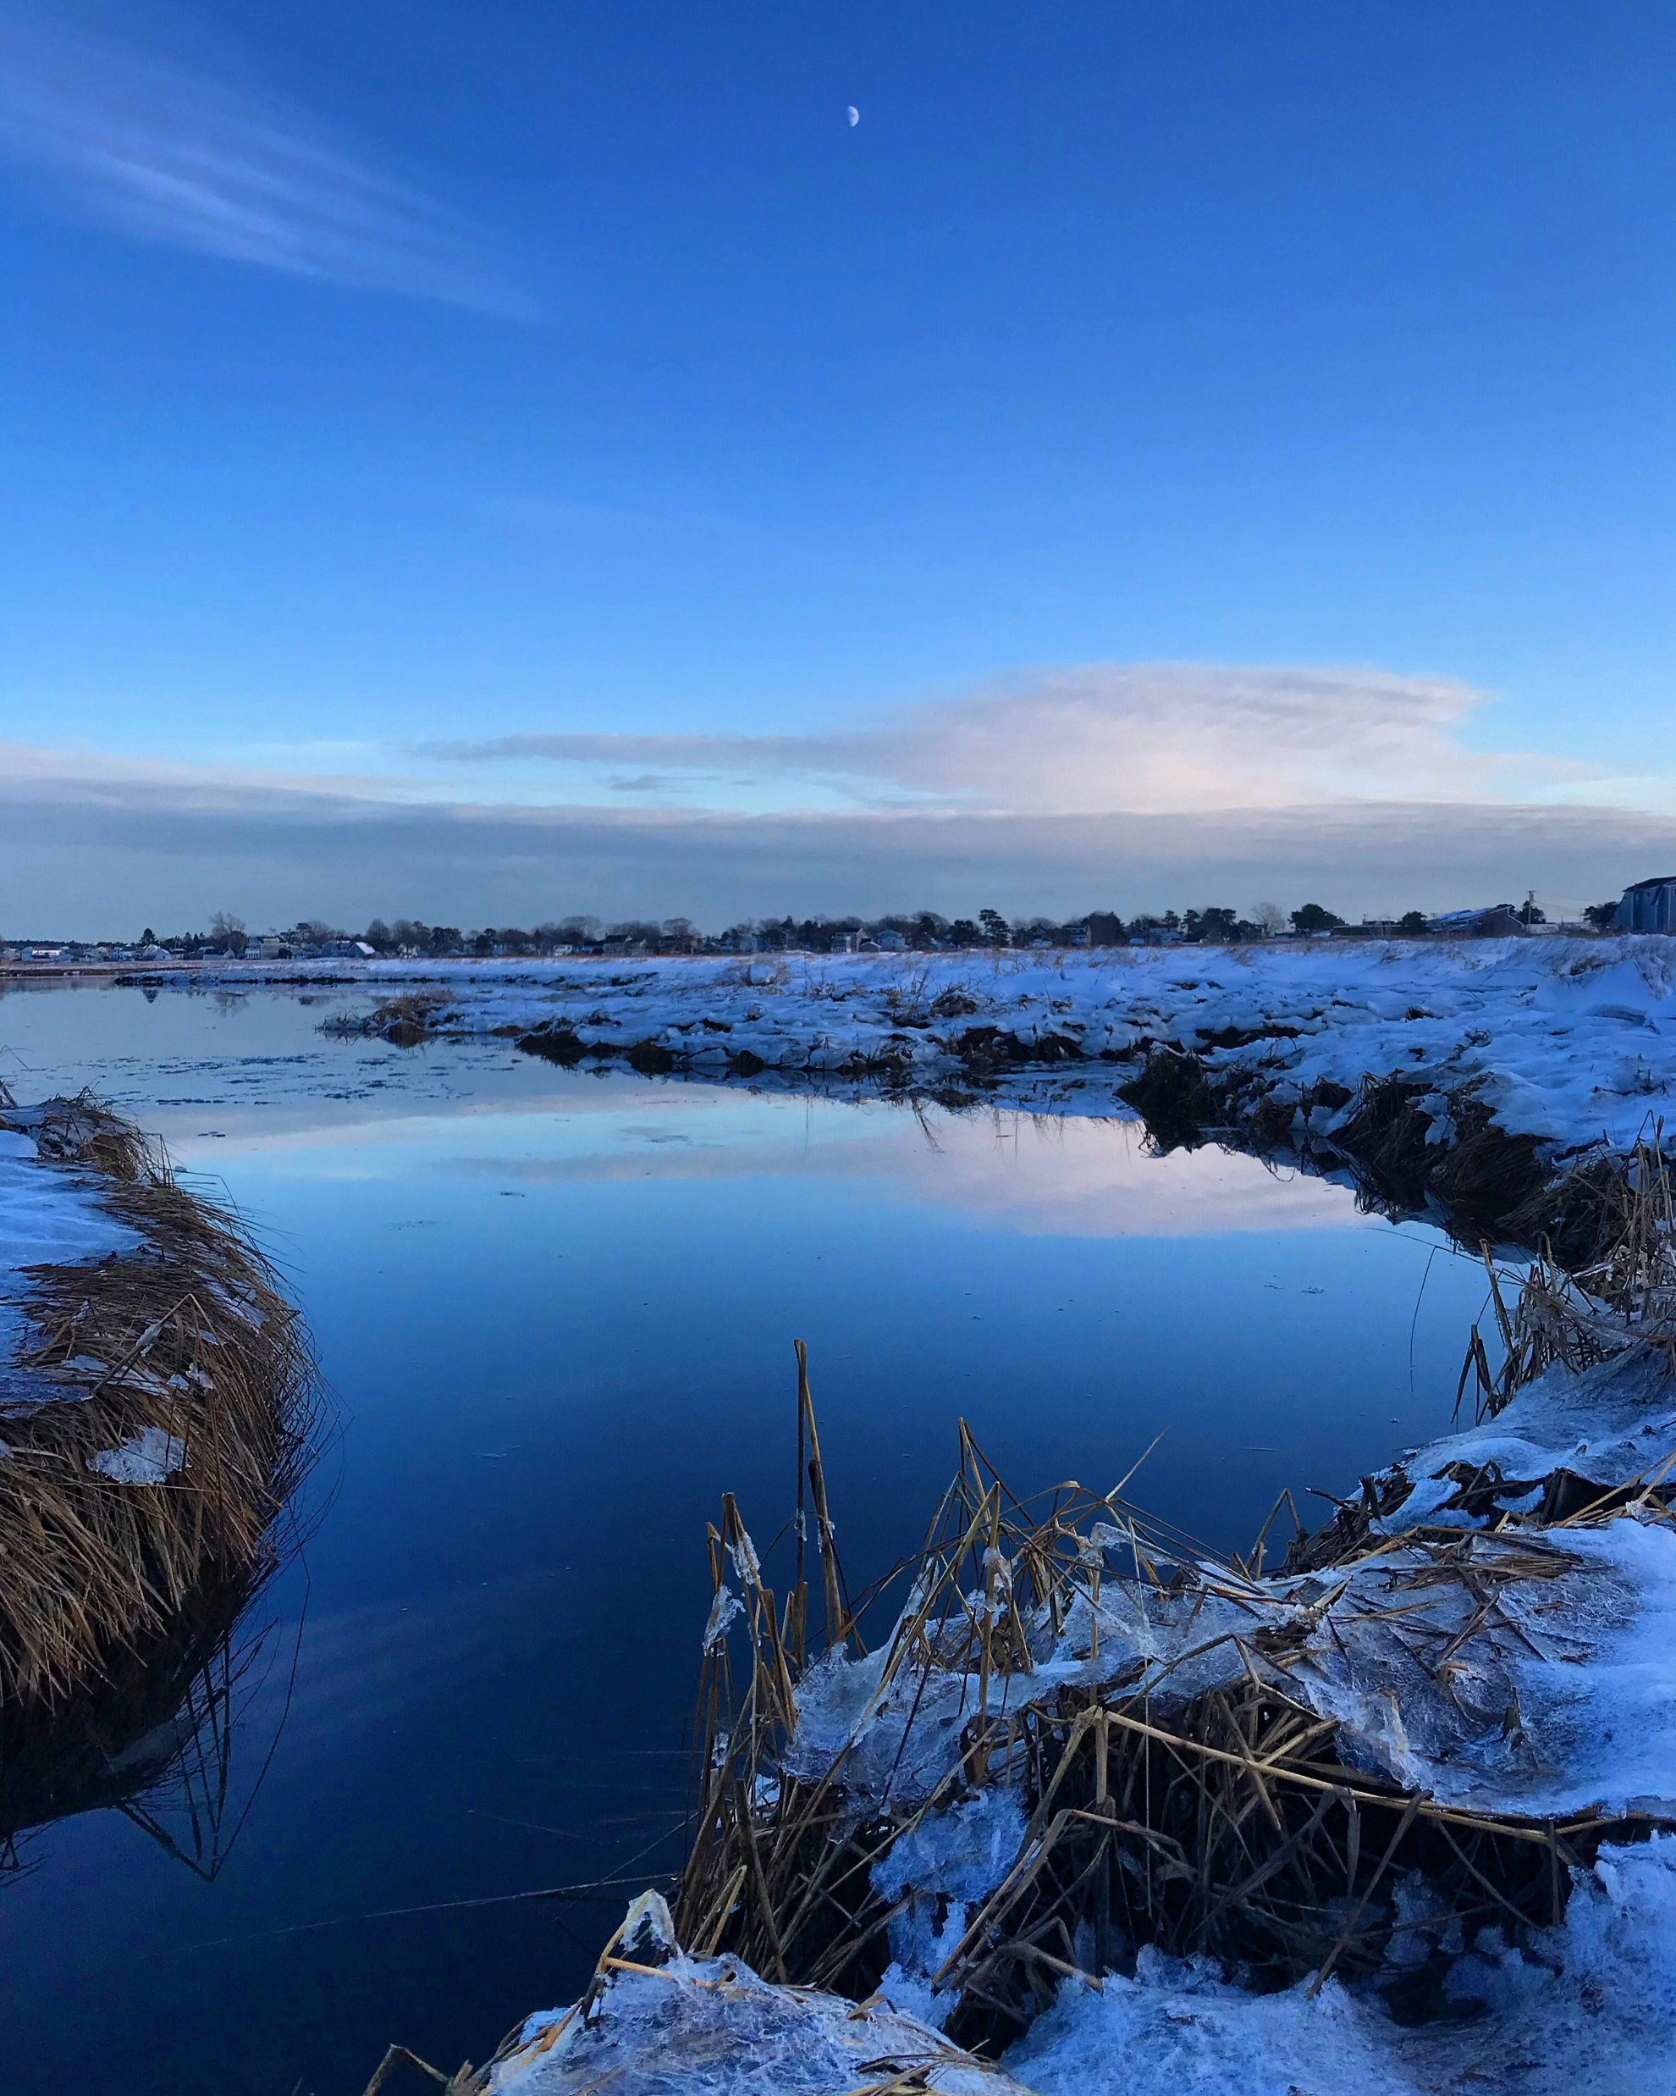
Sampling by Boat
Volunteers sampling by boat are required to provide GPS coordinates for all stations collected during each sampling trip OR to use a GPS preprogrammed with station locations.

Slide 13
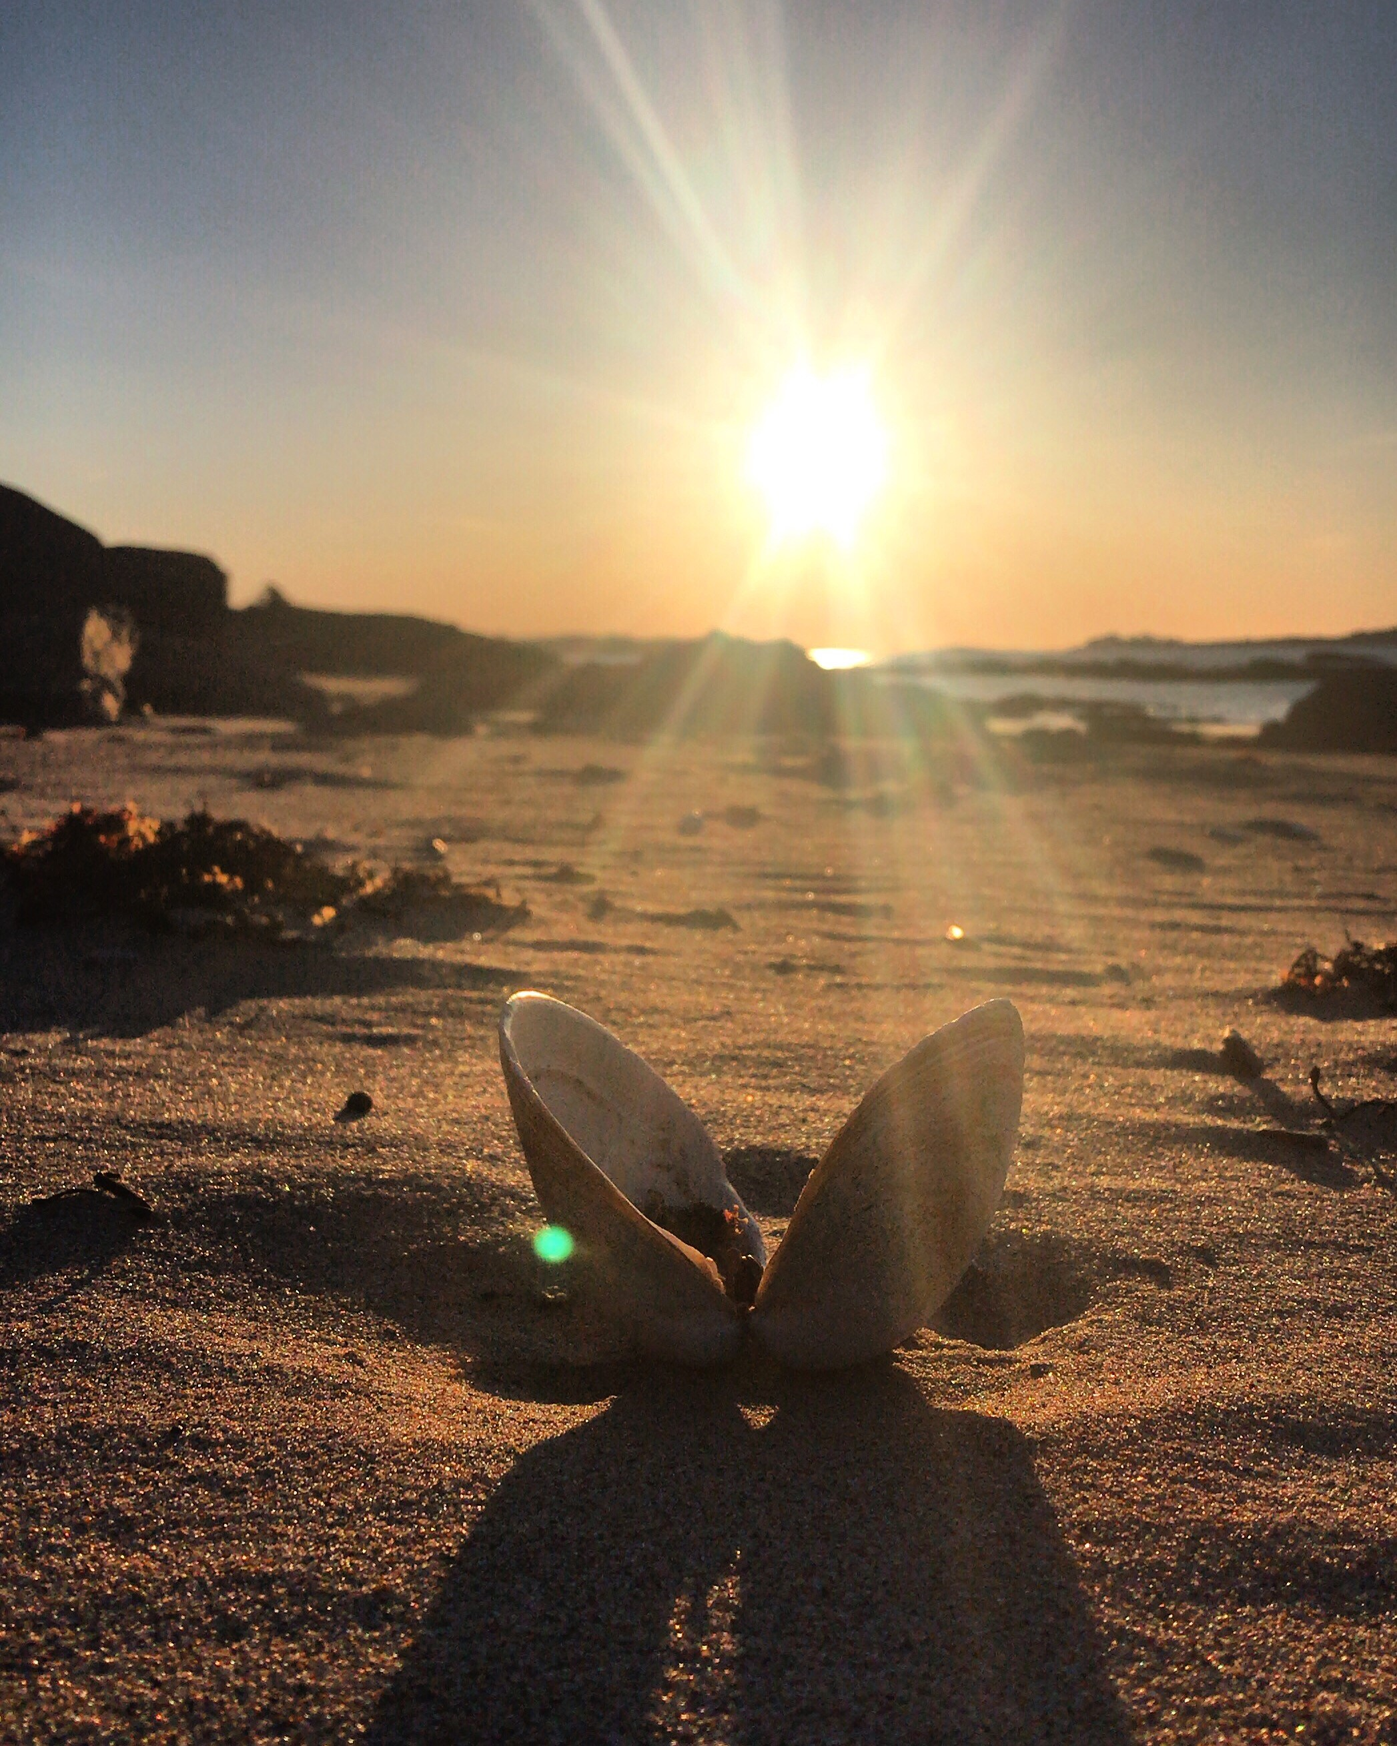
Training Check #1
Within how many feet of the plotted station location must a sample be collected?
What is the minimum water depth required to take a sample?
What is the minimum sample depth?
Is it required to use a DMR cooler for sample transportation?

Slide 14
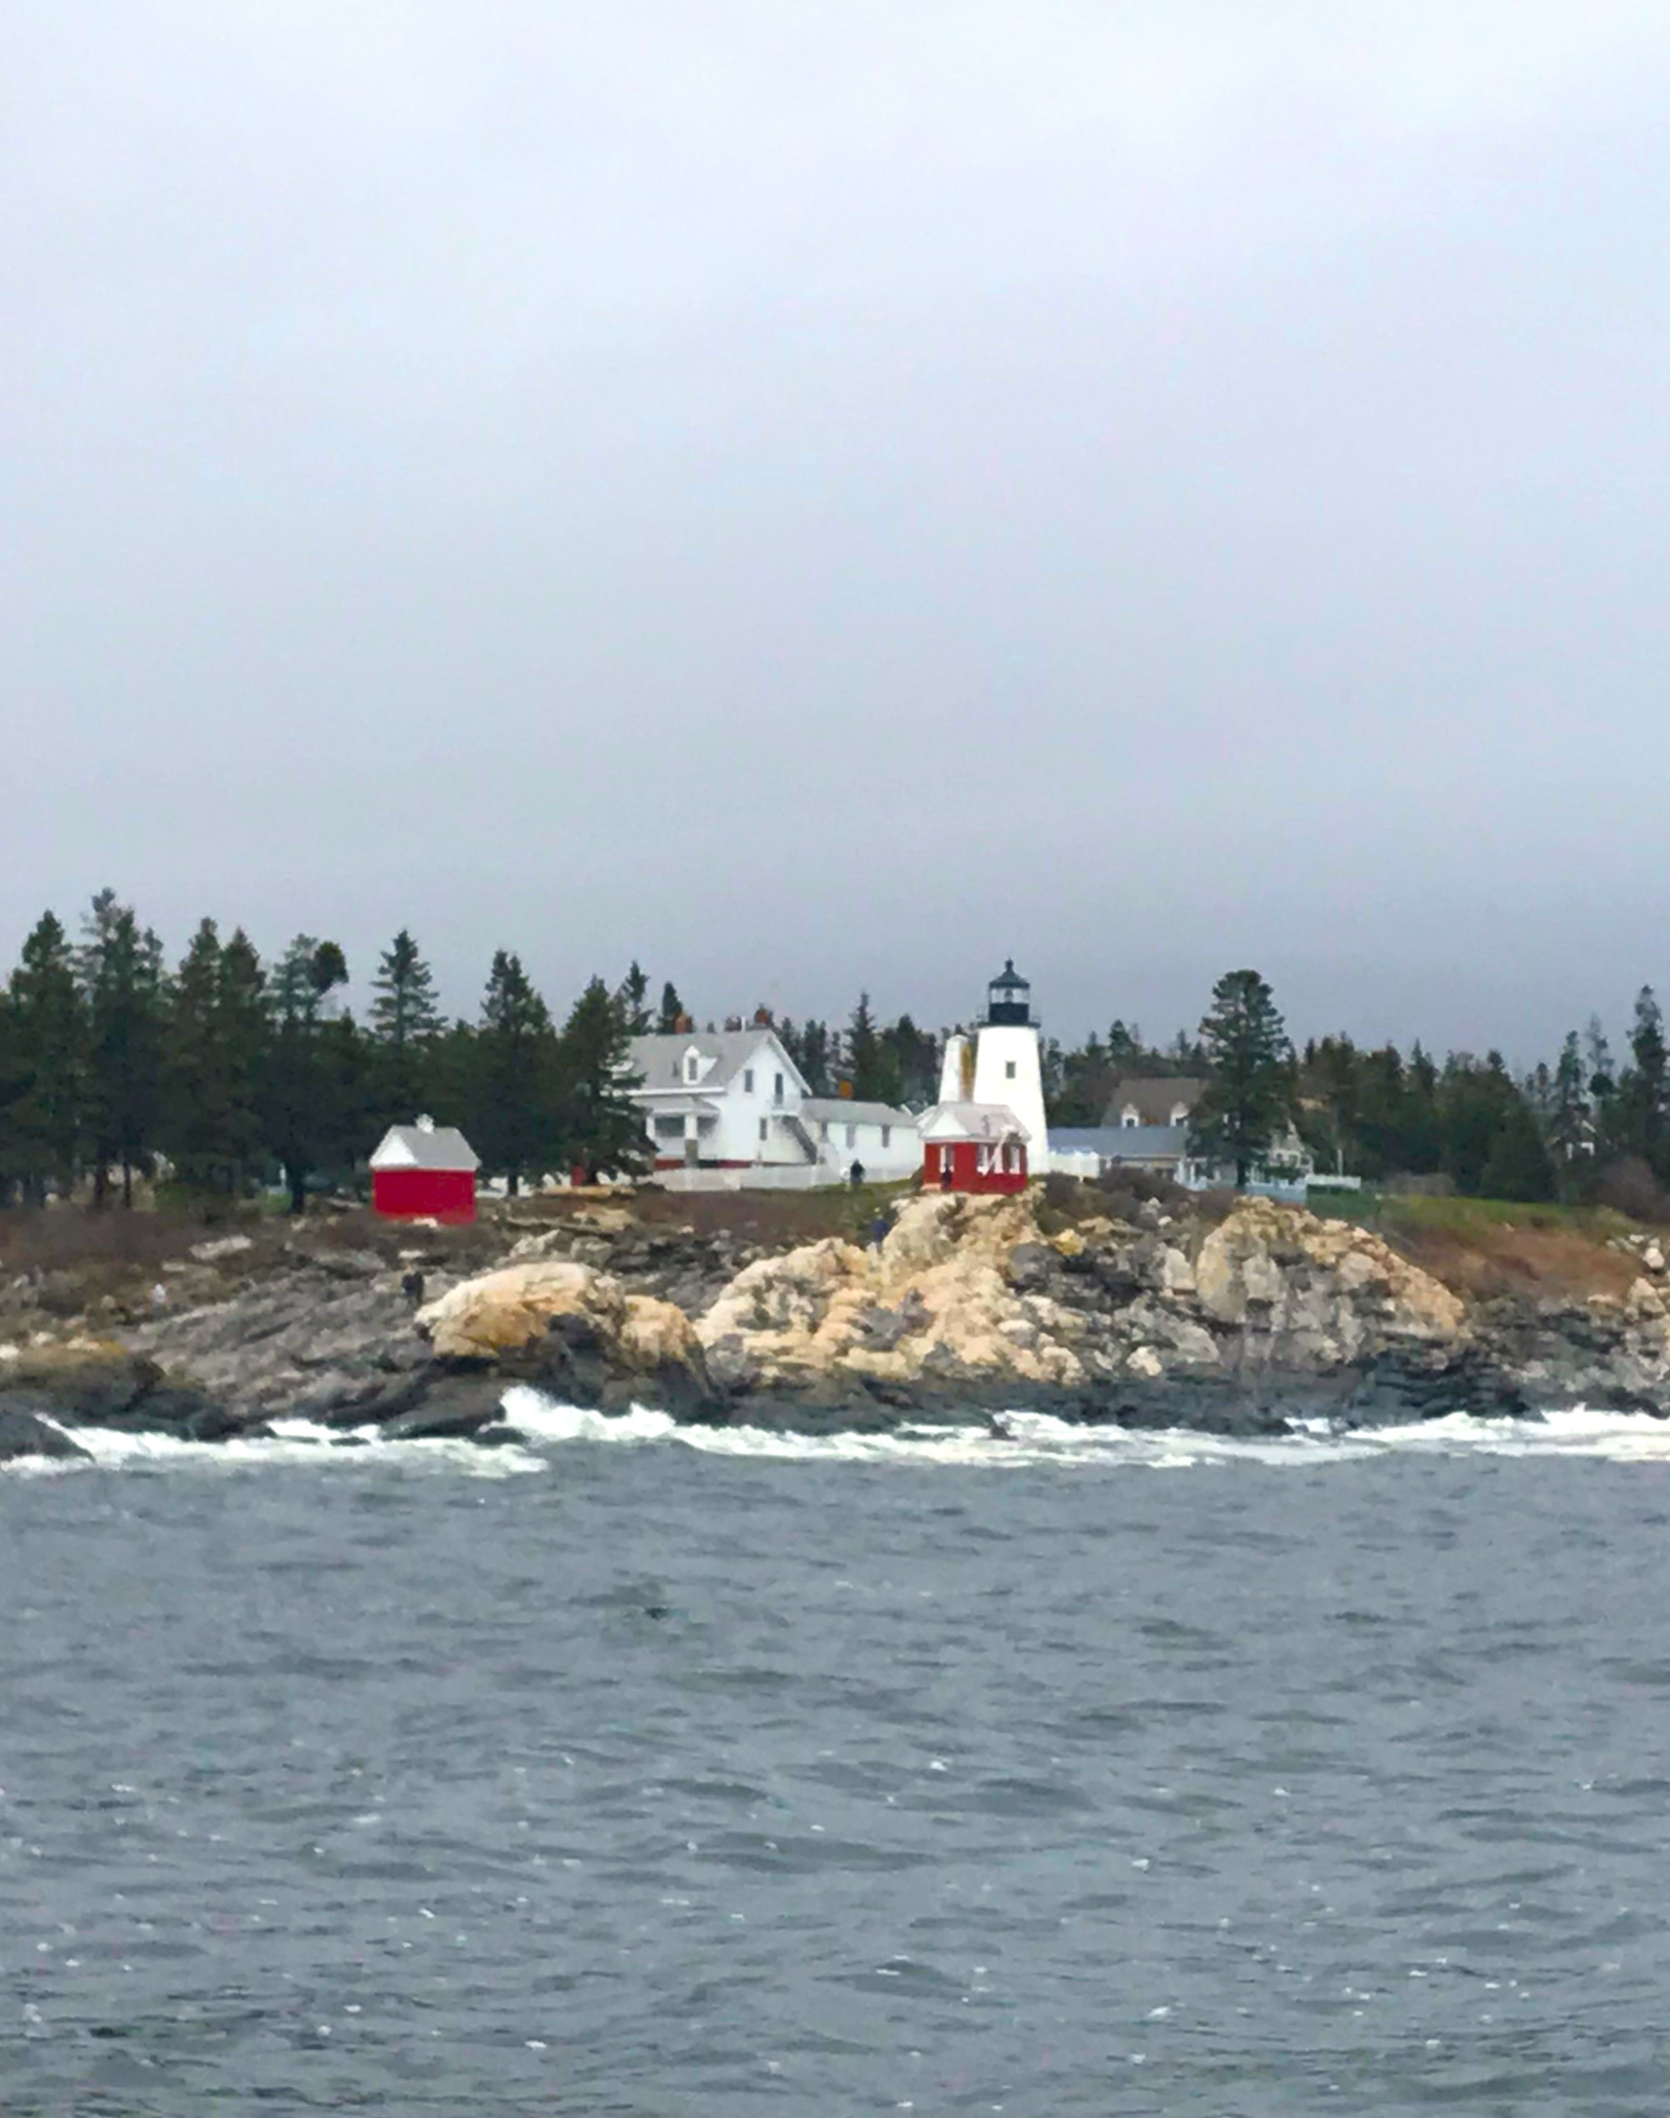
Training Check #2
What should you do if your sample bag is leaking?
If samples are being dropped off at a temperature-controlled satellite location, what information must be on the Chain of Custody form?
7. What critical pieces of information must be written on the sample bag?
8. Samples must be processed within how many hours of collection?

Slide 15
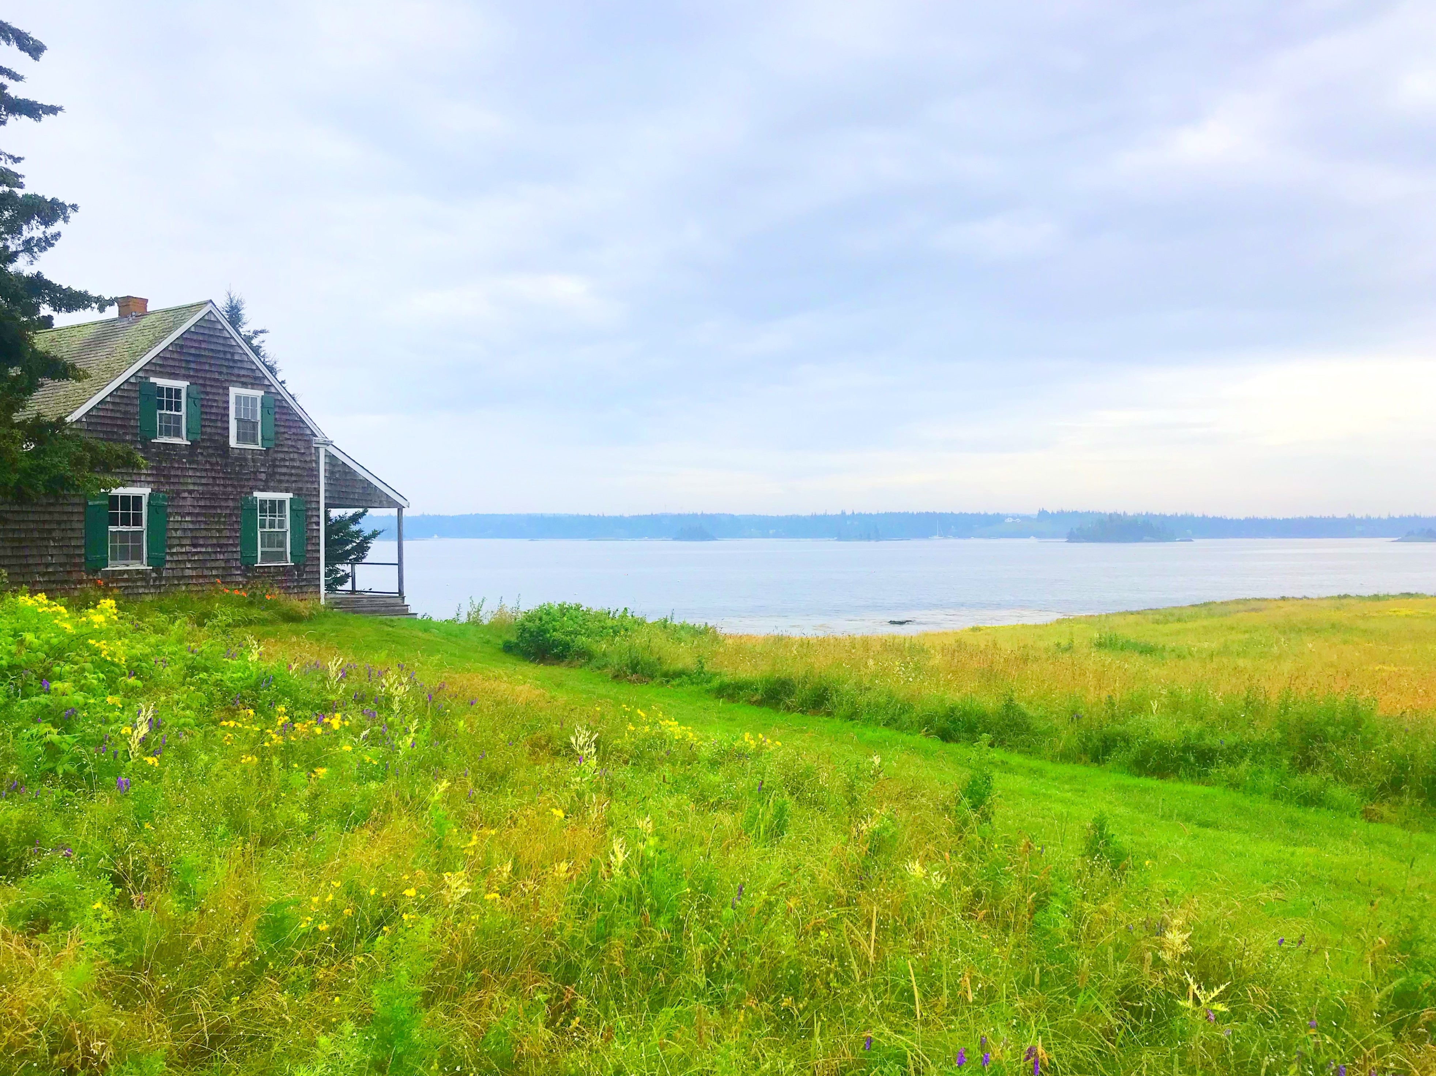
Answers
300 feet
18 inches
8 inches
Yes
Resample with a new, unopened bag.
Initials, date, time (military), temperature (C), number of samples, relinquished destination.
Growing Area, station #, date, time (military), and sampler initials.
Within 30 hours of collection

Slide 16
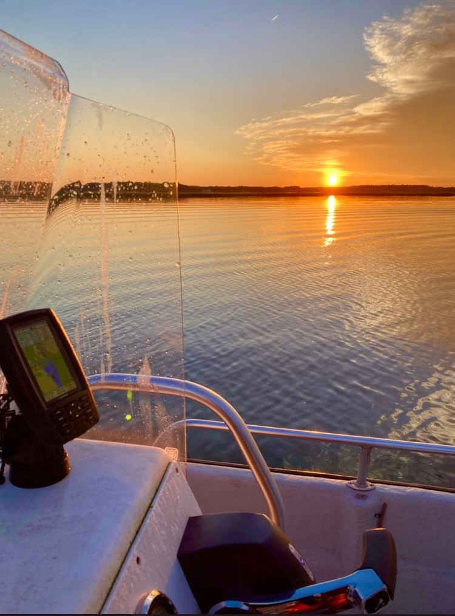
Resources
The volunteer application & waiver, this training guide, blank data sheets, blank GPS coordinate sheets, and the volunteer SOP can be found here:
https://www.maine.gov/dmr/node/779
A copy of the FDA National Shellfish Sanitation Program (NSSP) Guide, to which DMR must comply, can be found here:
https://www.fda.gov/food/federalstate-food-programs/national-shellfish-sanitation-program-nssp

