Slide 1

Aquatic Organism Health and Biosecurity
MDMR Aquaculture Division
www.maine.gov/dmr/

Slide 2

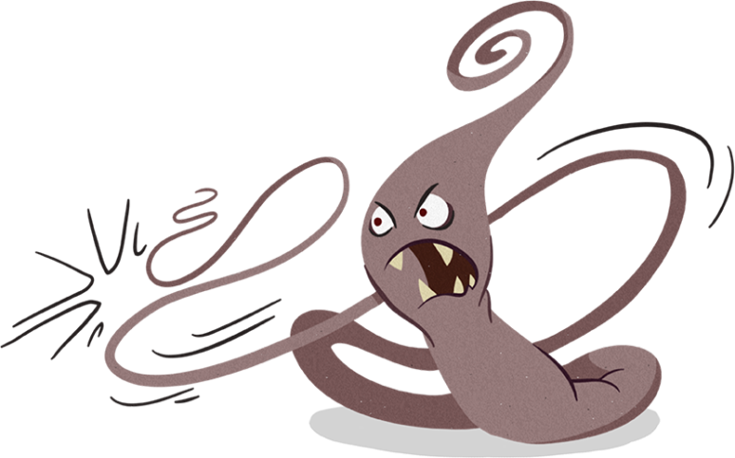
What is Biosecurity?
Tools and methods designed to reduce the risk of introduction and/or spread of pathogens, parasites, and pests (PPPs).
  Pathogen: microorganism that may cause disease (bacteria, virus, some parasites)
  Parasite: microorganism that depends on another living organism, causing harm to the host.
  Pest: organism that causes a “nuisance” but not disease.

Slide 3
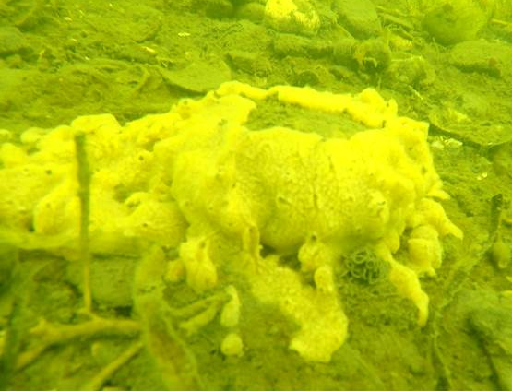
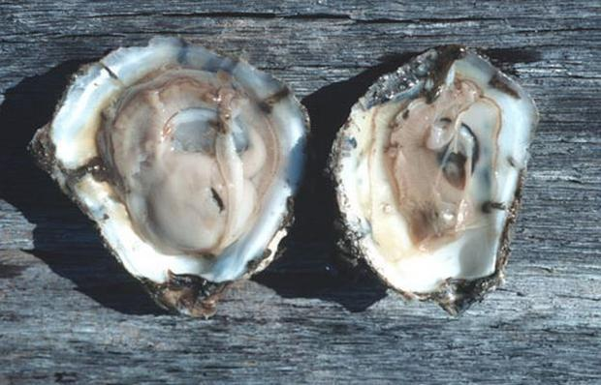
Why Should I Care?
Public trust
We’re all in this together
  Shared water = Shared PPPs
Losses of wild and farmed resources
Economic consequences
  Increased production costs
  Unpredictable product

Slide 4
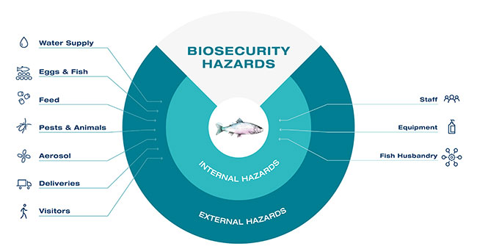
Biosecurity Basics
Risk Factors
Photo Credit: Skretting

Slide 5
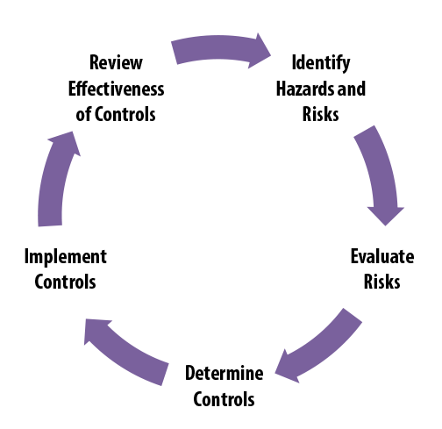
Biosecurity Basics
Risk Analysis and Control

Slide 6
The Role of MDMR
The Department of Marine Resources was established to conserve and develop marine and estuarine resources…
Notes:
12 M.R.S.A, Part 9, §6071: http://legislature.maine.gov/statutes/12/title12sec6071.html
DMR Regulations Chapter 24: https://www.maine.gov/dmr/laws-regulations/regulations/documents/Chapter24-08212018.pdf

Slide 7
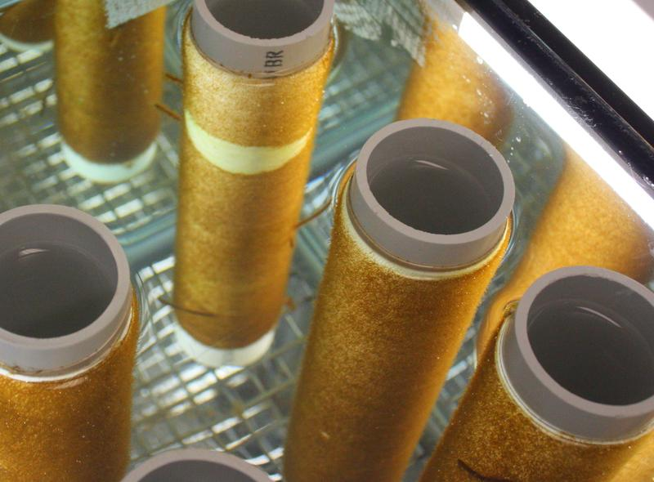
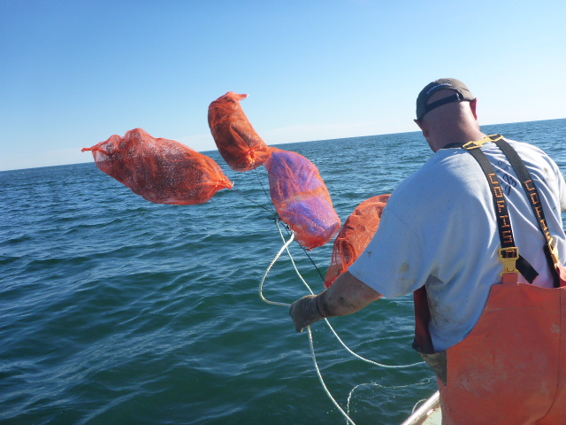
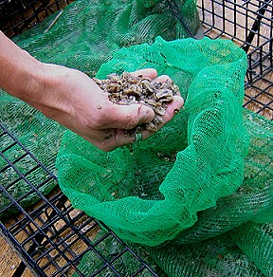
Sources of Seed
In-State Options
Out-of-State Options *
  Approved ME hatchery
  Secondary seed / nursery*
  Wild spat collection*
    No Soft, hard, or hen clams
  *Permit may be required
  Approved hatchery
  Secondary seed / nursery
  No algae or urchins
  *Permit required

Slide 8

If It’s From Maine It’s OK, Right?
It Depends.
Shellfish:
  Hatcheries – DMR
    Downeast Institute
    Mook Sea Farm
    Muscongus Bay Aq.
    Running Tide Tech.
  Secondary Seed
    Same LPA Health Area or a permit is required
  Wild
    Same LPA Health Area or a permit is required
Marine Algae:
  Hatcheries – DMR
    Atlantic Sea Farms
    Oceans Balance
    Sea Green Farms
    Springtide Seaweed
    Univ. of New England
  Wild
  All sorus tissue and seed must originate in Maine waters

Slide 9
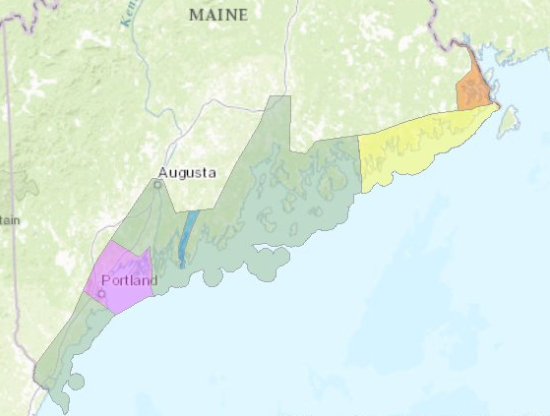
MDMR Regulations Chapter 2.05
LPA Health Areas
Notes:
All wild shellfish stock or seed used for cultivation or grow-out must originate from within the same Health Area defined under 2.05 (1) (J) as the LPA site. Once placed in the coastal waters of Maine it is considered “wild” for the purposes of this regulation.
Use of wild shellfish stock or seed originating from outside the Health Area of the LPA site will require evidence that the seed or stock is consistent with the species authorized under
2.90(4) and may require evidence that the seed or stock is free from disease, and will require a permit from DMR.

Slide 10
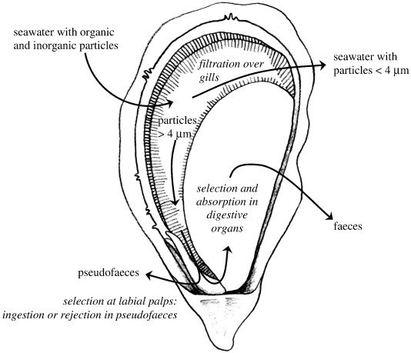
Why is seed from a lease/LPA treated as wild?
REMEMBER: YOU ARE WHAT YOU EAT!

Slide 11
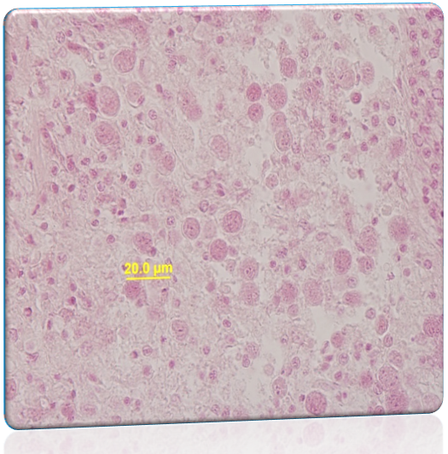
MSX (Haplosporidium nelsoni)
Introduction and Consequences
Protozoan parasite of oysters
1957: Delaware Bay import
90-95% mortality
Intermediate host?
Favors high temperature (>20°C) and salinity (>15 ppt)
No going back
Management:
  Limit impact and spread
  Disease-resistant strains

Slide 12
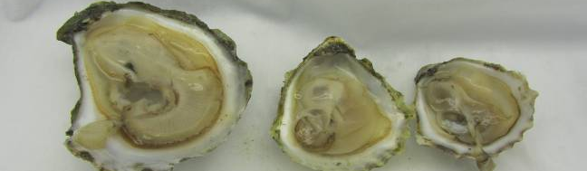
MSX History in Maine
1983: DMR Survey (Sherburne & Bean, 1991)
  2 oysters-Marsh River, 2 oysters-Piscataqua River (1983)
  Low levels (2.4%) at Darling Marine Center (1990)
  Limited mortality
1995: Piscataqua River (Barber et. al., 1997)
  Epizootic event (25-80% mortality)
  Low prevalence (% infected) previously
  Still present today
Photo D. Bouchard

Slide 13
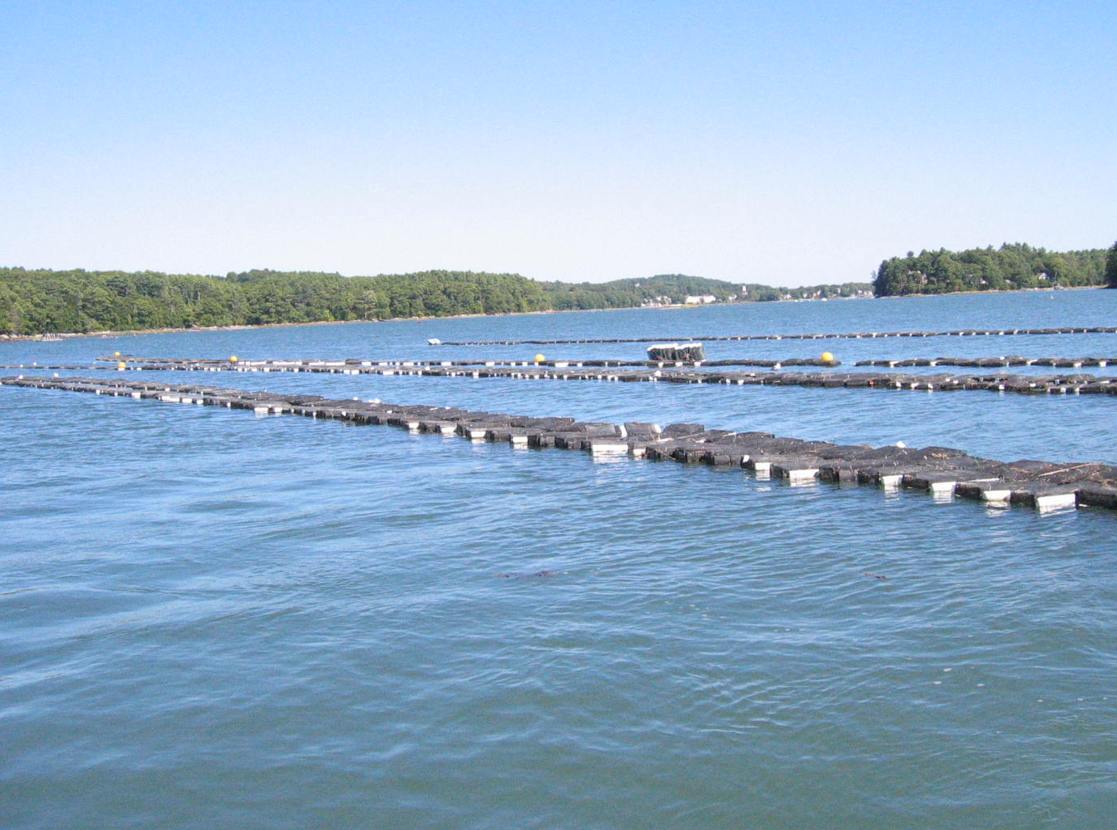
2010: Damariscotta River
  Mild winter followed by warm dry summer
  Producers noted increased mortality (up to 90%)
  Rutgers: MSX diagnosed by histology
    Prevalence 5-100%
    Intensity varied
  Genetic sequencing: Similar to Barnstable, MA…

Slide 14
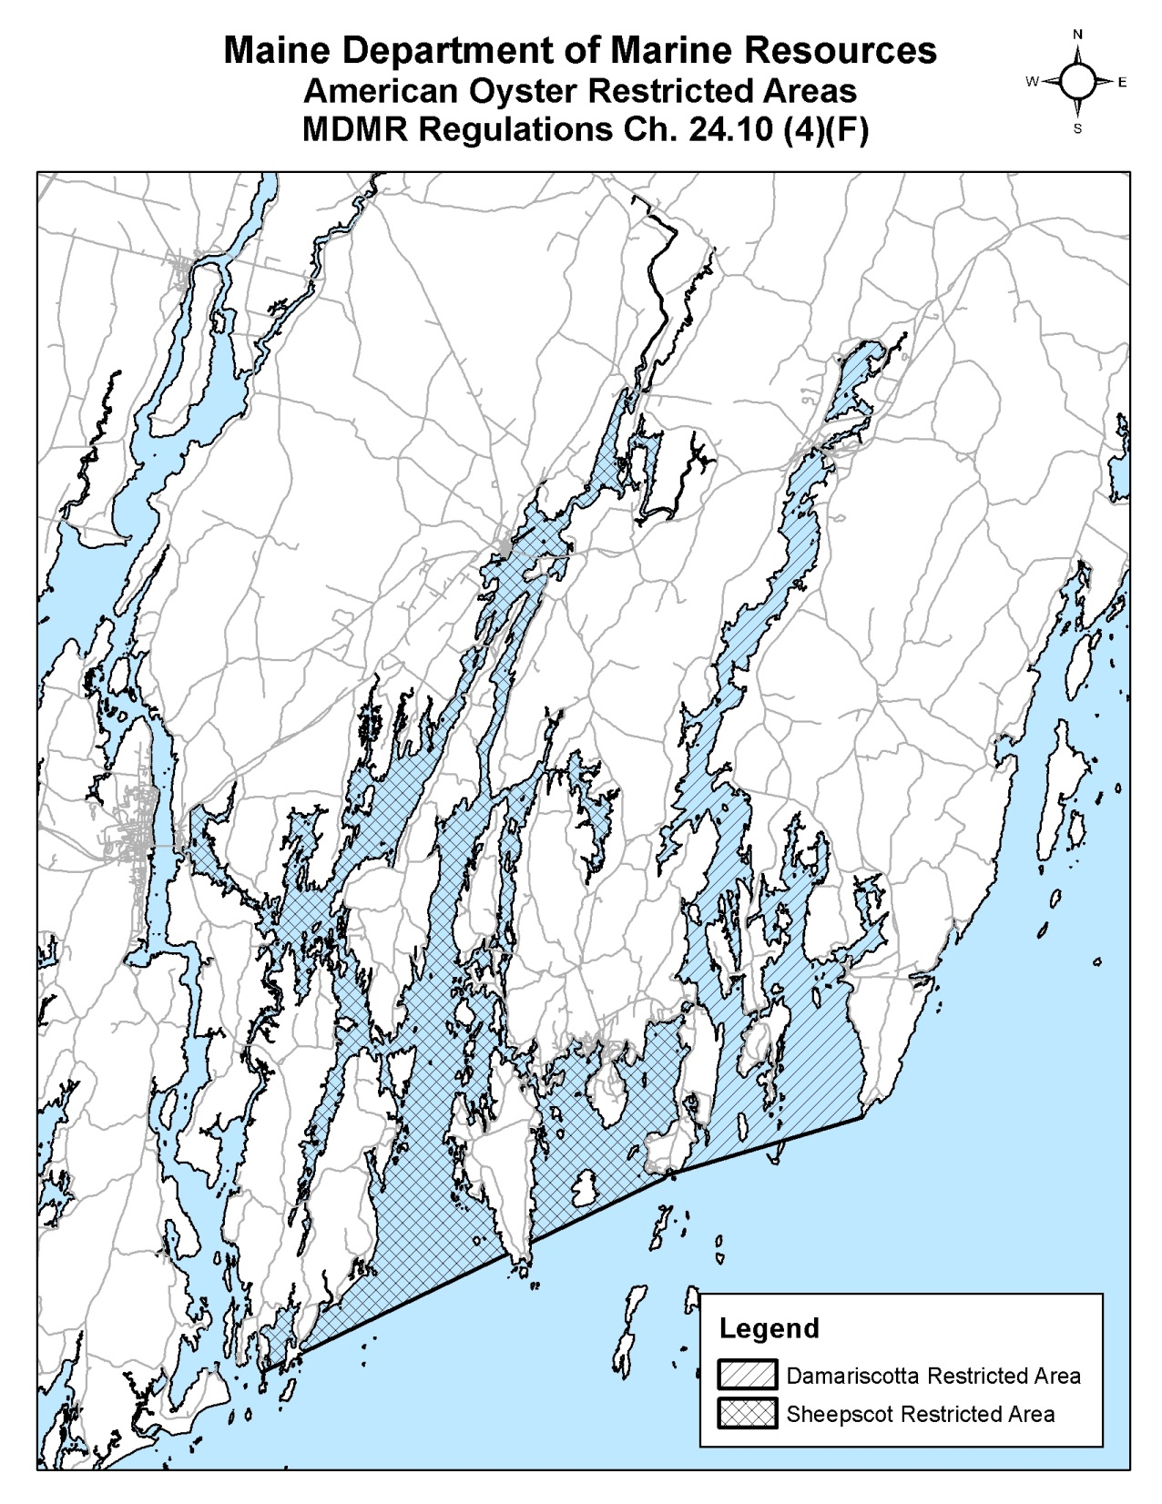
  No movement of oysters from “Restricted Areas” to other areas of Maine.
    Includes wet storage and flow through.
  Does not apply to the purchase of seed from approved hatcheries.
  MSX Detections
    Damariscotta River: 2010-2019
    Marsh River: 2013, 2019
    Westport Island: 2015
    Quahog Bay: 2020

Slide 15
Out-of-State Seed Sources
What you need to know to protect you and your neighbors.

Slide 16
MDMR Regulations Chapter 24:
24.03 Prohibited Activity
  It shall be unlawful to import for introduction or to introduce into any coastal waters any live marine organisms, whether indigenous or nonindigenous, without a permit issued by the commissioner…
Import: to bring into the State of Maine from outside Maine.
Introduce: to bring into any place subject to the jurisdiction of the State of Maine from any restricted areas within the State of Maine.
  Different from Public Health “Restricted Areas”
  Defined based on the presence of a pathogen, parasite, or pest of concern (i.e. MSX).

Slide 17
MDMR Regulations Chapter 24:
Permit Issuance Criteria
24.10 & 24.15 (including, but not limited to)
    A. the effects of any previous introduction of the same or a similar species in Maine or other areas;
    B. the relationship of the species of marine organism to be introduced with other members of the recipient area ecosystem; and
    C. the potential effects of infectious or contagious diseases, pests or parasites that might be associated with the species of marine organism to be introduced upon other members of the ecosystem of the recipient area.

Slide 18
Assessing Risk:
Seed
Broodstock
Regional pathogen status
Hatchery certification
  Filtration/UV
  3-year health history
  Biosecurity audits
Health screening
Hatchery quarantine
Wash eggs and larvae
Screen seed
Biosecurity Audits

Slide 19
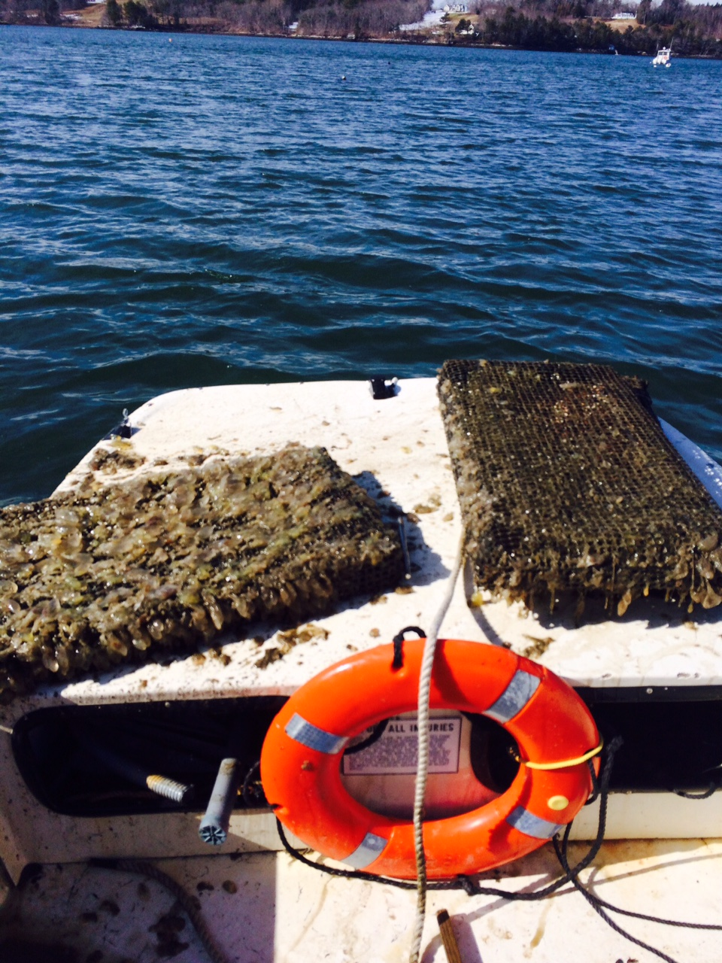
You Got A Great Deal on Used Gear. Now what?
Photo D. Morse

Slide 20
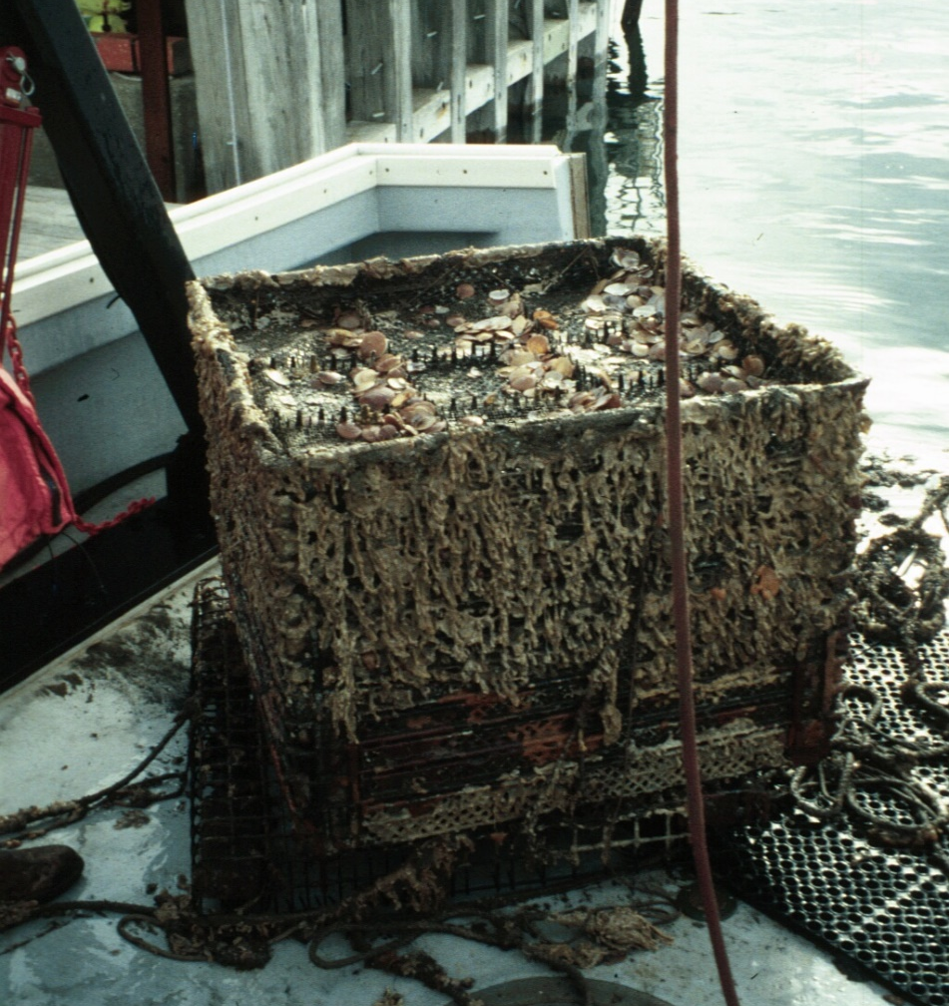
Biosecurity Basics
Used Equipment Best Practices
Clean and Disinfect!
  Before use and on land
Steps:
  Power wash/scrub
  Let dry ≥24 hours
  Soak in bleach ≥ 30 mins
    1 tablespoon of 5.25% sodium hypochlorite solution/gallon of water
  Rinse with freshwater
  Air-dry in the sun ≥ 24 hrs
Do not dispose of removed material in waters of the State, compost or landfill only.
Ropes, buy new
Photo D. Morse

Slide 21
Take Home Messages
“An ounce of prevention is worth a pound of cure.” – Benjamin Franklin
Small investment to prevent vs. widespread cost of disease
Know the rules
  Chapter 2: http://www.maine.gov/dmr/laws-regulations/regulations/documents/02_101713.pdf
  Chapter 24: http://www.maine.gov/dmr/laws-regulations/regulations/documents/24.pdf
When in doubt, please contact me first!
  Marcy.Nelson@Maine.gov or (207) 441-4681
THANK YOU!!

