Slide 1
Maine Universal
Immunization Program Office Hours
June 2026
*
Notes:
Good afternoon everyone, thanks so much for joining us today.
We’re going to go ahead and get started now! I just want to mention a couple housekeeping notes – please make sure you are muted, and feel free to post your questions in the chat. We’ll be covering them at the end.
I want to welcome everyone to the first in our office hours series to help guide providers through the July 1st transition. We’ll be hosting office hours every other Thursday, so our next one
Will be July 9^{th.}
My name is Caitlin Anton and I’m the Adult Vaccine Program Manager. We wanted to use today’s office hours to walk through the adult vaccine ordering changes that will take effect on July 1 and answer any questions you might ahead prior to the launch.

Slide 2

Agenda
  July 1 updates
  ImmPact ordering demo
  Ordering reminders
  New Universal Immunization Program website
  Questions?
Notes:
We’ll start with a few key updates and reminders, then we’ll jump into a demo of the ordering process in ImmPact. After that we’ll come back and talk through
a few ordering reminders, I’ll show you our new webpage and leave plenty of time for questions.
Most of today’s session is really focused on ordering and hopefully by the end you’ll see that the actual changes are pretty minimal.

Slide 3

July 1 Updates
Adult vaccine ordering opens July 1
Adult and pediatric vaccine may be ordered on the same order screen in ImmPact
Separating pediatric and adult inventories are no longer required.
Existing private inventory may continue to be used until depleted.
Providers should maintain a 6-week vaccine supply.
Notes:
Before we jump into the ordering demo, I wanted to cover a few quick reminders about inventory and ordering. A provider communication was sent out through our listserv yesterday outlining these updates, so I’ll go through them briefly. At the end we’ll cover our new website and show you where these communications are posted.
As you know, beginning July 1, enrolled providers will be able to order state supplied vaccine for eligible adults ages 19-64.
One of the biggest changes providers will notice with ordering is that pediatric and adult vaccine will now appear on the same ordering screen in ImmPact.
Separate pediatric and adult inventories are no longer required, and providers can continue to use existing private inventory until it has been depleted. Once vaccine is in your inventory, it can be used for any eligible patient as long as it’s age-appropriate and administered according to current recommendations.
If you still have private inventory on hand, continue using it until it’s depleted. During that transition period, providers may also continue billing insurers for privately purchased vaccine.
We also recommend maintaining about a six-week supply of vaccine and ordering conservatively as you transition into the new program.

Slide 4

ImmPact Ordering Demo
ImmPact Ordering Instructions
Notes:
I’m going to show you how this will actually look within ImmPact and walk you through the process so you will be comfortable with ordering on July 1.
MANAGE ORDERS
We’ll start in Manage Orders
For current providers, this should look very familiar.
CREATE ORDER
From here, you’ll select Create Order. Make sure that you have entered in your temps and reconciled otherwise you will not be able to place an order.
Again the overall process isn’t changing much.
PEDIATRIC AND ADULT VACCINES
Once you get to the ordering screen, you’ll see pediatric vaccines listed first.
If you scroll down, you’ll see the adult vaccine section.
This is really the biggest change providers will notice.
When ordering, we ask that you estimate your ordering needs for pediatric and adult and enter them in accordingly. However, the vaccine will be for EVERYONE
Once you have it in your inventory.
This is important for us, because your ordering is tied to funding streams and we’ll be using this information until we have more data.
For small practices, who may not need more than one box of vaccine for both populations, you will want to default to adding the doses into the adult section. For larger practices
You’ll want to estimate your needs and separate between peds and adult.
ORDER SUMMARY
After entering quantities, you can review your selections …once everything looks correct, you can submit the order as you normally would.
<I will now PASS TO KAYLA TO GO THROUGH the MANAGE INVENTORY screen and to go over eligibility codes>

Slide 5

Ordering Reminders
ImmPact Ordering Instructions
We recommend maintaining a 6-week supply of vaccine.
Smaller practices may only need one box of vaccine initially
  When splitting a box between peds and adult – put quantity in the adult intent
  Otherwise do your best to estimate how much to order for peds vs. adults and
  split accordingly on the order screen.
Ordering selections help MIP estimate future program needs
IMPORTANT: Once vaccine is in your inventory, it may be used for eligible patients ages 0-64 when indicated
Orders are expected to arrive within 5-7 business days
Notes:
Thank you, Kayla,
This slide really summarizes the ordering reminders that we just talked about during the demo, We won’t go through each item in detail, but it’ll be helpful to have as a reference when we share the slides afterward.

Slide 6
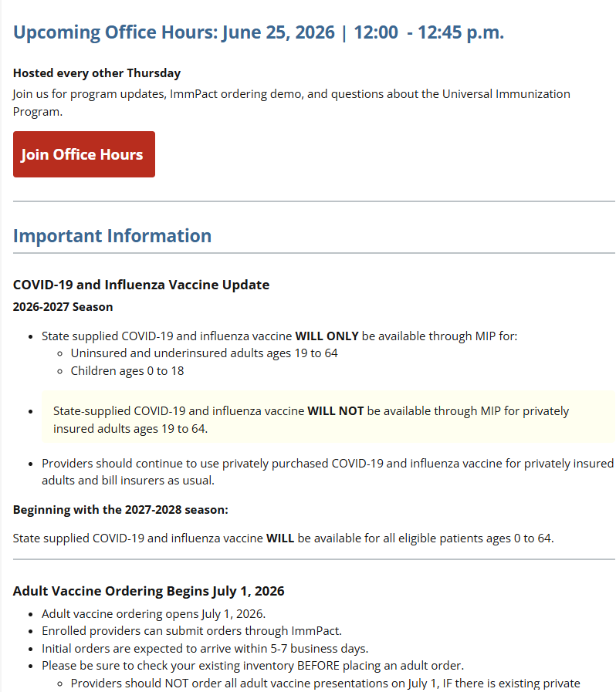
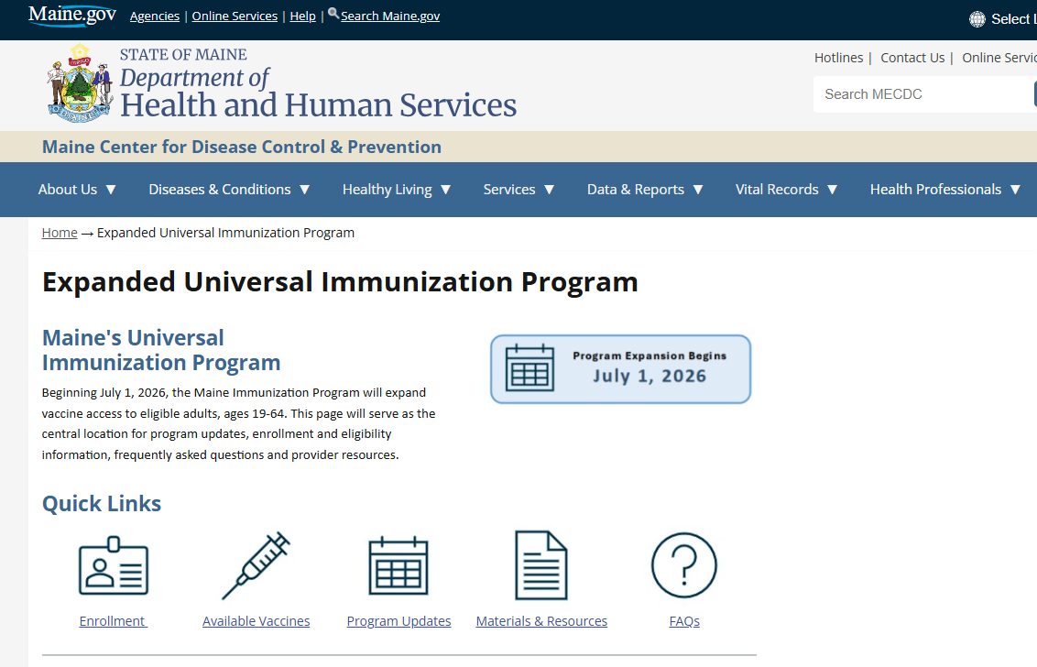
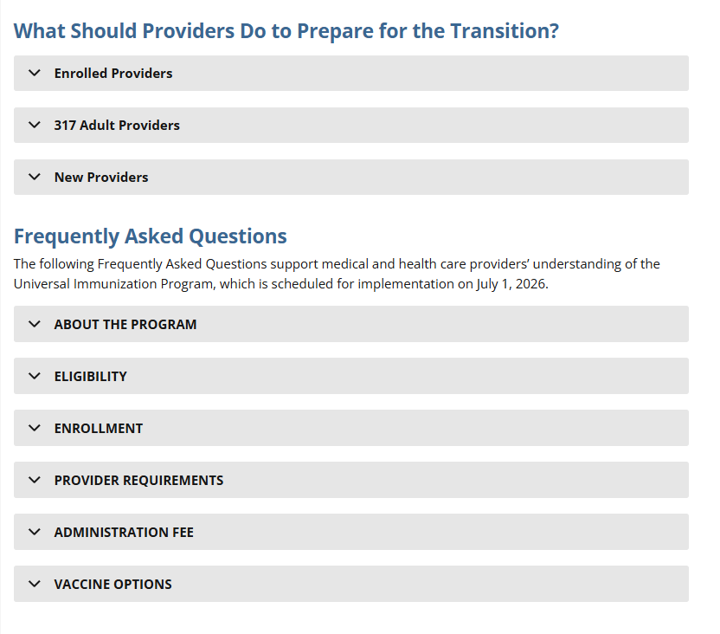
New Universal Immunization Program Website
Expanded Universal Immunization Program
Notes:
One thing that was not included in yesterday’s communication is that our new website is now live! This will be your one stop shop for enrollment guidance, program updates, ordering instructions, office hours information, FAQs and additional program resources.
We wanted to make this as comprehensive as possible, and we’ll continue to update as new information becomes available.

Slide 7
Questions?
General Email:
ImmunizeME.DHHS@maine.gov
ImmPact Help Desk Email:
ImmPact.Support@maine.gov
Notes:
That’s everything we wanted to cover today.
We’ll pause here and open it up for questions.
If we don’t get to your question today, or if something comes up later, please don’t hesitate to reach out to us!
We will be posting slides to our website by the end of the day.

