Slide 1

Maine CDC WIC Nutrition Program
Civil Rights Training
FFY2026
Adapted with permission from
California WIC Program
Notes:
Welcome to the “Equality for All” civil rights training.
This training developed by CA WIC Program, adapted for use in Maine

Slide 2
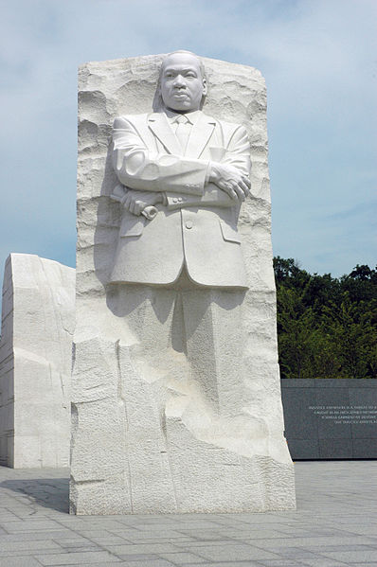
Equality for All
Civil Rights Training
Notes:
Explain the training purpose:
USDA requires all WIC staff attend civil rights training annually to prevent discrimination

Slide 3

Equality for All
Civil Rights Training
Notes:
Explain: What are Civil Rights? Our society was built on rights for the people and by the people. The Declaration of Independence mentions “inalienable rights.” We have constitutional, and we have civil rights. Civil rights are the rights of individuals to be treated equally. All civil rights categories must be honored and protected to ensure all people are treated fairly.

Slide 4


Protected Categories
Federal
State
Notes:
Say: The protected categories are mandated by State and Federal Laws.

Slide 5
State Civil Rights Resources
Maine’s Civil Rights Law
  Title 5, §4684-A: Civil rights (maine.gov)
Maine’s Civil Rights General Information
  Title 5, Chapter 337-B: CIVIL RIGHTS ACT (maine.gov)
Notes:
Say: Here you will find a list of the state of Maine resources for Civil Rights. (Click each link and review information)

Slide 6
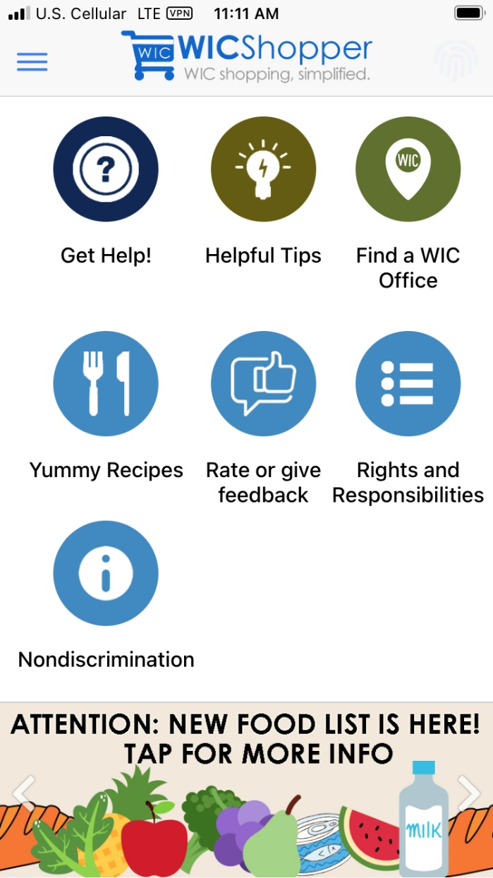
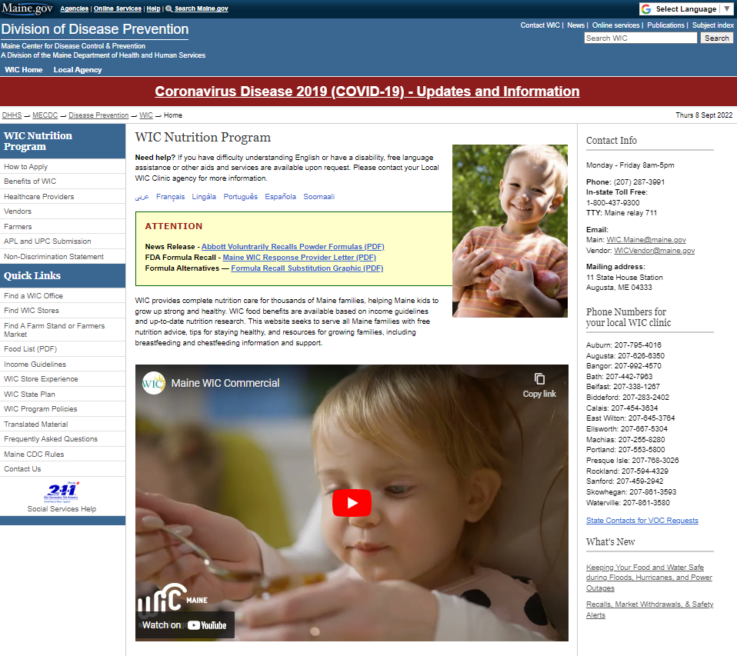
Notes:
Both state and federal WIC protected Civil Rights categories are listed in Rights & Responsibilities on in Spirit MIS, on our website and in the WICShopper App.

Slide 7
WIC Protected Categories
Federal
    Race
    Color
    National Origin
    Age
    Sex
    Disability
    Creed
    Sexual Orientation
    All complaints will be sent to the federal government
Notes:
Say: Here is a list of the state and federal protected categories.
Read: categories out loud.

Slide 8
Race | An individual belonging to one of the accepted anthropological groups; or the perception, based usually on physical characteristics, that a person is a member of a racial group.
Color | Color of skin; including shade of skin within a racial group.
National Origin | The country or part of the world that an individual or his or her ancestors are from.
Age | Age discrimination Act of 1967 applies to persons 40 years old and over.
Sex | Including sexual harassment, pregnancy, childbirth, breastfeeding
Disability | Physical or mental impairment, permanent or temporary
Creed | A followed spiritual belief
Sexual Orientation | The direction of one’s affection, sexual, or emotional attractions involving others.
Defined
Notes:
Race (read definition)
Color (read definition)
National Origin - (read definition) ***Most complaints associated with language or accents are covered here.
Age (read definition)
Sex ** includes pregnancy, childbirth, & breastfeeding status. This means pregnancy-related conditions are protected, including mastitis, gestational diabetes, postpartum depression, loss or end of pregnancy or recovery from loss or end of pregnancy. Lactation accommodations require employers to provide reasonable time to allow employee to express breastmilk, and place to pump milk in private that is near workplace; A toilet stall is not acceptable.
Disability ** (read definition)
Creed (read definition) – it is important to note that this does not have to be an organized group, traditional denomination, or world religion in order to be protected.
Sexual Orientation (read definition)
In addition to these protected categories, the UDSA also requires accommodations for individuals with disabilities and/or limited English proficiency.

Slide 9
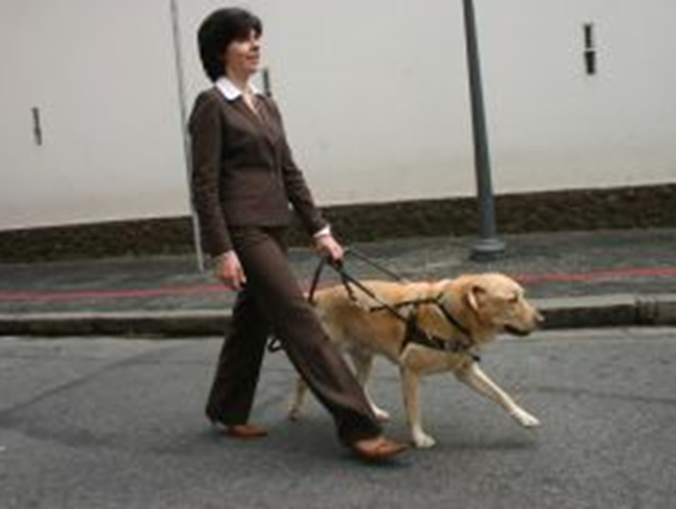
Americans with Disabilities Act
(ADA)
Notes:
The Americans with Disabilities Act (ADA) is the most comprehensive federal legislation that prohibits discrimination against people with disabilities
Who is protected by ADA? ADA protects individuals with disabilities. A disability is a physical or mental impairment that substantially limits an individual’s major life activities. Major life activity means functions such as caring for one’s self, performing manual tasks, walking, seeing hearing, speaking, breathing, learning and working. This includes function of the immune system, normal cell growth, digestive, bowel, bladder, neurological, brain, respiratory, circulatory, cardiovascular, endocrine, and reproductive functions (ADA Amendments Act 2008). In addition, women, infants and children must be accommodated if medically or nutritionally warranted (nutrition tailoring)
ADA mandates reasonable accommodation
Reasonable accommodation is a modification or adjustment to enable individuals with disabilities to have equal access to benefits and privileges of a service or program, such as: • Changing existing facilities to make them accessible or usable • Acquiring or modifying equipment • Modifying tests, training materials, or policies to accommodate program participants with disabilities

Slide 10
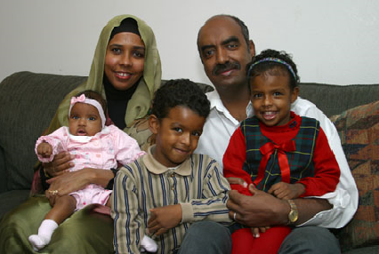
Limited English Proficiency
(LEP)
Notes:
State and local agencies must take reasonable steps to ensure “meaningful” access to program information and services by people with Limited English Proficiency (LEP).
These services may include:
• Providing interpreters
• Providing printed materials in different languages
Who is protected?
Individuals for whom English is not their primary language and who have a limited ability to read, speak, write or understand English.
Local agencies must adhere to LEP policies
Procedures taken by LA staff must include:
• Proper identification of individuals needing language assistance
• Consistent provision of interpreter services to LEP participants
• Documentation in participant record when interpreter service is refuse
Service provisions for LEP participants may depend on the number and frequency of LEP participants served. Volunteers or children may be used if they are competent enough to understand and interpret English. A shortage of resources does not eliminate the LEP requirement.
Now we will review some potential causes for a Civil Rights complaint.

Slide 11
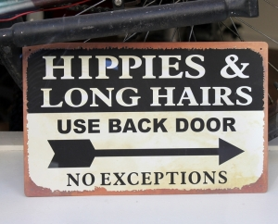
Stereotyping
Notes:
Stereotype is “a preconceived or oversimplified generalization involving beliefs about a particular group.”
Its what we think about a group of people (e.g. all police officers eat donuts or all women are bad drivers)
Stereotypes:
Can be negative or *positive
Do not consider individual characteristics
Based on what we hear, read, or believe
Based on how someone supposedly thinks or behaves.
*Example of a positive stereotype: "All breastfeeding mothers are caring and nurturing“
http://www.freeimages.com/photo/1344035

Slide 12

Prejudice
Notes:
Prejudice is “a rigid unfavorable judgment or opinion formed beforehand without knowledge or examination of the facts.”
Prejudice is often:
A pre-judgment.
Not factual (ignorance based)
Can be based on race, gender, nationality, social class, disability
http://quotes.lifehack.org/media/quotes/quote-E.-B.-White-prejudice-is-a-great-time-saver-you-125328.png

Slide 13

Discrimination
Notes:
Discrimination is “the act of treating people differently due to our prejudices.” This is our behavior toward an individual group
Discrimination:
Involves associating individuals to a group we’ve assigned them to
Usually includes:
keeping people out of activities/places
treating people with less respect
denying people certain things
Not providing the same opportunities to everyone, e.g. training and career opportunities
Discrimination is illegal!
http://www.freeimages.com/photo/1159994

Slide 14
Data Collection
American Indian/Alaska Native
Asian
Black or African American
Native Hawaiian or Other Pacific Islander
White
Notes:
Ask: So Why does WIC collect Ethnicity and Race data?
Debrief:
All USDA funded programs are required to collect this data.
Data is used to determine how well WIC is reaching potential eligible persons.
Data helps identify areas where additional outreach is needed.

Slide 15

Data Collection
Notes:
Explain: USDA requires WIC to tell every participant:
The collection of the information is strictly for statistical reporting requirements, and
Has no effect on the determination of their eligibility for WIC benefits.
Please note: When an applicant does not provide self-identified racial and ethnicity data, the staff member shall inform the applicant/participant that race and ethnicity will be recorded using visual observation in order to record the information as accurately as possible.
If a participant asks how the data is used, you may explain:
The information is used by USDA to determine how effectively WIC is reaching minority groups, and to identify where additional outreach is needed.

Slide 16
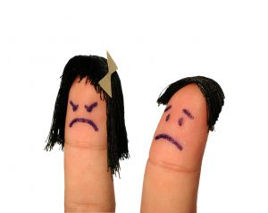
Customer Service
& Conflict Resolution
Conflicts can happen…
Be Prepared!
Notes:
We can often prevent conflict from occurring by providing excellent customer service to our participants during individual consultations, group education, front desk contact, phone calls, and language on signage and outreach materials.
Be patient and polite
Listen with presence and compassion
Avoid sarcasm
Be empathetic
Do not be afraid to ask for help to resolve a situation
Smile whenever possible  Apologize where appropriate
To avoid offending anyone, be open to valuing the other person’s opinion
Do not feel you have the need to have the last word
Treat everyone the same no matter who they are, how they look, or how they act
Impose policies that impact all people the same
Treat everyone with dignity and respect
While many conflicts can be resolved using the aforementioned strategies, your safety is the number one priority.
Be safe
Call 911 if needed (better safe than sorry)
And trust your instincts

Slide 17
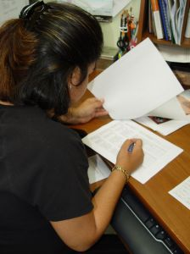
Complaints
What are the Local Agency responsibilities?
To file a program discrimination complaint, a Complainant should complete a Form AD-3027, USDA Program Discrimination Complaint Form which can be obtained online (PDF), from any USDA office, by calling (866) 632-9992, or by writing a letter addressed to USDA. The letter must contain the complainant’s name, address, telephone number, and a written description of the alleged discriminatory action in sufficient detail to inform the Assistant Secretary for Civil Rights (ASCR) about the nature and date of an alleged civil rights violation. The completed AD-3027 form or letter must be submitted to USDA by:
Mail: U.S. Department of Agriculture
Office of the Assistant Secretary for Civil Rights
1400 Independence Avenue, SW
Washington, D.C. 20250-9410; or
Fax: (833) 256-1665 or
(202) 690-7442; or
Email: program.intake@usda.gov
Notes:
If a participant claims to have been discriminated against, these steps must be followed:
Step 1
• Apologize to the participant and inform a supervisor immediately.
• Note: the participant has up to 180 days after the incident to report the complaint. Complaints may be written, verbal or anonymous.
Step 2
If the supervisor cannot resolve the situation:
• Share the rights and responsibilities information in the on our webpage and in the WICShopper app with the participant.
• Assist the participant with filing a complaint, if necessary.
• Note: Maine CDC WIC Policy CR-4 provides detail on filing a complaint.
Step 3
Send the complaint to the addresses listed here. If the participant files the complaint her/himself, provide the addresses for where to send the complaint.
• Note: the agency must respond to the complaint within 5 days.
You must protect the individual’s confidentiality. Details of the complaint should only be shared among:
- WIC supervisors
- the person filing the complaint
- State WIC Civil Rights Coordinator
- Staff involved in the incident
http://www.freeimages.com/photo/680529

Slide 18

Public Notification
Notes:
Public Notification
Explain: Federal law requires WIC programs to inform potential WIC applicants or participants about:
program availability
rights and responsibilities
nondiscrimination policy
complaint procedures

Slide 19
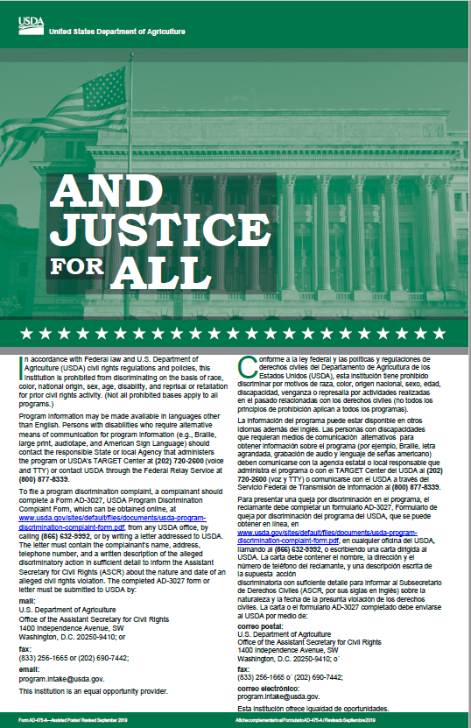
And Justice for All posters
Notes:
Debrief: USDA requires that posters are placed where easily visible. Agencies should check their “And Justice for All” posters to ensure they are posting the correct version (475A—September 2019) please be on the look out for updated 2022 posters. We are still waiting for the newest version of the poster and will distribute them to your local agencies as soon as we have them from FNS.
Agencies must post
“And Justice for All” poster where easily visible and use version AD-475A Revised September 2019.

Slide 20
Public Notification
Nondiscrimination Statement – Full Text
Non-Discrimination Statement
Federal Level
In accordance with federal civil rights law and U.S. Department of Agriculture (USDA) civil rights regulations and policies, this institution is prohibited from discriminating on the basis of race, color, national origin, sex, disability, age, or reprisal or retaliation for prior civil rights activity.
Program information may be made available in languages other than English. Persons with disabilities who require alternative means of communication to obtain program information (e.g., Braille, large print, audiotape, American Sign Language), should contact the responsible state or local agency that administers the program or USDA’s TARGET Center at (202) 720-2600 (voice and TTY) or contact USDA through the Federal Relay Service at (800) 877-8339.
To file a program discrimination complaint, a Complainant should complete a Form AD-3027, USDA Program Discrimination Complaint Form which can be obtained online (PDF), from any USDA office, by calling (866) 632-9992, or by writing a letter addressed to USDA. The letter must contain the complainant’s name, address, telephone number, and a written description of the alleged discriminatory action in sufficient detail to inform the Assistant Secretary for Civil Rights (ASCR) about the nature and date of an alleged civil rights violation. The completed AD-3027 form or letter must be submitted to USDA by:
Mail: U.S. Department of Agriculture
Office of the Assistant Secretary for Civil Rights
1400 Independence Avenue, SW
Washington, D.C. 20250-9410; or
Fax: (833) 256-1665 or
(202) 690-7442; or
Email: program.intake@usda.gov
This institution is an equal opportunity provider.
Notes:
There are two kinds of nondiscrimination statements: the “full” version and the “short” version.
Maine CDC WIC Program Policy CR-1 provides details on use of each statement.
The nondiscrimination statement is not required for nutrition education and breastfeeding promotion and support materials that strictly provide a nutrition message and simply carry the WIC logo with no other mention of the WIC program.

Slide 21
Public Notification
Nondiscrimination Statement – Short Statement
Short statement:
This institution is an equal opportunity provider.
Notes:
The short statement may be used if material is too small to permit the full statement, however must be the same size font as the body of the text to ensure the important of the statement is not overlooked.. Full details can be found in Policy CR-1

Slide 22

Monitoring Visits
Notes:
Compliance Reviews
When State WIC conducts a program evaluation, they check to ensure:
- WIC clinics are complying with civil rights laws and regulations.
- Staff attends annual civil rights training.
Resolution of Non-Compliance
If State WIC finds that a local agency has not complied with WIC civil rights laws and regulations:
- The agency must develop a corrective action plan to resolve the errors.
- State WIC will follow-up to ensure the errors have been corrected.
https://www.mycallfinder.com/blog/2014/10/financial-importance-call-monitoring-tcpa-compliance/

Slide 23
Policy Changes
Language Access (CR-6)
Notes:
In October 2023 when the State Plan is published you will see the following policy changes for the Civil Rights sections.
Pull up policies and review tracked changes
If you have further questions, please contact the State Agency for assistance

Slide 24
Questions?
Samantha Blanchard
Nutrition Coordinator
Maine WIC Nutrition Program
samantha.blanchard@maine.gov
Notes:
If you have further questions, please contact the State Agency for assistance

