Slide 1

Maine DHHS
Maine DHHS Introduction to
CMS Center for Innovation
Community Health Access & Rural Transformation (CHART) Model
Lisa M. Letourneau MD, MPH
Senior Advisor, Maine DHHS – Sept 2020
Augus

Slide 2
DHHS Goals

Slide 3
Maine DHHS - 8 Major Initiatives
Improve Health Care & Coverage Affordability
Support Rural Health Transformation
Lead Maine’s Opioid Response
Conduct Behavioral Health “Map and Match” Initiative
Adapt to Maine’s Aging Population
Promote Early Childhood Development
Support At-Risk Youth
Promote Opportunity through Education

Slide 4
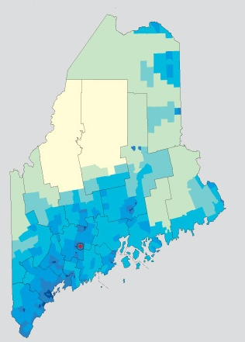
DHHS Rural Health
Transformation Framework: Key Elements
Ensure community engagement
Promote statewide efforts to strengthen infrastructure
Develop regional models of care – perinatal/maternity care
Support new payment models that support improved models for rural health care

Slide 5
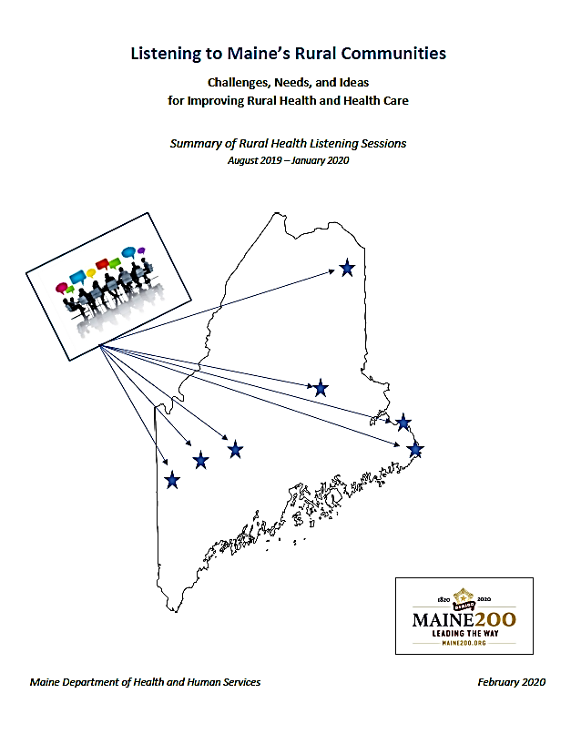
Rural Health Transformation Strategies
Engage Communities
Conducted listening sessions in rural communities: Caribou, Calais/Machias/Eastport, Farmington, Lincoln, Bethel, Skowhegan → “Listening to Maine’s Communities” Report
Convened multi-stakeholder Rural Health Transformation Team
Openly communicated work: ME DHHS Rural Health website
Listening to Maine’s Rural Communities

Slide 6
Rural Health Transformation
Prepare for CMS Rural Payment Model
Identified rural care model key components
Anticipated CMMI demonstration/pilot to test innovative payment arrangements for rural areas
Studied other state payment models (PA, VT, MD, OR)
Identifying laws, regulations that may need changes/waivers
Identifying rural areas that could participate in payment pilots, engage local leaders and stakeholders

Slide 7
https://innovation.cms.gov/webinars-and-forums/chart-overview

Slide 23
CMS CHART Model Community Transformation Track: Key Questions for
Rural Communities & Hospitals
Vision for transforming care in community
Readiness to commit to community-based, collaborative, cross-sector approach
Ability to meet CMS requirement of at least 10,000 Medicare FFS beneficiaries in region
Willingness to accept capitated payment (with details TBD) for Medicare, Medicaid
Interest in developing innovative approaches that leverage opportunity for CMS flexibility, waivers

Slide 24
Medicare FFS Beneficiaries by County
July 2020 Enrollment | FFS Medicare Mbrs*
Cumberland | 33,210
York | 30,682
Penobscot | 22,541
Kennebec | 16,508
Aroostook | 13,896
Androscoggin | 12,039
Hancock | 10,219
Somerset | 8,858
Oxford | 8,803
Washington | 7,380
Knox | 6,933
Waldo | 6,423
Lincoln | 6,070
Sagadahoc | 5,286
Franklin | 3,874
Piscataquis | 3,530
Total | 196,252
Rural Counties
*CMS Data

Slide 25
MaineCare Members by County
Rural Counties

Slide 26
MaineCare Members by Zip

Slide 32
CMS CHART Model: ME DHHS Goals
Align with CMS goals:
  Improve access to care in rural areas
  Improve quality of care & health outcomes
  Increase adoption of alternative payment models
  Improve financial sustainability of rural providers
Reflect needs of rural communities, per DHHS Rural Health Listening Sessions:
  Provide adequate primary care, specialty care, prevention svcs
  Ensure access to after-hours emergency care, EMS svcs
  Coordinate care across settings
  Provide care in home and/or as close to home as possible
h

Slide 33
CMS CHART Model: ME DHHS Framework
Adhere to ME DHHS guiding principles – e.g.
  Identify clear vision for transforming health & health care in community
  Commit to implementing multi-payer new VBP payment model
  Be community-focused, reflecting community needs & assets
  Utilize evidence-based approaches
Incorporate key elements for improving rural health care
  Primary care-based
  Expanded use of telehealth
  Use new workforce models
  Identify regional models of care
Include focus on key clinical areas:
  High-prevalence chronic diseases: COPD, HF, CVD, diabetes, dementia
  Behavioral health (mental health, SUD)
  Incorporate serious illness care, palliative care approaches

Slide 34
CMS CHART Model: ME DHHS Process
Share information widely
Ensure transparent, inclusive process
Encourage participation in both tracks:
  Support successful Maine application for Community Transformation Track
  Encourage ACOs to participate in ACO track
Support inclusive process for selecting Maine rural community/hospital(s) for participation in Community Transformation Track

Slide 35
CMS CHART Model: ME DHHS Timeline
Community Transformation Track participation:
Sept: share information re: opportunity for participation, model expectations
Early Oct: request indication of interest from interested rural communities/hospitals
Mid Oct: host community discussions with interested communities/hospitals
End Oct/Early Nov: Select community/hospital(s), identify Lead Organization for Maine application
Nov – Jan: Develop proposal
Feb 5: CMS proposal deadline

Slide 36
Rural Health Transformation
Questions?
Discussion!

Slide 37
Questions?
Lisa Letourneau MD, MPH
  Senior Advisor, Healthcare Delivery System Change
  Lisa.Letourneau@maine.gov
  C: 207-415-4043
Nicole Breton
  Director, ME CDC Office of Rural Health, Primary Care & Oral Health
  Nicole.Breton@maine.gov
  W: 207-287-5503

