Slide 1
Maine CDC WIC Nutrition Program Civil Rights Training
FFY2019
Adapted with permission from
California WIC Program

Slide 2
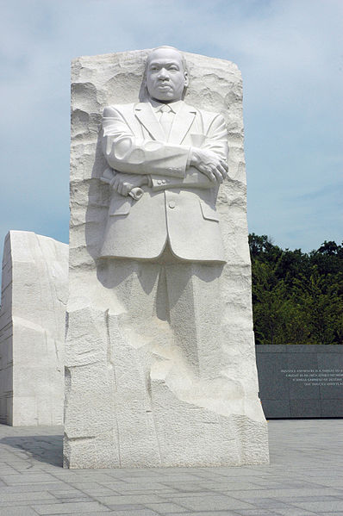
Equality for All Civil Rights Training
Notes:
Welcome trainees to the “Equality for All” civil rights training.
This training developed by CA WIC Program, adapted for use in Maine
Explain the training purpose:
USDA requires all WIC staff attend civil rights training annually to prevent discrimination
Housekeeping: duration of the training, breaks and cell phones
Instruct trainees to turn to the Agenda and Objectives on pages 2 and 3 in their workbooks and review.

Slide 3
Equality for All Civil Rights Training
Notes:
Ask trainees to call out:
What does the term “civil rights” mean? (everyone treated equally)
What are some civil rights you have?
Explain: Our society was built on rights for the people and by the people. The Declaration of Independence mentions “inalienable rights.” We have constitutional, and we have civil rights. Civil rights are the rights of individuals to be treated equally. All civil rights categories must be honored and protected to ensure all people are treated fairly.

Slide 4
Ethnicity
and Race
Notes:
What comes to mind when you hear the terms ethnicity and race?

Slide 5
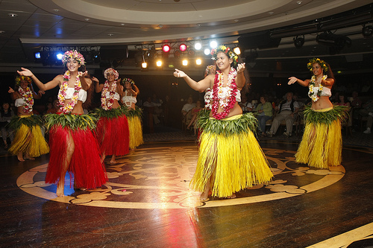
Ethnicity
Groups with Common Ancestry
Notes:
Explain: Ethnicity is socially defined. Ethnic groups share a common ancestry.
They may share: (next slide)

Slide 6
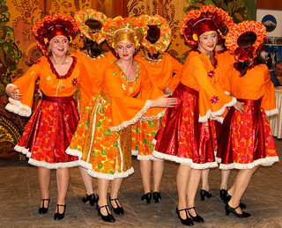
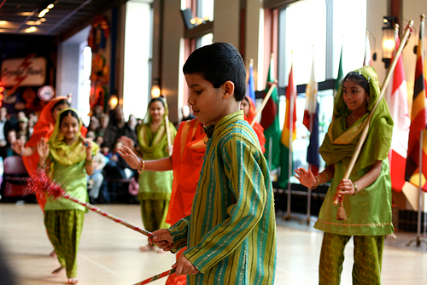
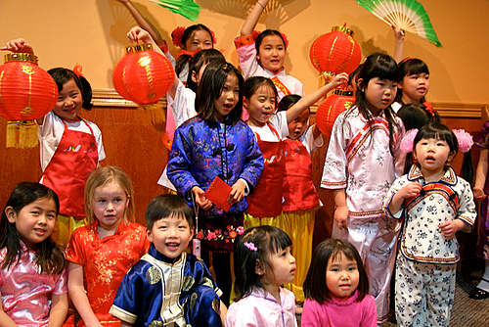
Ethnicity
Common Culture
Alaskan Dude's
stevendepolo's
stevendepolo's
Notes:
Culture
Genealogy (family tree)
Family History
Homeland (country of origin)
Cultural heritage
Cuisine
Clothing styles
1<a href="http://www.flickr.com/photos/72213316@N00/3334030967/" title="Sudarushka group shot by Alaskan Dude, on Flickr"><img src="http://farm4.staticflickr.com/3598/3334030967_54a7da9b9f.jpg" width="500" height="404" alt="Sudarushka group shot"></a>
2<iframe src="https://www.flickr.com/photos/stevendepolo/3239829063/player/d3345b53cd" height="334" width="500" frameborder="0" allowfullscreen webkitallowfullscreen mozallowfullscreen oallowfullscreen msallowfullscreen></iframe>
3<a href="http://www.flickr.com/photos/stevendepolo/3276038096/" title="Indian Dance Ethnic Heritage Festival 42 by stevendepolo, on Flickr"><img src="http://farm4.staticflickr.com/3381/3276038096_d0bbe02780_m.jpg" width="240" height="160" alt="Indian Dance Ethnic Heritage Festival 42"></a>>

Slide 7
Ethnicity
Religion
Notes:
Religion, mythology, or ritual
<a href="http://www.flickr.com/photos/mckaysavage/6582764551/" title="Laos - Luang Prabang 100 - evening prayer at Wat Xieng Thong by mckaysavage, on Flickr"><img src="http://farm8.staticflickr.com/7171/6582764551_22235e327c.jpg" width="500" height="333" alt="Laos - Luang Prabang 100 - evening prayer at Wat Xieng Thong"></a>

Slide 8
Ethnicity
Language
Notes:
Language or dialect

Slide 9
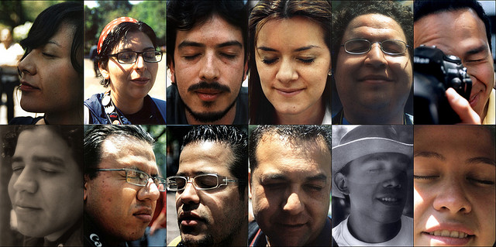
Race
Biological Origins
Notes:
Explain: Race is based on someone’s biological origins and refers to a person’s physical appearance including skin color, eye color, hair color, bone structure, and facial type.
Emphasize:
Hispanic or Latino is a culture, not a race.
In prior years a significant number of participants were classified as Native American, many whom were actually Hispanic or Latino.
Ethnicity choice for WIC was created to more accurately represent the Hispanic and Latino population.
Activity 1: Ethnicity and Race Page (4)
Instruct trainees to read the instructions for Activity 1 in their workbooks and share with their table group which ethnicity and race(s) they would choose for themselves and why.
Debrief: Invite trainee(s) to share what they chose with the larger group.
Explain that ethnicity and race questions:
Are for data collection purposes only
May not be the same descriptions participants would choose for themselves
<a href="http://www.flickr.com/photos/eneas/454903080/" title="Close Your Eyes. Open Your Heart by Eneas, on Flickr"><img src="http://farm1.staticflickr.com/223/454903080_777de302d1.jpg" width="500" height="249" alt="Close Your Eyes. Open Your Heart"></a>

Slide 10
Data Collection
American Indian/Alaska Native
Asian
Black or African American
Native Hawaiian or Other Pacific Islander
White
Notes:
Ask: Why does WIC collect Ethnicity and Race data?
Debrief:
All USDA funded programs are required to collect this data.
Data is used to determine how well WIC is reaching potential eligible persons.
Data helps identify areas where additional outreach is needed.

Slide 11
Data Collection
Notes:
Explain: USDA requires WIC to tell every participant:
The collection of the information is strictly for statistical reporting requirements, and
Has no effect on the determination of their eligibility for WIC benefits.
If a participant asks how the data is used, you may explain:
The information is used by USDA to determine how effectively WIC is reaching minority groups, and to identify where additional outreach is needed.

Slide 12
Protected Categories
Federal
State
Notes:
Say: The protected categories are mandated by State and Federal Laws

Slide 13
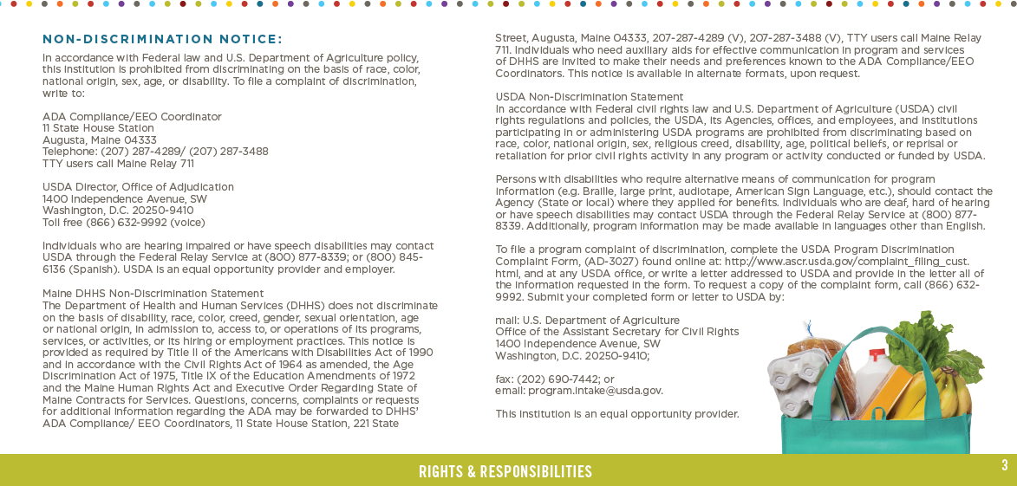
Notes:
Both state and federal WIC protected Civil Rights categories are listed in Rights & Responsibilities on pg. 3 of the WIC participant booklet

Slide 14
WIC Protected Categories
State
Disability
Race
Color
Creed
Gender
Sexual Orientation
Age
National Origin
Federal
Race
Color
National origin
Sex
Disability
Age
Reprisal
Notes:
Say: Here is a list of the state and federal protected categories.
Read: categories out loud.
Ask trainees: Are there any categories you were not aware of?
Activity 2: WIC Protected Classes
Instruct trainees to turn to page 5 in their workbooks and complete the matching exercise. They may work alone, in pairs , or table groups.
Debrief: Answers to matching exercise.
Activity 3:
Ask: trainees to turn to page 6-7 and review the definitions and the examples of each class. They can use this page for a reference. Discuss with a partner what protected class you found interesting
Read aloud the following story, or tell a personal story in your own words:
Imagine you are in a bank applying for a loan and you notice the loan officer is staring at you. After collecting your loan information, she excuses herself to discuss your application with her supervisor. You overhear the loan officer mentioning to her supervisor that you don’t look like the type of person who would repay a loan. The loan officer returns and informs you that you do not qualify for the loan and your application has been denied.
Debrief: Ask Trainees what they thought of the story
Ask trainees how that would make them feel.

Slide 15
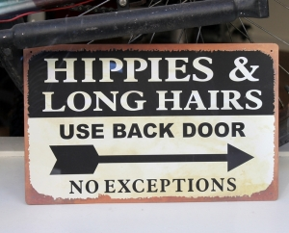
Stereotyping
Notes:
Stereotype is “a preconceived or oversimplified generalization involving beliefs about a particular group.”
Its what we think about a group of people (e.g. all police officers eat donuts or all women are bad drivers)
Stereotypes:
Can be negative or *positive
Do not consider individual characteristics
Based on what we hear, read, or believe
Based on how someone supposedly thinks or behaves.
*Example of a positive stereotype: "All breastfeeding mothers are caring and nurturing“
http://www.freeimages.com/photo/1344035

Slide 16
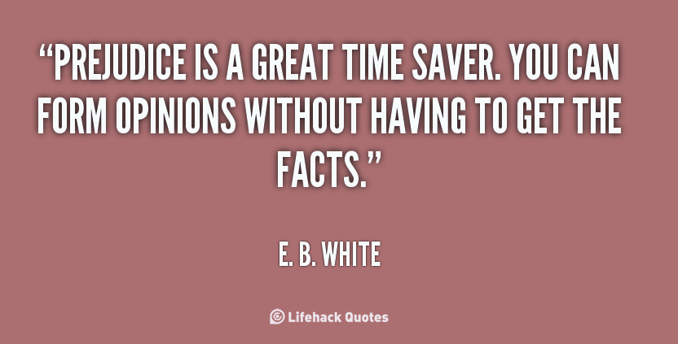
Prejudice
Notes:
Prejudice is “a rigid unfavorable judgment or opinion formed beforehand without knowledge or examination of the facts.”
Prejudice is often:
A pre-judgment.
Not factual (ignorance based)
Can be based on race, gender, nationality, social class, disability
http://quotes.lifehack.org/media/quotes/quote-E.-B.-White-prejudice-is-a-great-time-saver-you-125328.png

Slide 17
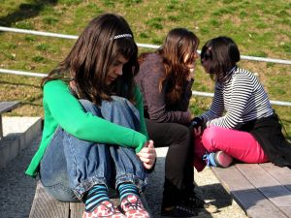
Discrimination
Notes:
Discrimination is “the act of treating people differently due to our prejudices.” This is our behavior toward an individual group
Discrimination:
Involves associating individuals to a group we’ve assigned them to
Usually includes:
keeping people out of activities/places
treating people with less respect
denying people certain things
Not providing the same opportunities to everyone, e.g. training and career opportunities
Discrimination is illegal!
Activity 4: Discrimination Concepts
Instruct trainees to turn to page 8 in their workbooks. Have them work in their groups or alone and answer each question.
Debrief: Have trainees share their answers with the larger group. Correct answers as needed.
Karen Read: “Brown Eyes, Blue Eyes” debrief with large group. (Include in facilitators guide) optional
Instruct trainees to turn to Activity 5 pages 9-10 in their workbooks. Have them work in their groups and answer questions about their assigned scenarios.
http://www.freeimages.com/photo/1159994

Slide 18
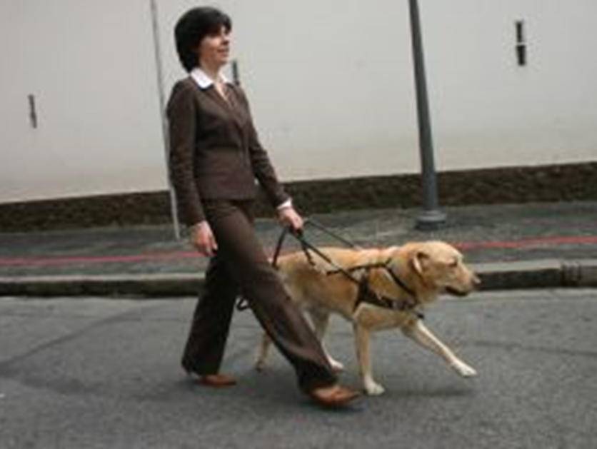
Americans with Disabilities Act
(ADA)
Notes:
Instruct trainees to refer to Activity 6 on page 11 ( ADA and LEP) in their workbooks.
Ask for a volunteer to read the top half under ADA.
Instruct the group to call out ways their agency provides reasonable accommodation for participants with disabilities.
Probe for:
Parking lots (disabled spaces)
Entrances/exits and halls (ramps)
Elevators and rest rooms

Slide 19
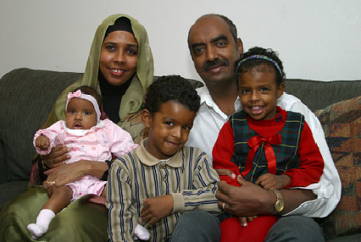
Limited English Proficiency
(LEP)
Notes:
LEP
3. Ask for a volunteer to read the bottom half of the ADA and LEP Overview. Bottom of page 11
4. Ask the group to call out ways their agency provides reasonable accommodation for participants with LEP.
Probe for:
interpreters
written materials in different languages
Mention:
Service provisions for LEP participants may depend on the number and frequency of LEP participants served.
Volunteers or children may be used if they are competent enough to understand and interpret English.
A shortage of resources does not eliminate the LEP requirement.
Debrief: Ask trainees to call out ways their agency might discriminate against a WIC applicant with a disability. participant based on a disability or LEP.
Probe for:
segregation (separation)
different waiting times
facilities or services not accessible to people with disabilities
failing to advise a LEP participant that an interpreter will be provided free of charge
requiring a person with LEP to bring their own interpreter
treating people with disabilities differently from other participants
operating a WIC site in an area that is not accessible to people in certain groups (no public transportation)
providing different WIC benefits to individuals based on their membership in a protected class
requesting extra verification or documentation from people based on membership in a protected class
Ask trainees what questions they have about ADA and LEP.
https://arabinformationcenterithaca.wordpress.com/arabic-child-rearing/

Slide 20
Customer Service
“Treat others the way you would want to be treated”
Notes:
Activity 8: Customer Service
Ask trainees to turn to Activity 8 on page 13 in their workbooks. Have a volunteer read the scenario as trainees follow along.
Ask trainees:
Does this sound familiar?
How many of you have been in a similar situation?
How may a participant get the impression she is being discriminated against?
How can a situation end up as a complaint if not handled correctly?
Instruct trainees to answer the questions in table groups.
Debrief: Ask trainees to select one spokesperson from each table group and share their answers with the larger group.
Ask trainees to provide one example of how someone helped resolve a similar situation at WIC and prevented a discrimination complaint.
Explain that often we can prevent conflict from occurring by providing excellent customer service to our participants during individual consultations, group education, front desk contact, phone calls, and language on signage and outreach materials.
Freeimages.comhttp://www.freeimages.com/photo/499019

Slide 21
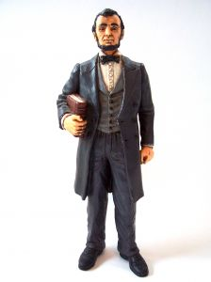
Great Service
Minimizes Conflict
“I do not like this person. I must get to know him better.”
Abraham Lincoln
Notes:
Ask: trainees what this quote means to them.
Probe: for situations where the initial contact with a person may have been an unfavorable experience.
http://www.freeimages.com/photo/457763

Slide 22
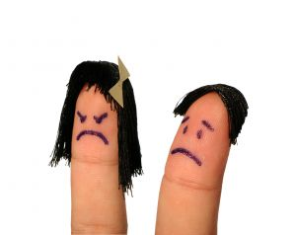
Conflict Resolution
Conflicts can happen…
Be Prepared!
Notes:
Review Handout: “In Times of Conflict” page 14
Ask: trainees what methods they have found difficult to do?
Emphasize the need to:
Be safe
Call 911 if needed (better safe than sorry)
Trust your instincts

Slide 23
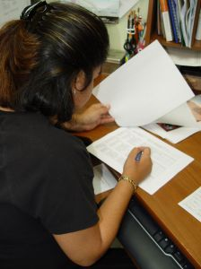
Complaints
What are the Local Agency responsibilities?
Notes:
Ask trainees to consider what their WIC agency should do if a participant or applicant felt they were being discriminated against?
Activity 9: Discrimination Complaint Process
Instruct Trainees to turn to Activity 9 beginning on page 15 in their workbooks. Briefly review the Discrimination Complaint Process.
Ask for a volunteer(s) to read the Complaint Procedures Overview on page 16 and discuss as a group.
Ensure trainees know they must protect the individual’s confidentiality. Details of the complaint should only be shared among:
WIC supervisors
the person filing the complaint
State WIC Civil Rights Coordinator
Staff involved in the incident
Ask what questions they have about the discrimination complaint process.
http://www.freeimages.com/photo/680529

Slide 24
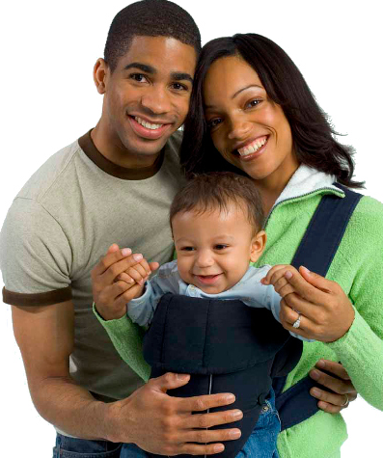
Public Notification
Notes:
Public Notification
Explain: Federal law requires WIC programs to inform potential WIC applicants or participants about:
program availability
rights and responsibilities
nondiscrimination policy
complaint procedures

Slide 25
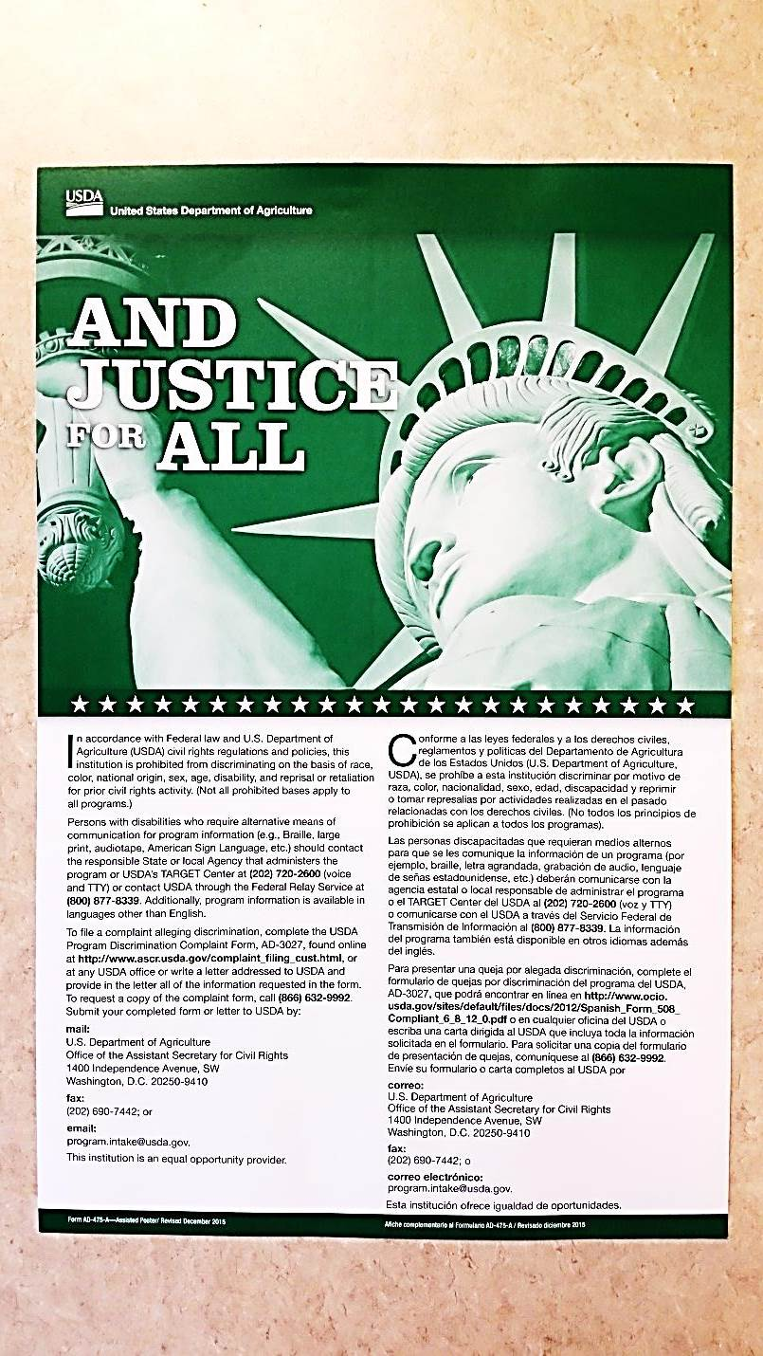
And Justice for All posters
Notes:
Ask trainees to call out where the “And Justice for All” posters should be posted in their WIC sites.
Debrief: USDA requires that posters are placed where easily visible. Agencies should check their “And Justice for All” posters to ensure they are posting the correct version (475A—December 2015)
Agencies must post
“And Justice for All” poster where easily visible and use version AD-475A Revised December 2015.
Refer trainees to appendix II on page 18 in their workbooks for instructions on downloading the “And Justice for All “ posters.

Slide 26
Public Notification
Nondiscrimination Statement – Full Text
In accordance with Federal civil rights law and U.S. Department of Agriculture (USDA) civil rights regulations and policies, the USDA, its Agencies, offices, and employees, and institutions participating in or administering USDA programs are prohibited from discriminating based on race, color, national origin, sex, disability, age, or reprisal or retaliation for prior civil rights activity in any program or activity conducted or funded by USDA.
Persons with disabilities who require alternative means of communication for program information (e.g. Braille, large print, audiotape, American Sign Language, etc.), should contact the Agency (State or local) where they applied for benefits. Individuals who are deaf, hard of hearing or have speech disabilities may contact USDA through the Federal Relay Service at (800) 877-8339. Additionally, program information may be made available in languages other than English.
To file a program complaint of discrimination, complete the USDA Program Discrimination Complaint Form, (AD-3027) found online at: http://www.ascr.usda.gov/complaint_filing_cust.html , and at any USDA office, or write a letter addressed to USDA and provide in the letter all of the information requested in the form. To request a copy of the complaint form, call (866) 632-9992. Submit your completed form or letter to USDA by:
mail: U.S. Department of Agriculture Office of the Assistant Secretary for Civil Rights 1400 Independence Avenue, SW Washington, D.C. 20250-9410;
fax: (202) 690-7442; or
email: program.intake@usda.gov.
This institution is an equal opportunity provider.

Slide 27
Public Notification
Nondiscrimination Statement – Short Statement
Short statement:
This institution is an equal opportunity provider.

Slide 28
Monitoring Visits
Notes:
Compliance Reviews
Explain: When State WIC conducts a program evaluation, they check to ensure:
WIC clinics are complying with civil rights laws and regulations.
Staff attends annual civil rights training.
Resolution of Non-Compliance
Explain: If State WIC finds that a local agency has not complied with WIC civil rights laws and regulations:
The agency must develop a corrective action plan to resolve the errors.
State WIC will follow-up to ensure the errors have been corrected.
Ask trainees what questions they have about public notification, compliance review, and resolution of non-compliance.
https://www.mycallfinder.com/blog/2014/10/financial-importance-call-monitoring-tcpa-compliance/

Slide 29
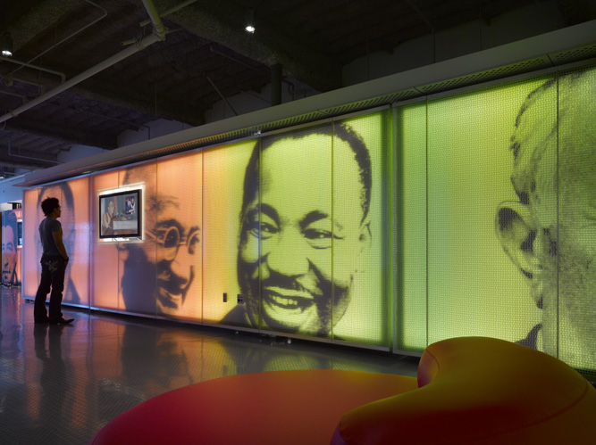
Notes:
Read aloud: The Museum of Tolerance in Los Angeles welcomes its visitors in a unique and compelling way. Visitors must wait in the lobby until invited into the museum by a tour guide. The guide points out there are only two doors to enter the museum. One door is marked “prejudiced” and the other door is marked “unprejudiced”. Visitors are instructed to enter the door that most represents them. Almost always, the door marked “unprejudiced” is selected. The brave visitor who is first to try the door is unable to turn the knob. Much to everyone’s surprise, the “unprejudiced” door is locked. The only way to enter the museum is through the door marked “prejudiced.”

Slide 30
Questions?
Presenter’s Name
Title
Contact Information

