Slide 1
Best Practice Recommendations for Handoff Communication during Transport from a Home or Freestanding Birth Center to a Hospital Setting Maine Center for Disease Control and Prevention
Notes:
Welcome to the tutorial for the Best Practice Recommendations for Handoff Communication during Transport from a Home or Freestanding Birth Center to a Hospital Setting. This project is the result of a multidisciplinary workgroup convened by the Maine Center for Disease Control and Prevention. Our goal was to enhance effective communication and support families and health care professionals when access to hospital-based services occurs for women who chose home or birth center birth and their babies. My name is <Nell Tharpe. I am a Certified Nurse Midwife> and a participant in the workgroup.
This tutorial provides a brief overview of the project, reviews the content of the Recommendations, then outlines their intended implementation.
The full document and each of the individual forms are available for download from the Maine CDC website. A link is provided at the end of the presentation. You are encouraged to have a copy of the full document to refer to during this tutorial. Before we begin the tutorial, let’s take a few moments to share the background on development of the Best Practice Recommendations for Handoff Communication.

Slide 2
The Continuum of Care Workgroup
Convened by Dr. Sheila Pinette, Director, Maine Center for Disease Control and Prevention
Broad-based workgroup including
CDC Staff (Physicians, Nurses, and Midwife)
Facilitator
Perinatal Health Professionals (Physicians, Nurses and Midwives)
Consultants (Physicians, Paramedics)
Legal representation
Notes:
The Continuum of Care workgroup was convened by Dr. Sheila Pinette, Director of the Maine CDC. The workgroup was comprised of Maine professionals concerned with the care of women and infants. Participants agreed to work together to create a culture of safety in which open dialogue could occur.
Discussion of issues and exploration of approaches led to development of recommendations for transport from planned home or birth center birth.
The concept of a “Continuum of Care” allows us all to effectively support access to the full range of maternity-related health services women in Maine.
Deep appreciation goes to the diverse workgroup members whose shared purpose was to work collaboratively so that families who choose home and freestanding birth center as the location for their baby’s birth have access to the full spectrum of effective and respectful maternity care.

Slide 3
Workgroup Purpose
“Work collaboratively to enhance the choice, access, and safety of pregnant women, new mothers and their newborns by continuing to build on applicable best practice standards, in order that families that choose birth at home or in a freestanding birth center are provided the full spectrum of respectful and effective maternity care.”
Notes:
The workgroup developed a formal purpose which recognizes that women have the right to choose the type of health care, birth location and health care provider that best meets their needs. About 1% of women who give birth in Maine choose home or a freestanding birth center for their birth, usually with a Certified Professional Midwife or CPM.
Ensuring ready access to care and services, particularly in an emergency, were identified as important public health measures and components of quality maternity care. The workgroup then identified several tools used by other states to support timely and seamless access to specialist or hospital care. A subcommittee was tasked to develop draft communication recommendations for health professionals who are involved in the transport of women or newborns from a home or birth center to a hospital.

Slide 4
Transport Communication Works
The Best Practice Recommendations for Handoff Communication during Transport from a Home or Birth Center to a Hospital Setting are intended to foster effective communication across settings and among interdisciplinary professionals who care for women and newborns transferred from a home or birth center to a hospital setting.
Notes:
The purpose of the Best Practice Recommendations is to share consistent and dependable tools that support a seamless continuum of care for the family who is being transported to the hospital from a home or freestanding birth-center setting.
The workgroup identified that uniform transport communication could be addressed within a public health framework and by engaging health professionals who come in contact with the family during transport.
Documents and tools from many sources were reviewed including from the <spell out all acronyms> AWHONN, ACOG, NARM, ACNM, and NNEPQIN, as well as recent evidence-based literature on handoff communication and perinatal care and transport.
Rather than simply developing a “Transport Form” we opted to create a package of communication tools to support families and professionals who may be involved during transport, and to foster communication and collaboration across disciplines for the benefit of the mother and baby.

Slide 5
Goals for Transport Communication
Every woman and newborn deserves ready access to quality maternity and newborn care that
Is efficiently and professionally coordinated
Is provided respectfully
Addresses identified health needs
Honors cultural and social preferences
Notes:
An integral component of quality care is the recognition that each woman’s pregnancy, labor and birth are major life events as well as an opportunity to address health needs. The overarching goals of the workgroup were to facilitate transport communication so that the associated physical transfer of mother or baby from one setting to another occurs as smoothly as possible, and that transport for hospital-based care is part of family-centered maternity care that is provided within the context of the woman’s life. Effective collaboration between professionals enhances quality care and can lead to greater understanding and appreciation of each professional’s unique role and skills that they bring to caring for the mother and her baby.

Slide 6
Recommendation and Tool Development Process
Broad perinatal literature review
Quality Patient Care in Labor and Delivery: A Call to Action http://www.acog.org/-/media/Departments/Patient-Safety-and-Quality-Improvement/Call-to-Action-Paper.pdf?la=en
Transport Forms From:
AWHONN
NNEPQIN
MMC
Washington State
SBAR format for communication
Tools created through consensus
Notes:
So how did we approach this work? The Document “Quality patient care in labor and delivery: A call to action” provided the basis for our project. This document is endorsed by each of the National professional associations whose membership serve the perinatal population.
Existing transport forms provided a starting place for discussion and communication tool development. Critical review of the draft document by workgroup members identified additional areas to be addressed. To ensure all aspects of professional care were appropriately addressed workgroup members then engaged in a “round-robin” process of review, discussion and thoughtful editing.
The commitment of the multidisciplinary group was to create a uniform process that is compatible with existing healthcare systems, for assuring access to care for birthing families that choose home or a free-standing birth center for their baby’s birth.
The benefits to all stakeholders (birthing women and their families, home and birth center midwives, EMS providers who might participate in transport from the birth setting, and health care professionals in the receiving hospital) were clarified through shared understanding of each other’s roles, identification of clear expectations for communication, and development of practical tools to support professionals and families.
Examination of transport processes and communication are first steps in optimizing outcomes for families who intend home or a freestanding birth center as the location for their baby’s birth and are transported for access to hospital-based services.

Slide 7
Reviewers
Convener: Sheila Pinette, DO – Director, MeCDC, Augusta, ME
Facilitator: Frank Chessa, PhD – Director, Clinical Ethics, Maine Medical Center, Portland, ME
Scribe: Toni Wall – Program Director, Children with Special Health Needs, MeCDC, Augusta, ME
Holly Arends Murphy, CPM
Kelley Bowden, RN, MSN – Perinatal Outreach Nurse, Maine Medical Center, Portland, ME
Jill Breen, CPM, CLC
Donna Broderick, CPM
Mark Brown MD, MSPH – Neonatal-Perinatal Medicine & Pediatrics, Eastern Maine Medical Center, Bangor, ME
Pam Cahill, Executive Director, Maine Nurse Practitioner’s Association
Pam Dyer Stewart, CPM
Heidi Fillmore, CPM, NHCM – Director, Birthwise Midwifery School, Bridgton, ME
Eleanor Mulcahy, RNC – Newborn Genetic Screening, MeCDC, Augusta, ME
Jay Naliboff, MD – Obstetrics & Gynecology, Franklin Health Women's Care, Farmington, ME
Suzanne Norgang, MSN, CNM – Women's Healthcare, Blue Hill Memorial Hospital, Blue Hill, ME
Christopher Pezzullo, DO – Medical Director, Division of Population Health, MeCDC, Augusta, ME
Valerie Ricker, RN, MSN, MS Assistant Director, Division of Population Health, MeCDC, Augusta, ME
Gordon Smith J.D. – Executive Vice President, Maine Medical Association, Manchester, ME
Nell Tharpe, MS, CNM – Maternal Child Health Consultant, Public Health Nursing Program, MeCDC, Augusta, ME
Joseph Wax, MD – Maternal Fetal Medicine, Maine Medical Center, Portland, ME
Consultant: Matt Sholl, MD, MPH – Maine State EMS Medical Director, Maine Medical Center, Portland, ME
Notes:
All workgroup participants and our EMS consultant had the opportunity to review drafts of the Recommendations and provide input for revision. This slide lists the workgroup members, all of whom were offered the opportunity to participate in this process. In addition, the draft tools were used and evaluated in two transport simulations; first by a group of Nurse Managers from Maine’s birthing hospitals, and second by a group of Maine Certified Professional Midwives who practice in the home setting. The results of those simulations and the related discussion were critical to the development of high quality Recommendations that are relevant to the primary professionals who will use them.

Slide 8
Tutorial Audience
Midwives
Certified Professional Midwives (CPM)
Certified Nurse Midwives (CNM)
Traditional Midwives
Doctors
Naturopathic Doctor (ND)
Osteopathic Doctor (DO)
Medical Doctor (MD)
Emergency Medical System (EMS) Professionals
Dispatch
EMT - all levels
Paramedic
Nurses
Registered Nurse (RN)
Notes:
Before we begin the tutorial, let’s take a moment to talk about who might be involved during the transport of a mother or baby from a planned home or birth center birth.
Most of the births in Maine that occur at home or a free standing birth center are attended by Certified Professional Midwives or CPMs. CPMs are educated and trained specifically to manage birth in the home or birth center setting. While CPMs are not currently licensed in Maine, they are authorized by Maine law to carry emergency medications and supplies including oxytocin for treatment of hemorrhage, and oxygen for resuscitation.
Other professionals who attend births at home or a freestanding birth center include traditional or apprentice-trained midwives, Certified Nurse-Midwives, Naturopathic and other Doctors, and occasionally family members.
The upcoming tutorial is for all professionals who may participate in the care of a woman or newborn who is transported from a home or freestanding birth center setting to a hospital. We each have our specific roles, responsibilities and perspectives when transport occurs. Our primary shared goal is effective professional communication that leads to families feeling supported when accessing the care they need.

Slide 9
ADD LINK TO DOCUMENT HERE
Notes:
Now let’s turn to the document. If you haven’t already downloaded a copy of the Recommendations, feel free to pause this presentation and do so. It will make it easier to follow along. The full copy of the Recommendations and the communication tools are available on the MeCDC website.
During the tutorial, we’ll briefly go over each aspect of the document. Feel free to stop the presentation as needed to read the documents, and jot down questions, or comments for later discussion.
Facilitated group discussion about the Recommendations and how they will be used in your Facility, Practice or Setting is recommended.
Interdisciplinary dialogue outside of the transport setting is also encouraged as a way to learn about each other and build a sense community as interdisciplinary professionals who serve the perinatal population. Examples of opportunities to engage include Newborn Resuscitation Courses, Transport Conferences, Continuing Education Programs, and professional perinatal gatherings.

Slide 10
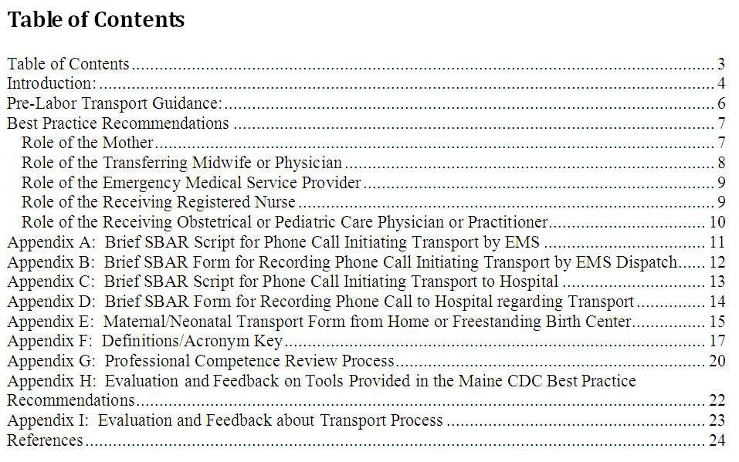
The Guidelines at a Glance
Notes:
First we’ll turn to the Table of Contents.
The Table of Contents is designed to quickly guide the reader to the content of interest. In the digital document “live links” allow direct rapid access to any portion of the document from the Table of Contents.
Each of the scripts and forms can be printed individually, based on your professional discipline and the manner in which you participate in the transport process. You are encouraged to share the document with professionals in your organization or discipline who may participate in a transport, and identify which of the relevant components will be used to support families being transported.

Slide 11
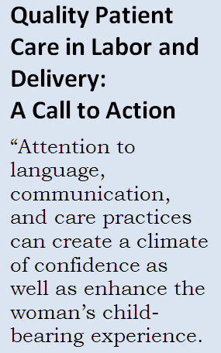
Introduction
Every woman and newborn deserves ready access to quality maternity and newborn care that is respectfully provided; addresses identified health needs; and honors cultural and social preferences.
Notes:
The Introduction on Page 5 provides the evidence-base for the development of the Recommendations. Effective communication is defined as patient-centered, timely, direct, and specific, and occurs between the woman, her family, and members of the care team.
Maine-specific hospital regulations and the federal Emergency Medical Treatment and Labor Act (EMTALA) law establish the legal framework for requiring open access to hospital care in the perinatal period. This document provides core elements to support effective handoff from home or birth center to hospital in a way that supports women, families, and professionals.

Slide 12
Pre-Labor Transport Guidance
Provides guidance for a methodical approach when planning for birth at home and when initiating a transport, including
Primary focus on provision and coordination of necessary care
Engagement with the woman (or baby’s parent) as a partner in the transport process
Identification of key decision-points
Identification and clarification of roles
Handoff communication strategies, including SBAR
Notes:
Turn to Page 6. The Transport Recommendations provide a one-page overview of the transport process for the Midwife or Physician who may arrange transport, and support discussion of transport as part of planning for home birth.

Slide 13
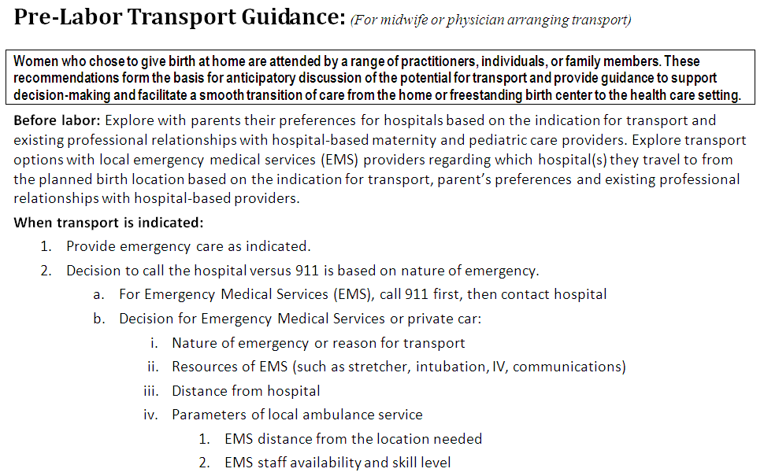
Notes:
This screen shot shows a portion of the stepwise guidance to support dialogue with the family before labor begins and decision-making when a transport occurs. These recommendations are intended to guide discussions with the family while planning for the birth and support decisions surrounding transport management. The recommendations provide opportunities for engagement with the woman as a partner in her birth and healthcare decisions regarding the specific factors that may affect how a potential transport is handled.

Slide 14
Best Practice Recommendations
Purpose: To provide communication guidelines for transfer from a planned home or birth center birth to a hospital setting.
The patient’s welfare is central to professional communication and action among all involved personnel.
The SBAR format for communication is used to guide Handoff communication from community-based providers to hospital-based care providers.
Notes:
The Best Practice Recommendations begin on Page 7 and describe broad foundational expectations for those who may participate in the transport process. Their focus is on fostering respectful and effective interprofessional communication using the Situation, Background, Assessment, Recommendation format, and acknowledgement of women’s autonomy to participate in decisions affecting their and their baby’s health.

Slide 15
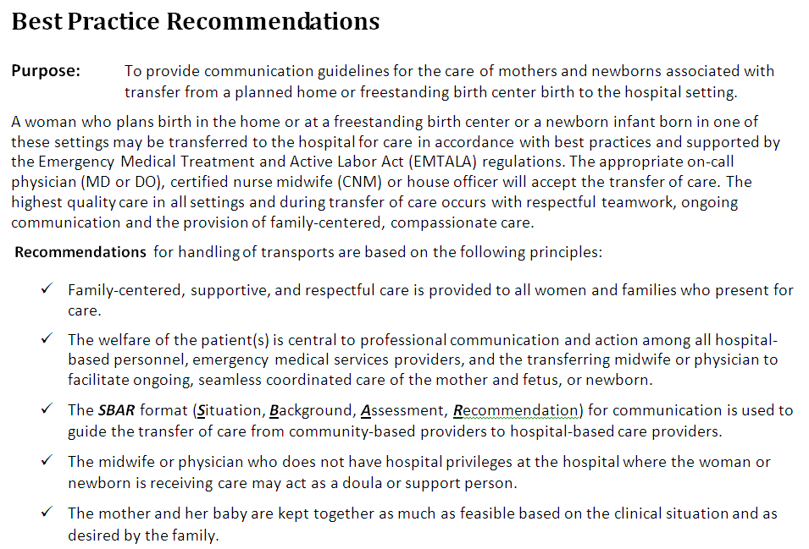
Notes:
This screen shot shows the purpose and some of the general recommendations for best practice during transport. The Best Practice Recommendations also include Role-specific recommendations for the Mother, Transferring Midwife or Physician, Emergency Medical Service Provider, Hospital-based Registered Nurse, Hospital-based Obstetrical or Pediatric Care Physician or Practitioner (CNM, NP, PA) to help inform the transport process and form the foundation for common understanding of these roles, and support effective professional communication.
It may be helpful to pause at this slide and read through the Recommendations.

Slide 16
EMS-Oriented Contents
Best Practice Recommendations
Role of transferring Birth Professional
Role of the EMS professional
Brief SBAR Script for Phone Call Initiating Transport by EMS
Brief SBAR Form for Recording Phone Call for Transport by Dispatch
Notes:
The EMS oriented content includes the topics listed here.
The Best Practice Recommendations highlight specific roles and expectations and provide the context for subsequent documents.
The SBAR Script is designed to ensure uniform delivery of critical clinical and demographic information and provides cues for the individual making the phone call.
The SBAR form for recording the call follows the SBAR script and offers a quick means to capture the content of the phone call in an organized and systematic fashion.
Next, we’ll look at these items on page 11 and 12.

Slide 17
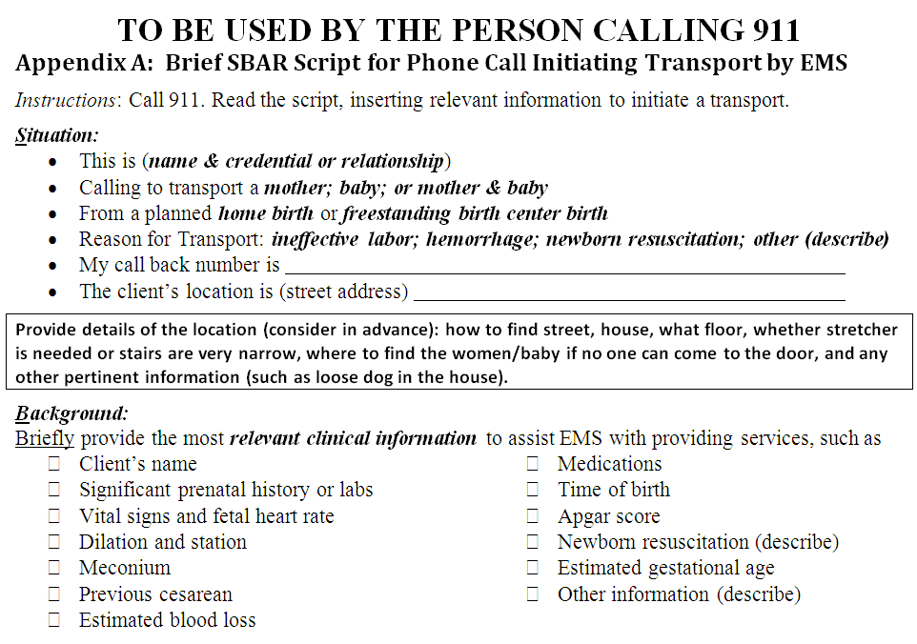
Notes:
This screen shot shows the SBAR script to aid in consistent communication from the birth provider or individual from the home or freestanding birth center who calls 911 and speaks with EMS dispatch personnel. The goal is to ensure that all essential components are included in the dialogue and are presented in a systematic and logical order. Cues are added to remind the caller to inform EMS of any specific guidance to find the home and conditions or factors needed for optimal EMS access and service delivery during transport.

Slide 18
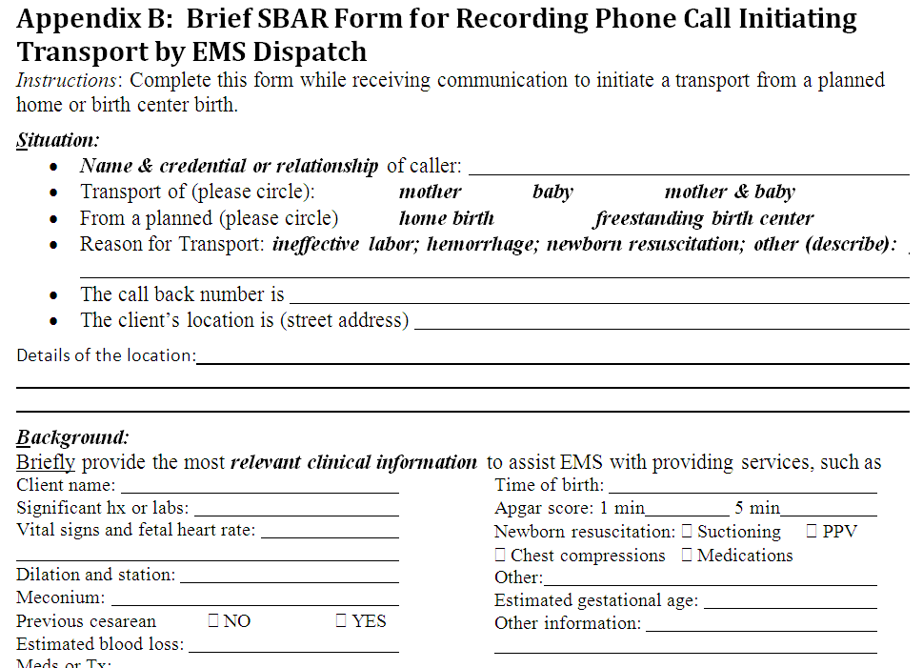
Notes:
This screen shot shows the companion form for dispatcher receiving the phone call. It mirrors the information of the script to support both parties in moving through the communication process and information collection efficiently and with a common set of expectations. It is understood that Dispatch operates from its own set of protocols and may have additional required information to be gathered. EMS expectations are that the caller will remain on the line until EMS arrives at the scene. In some instances, when notification of the receiving hospital or practitioner by the birth provider is necessary, the call to Dispatch may need to be terminated prior to the arrival of EMS.

Slide 19
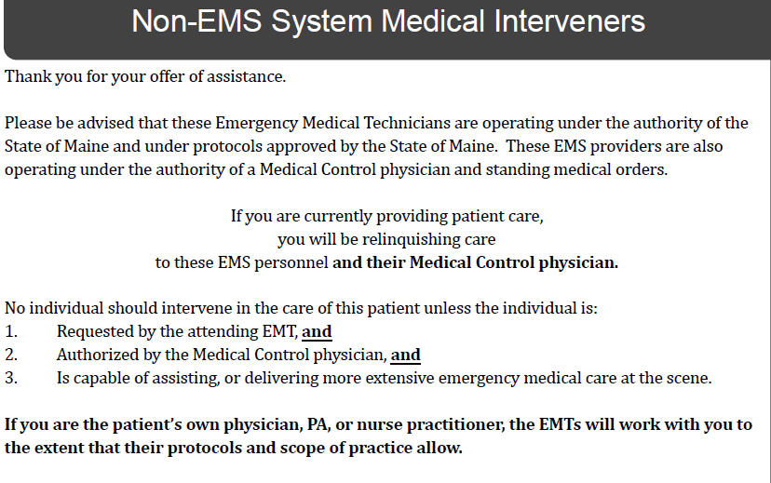
From: Maine Prehospital Treatment Protocols, 2013. Page 132. http://www.maine.gov/ems/documents/2013_Maine_EMS_Protocols.pdf
Notes:
It is recognized that EMS personnel function under strict medical protocols and direction from Medical Control. Participation of the birth provider in emergency care or transport is clearly defined in the protocol:
Birth providers who are currently providing care, will be relinquishing care to EMS personnel and their Medical Control Physician. The midwife may continue to participate in the care when
Requested by the attending EMT
Authorized by the Medical Control physician, and
Is capable of assisting or delivering more extensive emergency medical care at the scene.
Birth professionals who attend birthing women at home or a freestanding birth center are educated and trained to provide newborn resuscitation and other emergency measures. While a transport indicates a need for more advanced care or resources the attending birth professional may be the most skilled and an appropriate resource for continued care in preparation or during transport.

Slide 20
Hospital-Oriented Contents
Best Practice Recommendations
Role of transferring Midwife
Role of the Registered Nurse
Role of the OB or Pediatric provider
Brief SBAR Script for Phone Call Initiating Transport to Hospital
Brief SBAR Form for Recording Phone Call for Transport
Notes:
The hospital oriented content includes the topics listed here.
The Best Practice Recommendations highlight specific roles and expectations and provide the context for using the subsequent documents.
The SBAR Script is designed to ensure uniform delivery of critical clinical and demographic information and provide cues for the individual making the phone call.
The SBAR form for recording the call follows the SBAR script and offers a quick means to capture the content of the phone call in an organized and systematic fashion.
Next, we’ll look at these items on pages 13 and 14.

Slide 21
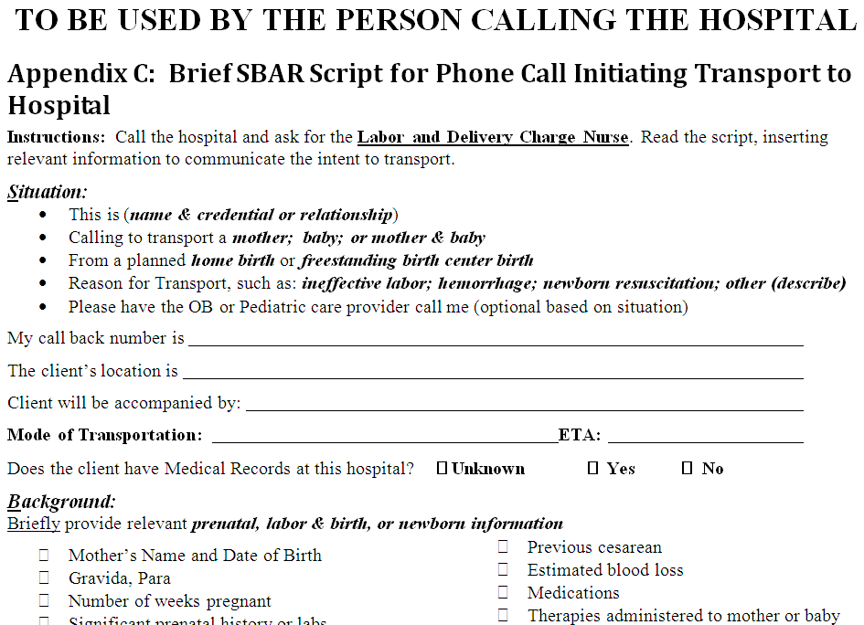
Notes:
This screen shot shows the SBAR script to aid in consistent communication from the birth provider with hospital-based personnel. The goal is to ensure that all essential components are included in the dialogue and are presented in a systematic and logical order. As you can see, some of this form can be completed in advance of the labor and birth to guide the communication process.

Slide 22
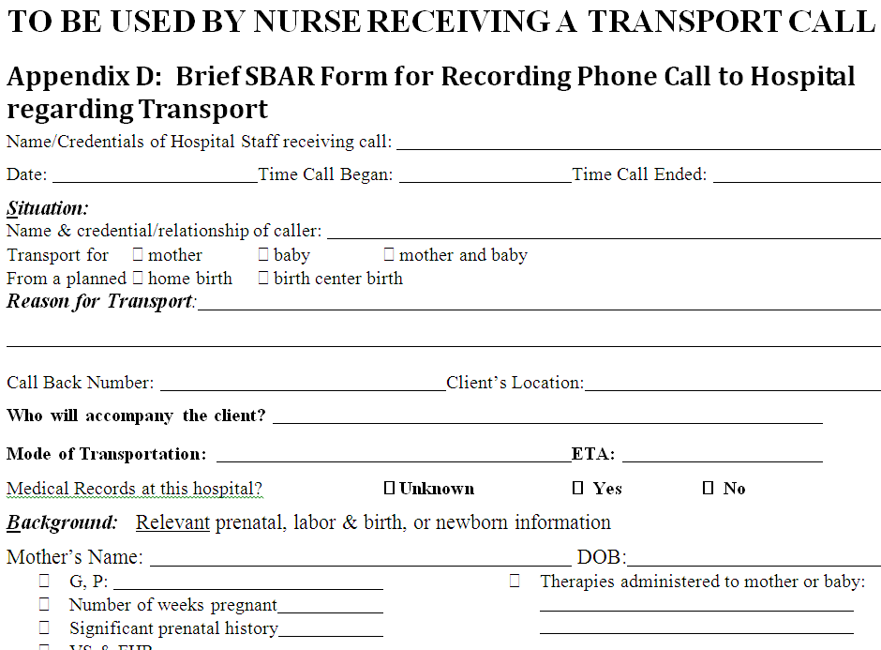
Notes:
This screen shot shows the companion form for the nurse receiving the phone call. It mirrors the information of the script to support both parties in moving through the communication process and information collection efficiently and with a common set of expectations.

Slide 23
Transport Form
Summary of essential information
Demographic information
Prenatal history
Details of reason for transport
Birth, postpartum and newborn history
Complications and interventions
Identification of established professional relationships with hospital-based professionals
Notes:
The Transport Form on pages 15 & 16 is a summary document that can be used to provide rapid access to essential information and serves as a springboard for discussion between midwife and family as pregnancy progresses and the basis for a shared plan for potential transport.

Slide 24
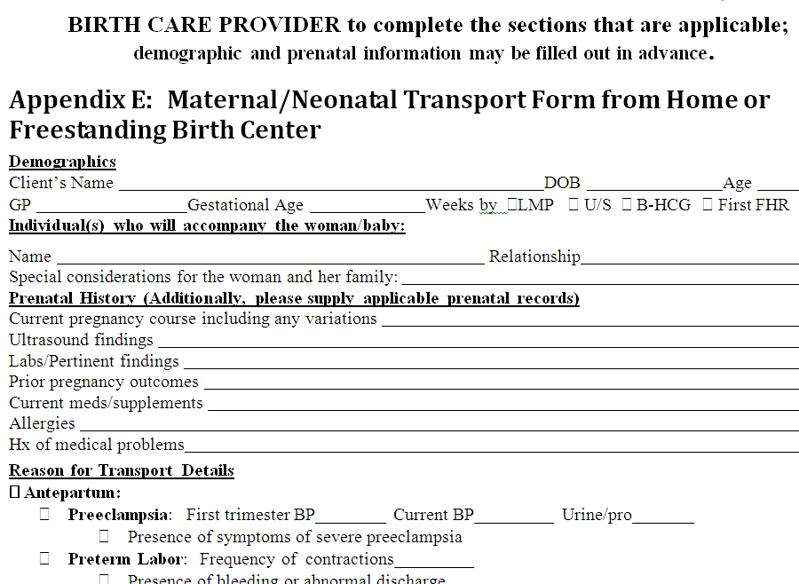
Notes:
This screen shot shows a portion of the Maternal/Neonatal Transport Form. The Demographic and other information can be completed in advance. The Reason for Transport portion is comprised primarily of check boxes to facilitate ease of completion when the decision for transport has been made and available time may be limited.

Slide 25
Definitions, Abbreviations and References
Definitions and a Key to Acronyms and Abbreviations are provided to support common understanding of terms, professions, credentials, and expectations
In-text citations are additionally cited in the list of references
Live links are included in the Definitions and the References for those who are seeking additional information
Notes:
This section begins on page 17, and includes Definitions for key terms with live links to source documents.

Slide 26
Notes:
This screen shot shows a portion of the Definitions

Slide 27
Evaluation Processes
Guidance to support constructive non-judgmental interdisciplinary communication about the transport process through professional competency review activities
Evaluation form to support feedback from healthcare professionals about the utility of the Transport tools and guidance
Evaluation form to support feedback from families who experience a transport from a home or birth center birth
Notes:
Evaluation is an integral part of the quality process. Feedback from all of those involved in transport is important to ensuring the guidance and tools are clinically useful and relevant to maintaining or improving quality practice.
Included in the Transport documents are guidelines for post-transport debriefing to support continuous quality improvement practices as part of the professional competency review process. The professional competence review should take place while events and actions are fresh in people's minds, ideally within 48 hours of transport. The goals of the professional competence review are to maintain or improve the quality of care rendered and to identify processes in the transport that worked well and opportunities for improvement. Such reviews must be confidential to encourage full and frank discussion among all participants and should be carried out in a non-judgmental manner that supports respectful dialogue, interdisciplinary exploration of shared processes and shared learning. In addition, there is a form to encourage evaluation of the document and associated tools.
The document also includes written evaluation tools which are shown in the next two slides.

Slide 28
Post-Transport Review Process
“Professional competence review activity" means study, evaluation, investigation, recommendation or action, by or on behalf of a health care entity and carried out by a professional competence committee, necessary to:
A. Maintain or improve the quality of care rendered in, through or by the health care entity or by physicians;
B. Reduce morbidity and mortality; or
C. Establish and enforce appropriate standards of professional qualification, competence, conduct or performance
From: http://www.mainelegislature.org/legis/statutes/24/title24sec2502-2.html
Notes:
“Professional competence review activity" means study, evaluation, investigation, recommendation or action, by or on behalf of a health care entity and carried out by a professional competence committee, necessary to:
A. Maintain or improve the quality of care rendered in, through or by the health care entity or by physicians;
B. Reduce morbidity and mortality; or
C. Establish and enforce appropriate standards of professional qualification, competence, conduct or performance
The post-transport review process is a multidisciplinary opportunity to identify what went well with the transport and where improvement could occur. The focus is on the transport communication and related activities. Guidance is provided for organizing and facilitating an effective professional discussion that occurs as soon after the transport as feasible, and within an environment that allows for open interdisciplinary dialogue and identification of mutual goals.

Slide 29
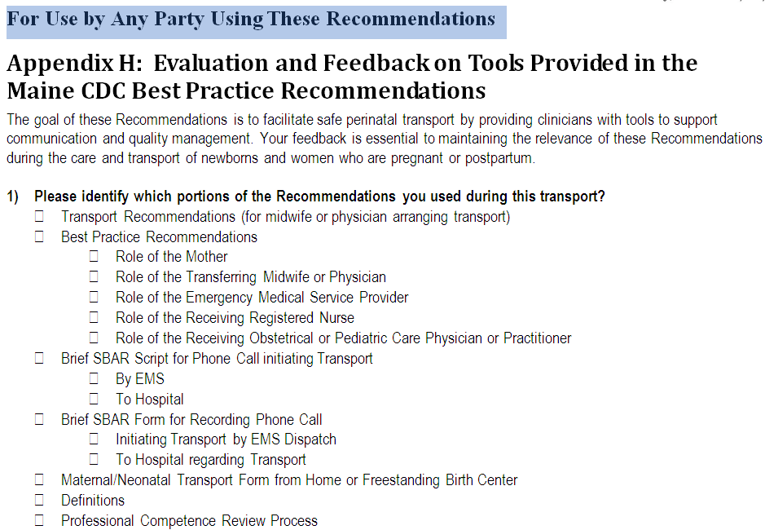
Notes:
The next tool is for evaluation of the Recommendations. This evaluation offers all participating professionals the opportunity to identify which communication tools were used, and whether the relevant Recommendations were readily understood and useful in practice. The purpose is to evaluate the utility of the content and specific communications tools. Comments and suggestions for tool improvement are welcomed.

Slide 30
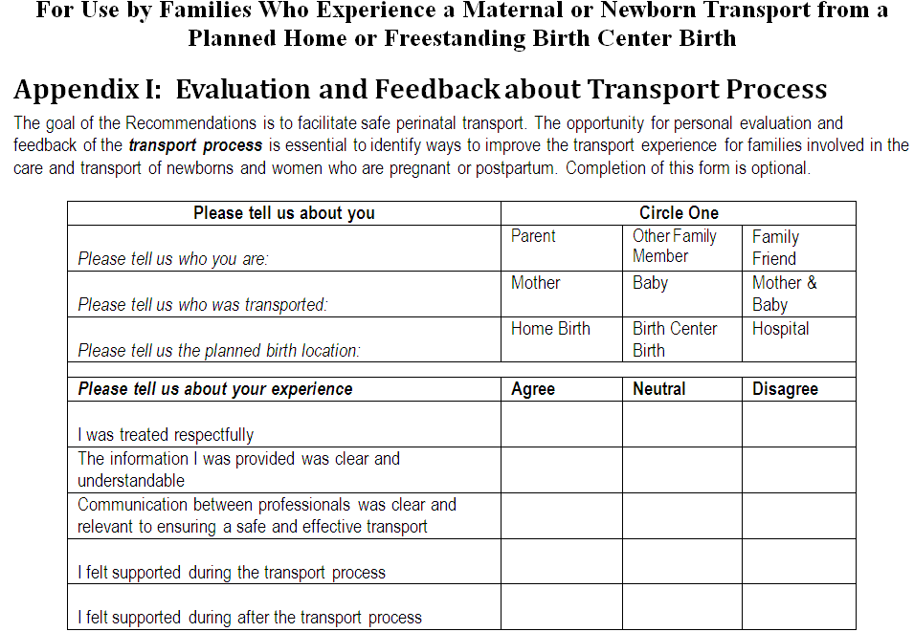
Notes:
The final evaluation tool is for families who experience a transport. This evaluation tool assesses family perceptions of how transport communication was handled, the information that was provided, the manner in which it was provided, and explores opportunities for improvement from the family point of view.

Slide 31
Summary
The Best Practice Recommendations for Handoff Communication during Transport from a Home or Freestanding Birth Center to a Hospital Setting were designed to
Reduce barriers to women seeking access to hospital care in the perinatal period
Provide a uniform approach to perinatal transport
Optimize perinatal outcomes through enhanced teamwork and seamless coordination of interprofessional care across settings
Notes:
The Best Practice Recommendations for Handoff Communication during Transport from a Home or Freestanding Birth Center to a Hospital Setting were designed to
Reduce barriers to women seeking access to hospital care in the perinatal period
Provide a uniform approach to perinatal transport
Optimize perinatal outcomes through enhanced teamwork and seamless coordination of interprofessional care across settings
This concludes the tutorial on the Maine CDC’s Best Practice Recommendations for Handoff Communication during Transport from a Home or Freestanding Birth Center to a Hospital Setting.

Slide 32
Thank You!
Birth is a significant life event for families.
Family preferences should be sought and honored whenever possible including during emergent situations.
Notes:
Thank you for your time and attention, and for all you do for Maine’s women and newborns.

