Slide 1
Maine Shared Community Health Needs Assessment
Midcoast Public Health District:
Lincoln County
Notes:
Local Facilitator

Slide 2
Welcome and Introductions
Notes:
Local Facilitator

Slide 3
Forum Agenda
Time Spent | Activity |  | Speaker/Facilitator
3:00 p.m. – 3:30 p.m. | Registration and Refreshments
3:30 p.m. – 3:35 p.m. | Welcome and Introductions | James W. Donovan, FACHE President and CEO LincolnHealth (LH)
3:35 p.m. – 3:50 p.m. | Review of CHNA requirements and activities since last effort | Drexell White, Public Health Liaison, Midcoast PHD Kate Marone, Healthy Lincoln County Anni Pat McKenney, LH Kristina Verney, LH
3:50 p.m. – 4:10 p.m. | Present key findings from Data Profile | JSI
4:10 p.m. – 4:20 p.m. | Questions on the Data | JSI
4:20 p.m. – 5:00 p.m. | Facilitated Table Breakouts: Data Discussion and Health Priorities | JSI & Local Facilitators
5:00 p.m. – 5:20 p.m. | Report back | JSI
5:20 p.m. – 5:30 p.m. | Wrap up and next steps | Cathy Cole, LH
Notes:
Local Facilitator

Slide 4
Why are we here?
Notes:
JSI or Other Facilitator
There are a number of things that bring us here today from the IRS, national accreditation boards, as well as the insight and leadership from the Maine Shared CHNA leader ship who long before the IRS and accreditation requirements saw an opportunity to work together to make Maine the healthiest state in the nation.

Slide 5

Guidance, Regulations & the Law
Maine Shared
Community
Health Needs Assessment
Images of PHAB and IRS from the internet
Notes:
JSI or Other Facilitator
See page 28 of the Community Engagement Toolkit for more information
Maine is the only state in the nation that conducts a statewide community health needs assessment through our unique public private partnership. These community health needs assessments – referred to as “CHNAs” – are required for non-profit hospitals (under the IRS and ACA) and for local health departments to meet requirements under the Public Health Accreditation Board (PHAB). Among the required activities are:
Obtain input from the community, including providers and communities served, on health needs (which is why we’re here today)
Evaluate previous actions taken to address needs identified in previous CHNAs
Choose needs to be addressed (and provide justification)
Summarize an implementation strategy

Slide 6
Maine Shared CHNA
Program Manager
Metrics Committee
Steering Committee
Data Analysis Team
Community Engagement Committee
Local Planning Teams
JSI
Governance
Notes:
JSI or Other Facilitator
Steering Committee consists of representatives from the signatory members: Central Maine Heath Care, Eastern Maine Healthcare (EMHS to become Northern Light Health on October 1) Maine General Healthcare, MaineHealth, and the Maine Center for Disease Control and Prevention. Major funding for the Maine Shared CHNA is provided by the partnering healthcare systems with generous in-kind support from the Maine CDC and the countless organizations who contribute to this effort.
Funding supports the Program Manager and contracting with a vendor to support this effort. John Snow, Inc. (JSI) was selected in January, 2018. Ask folks to stand if they have served in any or all of the following roles:
Data Analysis Team is made up of a subgroup with representatives from the Metrics Committee, analysts from Maine CDC, USM, and JSI. Their role has been to collect and analyze the list of 200 indicators identified by the Metrics Committee
Metrics Committee is made up of representatives from the signatory members with further support from UNE, USM, and subject matter experts.
The CEA made up of a subgroup with representatives from the Statewide Community Engagement Committee. Their role has been to provide advice and guidance to the Program Manager on every aspect of community engagement.
Statewide Community Engagement includes partners and interested parties who have provided feedback on all aspects of community engagement
Local Planning Teams have set dates, found venues, and organized every aspect of today’s event.
They deserve a hand!

Slide 7
Health Improvement Process
Community Health Needs Assessment (CHNA)
Hospital Implementation Strategies
(IS)
Public Health
District Health Improvement Plan
(DPHIP)
State Health Improvement Plan
(SHIP)
Evaluate
Partners
Partners
Partners
Partners
Partners
Partners
Notes:
JSI or other facilitator
Best practice = including regular community assessment of data and progress, which creates multi level health improvement plans, which are evaluated regularly. Health Improvement Plans cannot succeed without partners – many who are here today.

Slide 8
Local Activities and Accomplishments
Notes:
Local Facilitator

Slide 9
Midcoast Public Health District
Midcoast Public Health Council (MPHC)
The Midcoast Public Health District is one of nine public health districts in Maine. The district includes Waldo, Lincoln, Knox and Sagadahoc counties.
The Midcoast Public Health Council is the District Coordinating Council (DCC) for public health in the Midcoast with council membership or representation from the district’s four counties, as well as Brunswick and Harpswell.
District Public Health Improvement Plan (DPHIP) created in 2016
Notes:
Local Facilitator

Slide 10
Midcoast District Highlights
DPHIP 2017-2019 & Prevention Services
Priority | Elevated Blood Lead Levels | Mental Health – Youth & Adult | Obesity & Diabetes | Substance & Tobacco Use
Partners | Midcoast Public Health Council Pen Bay Medical Center Waldo County General Hospital | LincolnHealth Mid Coast Hospital Midcoast Public Health Council OUT Maine | Knox County Community Health Coalition LincolnHealth Mid Coast Hospital Midcoast Public Health Council Pen Bay Medical Center Waldo County General Hospital | Healthy Lincoln County Knox County Community Health Coalition LincolnHealth Mid Coast Hospital Pen Bay Medical Center Waldo County General Hospital
District Highlights | Strategic review of blood level testing in Midcoast Maine – June 2017 Work with Pediatric practices to increase testing rates | Mental health needs assessment for older adults in Midcoast Maine – July 2017 School and youth serving organizations surveys on youth mental health – July 2017 | Strategic review of Chronic Disease Self Management Programs in Midcoast District report and recommendation – July 2017 10 Mini-grants awarded
Notes:
Please note that our partners are listed here alphabetically for consistency sake.
Priorities for the hospitals and district are listed.
Under each, there are entities identified focusing efforts on these priorities either through the hospital, district or prevention services work.
NOTE: there are other community partners in our area that are focusing efforts on these priorities as well.

Slide 11
Lincoln County & LincolnHealth
Priority areas of work since the 2016 Shared CHNA
Priority | Mental Health Services | Healthy Eating and Active Living (Obesity, Physical Activity and Nutrition) | Substance Use
Partners | AOS 93 Boothbay Region School-Based Health Center Lincoln Academy Lincoln Medical Practices (LMP), LincolnHealth Maine Behavioral Health Coulombe Center for Health Improvement | AOS 93, AOS 98, Wiscasset Schools, Lincoln Academy and Coast Kids Preschool Boothbay Region YMCA Childcare sites CLC YMCA FARMS at the Y Healthy Lincoln County (HLC) LincolnHealth MaineHealth Let’s Go! Midcoast Public Health Council | Addiction Resource Center of Mid Coast Hospital Healthy Lincoln County Lincoln County Recovery Collaborative LincolnHealth Maine Health Access Foundation (MeHAF) Boothbay Region Community Resource Council (BRCRC) Local Police Departments Boothbay Region and CLC YMCA’s
District Highlights | Connected children, adults and families to mental health/behavioral health services provided within LMP Practices, Boothbay Region School-Based Health Center and Lincoln Academy | Awarded mini-grants to Let’s Go! School and Childcare Site Applicants CLC and Boothbay Region YMCAs’ provide Diabetes Prevention Program Healthy cooking classes hosted by FARMS, YMCAs, HLC and LincolnHealth | LincolnHealth expanded access to Medication-Assisted Treatment for Opioid Addiction with MeHAF planning grant Youth-oriented prevention programs provided by Healthy Lincoln County Work of Lincoln County Recovery Collaborative continues
Notes:
Local Facilitator
Priorities for the hospitals and district are listed.
Under each, there are entities identified focusing efforts on these priorities either through the hospital, district or prevention services work.
NOTE: there are other community partners in our area that are focusing efforts on these priorities as well.

Slide 12


Mental Health
Activities & Key Accomplishments | Maine Behavioral Health Clinicians are integrated into LincolnHealth, Lincoln Medical Partners Family, Pediatric and Women’s Health Practices. Behavioral health services were expanded at Boothbay Regional High School’s Health Center and Lincoln Academy. Made possible through the financial support of the LincolnHealth Coulombe Center for Health Improvement.

Slide 13
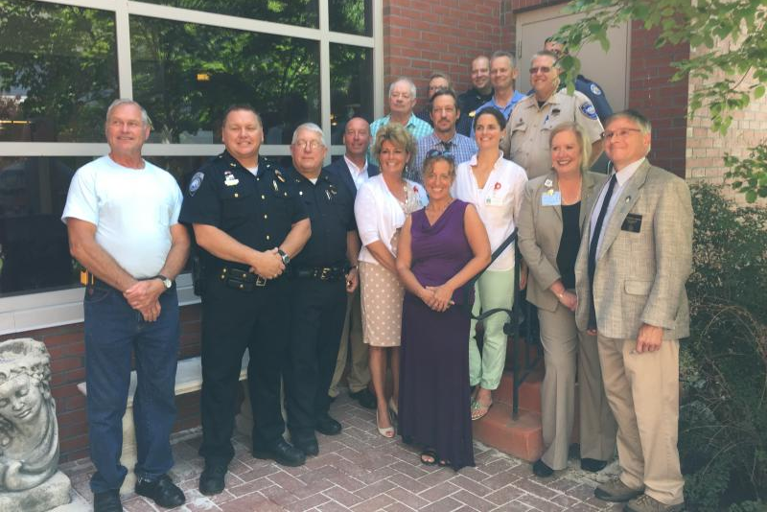
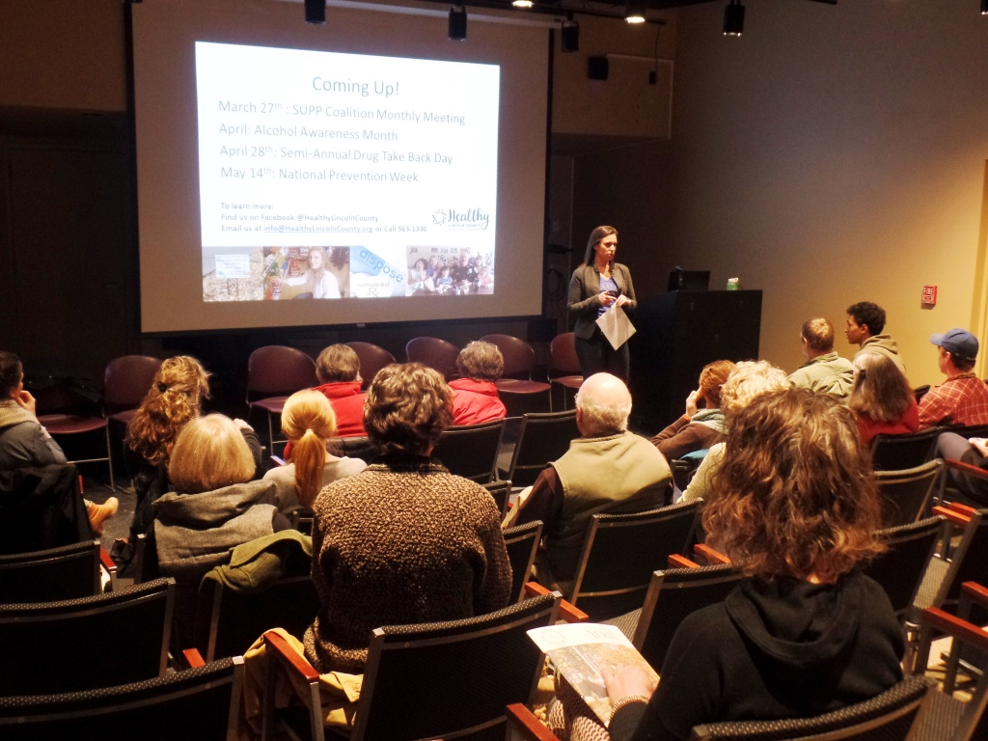
Substance Misuse Prevention & Treatment
Activities & Key Accomplishments | LincolnHealth expanded Medication Assisted Treatment with 2 additional physicians bringing the total to 5. Patients, who qualify, have greater access to treatment. With the support of Mid Coast Hospital’s Addiction Resource Center, LincolnHealth Emergency Department Physicians and Nurses are trained to screen patients with opioid addiction issues for possible suboxone treatment. 85% increase in the number of pounds of medication collected at disposal sites from 2017-2018 244 Lincoln County high school students received an evidence-based substance use prevention program provided by Healthy Lincoln County in school
Grant Work | MeHAF 2-year planning grant awarded to LincolnHealth in 2017 to expand Medical Assisted Treatment.
Lincoln County Resource Council
Healthy Lincoln County hosts information night.

Slide 14
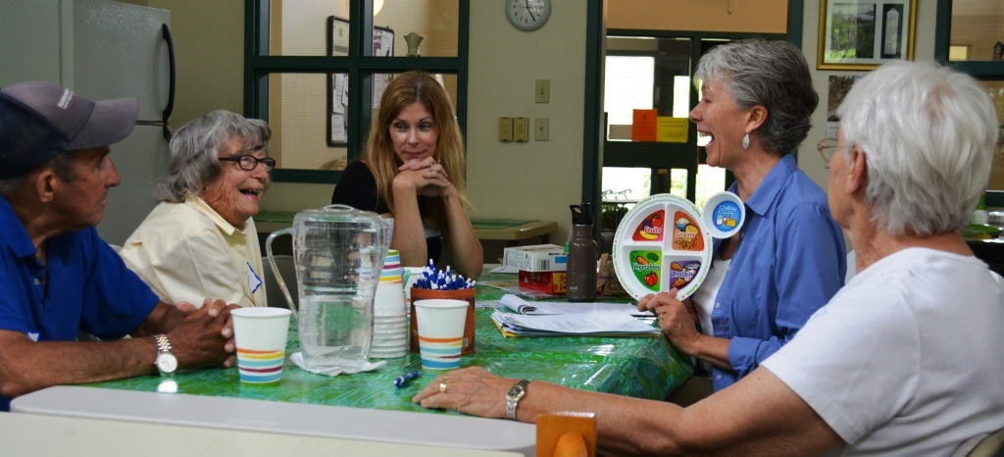

Healthy Eating/Active Living (Obesity & Nutrition)
Activities & Key Accomplishments | Let’s Go! 5210 in Lincoln County worked with more then 30 sites to help create environments where the healthy choice is the easy choice. This work was done in partnership with schools, childcares, out of school programs, superintendents, and food service directors. Healthy Lincoln County provided 1,300 youth with evidence-based SNAP-Ed nutrition education programs in school. The Lincoln County Gleaners established in 2017, distributing 5,894lbs of free produce from local farms to community sites The CLC and Boothbay YMCA’s began offering the national Diabetes Prevention Program in 2017, a collaborative effort with LincolnHealth.
Grant Work | LincolnHealth’s Let’s Go! Program gave out 10 mini-grants to schools and childcare sites for physical activity and healthy eating initiatives.
Bay Landing Residents in class with Lara Coger, HLC, Nutrition Education Coordinator
Coastal Kids Preschool students prepare vegetables.

Slide 15
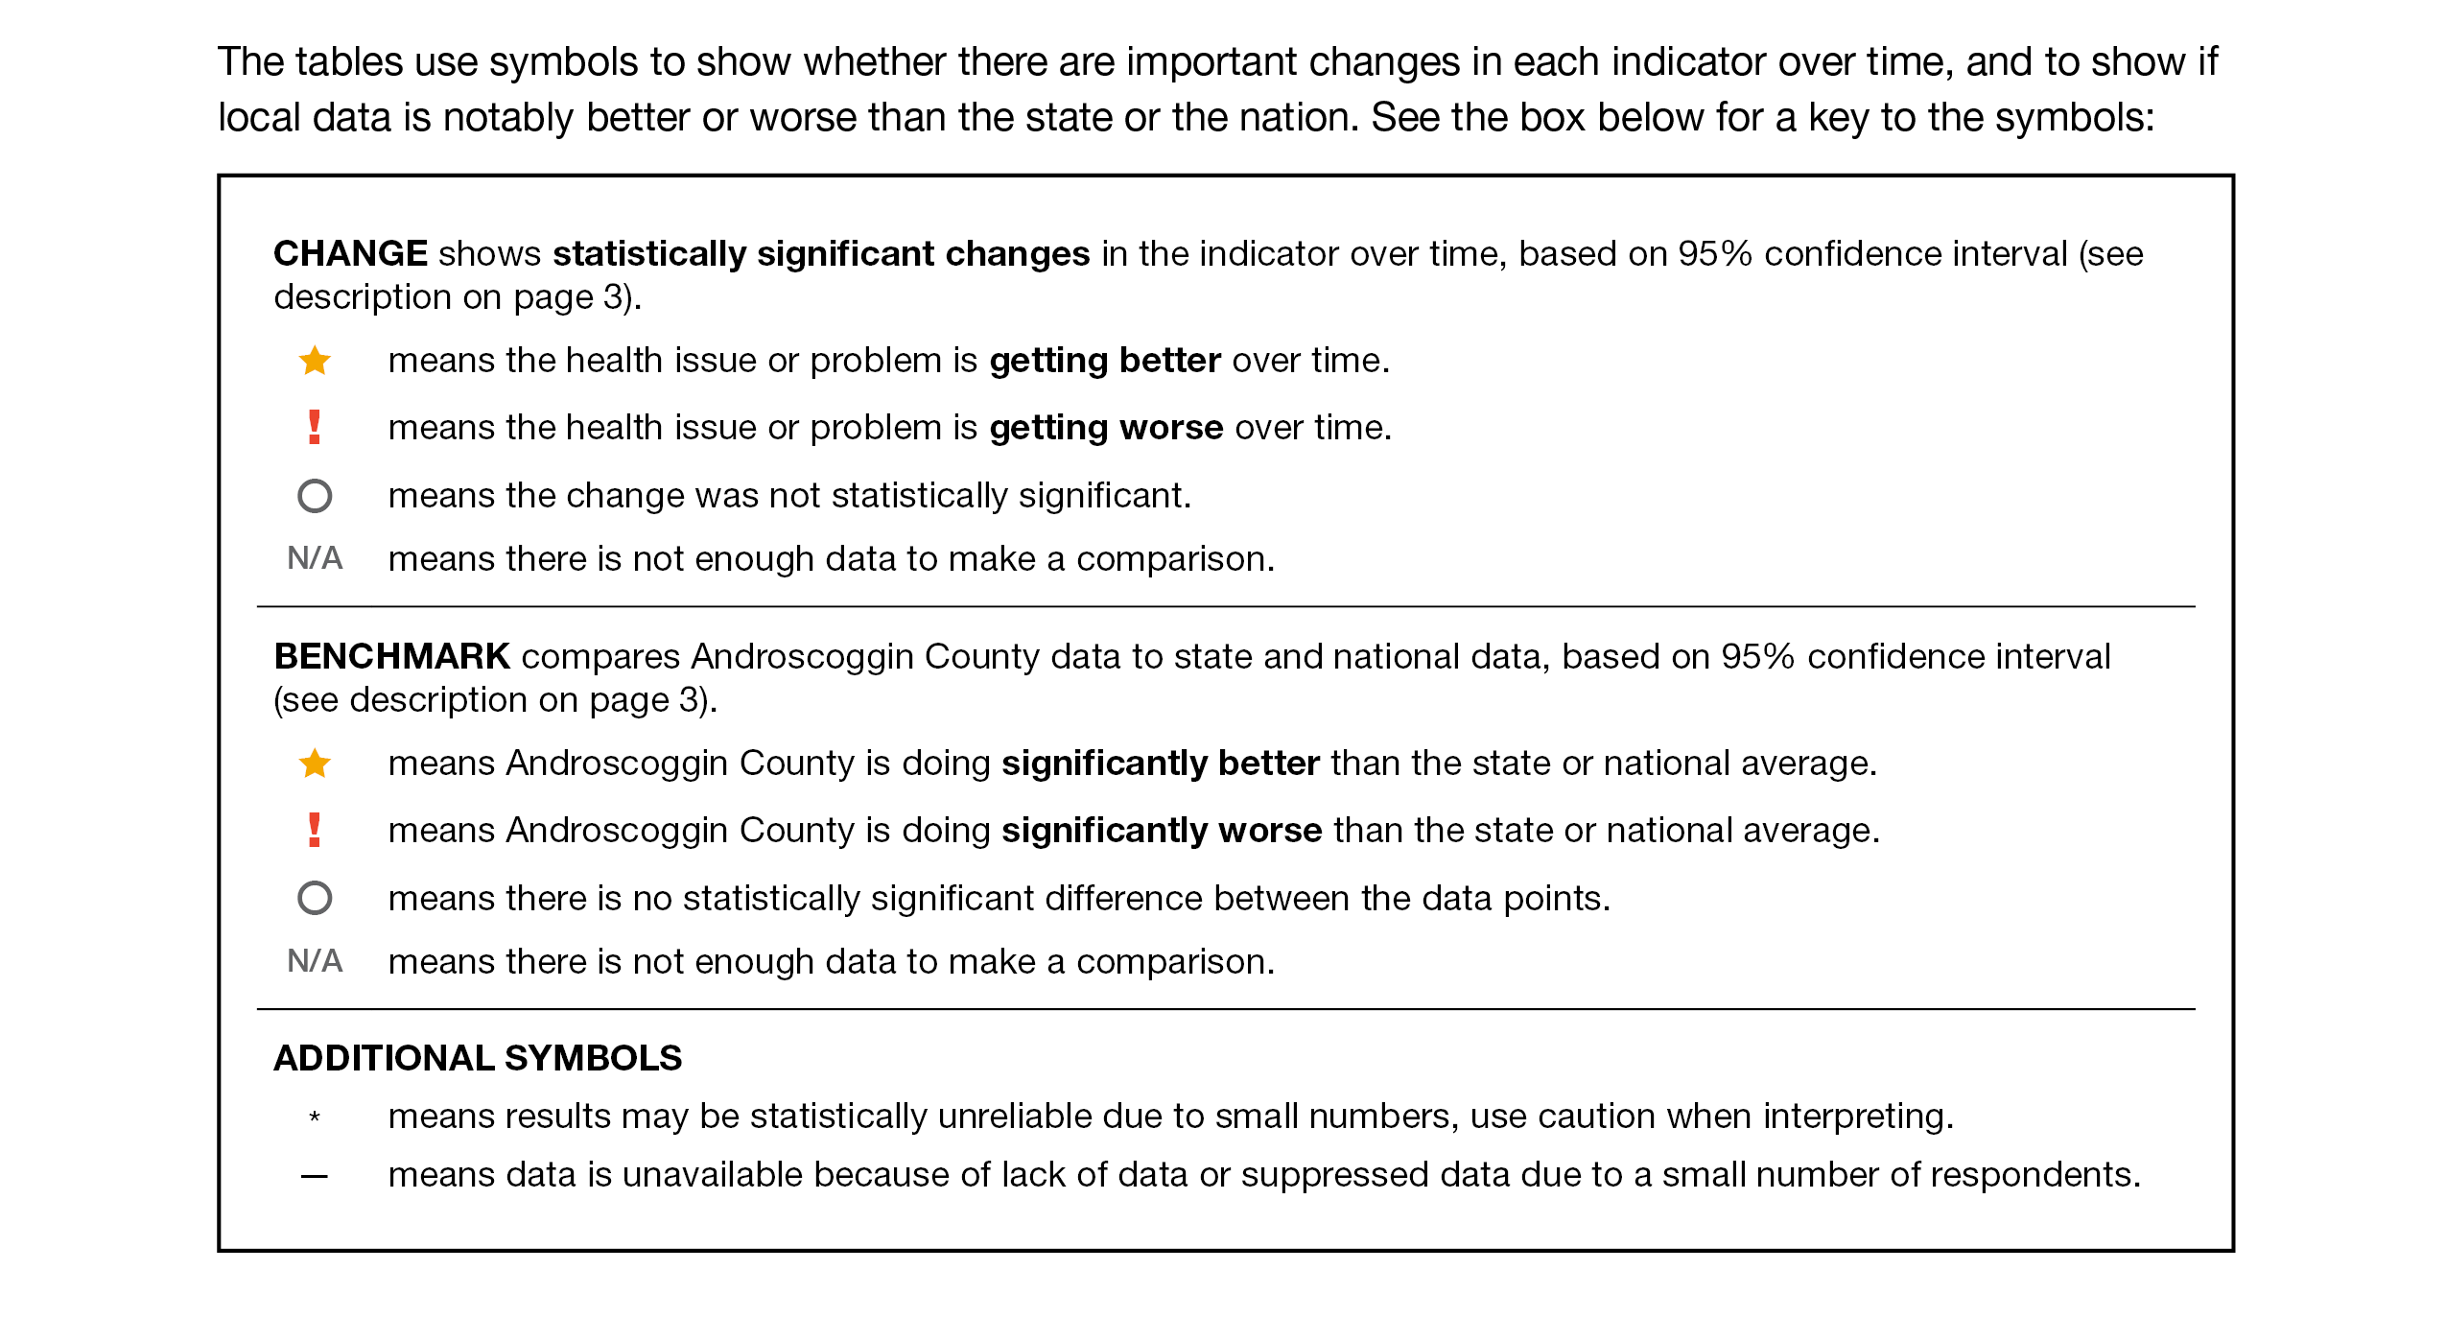
How to Read County Health Profile
EXAMPLE
Notes:
JSI or other facilitator
The County Profile provides almost 200 health data indicators from over 30 sources. Looking through the document, you’ll see that wherever possible, we’ve included data for the county for two points in time (to note any changes over time), state data (to compare the county to the state), and national data (to compare the county and the state to the US). Along with the data, you’ll notice some symbols. These symbols show whether there are important changes in the data over time, and show where County data is notably better or worse than the state or the nation.
When we’re looking at the County level data to see if things changed over time:
A star means that the health issue or problem is getting better over time
A red exclamation point means that the health issue or problem is getting worse over time
A gray circle means that any change in the data over time is not statistically significant
N/A means that there was not enough data to be able to make a comparison
Looking at County data in comparison to the state and national data:
A star means that the County is doing significantly better than the state or national average
An exclamation point means that the county is doing significantly worse than the state or national average
A gray circle means there is no statistically significance between the County and the state or national average
N/A means that there isn’t enough data to make a comparison
There are two additional symbols you might see:
A black dot means that you should use caution when interpreting the data – the results might be unreliable because of small numbers
A black dash means that data was unavailable, or that data was suppressed due to a small number of respondents
(Go to next slide and walk audience through an example)

Slide 16
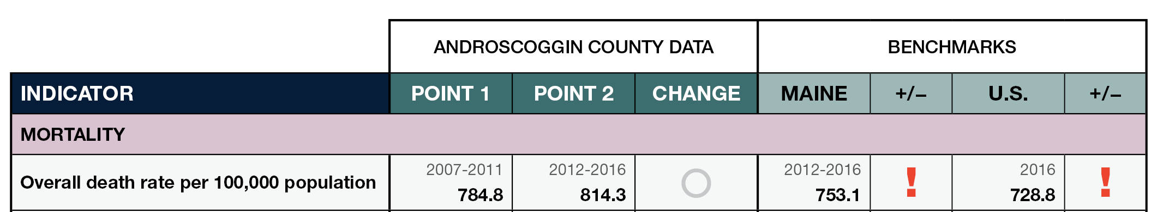
How to Read County Health Profile
EXAMPLE
Notes:
JSI or other facilitator
Lets use this line as an example
Here, we can compare the overall death rate in Androscoggin County between 2007-2011 and 2012-2016. Although the rate is higher in Point 2, the gray circle tells us that the change over time was not significant.
We then look at the most recent data compared to the state and to the US. Here, the red exclamation point tells us that the County rate is significantly higher then the state and the US.

Slide 17
Key Findings
Notes:
JSI or Other Facilitator
We encourage you to spend some time looking through the County Health Profile. We won’t be able to cover all that is in the document during this presentation today, but we’ve pulled out a number of key findings to give you an overview of health in each county.
The following data was chosen for this PowerPoint based on the criteria below:
Previous County Priorities
Indicators visualized in the County Health Profile
The county level data significantly diverges from the state and/or nation in either a positive or negative direction.
Significant changes in prevalence, incidence or health behavior over time (trend)
The magnitude of impact is significant (i.e. high rates of prevalence and incidence). (i.e.: does this indicator impact leading cause of mortality and/or morbidity?)
Based on the criteria above, the “33 Key Indicators” were used to prioritize “tie breaks”
Requests by local planning teams

Slide 18
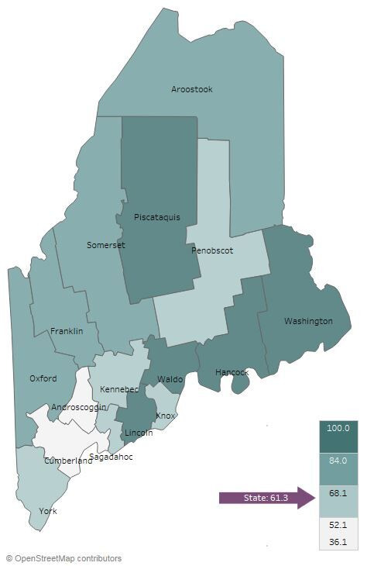

Demographics
Lincoln County: Age Distribution
Percent of Population Living in Rural Areas, 2012-2016
Notes:
JSI or Other Facilitator
Direct people to Page 5-8 of County Profile for more information on demographics
AGE:
Among all counties, Lincoln has the largest proportion of people over the age of 65 – 25%
It’s important to understand the age distribution in a community when assessing health status – for example, older individuals typically have more complex/chronic conditions and physical vulnerabilities (e.g. falls) and young people may be more apt to engage in risky behaviors (e.g alcohol and tobacco use, unprotected sex)
RURALITY:
Lincoln is one of two counties that is 100% rural
There are a number of risk factors associated with urban living that have an affect on ones health – population density, pollution, crime, lack of safe green space, and housing related health risks – just to name a few.

Slide 19
Demographics
Lincoln County: Births to 15-19 Year Olds
Per 1,000 Population
50%
Maine 16%
2010
2016
Notes:
JSI or Other Facilitator
Pregnancy among teenagers often creates a number of issues for the young mother. Many are still experiencing physical growth, have high nutritional requirements, and often have poor eating habits. It is common for young mothers to experience physiological, emotional, social, and economic problems. The younger the mother, the higher the probability of a low birth weight infant, poor infant development, neonatal death, and other conditions.
The teen birth rate in Lincoln County increased between 2010 and 2016, and is significantly higher than the state overall.
There are a number of other data points related to pregnancy and birth outcomes on Page 22 of the County Health Profile.

Slide 20
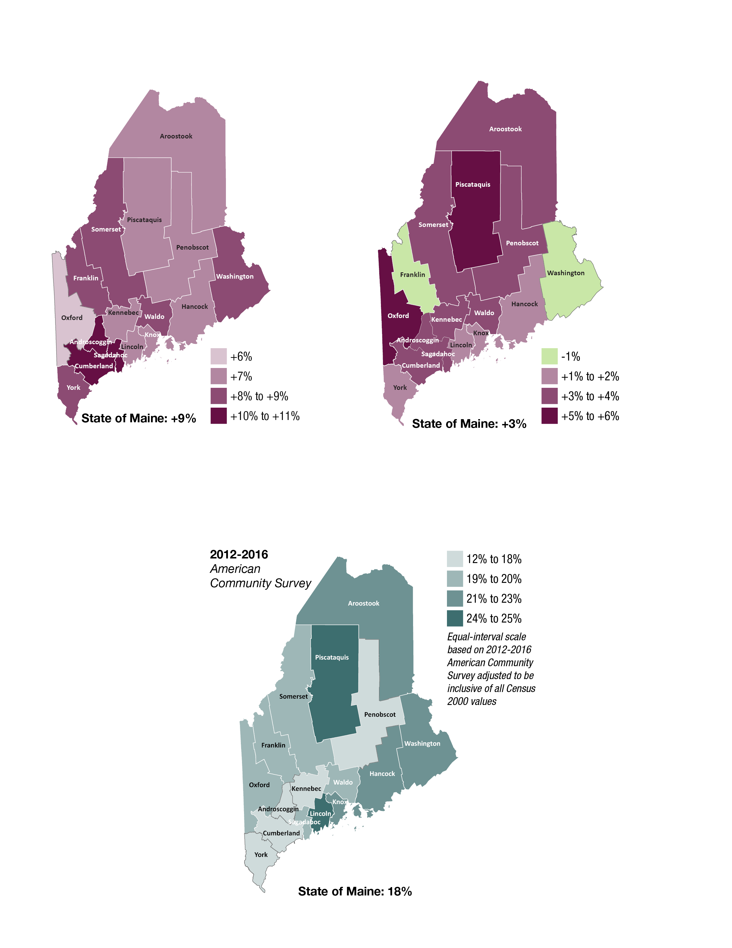
Demographics
Change in Percent of Population Age 25+ With Associates Degrees or Higher, 2000-2016
Notes:
JSI or Other Facilitator
EDUCATION:
Higher education is associated with improved health outcomes and social development at the individual and community level. The health benefits of higher education typically include better access to resources, safer and more stable housing, and better engagement with providers. Those with lower levels of education typically have more difficulty navigating the health system and are exposed to more chronic stress.
Darker purple on the map shows an increase between the year 2000 and 2016. In Lincoln County, the percentage of population with an Assoc degree or higher increased approximately 7% between 2000 and 2016. Lincoln County has a slightly larger percentage of residents with Assoc Degree or higher compared to the state overall – 40% compared to 37% REFER TO PAGE 8 OF YOUR PROFILES TO SEE MAPS FOR EACH POINT IN TIME.
Turn to Page 18 of the County Health Profile – the Social Determinants of Health Section. Here you find other data points related to socioeconomic status, like median household income and unemployment rate.

Slide 21
Health Equity Data
Handouts include selected data for:
Sex
Race
Ethnicity
Sexual orientation
Education
Income
Rurality
Notes:
JSI or Other Facilitator
In addition to the county health profiles, we are providing some tables showing health disparities among some populations within Maine.
These data are state level data. When we try to look at the same data at the county level, we generally found that:
Much of the data is suppressed due to small numbers and privacy concerns
The variation between these groups does not change very much from county to county. If the group shows a disparity at the state level, the same disparity will be at the local level
These tables show the percentage or rate of health or social determinants of health indicators (rows) by varying
education groups in Maine (columns). In the example on the screen, 59.6% of adults with less than a high school diploma have an income of less than $25,000, while 9.7% of adults with a bachelor’s degree or higher have an income of less than $25,000.
The columns in each row therefore do not add up to one hundred.
The bar chart in the final column shows the same data in the same order in a chart format. In the example on the on the screen, you can see that many indicators show better outcomes as peoples’ educational increases

Slide 22
Years of Potential Life Lost
Lincoln County: Years of Potential Life Lost Per 100,000 Population
10,000
YPLL measures premature death, or the years of potential life lost before the age of 75.
Maine 6529.2
Notes:
JSI or Other Facilitator
Rate of years of potential life can be found in the table on Page 14 of the County Health profile
The YPLL measure is used because simple mortality rates do not fully address the issue of premature death, the impact of disease and death, and their cost to society. The YPLL increased in Lincoln County between 2010-2012 and 2014-2016, though only slightly.
A high YPLL tells us that there is reason to focus attention on deaths that could have been prevented – there is reason to investigate the causes of premature death.
For example, a person dying at age 25 contributes 50 years of life lost, whereas a person who dies at 65 contributes 10 years of life lost to a County’s YPLL. In other words, high rates of years of potential life lost is an indicator of people dying young.

Slide 23
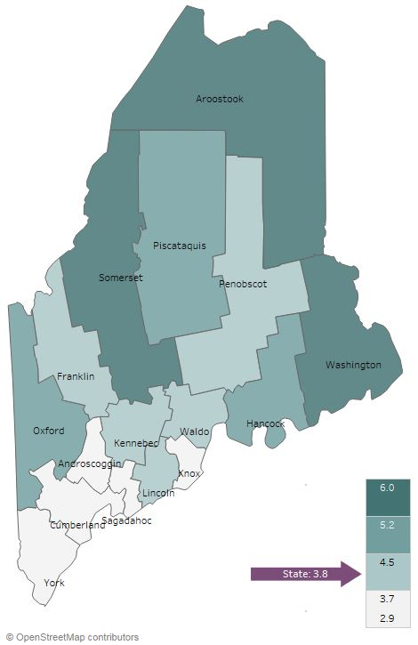
Social Determinants of Health
Unemployment rate (2012-2016)
Lincoln County: Percent of Individuals Living in Poverty, 2000-2016
Notes:
JSI or other facilitator
Direct people to page 18 of the county health profile for more data on the social determinants of health. The social determinants of health are the conditions that effect the environments in which people live, work, learn, and play
UNEMPLOYMENT
Between 2011-2013 and 2015-2017, the unemployment decreased from 7% to 4%
Lack of gainful employment is linked to several barriers to good health – lack of health insurance and inability to pay for care, inability to pay for transportation to/from appointments, etc.
POVERTY:
Poverty impacts all facets of an individuals life – it may prevent someone from continuing their education, can impede access to healthy food and safe housing, and overall, makes it more difficult to maintain good health.
In Lincoln, the % of population living in poverty has increased 1-2% since the year 2000. Approximately 12% of the population lives in poverty, compared to 14% of Maine’s population overall.
The median household income in Lincoln is higher than the state overall - $53.5K compared to $50.8K

Slide 24
Health Behaviors - Obesity
Lincoln County: Obesity (Adults)
Lincoln County vs. Maine: Obesity
(High School)
40%
40%
Maine 30%
2011
2016
Lincoln
Maine
Notes:
JSI or Other Facilitator
Lack of physical activity, poor nutrition, and obesity are among the leading risk factors associated with chronic health issues. Adequate nutrition helps prevent disease and is essential for the healthy growth and development of children and adolescents. Being physically active reduces the risk for many chronic health conditions and is linked to good emotional health.
Starting at the bottom of Page 21 and moving into Page 22 of the County Health Profile, you’ll find data on physical activity, nutrition, and weight.
Obesity – Adults
The percentage of adults in Lincoln County that are obese is lower than the state overall. The data shows an increase over time, though the change is not statistically significant.
On Page 22, you’ll see that the percentage of adults who reported meeting physical activity recommendations was slightly higher than the state (55% compared to 54%). The percentage with less than one serving of fruit and vegetables a day were both lower than the state, meaning Lincoln County is faring better in these categories.
Obesity – High School
The percentage of high school students in Lincoln County that are obese is very similar to the state overall
On Page 22, you’ll see that the percentage of high school students who reported meeting physical activity recommendations was higher than the state overall (22 vs 20%), as was the percentage who consumed 5+ servings of fruits and vegetables a day (17 vs. 16%)

Slide 25
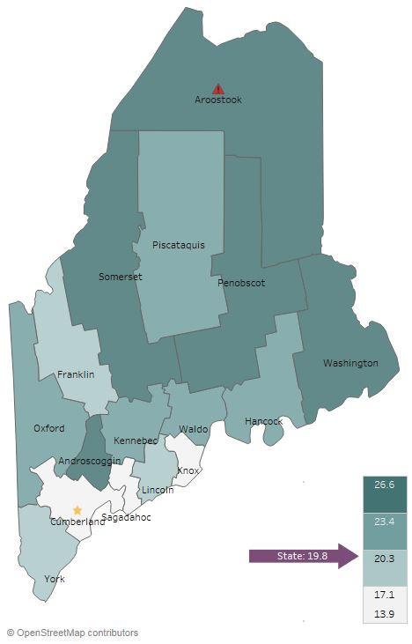

Health Behaviors- Smoking
Current Smoking (Adults), 2016
Notes:
JSI or Other Facilitator
Reducing tobacco use is the single most effective way to prevent death and disease in the US. Each year, almost half a million Americans die from tobacco related illnesses. For every person who dies from tobacco use, 30 more suffer with at least one serious tobacco-related illness, such as COPD, heart disease, or cancer
Page 27 of the County Health Profile has additional data on Tobacco Use
ADULT CURRENT SMOKING:
The percentage of adults in Lincoln County who currently smoke is the same as the state overall – approximately 20%.

Slide 26
Health Behaviors- Smoking
Lincoln County: Past-30-Day Cigarette Smoking (High School)
Lincoln County: Past-30-Day
E-Cigarette Use (High School)
25%
25%
Maine 15%
Notes:
JSI or Other Facilitator
PAST 30 DAY HIGH SCHOOL:
Over time, the percentage of high school students who reported smoking cigarettes in the past 30 days has decreased steadily, from 13 to 10%. The current percentage (10%) is slightly higher than the state (9%)
The percentage of high school students who reported e-cigarette use in the past 30 days has increased from 12% to 15% between 2015 and 2017
We recommend reading the data on e-cigarette use rates with caution as there is some concern of under-reporting due to the wording of the question as to whether students understood that e-cigarettes includes JUUL or ENDS or other devises. This question is likely to undergo rewording in 2019.”
On Page 27 of the County Health Profile, you will see there that the percentage of high school students exposed to secondhand smoke is higher than the state overall (34% vs. 31%), indicating that high schoolers are being exposed to tobacco smoke in the home. Secondhand smoke causes a number of health problems, including asthma, respiratory and ear infections, and cardiovascular disease

Slide 27
Health Behaviors- Alcohol and Marijuana
Lincoln County: Past 30-day Alcohol and Marijuana Use (High School)
35%
Notes:
JSI or Other Facilitator
Youth substance use can lead to problems in school, can aggravate physical and/or mental health issues, contribute to accidents and injury, and create lifelong health problems. Please see Page 26 and 27 of the County Health Profile for additional data on substance use
The line graph on the right shows past 30-day use for alcohol and marijuana among high school students over time.
Past 30 day alcohol use has decreased over time, from 25% in 2013 to 19% in 2017. The current percentage is lower than the state (23%). As you can see on Page 26 of the County Health Profile, the percentage of high school students who report binge drinking is also lower than the state (19 vs 23%)
Past 30 day marijuana use decreased between 2013 and 2015, but increased between 2015 and 2017. The current percentage, 22%, is higher than the state overall (19%)

Slide 28
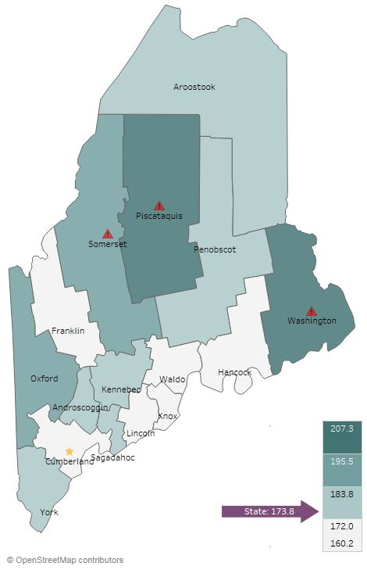
Health Outcomes - Cancer
Lincoln County: Prostate Cancer Incidence
Per 100,000 Population
All Cancer Deaths, 2016
500.0
Incidence per 100,000
Maine 87.1%
Notes:
JSI or Other Facilitator
Experts have an idea of the risk and causal factors associated with cancer, but more research is needed to understand the many unknowns that still exist. What we do know is that there are several common risk factors: age, family history, tobacco use, overweight/obesity, excessive alcohol consumption, exposure to the sun, and exposure to environmental and occupational pollutants.
Cancer is the leading cause of death in Lincoln County and in the state overall. The rate of all cancer deaths in Lincoln County is lower than the state– 164.4 vs. 173.8 per 100,000.
In the County Health Profile on Pages 19 and 20, you’ll see a number of other cancer-related data points, including death and incidence rates many different forms of cancer. As shown in the graph the right, the incidence of new prostate cancer cases significantly decreased over time in Lincoln County, from 114 to 63, and is lower than the state overall.

Slide 29
Health Outcomes-Adult Chronic Disease
Lincoln County: Diabetes Prevalence (Adults)
Lincoln County: Asthma Prevalence (Adults)
15%
15%
Maine 12%
Maine 10%
Notes:
JSI or Other Facilitator
In Lincoln, the percent of adults with diabetes has remained steady over time, at 9%. The current prevalence is right on par with the state.
The percent of adults with asthma also remained steady over time, and is significantly lower than the state overall (8% vs 12%)
Page 21 also includes a number of data points around diabetes, asthma, and respiratory conditions

Slide 30
Health Outcomes-Adult Chronic Disease
Lincoln County:
High Cholesterol (Adults)
Lincoln County:
High Blood Pressure
Maine 39%
Notes:
JSI or Other Facilitator
In Lincoln County, the percentage of adults with high cholesterol and the percentage of adults with high blood pressure is similar to the state overall. The percentage of adults with high cholesterol declined slightly over time, from 41 to 38%.
Both of these are risk factors for a number of cardiovascular diseases and conditions, including coronary heart disease, heart attack, and stroke. On Page 20 of the County Health Profile, you will see a number of data points related to cardiovascular disease

Slide 31
Health Outcomes – Injury
Lincoln County: Coronary Heart Disease Deaths Per 100,000 Population
100
Maine 84.1
Notes:
JSI or Other Facilitator
In Lincoln County, the rate of coronary heart disease deaths significantly declined over time, from 91 to 68 per 100,000 population, and is significantly lower than the state (and the nation!) overall.

Slide 32
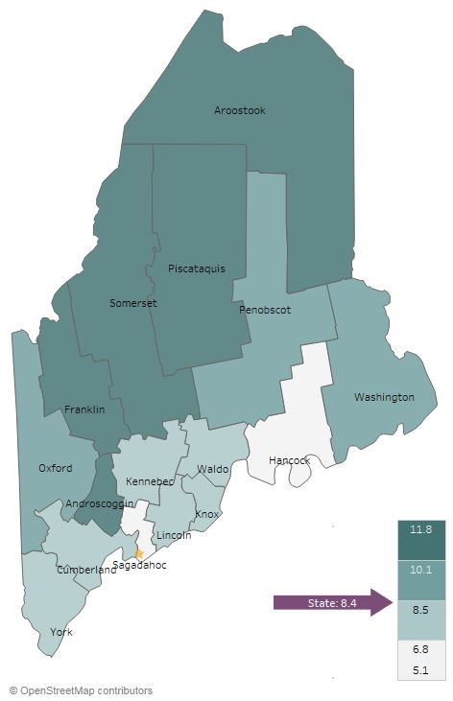
Health Outcomes - Mental Health
Current Depression (Adults), 2014-2016
Lincoln County vs. Maine: Sad/Hopeless
2+ Weeks in a Row (High School), 2017
35%
Lincoln
Maine
Notes:
JSI or Other Facilitator
Mental health has an impact on individuals, families, and communities. Like substance use, mental health impacts all segments of the population, across demographic and socioeconomic lines. You can see more data on mental health on Pages 25 and 26 of the County Profile.
Adults
Looking at the map, you’ll see that the percentage of adults with depression is right around the state percentage – approximately 8% for both.
High School
In 2017, the percentage of high school students who reported being sad/hopeless for two weeks in a row in the past 30 days was significantly smaller compared to the state overall (24 vs 27%).You can see more data on mental health on Pages 25 and 26 of the County Profile. Notice that although the sad/hopeless percentage is significantly smaller, the percentage of HS students who reported that they’ve seriously considered suicide is the same as the state overall – 14%.

Slide 33
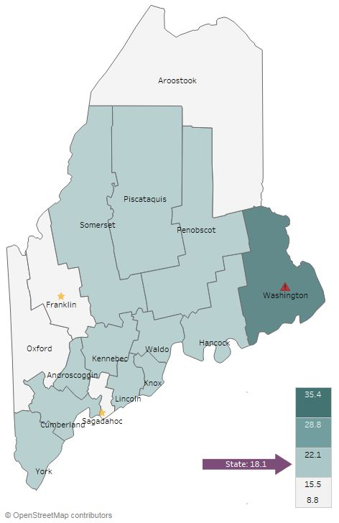
Health Outcomes - Substance Use
Overdose Deaths Per 100,000
2012-2016
Notes:
JSI or Other Facilitator
The rate of overdose deaths in Lincoln County is slightly higher than the state at 19 per 100,000 population. If you turn to Page 26 of the County Health Profile, you’ll see additional data points related to substance alcohol use. Notice that the rate of overdose deaths doubled between 2007-2011 and 2012-2016 – likely a result of the opioid epidemic.

Slide 34
Health Outcomes – Injury
Lincoln County: Traumatic Brain Injury ED Visits Per 10,000 Population
120.0
2017
114
Maine 85.1
Notes:
JSI or Other Facilitator
Injuries affect everyone, regardless of age, race, or economic status. Unintentional injuries are the fifth leading cause of death overall in the United States, and the leading cause of death for those under 35 years of age. The top three causes of fatal unintentional injuries include motor vehicle crashes, poisoning, and falls (CDC).
In Lincoln County, the rate of ED visits due to traumatic brain injury was steady over time, but is significantly higher than the state overall (96 vs 85 per 10,000)

Slide 35
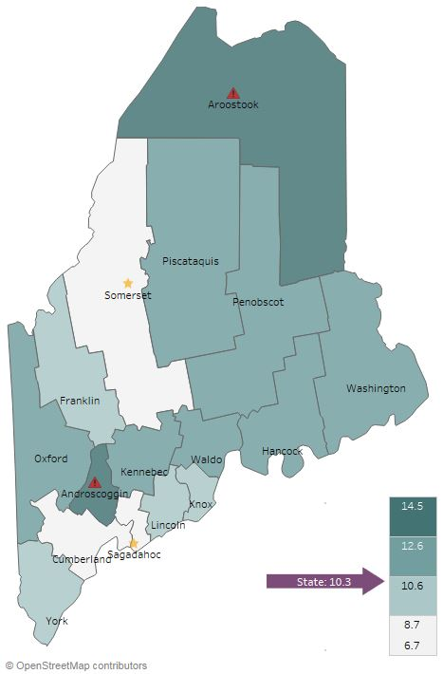
Health Access and Quality
Unable to Obtain Care Due to Cost, 2014-2016
Notes:
JSI or Other Facilitator
As shown in the map, Lincoln fares very similarly to the state overall. Approximately 9% of individuals are unable to obtain care due to cost, compared to 10% for the state overall

Slide 36
Facilitated Discussion
Notes:
JSI or Other Facilitator

Slide 37
Small Group Discussion Questions
Based on your own knowledge and experiences, are there any major health issues that are not represented in the data? (10 mins)
Based on the data, past priorities, and your observations, what do you see as the top needs of our community? (20 mins)
What community resources are available to address these needs, and what more may be needed? (10 mins)
Notes:
JSI or Other Facilitator
Overview/instructions (see page 11 of the Community Engagement Toolkit): These breakout sessions will provide an opportunity for you all to share their feedback. Table facilitators have question prompts to lead discussions. The purpose of these small group discussions is to identify up to 4 health priorities, local resources to address those priorities, and gaps in resources.
((Leave this slide up during table breakouts))

Slide 38
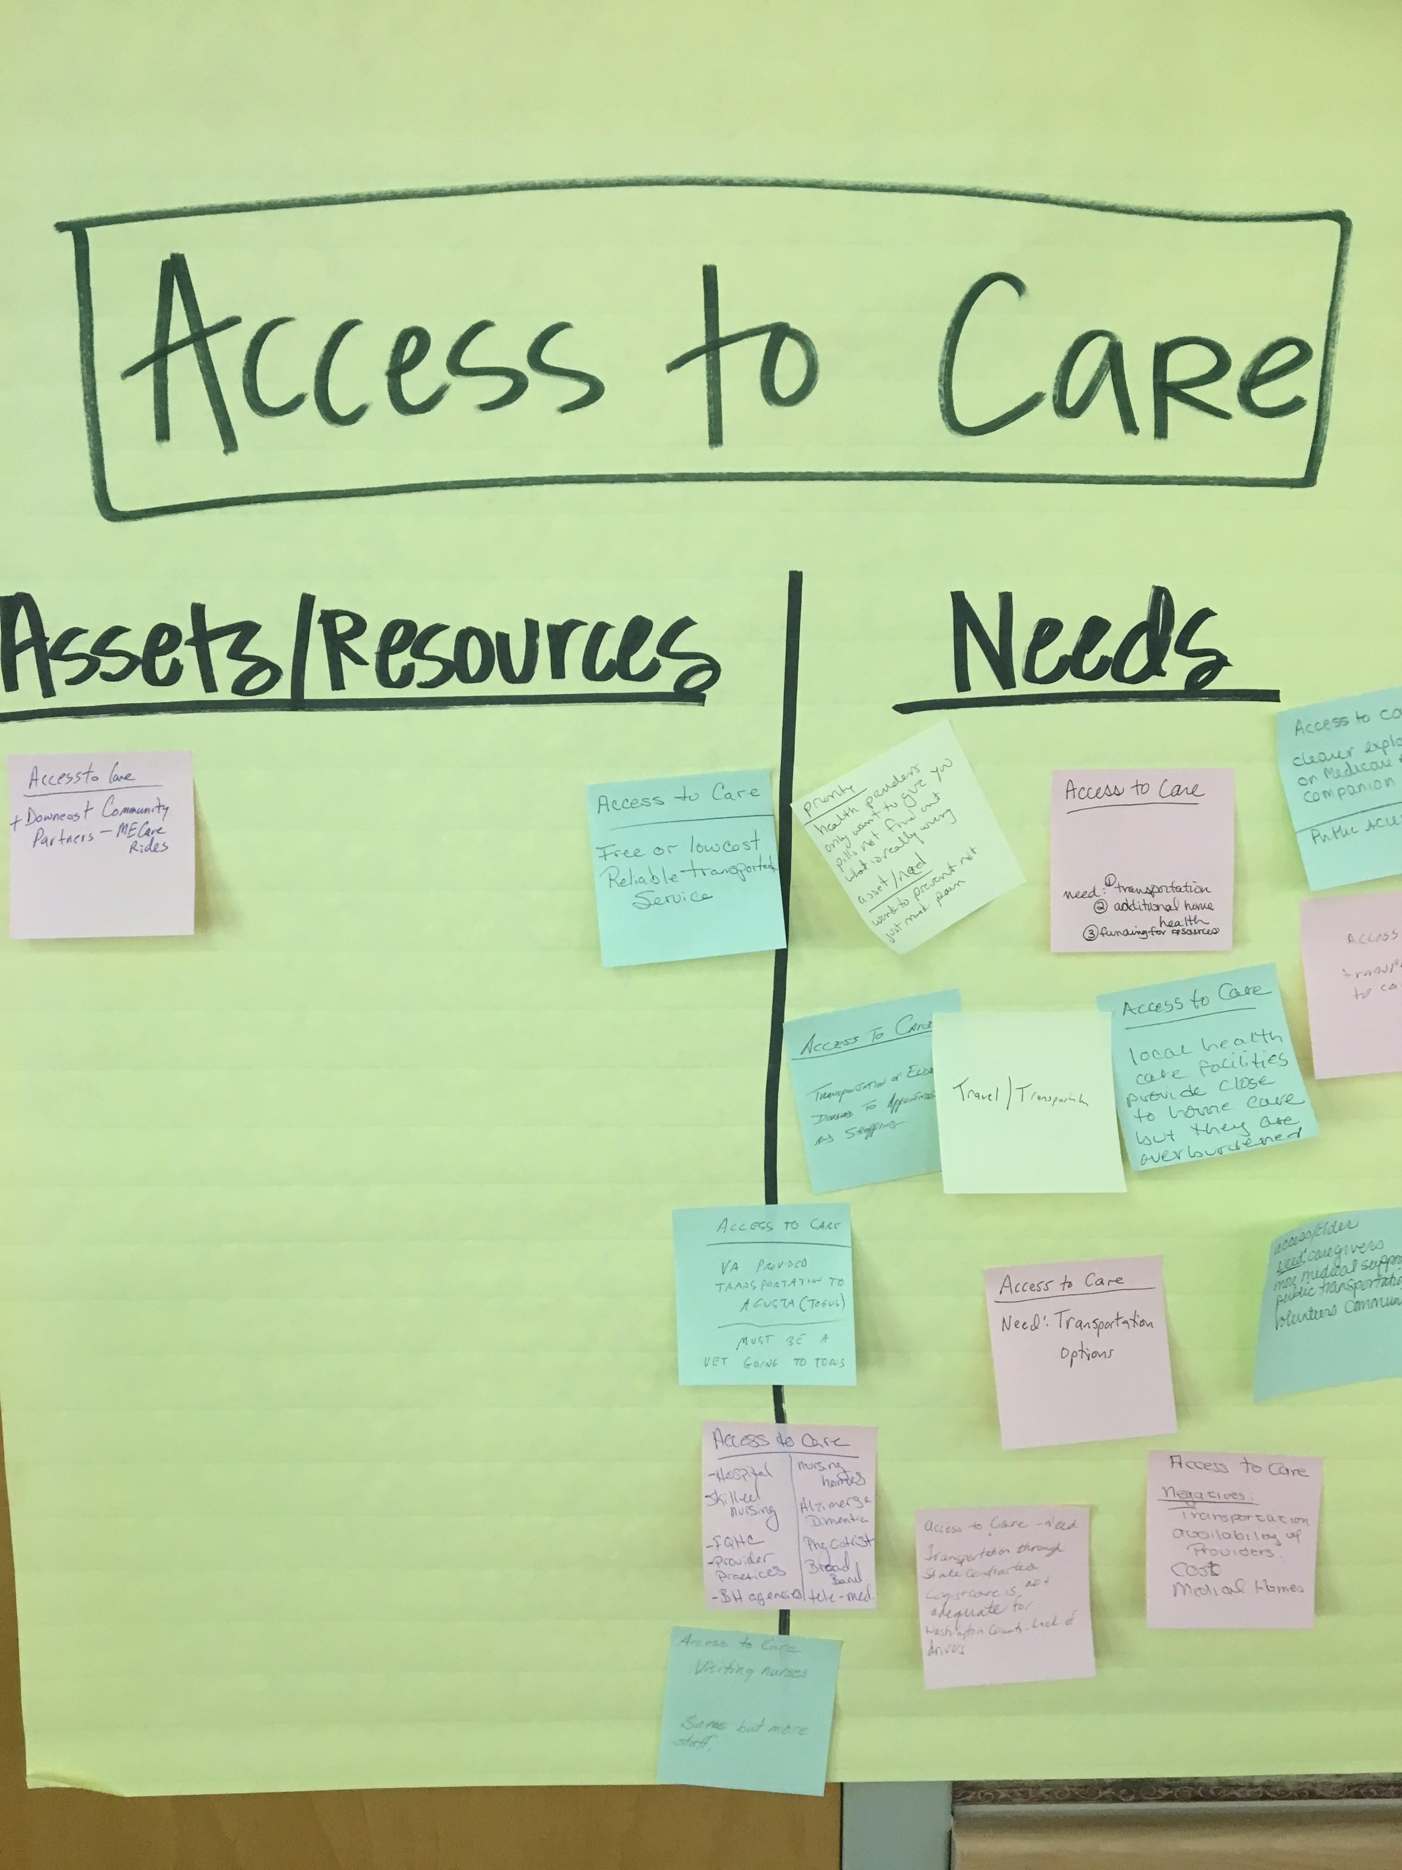
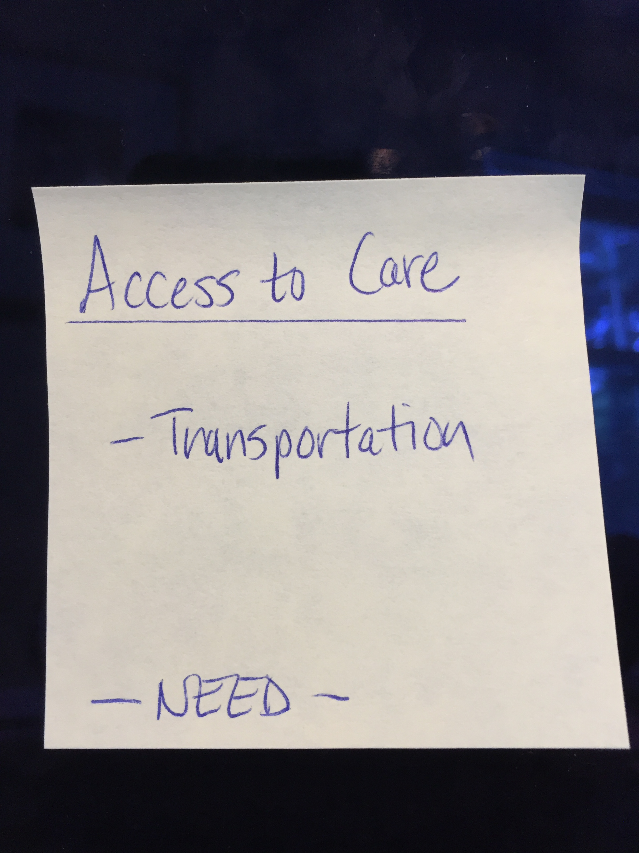
Assets/Resources and Needs
Notes:
JSI or other facilitator
Create sticky notes like the one you see here on the left. The priority area is on top, the asset or resource is on the note, and a label for Asset or Resource so that you remember later.
After we each have an individual opportunity to vote on the priorities which have been identified during the table breakouts, we will invite you to place your sticky notes with assets/resources and needs on the corresponding Priority Area sheet.
For those assets/resources and needs pertaining to other domains that did not make this forum’s final cut, please place then on the sheet marked “Other”. This is still valuable information that others may find useful down the road.

Slide 39
Prioritization Exercise
Notes:
JSI or Other Facilitator

Slide 40
Wrap Up and Next Steps
Notes:
Local Facilitator

