Slide 1
Maine Shared Community Health Needs Assessment
Knox county
Notes:
Local Facilitator

Slide 2






Thank you to the following sponsors of this forum!
Notes:
Local Facilitator

Slide 3
Welcome and Introductions
Notes:
Local Facilitator

Slide 4
Forum Agenda
Midcoast Public Health District: Knox County Forum Agenda
4:30 – 5:00 p.m. Registration and refreshments
5:00 – 5:05 p.m. | Welcome and introductions | Kendra Emery, DO Pen Bay Medical Center Drexell White, Midcoast Public Health District Liaison
5:05 – 5:20 p.m. | 2016 CHNA priorities and highlights | Drexell White Rachael McCormick, Manager Community Health & Wellness, Pen Bay Medical Center & Waldo County General Hospital
5:20 – 5:50 p.m. | Review Knox County Data Profile | JSI
5:50 – 6:25 p.m. | Discussion on data and health priorities | JSI
6:25 – 6:45 p.m. | Generate priorities from forum | JSI
6:45 – 7:00 p.m. | Evaluation and adjournment | Drexell White Rachael McCormick
Notes:
Local Facilitator

Slide 5
Why are we here?
Notes:
JSI or Other Facilitator
There are a number of things that bring us here today from the IRS, national accreditation boards, as well as the insight and leadership from the Maine Shared CHNA leadership, who long before the IRS and accreditation requirements saw an opportunity to work together to make Maine the healthiest state in the nation.

Slide 6

Guidance, Regulations & the Law
Maine Shared
Community
Health Needs Assessment
Images of PHAB and IRS from the internet
Notes:
JSI or Other Facilitator
See page 28 of the Community Engagement Toolkit for more information
Maine is the only state in the nation that conducts a statewide community health needs assessment through our unique public private partnership. These community health needs assessments – referred to as “CHNAs” – are required for non-profit hospitals (under the IRS and ACA) and for local health departments to meet requirements under the Public Health Accreditation Board (PHAB). Among the required activities are:
Obtain input from the community, including providers and communities served, on health needs (which is why we’re here today)
Evaluate previous actions taken to address needs identified in previous CHNAs
Choose needs to be addressed (and provide justification)
Summarize an implementation strategy

Slide 7
Maine Shared CHNA
Program Manager
Metrics Committee
Steering Committee
Data Analysis Team
Community Engagement Committee
Local Planning Teams
JSI
Governance
Notes:
JSI or Other Facilitator
Steering Committee consists of representatives from the signatory members: Central Maine Heath Care, Eastern Maine Healthcare (EMHS to become Northern Light Health on October 1) Maine General Healthcare, MaineHealth, and the Maine Center for Disease Control and Prevention. Major funding for the Maine Shared CHNA is provided by the partnering healthcare systems with generous in-kind support from the Maine CDC and the countless organizations who contribute to this effort.
Funding supports the Program Manager and contracting with a vendor to support this effort. John Snow, Inc. (JSI) was selected in January, 2018. Ask folks to stand if they have served in any or all of the following roles:
Data Analysis Team is made up of a subgroup with representatives from the Metrics Committee, analysts from Maine CDC, USM, and JSI. Their role has been to collect and analyze the list of 200 indicators identified by the Metrics Committee
Metrics Committee is made up of representatives from the signatory members with further support from UNE, USM, and subject matter experts.
The CEA made up of a subgroup with representatives from the Statewide Community Engagement Committee. Their role has been to provide advice and guidance to the Program Manager on every aspect of community engagement.
Statewide Community Engagement includes partners and interested parties who have provided feedback on all aspects of community engagement
Local Planning Teams have set dates, found venues, and organized every aspect of today’s event.
They deserve a hand!

Slide 8
Health Improvement Process
Community Health Needs Assessment (CHNA)
Hospital Implementation Strategies
(IS)
Public Health
District Health Improvement Plan
(DPHIP)
State Health Improvement Plan
(SHIP)
Evaluate
Partners
Partners
Partners
Partners
Partners
Partners
Notes:
JSI or Other Facilitator
Best practice = Regular community assessment of the data, reviewing progress on priorities, and updating health improvement plans based on findings. Health Improvement Plans cannot succeed without partners – many who are here today.
.

Slide 9
Local Activities and Accomplishments
Notes:
Local Facilitator

Slide 10
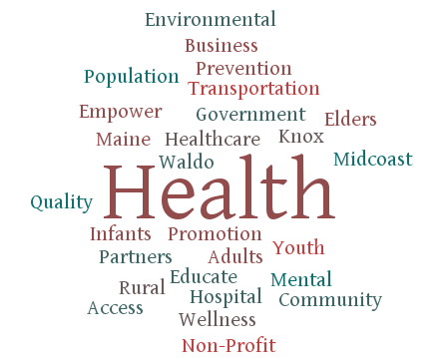
Health Improvement
Notes:
Local Facilitator

Slide 11
Midcoast Public Health District
Midcoast Public Health Council (MPHC)
The Midcoast Public Health District is one of nine public health districts in Maine. The district includes Waldo, Lincoln, Knox and Sagadahoc counties.
The Midcoast Public Health Council is the District Coordinating Council (DCC) for public health in the Midcoast with council membership or representation from the district’s four counties, as well as Brunswick and Harpswell.
Current District Public Health Improvement Plan (DPHIP) created in 2016
Notes:
Local Facilitator

Slide 12
Midcoast District – Knox County
Hospital and District priority areas of work since the 2016 Shared CHNA
Priority | Cancer Prevention & Screening | Elevated Blood Lead Levels | Mental Health – Youth & Adult | Obesity & Diabetes | Substance & Tobacco Use
Partners | Pen Bay Medical Center Waldo County General Hospital | Midcoast Public Health Council Pen Bay Medical Center Waldo County General Hospital | Midcoast Public Health Council OUT Maine | Knox County Community Health Coalition Mid Coast Hospital Midcoast Public Health Council Pen Bay Medical Center Waldo County General Hospital | Access Health Healthy Lincoln County Knox County Community Health Coalition Mid Coast Hospital Pen Bay Medical Center Waldo County General Hospital
District Highlights |  | Strategic review of blood level testing in Midcoast Maine – June 2017 Working with Pediatric practices to increase testing rates | Mental health needs assessment for older adults in Midcoast Maine – July 2017 School and youth serving organizations surveys on youth mental health – July 2017 | Strategic review of Chronic Disease Self Management Programs in Midcoast District report and recommendation – July 2017 10 Mini-grants awarded
Notes:
Local Facilitator

Slide 13

Cancer Screening & Prevention
Education & Programs | Impact Melanoma “Skinny on Skin” – May 2017 “Your Skin is In” – May 2018 Journey to Health “Fight Cancer in the Kitchen” – October 2017 Cancer Education Series – October 2018 Screenings Free mammogram, skin and colon screenings Expanded hours in radiology department 71 – 72% of patients over 50 screened for colorectal cancer and had an office visit within last 12 months
Grant Work | Maine Cancer Foundation Increase colorectal cancer screening rates (PBMC & WCGH)
William Fabricius, MD, Rachael McCormick and Jill Coyle, RN teaching the “Fight Cancer in the Kitchen” cooking class
Notes:
Local Facilitator

Slide 14
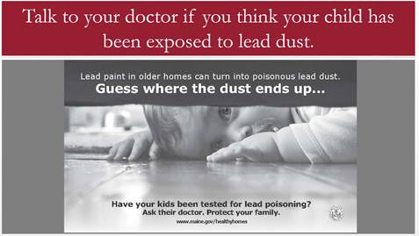
Elevated Blood Lead Levels
Education & Programs | Coordinated effort of hospitals, Maine CDC and Midcoast Public Health Council to conduct analysis of lead screening, testing and barriers Protocol developed and implemented to perform in-office capillary blood draw for testing patients for lead (Pen Bay Pediatrics) Educational outreach to childcare sites in Knox and Waldo counties
Notes:
Local Facilitator

Slide 15

Obesity & Diabetes
Education & Programs | Let’s Go! 40 Knox County Sites 48 Waldo County Sites PBMC & WCGH Wellness 704 employees participated in 14 Works on Wellness programs Bay View Café (PBMC) and Best Café (WCGH) make healthy choices the easiest choices Journey to Health 1613 participants in classes at 25 sites in 2017 Healthy Eating & Cooking, Physical Movement, and Healthy Mind & Body classes Diabetes Prevention Program Medical Nutrition Therapy
Grant Work | SNAP-Ed Nutrition Education Grant SNAP-Ed Nutrition Educator Waldo County General Hospital SNAP-Ed Nutrition Educator Knox County Community Health Coalition Maine Prevention Services Grant – Obesity Let’s Go! Coordinator expanded work with childcare sites and school district wellness policies
Notes:
Local Facilitator

Slide 16
Substance Use
Education & Programs | Expanded treatment for opioid use disorder – Maine Behavioral Healthcare, Pen Bay Medical Center and Waldo County General Hospital Integrated Medication Assisted Treatment (IMAT) Program Local PBMC and WCGH providers trained to provide buprenorphine Collaboration to host “Recovery Boys” Community Education – Knox County Community Health Coalition Impairment detection trainings Driver’s education curriculum for high schools Safe storage/disposal workshops Medication take back “Addiction As a Brain Disease”
Grant Work | Maine Prevention Services Grant Substance Abuse Prevention Specialist Knox County Community Health Coalition
Notes:
Local Facilitator

Slide 17

Tobacco Use
Education & Programs | Referrals to Maine Tobacco Helpline and local tobacco treatment classes New tobacco policies 14 Waldo County 7 Knox County Smoke-free Home Pledge
Grant Work | Maine Prevention Services Grant Tobacco Prevention Coordinator Knox County Community Health Coalition Tobacco Prevention Coordinator Waldo County General Hospital
Notes:
Local Facilitator

Slide 18
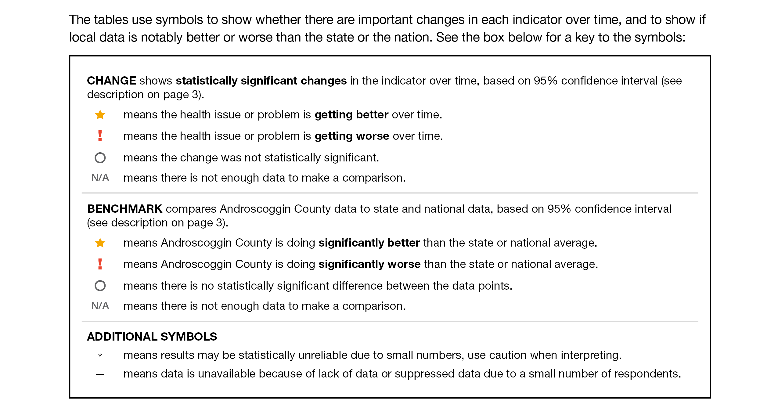
How to Read County Health Profile
EXAMPLE
Notes:
JSI or other facilitator
The County Profile provides almost 200 health data indicators from over 30 sources. Looking through the document, you’ll see that wherever possible, we’ve included data for the county for two points in time (to note any changes over time), state data (to compare the county to the state), and national data (to compare the county and the state to the US). Along with the data, you’ll notice some symbols. These symbols show whether there are important changes in the data over time, and show where County data is notably better or worse than the state or the nation.
When we’re looking at the County level data to see if things changed over time:
A star means that the health issue or problem is getting better over time
A red exclamation point means that the health issue or problem is getting worse over time
A gray circle means that any change in the data over time is not statistically significant
N/A means that there was not enough data to be able to make a comparison
Looking at County data in comparison to the state and national data:
A star means that the County is doing significantly better than the state or national average
An exclamation point means that the county is doing significantly worse than the state or national average
A gray circle means there is no statistically significance between the County and the state or national average
N/A means that there isn’t enough data to make a comparison
There are two additional symbols you might see:
A black dot means that you should use caution when interpreting the data – the results might be unreliable because of small numbers
A black dash means that data was unavailable, or that data was suppressed due to a small number of respondents
(Go to next slide and walk audience through an example)
The following data was chosen for this PowerPoint based on the criteria below:
Previous County Priorities
Indicators visualized in the County Health Profile
The county level data significantly diverges from the state and/or nation in either a positive or negative direction.
Significant changes in prevalence, incidence or health behavior over time (trend)
The magnitude of impact is significant (i.e. high rates of prevalence and incidence). (i.e.: does this indicator impact leading cause of mortality and/or morbidity?)
Based on the criteria above, the “33 Key Indicators” were used to prioritize “tie breaks”
Requests by local planning teams

Slide 19
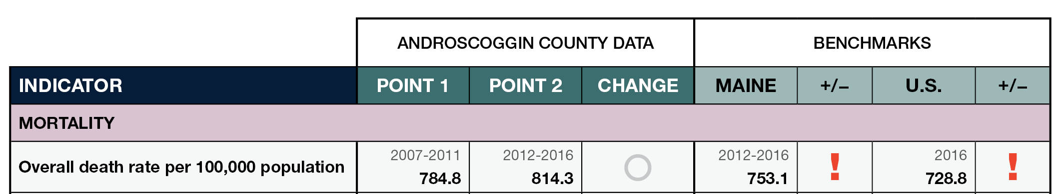
How to Read County Health Profile
EXAMPLE
Notes:
JSI or other facilitator
Lets use this line as an example
Here, we can compare the overall death rate in Androscoggin County between 2007-2011 and 2012-2016. Although the rate is higher in Point 2, the gray circle tells us that the change over time was not significant.
We then look at the most recent data compared to the state and to the US. Here, the red exclamation point tells us that the County rate is significantly higher then the state and the US.

Slide 20
Key Findings
Notes:
JSI or Other Facilitator
We encourage you to spend some time looking through the County Health Profile. We won’t be able to cover all that is in the document during this presentation today, but we’ve pulled out a number of key findings to give you an overview of health in each county.
The following data was chosen for this PowerPoint based on the criteria below:
Previous County Priorities
Indicators visualized in the County Health Profile
The county level data significantly diverges from the state and/or nation in either a positive or negative direction.
Significant changes in prevalence, incidence or health behavior over time (trend)
The magnitude of impact is significant (i.e. high rates of prevalence and incidence). (i.e.: does this indicator impact leading cause of mortality and/or morbidity?)
Based on the criteria above, the “33 Key Indicators” were used to prioritize “tie breaks”
Requests by local planning teams

Slide 21
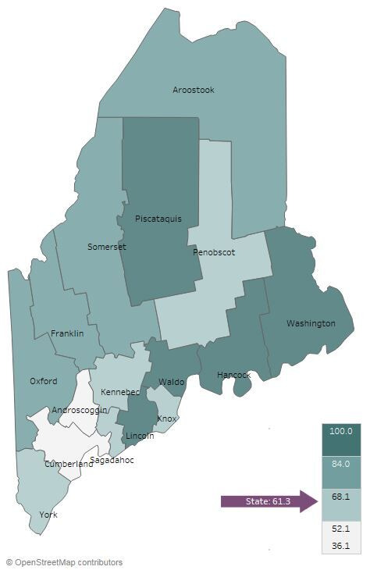

Demographics
Knox County: Age Distribution
Percent of Population Living in Rural Areas, 2012-2016
Notes:
JSI or Other Facilitator
Direct people to Page 5-8 of County Profile for more information on demographics
AGE:
Knox County is one of 4 counties where 21-23% of population is over 65
It’s important to understand the age distribution in a community when assessing health status – for example, older individuals typically have more complex/chronic conditions and physical vulnerabilities (e.g. falls) and young people may be more apt to engage in risky behaviors (e.g alcohol and tobacco use, unprotected sex)
RURALITY:
Of all counties in Maine, Knox has 67.9% percentage of people living in a rural area. This is significantly higher than the percentage for the state overall (61%)
There are a number of risk factors associated with urban living that have an affect on ones health – population density, pollution, crime, lack of safe green space, and housing related health risks – just to name a few.

Slide 22
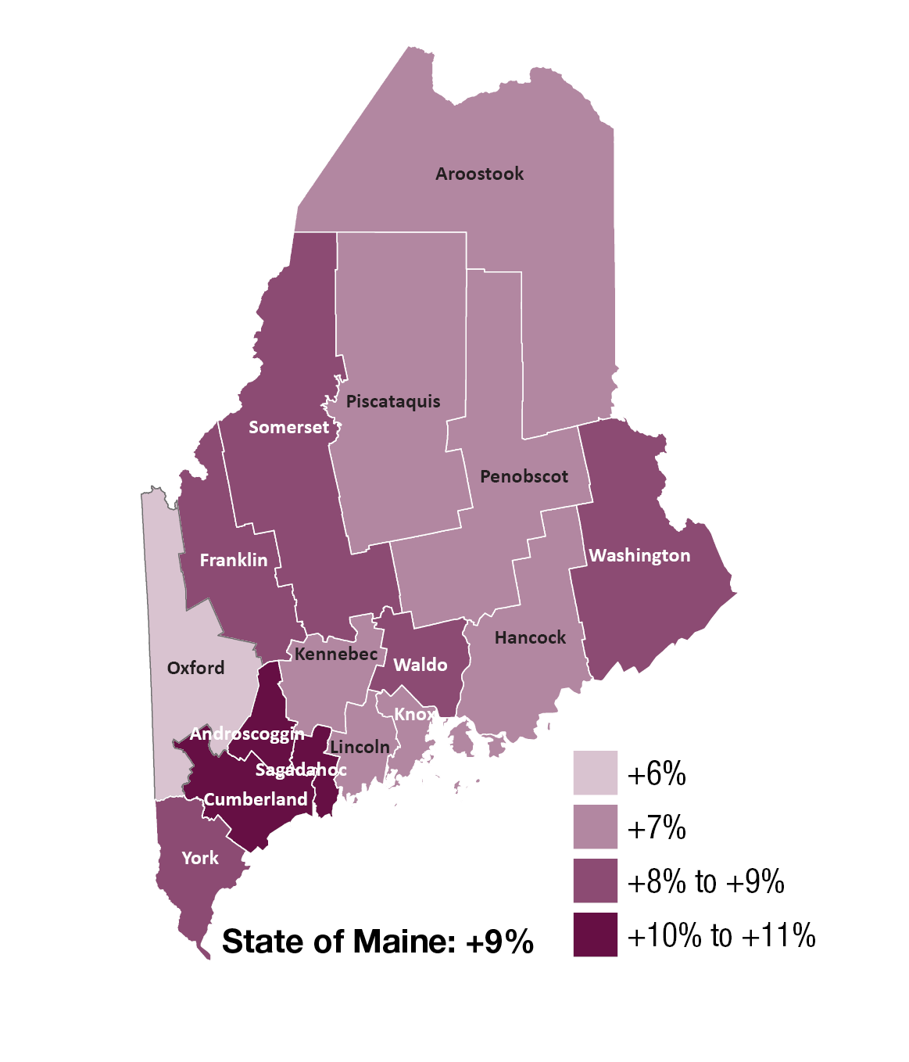
Demographics
Change in Percent of Population Age 25+ With Associates Degrees or Higher, 2000-2016
Notes:
JSI or Other Facilitator
EDUCATION:
Darker purple on the map shows an increase between the year 2000 and 2016. In Knox County, the percentage of population with an Assoc degree or higher increased approximately 7% between 2000 and 2016. Knox County has the percentage of residents with Assoc Degree or higher is 38.7%, compared to 37% for the state overall.
Higher education is associated with improved health outcomes and social development at the individual and community level. The health benefits of higher education typically include better access to resources, safer and more stable housing, and better engagement with providers. Those with lower levels of education typically have more difficulty navigating the health system and are exposed to more chronic stress.
Turn to Page 18 of the County Health Profile – the Social Determinants of Health Section. Here you find other data points related to socioeconomic status, like median household income and unemployment rate.

Slide 23
Demographics
Knox County: Gay, Lesbian, and Bisexual High School Students
12%
Maine 11%
2011
2017
Notes:
JSI or Other Facilitator
LGBT:
Between 2011 and 2017, the percentage of high school students identifying as LGB in Knox County nearly doubled – from 5% to 10%
Those that identify as LGB may face obstacles in accessing culturally competent health care services
LGB individuals are at a higher risk of being homeless when they are young, are more likely to be harassed and discriminated against at school and in the workplace, and face disparities with respect to rates of chronic disease, substance use, mental health issues, sexual health issues, and violence
The percentage of adults who identify as LGBTQ is 2.9%

Slide 24
Health Equity Data
Handouts include selected data for:
Sex
Race
Ethnicity
Sexual orientation
Education
Income
Rurality
Notes:
JSI or Other Facilitator
In addition to the county health profiles, we are providing some tables showing health disparities among some populations within Maine.
These data are state level data. When we try to look at the same data at the county level, we generally found that:
Much of the data is suppressed due to small numbers and privacy concerns
The variation between these groups does not change very much from county to county. If the group shows a disparity at the state level, the same disparity will be at the local level
These tables show the percentage or rate of health or social determinants of health indicators (rows) by varying
education groups in Maine (columns). In the example on the screen, 59.6% of adults with less than a high school diploma have an income of less than $25,000, while 9.7% of adults with a bachelor’s degree or higher have an income of less than $25,000.
The columns in each row therefore do not add up to one hundred.
The bar chart in the final column shows the same data in the same order in a chart format. In the example on the on the screen, you can see that many indicators show better outcomes as peoples’ educational level increases.
better outcomes as peoples’ educational level increases.

Slide 25
Years of Potential Life Lost
Knox County: Years of Potential Life Lost Per 100,000 Population
10,000
YPLL measures premature death, or the years of potential life lost before the age of 75.
Maine 6529.2
Notes:
JSI or Other Facilitator
Leading Cause of death by county and state can be found on page 15 of the County Health profile. Other mortality stats can be found on page 19.
The YPLL measure is used because simple mortality rates do not fully address the issue of premature death, the impact of disease and death, and their cost to society. The YPLL increased in Knox County has not changed significantly since 2010. Knox’s rate is not significantly different than the state rate.
A high YPLL tells us that there is reason to focus attention on deaths that could have been prevented – there is reason to investigate the causes of premature death.
For example, a person dying at age 25 contributes 50 years of life lost, whereas a person who dies at 65 contributes 10 years of life lost to a County’s YPLL. In other words, high rates of years of potential life lost is an indicator of people dying young.

Slide 26
Social Determinants of Health
Unemployment rate (2012-2016)
Knox County: Percent of Individuals
Living in Poverty, 2000-2016
25%
Maine 14%
2009-2011
2012-2016
Notes:
JSI or Other Facilitator
Direct people to page 18 of the county health profile for more data on the social determinants of health. The social determinants of health are the conditions that effect the environments in which people live, work, learn, and play
POVERTY:
Poverty impacts all facets of an individuals life – it may prevent someone from continuing their education, can impede access to healthy food and safe housing, and overall, makes it more difficult to maintain good health.
In Knox County , the % of population living in poverty has remained steady, around 11%. This percentage is lower than the state overall (14%).
The median household income increased by approximately $5K (increase from 46.8K to 52.2K) between 2007-2011 and 2012-2016, and is approximately $2K higher than the state

Slide 27
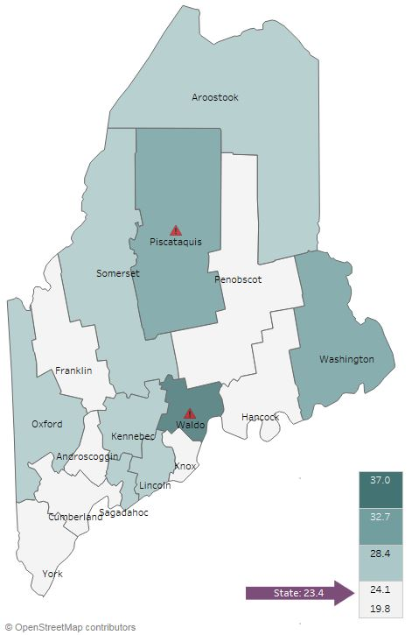

Social Determinants of Health
Adverse Childhood Experiences, 2017
Notes:
JSI or Other Facilitator
This map shows the percentage of high school students who report at least three out of eight adverse childhood experiences – such as abuse, neglect, and other stressful and/or traumatic events. Knox has a slightly lower percentage among all counties – 21.4% vs. 23.4% for the state overall.

Slide 28
Social Determinants of Health
Knox County: Violent Crime Rate Per 100,000
400.0
Maine 366.7
Notes:
JSI or Other Facilitator
Crime and violence are public health issues that impact health status on many levels – from death to injury, trauma, anxiety, isolation, and community cohesion
From 2010-2013 and 2014-2016, the rate of violent crime in Knox County decreased from 218 per 100,000 to 146 per 100,000. The rate of violent crime in this county is significantly lower than that of the state average (367).
Direct people to Page 25 of the County Health Profile for more data on violence and intentional injury

Slide 29
Health Behaviors - Obesity
Knox County: Obesity (Adults)
Knox County: Obesity (High School)
40%
40%
Maine 30%
Maine 15%
2011
2016
2011
2017
Notes:
JSI or Other Facilitator
Lack of physical activity, poor nutrition, and obesity are among the leading risk factors associated with chronic health issues. Adequate nutrition helps prevent disease and is essential for the healthy growth and development of children and adolescents. Being physically active reduces the risk for many chronic health conditions and is linked to good emotional health.
Starting at the bottom of Page 21 and moving into Page 22 of the County Health Profile, you’ll find data on physical activity, nutrition, and weight.
Obesity – Adults
The percentage of adults in Knox County that are obese is slightly lower than the state overall, and the data shows an increase over time, though the change is not statistically significant.
Knox County data indicates a high rate of healthy behaviors compared to the state overall. On Page 22, you’ll see that the percentage of adults who reported meeting physical activity recommendations was the same as the state (54%, respectively), and the percentage with less than one serving of fruit and vegetables is similar to the state.
Obesity – High School
The percentage of high school students in Knox County that are obese is lower than the state overall, and has decreased over time.
On Page 22, who consumed 5+ servings of fruits and vegetables a day has remained steady at 15%.

Slide 30
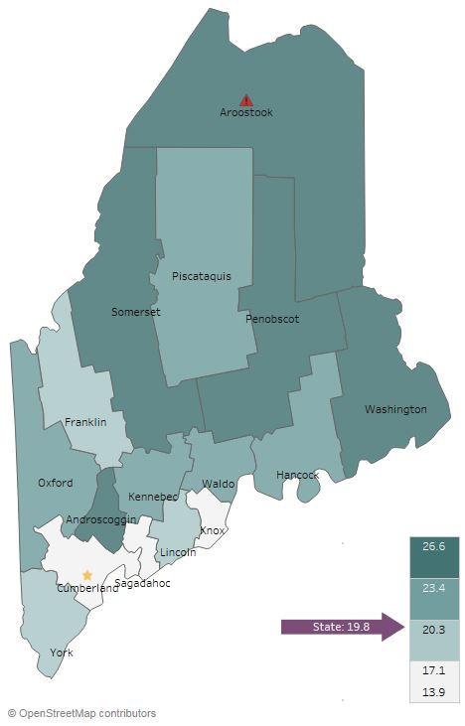
Health Behaviors- Smoking
Current Smoking (Adults), 2016
Notes:
JSI or Other Facilitator
Reducing tobacco use is the single most effective way to prevent death and disease in the US. Each year, almost half a million Americans die from tobacco related illnesses. For every person who dies from tobacco use, 30 more suffer with at least one serious tobacco-related illness, such as COPD, heart disease, or cancer
ADULT CURRENT SMOKING:
Knox has fewer adult smokers compared to the state overall (14% vs 20%)

Slide 31
Health Behaviors- Smoking
Knox County: Past-30-Day Cigarette Smoking (High School)
Knox County: Past-30-Day
E-Cigarette Use (High School)
30%
30%
Maine 15%
2011
2017
2017
Notes:
JSI or Other Facilitator
Page 27 of the County Health Profile has additional data on Tobacco Use
PAST 30 DAY HIGH SCHOOL:
Over time, the percentage of high school students who reported smoking cigarettes in the past 30 days has decreased significantly, from 24 to 10%. The current percentage (10%) is consistent with the state at (9%)
The percentage of high school students who reported e-cigarette use in the past 30 days is slightly higher than the state (17 vs. 15%)
As you can see on the County Health Profile, the percentage of high school students exposed to secondhand smoke decreased over time, from 52% to 31%, and is the same as the state percentage (31%)

Slide 32
Health Behaviors- Alcohol and Marijuana
Knox County: Past-30-Day Alcohol and Marijuana Use (High School)
35%
Notes:
JSI or Other Facilitator
Youth substance use can lead to problems in school, can aggravate physical and/or mental health issues, contribute to accidents and injury, and create lifelong health problems. Please see Page 26 and 27 of the County Health Profile for additional data on substance use
The chart shows past 30-day use for alcohol and marijuana among high school students over time.
Past 30 day alcohol use has not changed significantly over time, and is significantly higher than the state rate of 22%
Past 30 day marijuana use while appearing to decline, the change is not statistically significant

Slide 33
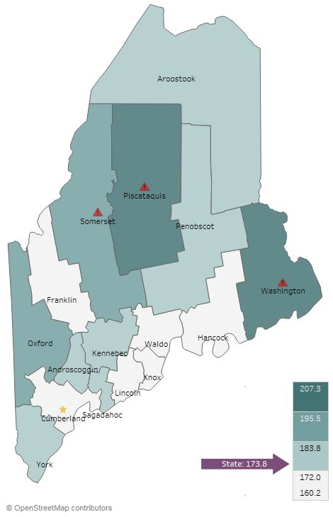
Health Outcomes - Cancer
Knox County:
All Cancer Incidence Per 100,000
All Cancer Deaths, 2016
500.0
Maine 473.7
Notes:
JSI or Other Facilitator
Experts have an idea of the risk and causal factors associated with cancer, but more research is needed to understand the many unknowns that still exist. What we do know is that there are several common risk factors: age, family history, tobacco use, overweight/obesity, excessive alcohol consumption, exposure to the sun, and exposure to environmental and occupational pollutants.
The rate of all cancer deaths in Knox County is significantly lower than the state– 173.8 vs. 166.7 per 100,000. All-cancer incidence is shown in the graph on the right. The rate of all new cancer cases decreased over time in Knox county, from 489 to 468 per 100,000 population.
In the County Health Profile on Pages 19 and 20, you’ll see a number of other cancer-related data points, including death and incidence rates many different forms of cancer.
Notice that:
Prostate cancer incidence per 100,000 (significant decrease from 128 to 67)
Female breast cancer late stage incidence per 100,000 (county rate 64.9 significantly higher than state rate)
Melanoma incidence per 100,000 (county rate 39.6 significantly higher than state)

Slide 34
Health Outcomes - Cancer
Knox County:
Colorectal Cancer Screening (Adults 50+)
100%
Maine 75%
2012 & 2014
2014 & 2016
Notes:
JSI or Other Facilitator
Colorectal cancer screening is remaining steady at about 69%, and while lower, is not significantly lower than the state screening rate.

Slide 35
Health Outcomes-Adult Chronic Disease
Knox County: Diabetes Prevalence (Adults)
Knox County: Asthma Prevalence (Adults)
15%
15%
Maine 12%
Maine 10%
Notes:
JSI or Other Facilitator
In Knox, the percent of adults with diabetes stayed the same over time (8%). The current prevalence is right on par with the state. On page 21 of the county health profile, you’ll see other data points around diabetes. For example Knox County has a significantly higher rate of formal diabetes education for adults with diabetes than the state. (71% -Knox, vs 59%-state)
Notice that the chronic lower respiratory death rate is significantly lower than the state rate.
The percent of adults with asthma decreased slightly over time, and is also very similar to the state (10% vs. 12%). Page 21 also includes a number of data points around asthma and other respiratory conditions. Notice that the asthma ED rate increased over time in Knox County, from 61 to 62 per 10,000 population, and is higher than the state overall (58).

Slide 36
Health Outcomes-Adult Chronic Disease
Knox County:
High Cholesterol (Adults)
Knox County:
High Blood Pressure (Adults)
Maine 39%
Notes:
JSI or Other Facilitator
The percentage of adults in Knox County with high cholesterol is similar to the state. The percentage of individuals with high blood pressure is similar to the state rate of 34%.
Both of these are risk factors for a number of cardiovascular diseases and conditions, including coronary heart disease, heart attack, and stroke. On Page 20 of the County Health Profile, you will see a number of data points related to cardiovascular disease
Of note is that coronary heart and cardiovascular disease deaths per 100,000 are significantly lower in Knox than the state and the nation.

Slide 37
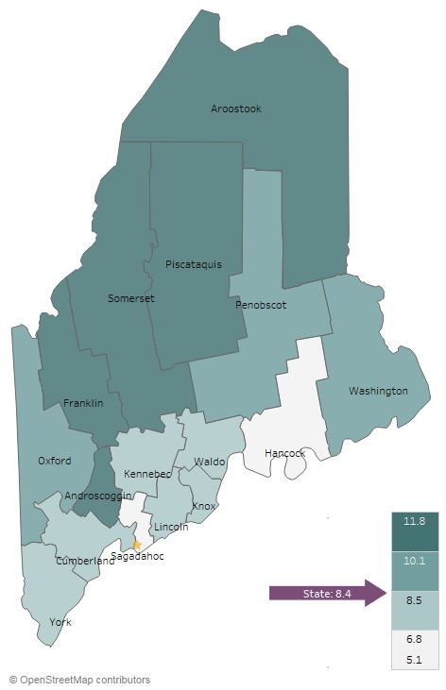
Health Outcomes - Mental Health
Current Depression (Adults), 2014-2016
Knox County: Sad/Hopeless
2+ Weeks in a Row (High School)
35%
Maine 27%
2011
2017
Notes:
JSI or Other Facilitator
Mental health has an impact on individuals, families, and communities. Like substance use, mental health impacts all segments of the population, across demographic and socioeconomic lines.
Adults
Looking at the map, you’ll see that the percentage of adults with depression is right around the state percentage – 7% in Knox County , and 8% in Maine overall
High School
Between 2011 and 2017, the percentage of high school students who reported being sad or hopeless for more than two weeks in a row did not change (24%). Rate of students considering suicide decreased from 19% in 2011 to 15% in 2017. (But this change is not significant)
You can see more data on mental health on Pages 25 and 26 of the County Profile.

Slide 38
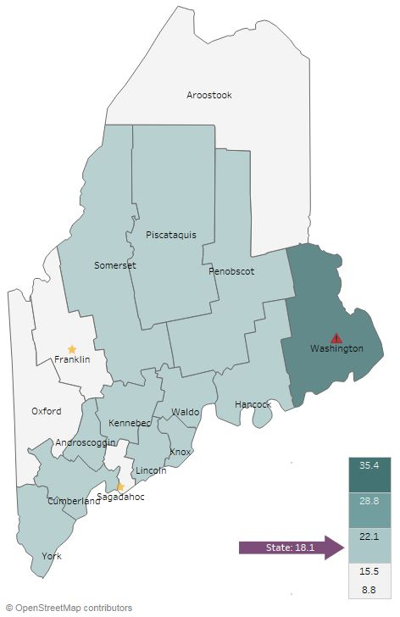
Health Outcomes - Substance Use
Overdose Deaths Per 100,000
2012-2016
Notes:
JSI or Other Facilitator
The rate of overdose deaths in Knox County significantly increased over time – from 14 to 16 per 100,000. The current death rate mirrors that of the state (also 18 per 100,000.
Additional data on substance use can be seen on Page 26 of the county Health Profile and will be discussed in the next slide

Slide 39
Health Outcomes – Substance Use
Knox County:
Drug Induced Deaths Per 100,000
Knox County:
Drug-Affected Infants Cases Per 1,000
100
120
2017
114
Maine 77.9
Maine 18.9
Notes:
JSI or Other Facilitator
Between 2007-2011 and 2012-2016, drug induced deaths per 100,000 increased in Knox County. As seen in the chart on the right, the reports of drug-affected infants also increased over time – in fact, it more than doubled, and is higher than Maine overall at 77.9

Slide 40
Health Outcomes – Injury
Knox County:
Injury Deaths Per 100,000
Knox County: Fall Related Injury (Unintentional) ED Visits Per 10,000
100
450.0
2017
114
Maine 67.9
Maine 340.9
Notes:
JSI or Other Facilitator
In Knox County, the rate of injury deaths increased slightly over time, but not significantly.
While the rate of unintentional fall-related ED visits decreased slightly over time, it remains significantly higher than the state overall (411 per 100,000 vs. 340).
Other data points around injury, both intentional and unintentional, can be found on page 24 and 25 of the County Health Profile.

Slide 41
Lead Screening Among Children
Knox County: Percent of Children Ages 12-23 Months with Lead Screening
100%
2017
114
Maine 53%
2011
2016
Notes:
JSI or Other Facilitator
Lead screening rates appear to be declining over time and remain significantly below the state rate for children age 12-23 months, as seen here in the graph, and children age 24-35 months (as seen on Page 23 of the County Health Profile.) Page 23 contains a number of other data points related to environmental health

Slide 42
Lead Levels Among Children
Knox County: Children with CONFIRMED Elevated Blood Lead Levels (% of those screened)
Knox County: Children with UNCONFIRMED Elevated Blood Lead Levels (% of those screened)
15%
15%
2017
114
Maine 3.3%
Maine 2.2%
2012-2016
2003-2007
2003-2007
2012-2016
Notes:
JSI or Other Facilitator
In Knox County, the rate of children with elevated blood levels among confirmed cases significantly declined over time. At the same time, the rate of unconfirmed cases slightly increased.

Slide 43
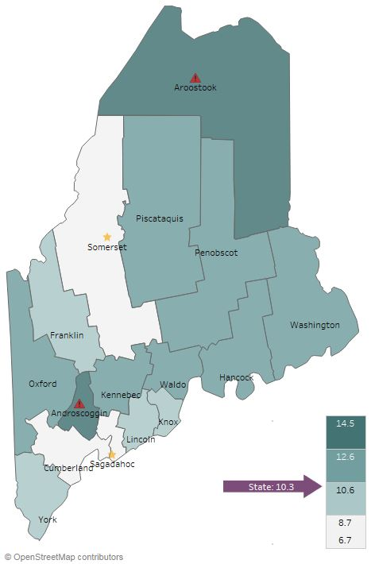
Health Access and Quality
Unable to Obtain Care Due to Cost, 2014-2016
Notes:
JSI or Other Facilitator
When it comes to cost barriers to health care, Knox fares slightly better than the state overall – 9% of individuals in Knox County report being unable to obtain care due to cost, compared to 10% for the state overall.

Slide 44
Facilitated Discussion
Notes:
JSI or Other Facilitator

Slide 45
Small Group Discussion Questions
Based on your own knowledge and experiences, are there any major health issues that are not represented in the data? (10 mins)
Based on the data, past priorities, and your observations, what do you see as the top needs of our community? (20 mins)
What community resources are available to address these needs, and what more may be needed? (5 mins)
Notes:
JSI or other facilitator
Overview/instructions (see page 11 of the Community Engagement Toolkit): These breakout sessions will provide an opportunity for you all to share their feedback. Table facilitators have question prompts to lead discussions. The purpose of these small group discussions is to identify up to 4 health priorities, local resources to address those priorities, and gaps in resources.
Leave this slide up during table breakouts

Slide 46
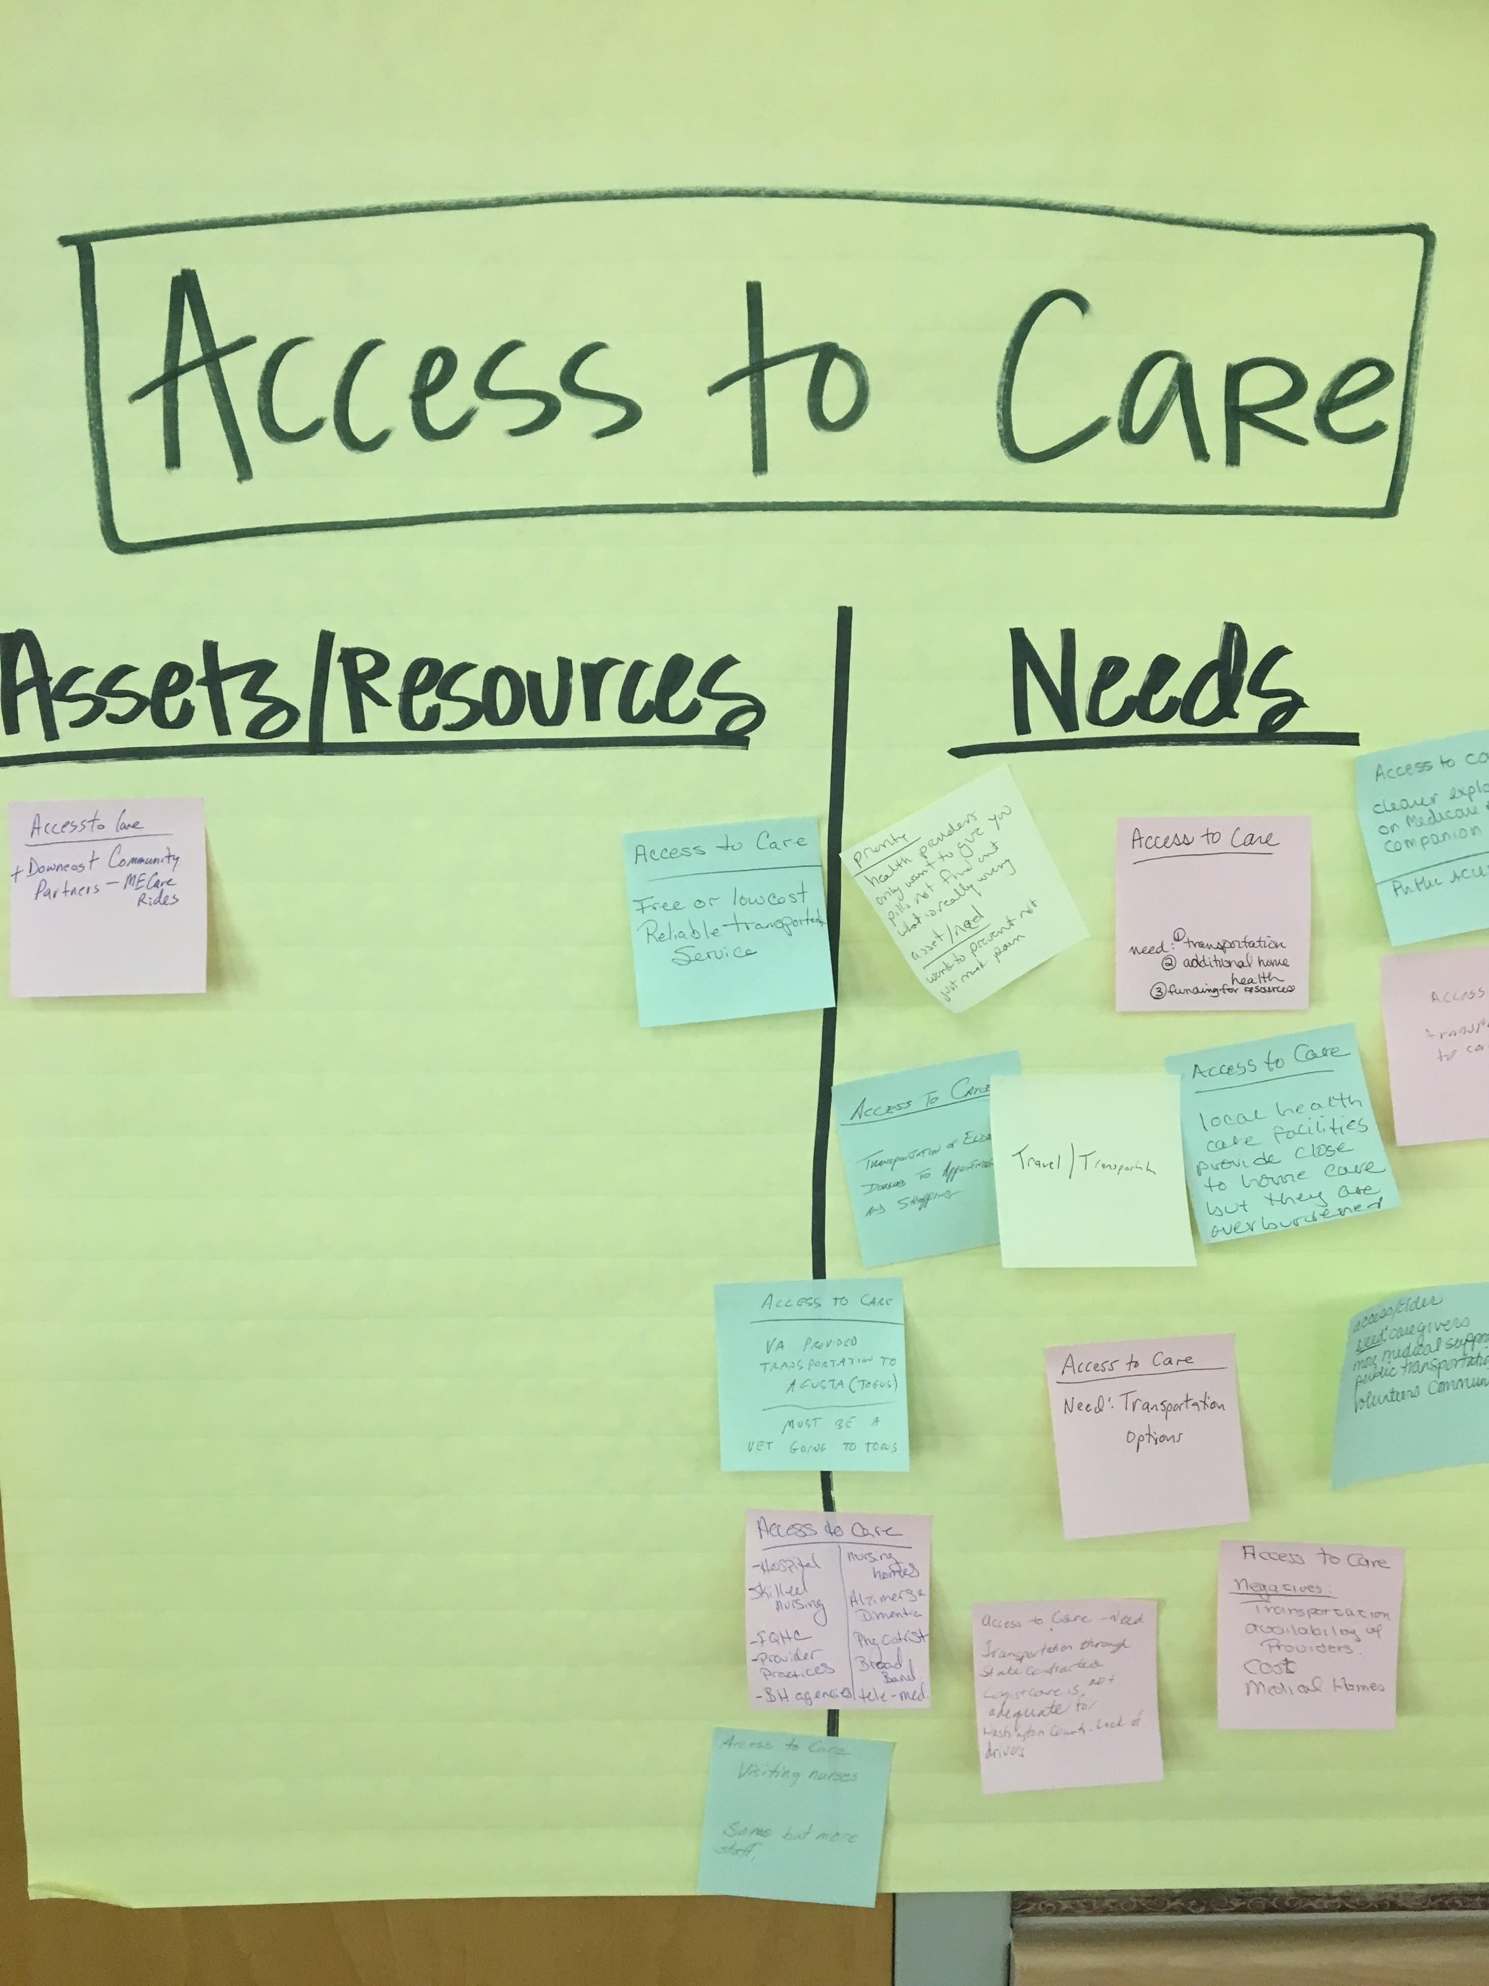
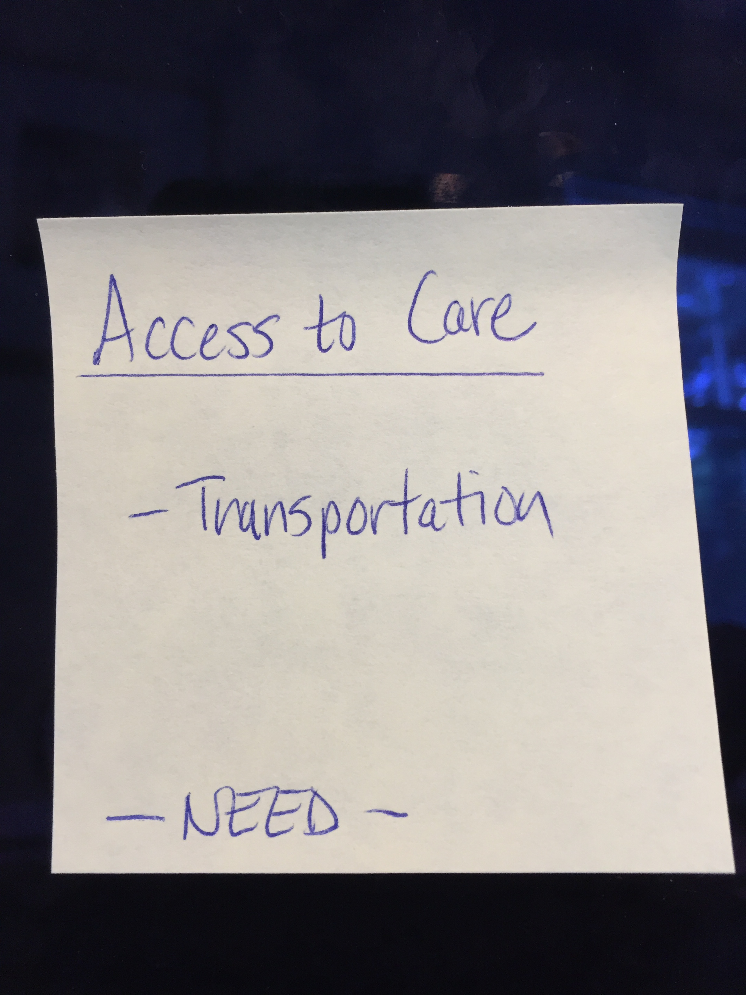
Assets/Resources and Needs
Notes:
JSI or other facilitator
Create sticky notes like the one you see here on the left. The priority area is on top, the asset or resource is on the note, and a label for Asset or Resource so that you remember later.
After we each have an individual oppty to vote on the priorities which have been identified during the table breakouts, we will invite you to place your sticky notes with assets/resources and needs on the corresponding Priority Area sheet.
For those assets/resources and needs pertaining to other domains that did not make this forum’s final cut, please place then on the sheet marked “Other”. This is still valuable information that others may find useful down the road.

Slide 47
Prioritization Exercise
Notes:
JSI or Other Facilitator

Slide 48
Wrap Up and Next Steps
Notes:
Local Facilitator

Slide 49
Shared CHNA Contacts
Knox County Community Health Coalition
Connie Putnam
cputnamkcchc@gmail.com
236-6313, ext. 1
MaineHealth Representatives
Jo Morrissey
jlmorrisse@mainehealth.org
661-3428
Ellen Freedman
efreedman@mainehealth.org
661-7670
Maine CDC District Liaison
Drexell White
drexell.r.white@maine.gov
596-4278
Phoebe Downer
phoebe.downer@maine.gov
596-4270
Pen Bay Medical Center |
Waldo County General Hospital
Rachael McCormick
rmccormick@pbmc.org
921-3957 | 505-4607

