Slide 1
Maine Shared Community Health Needs Assessment
2018 Community Event
Franklin County
Notes:
Local Facilitator

Slide 2
Thank you to the following sponsors of this forum!
Franklin Health Community Network
Healthy Community Coalition of Greater Franklin County
Evergreen Behavioral Services
United Way of the Tri-Valley Area
Franklin County Children’s Task Force
Notes:
Local Facilitator

Slide 3
Welcome and Introductions
Notes:
Local Facilitator

Slide 4
Forum Agenda
Time | Activity | Speaker/Facilitator
4:30-4:40pm | Welcome and Introductions
4:40-5:10pm | Keynote Speaker | Mark Sanders
5:10-5:25pm | Past Priorities and Accomplishments | Andrea Richards, Healthy Community Coalition
5:25-5:50pm | Franklin County Data Presentation | JSI
5:50-6:15pm | Dinner in Cafeteria
6:15-7:00pm | Discussion on data and health priorities | JSI
7:00-7:20pm | Generate priorities from forum | JSI
7:20-7:30pm | Wrap up and next steps
Notes:
Local Facilitator

Slide 5
Why are we here?
Notes:
JSI or other Local Facilitator
There are a number of things that bring us here today from the IRS, national accreditation boards, as well as the insight and leadership from the Maine Shared CHNA leader ship who long before the IRS and accreditation requirements saw an opportunity to work together to make Maine the healthiest state in the nation.

Slide 6

Guidance, Regulations & the Law
Maine Shared
Community
Health Needs Assessment
Images of PHAB and IRS from the internet
Notes:
JSI or other Local Facilitator
See page 28 of the Community Engagement Toolkit for more information
Maine is the only state in the nation that conducts a statewide community health needs assessment through our unique public private partnership. These community health needs assessments – referred to as “CHNAs” – are required for non-profit hospitals (under the IRS and ACA) and for local health departments to meet requirements under the Public Health Accreditation Board (PHAB). Among the required activities are:
Obtain input from the community, including providers and communities served, on health needs (which is why we’re here today)
Evaluate previous actions taken to address needs identified in previous CHNAs
Choose needs to be addressed (and provide justification)
Summarize an implementation strategy

Slide 7
Maine Shared CHNA
Program Manager
Metrics Committee
Steering Committee
Data Analysis Team
Community Engagement Committee
Local Planning Teams
JSI
Governance
Notes:
JSI or other Local Facilitator
Steering Committee consists of representatives from the signatory members: Central Maine Heath Care, Eastern Maine Healthcare (EMHS to become Northern Light Health on October 1) Maine General Healthcare, MaineHealth, and the Maine Center for Disease Control and Prevention. Major funding for the Maine Shared CHNA is provided by the partnering healthcare systems with generous in-kind support from the Maine CDC and the countless organizations who contribute to this effort.
Funding supports the Program Manager and contracting with a vendor to support this effort. John Snow, Inc. (JSI) was selected in January, 2018. Ask folks to stand if they have served in any or all of the following roles:
Data Analysis Team is made up of a subgroup with representatives from the Metrics Committee, analysts from Maine CDC, USM, and JSI. Their role has been to collect and analyze the list of 200 indicators identified by the Metrics Committee
Metrics Committee is made up of representatives from the signatory members with further support from UNE, USM, and subject matter experts.
The CEA made up of a subgroup with representatives from the Statewide Community Engagement Committee. Their role has been to provide advice and guidance to the Program Manager on every aspect of community engagement.
Statewide Community Engagement includes partners and interested parties who have provided feedback on all aspects of community engagement
Local Planning Teams have set dates, found venues, and organized every aspect of today’s event.
They deserve a hand!

Slide 8
Health Improvement Process
Community Health Needs Assessment (CHNA)
Hospital Implementation Strategies
(IS)
Public Health
District Health Improvement Plan
(DPHIP)
State Health Improvement Plan
(SHIP)
Evaluate
Partners
Partners
Partners
Partners
Partners
Partners
Notes:
JSI or other facilitator
Best practice = including regular community assessment of data and progress, which creates multi level health improvement plans, which are evaluated regularly. Health Improvement Plans cannot succeed without partners – many who are here today.

Slide 9
Local Activities and Accomplishments
Notes:
Local Facilitator

Slide 10
Franklin County Accomplishments
Hospital and District priority areas of work since the 2016 Shared CHNA
POVERTY
OBESITY
SUBSTANCE USE
ACCESS TO CARE
Notes:
Local Facilitator
After finishing this slide, segue to next slide: “And it is here where we return full circle to the beginning of the Health Improvement Process. To talk more about that, and the most recent data, here’s _{JSI, JO/NANCY, other} again

Slide 11
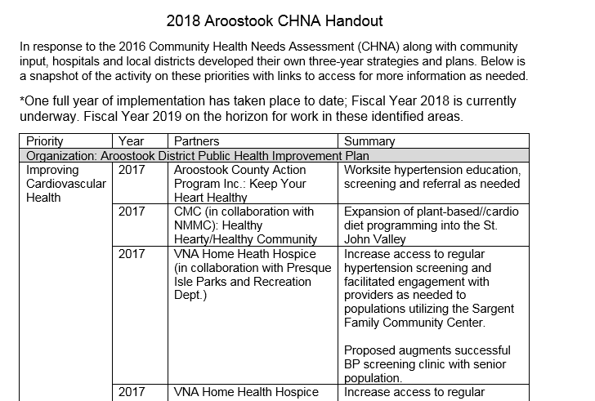
Accomplishments of Note
See Handout
Notes:
Local Facilitator
After finishing this slide, segue to next slide: “And it is here where we return full circle to the beginning of the Health Improvement Process. To talk more about that, and the most recent data, here’s _{JSI, JO/NANCY, other} again

Slide 12
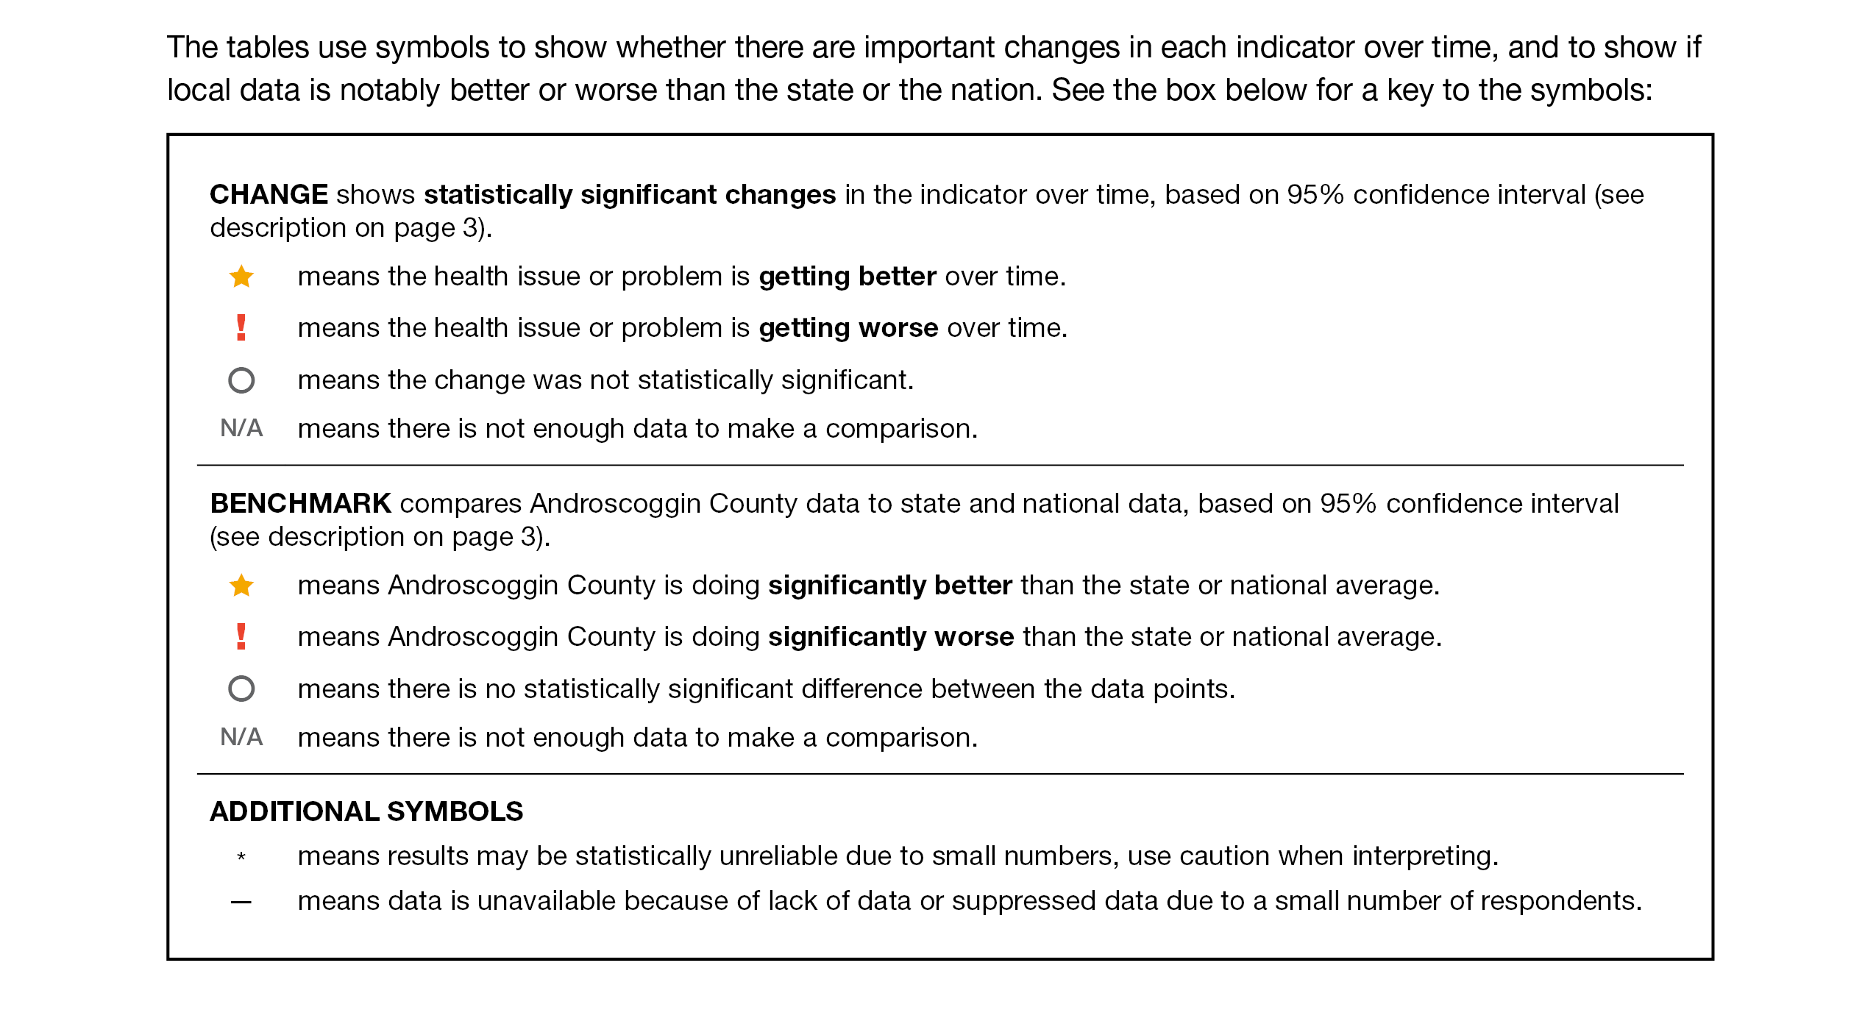
How to Read County Health Profile
EXAMPLE
Notes:
JSI or Other Facilitator
The County Profile provides almost 200 health data indicators from over 30 sources. Looking through the document, you’ll see that wherever possible, we’ve included data for the county for two points in time (to note any changes over time), state data (to compare the county to the state), and national data (to compare the county and the state to the US). Along with the data, you’ll notice some symbols. These symbols show whether there are important changes in the data over time, and show where County data is notably better or worse than the state or the nation.
When we’re looking at the County level data to see if things changed over time:
A star means that the health issue or problem is getting better over time
A red exclamation point means that the health issue or problem is getting worse over time
A gray circle means that any change in the data over time is not statistically significant
N/A means that there was not enough data to be able to make a comparison
Looking at County data in comparison to the state and national data:
A star means that the County is doing significantly better than the state or national average
An exclamation point means that the county is doing significantly worse than the state or national average
A gray circle means there is no statistically significance between the County and the state or national average
N/A means that there isn’t enough data to make a comparison
There are two additional symbols you might see:
A black dot means that you should use caution when interpreting the data – the results might be unreliable because of small numbers
A black dash means that data was unavailable, or that data was suppressed due to a small number of respondents
(Go to next slide and walk audience through an example)

Slide 13
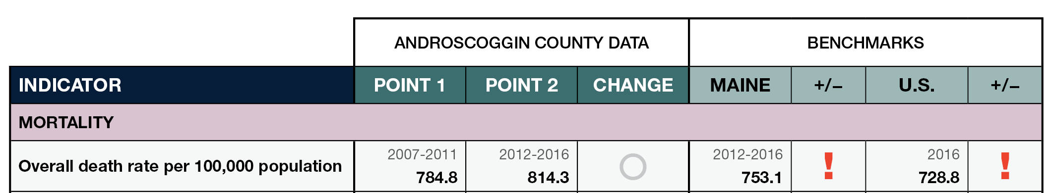
How to Read County Health Profile
EXAMPLE
Notes:
JSI or other facilitator
Lets use this line as an example
Here, we can compare the overall death rate in this County between 2007-2011 and 2012-2016. Although the rate is higher in Point 2, the gray circle tells us that the change over time was not significant.
We then look at the most recent data compared to the state and to the US. Here, the red exclamation point tells us that the County rate is significantly higher then the state and the US.

Slide 14
Key Findings
Notes:
JSI or other facilitator
We encourage you to spend some time looking through the County Health Profile. We won’t be able to cover all that is in the document during this presentation today, but we’ve pulled out a number of key findings to give you an overview of health in each county.
The following data was chosen for this PowerPoint based on the criteria below:
Previous County Priorities
Indicators visualized in the County Health Profile
The county level data significantly diverges from the state and/or nation in either a positive or negative direction.
Significant changes in prevalence, incidence or health behavior over time (trend)
The magnitude of impact is significant (i.e. high rates of prevalence and incidence). (i.e.: does this indicator impact leading cause of mortality and/or morbidity?)
Based on the criteria above, the “33 Key Indicators” were used to prioritize “tie breaks”
Requests by local planning teams

Slide 15
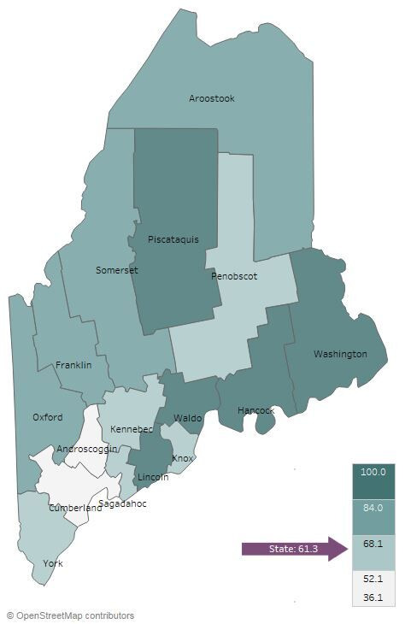

Demographics
Franklin County: Age Distribution
Percent of Population Living in Rural Areas, 2012-2016
Notes:
JSI or other facilitator
Direct people to Page 5-8 of County Profile for more information on demographics
AGE:
Franklin is one of 5 counties where 19-20% of population is over 65. As you can see in the histogram on the left, the county is aging.
It’s important to understand the age distribution in a community when assessing health status – for example, older individuals typically have more complex/chronic conditions and physical vulnerabilities (e.g. falls) and young people may be more apt to engage in risky behaviors (e.g alcohol and tobacco use, unprotected sex)
RURALITY:
83% of the population in Franklin County lives in a rural area, compared to 61% of the state overall
There are a number of risk factors associated with rural living that have an affect on ones health – geographic isolation, lower SES, higher rates of health risk behaviors, limited job opportunities, etc. Rural communities tend to have higher rates of poor overall health and chronic disease compared to urban populations

Slide 16
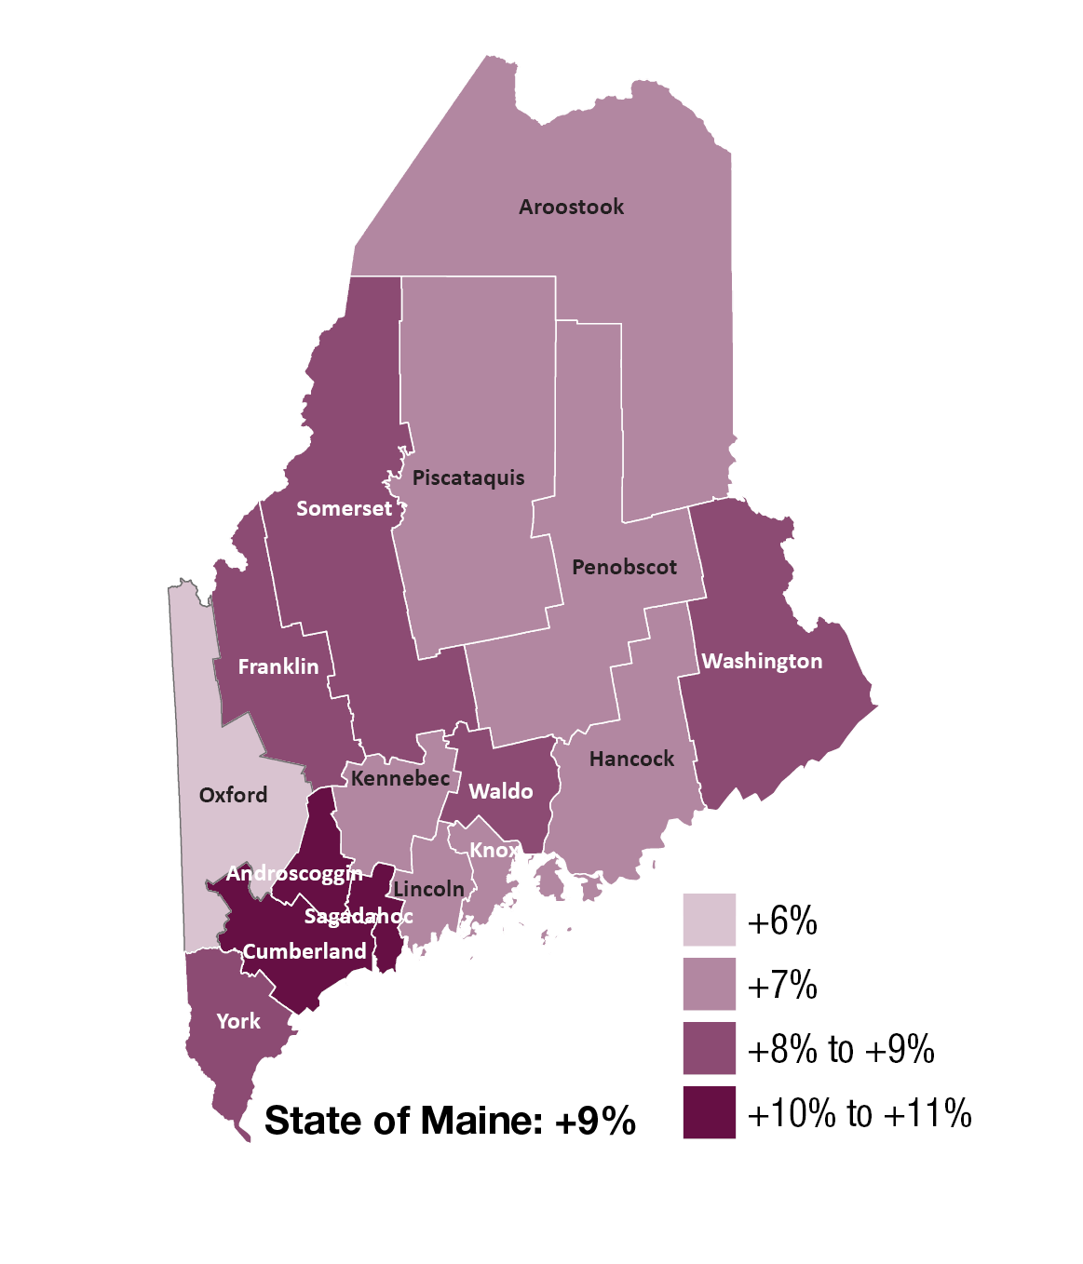
Demographics
Change in Percent of Population Age 25+ With Associates Degrees or Higher, 2000-2016
Notes:
JSI or other facilitator
EDUCATION:
Higher education is associated with improved health outcomes and social development at the individual and community level. The health benefits of higher education typically include better access to resources, safer and more stable housing, and better engagement with providers. Those with lower levels of education typically have more difficulty navigating the health system and are exposed to more chronic stress.
Darker purple on the map shows an increase between the year 2000 and 2016. You’ll see that Franklin County is one of five counties where the percentage of the population with Assoc degree or higher increased 8-9% 2000 and 2016. From 2012-2016, 35% of the population has an Assoc degree or higher, compared to 37% for Maine overall
Turn to Page 18 of the County Health Profile – the Social Determinants of Health Section. Here you find other data points related to socioeconomic status, like median household income and unemployment rate.

Slide 17
Demographics
Franklin: Gay, Lesbian, and Bisexual High School Students
14%
Maine 11%
2011
2011
2017
Notes:
JSI or other facilitator
LGBT:
Between 2011 and 2017, the percentage of high school students identifying as LGB nearly doubled in Franklin County, from 6% to 11%
Those that identify as LGB may face obstacles in accessing culturally competent health care services
LGB individuals are at a higher risk of being homeless when they are young, are more likely to be harassed and discriminated against at school and in the workplace, and face disparities with respect to rates of chronic disease, substance use, mental health issues, sexual health issues, and violence
The percentage of adults who identify as LGBTQ is 3%

Slide 18
Health Equity Data
Handouts include selected data for:
Sex
Race
Ethnicity
Sexual orientation
Education
Income
Rurality
Notes:
JSI or other facilitator
In addition to the county health profiles, we are providing some tables showing health disparities among some populations within Maine.
These data are state level data. When we try to look at the same data at the county level, we generally found that:
Much of the data is suppressed due to small numbers and privacy concerns
The variation between these groups does not change very much from county to county. If the group shows a disparity at the state level, the same disparity will be at the local level
These tables show the percentage or rate of health or social determinants of health indicators (rows) by varying
education groups in Maine (columns). In the example on the screen, 59.6% of adults with less than a high school diploma have an income of less than $25,000, while 9.7% of adults with a bachelor’s degree or higher have an income of less than $25,000.
The columns in each row therefore do not add up to one hundred.
The bar chart in the final column shows the same data in the same order in a chart format. In the example on the on the screen, you can see that many indicators show better outcomes as peoples’ educational level increases.

Slide 19
Years of Potential Life Lost
Franklin County: Years of Potential Life Lost Per 100,000 Population
10,000
YPLL measures premature death, or the years of potential life lost before the age of 75.
Maine
6,529.2
Notes:
JSI or other facilitator
Rate of years of potential life can be found in the table on Page 14 of the County Health profile
The YPLL measure is used because simple mortality rates do not fully address the issue of premature death, the impact of disease and death, and their cost to society. The YPLL decreased slightly in Franklin County between 2010-2012 and 2014-2016. A high YPLL tells us that there is reason to focus attention on deaths that could have been prevented – there is reason to investigate the causes of premature death.
For example, a person dying at age 25 contributes 50 years of life lost, whereas a person who dies at 65 contributes 10 years of life lost to a County’s YPLL. In other words, high rates of years of potential life lost is an indicator of people dying young.

Slide 20
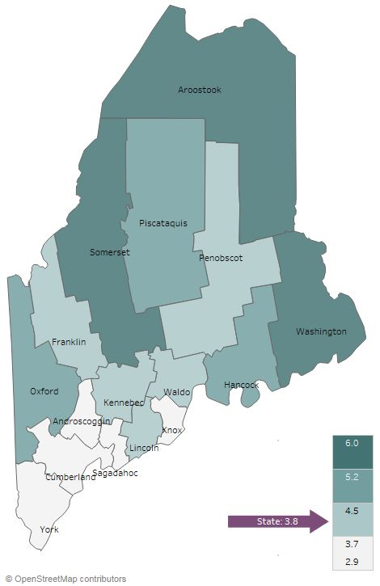
Social Determinants of Health
Unemployment rate (2012-2016)
Franklin County: Individuals Living in Poverty
20%
Maine 14%
Notes:
JSI or other facilitator
Direct people to page 18 of the county health profile for more data on the social determinants of health. The social determinants of health are the conditions that effect the environments in which people live, work, learn, and play
UNEMPLOYMENT
The unemployment rate in Franklin County is 4%, mirroring the state overall
Lack of gainful employment is linked to several barriers to good health – lack of health insurance and inability to pay for care, inability to pay for transportation to/from appointments, etc.
POVERTY:
Poverty impacts all facets of an individuals life – it may prevent someone from continuing their education, can impede access to healthy food and safe housing, and overall, makes it more difficult to maintain good health.
In Franklin County, the % of population living in poverty has remained steady between 2009-2011 and 2012-2016
The median household income in Franklin County is approximately $8K lower than the state ($43K vs. 50.8K)

Slide 21
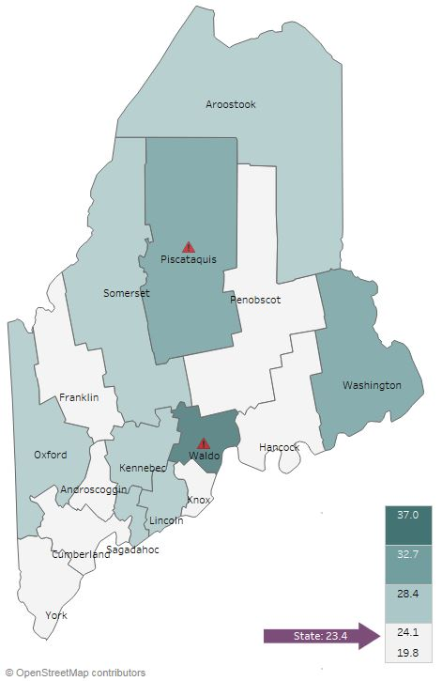

Social Determinants of Health
Adverse Childhood Experiences, 2017
Notes:
JSI or other facilitator
This map shows the percentage of high school students who report at least three out of eight adverse childhood experiences, such as physical or sexual abuse, the death of a parent, child abuse/neglect, etc.
The percentage in Franklin County mirrors that of the state overall, with both at 23%.

Slide 22
Health Behaviors - Obesity
Franklin County: Obesity (Adults)
Franklin County: Obesity (High School)
40%
40%
Maine 30%
Maine 15%
2011
2017
2011
2017
Notes:
JSI or other facilitator
Lack of physical activity, poor nutrition, and obesity are among the leading risk factors associated with chronic health issues. Adequate nutrition helps prevent disease and is essential for the healthy growth and development of children and adolescents. Being physically active reduces the risk for many chronic health conditions and is linked to good emotional health.
Starting at the bottom of Page 21 and moving into Page 22 of the County Health Profile, you’ll find data on physical activity, nutrition, and weight.
Obesity – Adults
The percentage of adults in Franklin County that are obese decreased slightly between 2011 and 2017- but change and was not statistically significant. State rate is not statistically different than Franklin.
The percent of adults that consumed less than one serving of fruits and vegetables increased
Obesity – High School
The percentage of high school students in Franklin County that are obese significantly increased between 2011 and 2017 – from 10% to 18%. The percentage in 2017 was higher than the state, though not significantly
If you turn to page 22 of the County Health Profile, you’ll see data around physical activity and nutrition- the percentage of high school students that met physical activity recommendations was slightly higher than the state, as was the percentage who reported eating five or more fruits and vegetables a day.

Slide 23
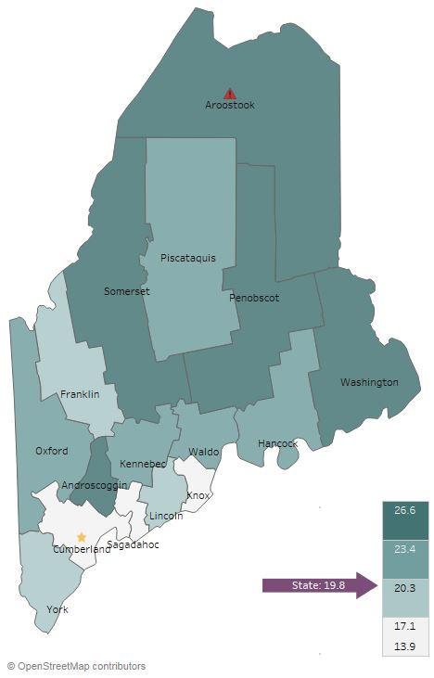
Health Behaviors - Smoking
Current Smoking (Adults), 2016
Notes:
JSI or other facilitator
ADULT CURRENT SMOKING:
The percentage of adults in Franklin County who currently smoke is lower than the state overall, though not significantly– 18% in Franklin compared to 20% in Maine overall
Turn to Page 27 of the County Health Profile to see more data around tobacco use

Slide 24
Health Behaviors - Smoking
Franklin County: Past-30-Day Cigarette Smoking (High School)
Franklin County: Past-30-Day E-Cigarette Use (High School)
25%
25%
Maine 15%
Notes:
JSI or other facilitator
Reducing tobacco use is the single most effective way to prevent death and disease in the US. Each year, almost half a million Americans die from tobacco related illnesses. For every person who dies from tobacco use, 30 more suffer with at least one serious tobacco-related illness, such as COPD, heart disease, or cancer
PAST 30 DAY HIGH SCHOOL:
In 2017, the percentage of high school students who report smoking cigarettes in the past 30 days was significantly higher in Franklin County (13%) than the state overall (9%)
The percentage of high school students who reported e-cigarette use in the past 30 days has increased slightly, from 16 to 18%. Rate is not statistically different than state.
We recommend reading the data on e-cigarette use rates with caution as there is some concern of under-reporting due to the wording of the question as to whether students understood that e-cigarettes includes JUUL or ENDS or other devises. This question is likely to undergo rewording in 2019.”
Page 27 of the County Health Profile has other data points related to tobacco use – notice that the percentage of high school students exposed to secondhand smoke is significantly higher than the state (41% to 31%).

Slide 25
Health Behaviors – Alcohol and Marijuana
Franklin County: Past-30-Day Alcohol and Marijuana Use (High School)
Franklin County: Binge Drinking (High School)
25%
35%
Maine 12%
Notes:
JSI or other facilitator
Youth substance use can lead to problems in school, can aggravate physical and/or mental health issues, contribute to accidents and injury, and create lifelong health problems. Please see Page 26 and 27 of the County Health Profile for additional data on substance use
The percentage of high school students who reported alcohol use in the past 30 days declined over time, from 31 to 26% (but change was not statistically significant). As seen in the in the graph on the right, the percentage of high school students who reported binge drinking also declined over time, but the change was not statistically significant.
The percentage who reported marijuana use in the past 30 days did not change significantly– in 2017, the percentage of past 30-day marijuana use was significantly high in Franklin County compared to the state overall (19%).

Slide 26
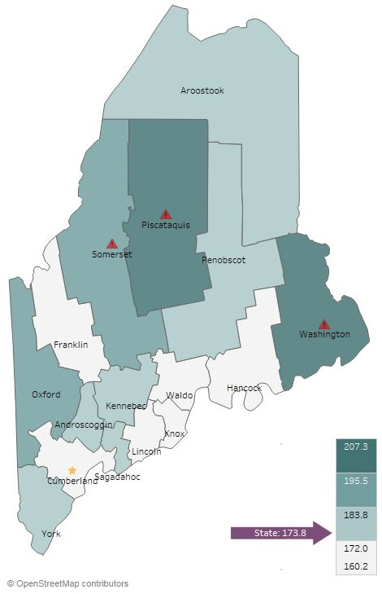
Health Outcomes - Cancer
All Cancer Deaths, 2016
Notes:
JSI or other facilitator
Please see Pages 19 and 20 of the County Health Profile for more Cancer related data
Experts have an idea of the risk and causal factors associated with cancer, but more research is needed to understand the many unknowns that still exist. What we do know is that there are several common risk factors: age, family history, tobacco use, overweight/obesity, excessive alcohol consumption, exposure to the sun, and exposure to environmental and occupational pollutants.
The rate of all cancer deaths in Franklin is lower than the state overall– 164 per 100,000, compared to 174 for the state.

Slide 27
Health Outcomes - Adult Chronic Disease
Franklin County: Diabetes Prevalence
Franklin County: Asthma Prevalence
15%
15%
Maine 12%
Maine 10%
Notes:
JSI or other facilitator
The percent of adults with diabetes and the percent of adults with asthma in Franklin County is similar to the state overall and has increased only slightly over time.
You can see more data on Diabetes and Asthma on Page 21 of the County Health Profile

Slide 28
Health Outcomes - Adult Chronic Disease
Franklin County:
High Cholesterol
Franklin County:
High Blood Pressure
Maine 39%
Notes:
JSI or other facilitator
The percent of adults with high cholesterol, while lower, did not change significantly. high blood pressure has barely moved between 2011 and 2015, and rates are very similar to the state. Both of these are risk factors for a number of cardiovascular diseases and conditions, including coronary heart disease, heart attack, and stroke. On Page 20 of the County Health Profile, you will see a number of data points related to cardiovascular disease

Slide 29
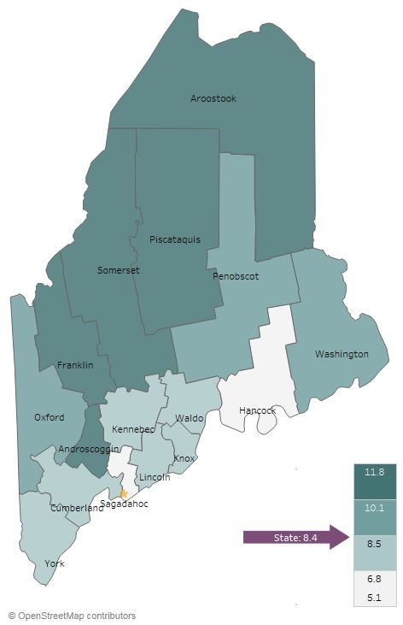
Health Outcomes - Mental Health
Current Depression (Adults), 2014-2016
Franklin: Sad/Hopeless 2+ Weeks in a Row (High School)
30%
Maine 27%
2011
2017
Notes:
JSI or other facilitator
Mental health has an impact on individuals, families, and communities. Like substance use, mental health impacts all segments of the population, across demographic and socioeconomic lines.
In Franklin County, the percentage of adults with current symptoms of depression was 11% in 2014-2016, compared to 8% in Maine overall. Difference is not statistically significant.
Between 2011 and 2017, the percentage of high school students who reported being sad or hopeless for more than two weeks in a row increased significantly from 20 to 26%
You can see more data on mental health on Pages 25 and 26 of the County Profile.

Slide 30
Health Outcomes- Mental Health
Franklin: Seriously Considered Suicide
(High School)
20%
Maine 15%
Notes:
JSI or other facilitator
In Franklin County, the percentage of high school students who reported that they had seriously considered suicide increased between 2011 and 2017, from 12% to 15%. Rate comparable to state, and trend while increasing is not statistically significant.

Slide 31
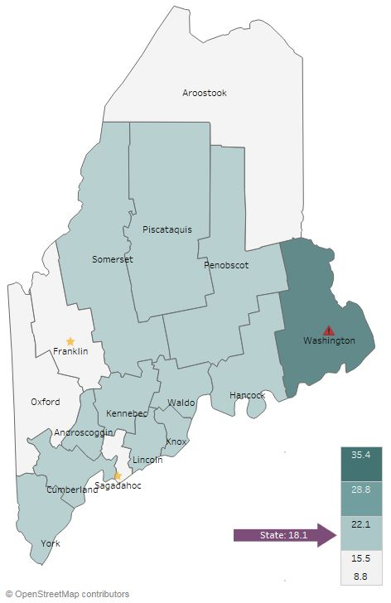
Health Outcomes - Substance Use
Overdose Deaths Per 100,000
2012-2016
Notes:
JSI or other facilitator
In Franklin County, the rate of overdose deaths decreased between 2007-2011 and 2012-2016, from 11 to 9 per 100,000. Franklin is the only county with an overdose death rate significantly lower than the state average.
Additional data on substance use can be seen on Page 26 of the county Health Profile

Slide 32
Health Outcomes - Injury
Franklin County: Traumatic Brain Injury
ED Visits Per 10,000 Population
Franklin County: Fall-Related (Unintentional)
ED visits Per 10,000 Population
400
400
Maine 340.9
Maine 85.1
32
Notes:
JSI or other facilitator
The rate of traumatic brain injury ED visits increased significantly over time – from 60.3 per 10,000 to 79.7.
The rate of fall-related (unintentional) deaths decreased significantly between 2007-2011 and 2012-2016 – from 389 per 10,000 to 356.9. However, the rate in 2012-2016 is significantly higher than the state overall (340.9).
You can see other data points related to injury – both intentional and unintentional – on pages 24 and 25 of the County Health Profile.

Slide 33
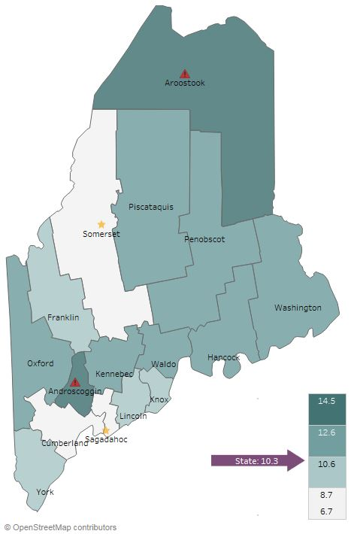
Health Access and Quality
Unable to Obtain Care Due to Cost, 2014-2016
Notes:
JSI or other facilitator
The percentage of Franklin County’s population who reported being unable to obtain health care due to cost was 9.4% in 2014-2016 – not statistically different than the state average of 10.3%
You can find other data points related to health care access on Page 19 of the County Health Profile..

Slide 34
Health Access and Quality-Screening
Franklin Community Health Network:
Eligible Patients Up-to-Date for
Colorectal Cancer Screening
100%
Maine 75%
Notes:
JSI or other facilitator
The percent of patients cared for by Franklin Community Health Network providers, who were up-to-date for colorectal cancer screening has increased in recent months- from 70% of eligible patients in July 2016-June 2017 up to 85% in Aug 2017-July 2018. “Eligible patients” refers to those patients who met age and other criteria for screening, according to national guidelines.

Slide 35

Dinner break
Please join us in the cafeteria for pizza.

Slide 36
Facilitated Discussion
Notes:
JSI or other facilitator

Slide 37
Small Group Discussion Questions
Based on your own knowledge and experiences, are there any major health issues that are not represented in the data? (10 mins)
Based on the data, past priorities, and your observations, what do you see as the top needs of our community? (25 mins)
What community resources are available to address these needs, and what more may be needed? (10 mins)
Notes:
JSI or other facilitator
Overview/instructions (see page 11 of the Community Engagement Toolkit): These breakout sessions will provide an opportunity for you all to share their feedback. Table facilitators have question prompts to lead discussions. The purpose of these small group discussions is to identify up to 4 health priorities, local resources to address those priorities, and gaps in resources.
((Leave this slide up during table breakouts))

Slide 38
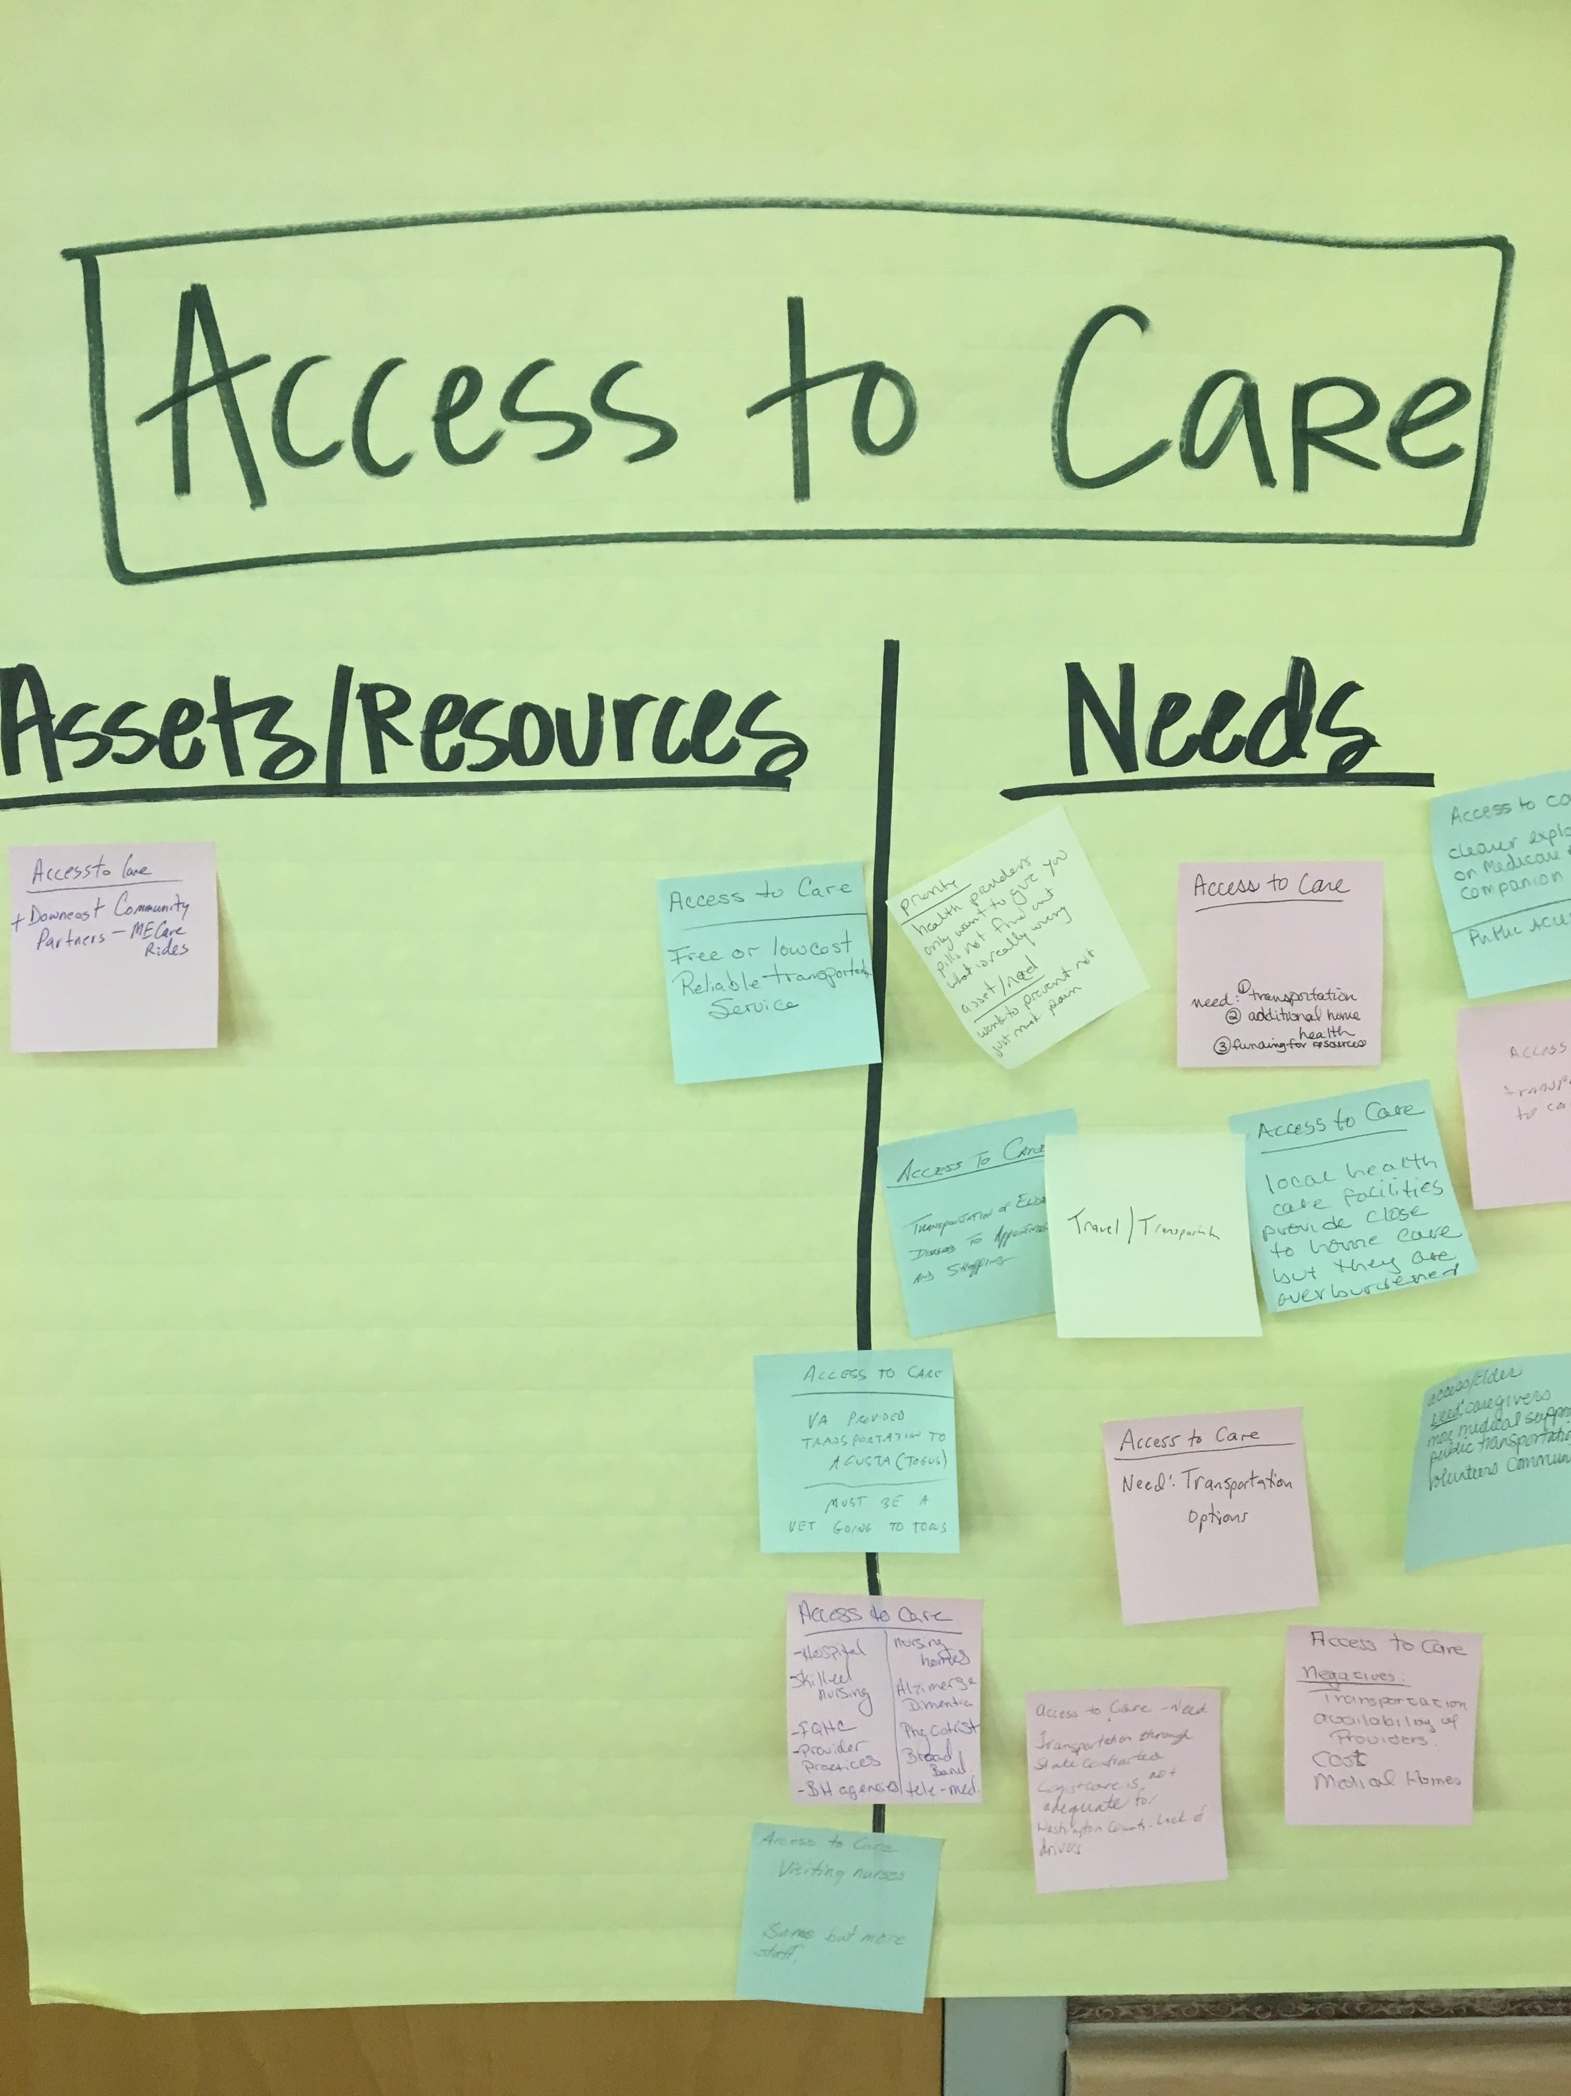
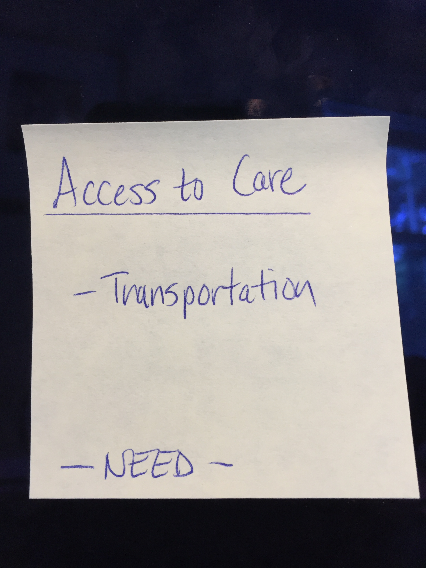
Assets/Resources and Needs
Notes:
JSI or other facilitator
Create sticky notes like the one you see here on the left. The priority area is on top, the asset or resource is on the note, and a label for Asset or Resource so that you remember later.
After we each have an individual opportunity to vote on the priorities which have been identified during the table breakouts, we will invite you to place your sticky notes with assets/resources and needs on the corresponding Priority Area sheet.
For those assets/resources and needs pertaining to other domains that did not make this forum’s final cut, please place then on the sheet marked “Other”. This is still valuable information that others may find useful down the road.

Slide 39
Prioritization Exercise
Notes:
JSI or other facilitator

Slide 40
Wrap Up and Next Steps
Notes:
Local Facilitator

Slide 41
Contact information:
Tracy Harty
Healthy Community Coalition
(207) 779-2830
tharty@fchn.org
Andrea Richards
Healthy Community Coalition
(207) 779-2435
amrichards@fchn.org

