Slide 1
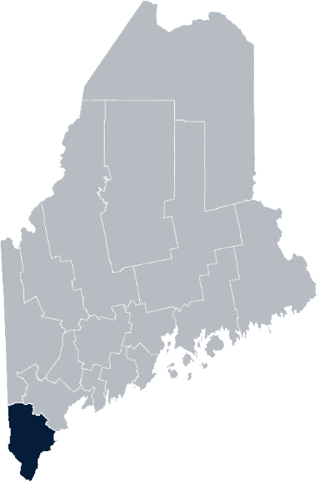
Maine Shared Community Health Needs Assessment York County
2021

Slide 2
The Maine Shared CHNA is a collaboration between the Maine Center for Disease Control and Prevention (Maine CDC), Central Maine Healthcare, Northern Light Health, MaineGeneral Health, and MaineHealth.
Notes:
Local Planning Committee Member

Slide 3
Forum Agenda
Time | Activity | Speaker/Facilitator
10:00 – 10:05 am | Welcome and Introductions | Adam Hartwig, York Public Health District Liaison, ME CDC
10:05-10:10 am | Overview of Zoom | Jo Morrissey, Maine Shared CHNA Program Manager
10:10 – 10:15 am | Leadership Remarks | Susan Keiler, VP Strategic Development of Southern Maine Health Care Dr. Patrick Taylor, CEO/President of York Hospital
10:15 – 10:20 am | Review previous CHNA priorities and activities 2019-2021 | Adam Hartwig, District Liaison ME CDC Sally Manninen, Director, Community Health, York Hospital Betsy Kelly Director, Community Health Improvement, SMHC
10:20 – 10:45 am | Presentation of key findings from the data | John Snow, Inc.
10:45 – 11:40 am | Break-out session – facilitated discussion on data and health priority identification | John Snow, Inc. & Local Facilitators
11:40 – 11:50 am | Reconvene and Review | John Snow, Inc.
11:50 – 12:00 pm | Wrap up and next steps | Adam Hartwig, York Public Health District Liaison, ME CDC
Notes:
Local Planning Committee Member to go over agenda and then turn it over to Jo Morrissey to provide an overview of the Zoom tools available and the purpose of today’s forum

Slide 4
Share screen
Join Audio, Mute On/Off
Open/close participant list or chat
Turn Video On/Off
Reactions
Notes:
Jo or JSI

Slide 5
Matching Interests
Maine Shared
Community Health Needs Assessment
Images of PHAB and IRS from the internet
Notes:
Jo or JSI

Slide 6
The Evolution of an Idea…
2010 OneMaine | 2015 SHNAPP | 2018 Maine Shared CHNA | 2021 Maine Shared CHNA
Forums Surveys | 16 Forums 1639 Surveys | 22 Mainstream Forums (live) 2 Immigrant Forums 45 Interviews | 16+ Mainstream Forums (virtual) 10+ Community Sponsored Events 1500+ Oral Surveys
Notes:
Jo or JSI

Slide 7
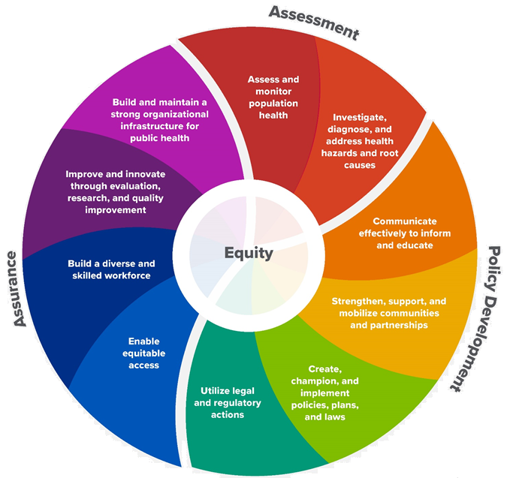
10 Essential Public Health Services
Notes:
Jo or JSI

Slide 8
Maine Shared CHNA Organizational Chart
Steering Committee
Program Manager
Vendor Support
Metrics Committee
Health Equity Community Engagement Committee
Data Analysis Teams
Local Planning Teams
Notes:
Jo or JSI

Slide 9
Inputs and Outcomes
Ways to Provide Input
Data Collected
Outcomes
District & County Reports DUE APRIL 2022
4 Health Priorities by county
Related indicators
Gaps/barriers and resources/assets
Notable comparisons between attendee input and the data.
Description of those who provided input
Methodology
Mainstream county forums
Number of attendees
Where attendees live (not CSE)
List of data identified Forums and CSE only)
Discussion notes (Forums and CSE only)
Chat box comments (Forums and CSE only)
Health Priorities
Gaps and Resources
Community sponsored events
State Report DUE APRIL 2022
4 Health Priorities by Community Event and immigrant population.
Related indicators
Gaps/barriers and resources/assets,
Notable comparisons to mainstream population.
Description of those who provided input
Methodology
Oral Survey
Forums, Events and Surveys conducted Fall 2021
Notes:
Susan Keiler, VP Strategic Development of Southern Maine Health Care
Dr. Patrick Taylor, CEO/President of York Hospital
Community Sponsored Event Partners include
Disability Rights Maine (2 events: people who are deaf or hard of hearing and people with other disabilities)
Maine Primary Care Association (People who are served by Maine’s Federally Qualified Health Centers
Maine Council on Aging (Older Adults 65+
Consumer Right Council of Maine (people with a mental health diagnosis)
Maine Youth Action Network and Friends (Raising the voices of Maine’s diverse youth)
Green Memorial A.M.E. Zion Church (Black/African American)
Health Equity Alliance (LGBTQ+ community)
Portland Recovery Center (for people with a substance use disorder or in recovery)
ADD HOUSING INSECURE IF NEED BE
ADD VETERAN IF NEED BE
Oral Survey Partners include:
City of Portland’s Minority Health Program
New Mainer’s Public Health Initiative
Maine Immigrant Access Network
Gateway Community Services
Maine Immigrant and Refugee Services
Maine Community Integration
Mano en Mano
We are piloting these additional outreach methods with support from
State of Maine’s Preventative Health and Health Services Block Grant
Maine Health Access Foundation
Introduce leader for leadership remarks

Slide 10
Leadership remarks
Notes:
Leadership remarks
Leader to introduce the following who will provide comments on recent health improvement efforts
Adam Hartwig, District Liaison ME CDC
Sally Manninen, Director, Community Health, York Hospital
Betsy Kelly Director, Community Health Improvement, SMHC

Slide 11
CHNA Accomplishments 2019-2021 York County
Notes:
Local facilitator

Slide 12
ME CDC - CHNA Highlights 2019-2021
Healthy Brain Initiative Task Force
This is a broad group of multi sector stakeholders focused on awareness and action around brain health.
Worked with UNE students to assess cognitive screening practices with SMHC physicians.
COVID WORK
Provided logistical support and coordination around each outbreak.
Coordinated PPE distribution in conjunction with York County Emergency Management, and Maine Emergency Management Agency.
Provided timely information via weekly updates to community stakeholders.
Worked with FEMA, YCEMA, MEMA and others to coordinate mobile vaccination units.
Provided 7 day a week 24 hour a day coverage during COVID-19 response.
Notes:
ADAM
Previous CHNA efforts point person

Slide 13
York Hospital - CHNA Highlights 2019-2021
Priority Issue: Substance Use Disorder, Treatment
YH received funding from MeHAF and Kennebunk Savings for developing MAT and training for Recovery Coaches.
With the need to switch to telehealth platform still able to offer continuous services in all areas of treatment.
YH added Narcan standing order to the York Apothecary- for ANYONE to pick up without an Rx.
YH held several panel discussions in communities on addiction, MAT and distributing Narcan.
YH continues to work on stigma reduction within the YH community.
Priority Issue: Substance Use Disorder (SUD), Prevention
YH held regular Lunch ‘N Learns for community on SUD.
Choose To Be Healthy Coalition (CTBH) awarded second CARA Opioid Prevention grant for 5 years.
CTBH collaborated with local Adult Education to implement, Prime for Life curriculum.
Student Intervention and Reintegration Program offered to area youth in schools and court system.
YH provides free space and admin for local community health coalition, CTBH.
Recovery Ready Workplace webinar held for local businesses.
Notes:
SALLY
Previous CHNA efforts point person

Slide 14
York Hospital - CHNA Highlights 2019-2021
Priority Issue: Mental Health
YH hosted six Family 2 Family series for community members.
CTBH sponsored two Youth Mental Health First Aid trainings.
YH and CTBH brought mental health awareness and regular webinars during pandemic to YH staff and community.
YH Staff trained to provide Mental Health first Aid.
Priority Issue: Healthy Aging
Created Center on Healthy Aging.
YH received MEHAF grant to support healthy aging efforts (house calls, prescription and meal delivery, outpatient consult service).
Meal delivery continued during pandemic.
Priority Issue: Food Insecurity
Free meal delivery to York Housing Authority and Yorkshire Commons.
Free meals for families every two months through Table of Plenty Program in York.
Provided at-cost and discounted food to Table of Plenty Program serving area.
Provided food donation to local food pantries once a month in York, Kittery and Wells.
Provided meal vouchers for clients at Recovery Center, YH volunteers, and participants in parent education series.
Provided hundreds of meals to community and hospital on Thanksgiving and Christmas.
Provided free and discounted food at community events (Special Olympics, Autism Awareness Event at Wild Kingdom, York Community Dialogue.
Meal delivery continued during pandemic.
Notes:
SALLY
Previous CHNA efforts point person

Slide 15
Southern Maine Health Care – CHNA Highlights 2019-2021 Food Insecurity
Screened 1737 inpatients for food insecurity in 2020.
14% positive screening.
213 bags of shelf stable food given.
Food available to all inpatient, MHU and ER departments as of June 2021.
Produce bags started in May 2021 received free from Good Shepherd Food Bank.
41 bags given out to date with 10lbs of produce in each bag.
Donated through MaineHealth Prevention and Wellness, SMHC received 2 raised bed gardens in May 2021.
Produce harvested from the garden in addition to produce from the Good Shepherd Food Bank delivered to SMHC care team members in need of a Helping Hand.
Helping Hands (funded though philanthropic events) provides confidential assistance to care team members, who may be faced with dynamic challenges of financial hardship as a result of catastrophic personal or medical emergency situations.
10 produce bags from garden harvest to care team members to date.
Notes:
BETSY
Previous CHNA efforts point person

Slide 16
Southern Maine Health Care – CHNA Highlights 2019-2021 Healthy Aging
Completed Geriatric Needs Assessment.
Steering Committee meeting monthly focused on healthy aging initiatives.
Started the Hospital Elder Life Program (HELP), an evidence based program that has been shown to help decrease delirium for inpatient elderly patients along with decrease hospital stays.
Southern Maine Health Care was recognized as Age Friendly Health System through the Institute for Health Care Improvement in 2020.
Sanford Family Practice also recognized as an Age Friendly Practice.
Ongoing work towards improving transitions of care for older patients.
Notes:
BETSY
65 and older

Slide 17
Southern Maine Health Care - CHNA Highlights 2019-2021
Behavioral Health and Substance Use Prevention/Treatment
Partnered with Maine Behavioral Healthcare to open Behavioral Health Inpatient Unit in Sanford 2020.
Increased from 12 beds to 40 licensed beds at the new Sanford site.
Received 3 year HRSA grant for Substance Use Prevention.
Trained Law Enforcement for Substance Use Disorders.
Increased Naloxone availability and training in York County.
Increased Naloxone in Hub and Spoke IMAT sites.
Trained ACEs to local community organizations focused on youth resiliency.
Student Intervention and Reintegration Program (SIRP) offered through local schools to youth.
Grant funds received from Kennebunk Savings used to increase prevention efforts in Sanford area.
Aunt Bertha Tool for Social Determinants of Health (SDOH)
Increased number of community resources available on the Aunt Bertha Site.
Increased number of providers who utilize the resource to help patient with SDOH through the EPIC (EMR).
Notes:
BETSY

Slide 18
Covid-19 Response: Southern Maine Health Care and York Hospital
SMHC partnered with Maine CDC and York County Emergency Management (YCEMA) to open high volume vaccine clinic in Sanford.
Operated 6 days a week from March – June 2021
SMHC able to reach 1,000 people daily for first and second dose.
Worked collaboratively with York Hospital to ensure that vaccine was made available to 12 and over at the York County Schools.
Transitioned vaccines to Primary Care offices and Walk in after closure of Sanford Clinic.
YH partnered with SMHC, Maine CDC and York County Emergency Management (YCEMA) to plan vaccine access in York County.
YH role was to create a medium-sized vaccine center to improve access for Southern York County – located in York, ME in partnership with St. Christopher’s church.
YH maximum capacity was approx. 450 patients/day.
Transitioned vaccines to Primary Care offices and York Walk in after closure of York Clinic.
Vaccinations to Date
 | York County Vaccinations | % of York County Population | SMCH Community Vaccination Clinic | % of York County Pop. | % of York County Total | YH Community Vaccination Clinic | % of York County Pop. | % of York County Total
First Dose | 113,525 | 62.0% | 23,946 | 13.1% | 21.1% | 12,038 | 7% | 11%
Second Dose | 117,405 | 64.1% | 23,925 | 13.1% | 20.4% | 11,969 | 7% | 10%
Notes:
BETSY
Introduce Madison MacLean of John Snow, Inc. (JSI) who will now give a data presentation on the top indicators

Slide 19
How to Read the County Health Profiles and Health Equity Data Sheets
Notes:
JSI or other facilitator

Slide 20
How to Read County Health Profile
CHANGE shows statistically significant changes in the indicator over time, based on 95% confidence interval (see description on page 3).
ê | means the health issue or problem is getting better over time.
! | means the health issue or problem is getting worse over time.
○ | means the change was not statistically significant.
N/A | means there is not enough data to make a comparison.
BENCHMARK compares [COUNTY] data to state and national data, based on 95% confidence interval (see description on page 3).
ê | means [COUNTY] is doing significantly better than the state or national average.
! | means [COUNTY is doing significantly worse than the state or national average.
○ | means there is no statistically significant difference between the data points.
N/A | means there is not enough data to make a comparison.
ADDITIONAL SYMBOLS
* | means results may be statistically unreliable due to small numbers, use caution when interpreting.
— | means data is unavailable because of lack of data or suppressed data due to a small number of respondents.
EXAMPLE
Notes:
JSI or other facilitator
A star means that the health issue or problem is getting better over time or better in comparison to another place
A red exclamation point means that the health issue or problem is getting worse over time or worse in comparison to another place
A gray circle means that the dating hasn’t changed over time or isn’t much different in comparison to another place
N/A means that there was not enough data to be able to make a comparison
There are two additional symbols you might see:
A black dot means that you should use caution when interpreting the data – the results might be unreliable because of small numbers
A black dash means that data was unavailable, or that data was suppressed due to a small number of respondents
(Go to next slide and walk audience through an example)

Slide 21
How to Read County Health Profile
EXAMPLE
 | AROOSTOOK COUNTY |  |  | BENCHMARKS
INDICATOR | POINT 1 | POINT 2 | CHANGE | MAINE | +/- | U.S. | +/-
Individuals living in poverty | 2009-2011 15.6% | 2015-2019 16.1% | ¡ | 2015-2019 11.8% | ! | 2019 12.3% | N/A
Notes:
Here’s an example of how we’ve visualized the data in the County Health Profiles.
The charts in this presentation are all excerpts from the Data Health Profiles that were created by MaineHealth and the Maine CDC. They contain data pulled from publicly available sources that are designed to help people learn more about the health of their communities. Not all the data points are available for every measure, but we’ve included data wherever we can.
The green bars represent data from your community. The left most one represents a past data point, and the right bar represents the most recent data point available when the data was gathered. These are the same data points used in the Data Health Profiles.
The grey bars represent data for the state of Maine as a whole- on the left- and for the United States as a whole- on the right, when it is available.
We’ve also noted where differences in the data points are ‘statistically significant’. A difference between two measurements is significant when scientists can say, with a known degree of confidence, that the difference between them is large enough that the difference is most likely to be caused by an actual difference in the item being measured, and not caused by error associated taking the measurement. All of these tests are comparing the most recent data point for your community to other data points. A red exclamation mark indicates a difference that your community is significantly different in a less desirable direction compared to the data point with the symbol. A green star indicates that your community is significantly different in a more desirable direction. A grey circle indicates that there is no significant difference.
A difference between two measurements is significant when scientists can say, with a known degree of confidence, that the difference between them is large enough that the difference is most likely to be caused by an actual difference in the item being measured, and not caused by an error associated taking the measurement. All of these tests are comparing the most recent data point for your community to other data points.
For example, in this slide, we have two symbols. The grey circle next to the measurement for 2009-2011 Aroostook County means that there is no significantly different change in the rate of poverty in Aroostook County when comparing the data from 2009-2011 to the data from 2015-2019. The red exclamation mark next to the Maine data point says there is a significant difference between 2015-2019 Aroostook County and 2015-2019 Maine, and that it is less desirable that Aroostook County has a higher rate of individuals living in poverty. No comparison could be made to the data for the U.S. because the years of data collection were different.

Slide 22
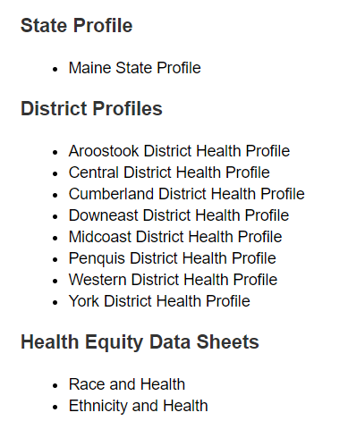
For More Data
www.mainechna.org
Notes:
The Maine Shared CHNA website contains health profiles for 3 of Maine’s largest cities, 16 counties, 5 public health districts, the state, as well as data provided by race, ethnicity, educational attainment, gender, sexual orientation, older adults, insurance status, income, and rurality.
IN addition, there is an interactive data portal where you can search by specific data points. All these breakdowns are then provided by data point.
REGARDING COVID-19 DATA
The Maine Shared CHNA data set does not include any data of COVID-19. This is largely due to the fact that there is a much more up-to-date and comprehensive Maine Data Dashboard continually being updated on the Maine CDC website.
Here you can find daily lab results, new case counts by date, trends, county breakdowns, data by race, and comparisons to other states and the nation.

Slide 23
Key Findings
Notes:
As we walk through the following data slides together, take notes. What surprises you? What stands out? What’s moving in the wrong direction?
Once the data presentation is over, you will be divided into breakout groups to discuss the data, share your top concerns, identify your top priorities, and share your knowledge about what’s working and what we need to work on to addres those top concerns.
Ready? Here we go.

Slide 24
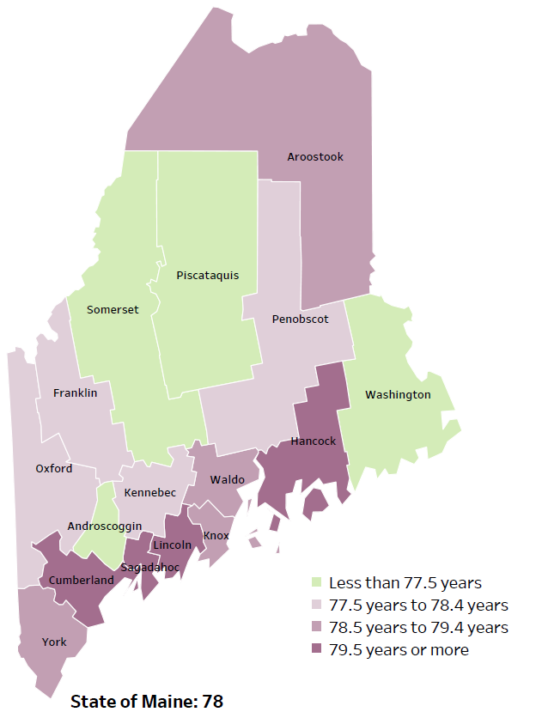
Demographics
Life Expectancy
2017-2019
National Center for Health Statistics,
CDC
RANK | MAINE | YORK COUNTY
1 | Cancer | Cancer
2 | Heart Disease | Heart Disease
3 | Unintentional Injury | Unintentional Injury
4 | Chronic Lower Respiratory Disease | Chronic Lower Respiratory Disease
5 | Stroke | Stroke
Notes:
The life expectancy in York County is 79.2, which is higher than the state average of 78. York County has one of the highest life expectancies in the state. This is an indication that fewer people are dying younger than residents in many other counties in Maine.
The table on the right side of the slides shows the five leading causes of death in York County. They are also the leading causes of death for the whole state of Maine.
The leading cause of death is cancer, the same as the state leading cause of death. As we will see later in the presentation, York has an increasing rate of cancer diagnoses when compared to prior years, which is reflected with the leading cause of death.
Some highlights:
In York County and Maine overall, the leading cause of death is Cancer followed by Heart Disease. The opposite is true in the U.S. overall- Heart Disease is the leading cause of death, and cancer is the 2nd leading cause. One of the reasons that this is true is because we have higher rates of risk factors for cancer, such as smoking/tobacco use. At the same time, there has been a lot of success implementing treatment of heart disease, resulting in folks with heart disease living longer.
The 3rd leading cause of death- Unintentional Injury- includes a number of accidental causes: Three of the most common causes are i) Deaths due to motor vehicle crashes, ii) deaths due to accidental falls, and iii) deaths due to poisonings that either were unintentional or the intent was undetermined. Suicides and Firearm deaths are classified as intentional injury.

Slide 25
Demographics
Age distribution for York County
AGE
YORK COUNTY
POPULATION
204,316
STATE OF MAINE
POPULATION
1,362,359
Notes:
York has the 2nd largest population of any Maine County after Cumberland County. The population is aging. There are fewer children and young adults and more adults over the age of 65, and fewer adults of the age where they might expect to have children. However, this is less severe in York than in many other Maine counties.
Source: US Census Bureau, American Community Survey

Slide 26
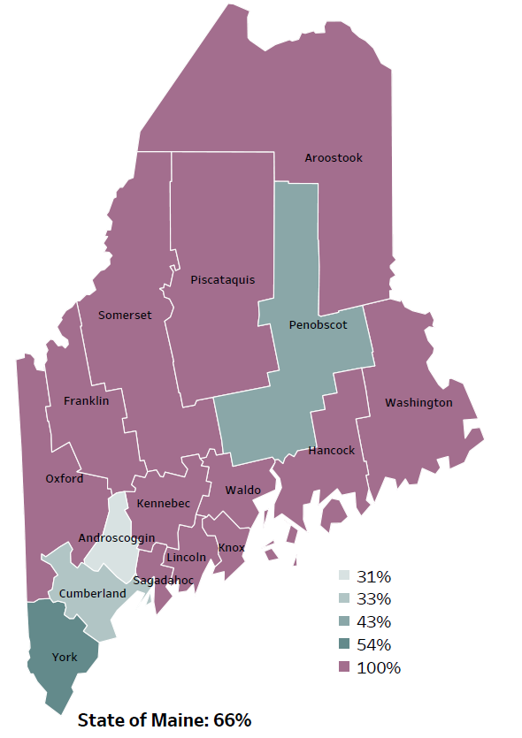
Demographics
Percentage of people living in
rural areas
2019
New England Round Table for Rural Health
Notes:
York County is one of 4 counties with a portion of its population living in a metro area. These data are based on the most recent Census estimates at the Zip-code level, and calculated use rural Urban Commuting Area codes. The categories were established by the New England Rural Health Association. This data is NOT comparable to 2010 US Census data on populations living in rural areas, as that data uses a different definition for rural]
Source: Data, Research and Vital Statistics town-level population file

Slide 27
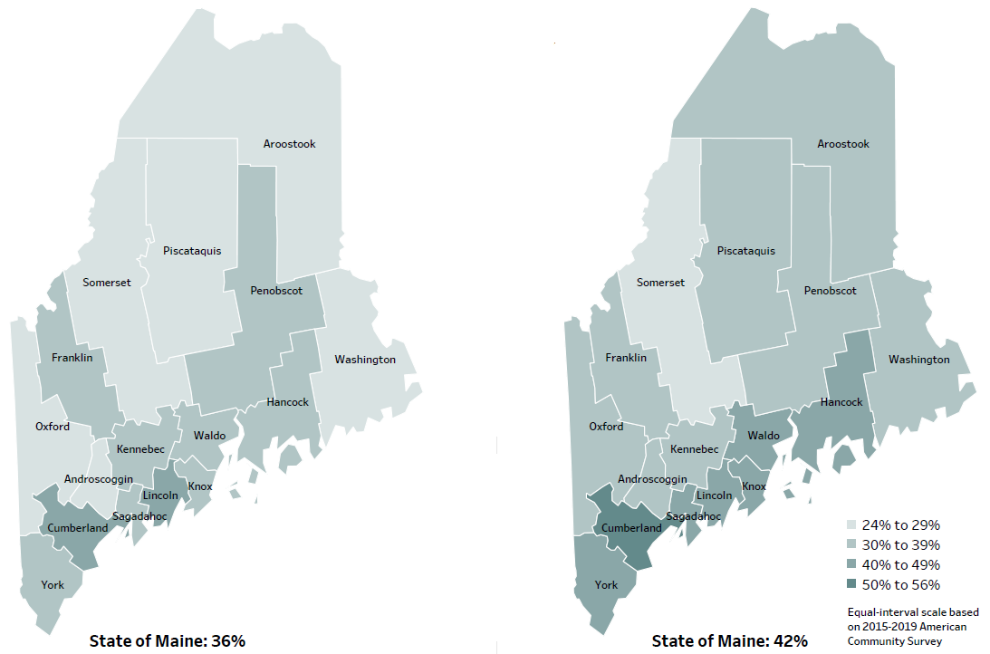
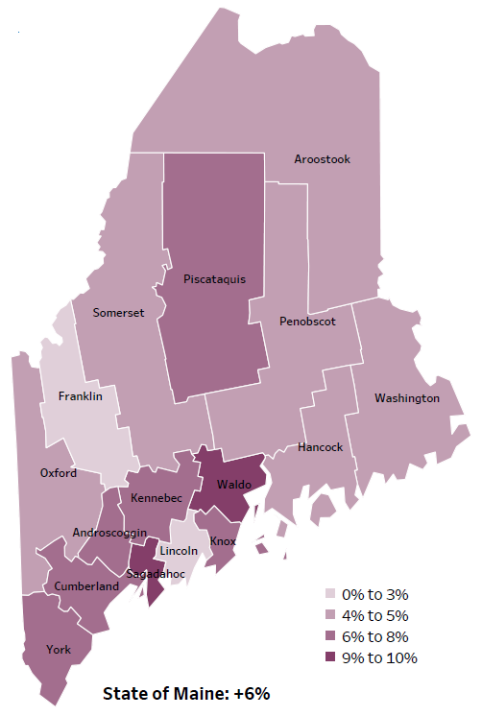
Demographics
Percent of population over age 25 with an associate’s degree or higher
2010
American Community
Survey
Change in percent of population over age 25 with an associate’s degree or higher
2010 to 2015-2019
2015-2019
American Community
Survey
Notes:
These maps show the educational attainment of adults over 25 for two different time periods. York County has had an increase in the rate of adults who have achieved an associate’s degree or higher degree of education. This is highlighted in the change over time map, which shows that this was a greater increase than 8 other counties and equal to 4 other counties.
Source: US Census Bureau, American Community Survey

Slide 28
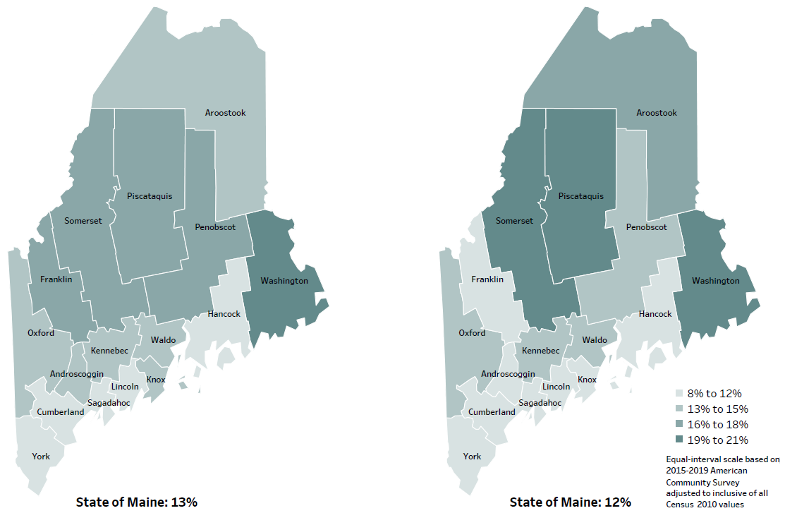
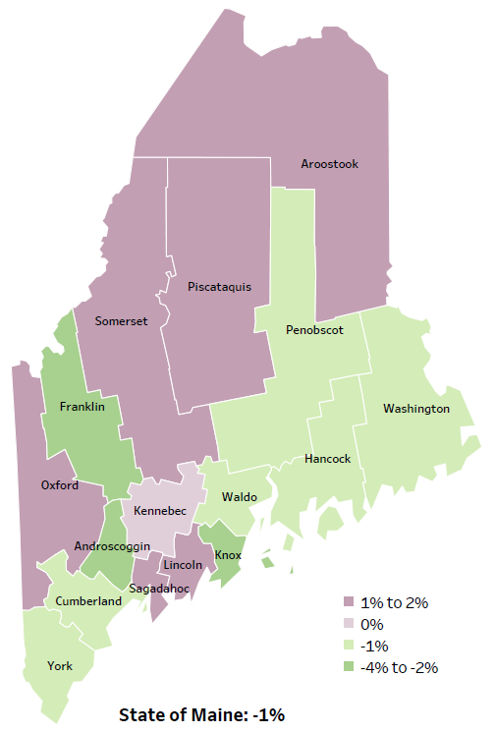
Demographics
Percent of population in poverty
2010
American Community
Survey
Change in percent of population in poverty
2010 to 2015-2019
2015-2019
American Community
Survey
Notes:
These maps show the rate of poverty for two different time periods. York county’s poverty rate has remained stable over the time period with a change of about 1%, as shown in the change over time map. York county has one of the lowest rates of poverty in the state. During this period, poverty decreased in Maine overall.
Source: US Census Bureau, American Community Survey

Slide 29
Health Indicators
Notes:
This slide shows the percentage of York County residents who rate their overall health as fair or poor. While the rate is lower than the state, a significantly higher number of residents report poor health when compared to prior years.
Data Source: Behavioral Risk Factor Surveillance System Definition: Percentage of adults who rate their health as fair or poor (vs. excellent, very good or good).

Slide 30
Health Indicators
Notes:
This indicator represents the rate per 100,000 people of the total number of years lost before the age of 75. This is calculated by subtracting the age at which a person died from 75. The difference in years (of potential life lost) for all those who died before age 75 is added together. As you can see, the rate of life lost in York County is higher than Maine overall but this difference is not significant. The rate has risen significantly within the county since 2012-2014.
Source: County Health Rankings

Slide 31
Health Indicators
Notes:
York County has a significantly lower rate of individuals without health insurance than the state and within the county when compared to past years. No comparison could be made to the US because different years of data were used.
Source: US Census Bureau, American Community Survey

Slide 32
Health Indicators
Notes:
Cancer deaths in York have decreased over time, but not significantly. The rate of deaths in York county are about equal to the state rates. These data are age-adjusted, meaning that we have calculated the rates so that they can be compared to other parts of the state that might have a younger, or an older population. Older people tend to have higher rates of many diseases, including cancer. It’s important to adjust for age so that we don’t accidentally mistake a place with older people for a place with an unusual number of disease-related deaths.
Source: Maine CDC Vital Records

Slide 33
Health Indicators
Notes:
Those diagnosed with prediabetes in York County is significantly higher than the state overall.
Data Source: Behavioral Risk Factor Surveillance System

Slide 34
Health Indicators
Notes:
These graphs show a higher percentage of adults in York County are not engaging in physical activity outside of work, the difference- compared to both past years has increased, but not significantly.
Source: Behavioral Risk Factor Surveillance System

Slide 35
Health Indicators
Notes:
This slide shows the percentage of children, ages 0-36 months, among those screened, who had a finger stick blood lead test showing a blood lead level above 5 micrograms per deciliter. The rate of children with unconfirmed elevated blood lead levels has decreased significantly from past years. There is no significant difference between York County and the state.

Slide 36
Health Indicators
Notes:
This graph shows that injury deaths have increased significantly in York County over time. Rates of injury deaths in York County are also higher than the state overall but not significantly.
Source: Maine CDC Vital Records

Slide 37
Health Indicators
Notes:
Those dying in unintentional falls has risen significantly in York County when compared to past years. The rate is higher than the state overall, but not to a significant degree.
Data Source: Maine CDC Vital Records

Slide 38
Health Indicators
Notes:
The rates of depression among York County adults is rising but is not significantly different from the overall state rates or when compared to prior years.
Source: Behavioral Risk Factor Surveillance System

Slide 39
Health Indicators
Notes:
The percentage of high school students who have seriously considered suicide was 16.8% an increase from 2017, but not a significant difference. York County rates are similar to the state overall. While the percentage is relatively low there is concern about the mental health of York County students.
Source: Behavioral Risk Factor Surveillance System

Slide 40
Health Indicators
Notes:
Similar to high school students, there has been in increase in middle school students who have seriously considered suicide between 2017 and 2019, although the difference is not significant. The percentage of York County middle school students is similar to the overall state rate.
Source: Behavioral Risk Factor Surveillance System

Slide 41
Health Indicators
Notes:
The number of overdose deaths in 2020 have increased in York County after a short period of decline in 2018 and 2019. Maine as a whole had a similar pattern/trend. The increase in 2020 was driven by the continuing opioid crisis in Maine and across the country. Of the 504 drug deaths in 2020, statewide, 83% were caused by opioids. The rise from 2019 to 2020 was primarily due to overdoses of fentanyl- a nonpharmaceutical opioid. Further, more and more often, deaths due to fentanyl also involve use of methamphetamine or cocaine.
York County’s 2020 rate is lower than the state, but not significantly.
Of note, these rates include both unintentional and intentional drug overdose deaths.
These rates do NOT include overdose deaths where alcohol was the only substance/cause of overdose.
Source: Maine Office of the Medical Examiner

Slide 42
Health Indicators
Notes:
This graph shows rate of deaths for which drugs are the underlying cause. These include both deaths attributable to acute poisoning by drugs and deaths from medical conditions resulting from chronic drug use. Deaths due to alcohol use are not included. The rate of drug-induced deaths among York County residents has increased significantly over time. In addition, the 2015-2019 rate for York County is significantly higher than Maine’s statewide rate.
Source: Maine CDC Vital Records and CDC WONDER Online Database

Slide 43
Health Indicators
Notes:
The rates of poisoning deaths within York County have increased significantly since 2007-2011. This indicator shows unintentional or undetermined poisoning, meaning these deaths are not due to suicide or other intentional injuries. While the York County rate is higher than the state, the difference is not significant.
Source: Maine CDC Vital Records

Slide 44
Health Indicators
Notes:
Similar to the last slide, rates of alcohol-induced deaths have increased significantly in York County. Rates are lower than the state, but this difference is not significant.
Source: Maine CDC Vital Records and CDC WONDER Online Database

Slide 45
Health Indicators
Notes:
This slide shows the percentage of adults who engage in chronic heavy drinking, which is defined as two drinks per day for men and more than one drink per day for women. Chronic drinking has increased in York County when compared to both past years and the state overall, but these differences are not significant.
Source: Behavioral Risk Factor Surveillance System

Slide 46
Health Indicators
Notes:
This graph shows an increase over time in reported binge drinking among high school students. There was a significant difference between 2015 and 2017 but the percentage has remained stable between 2017 and 2019. The difference is not significant when compared to the state.
Source: Maine Integrated Youth Health Survey

Slide 47
Health Indicators
Notes:
Cigarette smoking among high school students has been decreasing overtime and has improved significantly when compared to past years. The number of students who smoke in York County is lower than the state, but the difference is not significant.
Data Source: Maine Integrated Youth Health Survey

Slide 48
Health Indicators
Notes:
Similar to the prior slide, middle school cigarette smoking rates have decreased significantly when compared to past years. The rate is slightly lower than the state.
Data Source: Maine Integrated Youth Health Survey

Slide 49
Health Indicators
Notes:
While fewer high school students are smoking cigarettes, there has been a significant increase in those using e-cigarettes when compared to past years.
Data Source: Maine Integrated Youth Health Survey

Slide 50
Health Indicators
Notes:
As was seen with high school students, significantly more middle school students are using e-cigarettes when compared to past years. York County and the state have the same percentage of students reporting the use of e-cigarettes.
Data Source: Maine Integrated Youth Health Survey

Slide 51
Breakout Discussions

Slide 52
Reconvene

Slide 53
Wrap up and Next Steps

Slide 54
Contacts
Adam Hartwig, York District Public Health Liaison, adam.hartwig@maine.gov 207-490-4625
Sally Manninen, Director of CTBH and Community Health, York Hospital smanninen@yorkhospital.org 207-351-2655
Betsy Kelly, Director of Community Health Improvement, SMHC blkelly@smhc.org 207-490-7853
Jo Morrissey, MPH
Maine Shared CHNA
www.mainechna.org
info@mainechna.org

