Slide 1
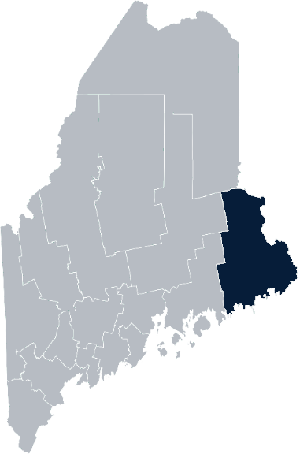
Maine Shared Community Health Needs Assessment Washington County
2021

Slide 2
Welcome
Introductions
Overview of Tools
Purpose
Notes:
Welcomes participants
Request folks go ahead and enter their name in the chat box.
Overview and purpose coming up, but first let us introduce ourselves.

Slide 3
The Maine Shared CHNA is a collaboration between the Maine Center for Disease Control and Prevention (Maine CDC), Central Maine Healthcare, Northern Light Health, MaineGeneral Health, and MaineHealth.
Notes:
Local Planning Committee Member

Slide 4
Thank you, forum sponsors!
Calais Community Hospital | Maine Center for Disease Control and Prevention
Community Caring Collaborative | Maine Seacoast Mission
Down East Community Hospital | Northern Light Health
Downeast Public Health Council | Sunrise County Economic Council
Harrington Family Health Center | University of Maine at Machias
Healthy Acadia
Notes:
Local Planning Committee Member

Slide 5
Forum agenda
Time | Activity | Speaker/Facilitator
1:00 – 1:05 pm | Welcome and introductions | Al May, Public Health Liaison, Downeast Public Health District Julie Hixson, Director, Marketing & Communications, Down East Community Hospital
1:05 – 1:10 pm | Zoom environment and CHNA background | Jo Morrissey, Program Manager, Maine Shared Community Health Needs Assessment
1:10 – 1:15 pm | Leadership remarks | Steve Lail, President/CEO, Down East Community Hospital and Calais Community Hospital
1:15 – 1:25 pm | Review previous CHNA priorities and activities since last effort | Julie Hixson, Director, Marketing & Communications, Down East Community Hospital DeeDee Travis, Director, Community Relations, Calais Community Hospital Al May, Public Health Liaison, Downeast Public Health District
1:25 – 1:50 pm | Presentation of key findings from the data | John Snow, Inc.
1:50 – 2:50 pm | Break-out session – facilitated discussion on data and health priority identification | John Snow, Inc. & Local Facilitator(s)
2:50 – 3:00 pm | Wrap up and next steps | DeeDee Travis, Director, Community Relations, Calais Community Hospital Al May, Public Health Liaison, Downeast Public Health District
Notes:
Local Planning Committee Member to go over agenda and then turn it over to Jo Morrissey to provide an overview of the Zoom tools available and the purpose of today’s forum

Slide 6
Share screen
Join Audio, Mute On/Off
Open/close participant list or chat
Turn Video On/Off
Reactions
Notes:
Jo or JSI

Slide 7
Matching Interests
Maine Shared
Community Health Needs Assessment
Images of PHAB and IRS from the internet
Notes:
Jo or JSI

Slide 8
Maine Shared CHNA Organizational Chart
Steering Committee
Program Manager
Vendor Support
Metrics Committee
Health Equity Community Engagement Committee
Data Analysis Teams
Local Planning Teams
Notes:
Jo or JSI

Slide 9
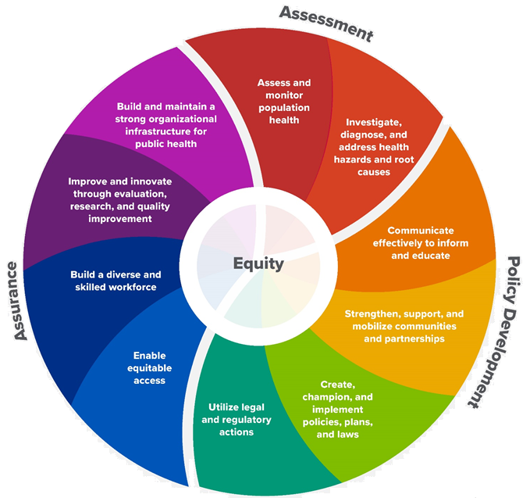
10 Essential Public Health Services
Notes:
Jo or JSI
WHY do the folks who work in public health conduct community health needs assessments?
As this wheel shows: conducting a community health needs assessment feeds into all other public health services. Such as: informing health improvement plans, choosing the right strategy at the right time for the right purpose, policy development, and ensuring equity.
By truly understanding the needs of those we serve, we can serve more effectively and efficiently.

Slide 10
The Evolution of an Idea…
2010 OneMaine | 2015 SHNAPP | 2018 Maine Shared CHNA | 2021 Maine Shared CHNA
Forums Surveys | 16 Forums 1639 Surveys | 22 Mainstream Forums (live) 2 Immigrant Forums 45 Interviews | 16+ Mainstream Forums (virtual) 12+ Community Sponsored Events 2000+ Oral Surveys
Notes:
Jo or JSI
Different communities require outreach that meets their members where they are at.
In addition to the mainstream county forums, we’re partnering with community organizations to host events by and for their communities. We also set a goal to conduct up to 2000 oral surveys in order to capture meaningful input from maine’s immigrant communities.
To date, our community sponsored event partners include:
Community Sponsored Event Partners include
Disability Rights Maine (2 events: people who are deaf or hard of hearing and people with other disabilities)
Maine Primary Care Association (People who are served by Maine’s Federally Qualified Health Centers
Maine Council on Aging (Older Adults 65+)
Consumer Right Council of Maine (people with a mental health diagnosis)
Formerly Incarcerated (Maine Prisoner Re-Entry Network)
Maine Youth Action Network and Friends (Raising the voices of Maine’s diverse youth)
Green Memorial A.M.E. Zion Church (Black/African American)
Health Equity Alliance (LGBTQ+ community)
Portland Recovery Center (for people with a substance use disorder or in recovery)
ADD HOUSING INSECURE IF NEED BE
ADD VETERAN IF NEED BE
Oral Survey Partners include:
Capital Area New Mainers
City of Portland’s Minority Health Program
New Mainer’s Public Health Initiative
Maine Immigrant Access Network
Gateway Community Services
Maine Immigrant and Refugee Services
Maine Community Integration
Mano en Mano
Sister Patricia Pora, formerly of the Portland Dioceses Hispanic Ministry
We are piloting these additional outreach methods with support from
State of Maine’s Preventative Health and Health Services Block Grant
Maine Health Access Foundation

Slide 11
Inputs and Outcomes
Ways to Provide Input
Data Collected
Outcomes
District & County Reports DUE APRIL 2022
4 Health Priorities by county
Related indicators
Gaps/barriers and resources/assets
Notable comparisons between attendee input and the data.
Description of those who provided input
Methodology
Mainstream county forums
Number of attendees
Where attendees live (not CSE)
List of data identified Forums and CSE only)
Discussion notes (Forums and CSE only)
Chat box comments (Forums and CSE only)
Health Priorities
Gaps and Resources
Community sponsored events
State Report DUE APRIL 2022
4 Health Priorities by Community Event and immigrant population.
Related indicators
Gaps/barriers and resources/assets,
Notable comparisons to mainstream population.
Description of those who provided input
Methodology
Oral Survey
Forums, Events and Surveys conducted Fall 2021
Notes:
Jo or JSI
While we may use different formats to engage with different communities, the data we collect and how we will use that data is very similar.

Slide 12
Leadership remarks
Notes:
Leadership remarks
Leader to introduce point person for review of previous health improvement efforts.

Slide 13
Local Activities and Accomplishments
Notes:
Local facilitator

Slide 14
Downeast District – Washington County Hospital and District priority areas of work since the 2019 Shared CHNA
COVID-19
Downeast Public Health District (Maine CDC) Calais Community Hospital Down East Community Hospital Northern Light Acadia Hospital Northern Light Eastern Maine Medical Center
Substance use
Calais Community Hospital Down East Community Hospital Northern Light Acadia Hospital Northern Light Eastern Maine Medical Center
Access to care
Calais Community Hospital Down East Community Hospital Northern Light Eastern Maine Medical Center
Healthy aging
Downeast Public Health District (Maine CDC) Calais Community Hospital Down East Community Hospital
Community Caring Collaborative, Harrington Family Health Center, Healthy Acadia, Maine Seacoast Mission, Sunrise County Economic Council, and the University of Maine at Machias' work spans all categories.
Notes:
Previous CHNA efforts point person

Slide 15
Downeast District – Washington County Hospital and District priority areas of work since the 2019 Shared CHNA
Cancer
Downeast Public Health District (Maine CDC) Down East Community Hospital
Cardiovascular Disease
Calais Community Hospital Down East Community Hospital
Diabetes
Calais Community Hospital Down East Community Hospital
Mental Health
Northern Light Acadia Hospital Northern Light Eastern Maine Medical Center
Social Determinants of Health
Northern Light Acadia Hospital Northern Light Eastern Maine Medical Center
Emergency Preparedness | Downeast Public Health District (Maine CDC)
Health Literacy | Downeast Public Health District (Maine CDC)
Palliative Care and Hospice Service | Downeast Public Health District (Maine CDC)
Community Caring Collaborative, Harrington Family Health Center, Healthy Acadia, Maine Seacoast Mission, Sunrise County Economic Council, and the University of Maine at Machias' work spans all categories.
Notes:
Previous CHNA efforts point person

Slide 16
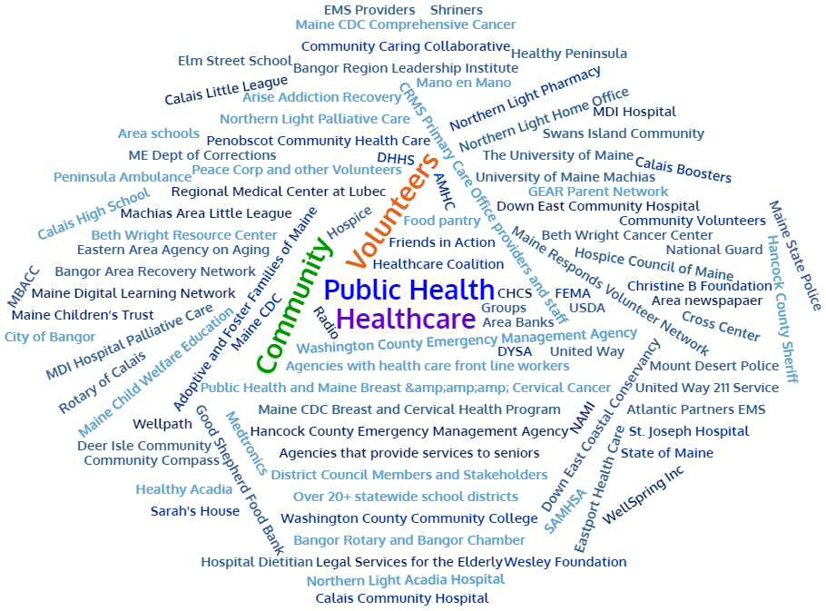
Partners
Notes:
Previous CHNA efforts point person

Slide 17
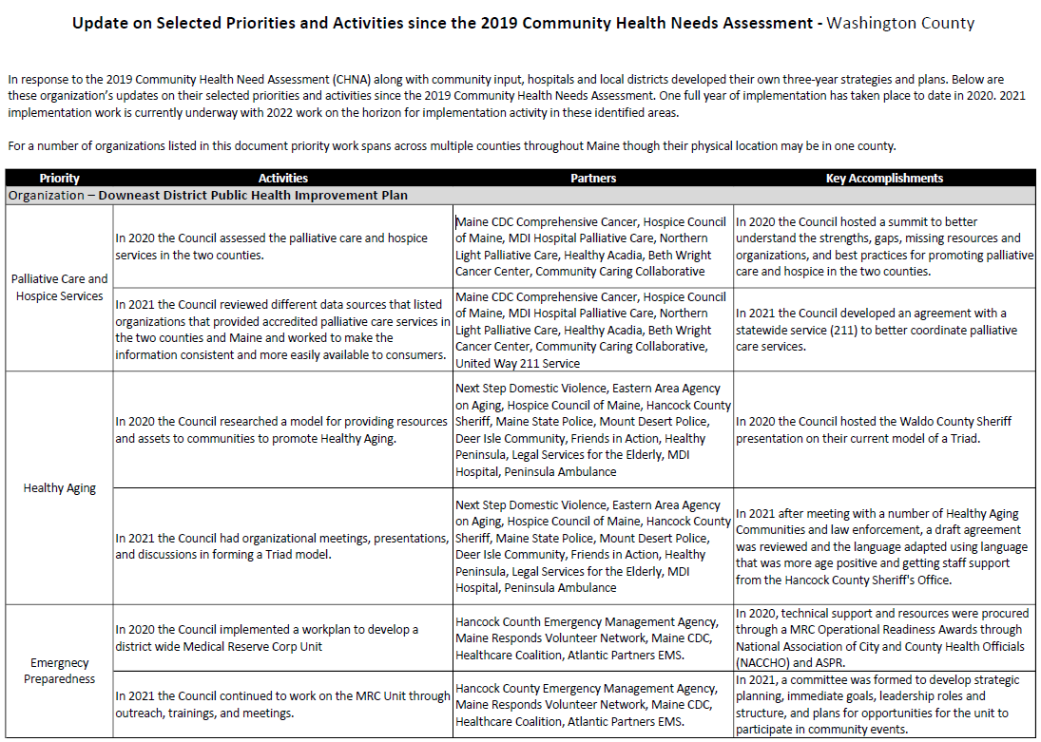
Accomplishments of Note
Update on selected priorities and activities since the 2019 Shared CHNA
Notes:
Previous CHNA efforts point person
Introduce JSI

Slide 18
Downeast Public Health District Downeast Public Health Council (DEPHC)
The Downeast Public Health District is one of nine Public Health Districts in Maine. The District includes Hancock and Washington Counties.
The Downeast Public Health Council is a representative, district-wide body authorized to engage in collaborative planning and decision making in the delivery and assurance of the ten essential public health services.
The Downeast Public Health Council creates a District Public Health Improvement Plan as one result of the Community Health Needs Assessment Process. Current 2019 – 2021 priorities are palliative care and hospice services, healthy aging, emergency preparedness, cancer and health literacy.
Notes:
Previous CHNA efforts point person

Slide 19
How to Read the County Health Profiles and Health Equity Data Sheets
Notes:
Data Health profiles for each county, public health district, and the state of maine are continually being added to the Maine shared CHNA website. There is also a newly redesigned interactive data portal which is set to go live in the coming days.
What I’m about to show you will apply to these materials as they become available.

Slide 20
How to Read County Health Profile
CHANGE shows statistically significant changes in the indicator over time, based on 95% confidence interval (see description on page 3).
ê | means the health issue or problem is getting better over time.
! | means the health issue or problem is getting worse over time.
○ | means the change was not statistically significant.
N/A | means there is not enough data to make a comparison.
BENCHMARK compares [COUNTY] data to state and national data, based on 95% confidence interval (see description on page 3).
ê | means [COUNTY] is doing significantly better than the state or national average.
! | means [COUNTY is doing significantly worse than the state or national average.
○ | means there is no statistically significant difference between the data points.
N/A | means there is not enough data to make a comparison.
ADDITIONAL SYMBOLS
* | means results may be statistically unreliable due to small numbers, use caution when interpreting.
— | means data is unavailable because of lack of data or suppressed data due to a small number of respondents.
EXAMPLE
Notes:
JSI or other facilitator
A star means that the health issue or problem is getting better over time or better in comparison to another place
A red exclamation point means that the health issue or problem is getting worse over time or worse in comparison to another place
A gray circle means that the dating hasn’t changed over time or isn’t much different in comparison to another place
N/A means that there was not enough data to be able to make a comparison
There are two additional symbols you might see:
A black dot means that you should use caution when interpreting the data – the results might be unreliable because of small numbers
A black dash means that data was unavailable, or that data was suppressed due to a small number of respondents
(Go to next slide and walk audience through an example)

Slide 21
How to Read County Health Profile
EXAMPLE
 | AROOSTOOK COUNTY |  |  | BENCHMARKS
INDICATOR | POINT 1 | POINT 2 | CHANGE | MAINE | +/- | U.S. | +/-
Individuals living in poverty | 2009-2011 15.6% | 2015-2019 16.1% | ¡ | 2015-2019 11.8% | ! | 2019 12.3% | N/A
Notes:
Here’s an example of how we’ve visualized the data in the County Health Profiles.
The charts in this presentation are all excerpts from the Data Health Profiles that were created by MaineHealth and the Maine CDC. They contain data pulled from publicly available sources that are designed to help people learn more about the health of their communities. Not all the data points are available for every measure, but we’ve included data wherever we can.
The green bars represent data from your community. The left most one represents a past data point, and the right green bar represents the most recent data point available when the data was gathered. These are the same data points used in the Data Health Profiles.
The grey bars represent data for the state of Maine as a whole- the left grey bars is for the United States as a whole- on the right, for the U.S. when it is available.
We will also tell you where differences in the data points are ‘statistically significant’. A difference between two measurements is significant when scientists can say, with a known degree of confidence, that the difference between them is large enough that the difference is most likely to be caused by an actual difference in the item being measured, and not caused by error associated taking the measurement. All of these tests are comparing the most recent data point for your community to other data points. A red exclamation mark indicates a difference that your community is significantly different in a less desirable direction compared to the data point with the symbol. A green star indicates that your community is significantly different in a more desirable direction. A grey circle indicates that there is no significant difference.
(keep in presentation – do not read for deaf/HOH event or people with disabilities). A difference between two measurements is significant when scientists can say, with a known degree of confidence, that the difference between them is large enough that the difference is most likely to be caused by an actual difference in the item being measured, and not caused by an error associated taking the measurement. All of these tests are comparing the most recent data point for your community to other data points.
For example, in this slide, the Data Health Profile has two symbols. The grey circle next to the measurement for 2009-2011 Aroostook County means that there is no significantly different change in the rate of poverty in Aroostook County over time. The red exclamation mark next to the Maine data point says there is significantly more individuals living in poverty in 2015-2019 Aroostook County than in Maine. Note: lower is better. No comparison could be made to the data for the U.S. because the years of data collection were different.

Slide 22
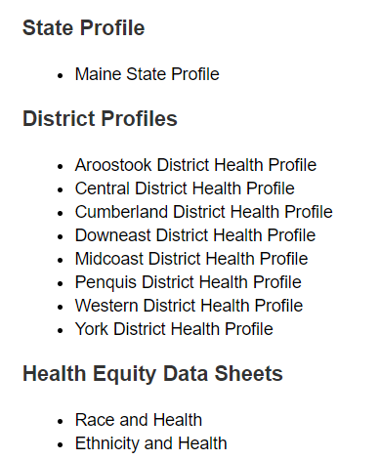
For More Data
www.mainechna.org
Notes:
The Maine Shared CHNA website contains (or will contain) health profiles for 3 of Maine’s largest cities, 16 counties, 5 public health districts, the state, as well as data provided by race, ethnicity, educational attainment, gender, sexual orientation, older adults, insurance status, income, and rurality.
In addition, there is an interactive data portal where you can search by specific data points. All these breakdowns are then provided by data point.

Slide 23
Key Findings

Slide 24
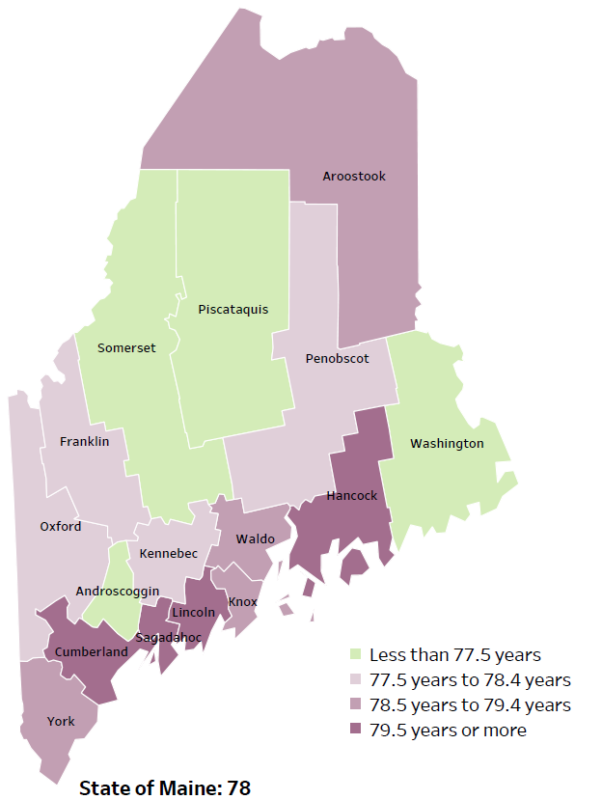
Demographics
Life Expectancy
2017-2019
National Center for Health Statistics,
CDC
Notes:
Washington County has one of the lowest life expectancy in the state. This is an indication that more people are dying at younger ages than residents in many other counties in Maine.
The table on the right side of the slides shows the five leading causes of death in Washington County. They are also the leading causes of death for the whole state of Maine.
Some highlights:
In Washington County and Maine overall, the leading cause of death is Cancer followed by Heart Disease. The opposite is true in the U.S. overall- Heart Disease is the leading cause of death, and cancer is the 2nd leading cause. One of the reasons that this is true is because we have higher rates of risk factors for cancer, such as smoking/tobacco use. At the same time, there has been a lot of success implementing treatment of heart disease, resulting in folks with heart disease living longer.
The 3rd leading cause of death- Unintentional Injury- includes a number of accidental causes: Three of the most common causes are i) Deaths due to motor vehicle crashes, ii) deaths due to accidental falls, and iii) deaths due to poisonings that either were unintentional or the intent was undetermined. Suicides and Firearm deaths are classified as intentional injury.
In Washington County, the rates of cancer deaths, cardiovascular disease deaths, coronary heart disease deaths, unintentional motor vehicle traffic crash deaths, and unintentional poisoning deaths are significantly higher than Maine’s statewide rates.
Source: National Center for Health Statistics, US CDC

Slide 25
Demographics
Age distribution for Washington County
AGE
WASHINGTON COUNTY
POPULATION
31,491
STATE OF MAINE
POPULATION
1,362,359
Notes:
Washington County has one of the 3rd smallest populations of any Maine County after Piscataquis and Franklin. The population is aging. There are fewer children and young adults and more adults over the age of 65, and fewer adults of the age where they might expect to have children.
Source: US Census Bureau, American Community Survey

Slide 26
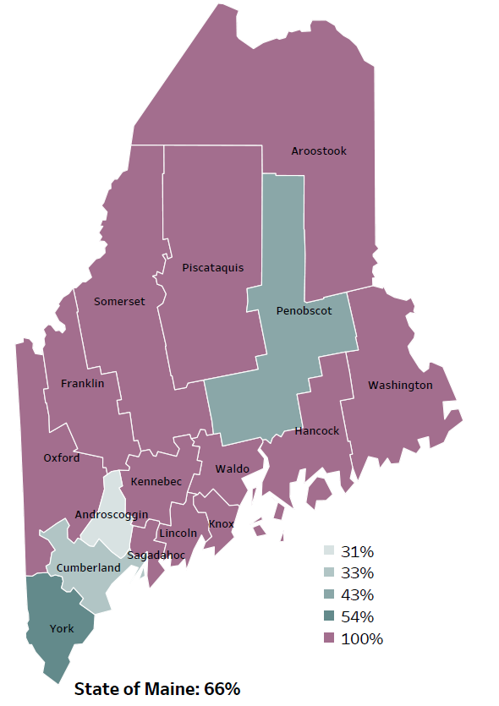
Demographics
Percentage of people living in
rural areas
2019
New England Round Table for Rural Health
Notes:
Washington County is one of 12 counties with no population in a metro area. These data are based on the most recent Census estimates at the Zip-code level, and calculated use rural Urban Commuting Area codes. The categories were established by the New England Rural Health Association. This data is NOT comparable to 2010 US Census data on populations living in rural areas, as that data uses a different definition for rural
Source: Data, Research and Vital Statistics town-level population file

Slide 27
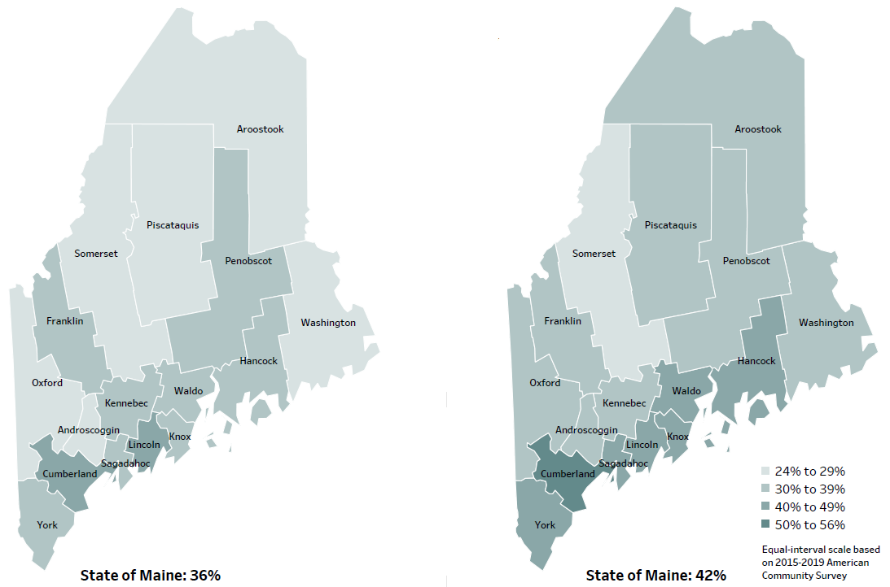
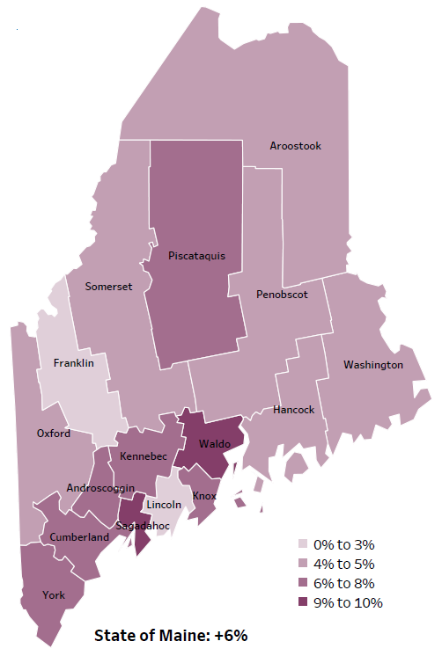
Demographics
Percent of population over age 25 with an associate’s degree or higher
2010
American Community
Survey
Change in percent of population over age 25 with an associate’s degree or higher
2010 to 2015-2019
2015-2019
American Community
Survey
Notes:
These maps show the educational attainment of adults over 25 for two different time periods. Washington County has had an increase in the rate of adults who have achieved an associate’s degree or higher degree of education. This is highlighted in the change over time map, which shows that this was a greater increase than 2 other counties and equal to 6 other counties.
Source: US Census Bureau, American Community Survey

Slide 28
Demographics
Life Expectancy
2017-2019
National Center for Health Statistics,
CDC
Notes:
Washington data has one of the lowest life expectancies in the state. This is an indication of premature deaths caused by any source.
Source: US Census Bureau, American Community Survey

Slide 29
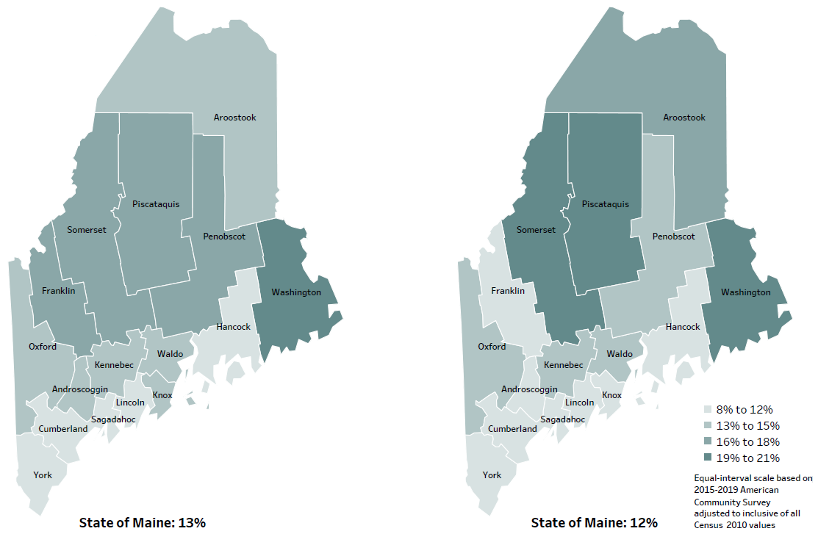
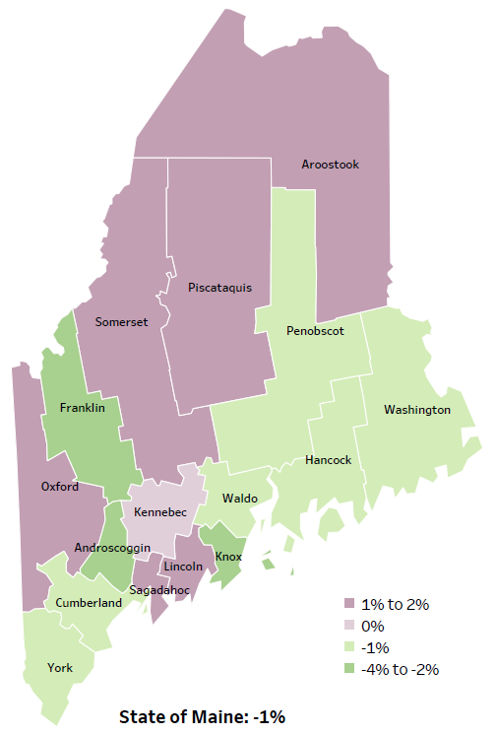
Demographics
Percent of population in poverty
2010
American Community
Survey
Change in percent of population in poverty
2010 to 2015-2019
2015-2019
American Community
Survey
Notes:
These maps show the rate of poverty for two different time periods. Washington county’s poverty rate has decreased slightly over the time period, as shown in the change over time map, but does have among the highest levels of poverty in the state. During this period, poverty decreased in Maine overall.
Source: US Census Bureau, American Community Survey

Slide 30
Health Indicators
Notes:
This indicator represents the rate per 100,000 people of the total number of years lost before the age of 75. This is calculated by subtracting the age at which a person died from 75. The difference in years (of potential life lost) for all those who died before age 75 is added together. As you can see, the rate of life lost in Washington County is significantly higher than Maine overall. The rate is rising within the county, but this difference over time is not significant.
Source: County Health Rankings

Slide 31
Health Indicators
Notes:
Washington County has a significantly higher rate of uninsured than the state, but no comparison could be made to the US because different years of data were used. While rates are high in the county, they have improved since 2009-2011.
Source: US Census Bureau, American Community Survey

Slide 32
Health Indicators
Notes:
These graphs show that an increasing number of Washington County residents are enrolled in MaineCare when compared to past years. There has been a notable increase in the past year. Rates of enrollment are also higher than the state overall. This data does not have confidence intervals, so we can’t tell if the difference is statistically significant. The rate of enrollment is influenced by many things, including changing poverty levels but could also be influenced by more eligible individuals enrolling in programs they were already eligible for. We do not know how much the differences shown here are influenced by these different factors.
Source: MaineCare

Slide 33
Health Indicators
Notes:
These are measures of quality of care, showing the rates of hospitalizations and visits to the ED for conditions that could have been handled in a doctor’s office include PCPs and urgent care. Often this happens because the patient does not have access to a PCP. Washington County has a significantly higher rate when compared to the state, but rates are improving within the county. These data combine multiple years, in order to make the data more precise.
Source: Maine Health Data Organization Hospital Inpatient Database

Slide 34
Health Indicators
Notes:
Cancer deaths in Washington County have decreased over time, but not significantly. However, they are significantly higher than cancer deaths in the state. These data are age-adjusted, meaning that we have calculated the rates so that they can be compared to other parts of the state that might have a younger population. Older people tend to have higher rates of many diseases, including cancer. It’s important to adjust for age so that we don’t accidentally mistake a place with older people for a place with an unusual number of disease-related deaths.
Source: Maine CDC Vital Records

Slide 35
Health Indicators
Notes:
This graph shows the percentage of females, ages 50 years and older, who had a mammogram within the past 2 years. Data is collected in even numbered years. Although up-to-date breast cancer screenings in Washington County are improving, rates are lower than the state.
Source: Behavioral Risk Factor Surveillance System

Slide 36
Health Indicators
Notes:
This graph shows that although cardiovascular disease deaths went down slightly in Washington County over time but are significantly higher that the state. Again, this data is age adjusted, so the difference is NOT affected by Washington’s older population relative the state’s population.
Source: Maine CDC Vital Records

Slide 37
Health Indicators
Notes:
This slide shows a similar story for one type of cardiovascular disease death - coronary heart disease.
Rates in Washington County are significantly higher than the state but improving within the county.
Source: Maine CDC Vital Records

Slide 38
Health Indicators
Notes:
Diabetes deaths have improved significantly within the county over time. While rates are lower than the state, the difference is not significant.
Source: Maine CDC Vital Records

Slide 39
Health Indicators
Notes:
This slide shows that the number of middle school students who are overweight in Washington County is increasing and is significantly higher that the state rate. Although the increase look quite large, it is important to remember that because of the smaller number of middle school students in the county, a small change in the number of individuals effected can look large when expressed as a rate.
Source: Maine Integrated Youth Health Survey

Slide 40
Health Indicators
Notes:
These graphs show a higher percentage of adults in Washington County are not engaging in physical activity outside of work, the difference- compared to both the past year and within Maine is significant.
Source: Behavioral Risk Factor Surveillance System

Slide 41
Health Indicators
Notes:
This slide shows the percentage of adults, ages 45 and over, who experienced confusion or memory loss that happened more often or got worse within the past 12 months. Data collected in 2012 and 2016. There is no significant difference from past years or the state.
Source: Behavioral Risk Factor Surveillance System

Slide 42
Health Indicators
Notes:
This graph shows that injury deaths have increased significantly in Washington County. Rates of injury deaths in Washington County are also significantly higher than the state overall.
Source: Maine CDC Vital Records

Slide 43
Health Indicators
Notes:
The rates of poisoning deaths within Washington County have increased significantly since 2007-2011. This indicator shows unintentional or undetermined poisoning, meaning these deaths are not due to suicide or other intentional injuries.
Again, the state data does not have confidence intervals, so we can’t determine if the difference is statistically significant.
Source: Maine CDC Vital Records

Slide 44
Health Indicators
Notes:
The rate of suicide deaths increased slightly over time in Washington County and are slightly higher than Maine as a whole. None of these differences are significantly different.
Source: Maine CDC Vital Records

Slide 45
Health Indicators
Notes:
This slide shows the percentage of seventh- and eighth-grade students who have ever done something to purposely hurt themselves without wanting to die, such as cutting or burning themselves on purpose. Data collected in odd numbered years. The rates of self-injury among Washington County middle school students is significantly higher than in past years and the state overall.
Source: Maine Integrated Youth Health Survey

Slide 46
Health Indicators
Notes:
The rates of depression among Washington County adults is not significantly different from the overall state rates or when compared to prior years.
Source: Behavioral Risk Factor Surveillance System

Slide 47
Health Indicators
Notes:
Middle school students in Washington County are significantly more likely than Maine middle school students as a whole to report feeling sad or hopeless for two weeks in a row. The change over time within the county is also significant. This is a small population so a small increase in students reporting symptoms could cause a significant change, however it is clear that the mental health of these students should be a priority.
Source: Maine Integrated Youth Health Survey

Slide 48
Health Indicators
Notes:
The number of overdose deaths have increased in Washington County after a short period of decline in 2017 and 2018. The rates are higher than the state, but not significantly. These increases could be attributed to the opioid crisis in the state and across the country.
Because the number of overdose deaths is small, there is not a statistically significant difference between Washington Cty and the state, but given the large difference, this may be a higher concern in Washington County”
Of note, in 2018, the state rate was 26.4 and Washington Cty was 28.7, in 2019 they were 28.3 & 31.9 respectively. Given this the larger difference may indeed be a blip (or not). The absolute numbers are 20, 13, 9, 10 and 20 for 2016, 2017, 2018, 2019, and 2020,
Source: Maine Office of the Medical Examiner

Slide 49
Health Indicators
Notes:
This graph shows rate of deaths for which drugs are the underlying cause, including those attributable to acute poisoning by drugs and those from medical conditions resulting from chronic drug use. Deaths due to alcohol use are not included. The rate of drug-induced deaths among Washington County residents is significantly higher with in the county, but not when compared to the state.
Source: Maine CDC Vital Records and CDC WONDER Online Database

Slide 50
Health Indicators
Notes:
Similar to the last slide, rates of alcohol-induced deaths are increasing in Washington County. Rates are also higher than the state, but this difference is not significant.
Source: Maine CDC Vital Records and CDC WONDER Online Database

Slide 51
Health Indicators
Notes:
This graph shows an increase over time in reported binge drinking among high school students. The difference is significant within the county, but not the state.
Source: Maine Integrated Youth Health Survey

Slide 52
Health Indicators
Notes:
This slide shows the rate of emergency department discharges with a principal diagnosis of opiate poisoning. There is not enough data available to determine if the difference between Washington County and the state is significant.
Source: Maine Health Data Organization Hospital Inpatient and Outpatient Databases

Slide 53
Health Indicators
Notes:
This slide shows a slight decrease in cigarette smoking among Washington County high school students over time (from 22% in 2011 to 12% in 2019). When compared to the state, there are significantly more students reporting past 30-day smoking in Washington County in 2019.
Source: Maine Integrated Youth Health Survey

Slide 54
Breakout Discussions

Slide 55
Wrap up and Next Steps

Slide 56
Contacts
Julie Hixson, Director, Marketing & Communications, Down East Community Hospital jhixson@dech.org 207-255-0433
DeeDee Travis, Director, Community Relations, Calais Community Hospital deedee@calaishospital.org 207-454-9227
Alfred May, Downeast District Public Health Liaison, alfred.may@maine.gov 207-255-2017
Nicole Hammar, Manager, Community Health Improvement, Northern Light Health nhammar@northernlight.org 207-973-7245
Maine Shared CHNA: info@mainechna.org
www.mainechna.org

